Slide 1
Research4Life
Free or low-cost access to academic and professional content online

Slide 2
What is Research4Life?
Research4Life provides institutions in lower income countries with online access to 203,000+ academic and professional peer-reviewed content.
Our goal is to close the knowledge gap between the Global North and South, by making it easier for researchers in the Global South to access research and to publish, and as such contribute to a more equitable world of research.
Numbers from September 2023

Slide 3
Advantages of Research4Life
UN agencies working in unison
Providing more than 125 countries with free or low-cost access
Content from up to 200 publishers
Regular trainings for researchers and librarians
More than 200,000 leading journals, books and databases available online
More than 11,500 institutions registered
Latest technology support

Slide 4
Five collections
Health WHO
Agriculture FAO
Environment UNEP
Innovation and technology WIPO
Law and social sciences ILO

Slide 5
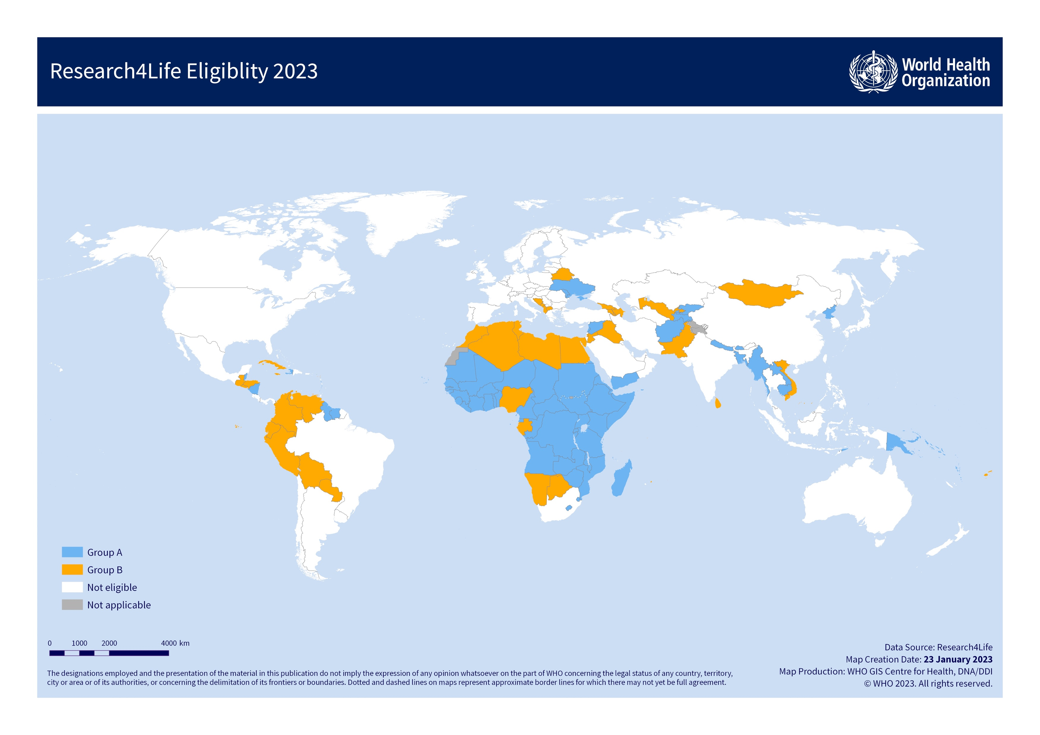
Access by country
Free access
Low-cost access

Slide 6
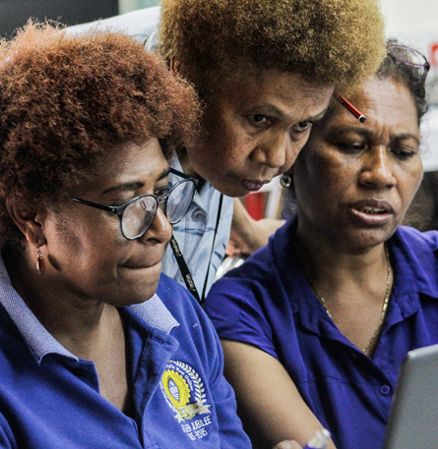
Who can use Research4Life?
Research Institutes
Teaching hospitals, Healthcare Services
National NGOs
National Libraries
Government Offices
Vocational Training Centres
Universities

Slide 7
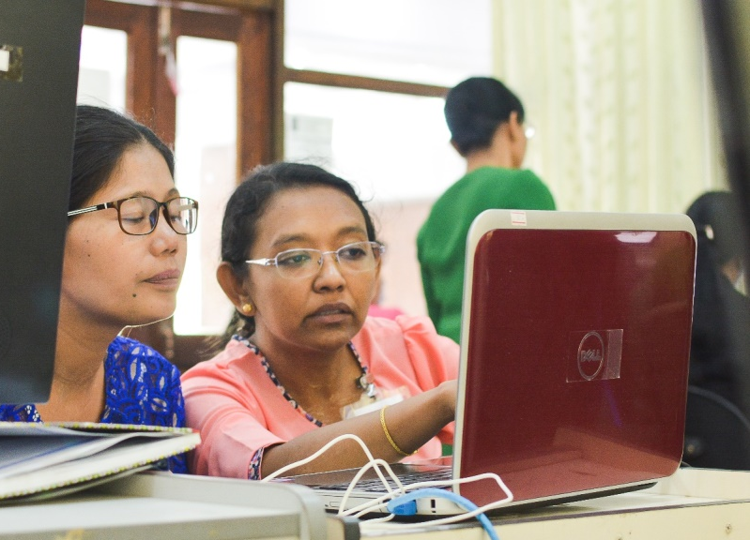
How to access Research4Life?
With UserID
Each institution has one UserId/password
Via your campus network
IP based login inside your institution’s network grants convenient access – if your institution has established
Contact your library or director’s office for access

Slide 8
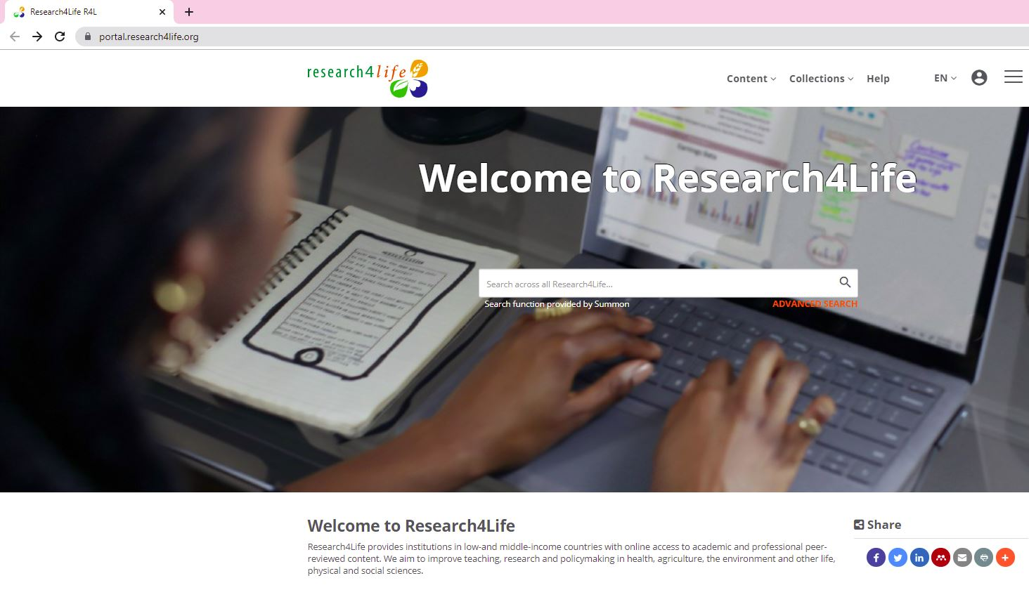
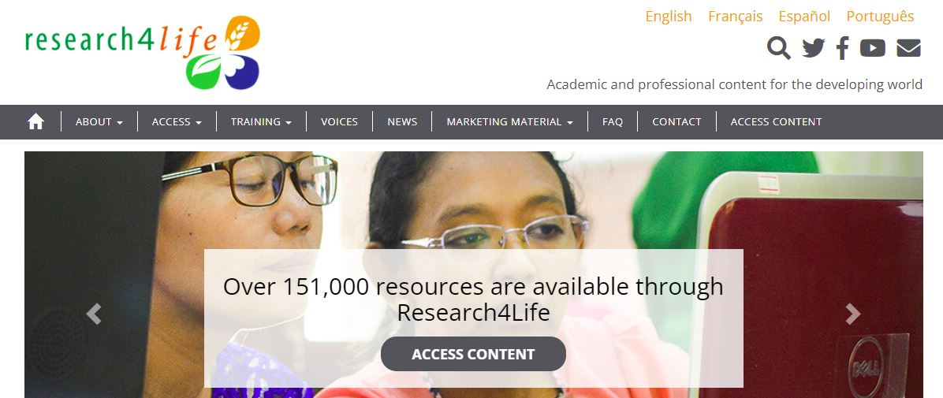
Log in from our homepage
https://www.research4life.org/

Slide 9
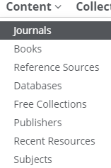
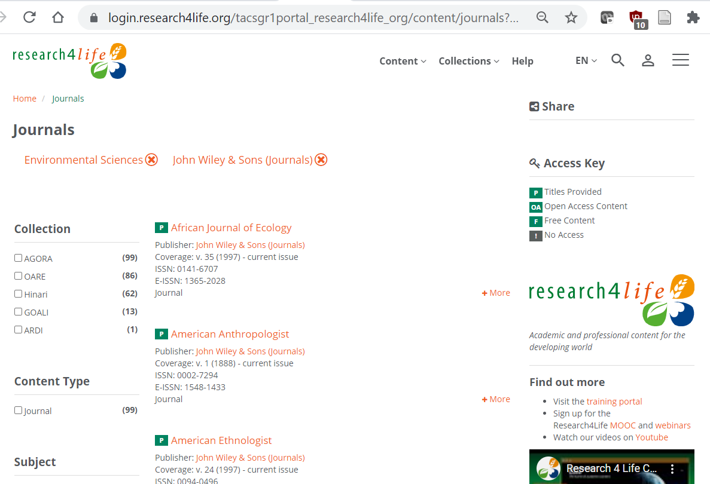
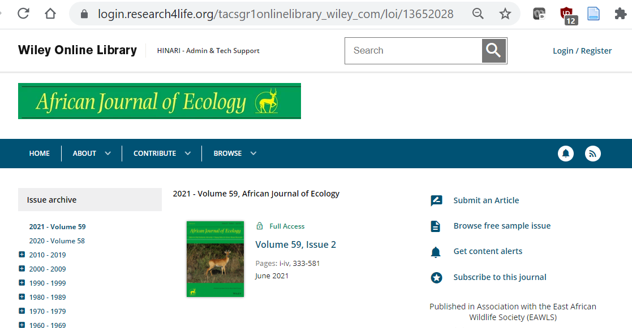
Browse thousands of journals and books

Slide 10
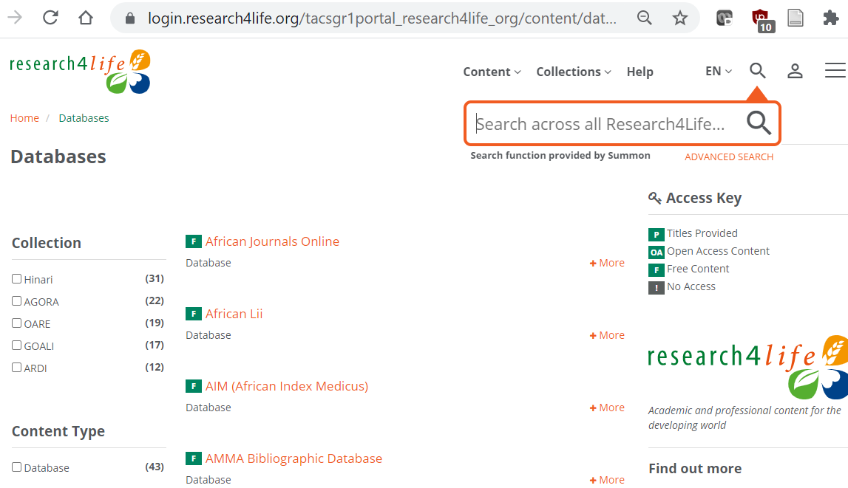
Access databases

Slide 11
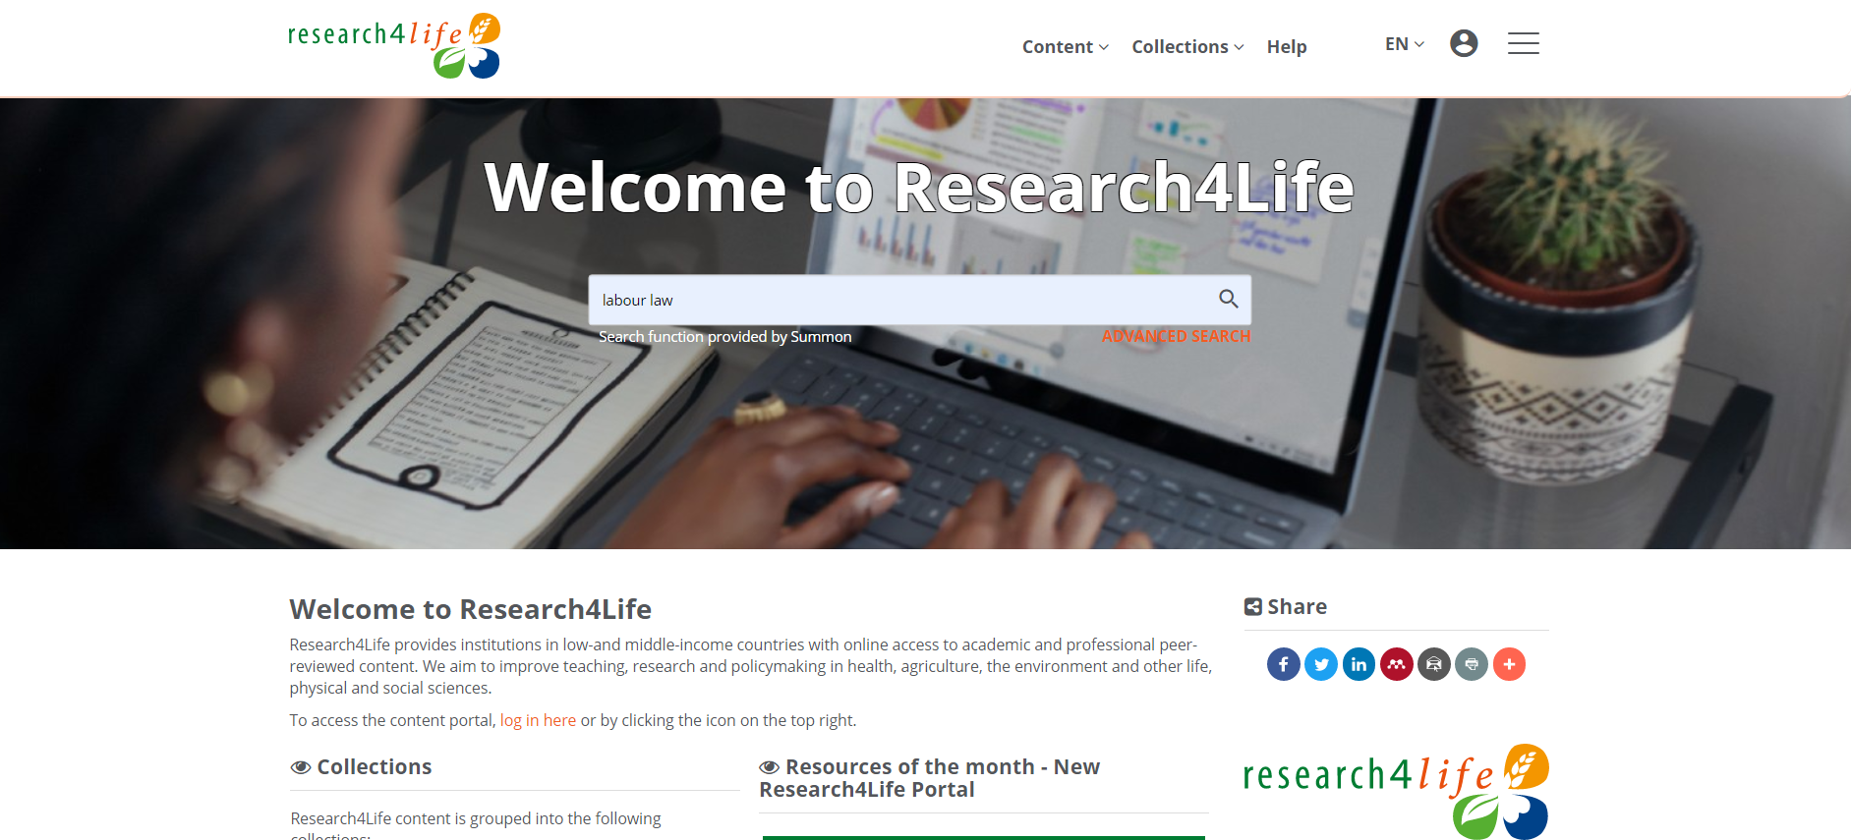
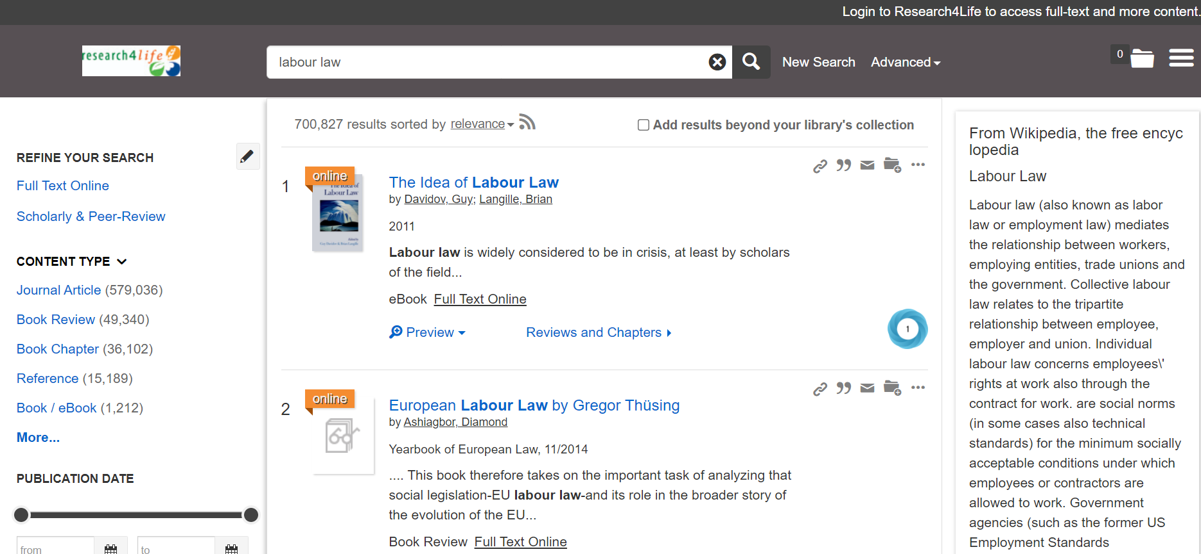
Search on all content by keywords

Slide 12
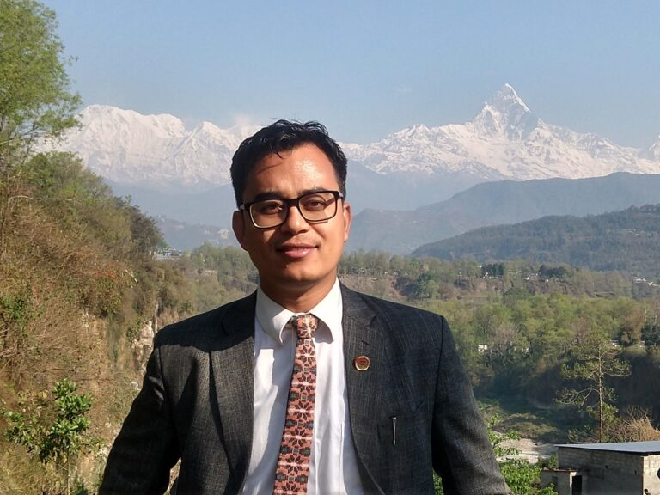
How we make a difference
“We can’t always buy the latest books and journals, so Research4Life is really our only source of current information. It allows me to read what I need to read to be able to stay up to date.”
Neurosurgeon Dr. Pratyush Shrestha from Nepal

Slide 13
Research4Life is committed to the UN's Sustainable Development Goals.
Research4Life contributes to the United Nations Decade of Action by increasing research participation from the Global South.
The recent Strategic Plan to 2030 focuses on inclusion and equity in the global research community, supporting the creation of an even richer body of research which will help to advance the Sustainable Development Goals.
Research4Life offers our partners, users and supporters the opportunity to contribute to the creation of a diverse. inclusive and equitable research ecosystem for all.

Slide 14
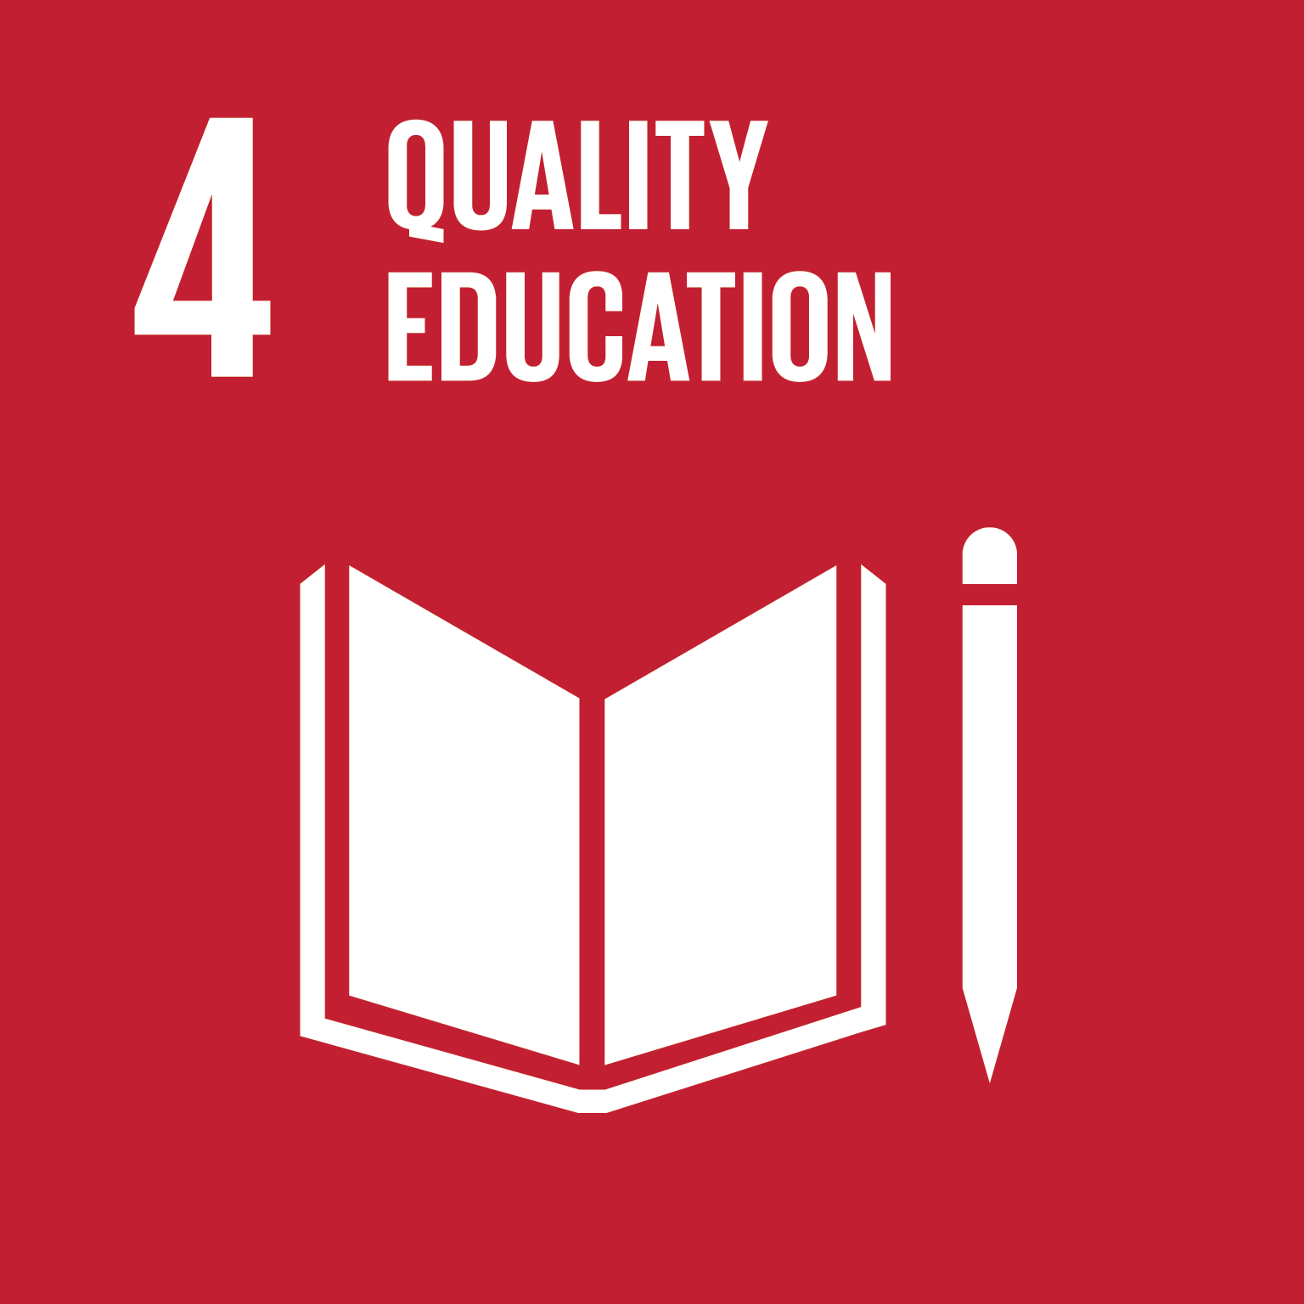
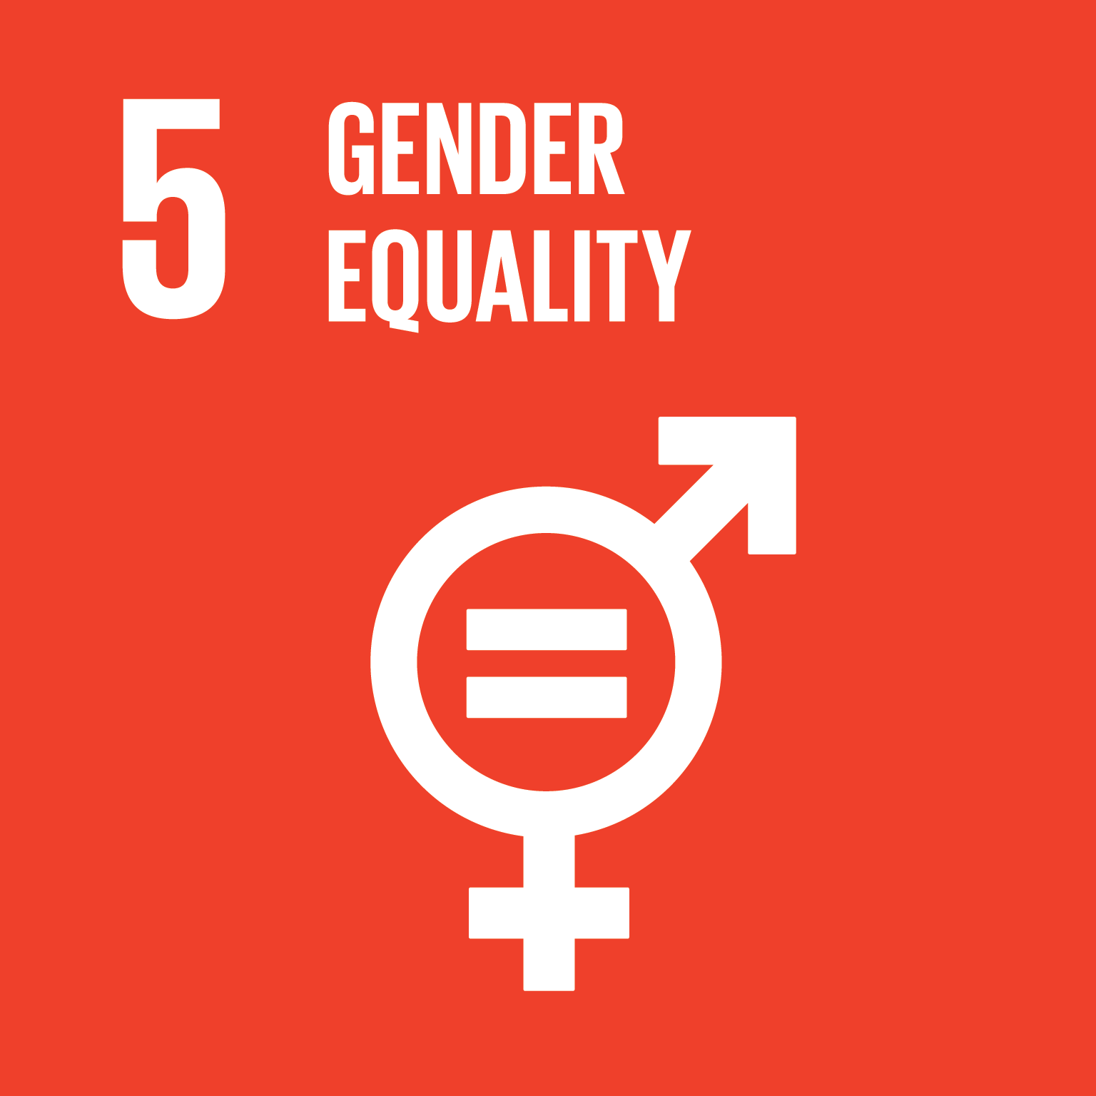
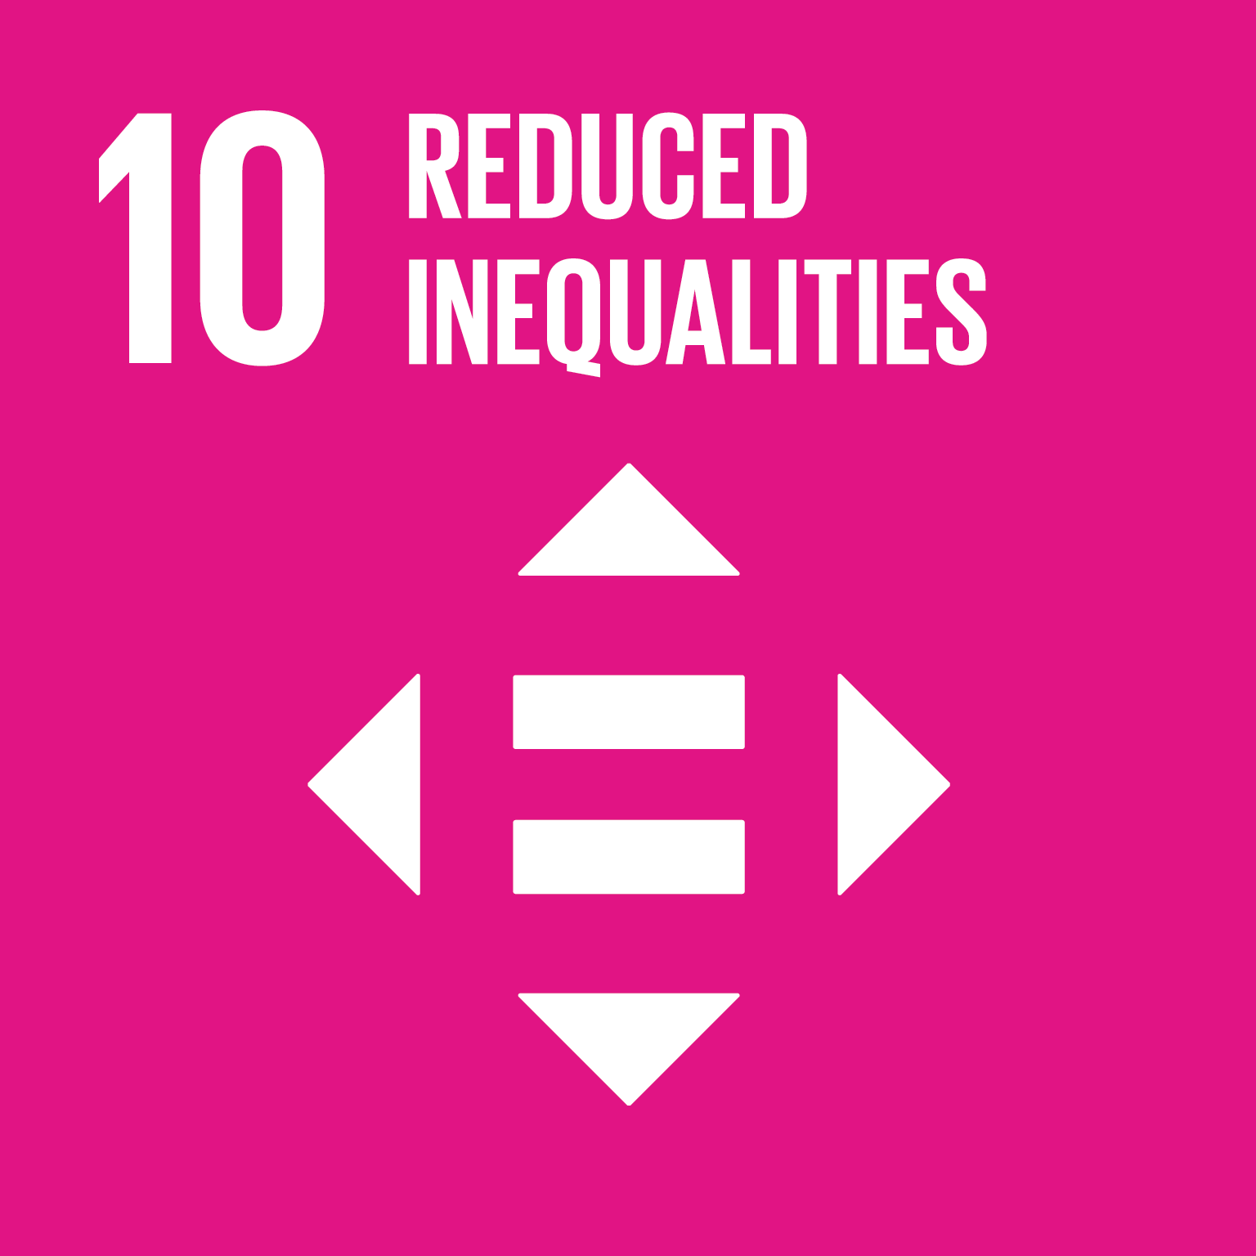
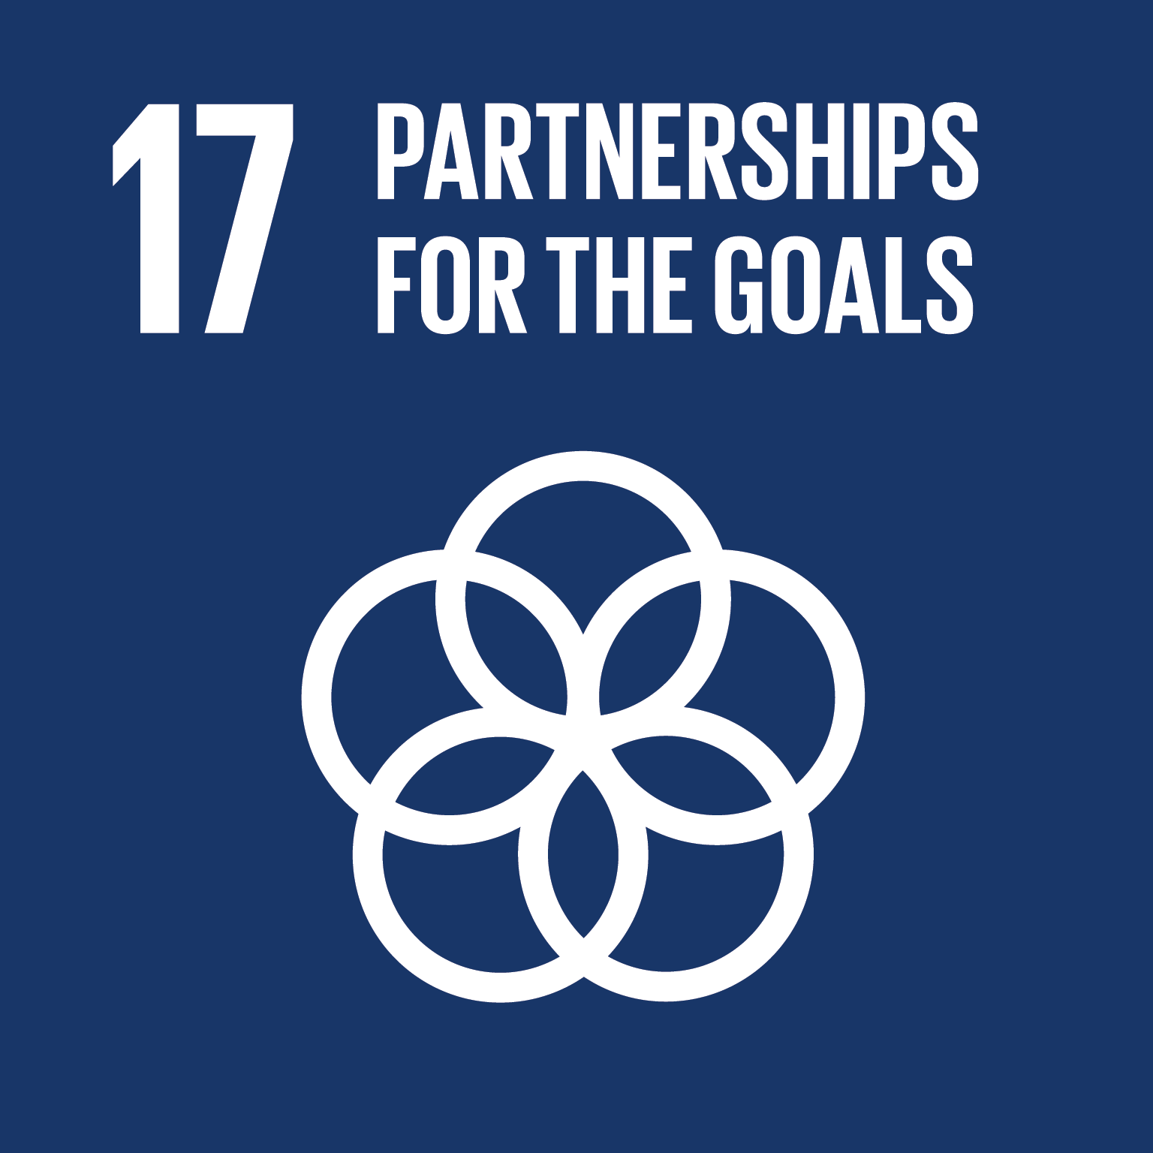
Our unique public-private structure allows us to work effectively in alignment with SDG17: Partnership for the Goals for sustainable development and to support our community of users as both consumers and producers of critical research and advance SDG10: Reduced Inequalities within and among countries.
While our activities directly and indirectly support all the SDGs such as Good health and Wellbeing, Zero Hunger, Clean Water and Sanitation; Industry, Innovation and Infrastructure as well as Peace, Justice and Strong Institutions, the Research4Life Program is closely aligned to SDG4: Quality Education that is fundamental to creating a peaceful and prosperous world and SDG5: Gender Equity to achieve the empowerment of all women and children.

Slide 15
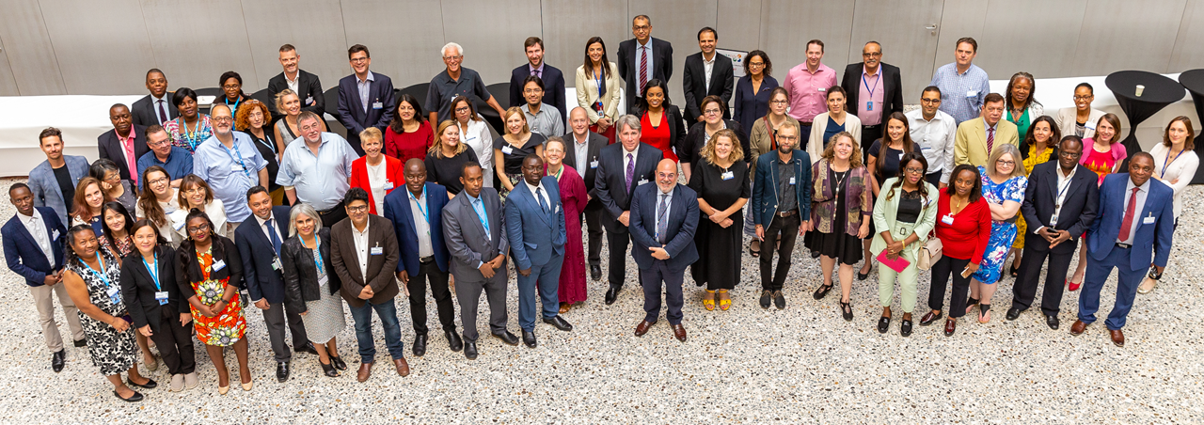
More information?
Visit www.research4life.org or write to r4l@research4life.org.

