Slide 1
PubMed Refresher Updates for Research4Life users
23 August 2023
Kathy Kwan
Research4Life
Research4Life is a public-private partnership of five programmes

Slide 2
Outline
What is PubMed and what is in it?
Access to the full text from Research4Life publishers partners and other free full text sources
Noteworthy updates since the webinar “Re-introducing PubMed” in July 2020
Proximity searching
Automated Indexing for MEDLINE citations
Filters updates
and more ….
Searching in PubMed – an overview
Live demonstration, based on your feedback in registration
Q & A
Recording and slides will be shared in the Research4Life webinars page: https://www.research4life.org/training/webinars/
This work is licensed under Creative Commons Attribution-ShareAlike 4.0 International (CC BY-SA 4.0)

Slide 3
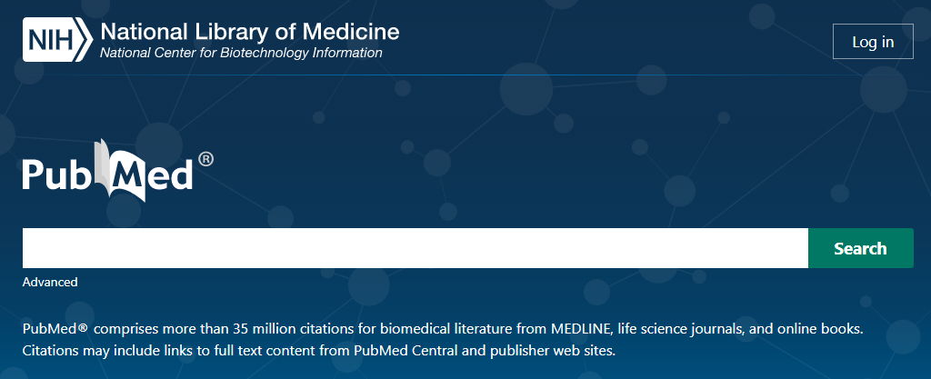
What is PubMed?
What is PubMed?
PubMed, a premier and free database of citations for biomedical and life sciences literature from peer reviewed journals and online books
over 36 millions records, may link to full text
around 3 and a half million unique users worldwide daily
significant amount of access through API calls and files downloaded
a program of the National Center for Biotechnology Information (NCBI) at the US National Library of Medicine (NLM)

Slide 4
A rich history
Index Medicus
- dated back to 1879
MEDLINE (1971)
Medical Literature Analysis and Retrieval System (MEDLARS) Online
PubMed (1997) - freely available on Internet, includes citations besides MEDLINE
Print
Online (Mainframe and CD ROM)
Internet/WWW
OLDMEDLINE data. “https://www.nlm.nih.gov/databases/databases_oldmedline.html” Retrieved on 2023-08-16
Greenberg SJ, Gallagher PE. The great contribution: Index Medicus, Index-Catalogue, and IndexCat. J Med Libr Assoc. 2009 Apr;97(2):108-13. doi: 10.3163/1536-5050.97.2.007. PMID: 19404501; PMCID: PMC2670211.
Williamson PO, Minter CIJ. Exploring PubMed as a reliable resource for scholarly communications services. J Med Libr Assoc. 2019 Jan;107(1):16-29. doi: 10.5195/jmla.2019.433. Epub 2019 Jan 1. PMID: 30598645; PMCID: PMC6300231.

Slide 5
What is in PubMed?
What is in PubMed?
NNLM, July 2023. How PubMed Works: Selection. https://www.youtube.com/watch?v=7yzkBphAy-8 Retrieved on 2023-08-16

Slide 6
What is in PubMed?
MEDLINE (30,678K, 85%)
journals selected by Literature Selection Technical Review Committee (LSTRC)
PubMed not MEDLINE (5,405K, 15%)
PMC journal articles
PMC journal selection process
Author manuscripts from PMC (103K, 0.3%)
repository of manuscripts to compile with funders’ public access policies
NIH, US government agencies and NGOs
International funders through Europe PMC
Preprint, a NIH pilot (12K, 0.03%)
Books (32K, 0.09%)
Selection process

Slide 7
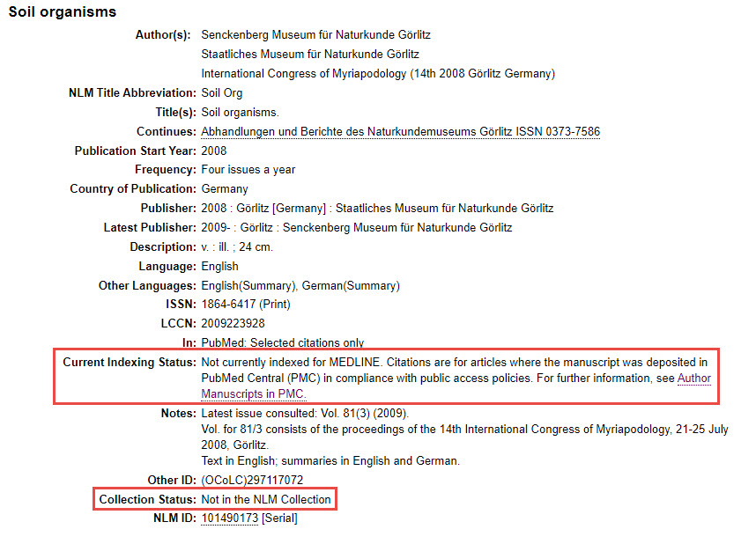
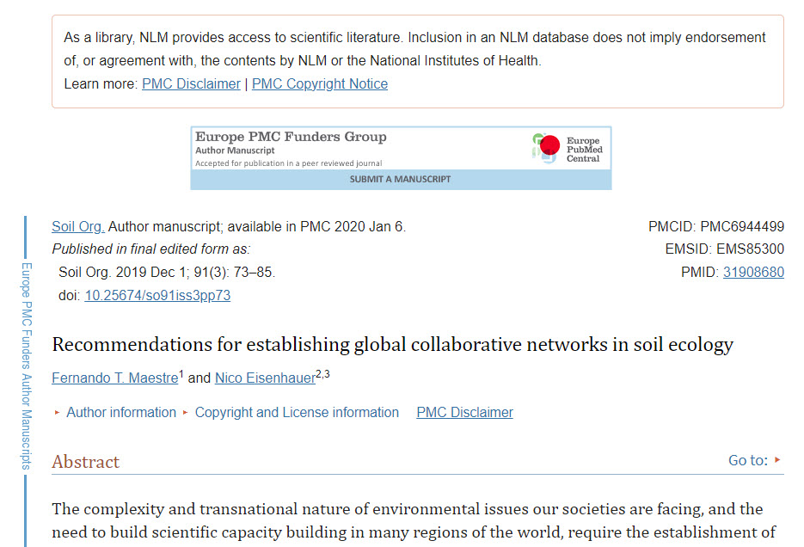
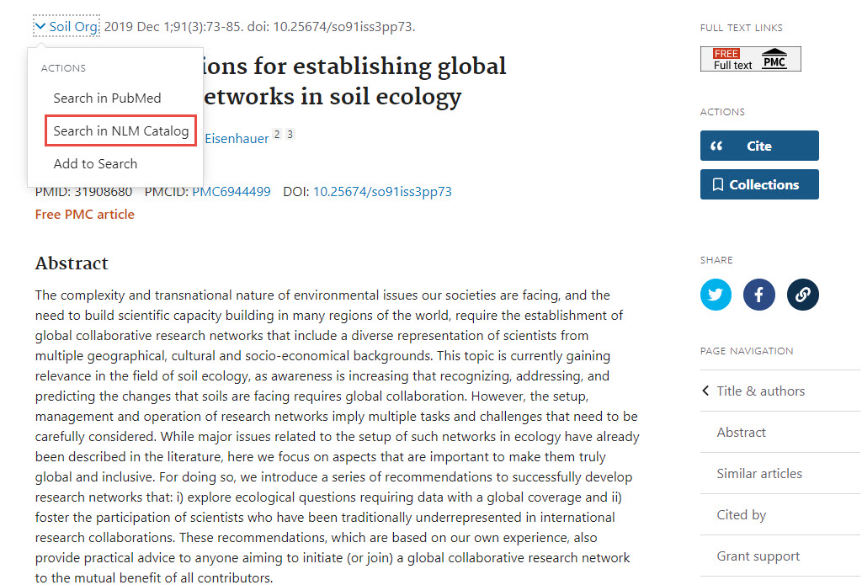
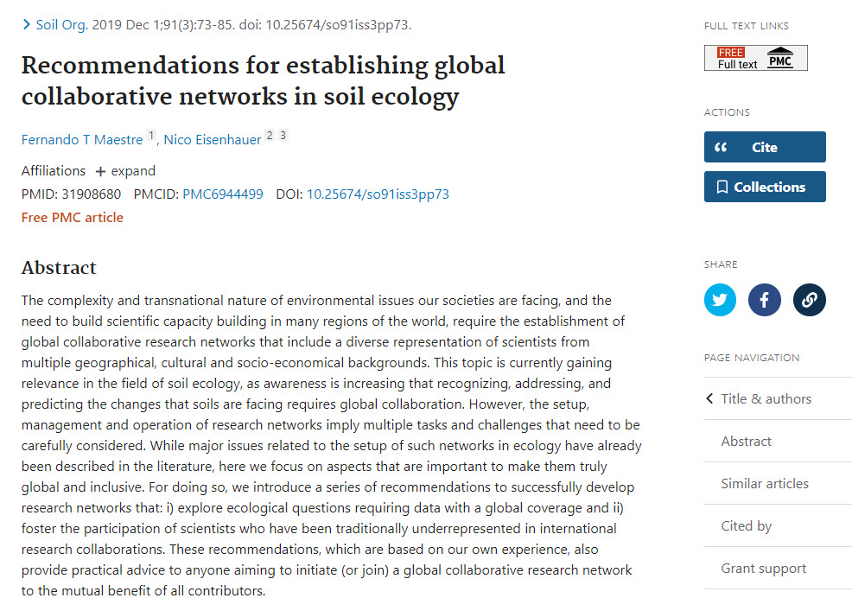
Author manuscripts
US NLM, 2023, Author manuscripts in PMC. https://www.ncbi.nlm.nih.gov/pmc/about/authorms/ Retrieved on 2023-08-20

Slide 8
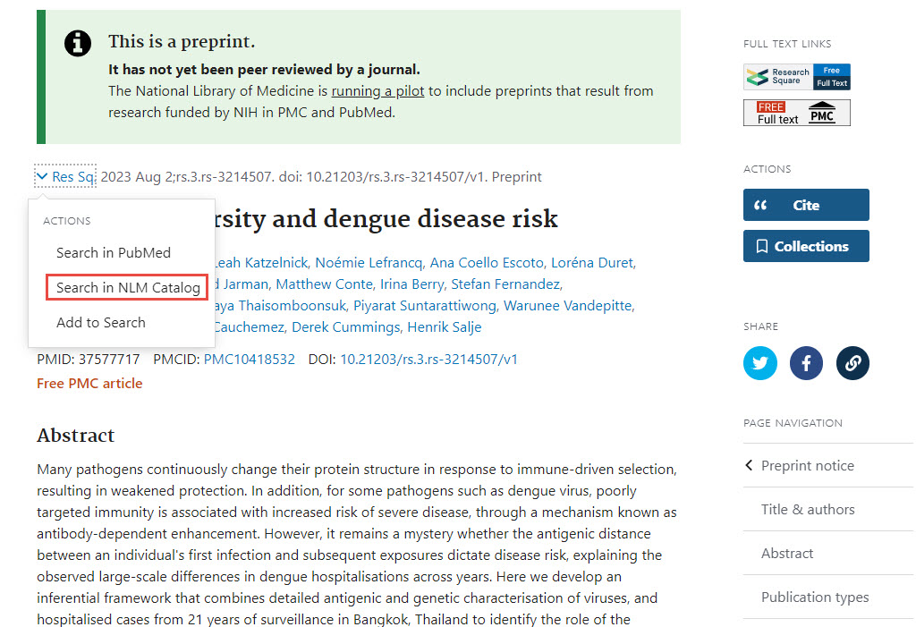
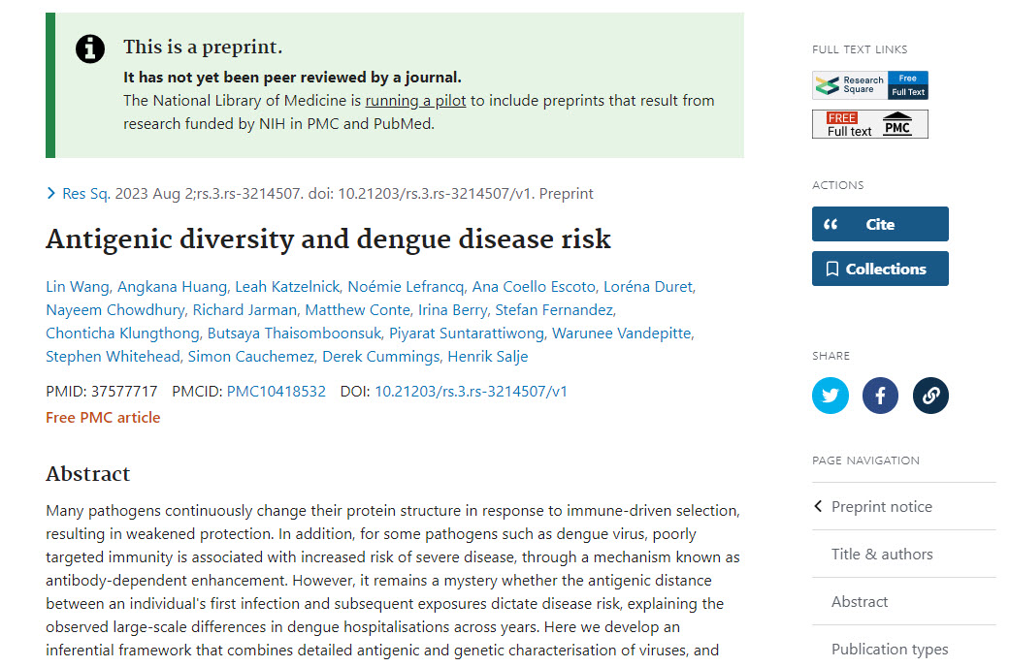
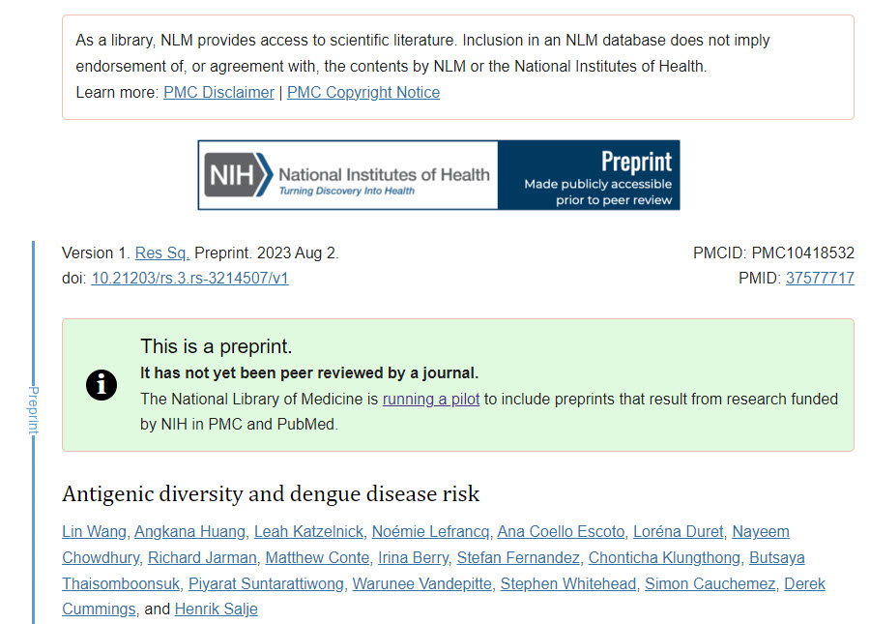
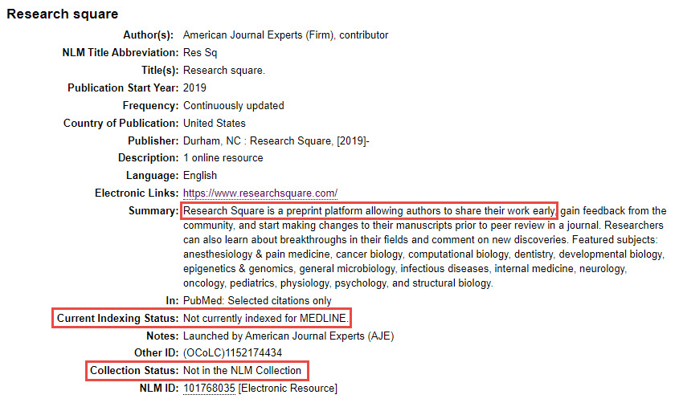
Preprints
See: US NLM, 2023. NIH Preprint Pilot. https://www.ncbi.nlm.nih.gov/pmc/about/nihpreprints/ Retrieved on 2023-08-20

Slide 9
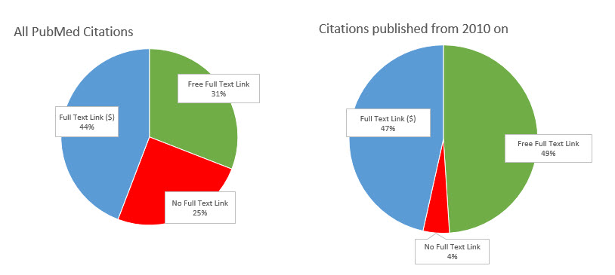
Access full text from PubMed citations
as of 2023/08/17
Access full text from PubMed Ac

Slide 10
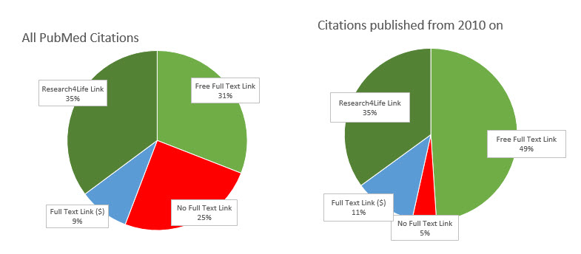
Access for Research4Life users
as of 2022/03/16
Access full text for Research4Life users
as of 2023/08/17

Slide 11
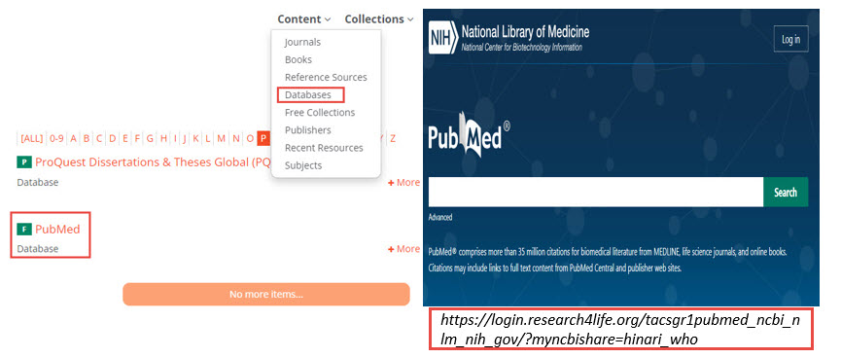
Access PubMed via the Research4Life content portal via the Research4Life content

Slide 12
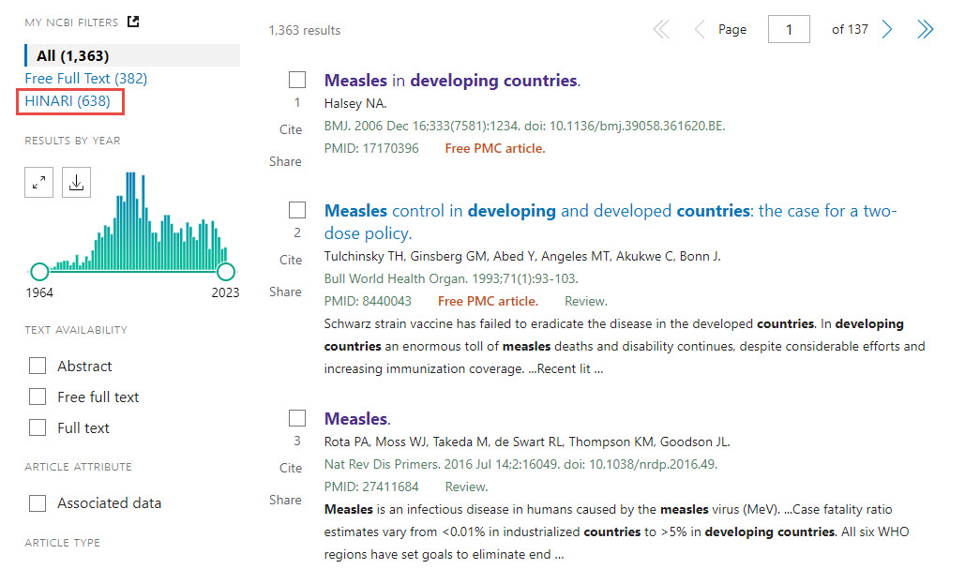
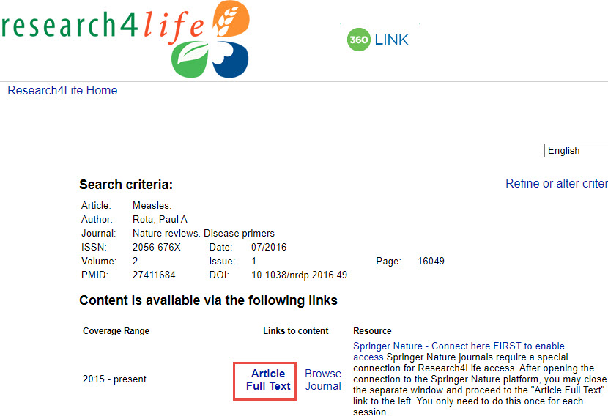
Research4Life filter and icon in PubMed summary and abstract displays Research4Life content portal

Slide 13
Updates since July 2020 - highlights
Interface
Page navigation at top and bottom of search results
See https://www.nlm.nih.gov/pubs/techbull/nd21/nd21_pubmed_interface_update.html
“Sort by” button out of Display options
See https://www.nlm.nih.gov/pubs/techbull/ja23/brief/ja23_july_pubmed_updates.html
Author lists in summary display truncated after 1.2K characters
See https://www.nlm.nih.gov/pubs/techbull/ma23/ma23_pubmed_update_usability_citations.html
Email up to 1K citations; Cite button remembers citation style preference; Improved workflow for Save, Email and Send to
See https://www.nlm.nih.gov/pubs/techbull/ja21/ja21_pubmed_update.html
Functionalities
Filters: “Journal” and “Subject” categories removed;
“Other” category includes MEDLINE and “Exclude preprints”
See https://www.nlm.nih.gov/pubs/techbull/so21/so21_pubmed_queries.html
Journal names can be searched with or without initial articles
See https://www.nlm.nih.gov/pubs/techbull/ja22/ja22_pubmed_journals_search.html

Slide 14
Noteworthy: Access to more free full text and associated data
US Office of Science and Technology Policy 2022 August memo
All federal agencies to update their public access policies, with an effective date no later than 2025-12-31
To make publications and supporting data resulting from federally funded research publicly accessible without an embargo
See https://www.whitehouse.gov/wp-content/uploads/2022/08/08-2022-OSTP-Public-Access-Memo.pdf
2023 NIH Data Management and Sharing Policy
Effective 2023-01-25, researchers and institutions seeking NIH research funding are expected to
plan and budget for the managing and sharing of data
submit a data management and sharing plan (DMS plan) for review when applying for funding
comply with the approved DMS plan
See https://sharing.nih.gov/data-management-and-sharing-policy

Slide 15
Noteworthy: proximity search
Supplement topical searches, e.g. searches not using MeSH
Search for multiple terms in any order within a specified distance
“search terms”[field:~N]
Search terms = two or more words enclosed in double quotes
Field = [Title], [Title/Abstract] or [Affiliation] ; [ti], [tiab] or [ad]
N = The maximum number of words that may appear between search terms; for the affiliation field, N <= 1000
Example: “hip pain”[tiab:~2]
Turn off Automatic Term Mapping; not compatible with term truncation (*)
Can combine proximity searches with other terms using Boolean operators

Slide 16
Proximity search
For more information:
PubMed Update: Proximity Search Now Available in PubMed. NLM Tech Bull. 2022 Nov-Dec;(449):e4. Available at: https://www.nlm.nih.gov/pubs/techbull/nd22/nd22_pubmed_proximity_search_available.html
PubMed Update: Proximity Searching Now Available for Affiliation Search Field. NLM Tech Bull. 2023 Jul-Aug;(453):e2. Available at: https://www.nlm.nih.gov/pubs/techbull/ja23/ja23_pubmed_proximity_searching_affiliation.html
Try the Proximity Searching tutorial https://www.nlm.nih.gov/oet/ed/pubmed/quicktours/proximity/index.html\
NLM Office Hours: Proximity Search (March 2023) https://www.nlm.nih.gov/oet/ed/pubmed/nlm-office-hours_proximity_searching.html
PubMed User Guide: https://pubmed.ncbi.nlm.nih.gov/help/#proximity-searching

Slide 17
Noteworthy:
Transition to Automatic Indexing
Implemented to all incoming Medline citations since April 2022
Comments and questions to NLM support: https://support.nlm.nih.gov/
MEDLINE 2022 Initiative: Transition to Automated Indexing. NLM Tech Bull. 2021 Nov-Dec;(443):e5. Available at https://www.nlm.nih.gov/pubs/techbull/nd21/nd21_medline_2022.html

Slide 18
Automated Indexing
Provide MeSH indexing to a MEDLINE citation within 24 hours after it appears in PubMed
Based on the title and abstract of an article; may expand to the full text where possible in the future
Use Medical Text Indexer-Auto (MTIA) algorithm which is pattern based, and combines MeSH terms mapped from the title and abstract with the MeSH terms from related PubMed records
Human indexers performs quality assurance review of selected indexing result
Identified in PubMed XML as “IndexingMethod=“Automated”
See https://www.nlm.nih.gov/pubs/techbull/ja18/ja18_indexing_method.html
Search PubMed for this type of citations: indexingmethod_automated
Author can provide MeSH terms as keywords to publisher to be included in their articles, such that those terms can be used in the automated indexing
US NLM, 2023. Frequently Asked Questions about Indexing for MEDLINE. https://www.nlm.nih.gov/bsd/indexfaq.html retrieved on 2023-08-20

Slide 19
Search Tips from the US National Library of Medicine
Be specific
No punctuation necessary
No need for Boolean operators
No need to capitalize
PubMed can find phrases
No need for search tags e.g. [tiab] [author]
PubMed is smart!
NNLM , July 2023. How PubMed Works: Automatic Term Mapping. https://www.youtube.com/watch?v=XBRi0zy_B_g retrieved on 2023-08-18

Slide 20
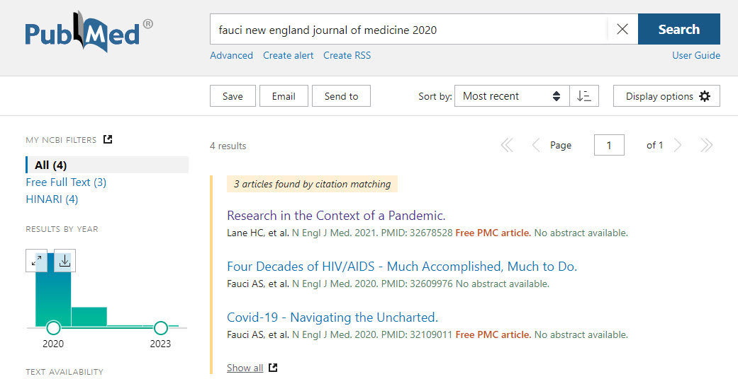
AuthA
Frequently searched: a specific citation

Slide 21
3rd stop: Author Translation Table
Frequently search: Author’s work
last name, 1st initial
example: fauci a
last name, all initials
example: fauci as
full name in natural and inverted order
example: anthony fauci
Notes:
Author index back to 1946

Slide 22
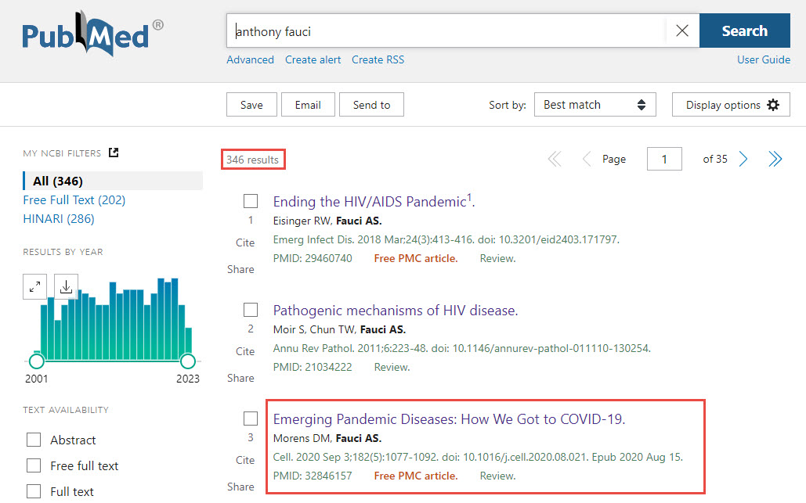
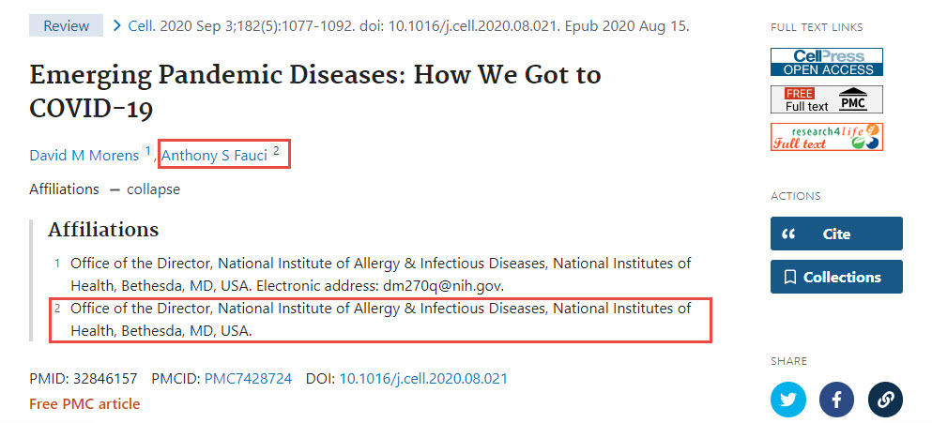
AuthA
Author search - PubMed can help

Slide 23
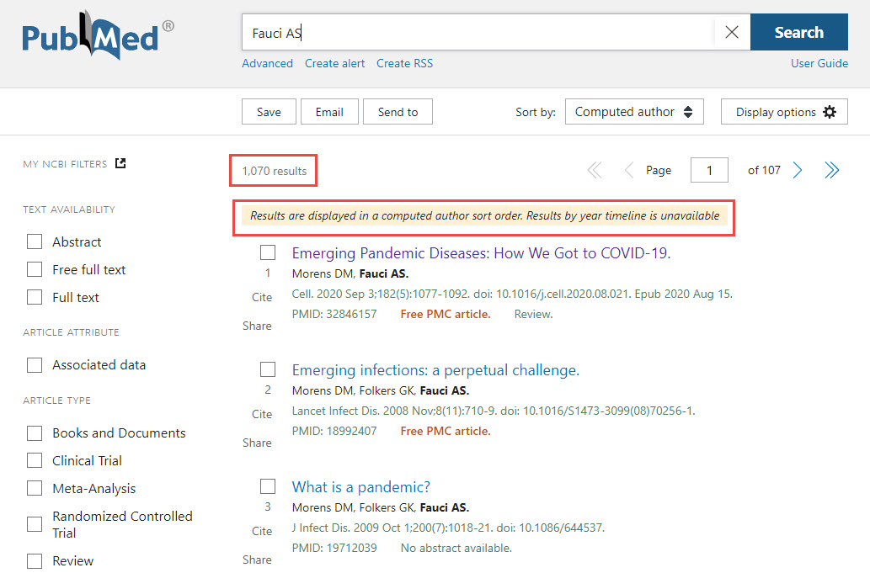
AuthA
Author search - PubMed can help (cont’d)
Canese K. PubMed and Computed Author Sorted Display NLM Tech Bull. 2012 May-Jun;(386):e2. https://www.nlm.nih.gov/pubs/techbull/mj12/mj12_pm_author_ranking.html retrieved 2023-08-18

Slide 24
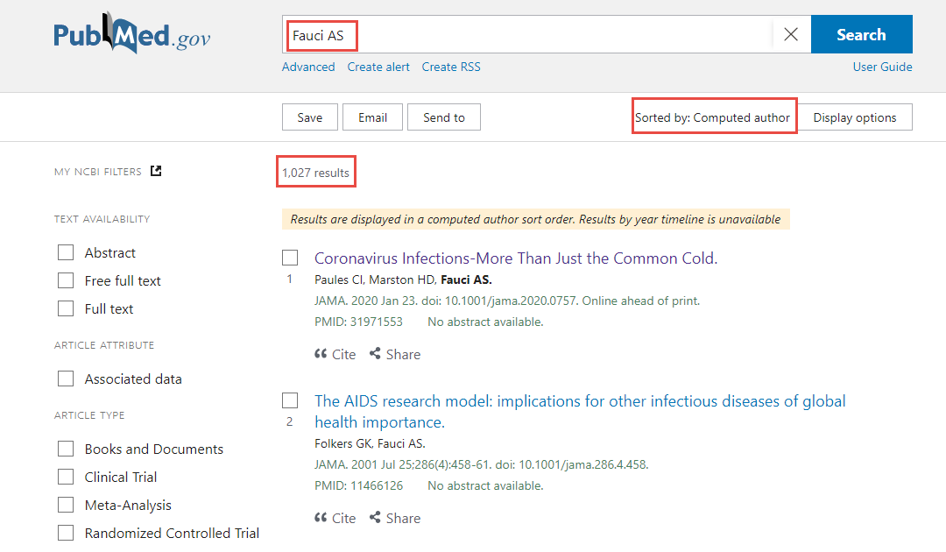
AuthA
Computed Author Sort

Slide 25
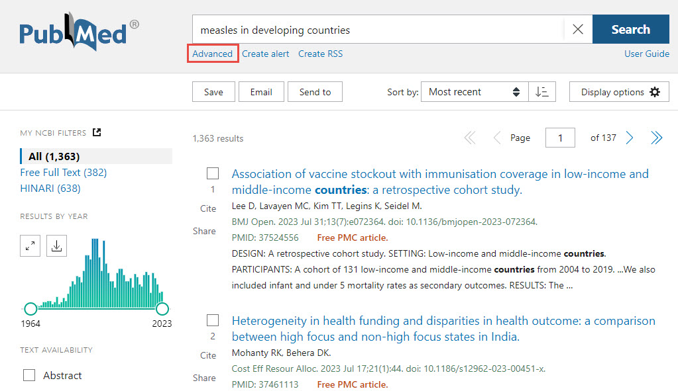
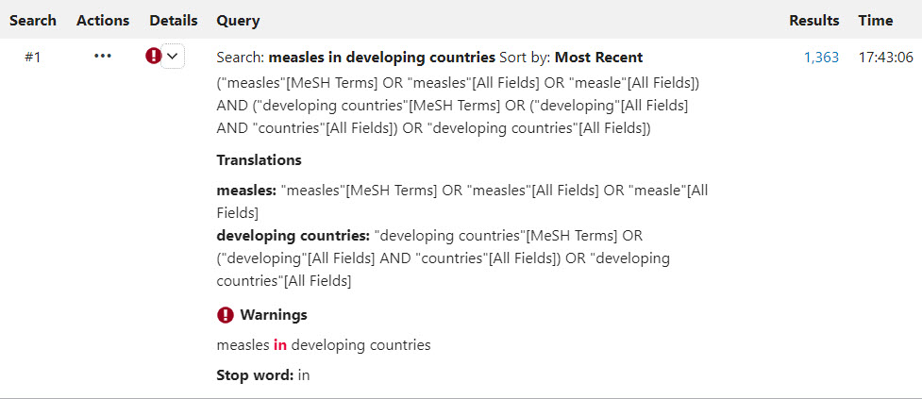
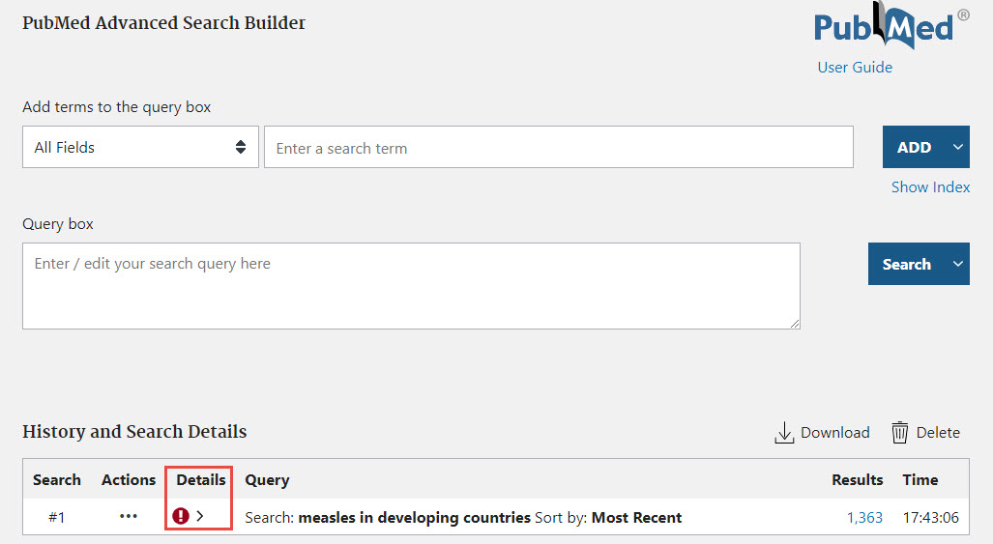
How PubMed search? Search Details
PubMed search details

Slide 26
Automatic Term Mapping (ATM):
Three translation tables
Automatic Term Mapping (ATM):
Three translation tables
NNLM , July 2023. How PubMed Works: Automatic Term Mapping. https://www.youtube.com/watch?v=XBRi0zy_B_g retrieved on 2023-08-18

Slide 27
1st stop: Subject Translation Table
MeSH (Medical Subject Headings)
Headings, Subheadings, Supplementary Concepts
Entry Terms (synonyms)
Publication Types, a Mesh category
Pharmacologic actions, a Mesh category
Singular and plural word forms
British and American Spellings
Drug brand name to generic name translation
UMLS (Unified Medical Language System)
NNLM , July 2023. How PubMed Works: Automatic Term Mapping. https://www.youtube.com/watch?v=XBRi0zy_B_g retrieved on 2023-08-18

Slide 28
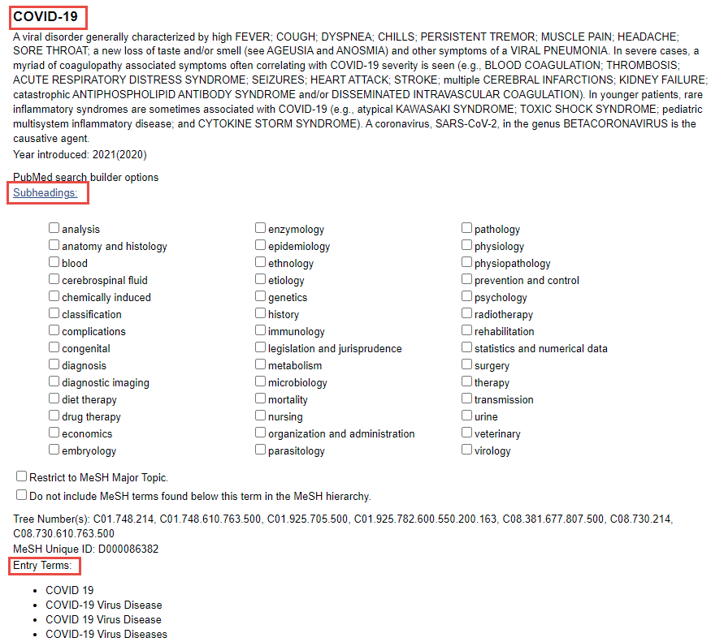
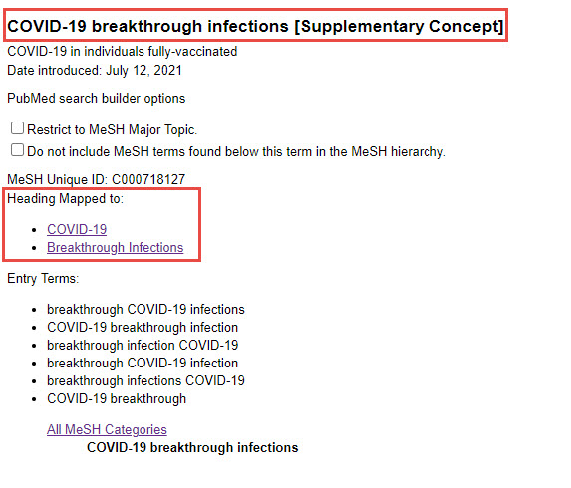
MeSH term: COVID-19
Supplementary concept:
COVID-19 breakthrough infections
https://www.ncbi.nlm.nih.gov/mesh/2052179
https://www.ncbi.nlm.nih.gov/mesh/2100363

Slide 29
2nd stop: Journal Translation Table
2nd stop: Journal Translation Table
Full journal titles
example: The New England journal of medicine
NLM title abbreviation
example: N Engl J Med
ISSN with dashes
example: 0028-4793
For journal titles of all PubMed citations/NCBI databases
NNLM, July 2023. How PubMed Works: Automatic Term Mapping. https://www.youtube.com/watch?v=XBRi0zy_B_g retrieved on 2023-08-18

Slide 30
3rd stop: Author Translation Table
NNLM, July 2023. How PubMed Works: Automatic Term Mapping. https://www.youtube.com/watch?v=XBRi0zy_B_g retrieved on 2023-08-18

Slide 31
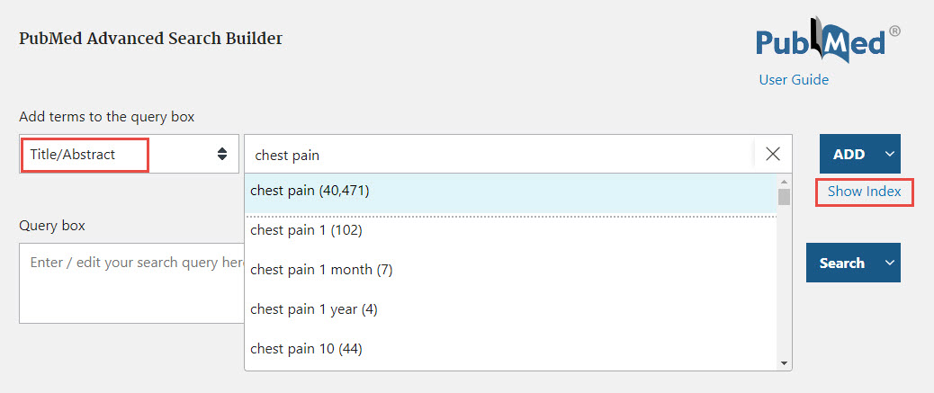
How to turn off ATM
Quotation marks
“chest pain” vs chest pain
Search tags
chest pain [tiab] vs chest pain
Advanced Search Builder
same as using search tag
explore the index related to a search field
NNLM, July 2023. How PubMed Works: Automatic Term Mapping. https://www.youtube.com/watch?v=XBRi0zy_B_g retrieved on 2023-08-18

Slide 32
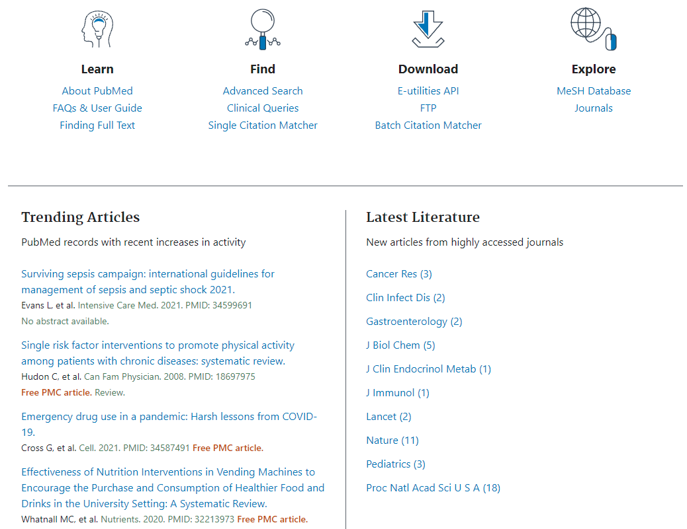
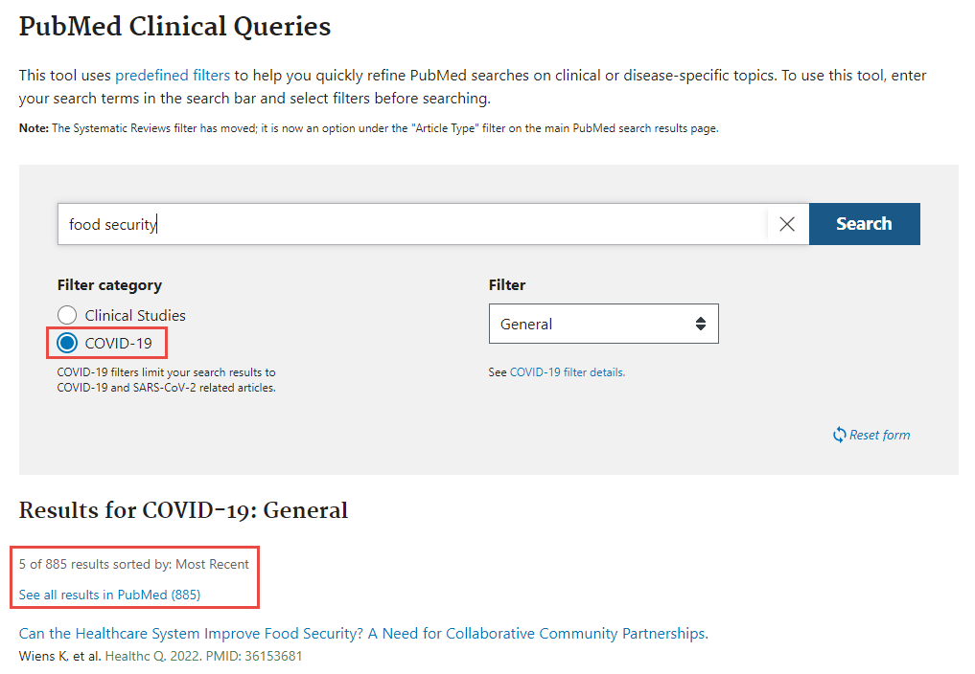
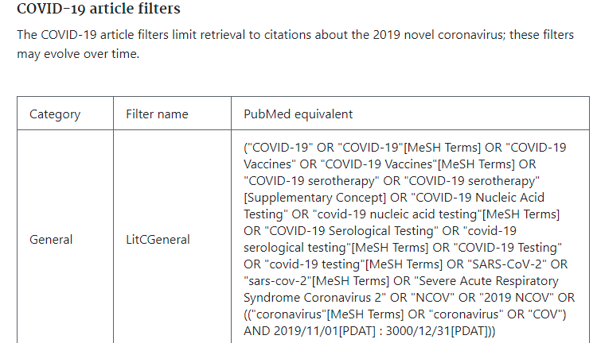
More on the PubMed home page
More on the PubMed home page

Slide 33
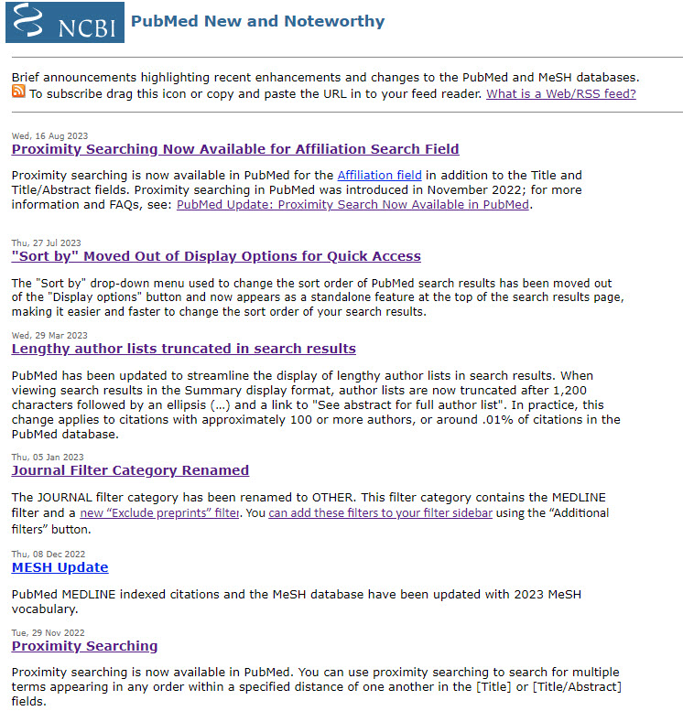
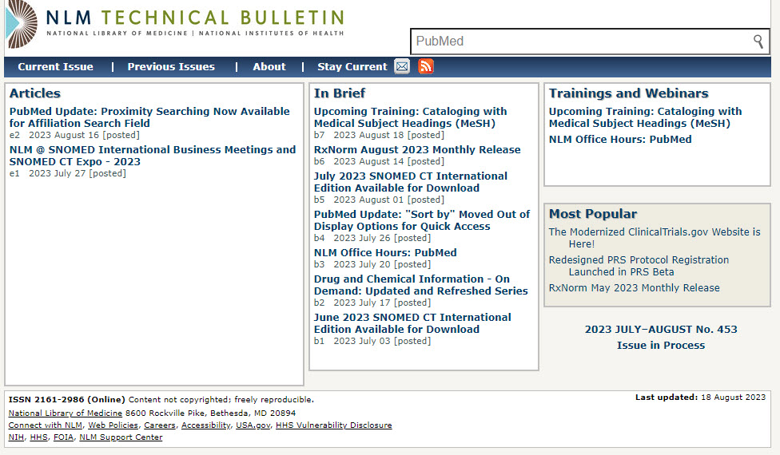
PubMed New and Noteworthy and
NLM Technical Bulletin
https://www.ncbi.nlm.nih.gov/feed/rss.cgi?ChanKey=PubMedNews
https://www.nlm.nih.gov/pubs/techbull/

Slide 34
Excellent resources from NLM and NNLM (Network of the National Library of Medicine)
PubMed User Guide
https://pubmed.ncbi.nlm.nih.gov/help/
How PubMed Works
https://nnlm.gov/training/class-catalog/how-pubmed-works
PubMed Online Training
https://learn.nlm.nih.gov/documentation/training-packets/T0042010P/
PubMed Customer Support
https://support.nlm.nih.gov/

