Slide 1
Additional discipline-specific resources
Agriculture
Research4Life is a public-private partnership of five collections:

Slide 2
Outline
Introduction
AGRIS - International Information System of Agricultural Science and Technology
Content coverage
How to search AGRIS database?
How to become a data provider?
Databases in Agriculture
CAB Abstract
USDA National Agricultural Library - PubAg
This work is licensed under Creative Commons Attribution-ShareAlike 4.0 International (CC BY-SA 4.0)

Slide 3
Learning objectives
Become familiar with discovery resources related to agriculture.
Understand how to use and contribute to AGRIS.
Notes:
In this lesson, learners will be introduced to the AGRIS database and additional discipline-specific external resources in the fields of agricultural sciences.

Slide 4
What is AGRIS ?
AGRIS stands for International Information System of Agricultural Science and Technology.
AGRIS has been maintained by the Food and Agriculture Organization of the United Nations (FAO) since 1974.
Its main objective is to improve the access to & exchange of information on agricultural research to developed and developing countries.
More than 460 data providers from 153 countries provide free access to more than 13 million bibliographic records in up to 187 different languages
Notes:
AGRIS is a network of more than 460 data providers (research centres, academic institutions, publishers, governmental bodies, development programmes, international and national organizations) from up to 153 countries.

Slide 5
Content coverage
AGRIS has a data set of multilingual bibliographic resources on agricultural research and other related subjects.
AGRIS Data Providers submit bibliographic metadata of data sets, journal articles, book chapters, monographs, grey literature and other content types related to agriculture.
AGRIS records are fully indexed by Google Scholar; 85% of AGRIS records are indexed by the AGROVOC multilingual thesaurus;
covers all areas of interest of FAO including food, nutrition, agriculture, fisheries, forestry, the environment and more.
AGRIS is accessed by up to 400,000 users each month from more than 200 countries and territories.
Audience includes researchers, graduate students, librarians and many others.
Notes:
AGROVOC is a controlled vocabulary covering all areas of interest of the Food and Agriculture Organization (FAO) of the United Nations, including food, nutrition, agriculture, fisheries, forestry, environment etc. It is published by FAO and edited by a community of experts. It is widely used in specialized libraries as well as digital libraries and repositories to index content and for the purpose of text mining. It is also used as a specialized tagging resource for content organization by FAO and third-party stakeholders.
AGROVOC consists of +41 000 concepts and +990 000 terms in up to 42 languages
AGRIS is an international brand with an international audience for the data providers increasing visibility of resources, creating the opportunity to contribute to agriculture and related sciences globally.
AGRIS Data providers can submit including unpublished science, technical reports, theses, dissertations, conference papers).
AGRIS supports both developed and developing countries.
The audience is researchers, professors, and graduate students looking for bibliographies; plus librarians, cataloguers; journal publishers, conference organizers, and decision makers in the agricultural domain.

Slide 6
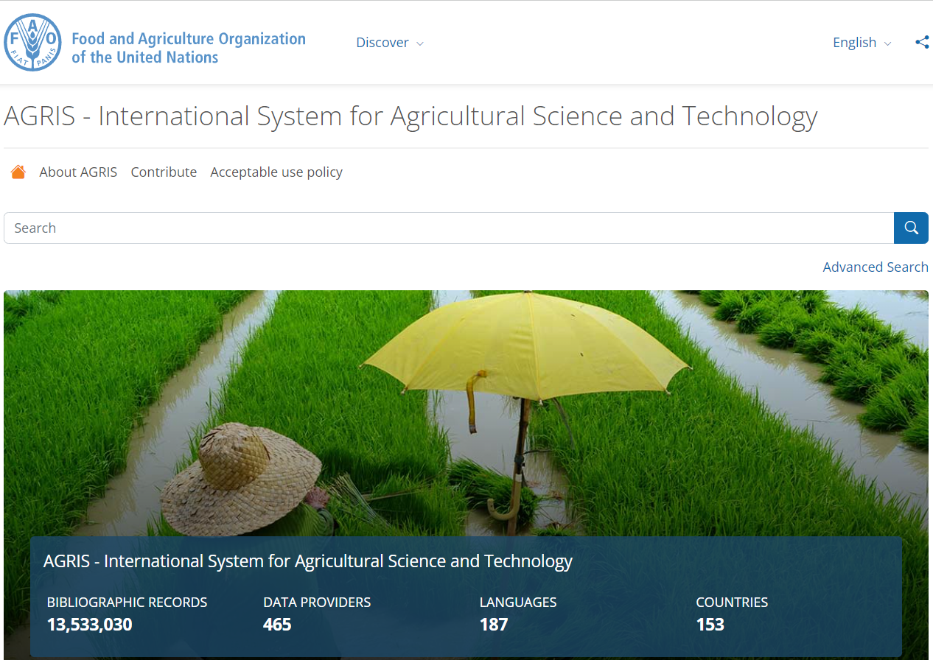
AGRIS access
After logging into the AGORA or Unified Content Portal, open the Content list, scroll down the titles, click on Free Collections then click on AGRIS or open directly
https://agris.fao.org/

Slide 7
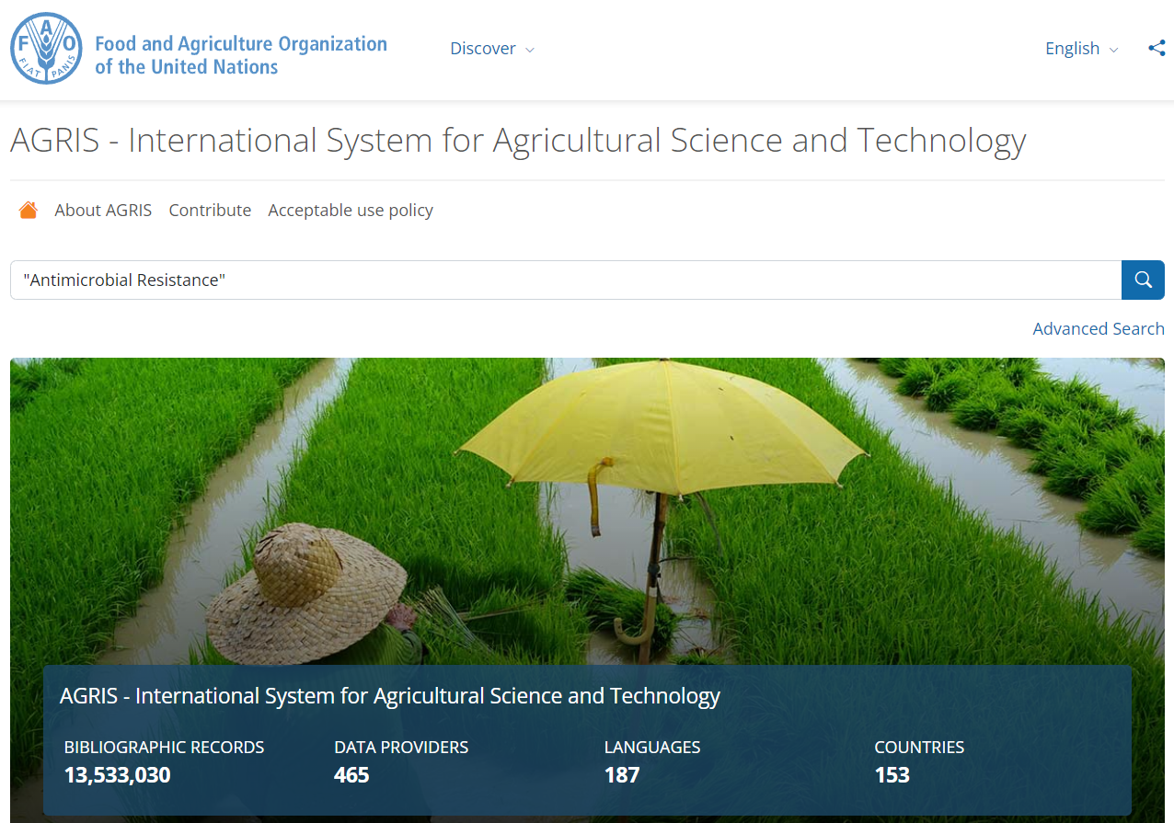
How to search the AGRIS database?
The interface allows users to perform basic searches.
Users can perform a simple (basic) search with any keywords through the search box.
Quotation marks can be used to to limit the search results.
The advanced search option will be explored later in this presentation.

Slide 8
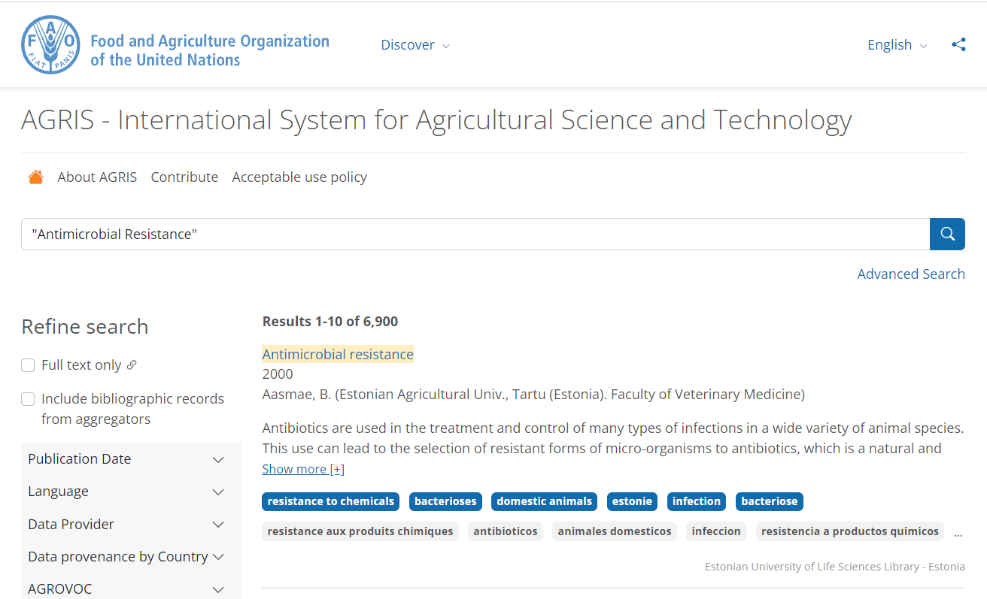
Understanding the search results
This search produced 6,900 results.
Title of the source
Year of publication
Name and Affiliation of the Author
Abstract which can be expanded using the Show more[+] option
AGROVOC Keywords
Currently, the page displays 10 results. The number can be changed at the bottom of the page.
Click on the title to access the bibliographic details.
A
B
C
D
E

Slide 9
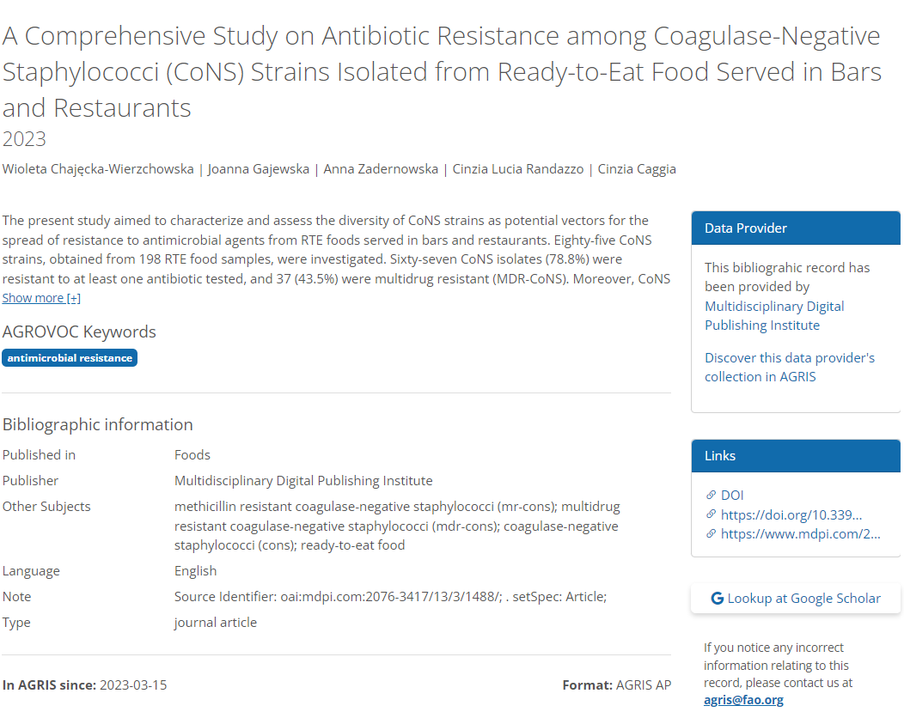
Bibliographic details on a record in AGRIS
Title
Authors
Abstract
Data Provider
AGROCVOC Keywords
Access full text
Bibliographic information

Slide 10
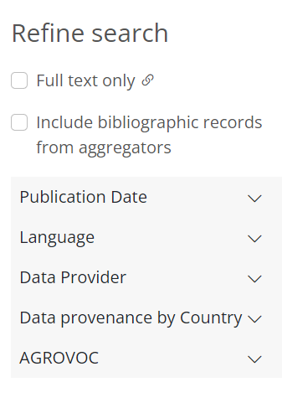
Refining options in AGRIS
Once the search has been completed, the AGRIS results can be filtered using the Refine Search options available on the left side of the results page.
Limit search results to records with/without links to full text.
Enable or disable results from aggregators.
Refine by publication date.
Retrieve results in different languages.
Limit search results to a specific data provider.
Retrieve data from a specific country
Refine by AGROVOC keywords.

Slide 11
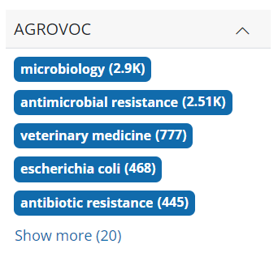
AGROVOC Keywords
Most of the AGRIS records are indexed by AGROVOC.
The AGROVOC keywords option is a very useful tool to help find the precise and most relevant records to your search terms.
Notes:
FAO’s multilingual Thesaurus and the contributors, data providers are advised to describe their collections by using AGROVOC thesaurus.

Slide 12
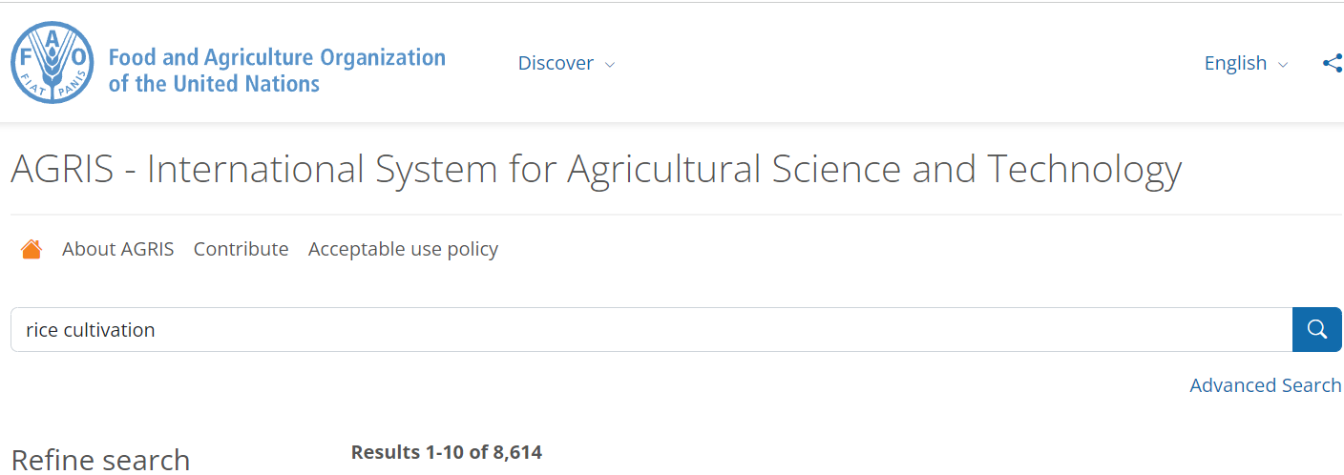
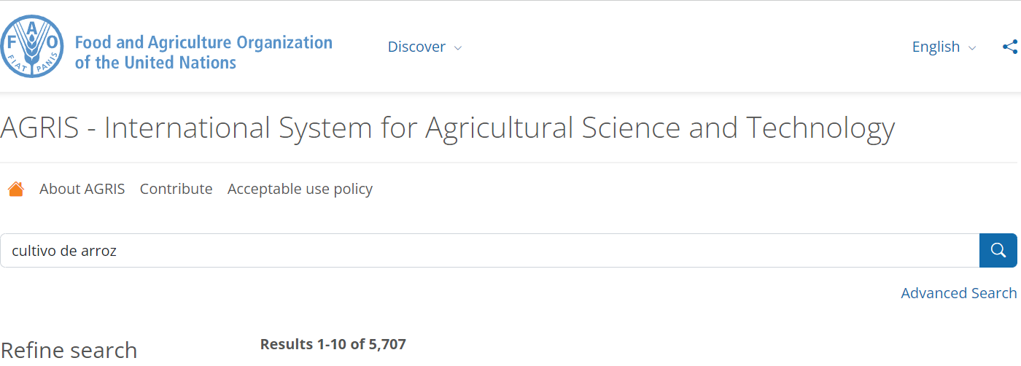
Default (English) display/search terms in multiple languages
The default AGRIS display language option is in English. This search is in English (cultivation of rice) and Spanish (cultivo de arroz). The search results were 8,614 citations in English and 5,707 for Spanish
Note: AGRIS contains numerous quantities of information in different languages using AGORVOC – the FAO multilingual thesis in more than 40 languages.

Slide 13
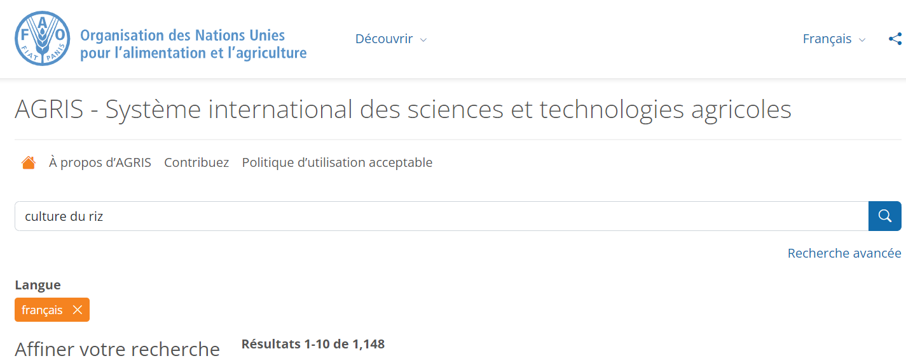
Language display and searches
Two useful options are the AGRIS display language options and the Language drop down menu option for material in a specific language.
In this example, the display is in French, and French has been selected from the language dropdown menu with the search being culture du riz (rice cultivation) – 1,148 citations.
In the French display keyword search box, searches can be completed in multiple languages.

Slide 14
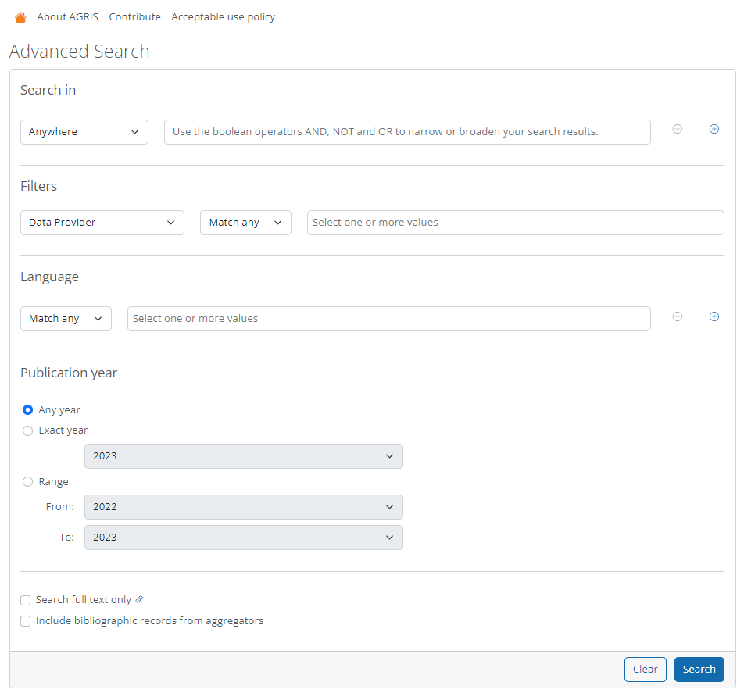
Advanced search in AGRIS
The Advanced Search tool is highly valuable as it provides multiple search options all on a single page
Users can enter keywords in the initial box & limit the search by using the available fields.
The previously discussed filters also are available.
*For example, on the next slide, the search results for 'Antimicrobial Resistance’ was narrowed down by adding the keyword 'Farm'.

Slide 15
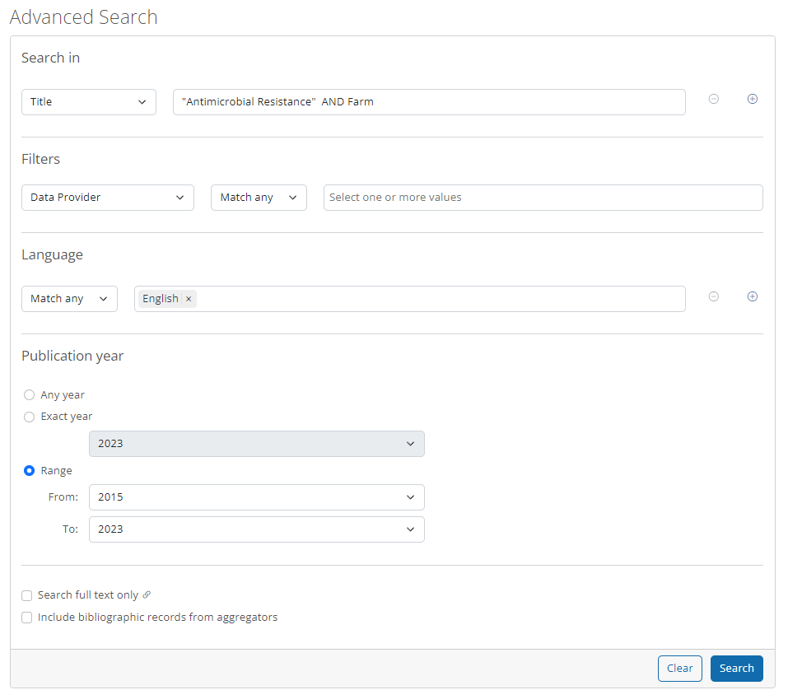
Example: Advanced search in AGRIS
The Title field was selected for this search.
The language (English) and publication year (from 2015 to 2023) filters were also applied.
The search results are available on the next slide.

Slide 16
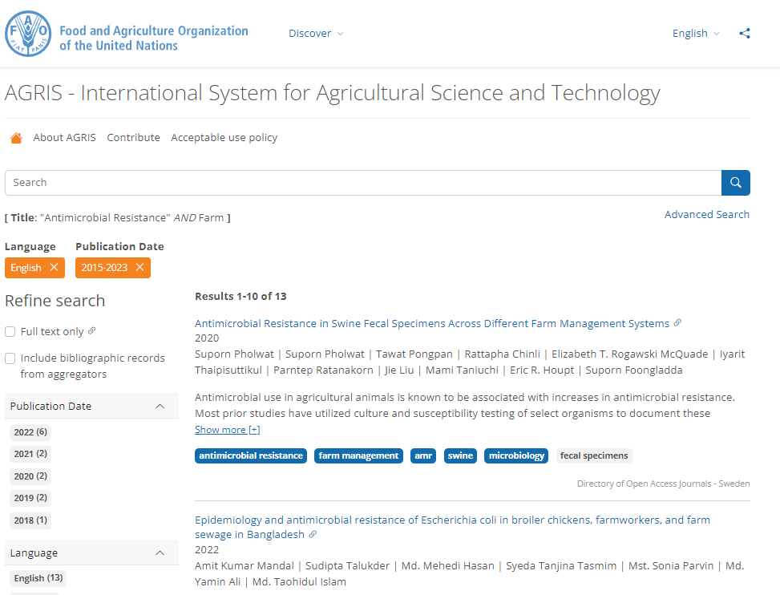
Search results :Advanced search in AGRIS
This search yielded 13 results, as displayed on the right.
The applied filters are highlighted in orange at the top of the Refine search options.
To remove any of these filters, simply click on the 'X' icon located after each filter.

Slide 17
How to become a data provider?
Organizations which are eligible to become data providers in AGRIS are institutional repositories, journal publishers and aggregators.
Individual author contributors are not accepted as data providers.
Resources should be in the area of food, nutrition, agriculture, forestry, fishery, environmental or other related sciences which are included in the AGROVOC thesaurus.
If you are interested to register as a data provider, please contact agris@fao.org.
Recommendations of a set of metadata properties and encoding vocabularies are provided on FAO’s AIMS website.
More information about providing data to AGRIS can be found at http://agris.fao.org/agris-search/info.action. AGRIS also has a dedicated mailing list at https://dgroups.org/fao/agris where anyone interested in it can join the list to stay up-to-date with the database and relevant activities.
Notes:
AGRIS receives metadata in various formats, like the AGRIS Application Profile (AP) XML format as a minimum standard or better.
Recommendations of a set of metadata properties and encoding vocabularies are provided on FAO’s AIMS website. Meaningful Bibliographic Metadata is intended to assist content providers in selecting appropriate metadata properties for the creation, management and exchange of meaningful bibliographic information in open repositories.
The most common metadata standard formats are: Crossref, DOAJ, Endnote, MARC21, MODS, Simple DC, and PubMed. When there is a need to create metadata from scratch, it is recommended to use a reference management software to export the data in XML format. There are also reference management software applications that can be downloaded for free, for example Mendeley or Zotero.

Slide 18
Databases in Agriculture
This section will introduce two of the databases that are available through the AGORA Portal or the R4L United Content Portal, from the list of Databases or externally at the given URLs.
CAB Abstract
USDA National Agricultural Library - PubAg

Slide 19
CAB Abstracts
CAB Abstracts is a comprehensive database for applied life sciences.
It is published by CABI (formerly the Centre for Agriculture and Biosciences International).
CAB Abstracts provides users access to more than 13 million records from 1973 onwards.
Subject coverage includes agriculture, environment, veterinary sciences, applied economics, food science and nutrition.
CAB Abstracts is indexed with the CAB Thesaurus which makes searching easier and provides a more precise access to all relevant research.
CAB Abstracts has an international focus with strong representation in developing countries.

Slide 20
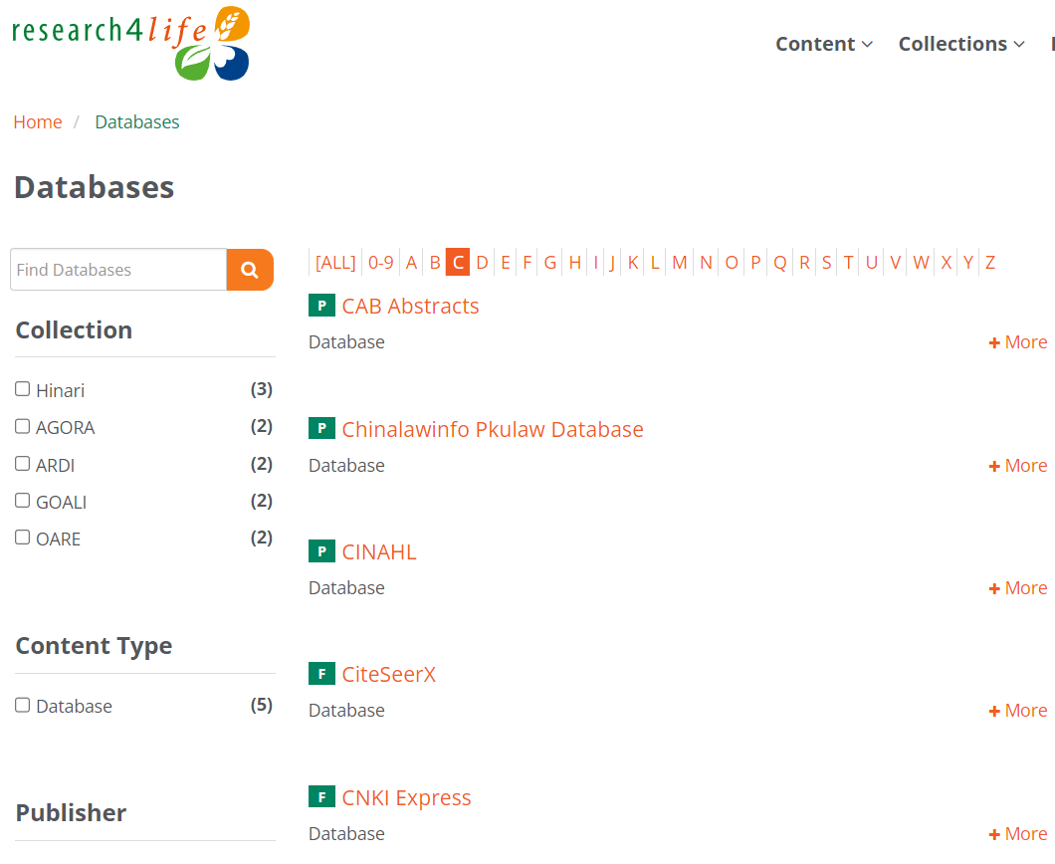
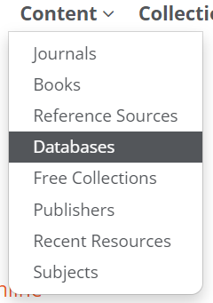
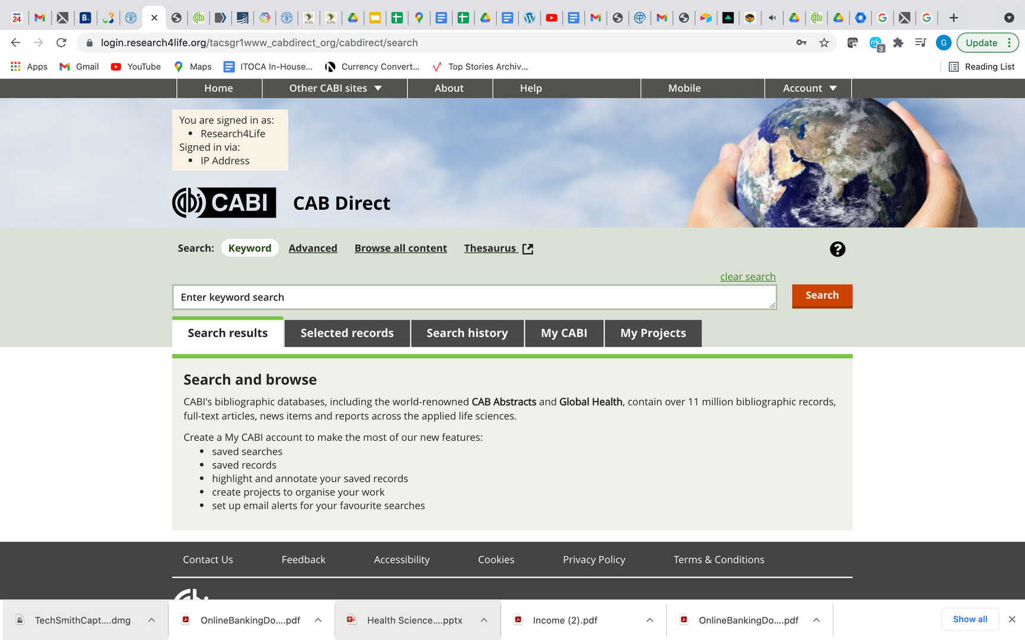
CAB Abstracts
After logging into the AGORA or Unified Content Portal, open the Content list, scroll down the titles and click on Databases, then click on letter C on the alphabetical list to open CAB Abstracts.

Slide 21
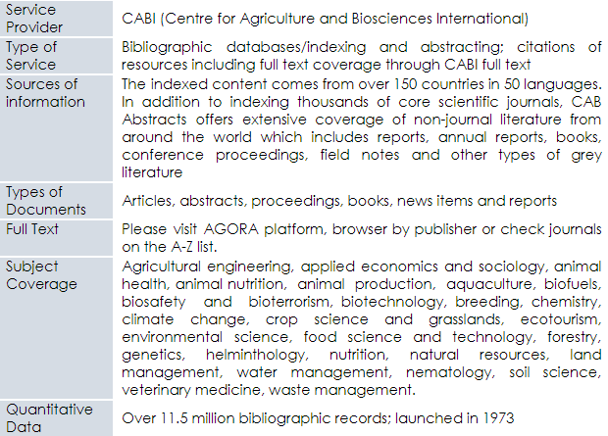
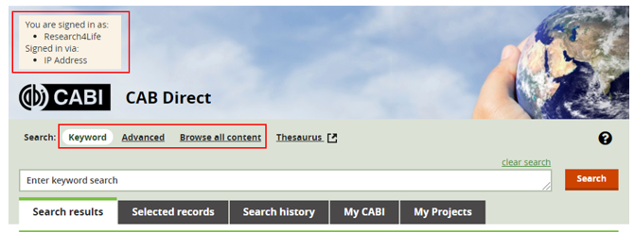
CAB Abstracts cont.
Available at :
Login into AGORA or Unified Content Portal, open Content and click on Databases to access CAB Abstracts.
CAB Abstracts search page

Slide 22
USDA National Agricultural Library - PubAg
PubAg is a search engine that gives the public enhanced access to research published by scientists from US Department of Agriculture (USDA) scientists.
It is provided by the US Department of Agriculture (USDA) National Agricultural Library.
PubAg is a portal to USDA-authored and other highly relevant agricultural research.
PubAg is easy to use an and it serves diverse users, including the public, farmers, scientists, academicians and students.
There is no requirement for a username, password or any other form of registration to use PubAg.

Slide 23
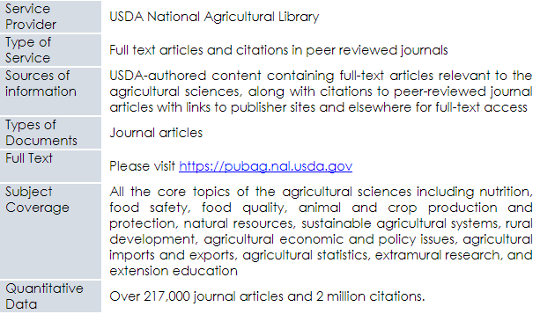
USDA National Agricultural Library – PubAg cont.
Available at https://pubag.nal.usda.gov
PubAg search page

Slide 24
Summary
This lesson focused on databases for discovery in agriculture.
The lesson introduced learners to AGRIS and it provided training on how to use and contribute to AGRIS.
Learners were also introduced to CAB Abstracts and USDA National Agricultural Library – PubAg, these resources can be used to search for agriculture related content.

Slide 25
References and useful resources
CABi. 2020. CABI Direct. In: CABI Direct [online]. [Cited 29 September 2020]. https://www.cabdirect.org/cabdirect/about
FAO. 2019. How to submit data to AGRIS. Instructions to data providers. In: Agricultural Information Management Standards (AIMS) [online]. [Cited 29 September 2020]. http://aims.fao.org/how-submit-data-agris-instructions-data-providers
FAO. 2020c. AGROVOC. In: Agricultural Information Management Standards (AIMS) [online]. [Cited 25 September 2020]. http://aims.fao.org/vest-registry/vocabularies/agrovoc
FAO. 2020a. AGRIS: Agricultural Science and Technology Information. In: AGRIS [online]. [Cited 25 September 2020]. http://agris.fao.org/agris-search/index.do
Research4Life. 2021. Training Presentations. In: Research4Life Training/Librarians Hub [online]. [Cited 31 December 2021]. https://www.research4life.org/training/librarians-hub/
Subirats, I. & Zeng, M.L. 2012. Meaningful Bibliographic Metadata (M2B). In: Agricultural Information Management Standards (AIMS) [online]. [Cited 29 September 2020]. http://aims.fao.org/metadata/m2b
USDA National Agricultural Library. 2020. PubAg. In: USDA National Agricultural Library [online]. [Cited 29 September 2020]. https://pubag.nal.usda.gov/faq
FAO. 2020b. What is AGRIS? In: AGRIS [online]. [Cited 29 September 2020]. https://agris.fao.org/agris-search/info.action

Slide 26
You are invited to;
Visit us at www.research4life.org
Contact us at r4l@research4life.org
Find out about other training materials [www.research4life.org/training]
Subscribe to Research4Life newsletter [www.research4life.org/newsletter]
Check out Research4Life videos [https://bit.ly/2w3CU5C]
Follow us on Twitter @r4lpartnership and Facebook @R4Lpartnership

Slide 27
Research4Life is committed to the UN's Sustainable Development Goals.
Research4Life contributes to the United Nations Decade of Action by increasing research participation from the Global South.
The recent Strategic Plan to 2030 focuses on inclusion and equity in the global research community, supporting the creation of an even richer body of research which will help to advance the Sustainable Development Goals.
Research4Life offers our partners, users and supporters the opportunity to contribute to the creation of a diverse. inclusive and equitable research ecosystem for all.

Slide 28
Our unique public-private structure allows us to work effectively in alignment with SDG17: Partnership for the Goals for sustainable development and to support our community of users as both consumers and producers of critical research and advance SDG10: Reduced Inequalities within and among countries.
While R4L activities directly and indirectly support all the SDGs such as Good health and Wellbeing, Zero Hunger, Clean Water and Sanitation, Industry, innovation and infrastructure, and Peace and Justice, the Research4Life Program is closely aligned to SDG4: Quality Education that is fundamental to creating a peaceful and prosperous world and SDG5: Gender Equity to achieve the empowerment of all women and children.

Slide 29
For more information on Research4Life
www.research4life.org
r4l@research4life.org
Research4Life is a public-private partnership of five collections:

