Slide 1
Advocate for Research4life and facilitate capacity development
Training your audience on how to use Research4life
Research4Life is a public-private partnership of five collections:

Slide 2
Outline
Marketing Plan Tool
Workshop Plan Tool
Training and promotional material
Social Media
Summary
This work is licensed under Creative Commons Attribution-ShareAlike 4.0 International (CC BY-SA 4.0)

Slide 3
Learning objectives
Understand the benefits of marketing and promoting Research4Life at your institution
Prepare a Research4Life marketing plan based on the user needs of your institution
Construct a workshop plan to train members of your institution on how to use Research4Life resources based on the specific user needs
Know where to find Research4Life training, marketing, and promotional materials
Note: To complete the Marketing Plan Tool and the Workshop Plan Tool, print a copy of the spreadsheet and enter the information manually or download a copy and use your computer to enter the data. The spreadsheet links are provided in the subsequent slides.

Slide 4
Marketing for Research4Life
There are some similarities between developing a marketing strategy and an advocacy strategy.
Marketing is more customer-oriented and aims to “sell” a product or service.
Marketing can increase the library’s visibility therefore it should be part of a library’s overall strategic plan.
A marketing plan provides libraries with a framework for the effective, logical and comprehensive development of marketing activities.
A marketing plan that is tailored to an institution can help the library use its resources more efficiently and benefit advocacy work.

Slide 5
Marketing for Research4Life
A marketing plan will educate the institution’s customers or client groups about the full potential of the resources available through the Research4Life platform.
This will benefit research, education, policy-making, and other outcomes.
An effective marketing strategy will increase the use of the Research4Life and justify the continued support by the participating publishers.

Slide 6
Reflection
What marketing plan does your organization currently use for Research4Life? Is it working well? How could it be improved?
If you do not have a R4L marketing plan, would this type of tool be useful?
Notes:
Self-reflection activity - 3 mins

Slide 7
Research4Life Marketing Plan Tool
To access the Research4Life Marketing Plan Tool
, go to the Librarians’ Hub, scroll down to Promote your library with a successful marketing plan and click on Download workbook

Slide 8
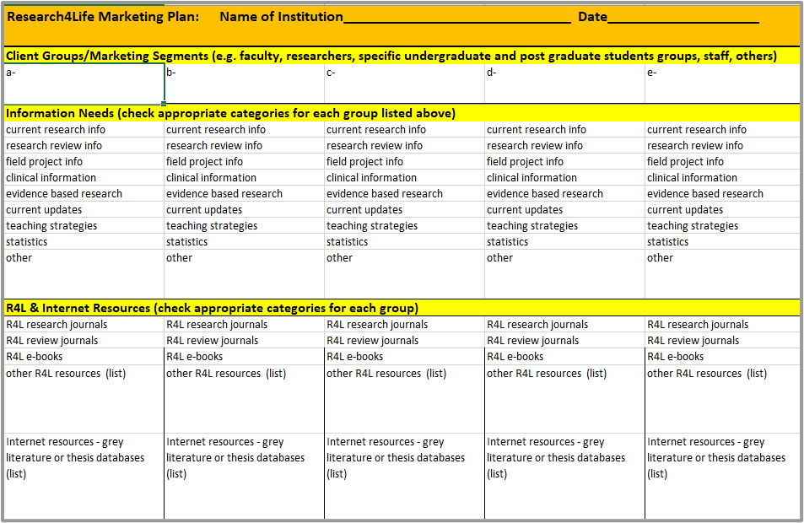
First page of the Research4Life Marketing Plan Tool
The first page of the Research4Life marketing plan tool allows a user to enter
the institution’s Client Groups (listed horizontally for up-to-five)
each group’s Information Needs (list vertically with an X)
the R4L & Internet Resources options (list vertically with an X or type in term)
Notes:
Enter the institution’s client groups horizontally in the five boxes.
Once these groups have been added, work vertically down the column. For example, if the first group is lecturers, put checks next to the appropriate categories for the group’s Information Needs – listed below in the same column.
Continue down the column and check the Research4Life and Internet Resources for lecturers. For the second client group (for example researchers), again go down that specific column vertically and check the boxes for this group.

Slide 9
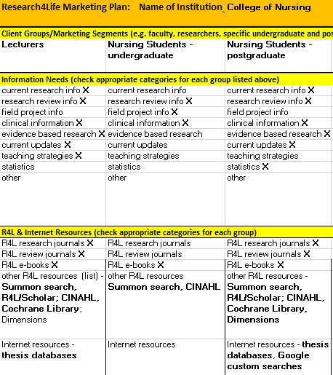
Sample of completed first page of the Marketing Plan for a College of Nursing
Sample for a College of Nursing
add the institution’s Client Groups (listed horizontally)
note each group’s Information Needs (listed vertically with an X)
note the Research4Life & Internet Resources options (list vertically with an X or type in term)

Slide 10
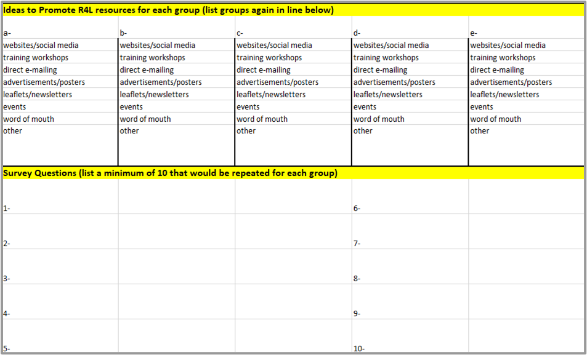
Second page of the Research4Life Marketing Plan Tool
The second page Marketing Plan tool allows a user to enter
the Client Groups that were listed horizontally on the previous pages.
the Ideas to Promote Research4Life resources for each group (listed vertically with an X).
ten Survey Questions for all the client groups in boxes.

Slide 11
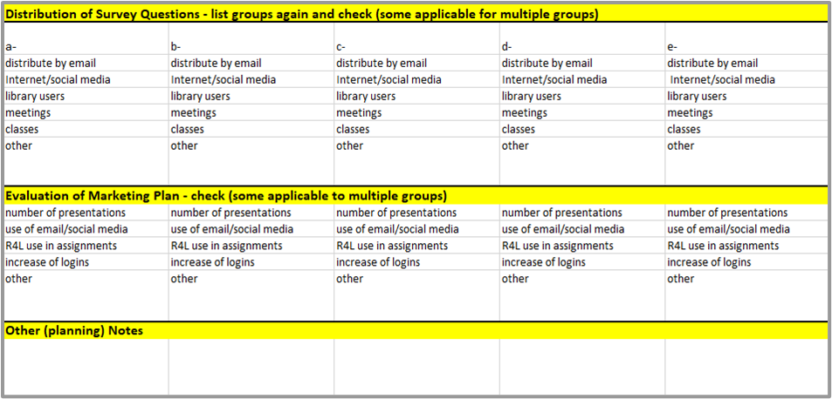
Third page of the Research4Life Marketing Plan Tool
The third page of the Marketing Plan Tool allows a user to enter
the Client Groups in the appropriate boxes (horizontally).
the methods for Distribution of Survey Questions for each group (listed vertically with an X).
the options for Evaluation of Marketing Plan for each group (listed vertically with an X),

Slide 12
Group Activity
Select a client group and work on at least one column of the Marketing Plan tool. Brainstorm at least 3-4 survey questions together.
Note: To complete the Marketing Plan Tool and the Workshop Plan Tool, print a copy of the spreadsheet and enter the information manually or download a copy and use your computer to enter the data. The workbook is downloadable from: https://www.research4life.org/training/librarians-hub/
Notes:
Small groups - 10-15 mins
Groups should be pre-assigned by instructor based off of pre-course survey based on institution type (i.e. academic, government, non-profit, etc.)
Ask each group to select a leader who will gather group email addresses, download the tool and share their screen so that the group can work on the plan in real time, and email the finished product to the entire team after the session is complete.

Slide 13
User training and workshops
Depending on the institution’s client groups and their specific information needs and the time available, each training will be unique.
Learn to incorporate adult learning techniques to create a successful workshop. See Addition Resources for teaching adults in the Additional Resources section.
Use the Workshop Plan Tool to determine the training needs of the client group and select the appropriate training materials and methods to fulfill the learning objectives.

Slide 14
Examples of how different workshops need to be developed for unique groups with specific requirements
Example 1
Two two-hour sessions:
Participants are agriculture extension agents attending a week-long meeting. One of the most discussed topics in the field is “high protein forage and dairy production”. Where can the participants find current research and useful grey literature?
What search tools should be taught during the four hours of instruction?
Example 2
Three two-hour sessions:
Participants are fourth-year nursing students about to begin their literature searches for their graduation thesis. Besides learning how to identify and read current research information, students need a tool to keep track of the articles they find and create citations and bibliographies.
What material should be included in this six-hour training?

Slide 15
Research4Life Workshop Plan Tool
The Research4Life workshop plan tool is available in the Training and information literacy section of the Librarians’ Hub

Slide 16
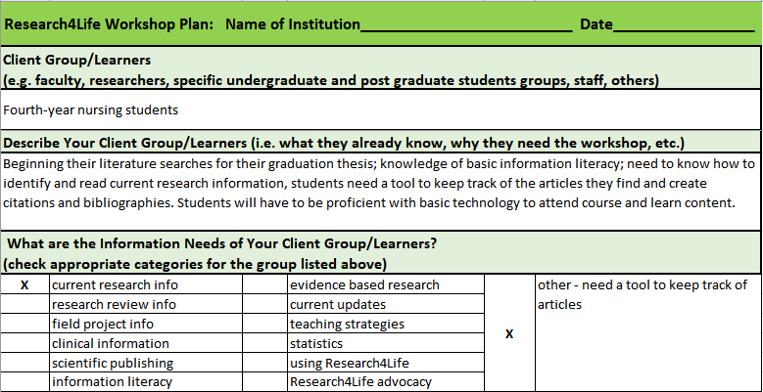
Research4Life Workshop Plan Tool
The first section of the Research4Life workshop plan tool allows a user to enter
A Client Group of the institution
A description of the client group
The information needs of the client group.
Notes:
Enter the client group that you want to host a workshop for
Describe the client group including details about why you think they would benefit from a workshop, what they already know that you don’t need to include in the workshop, and any relevant information about the client group.
Check off the relevant information needs of the client group

Slide 17
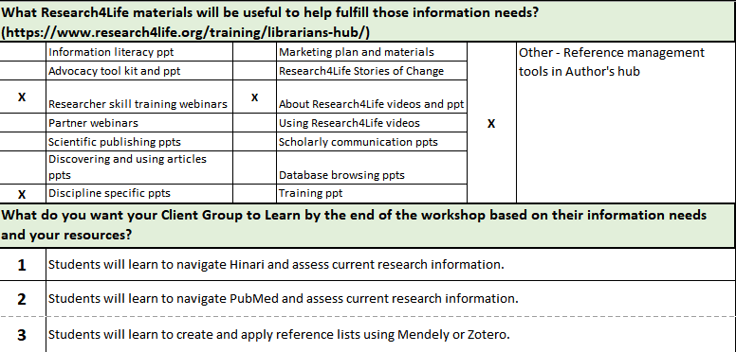
Research4Life Workshop Plan Tool
Check off what Research4Life training materials may be helpful to fulfil the learning objectives.
Create learning objectives for the client group.
Notes:
4. Directly link what you want the client group to learn to Research4Life trainings and resources.
5. Use the information needs to create learning objectives for the workshop. What do you want the learners to have gained by the end of the workshop? Enter them clearly and concisely. Can use Bloom’s taxonomy action verbs.

Slide 18
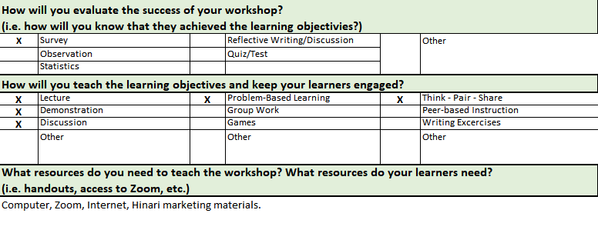
Research4Life Workshop Plan Tool
Decide how you will evaluate the success of the workshop
Check off how you will teach the workshop
List additional resources that you’ll need to run the workshop
Notes:
6. Decide how you’ll evaluate whether your workshop has been successful to build it into your outline.
7. Decide if you’ll include multiple teaching methods in your workshop such as group discussion or activities to help the learners understand the material.
8. List any additional resources that you’ll need to run the workshop such as creating handouts, additional technology or software, etc. to assess if you have all the resources you need.

Slide 19
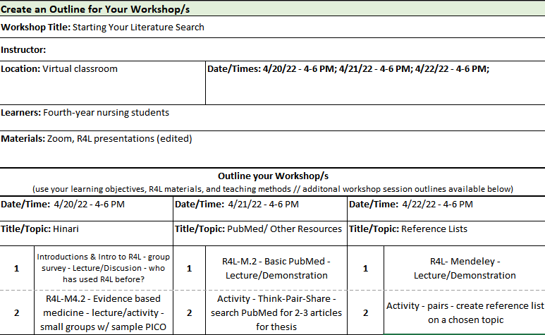
Research4Life Workshop Plan Tool
Use the answers you provided above to create an outline for your workshop.
Multiple outline columns are available if your workshop will span over multiple sessions (i.e., separate topics, multiple days, etc.)
Notes:
When outlining your workshop, you should make sure to include what resources you’ll use to fulfill a single learning objective and how you’ll want to teach the objective

Slide 20
Group Activity
Create a workshop plan that could be applied to a client group.
Notes:
Small groups (same groups as previous group activity) - 10-15 mins
The group leader should download the tool and share their screen so that the group can work on the plan in real time, and email the finished product to the entire team after the session is complete.

Slide 21
Tips for Teaching Adults
The training audience will be comprised of Adult Learners. Listed below are:
Six Principles of Adult Learning - Malcolm Knowles
Need to Know - why should they learn?
Experience - capitalize on their experience
Self-directed learning - a process where individuals take
primary charge of planning, continuing and evaluating their learning experience
Knowles, M. S., Holton, I. E. F., & Swanson, R. A. (2005). The adult learner : The definitive classic in adult education and human resource development. Taylor & Francis Group
Notes:
Malcolm Knowles - Six Principles of Adult Learning
Need to Know
Adults need to know why they should learn
Experience
Adults have a lot of life experience, capitalize and value this
Make learning more individualized
Opportunities for self-reflection
Self-concept
Adults don’t have to be guided through a learning process, but work better autonomously
Collaborative environments, self-directed learning
Readiness
Learn best when they can immediately apply their learning
Problem orientation
Problem vs content orientation
Appreciate getting specific knowledge, skills, or abilities
Intrinsic motivation
Relevancy is key

Slide 22
Adult Learners continued
Readiness - immediately apply the learning
Problem Orientated - a student-centered approach in which students learn about a subject by working in groups to solve an open-ended problem
Intrinsic motivation - occurs when students are engaged because of internal rewards, e.g., interest in the subject, use in work setting
Adult Learner. Wikipedia, 28 December 2022 https://en.wikipedia.org/w/index.php?title=Adult_learner&oldid=1100281814
Adult Education. Wikepedia, 28 December 2022
https://www.wgu.edu/blog/adult-learning-theories-principles2004.html

Slide 23
Training and promotional/marketing materials
Capacity development is a central part of the Research4Life partnership.
The subsequent slides will discuss various training and promotional material that are available from the Research4Life website.
Besides the training material focused on Research4Life collections, the training portal contains information on the MOOCs, sponsored webinars, publishing and author skills including reference management software tools plus resources from publishers and related organizations.
Notes:
This section focuses on where to find training and promotional materials. As previously noted, this material is necessary to successfully implement the numerous Advocacy Toolkit and Marketing Plan Tool tasks. These resources are located on the Research4Life website and the training pages of the five programmes. Alert learners that they can follow along on the Research4Life website and ask questions.

Slide 24
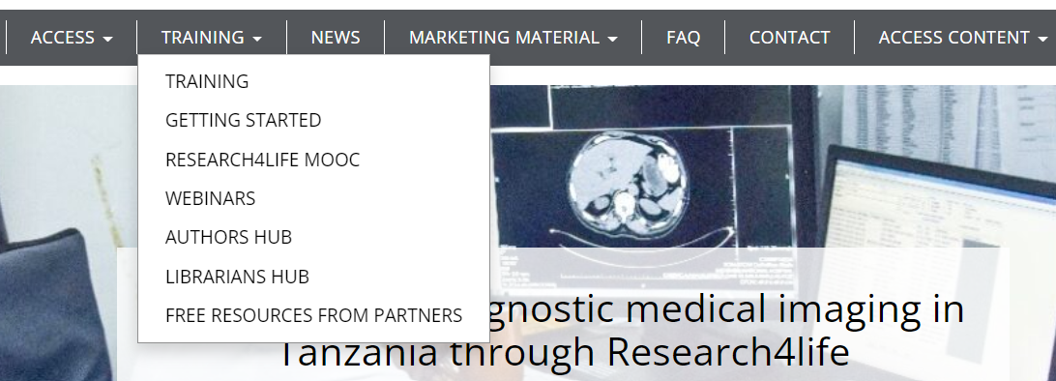
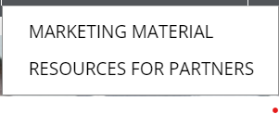
Access to Training, Promotional and Marketing Material
For access to the pages with these resources, go to horizontal bar on the Research4Life page and click on the appropriate tab.

Slide 25
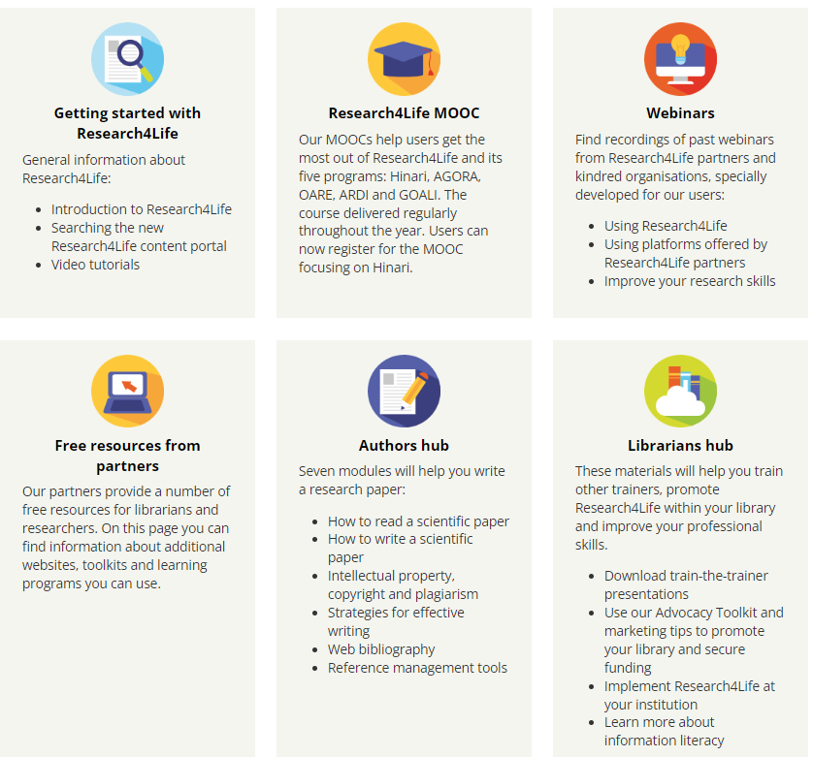
Research4Life Training Portal
Use this link to directly open the Research4Life Training menu.
Note the six distinct sections. Click on the symbol for any subject that is of interest.
Notes:
For trainers preparing a workshop or speech, these resource pages have numerous presentations and exercises that can be adapted for a specific activity.

Slide 26
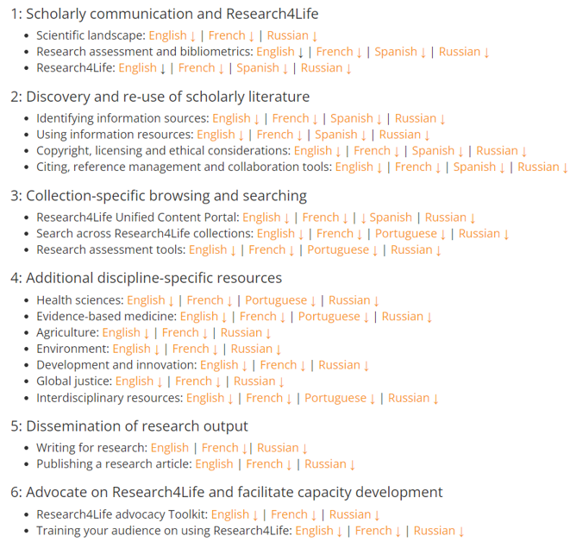
Training Presentations
Scroll down to the bottom of the Librarians hub page to open the extensive list of Training Presentations
The material is licensed under the Creative Commons Attribution- ShareAlike 4.0 International License (CC BY-SA 4.0) that allows trainers to modify and adapt the material for specific training purposes to meet the group’s specific needs.

Slide 27
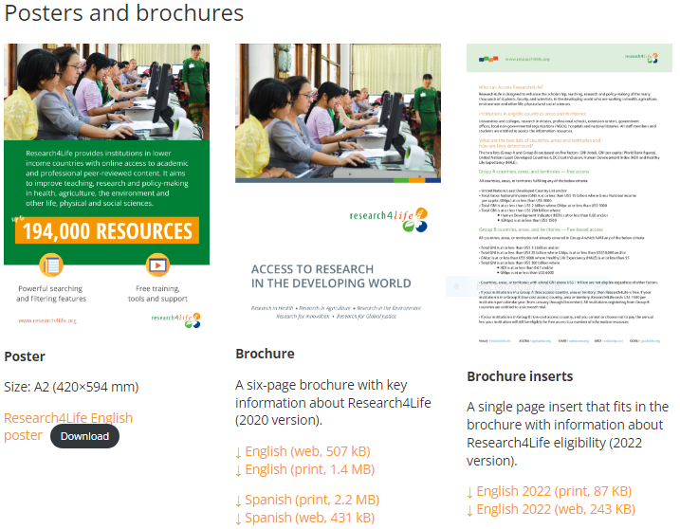
Marketing/promotional material
Users can download and print a Research4Life poster and six-page Access to Research in the Developing World brochure, available in English, Spanish and French.
Also available to download is a one-page brochure insert with information about Research4Life eligibility that is accessible in the three languages plus Arabic.
All these items can be useful to distribute at presentations and workshops.
See Marketing material

Slide 28
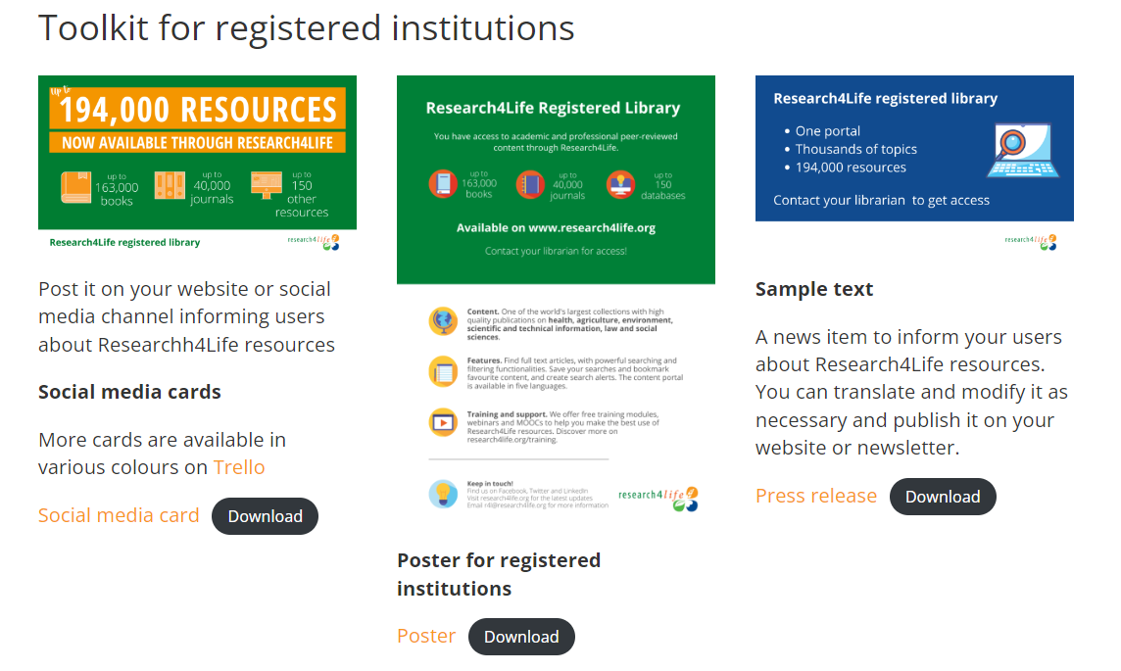
Toolkit for registered institutions
The marketing materials page has several resources that focus on promoting R4L in registered institutions – social media cards, posters and sample text for news items.
Scroll down the Marketing material page to access these resources.

Slide 29
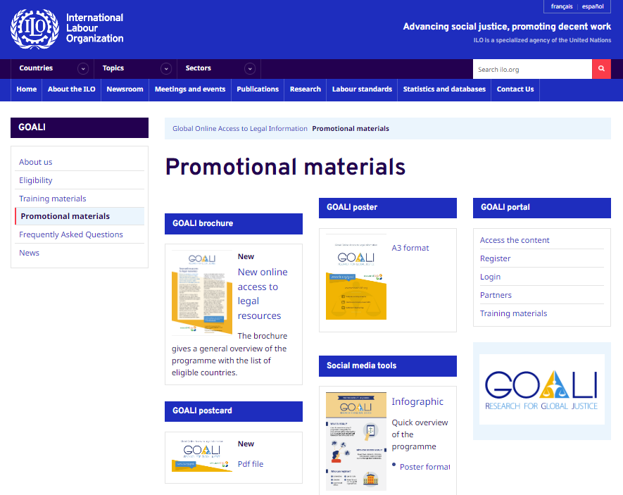
Promotional materials: GOALI
Go to GOALI Promotional materials for additional global justice-specific resources.
Also note the links to the GOALI portal options – Access the content, Register, Login, Partners and Training material.
For a lesson on R4L GOALI-related material, go to Training Presentations Section 4: Additional discipline specific resources: Global Justice.

Slide 30
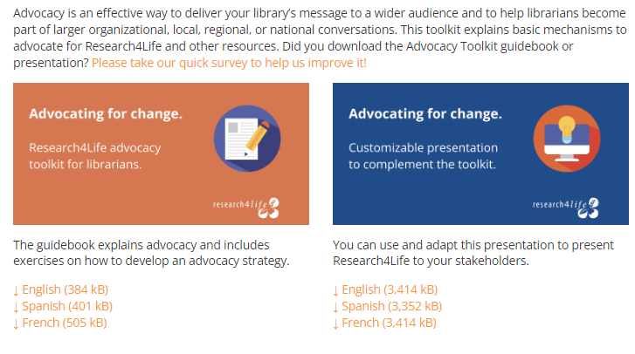
Promote your library/
“Advocating for Change”
This page includes the Advocacy Toolkit, the Advocacy Toolkit PowerPoint presentation and factsheet.
Please note that the Toolkit and presentation are available in English, Spanish and French.
This material will be invaluable for advocacy-related presentations.
Scroll down to the Promotion, advocacy and marketing section of the Librarians Hub to access the Advocacy Toolkit

Slide 31
Research4Life Voices
The Voices section has links to:
Stories of Change: a series of videos and photo stories showcasing the impact of access to information in the developing world
Case study booklets: insights into how access to peer-reviewed research from Research4Life is benefiting the health, well-being, and economic and social development of communities in the developing world
Testimonials from Research4Life users
Videos that have been posted on the Research4Life YouTube channel
See: Research4Life Voices

Slide 32
Social Media
The Research4Life Communications team is responsible for communicating about Research4Life through its official channels on Twitter and Facebook:
Twitter: Users can tag @R4Lpartnership in their tweets about Research4Life. Also consider the following hashtags: #accesstoinformation #equityinresearch #africanresearch or anything else that is appropriate.
Facebook: The Research4Life address at www.facebook.com/r4lpartnership; join the community of over 14.000 followers.
Notes:
Social media channels can be a powerful tool to promote events that are related to Research4Life and highlight success stories from users around the world.

Slide 33
For trainers
Trainers who are organizing a workshop and would like to promote it online or want to share a story or a case study should contact the Communications team via the comms@research4life.org email address and the staff will help spread the word.

Slide 34
For individuals
Individuals are encouraged to share information about Research4Life through their own channel, or that of their institution – and don’t forget to add visual content to the article or social media post!
Visual content such as photos gets viewed up to 90% more often than purely textual content online.

Slide 35
Discussion
What Research4Life promotional and marketing materials seem the most useful?
What promotional and marketing materials might be missing, or would be useful for your institution that isn’t currently available?
Notes:
Class discussion - 5-10 mins

Slide 36
Summary
Compared to an advocacy strategy, marketing is more customer-oriented and aims to “sell” a product or service.
A marketing plan will educate the institution's members or client groups about the full potential of the resources available through the Research4Life platform and increase the use of the material.
Using the Marketing strategies for Research4Life resources workbook, the library staff can identify the institution’s client groups, their information needs and what resources are available, plus develop a survey and the strategy for distributing the questionnaire.
This lesson also discussed the Research4Life promotional and marketing material plus the social media channels. These resources are useful for all advocacy and marketing activities.
The lesson concludes with examples of two workshop programmes. These examples show how training is tailored to the unique information needs of various client groups.
Notes:
If time is available - encourage an entire class group discussion. Have the class share the most useful information that they learned during the course.

Slide 37
Additional Resources
Association of College & Research Libraries (ACRL). ‘Marketing The Academic Library’. Text, 11 September 2011. Accessed 23 June 2021
Hardenbrook, Joe. ‘Marketing and Advocating for the Academic Library’. Mr. Library Dude (blog), 5 March 2019. Accessed 23 June 2021 https://mrlibrarydude.wordpress.com/2019/03/04/marketing-and-advocating-for-the-academic-library/
Saunders, L., & Wong, M. A. (2020). Instruction in libraries and information centers: An introduction. Windsor & Downs Press. https://doi.org/10.21900/wd.12

Slide 38
Additional Resources for Teaching Adults
Arghode, V., Brieger, E. W., & McLean, G. N. (2017). Adult learning theories: Implications for online instruction. European Journal of Training and Development, 41(7), 593-609. http://dx.doi.org/10.1108/EJTD-02-2017-0014
Adult Learner. Wikipedia, 28 December 2022 https://en.wikipedia.org/w/index.php?title=Adult_learner&oldid=1100281814
Adult Education. Wikepedia, 28 December 2022
https://www.wgu.edu/blog/adult-learning-theories-principles2004.html
Arizona State University. (n.d.). Learning objectives builder. ASU for You. Retrieved April 21, 2022, from https://teachonline.asu.edu/objectives-builder/
Blaschke, L. M. (2012). Heutagogy and lifelong learning: A review of heutagogical practice and self-determined learning. The International Review of Research in Open and Distributed Learning, 13(1), 56-71. https://doi.org/10.19173/irrodl.v13i1.1076
Cunningham, & Wandei, E. (2019). Critical reflections on postgraduate andragogy from the points of view of a Kenyan student and an Australian academic. Reflective Practice., 20(3), 305–324. https://doi.org/10.1080/14623943.2019.1598350

Slide 39
Additional Resources for Teaching Adults
Domarle, Randrianarivelojosia, M., Duchemin, J.-B., Robert, V., & Ariey, F. (2008). Atelier paludisme: an international malaria training course held in Madagascar. Malaria Journal, 7(1). https://doi.org/10.1186/1475-2875-7-80
Knowles, M. S., Holton, I. E. F., & Swanson, R. A. (2005). The adult learner : The definitive classic in adult education and human resource development. Taylor & Francis Group.
Merriam. (2001). Andragogy and Self-Directed Learning: Pillars of Adult Learning Theory. New Directions for Adult and Continuing Education, 2001(89), 3–14. https://doi.org/10.1002/ace.3
UNESCO Institute for Lifelong Learning & Commonwealth of Learning. (2021). Guidelines on open and distance learning for youth and adult literacy. https://unesdoc.unesco.org/ark:/48223/pf0000379397

Slide 40
You are invited to;
Visit us at www.research4life.org
Contact us at r4l@research4life.org
Find out about other training materials [www.research4life.org/training]
Subscribe to Research4Life newsletter [www.research4life.org/newsletter]
Check out Research4Life videos [https://bit.ly/2w3CU5C]
Follow us on Twitter @r4lpartnership and Facebook @R4Lpartnership

Slide 41
Research4Life is committed to the UN's Sustainable Development Goals.
Research4Life contributes to the United Nations Decade of Action by increasing research participation from the Global South.
The recent Strategic Plan to 2030 focuses on inclusion and equity in the global research community, supporting the creation of an even richer body of research which will help to advance the Sustainable Development Goals.
Research4Life offers our partners, users and supporters the opportunity to contribute to the creation of a diverse. inclusive and equitable research ecosystem for all.

Slide 42
Our unique public-private structure allows us to work effectively in alignment with SDG17: Partnership for the Goals for sustainable development and to support our community of users as both consumers and producers of critical research and advance SDG10: Reduced Inequalities within and among countries.
While R4L activities directly and indirectly support all the SDGs such as Good health and Wellbeing, Zero Hunger, Clean Water and Sanitation, Industry, innovation and infrastructure, and Peace and Justice, the Research4Life Program is closely aligned to SDG4: Quality Education that is fundamental to creating a peaceful and prosperous world and SDG5: Gender Equity to achieve the empowerment of all women and children.

Slide 43
For more information on Research4Life
www.research4life.org
r4l@research4life.org
Research4Life is a public-private partnership of five collections:

