Slide 1
Dissemination of research output
Publishing a research article
Research4Life is a public-private partnership of five collections:

Slide 2
Outline
Introduction
Submission and peer review
Submission
Technical screening
Peer review
Response and revision
Promotion and monitor impact
Resources for further study
Resources from Research4Life partners
Web bibliography on Research4Life Authors hub
Summary
This work is licensed under Creative Commons Attribution-ShareAlike 4.0 International (CC BY-SA 4.0)

Slide 3
Learning objectives
Understand the publishing process of a research article
Navigate peer reviews process
Promote and monitor one’s research
Get help for further study

Slide 4
Introduction
Complement presentation Writing for research, this lesson discusses important areas in publishing a research article
Peer review
Promotion and monitoring impact of the article
Highlight resources for further study in publishing research articles

Slide 5
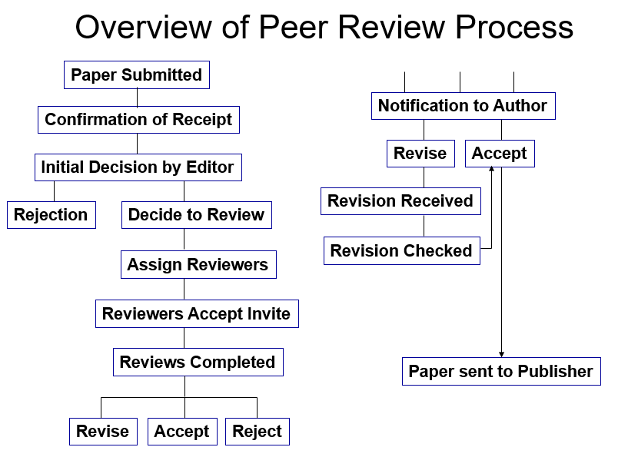
Submission and peer review
Figure below highlights what may happen to the manuscript after it has been submitted to the target journal, i.e., the peer review process
Overview of peer review process (Research4Life, 2021a)

Slide 6
Submission
Submit your manuscript using the online submission platform of the target journal. Details of submission are described in the Instruction for Authors
Cover letter which accompanies the submission should:
address to the editors by their formal names and include the correct name of the journal
explain why the article is suitable for the journal, and how it will contribute to furthering the aims and scope of the journal
Where appropriate, make formal declarations regarding the originality of the work and all co-authors agree to the submission. If applicable, provide conflict of interest statements for the whole research team
(IFIS, 2021a)
If requested, suggest reviewer for your article to speed up the review process. You will benefit from the reviewers’ expertise to refine the research, should the manuscript is accepted for review. Suggest peers who have published and/or presented in conferences in your subject area. Consider suggesting international colleagues to represent views from an international audience (Tress Academic, 2019)

Slide 7
Technical screening
Initial screen by journal editorial staff, will check if the submitted manuscript
fits the journal’s aims and scope
is written in clear and understandable language
contains any signs of plagiarism or infringement of publication ethics
Typically, a submitted manuscript will be examined by a similarity checker, such as iThenticate or Crossref Similarity Check service. If a manuscript was flagged by the checker, it will be further examined according to the journal’s policy and procedures
Roughly 35% of manuscripts submitted are rejected at this stage – Desk Rejection. Therefore, it is critically important to prepare your manuscript according to the Instructions for Authors of the target journal, and points laid out in the presentation “Writing for research”
(Researcher Academy, 2018a

Slide 8
Peer review
Determine the quality, validity, significance, and originality of the research. Reviewers may suggest improvement to the writing and the research (Researcher Academy, 2018b)
The review process of a journal should be publicly available. Otherwise, it could be an indicator of a predatory journal.
Should adhere to the Committee on Publication Ethics (COPE) Guidelines for Reviewers, one of the most important authorities on publication ethics
understand the type of review used by the target journal to know what to expect
Type of peer reviews:
Single Blind – author does not know the names of the reviewers. It is the most common form of peer review.
Double Blind – all author information is removed from a paper, neither reviewers nor authors can be identified.
Open review – with multiple levels of transparency (Ross-Hellauer, 2017) https://doi.org/10.12688/f1000research.11369.2
(IFIS, 2021b)

Slide 9
Peer review (cont’d)
Journal editors invite reviewers for a submitted manuscript and gather their feedback, Editors may ask an author to suggest potential reviewers for the article submitted.
Reviewers are generally researchers of the same subject area discussed in the manuscript.
May take a few rounds of invitation to gather enough reviewers
If a web-based reviewing platform is available for the journal, check the submission status and communicate with journal staff there.
Journal may make their estimated length of the review process publicly available.

Slide 10
Peer review (cont’d - 2)
After gathering feedback and recommendations from all reviewers of a manuscript, editor(s) will render one of the following decisions:
Accept the manuscript for publication
Ask for revisions likely to result in acceptance
Ask for revisions with an uncertain outcome
Reject
IFIS, 2021 a)
Notes:
accept the manuscript for publication – It is very rare that a first submission will be accepted without any changes being requested.
ask for revisions likely to result in acceptance – This means that the editor shows positivity towards a final acceptance.
ask for revisions with an uncertain outcome – Extensive revisions are requested, with no commitment for final acceptance.
reject – revision is not invited.

Slide 11
Response and revision
When the manuscript is returned with comments and revision of the paper is invited
Take time to review the comments and discuss with your research team
Use a structured approach to revise the article, e.g., list the comments point by point, lay out the response and the corresponding action taken
If disagree with a comment, provide evidence-based feedback
Complete the revision by the requested deadline, ask an extension if necessary
(IFIS, 2021a)

Slide 12
Rejection
Rejection by a journal is not uncommon, does not mean that the manuscript will not be published
When you are ready to proceed to submit the manuscript to another journal
consider the second place in your list of potential journals
review the comments and suggestions from the rejection, to improve the research and the manuscript
follow the Instructions for Authors of the new target journal, and adjust the cover letter accordingly
(IFIS, 2021a)

Slide 13
Acceptance
After a manuscript is accepted for publication, publisher may request author(s) to:
sign copyright or licensing documents, to give the publisher the right to publish. Make sure to read these documents and understand their implication. Should the work is covered by a funder’s mandate, such as NIH Public Access Policy, make sure the funder’s requirement is addressed
if available and you choose to publish the article in Open Access, the article processing charge will be requested at this stage
Accepted manuscripts will then be sent to the journal production team to format into the specific style of the journal. For journals which publish an online accepted version before the final version is ready, the article may be available and searchable in databases just a few days after acceptance.
Post acceptance processing varies among journals, contact the journal’s office for details
(IFIS, 2021a)

Slide 14
Promotion
In order to make your article and findings stands out and reach the target audience, promotion should be kept in mind when writing of an article and after it is published. Possible ways for promotion:
Write clear and understandable Title, Abstract and Conclusion, with strong keywords or key points to facilitate search engines and indexing databases, such as Google and PubMed.
Consider writing a plain language summary, to communicate the research result to a wider audience outside of a specific scientific circle. Plain language summary is required by some journals.
After the article is published, share the link to the article in Social Media, such as LinkedIn, Facebook, and Twitter. You should also share the link in your professional blogs as well as in your institution’s site. These links should point to a version of the article which is accessible to the audience. Consider including a relevant and an engaging image/video to encourage people to click to read. Make sure to obtain proper copyright clearance of the image/video
Create online profiles, at your institution’s website, LinkedIn, ORCID and other appropriate places for your subject area. Put the list of your publications in your profiles, with links to the final version of the article as well as the freely accessible version, where appropriate. Make sure to keep these profiles up to date.
Promote your work in conferences. If possible, present the results of the article with updates in the poster or paper section. Conferences are great places to bring in collaboration.
(Researcher Academy. 2018b), (Taylor & Francis, 2021)

Slide 15
Monitor impact
Dissemination of the research output aims to make an impact on the audience of your research.
Research impact can be measured in a number of ways, including bibliometrics and citation analysis of researcher’s articles.
To showcase your research impact, make sure to keep track of the metrics, including altmetrics, of your publications, and make these metrics available in your profile.
Refer to presentation1.2 Research Assessment and Bibliometrics for the details of this topic.

Slide 16
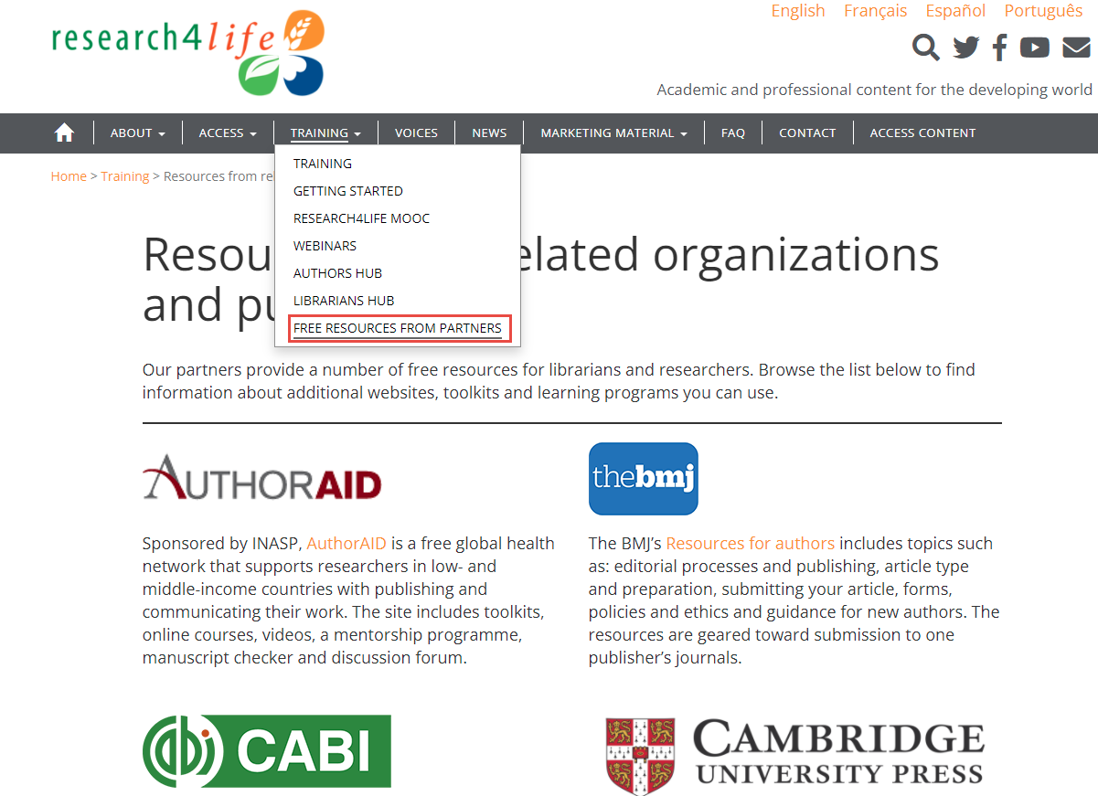
Resources for further study - from Research4Life partners
Excellent resources on publishing and research communication topics listed on the page Resources from related organizations and publishers:
Most resources listed are freely available online. The contents gear towards a variety of audiences. Topics of the learning units cover all phases of a research lifecycle.
(Research4Life, 2021b)
Notes:
Resources listed on the page that are referenced in Lesson 5.1 and 5.2 include: AuthorAID from INASP, Research Academy from Elsevier, Guide to Getting Published in Journals from IFIS, Taylor & Francis Author Services, and Media Toolkit form PLOS. For a comprehensive listing, consult the page on the Research4Life training portal.

Slide 17
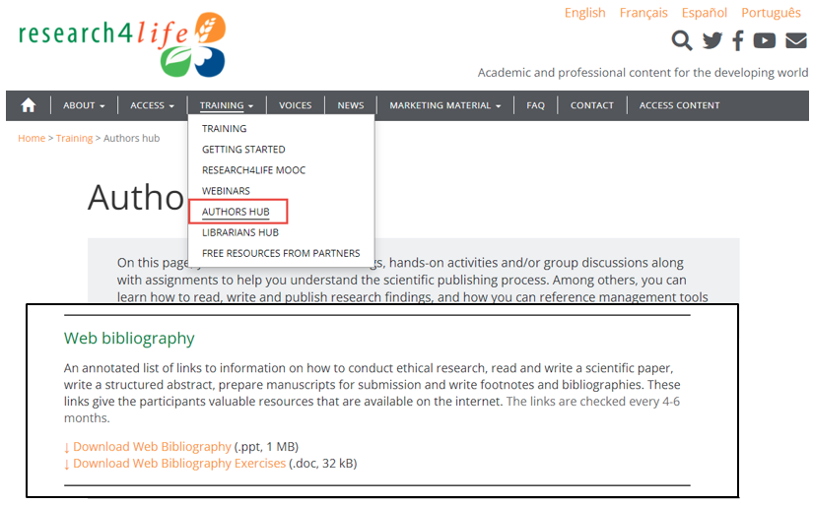
Resources for further study - Web bibliography on Research4Life Authors hub
Accessible from the Authors hub under the Resesarch4Life training drop down menu, the Author Skills Web-bibliography is
“an annotated list of links to information on how to conduct ethical research, read and write a scientific paper, write a structured abstract, prepare manuscripts for submission, and write footnotes and bibliographies. These links give the participants valuable resources that are available on the internet.”
Author skills Web-bibliography (Research4Life, 2021c)

Slide 18
Summary
This presentation:
discussed the submission and peer review processes of publishing a scholarly article.
highlighted the importance of promotion and monitoring the impact of research output.
included pointers to resources to Research4Life partners and Research4Lifew Authors Hub for future study.
Notes:
S.

Slide 19
References and useful resources
IFIS, 2021a. Submitting your paper. In: Guide to Getting Published in Journals [Online] [Cited 16 September 2021]. https://ifis.libguides.com/journal-publishing-guide/submitting-your-paper
IFIS 2021b, How different journals approach peer review. In: Guide to Getting Published in Journals [Online] [Cited 16 September 2021]. https://ifis.libguides.com/journal-publishing-guide/peer-review-part-1
Research4Life, 2021a. How to write a scientific paper: a general guide. In Research4Life Training Authors hub at Research4Life Training portal. [Online] [Cited 15 September 2021] https://www.research4life.org/training/authors-hub/
Research4Life, 2021b. Resources from related organizations and publishers. In Research4Life Training portal [Online] [Cited 17 September 2021] https://www.research4life.org/training/resources-related-organizations/
Research4Life, 2021c. Web bibliography. In Author hub at Research4Life Training portal [Online] [Cited 19 September 2021] https://www.research4life.org/training/authors-hub/
Researcher Academy, 2018a. How to get published: what distinguishes a good manuscript from a bad one? In Researcher Academy, Elsevier [Online] [Cited 16 September 2021]. https://researcheracademy.elsevier.com/uploads/2018-05/1.pdf
Researcher Academy. 2018b. How to publish in scholarly journals. In Researcher Academy, Elsevier [Online] [cited 16 September 2021] https://researcheracademy.elsevier.com/uploads/2018-04/Understanding%20the%20Publishing%20Process_Apr2018_Web.pdf
Ross-Hellauer, 2017. What is open review? A systematic review. F1000Research 6:588. [Cited 16 September 2021] https://doi.org/10.12688/f1000research.11369.2
Taylor & Francis. 2021. How to promote your research article. In Author Services, Taylor & Francis. [Online] [Cited 16 September 2021] https://authorservices.taylorandfrancis.com/research-impact/#promoteyourarticle
Tress Academic. 2019 Suggesting reviewers for your paper: rules to consider. In Tress Academic Blog. [Online] [Cited 16 September 2021) https://tressacademic.com/suggest-reviewers/?cookie-state-change=1631293703144

Slide 20
You are invited to;
Visit us at www.research4life.org
Contact us at r4l@research4life.org
Find out about other training materials [www.research4life.org/training]
Subscribe to Research4Life newsletter [www.research4life.org/newsletter]
Check out Research4Life videos [https://bit.ly/2w3CU5C]
Follow us on Twitter @r4lpartnership and Facebook @R4Lpartnership

Slide 21
Research4Life is committed to the UN's Sustainable Development Goals.
Research4Life contributes to the United Nations Decade of Action by increasing research participation from the Global South.
The recent Strategic Plan to 2030 focuses on inclusion and equity in the global research community, supporting the creation of an even richer body of research which will help to advance the Sustainable Development Goals.
Research4Life offers our partners, users and supporters the opportunity to contribute to the creation of a diverse. inclusive and equitable research ecosystem for all.

Slide 22
Our unique public-private structure allows us to work effectively in alignment with SDG17: Partnership for the Goals for sustainable development and to support our community of users as both consumers and producers of critical research and advance SDG10: Reduced Inequalities within and among countries.
While R4L activities directly and indirectly support all the SDGs such as Good health and Wellbeing, Zero Hunger, Clean Water and Sanitation, Industry, innovation and infrastructure, and Peace and Justice, the Research4Life Program is closely aligned to SDG4: Quality Education that is fundamental to creating a peaceful and prosperous world and SDG5: Gender Equity to achieve the empowerment of all women and children.

Slide 23
For more information on Research4Life
www.research4life.org
r4l@research4life.org
Research4Life is a public-private partnership of five collections:

