Slide 1
Dissemination of research output
Writing for research
Research4Life is a public-private partnership of five collections:

Slide 2
Outline
Introduction
Getting started
Target the appropriate journal
Create a list of potential journals
Investigate the potential journals
Fundamentals of manuscript preparation
Article Structure
Strategies for effective writing
Summary
This work is licensed under Creative Commons Attribution-ShareAlike 4.0 International (CC BY-SA 4.0)

Slide 3
Learning objectives
Disseminate research output and journal publication
Target the appropriate journal
Learn the fundamentals of manuscript preparation
Highlight effective writing skills

Slide 4
Introduction
Disseminating research output
An important step in research lifecycle
Sharing the findings, conclusions and inferences of the research will help the understanding and advancement of the field of study
Publication in scholarly journals is a de-facto way to disseminate research output
Key benefits for publishing research output in journal
enhance discoverability of the work
contribute to the records of research in the field
leverage the benefit of peer review
disseminate and engage a wide audience
meet criteria form research assessment body, for career advancement
prevent duplication of effect in research
This presentation provides an overview of key considerations for writing an article to publish in a scholarly journal
Research Life cycle (Vaughan, 2013)

Slide 5
Getting started
Majority of submissions to scholarly journals were rejected before peer review, sufficient preparation should be done to improve the chance of acceptance (Researcher Academy, 2018a)
Ask these questions to determine if your research is ready to be published:
Does the research advance the understanding is a specific field? Is it original and innovative, and the conclusion based on robust data?
Is there an audience for the research and who are they?
What types of articles that the research story would be suitable for?
Letters and rapid or short communications
Review papers
Full articles
Research elements (Researcher Academy, 2018b)
This presentation focuses on writing a full article
Notes:
Typical types of research articles are:
1. Letters and rapid or short communications are intended for the quick and early communication of significant or original advances, without including too much data or detail.
2. Review papers summarize recent developments on a specific topic, without introducing new data.
3. Full articles contain significant data, detail, developments, and outcomes.
4. Research elements enable you to publish research output, such as data, software, methods, videos and much more, in brief and citable articles.

Slide 6
Target the appropriate journal
Identify the appropriate scholarly journal to submit an article is an important, yet complicated task
Use a systematic approach to identify journals for submitting articles, like creating a list of potential journals
(IFIS, 2021a)

Slide 7
Create a list of potential journals
The list of potential journals could be based on:
past readings
suggestions from colleagues, supervisors, and librarians
reference list of your article
key indexing databases in your field of study, such as PubMed, Web of Science, Scopus and DOAJ - Journals included in these databases usually have been vetted by some criteria. Their relevancy, quality, and the target audience could be ascertained.
journal lists from publisher websites – search or filter these lists to select journals relevant to your research
journal finder/suggester from indexing databases and publisher websites - these tools suggest journal titles based on the match between the title/abstract segments submitted by users and the tools’ collection of journals.
(IFIS, 2021a)
Notes:
Examples of such tools that searching journals from:
indexing/citation databases: Manuscript Matcher from Web of Science Core Collection, FSTA Journal Recommendation Service
a publisher’s collection: Elsevier Journal Finder, Springer Nature Journal Suggester, Taylor & Francis Journal Suggester, Wiley Journal Finder
miscellaneous sources: Jane (Journal/Author Name Estimator), Journal Guide

Slide 8
Create a list of potential journals (cont’d)
Put journal characteristics into a spreadsheet. Characteristics may include:
Journal Name, URL, Publisher, Name of Society, Editorial Board.
Aim & Scope, including main themes, audience
Instructions and/or Guide for authors
Types of research articles accepted, check if a journal is invitation-only
Limits on word counts, Abstract, References, Figure/Table
Style/Format
Peer review policies, speed of peer review, time from submission to publication
Publication models – Full Open Access, Subscription, Hybrid, etc.
Charges and fees - Article processing charge, paged/colour figure fees
Ethics statements and adherence to guidelines
Compliance with funding or institutional mandates
Social media links
Index Database listing
Metrics, such as Impact Factor and h-index
(IFIS, 2021b)

Slide 9
Investigate the potential journals
Key points of a good manuscript which is likely to get published :
in scope
adheres to publication ethics
follows the Guide for Authors (Researcher Academy, 2018a)
A paper should be submitted to one journal at a time.
Submission process of a paper can be lengthy and bumpy.
In-depth knowledge on the target journal helps to comply with the journal requirements and increase the chance of acceptance.

Slide 10
Aim & scope
Article submitted must meet the journal’s aim & scope, those not in scope will be rejected
Pay special attentions to these elements in the Aims & Scope section of a journal, to determine if your research paper will be in scope:
Statements about novelty or contributions - does the journal only accept the most ground- breaking papers or those make substantial theoretical advances?
Subject scope - make sure that your paper addresses fully the subject of the journal.
Geographic scope – whether a journal would focus on the work originated a specific region, or relevant to a specific population and demographics, and if your paper fits
Readership - what is the journal’s primary readership and is it in line with your research?
(IFIS, 2021c)

Slide 11
Publication ethics
High-quality journal adheres to codes of conducts for both research ethics and publishing ethics and lays out its ethical policies and procedures and expect authors to comply. Information includes:
Research subjects and environments
Falsification and fabrication of data
Similarity and plagiarism
Authorship
Acknowledgement of conflict of interest
Roles and responsibilities
Ownership and management
Indexing database criteria
(IFIS, 2021d)
Make sure your research and research report adheres to these standards; use the information to assess a potential and avoid predatory journal

Slide 12
Instructions for Authors
Failure to comply with the Instruction for Authors of a journal is a reason for immediate reject, before it could be sent for review (desk rejection)
Instructions for Authors include information like:
article type, study type, word limits, abstract, blinding requirements of submissions
requirements for reference style, titling, presentation of modular elements of the paper (Introduction, Methods, Results),
use of units of measurements, abbreviation, statistics and data presentation, formatting and style of figures and tables
JAMA Network Open’s Instructions for Author - a good example for authors
(IFIS,2021e)
Having a good grasp of Instructions for Authors of journals in your subject area will help to decide target journals and prioritize them in submission. Instructions to Authors in the Health Sciences is a convenient starting point for authors in the health sciences field

Slide 13
Fundamentals of manuscript preparation
Write according to the Instructions for Authors of the target journal
Select a few articles of the same type as your article from the target journal, to familiarize with what the journal is looking for
If a formatting template is available for your target journal, use it
– Example: the formatting template at this site

Slide 14
Article structure
A typical research article in the Science, Technology and Medicine (STM) field contains the following sections:
Front matter – Title, Authors, Keyword list, Abstract, etc.
Body – Introduction, Methods, Result, Discussion & Conclusions
Back matter – Acknowledgements, references, supporting materials
(NLM, 2021a)

Slide 15
Front matter – Title
Main advertisement for an article, people may decide to read an article based on the title
Abstracting and indexing services rely on titles of articles to build their services
Titles should:
identify the article’s main issue
reflects the article content clearly and accurately
be specific, complete unambiguous
be enticing and interesting, make people want to read further
(Researcher Academy, 2018b)

Slide 16
Front matter – Authors
List those who have made intellectual contribution to the research:
take responsibility for the data and conclusions
approved the final manuscript
Order of author names depends on the research discipline, consult the Instructions for Authors of the journal
Refer to this recommendation by the International Committee of Medical Journal Editors for further information on Authorship (ICMJE, 2021)
(Researcher Academy, 2018b)

Slide 17
Front matter – Keyword list
Keywords and title words are indexed by abstracting and indexing services to facilitate searching – very important to enhance the chance the article is discovered by the target audience
Check the prevalent controlled vocabulary in your field for ideas of keywords. For example, in the health sciences field, consult the US National Library of Medicine Medical Subject Headings (MeSH)
Prepare the subject classification for your article, which may help the journal to identify reviewers for your article
(Researcher Academy, 2018b)

Slide 18
Front matter – Abstract
Specific requirements laid out in the Instruction for Authors; typically around 200 words
Free to read on indexing and abstracting services – very important to reach a wide audience beyond the journal site. For subscription-based journal, readers may decide whether to request the whole article base on the abstract
Should summarize the objective, results and conclusion of the research
Together with Title, they could stand on their own to represent the article
Structured abstract –
abstract with distinct, labeled sections, such as Introduction, Methods, Results, Discussion
is required for original research articles, systematic reviews, and meta-analyses by the International Committee of Medical Journal Editors (NLM, 2021b)
International Committee of Medical Journal Editors. Recommendations for the Conduct, Reporting, Editing, and Publication of Scholarly Work in Medical Journals (ICMJE Recommendations). 2013 Aug [cited 2013 Aug 21]. Available from: http://www.icmje.org.

Slide 19
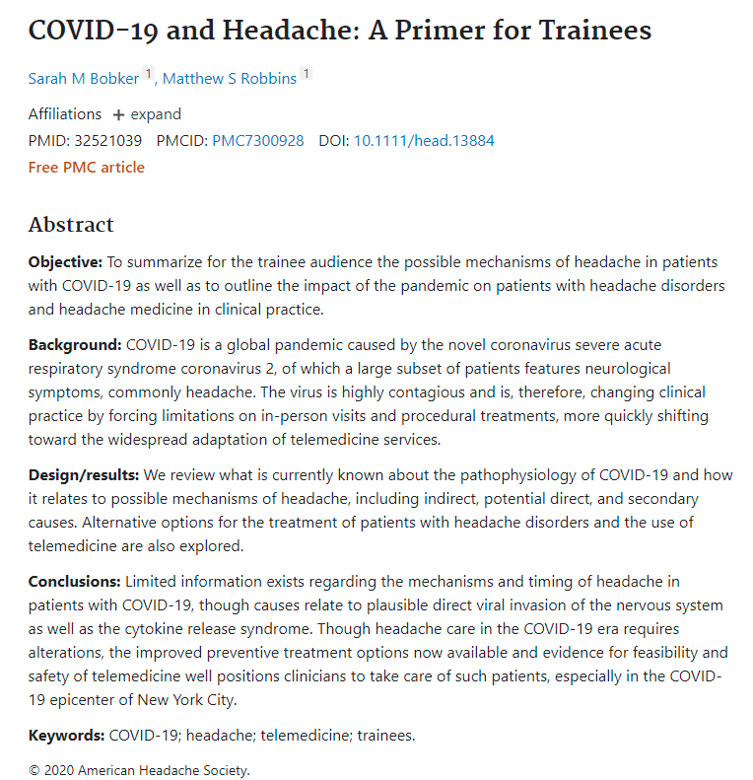
Example of a structured abstract
Bobker SM, Robbins MS. COVID-19 and Headache: A Primer for Trainees. Headache. 2020 Sep;60(8):1806-1811. doi: 10.1111/head.13884. Epub 2020 Jun 19.

Slide 20
Body of the article – Introduction
Make a case for your research
Be brief
State the problem being investigated and provide context and background
State the reasons for conducting the research
State the questions that you are answering and explain other’s findings that you are challenging or furthering
Briefly state your hypothesis and experimental design or method
(George Mason University, 2021), (Researcher Academy, 2018b)

Slide 21
Body of the article – Methods
What did you do?
Provide detailed and adequate information for readers to replicate the research being reported, in order to assess the validity of the research
Past tense should be used
Key information to be laid out:
explain how the problem was studied
identify the procedure was followed
for new methods, provide explanation in detail
for methods used in other research reports, cite the original work, and include any modifications applied
state the frequency of observations and types of data recorded. Give measurements, name any statistical tests, so that quantitative result can be judged
If human participants, animals, stem cells or biohazard materials were used, ethics statements, like the committee approvals, or permission to publish should be included.
(George Mason University, 2021), (Researcher Academy, 2018b)

Slide 22
Body of the article – Results
What did you find?
Findings to be presented and explained clearly, logically and objectively
Show how it contributes to the existing knowledge of the problem
Do not interpret the results in this section
Sequence of the text should be based on the tables, figures and graphs that present the findings
Emphasize significant findings
Tables and figures must be numbered separately
Figures should have a brief but complete description, i.e., a legend that shows how the data was produced
(George Mason University, 2021), (Researcher Academy, 2018b)

Slide 23
Body of the article – Discussion & Conclusions
What does your findings mean?
Present both general and specific conclusions, not summarize the article
Refer to the questions or hypothesis laid out in the introduction, cover how the results relate to your expectations and cited sources
Discuss
whether the results support or contradict the existing theories
any limitations on the research
suggest further experiments, uses and extensions
Most importantly, explain how your research has moved the body of knowledge forward, supported directly by the research findings, not speculation
(George Mason University, 2021), (Researcher Academy, 2018b)

Slide 24
Back matters – acknowledgments and references
Acknowledgments
Be brief, name those who helped with the research, and contributors or suppliers who provided free materials
Disclose any financial or substantive conflict of interest
References
Any information which is not from your experiment and not “common knowledge” should be recognized by a citation.
Refer to the Instructions for Authors of the journal on the style and format of citations
(Researcher Academy, 2018b)

Slide 25
Back matters – illustrations, supporting materials and research data
Most commonly used illustrations: figures and tables.
Captions and legends of illustrations must be detailed enough to make tables and figures self-explanatory, not duplication of results described in text or other illustrations
Supporting materials, also known as supplementary materials, could be submitted to support the paper
Make research data available, following FAIR (Findable, Accessible, Interoperable and Reusable) principles; store their data in a repository and make the dataset independently citable, or submit a brief, peer-reviewed data articles. These articles will be indexed and linked with one’s original research article
(Researcher Academy, 2018b)

Slide 26
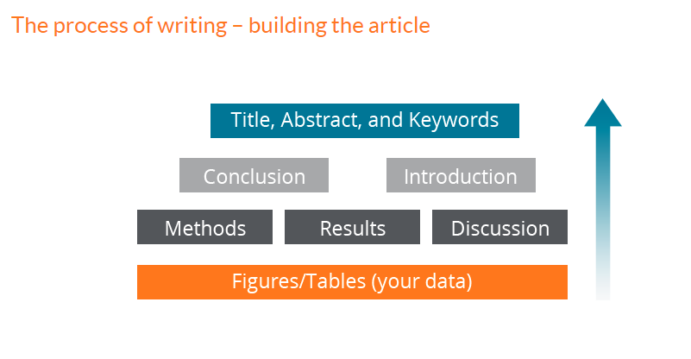
Strategies for effective writing – order of writing
Order of writing: Body, Back matter and Front matter
- start with presenting data in Figures, Tables and/or other illustrations
- describe Methods used and Results found
- Discussion will be around Methods and Results
- then write Conclusion and Introduction
- finally, write the Title, Abstract and keywords to highlight the content of the article
Order of writing (Researcher Academy, 2021)

Slide 27
Strategies for effective writing – Language quality
Should be presented in a clear and concise manner
Keep it simple – avoid unnecessary words or phrases
Use correct tense -
for known facts and hypotheses, use the present tense
use past tense to describe the experiment conducted and their result
Make sure that the article is free of grammatical, spelling and other common errors
Before article submission, ask trusted colleagues who are familiar with the subject area to read the article; when submitting to an English language journal and English is your second language, ask a native English speaker or use a language editing service to review the writing
(Researcher Academy, 2018b)

Slide 28
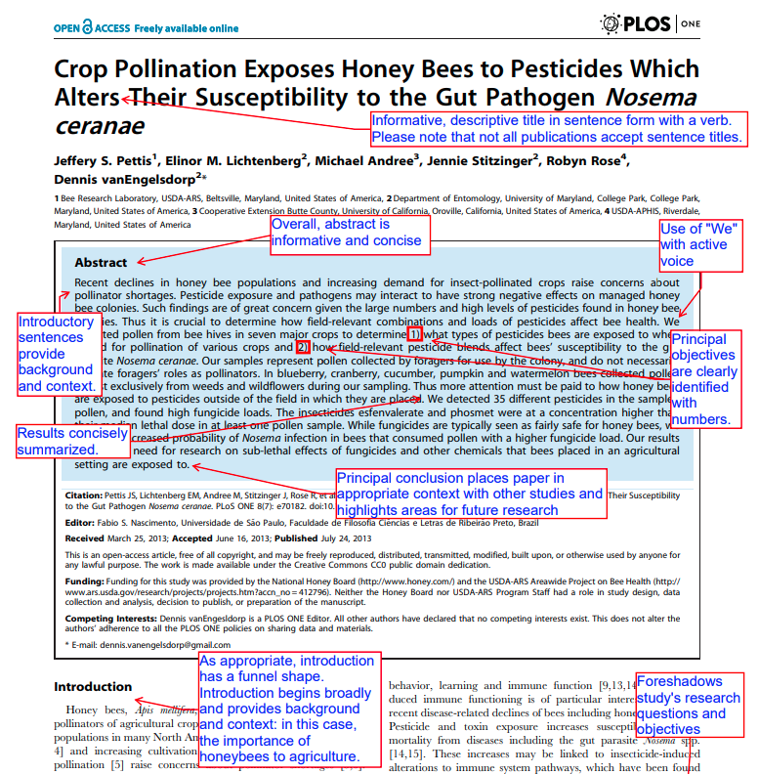
Example of a well written article
Michelle Yeoman annotated this PLOS One article to illustrate different aspects of a well written scientific article. (Yeoman 2013) This is a good reference for authors and can be found on the AuthorAid site.
(Yeoman, 2013)

Slide 29
Summary
This presentation summarized the key steps for publishing a research report in a scholarly journal, an important method for disseminating research output.
Highlighted the aspects that authors should consider in
targeting the appropriate journal
preparing the manuscript
Summarized the typical article structure, and how each section should be written.
Discussed publication ethics, in the context of selecting an appropriate journal to publish.

Slide 30
References and useful resources
George Mason University, 2021. Writing a scientific research report (IMRaD). [Online] [Cited 13 September 2021] https://writingcenter.gmu.edu/guides/writing-an-imrad-report
IFIS. 2021a. Identifying potential journals. In: Guide to Getting Published in Journals [Online] [Cited 13 September 2021]. https://ifis.libguides.com/journal-publishing-guide/identifying-potential-journals
IFIS, 2021b. Creating a journal comparison spreadsheet. In: Guide to Getting Published in Journals [Online] [Cited 13 September 2021]. https://ifis.libguides.com/journal-publishing-guide/journal-comparison-spreadsheet
IFIS, 2021c. Aims & Scope. In: Guide to Getting Published in Journals. [Online] [Cited 13 September 2021]. https://ifis.libguides.com/journal-publishing-guide/aims-and-scope
IFIS, 2021d. Ethics and malpractice statements. In: Guide to Getting Published in Journals. [Online] [Cited 13 September 2021] https://ifis.libguides.com/journal-publishing-guide/ethics-malpractice.
IFIS, 2021e. Instructions for Authors. In: Guide to Getting Published in Journals. [Online] [Cited 13 September 2021] https://ifis.libguides.com/journal-publishing-guide/instructions-for-authors
ICMJE, 2021. Defining the Role of Authors and Contributors. In ICMJE Recommendations [Online] [Cited 13 September 2021]. http://www.icmje.org/recommendations/browse/roles-and-responsibilities/defining-the-role-of-authors-and-contributors.html
Li Y, Wu C, Yan E, Li K (2018) Will open access increase journal CiteScores? An empirical investigation over multiple disciplines. PLoS ONE 13(8): e0201885. [Cited 19 September 2021] https://doi.org/10.1371/journal.pone.0201885.

Slide 31
References and useful resources (cont’d)
NLM, 2021a. Journal Publishing Tag Library NISO JATS Version 1.3. [Online] [Cited 13 September 2021] https://jats.nlm.nih.gov/publishing/tag-library/1.3/chapter/getting-started.html
NLM, 2021b. Structured abstracts. [Online] [Cited 13 September 2021)https://www.nlm.nih.gov/bsd/policy/structured_abstracts.html
Research4Life, 2021. Strategies for effective writing. In Research4Life Training Authors hub at Research4Life Training portal. [Online] [Cited 15 September 2021] https://www.research4life.org/training/authors-hub/
Researcher Academy, 2018a. How to get published: what distinguishes a good manuscript from a bad one? In Researcher Academy of Elsevier [Online] [Cited 13 September 2021]. https://researcheracademy.elsevier.com/uploads/2018-05/1.pdf
Researcher Academy. 2018b. How to publish in scholarly journals. In Researcher Academy of Elsevier [Online] [cited 13 September 2021] https://researcheracademy.elsevier.com/uploads/2018-04/Understanding%20the%20Publishing%20Process_Apr2018_Web.pdf
Researcher Academy, 2021. Structuring your article correctly. In Research Academy of Elsevier [Online] [Cited 15 September 2021] https://researcheracademy.elsevier.com/writing-research/fundamentals-manuscript-preparation/structuring-article-correctly
Taylor and Francis. 2021. Guide to Getting Published. [Cited 18 October 2021]. https://ifis.libguides.com/journal-publishing-guide/open-access-models
Vaughan KT, Hayes BE, Lerner RC, McElfresh KR, Pavlech L, Romito D, Reeves LH, Morris EN. 2013. Development of the research lifecycle model for library services. J Med Libr Assoc, 101(4):310-4. [Cited 15 September 2021] https://www.ncbi.nlm.nih.gov/pmc/articles/PMC3794687/figure/mlab-101-04-13-f01/
Yeoman 2013. Annotated journal article. In AuthorAID [Online] [Cited 15 September 2021] https://www.authoraid.info/en/resources/details/648/

Slide 32
You are invited to;
Visit us at www.research4life.org
Contact us at r4l@research4life.org
Find out about other training materials [www.research4life.org/training]
Subscribe to Research4Life newsletter [www.research4life.org/newsletter]
Check out Research4Life videos [https://bit.ly/2w3CU5C]
Follow us on Twitter @r4lpartnership and Facebook @R4Lpartnership

Slide 33
Research4Life is committed to the UN's Sustainable Development Goals.
Research4Life contributes to the United Nations Decade of Action by increasing research participation from the Global South.
The recent Strategic Plan to 2030 focuses on inclusion and equity in the global research community, supporting the creation of an even richer body of research which will help to advance the Sustainable Development Goals.
Research4Life offers our partners, users and supporters the opportunity to contribute to the creation of a diverse. inclusive and equitable research ecosystem for all.

Slide 34
Our unique public-private structure allows us to work effectively in alignment with SDG17: Partnership for the Goals for sustainable development and to support our community of users as both consumers and producers of critical research and advance SDG10: Reduced Inequalities within and among countries.
While R4L activities directly and indirectly support all the SDGs such as Good health and Wellbeing, Zero Hunger, Clean Water and Sanitation, Industry, innovation and infrastructure, and Peace and Justice, the Research4Life Program is closely aligned to SDG4: Quality Education that is fundamental to creating a peaceful and prosperous world and SDG5: Gender Equity to achieve the empowerment of all women and children.

Slide 35
For more information on Research4Life
www.research4life.org
r4l@research4life.org
Research4Life is a public-private partnership of five collections:

