Slide 1
Additional discipline-specific resources
Interdisciplinary resources
Research4Life is a public-private partnership of five collections:

Slide 2
Outline
Introduction
Aggregator Search Tools and Repositories
Free E-journal resources/databases and publishers
Thesis/Dissertation Portals and Gateways
Miscellaneous tools
E-book resources
Summary
This work is licensed under Creative Commons Attribution-ShareAlike 4.0 International (CC BY-SA 4.0)

Slide 3
Learning objectives
Become aware of existing additional resources which are interdisciplinary and beneficial for at least two or more of Research4Life thematic topic.
Understand the additional collections and how to use them.

Slide 4
Introduction
This lesson focuses on multi-disciplinary internet resources and tools that should be of use for all specialties.
These tools range from the following categories: Aggregator Search Tools and Repositories; Free E-journal Resources, Databases and Publishers; Thesis/Dissertations Portals and Gateways, Miscellaneous Tools; and E-books.
Besides peer-reviewed articles, many of these resources provide links to grey literature (technical or research reports, thesis and dissertations, preprint material and many more).
The use/value of each tool will be summarized in sections that follow.
Notes:
Depending on specific information needs (i.e., peer review articles vs. policy issues or teaching material), some of these tools will be more useful than others.
Note that this lesson is a sampling and that there are other useful resources that have not been discussed.
see Modules 4.1 - 4.5 Lessons for more information on internet resources that are geared toward Research4Life discipline specific programmes can be found in.

Slide 5
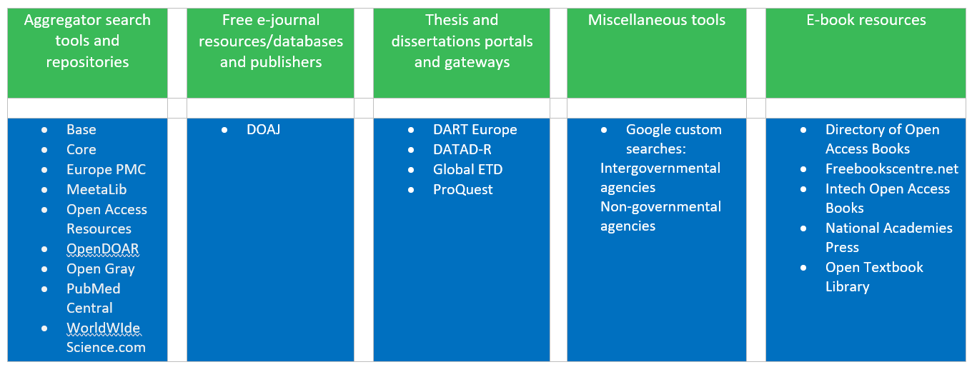
Categories for multi-disciplinary internet resources and tools .

Slide 6
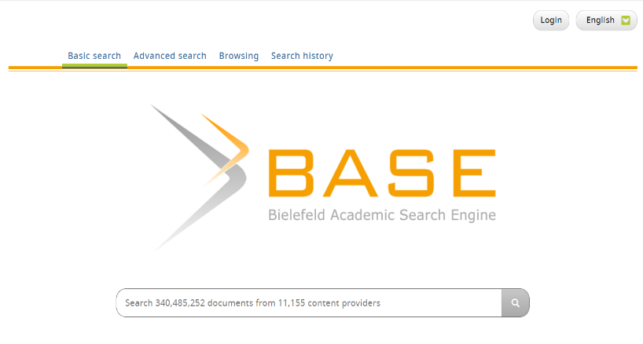
AGGREGATOR SEARCH TOOLS AND REPOSITORIES - BASE
Available at https://base-search.net
Search page for BASE

Slide 7
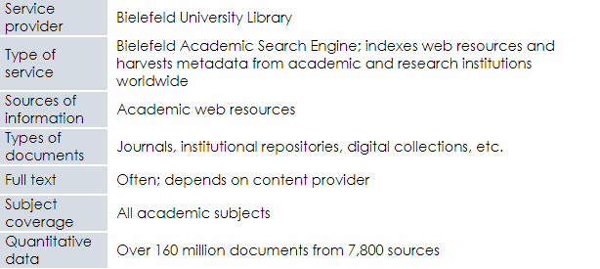
BASE cont.

Slide 8
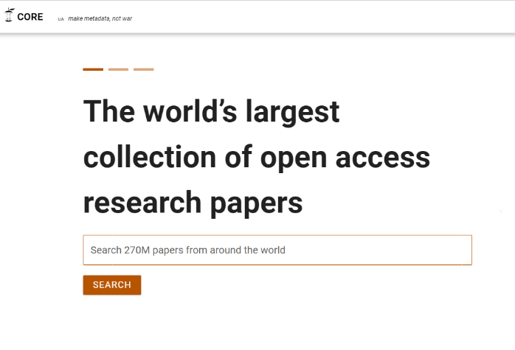
CORE
Available at https://core.ac.uk
Search page for CORE

Slide 9
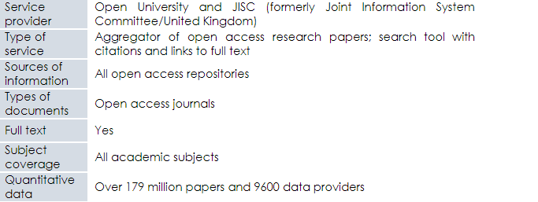
CORE cont.

Slide 10
Europe PMC
Available at https://europepmc.org
Search page for Europe PMC

Slide 11
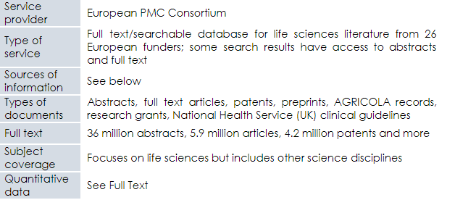
Europe PMC cont.

Slide 12
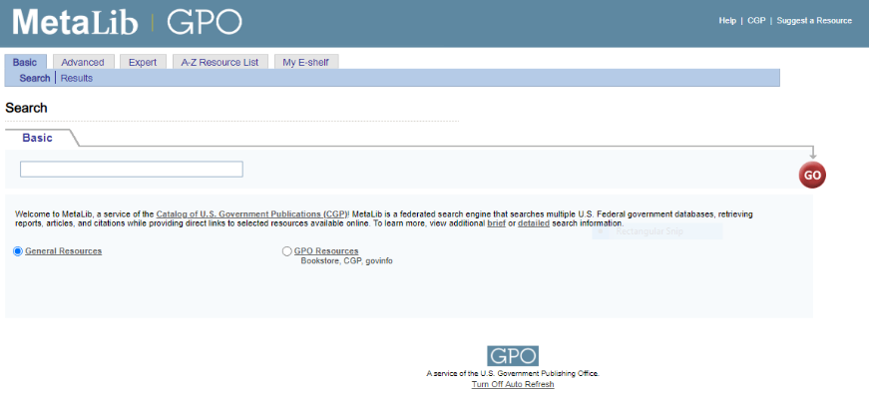
MetaLib
Available at https://metalib.gpo.gov/
Search page for MetaLib

Slide 13
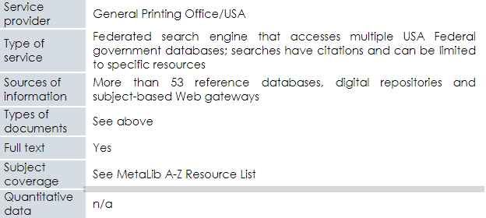
MetaLib cont.

Slide 14
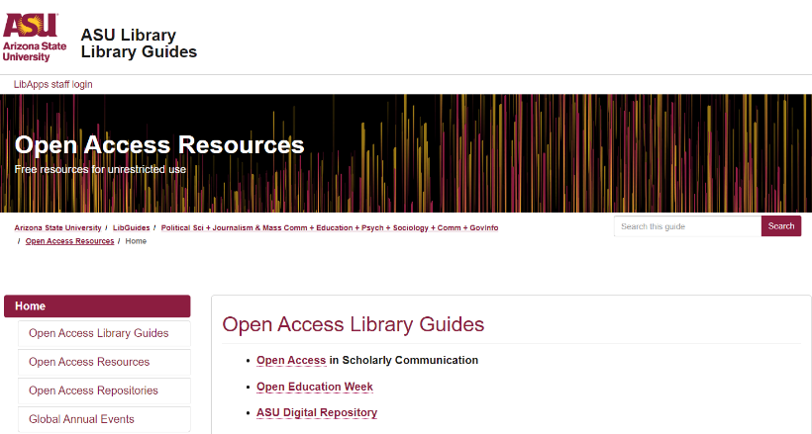
Open Access Resources
Available at https://https://libguides.asu.edu/openaccessresources
Search page for Open Access Resources

Slide 15
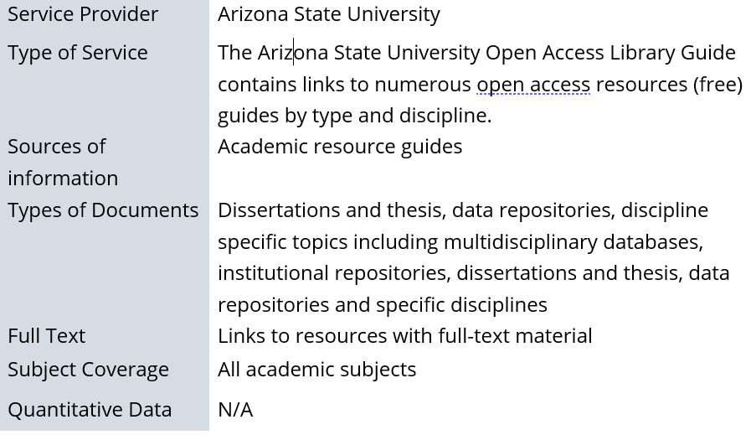
Open Access Resources cont.

Slide 16
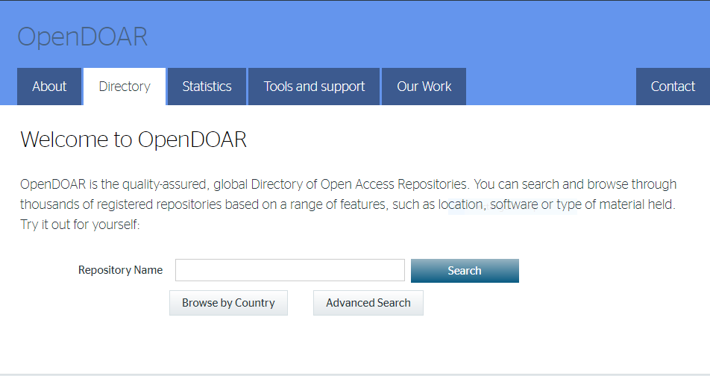
OpenDOAR
Available at https://v2.sherpa.ac.uk/opendoar/
Search page for OpenDOAR

Slide 17
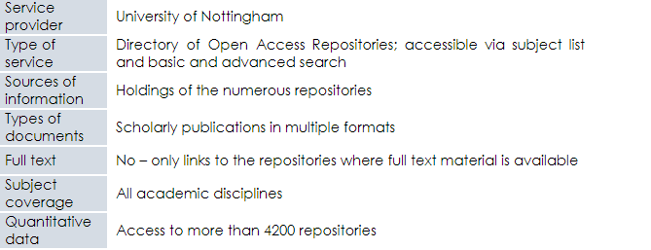
OpenDOAR cont.

Slide 18
PubMed Central
Available at https://www.ncbi.nlm.nih.gov/pmc
Search page for PubMed Central

Slide 19
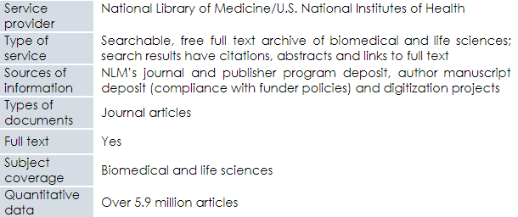
PubMed Central cont.

Slide 20
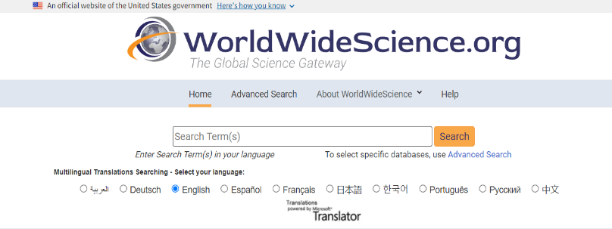
WorldWideScience.org
Available at https://worldwidescience.org/
Search page for WorldWideScience.org

Slide 21
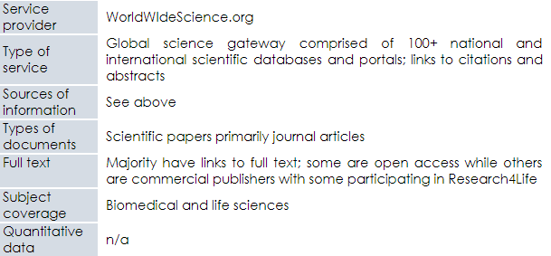
WorldWideScience.org cont.

Slide 22
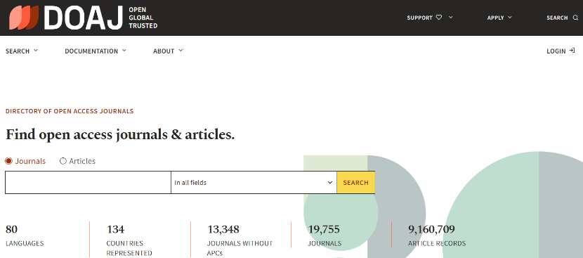
FREE E-JOURNAL RESOURCES - DOAJ: Directory of Open Access Journals
Available at https://doaj.org/
Search page for DOAJ

Slide 23
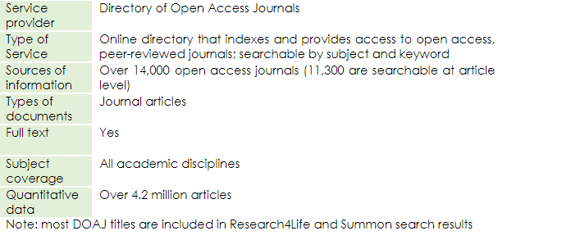
DOAJ: Directory of Open Access Journals cont.

Slide 24
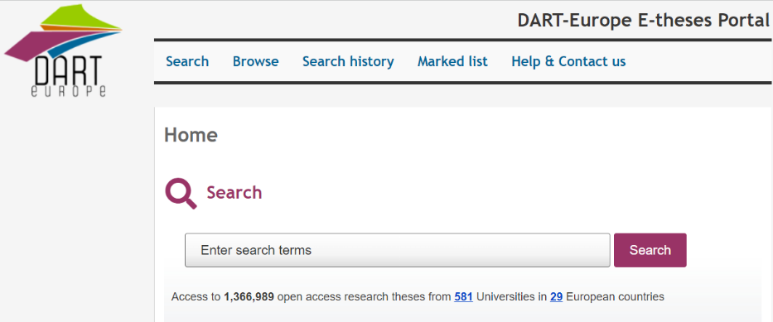
Thesis/Dissertations Portals and Gateways: DART-Europe E-thesis Portal
Available at https://www.dart-europe.org/basic-search.php
Search page for DART-Europe

Slide 25
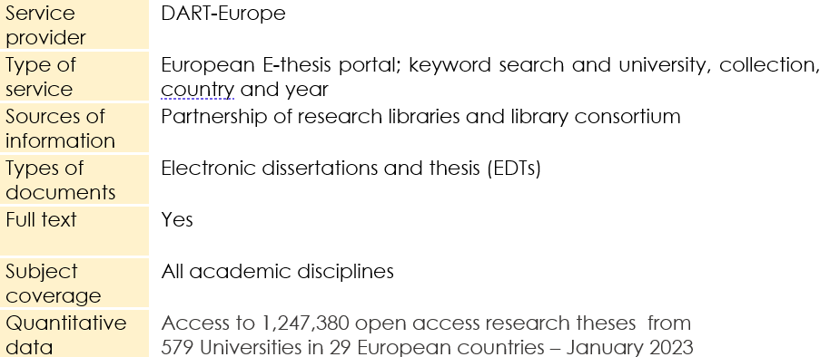
DART-Europe cont.

Slide 26
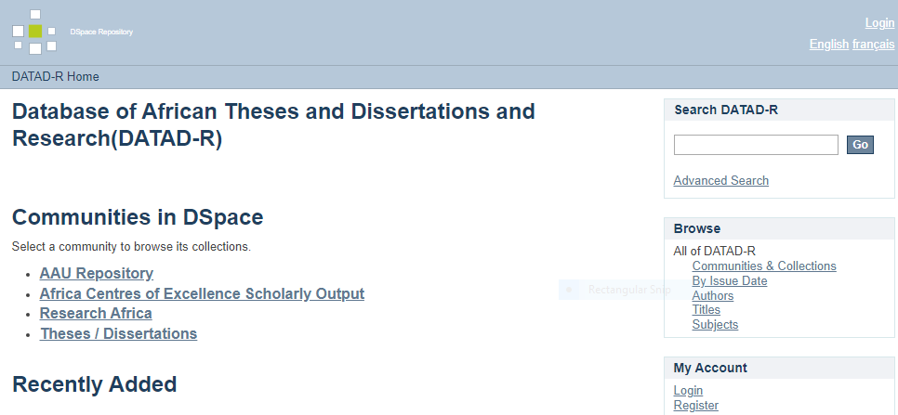
DATAD-R
Available at http://datad.aau.org:8080/xmlui/
Search page for DATAD-R

Slide 27
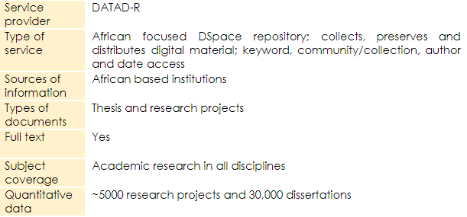
DATAD-R cont.

Slide 28
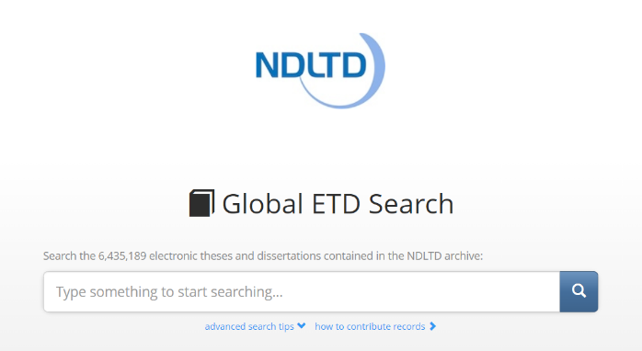
Global ETD
Available at http://search.ndltd.org/
Search page for Global ETD

Slide 29
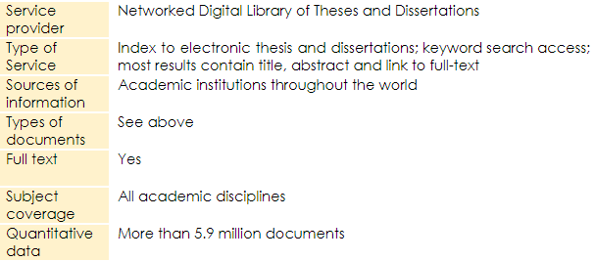
Global ETD cont.

Slide 30
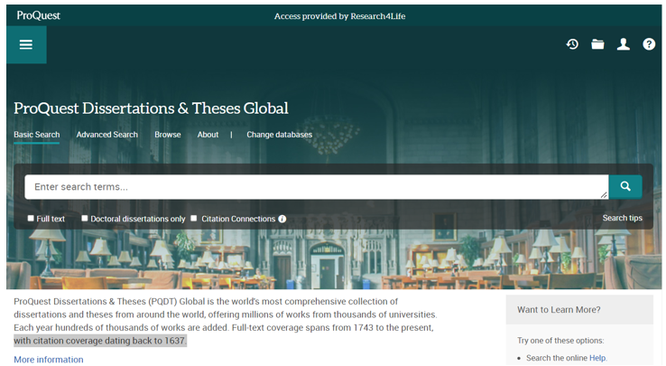
ProQuest Thesis and Dissertations Global
See Research4Life Unified Content Portal Databases list; click on P
Search page for ProQuest

Slide 31
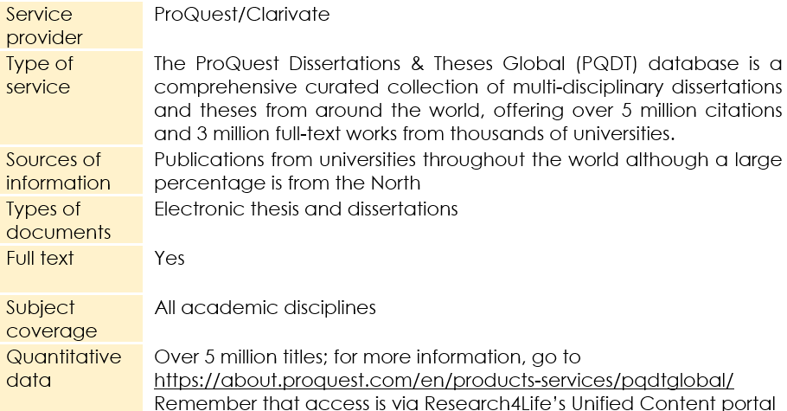
ProQuest cont.

Slide 32
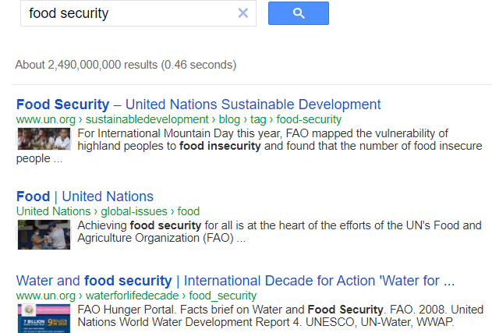
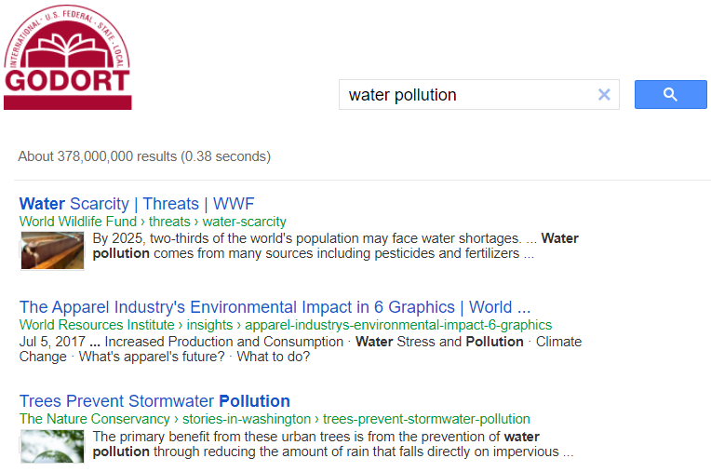
MISCELLANEOUS TOOLS -
Google Custom Search
In Google, search Intergovernmental Organization Search Engine – Google or Non-governmental Organization Search Engine - Google

Slide 33
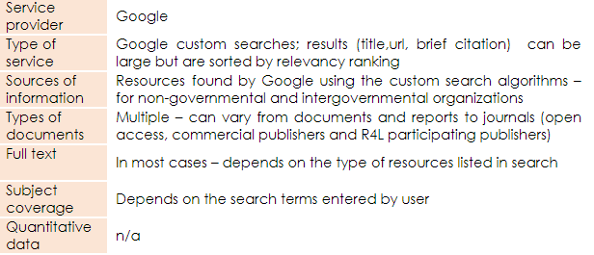
Google Custom Search cont.

Slide 34
E-BOOK RESOURCES:
Directory of Open Access Books
Available at https://www.doabooks.org/
Search page for DOAB

Slide 35
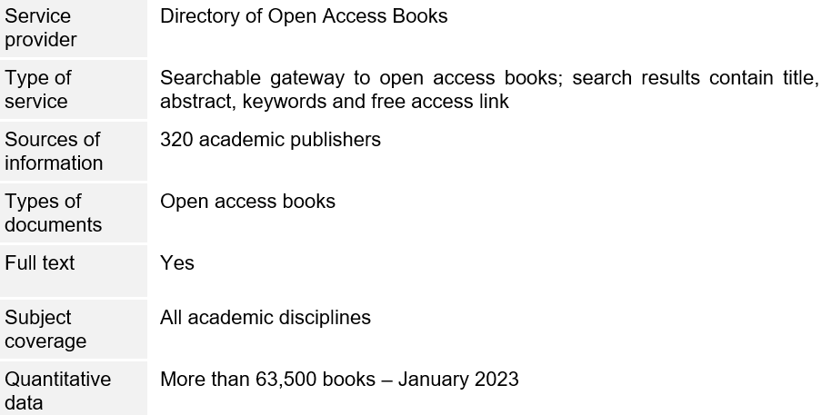
Directory of Open Access Books cont.

Slide 36
Free Book Centre
Available at http://freebookcentre.net/
Search page for Free Book Centre

Slide 37
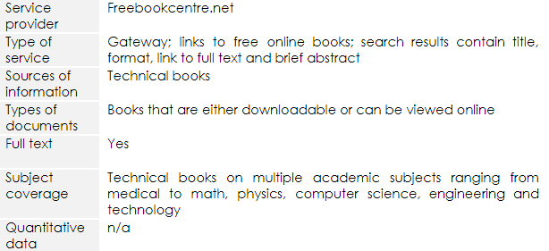
Free Book Centre cont.

Slide 38
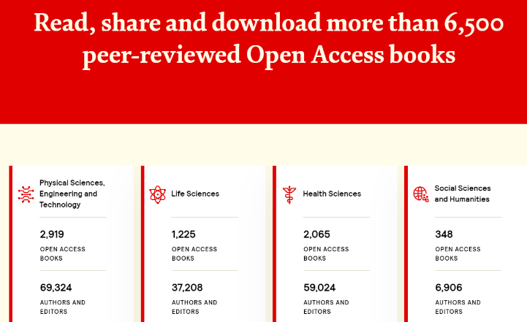
IntechOpen Access Books
Available at https://www.intechopen.com/books
Search page for IntechOpen Access Book

Slide 39
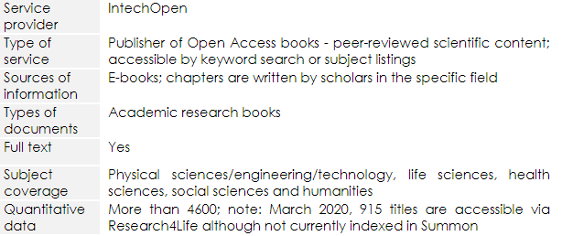
IntechOpen Access Book cont.

Slide 40
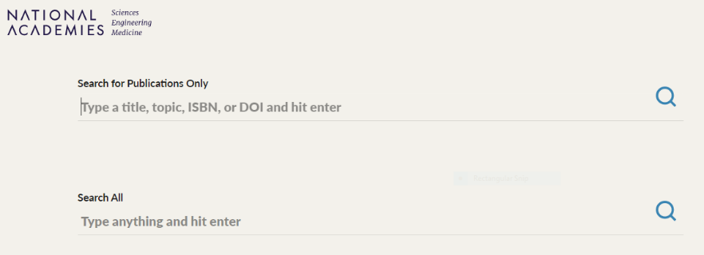
National Academies Press
Available at https://www.nap.edu/
Search page for National Academies Press

Slide 41
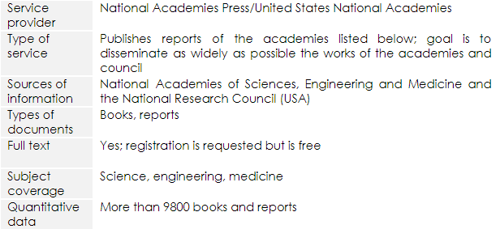
National Academies Press cont.

Slide 42
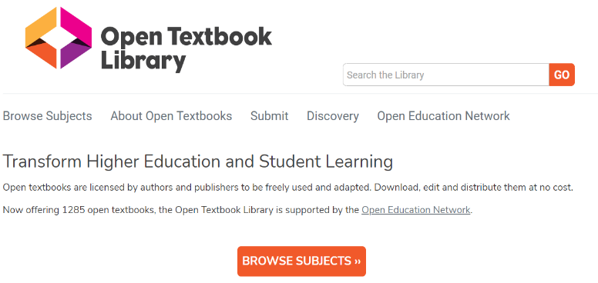
Open Textbook Library
Available at https://open.umn.edu/opentextbooks/
Search page for Open Textbook Library

Slide 43
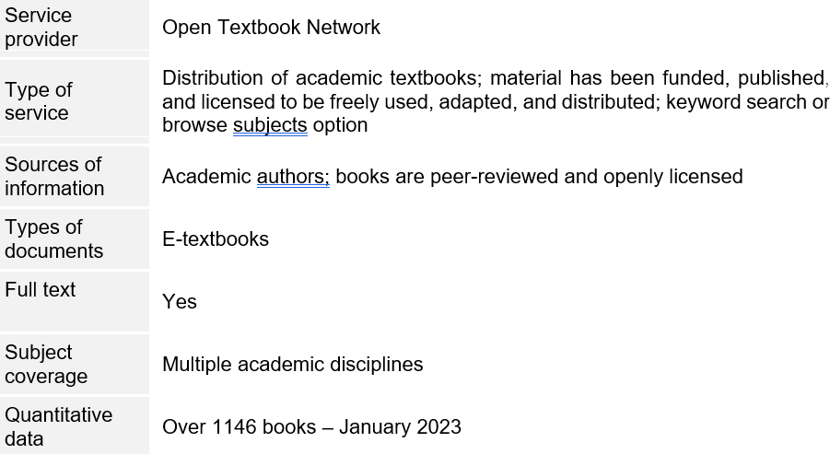
Open Textbook Library cont.

Slide 44
Summary
This lesson has focused on Internet resources that would be of use by users from all the Research4Life collections.
It expands on the discipline specific resources discussed in Lessons 4.1–4.5. The tools were divided into the following categories: Aggregator Search Tools and Repositories; Free E-journal Resources, Databases and Publishers; Thesis/Dissertations Portals and Gateways, Miscellaneous Tools; and E-books.
These category lists highlight key Internet resources and are not comprehensive.
Remember that search results from several of these tools will link to grey literature plus open access and fee-based journals and books.

Slide 45
Additional Resources
‘Indispensable Resources for Online Academic Research: OnlinePhDprogram.Org’. Accessed 23 June 2021. https://onlinephdprogram.org/academic-research/
Rebar, Lauri. ‘LibGuides: Free Resources: Welcome’. Accessed 23 June 2021. https://libguides.fau.edu/freeresources
‘Wikipedia: List of Free Online Resources’. Accessed 23 June 2021. https://en.wikipedia.org/wiki/Wikipedia:List_of_free_online_resources

Slide 46
You are invited to;
Visit us at www.research4life.org
Contact us at r4l@research4life.org
Find out about other training materials [www.research4life.org/training]
Subscribe to Research4Life newsletter [www.research4life.org/newsletter]
Check out Research4Life videos [https://bit.ly/2w3CU5C]
Follow us on Twitter @r4lpartnership and Facebook @R4Lpartnership

Slide 47
Research4Life is committed to the UN's Sustainable Development Goals.
Research4Life contributes to the United Nations Decade of Action by increasing research participation from the Global South.
The recent Strategic Plan to 2030 focuses on inclusion and equity in the global research community, supporting the creation of an even richer body of research which will help to advance the Sustainable Development Goals.
Research4Life offers our partners, users and supporters the opportunity to contribute to the creation of a diverse. inclusive and equitable research ecosystem for all.

Slide 48
Our unique public-private structure allows us to work effectively in alignment with SDG17: Partnership for the Goals for sustainable development and to support our community of users as both consumers and producers of critical research and advance SDG10: Reduced Inequalities within and among countries.
While R4L activities directly and indirectly support all the SDGs such as Good health and Wellbeing, Zero Hunger, Clean Water and Sanitation, Industry, innovation and infrastructure, and Peace and Justice, the Research4Life Program is closely aligned to SDG4: Quality Education that is fundamental to creating a peaceful and prosperous world and SDG5: Gender Equity to achieve the empowerment of all women and children.

Slide 49
For more information on Research4Life
www.research4life.org
r4l@research4life.org
Research4Life is a public-private partnership of five collections:

