Slide 1
Additional discipline-specific resources
Global justice
Research4Life is a public-private partnership of five collections:

Slide 2
Outline
Introduction
BLDS Index to Development Studies
Accessing BLDS Index to Development Studies
Searching BLDS Index to Development Studies
NATLEX
Accessing NATLEX
Browsing for laws/legislation by country
Accessing laws/legislation
Browsing for laws/legislation by subject
Searching for laws/legislation on NATLEX
NORMLEX
Summary
This work is licensed under Creative Commons Attribution-ShareAlike 4.0 International (CC BY-SA 4.0)

Slide 3
Learning objectives
Become aware of existing additional resources related to global justice.
Understand the additional collections and how to use them.

Slide 4
Introduction
This lesson focuses on key collections-specific (law and justice) resources accessed through Research4life. The lesson reviews four databases namely;
BLDS Index to Development Studies,
NATLEX and
NORMLEX.
These databases are accessible through the Databases option of the Content drop down menu from the top of the Research4life Content portal.

Slide 5
BLDS Index to Development Studies
According to University of Sussex Library Subject Guide;
The British Library for Development Studies (BLDS) is Europe's most comprehensive research collection on development issues in Europe.
It holds over 80,000 monographs, including individual research reports, working papers and books, and over 10,000 magazines, newspapers, and annual reports and newsletter titles.
Over 50% of the collection is published in the Global South.
The Africa Desk says;
BLDS is an extensive collection from and about Sub-Saharan Africa, broadly in relation to social and economic development.
Sources of information include developing and donor country governments, international and regional organizations, non-governmental organizations, research institutions and commercial publishers.
Notes:
Please note that African Government publications are on closed access, but visitors can be given access to the stacks if necessary

Slide 6
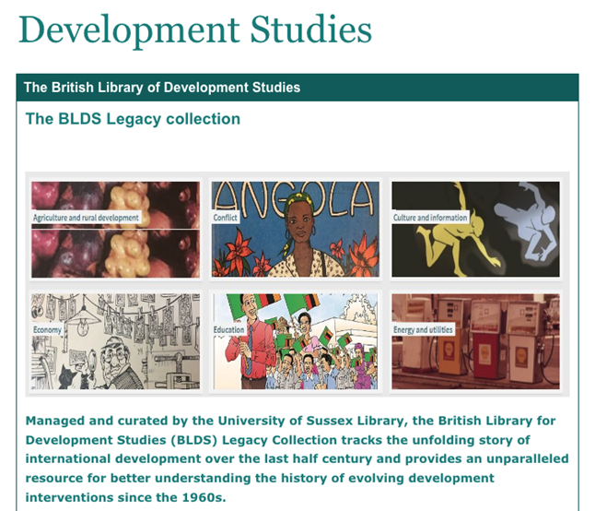
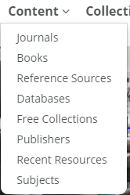
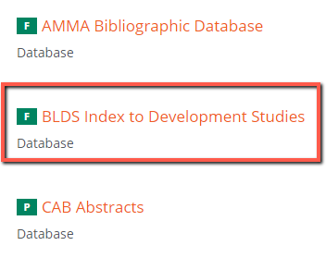
Accessing BLDS Index to Development Studies from the R4L Unified Portal
To access the database, go to Content on the Research4life Unified Portal homepage,click Databases, select B and scroll to BLDS Index to Development Studies as shown above.

Slide 7
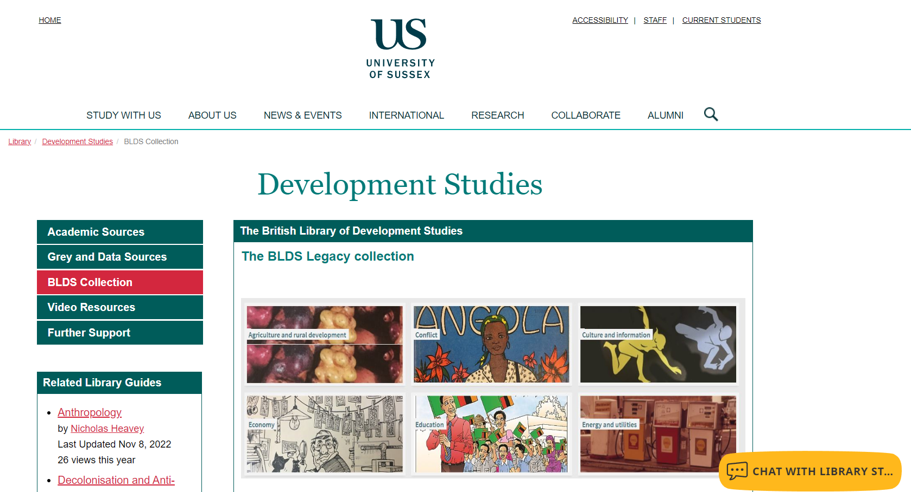
BLDS Index to Development Studies homepage
The Collection can be searched, and items requested via the University of Sussex Library catalogue or via the BLDS Legacy Collection’s dedicated project website.
A live chat widget is available to enables users to chat with the University of Sussex Library staff who manages the collection.

Slide 8
Accessing the BLDS Legacy Collection
The link to the BLDS Legacy Collection is provided on the homepage
Simply click on it to be taken to the project website. The homepage is displayed in the next slide.

Slide 9
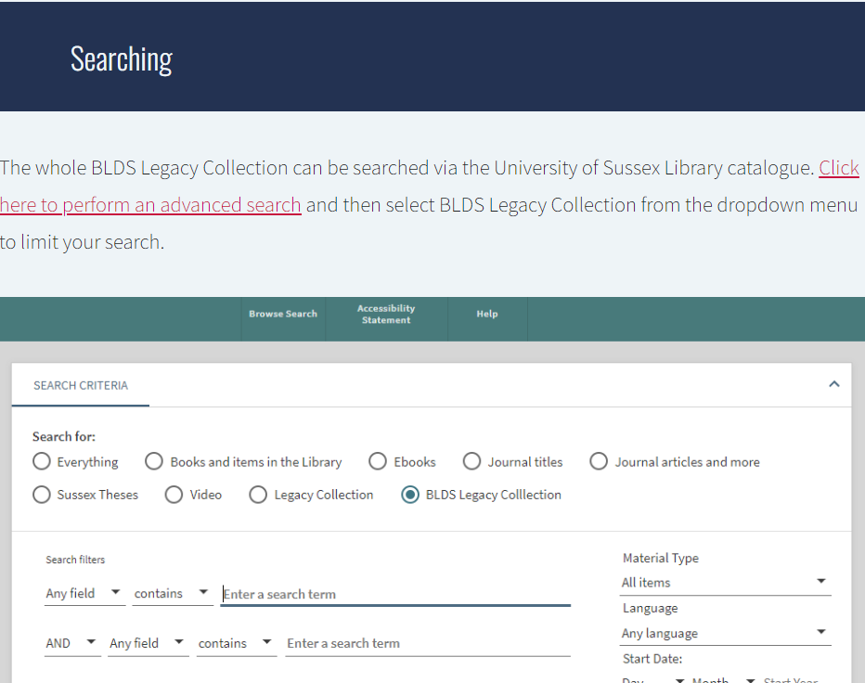
BLDS Legacy homepage
The collection comprises of 33,052 records, from 160 countries and they are available in 90 languages
Click on the ACCESSING THE COLLECTIONS tab to access the content.
Scroll down until you get to “Searching” for instructions on how to search for content.
Click on the link provided. In the next screen, click on Simple search and then select BLDS Legacy Collection from the drop-down menu to limit your search.

Slide 10
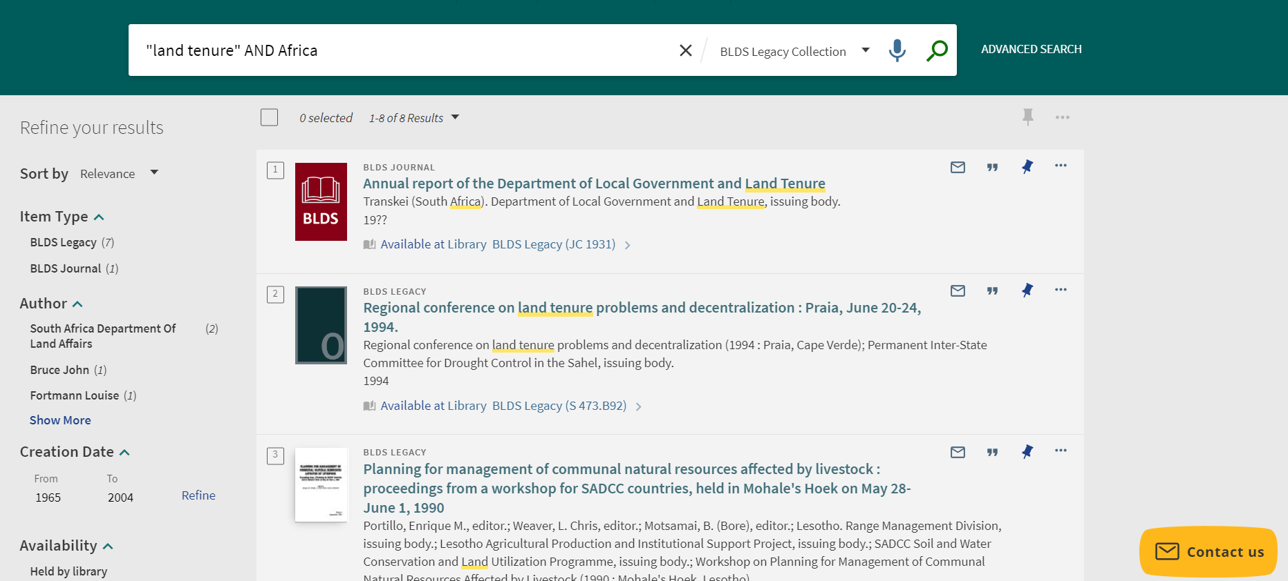
Searching BLDS Index to Development Studies
To illustrate type in the searching using the Simple search box, type in the keywords "land tenure" AND Africa.
Note that the “AND” Boolean operator is used to limit the search results, and quotation marks are used for phrase searching.
Click the Search icon to display results, in the search conducted, 8 results were retrieved.
Functionalities to Sort by and the options to refine the search options also are available.
Notes:
Please note some of the BLDS collection is available in print format and located at the University of Sussex, Brighton, UK, and users should have library membership in order to access the collection.

Slide 11
BLDS Search results screen
The keywords used in the search are underlined with a yellow highlighter.
Each article displays the Title, Author details and a link to the location of the article.

Slide 12
BLDS Article Functions
BDLS provides an option to Bookmark each article.
Additional functionalities for exporting the citation to Excel and different reference managers, Print, Cite, Article Permanent Link and Email are also available.
*Note that users can only export a citation to a reference manager that is installed on their computer.

Slide 13
Accessing full text online on BLDS
All content that is available online will be displayed with a Available online access link below each search result.
Click on the link to access the full-text.
Note that some content on the BLDS site may not be accessible for free.
Users may need to access them through GOALI by clicking on the “Collections” tab from the Research4life Unified portal and selecting “GOALI” and check if access to the publication is available.

Slide 14
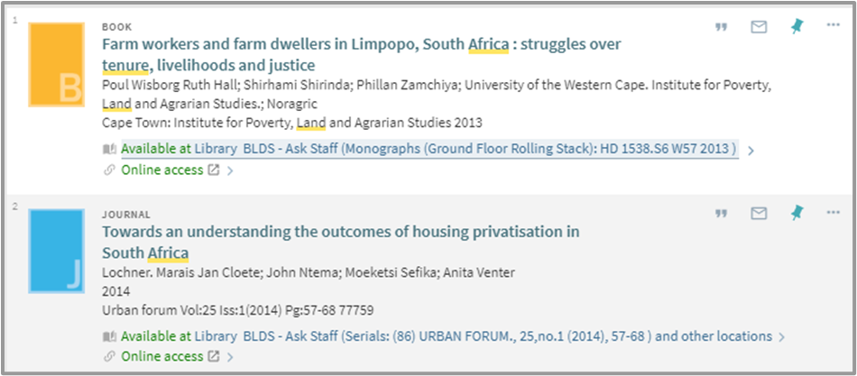
Accessing full text online using GOALI
For example; full access to the highlighted article in the Urban Forum journal is not available through BLDS but can be accessed via the GOALI collection.

Slide 15
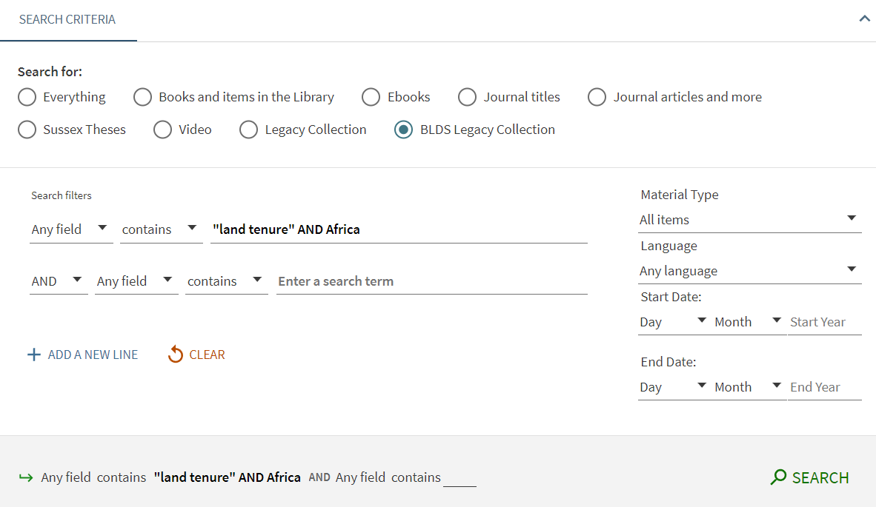
BLDS Advanced Search
The Advanced Search feature on the BLDS site allows field searching using Boolean operators.
The functionalities on the right side of the screen allow the user to limit the results by Material Type, Language and Publication Date.

Slide 16
NATLEX
NATLEX is a database of national labour, social security and related human rights legislation maintained by the ILO's International Labour Standards Department.
NATLEX contains;
more than 100,000 entries covering 196 countries as well as 160 territories, provinces or other subdivisions.
The records on NATLEX provide full texts or abstracts of legislation and citation information and are indexed by subject classifications.
Records appear in only one of the three ILO official languages (English/French/Spanish).
The full text of the law or a relevant electronic source are linked to the records.

Slide 17
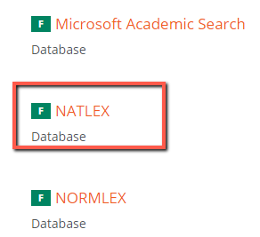
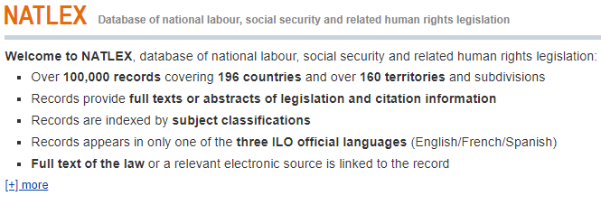
Accessing NATLEX from the R4L Unified Portal
To access the database, click Databases on the Research4life Unified Portal homepage, and select NATLEX as shown above.

Slide 18
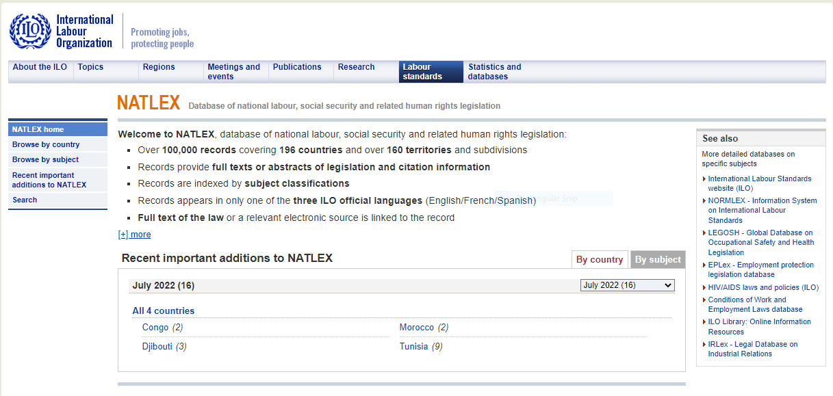
NATLEX homepage
The homepage lists recent laws/legislation added to NATLEX by country.
Users can change to view the laws/legislation by subject.
NATLEX also provides links to other law subject-specific databases
These are available under the See also more detailed databases on specific subjects heading.

Slide 19
Browsing for laws/legislation by country
Click Browse by country on the NATLEX homepage.
All countries with laws/legislation on NATLEX will be displayed: select the country of interest.
The database will show the selected country together with the number of laws and legislation from that country that are accessible from the NATLEX database.
For example,
select Zimbabwe, and the database shows that it has 395 laws or items of legislation from that country.
The laws/legislation are further broken down by subject.
Select the subjects to be displayed by ILO order or Alphabetical order. Some subjects have multiple sub-topics.
To display the sub-topics click the Show/Hide sub-topics tab or click the + button next to the subject.
The number next to each subject represents the number of laws/legislation available in that subject.
Notes:
See next slide for search results.

Slide 20
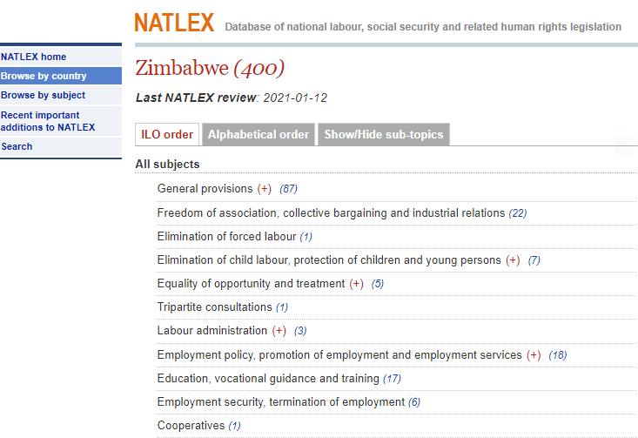
NATLEX - Browse by country
Search results showing 400 laws or items of legislations in Zimbabwe.

Slide 21
Accessing laws/legislation
To view a specific law or piece of legislation, click the number next to the subject; this action will display all the laws/legislation under that subject.
Select the law/legislation of interest by clicking on it.
This shows more details about the law, i.e. Name, Country, Type of Legislation, Date of Adoption, Date of Entry into force, ISN, Bibliography, Abstract/Citation; Repealed text(s); Implementing text(s) and Amended text(s
To access the full text of a statute, click Legislation online or PDF links under the Bibliography field.
This will lead to a page to view or download the law/legislation.
Note that some laws/legislation do not have links to full text online.

Slide 22
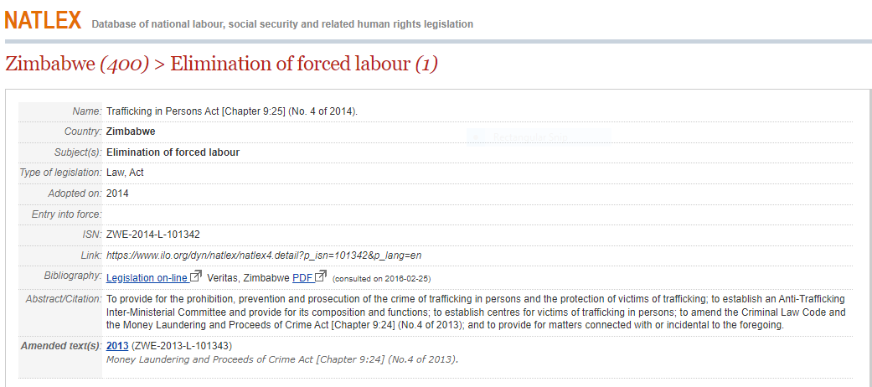
Accessing laws/legislation cont.
To access the full text of a statute, click Legislation on line or PDF links. This action will open the full text that can be downloaded to a computer.

Slide 23
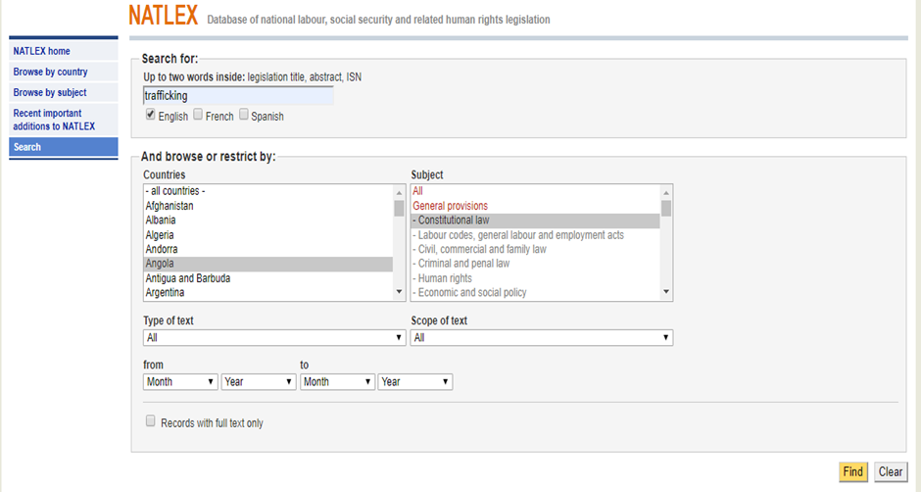
Searching for laws/legislation on NATLEX
To search for laws/legislation, click the Search button on the left side of the NATLEX homepage.
This action will lead to a window where a user can search using keywords.
After entering the keywords, results can be filtered by language, country, subject, type of text, scope of text, date and full text content .
After applying the needed filters click the Find button at the bottom of the screen.
All laws/legislation that match the search will be displayed.
Notes:
Note that applying too many filters may get no results
Before starting a new search, press the Clear button so that all previously applied filters will be cleared.

Slide 24
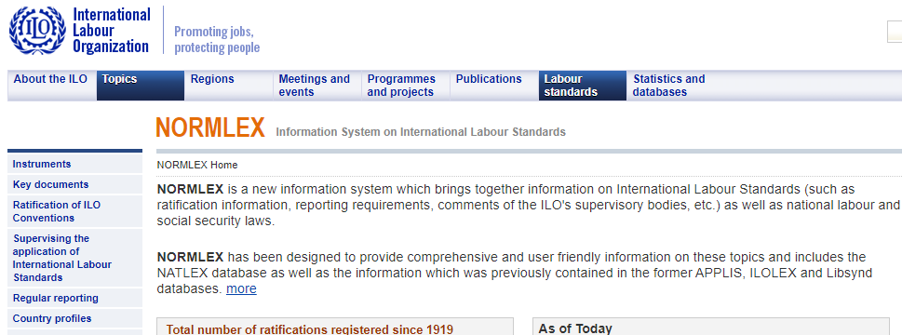
NORMLEX
Available through the Research4life Databases list.
Can be accessed through this link https://www.ilo.org/dyn/normlex/en/f?p=1000:1::::::
Homepage for NORMLEX

Slide 25
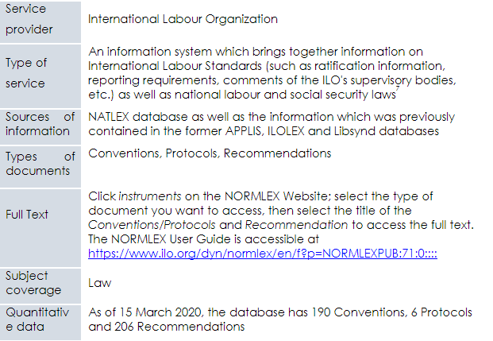
NORMLEX cont.

Slide 26
Summary
This lesson looked at four law and justice databases namely BLDS Index to Development Studies, NATLEX and NORMLEX.
The lesson explored ways of accessing, searching and browsing the databases.

Slide 27
You are invited to;
Visit us at www.research4life.org
Contact us at r4l@research4life.org
Find out about other training materials [www.research4life.org/training]
Subscribe to Research4Life newsletter [www.research4life.org/newsletter]
Check out Research4Life videos [https://bit.ly/2w3CU5C]
Follow us on Twitter @r4lpartnership and Facebook @R4Lpartnership

Slide 28
Research4Life is committed to the UN's Sustainable Development Goals.
Research4Life contributes to the United Nations Decade of Action by increasing research participation from the Global South.
The recent Strategic Plan to 2030 focuses on inclusion and equity in the global research community, supporting the creation of an even richer body of research which will help to advance the Sustainable Development Goals.
Research4Life offers our partners, users and supporters the opportunity to contribute to the creation of a diverse. inclusive and equitable research ecosystem for all.

Slide 29
Our unique public-private structure allows us to work effectively in alignment with SDG17: Partnership for the Goals for sustainable development and to support our community of users as both consumers and producers of critical research and advance SDG10: Reduced Inequalities within and among countries.
While R4L activities directly and indirectly support all the SDGs such as Good health and Wellbeing, Zero Hunger, Clean Water and Sanitation, Industry, innovation and infrastructure, and Peace and Justice, the Research4Life Program is closely aligned to SDG4: Quality Education that is fundamental to creating a peaceful and prosperous world and SDG5: Gender Equity to achieve the empowerment of all women and children.

Slide 30
For more information on Research4Life
www.research4life.org
r4l@research4life.org
Research4Life is a public-private partnership of five collections:

