Slide 1
Additional discipline-specific resources
Evidence-based medicine
Research4Life is a public-private partnership of five collections:

Slide 2
Outline
Evidence and Evidence-based Practice background
Definitions - Systematic reviews and Meta-analysis
Filtered vs. Non-filtered information
Hierarchy of evidence
5 step EBP process – ask, access, appraise, apply, access
Question formulation
Hinari Resources
Reference Sources - Cochrane Library, Clinical Key, Essential Evidence Plus
Databases – Johanna Briggs Institute EBP Database
R4L/PubMed
Clinical Queries
Filters
Internet Resources
This work is licensed under Creative Commons Attribution-ShareAlike 4.0 International (CC BY-SA 4.0)

Slide 3
Learning objectives
Become aware of key concepts of evidence-based medicine (EBM) and strategies for evidence-based practice (EBP).
Understand the Research4Life EBP tools and how to use them.
Understand the PubMed EBP tools and how to use them.
Become knowledgeable of Internet-based EBP resources.

Slide 4
Introduction
This lesson will focus on the concepts of evidence-based medicine/practice and key EBP resources that are available.
The first part of the lesson is an overview of components of EBP (systematic reviews, study-types, hierarchy of resources) and the 5-step EBP process.
The second part of the lesson focuses on the key information resources that are available from Research4Life, PubMed and the Internet.

Slide 5
What is Evidence?
What is Evidence?
Evidence concerns facts intended for use to support a conclusion:
A fact is something known by experience or observation
Evidence is used to support a conclusion; it is not the conclusion itself
Lomas J et al. Conceptualizing and combining
evidence for health system guidance. Canadian
Health Services Research Foundation, 2005
Context-free scientific evidence (medical effectiveness or biomedical research)
Tacit evidence (views and realities of doctors and patients)
Context sensitive scientific evidence (putting evidence into a particular operational setting)

Slide 6
What are EBM and EBP
Evidence-based Medicine is “the integration of best evidence from current research, patient preferences and values, and clinical expertise to clinical questions in a timely fashion”. Sackett D et al. Evidence-based medicine: How to practice and teach EBM. London: Churchill Livingstone, 2000.
Evidence-based Practice “requires that decisions about health care are based on the best available, current, valid and relevant evidence. These decisions should be made by those receiving care, informed by the tacit and explicit knowledge of those providing care, within the context of available resources”.
Sicily statement on evidence-based practice. BMC Medical Education, 2005 Jan 5;5(1):1
Best Evidence
Patient Values/Local Conditions
Clinical Expertise

Slide 7
Why use EBP? What are some of the barriers?
Why use EBP
Improve care & prevent death
To bridge the gap between research & practice
New treatments, fewer side effects, cheaper or less invasive options, resistance to existing therapies,
Keep knowledge and skills current (continuing education)
To save time to find the best information
Barriers
Time, effort & skills needed
Lack of access to evidence
Overuse, underuse, misuse of evidence
Poor decision making
Environment not supportive of EBP
Intimidation by senior clinicians

Slide 8
PuPuvbb
How does EBP help?
A patient comes to a clinic with a fresh dog bite. It looks clean and the nurse and patient wonder if prophylactic antibiotics are necessary. The nurse searches PubMed and found a meta-analysis study indicating that the average infection rate for dog bites was 14% and that antibiotics halved this risk to 7%.
For every 100 people with dog bites, treatment with antibiotics will save 7 from infection.
Treating 14 (NNT) people with dog bites will prevent 1 infection.
You explain these numbers to the patient along with possible consequences and patient decides not to take antibiotics.
On a follow up visit you find out that he did not get infected.
Glasziou P, Del Mar C, Salisbury J. EBP Workbook, 2nd. ed. BMJ Books, 2007.

Slide 9
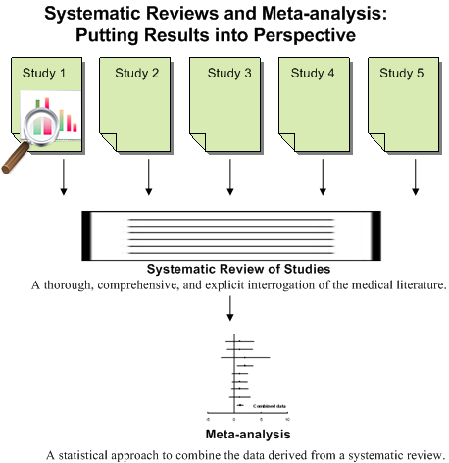
Systematic Review and Meta-analysis definitions
Systematic Review:
A review in which specified and appropriate methods have been used to identify, appraise, and summarize studies addressing a defined question. (It can, but need not, involve meta-analysis). Aims to decrease bias and increase reproducibility and transparency. They provide guidance for practice and policy-making, identify gaps in knowledge and need for further research.
Meta-analysis:
A statistical technique that summarizes the results of several studies in a single weighted estimate in which more weight is given to results of studies with events and sometimes to studies of higher quality. “Guides: Evidence-Based Medicine Resource Guide: Defining EBM.” Accessed June 24, 2022. https://guides.dml.georgetown.edu/ebm/definingebm

Slide 10
Traditional (narrative) literature review vs. systematic review
Review stage | Narrative review | Systematic review
Review question | Question is broad and terms are not well-defined | Question is specific; terms and protocol are defined in advance
Study selection | Convenience sampling and biased selection | Exhaustive searches with pre-defined criteria applied for selection by more than one reviewer
Quality assessment | None | Selected studies assessed for risk of bias and study quality
Synthesis | Qualitative and narrative; vote-counting may be used | Sometimes quantitative, including meta-analysis with risk of bias considered

Slide 11
Definitions of other study types
Randomized Controlled Trial: a trial in which participants are randomly assigned to two or more groups: at least one (the experimental group) receiving an intervention that is being tested and another (the comparison or control group) receiving an alternative treatment or placebo. This design allows assessment of the relative effects of interventions.
Controlled Clinical Trial: a trial in which participants are assigned to two or more different treatment groups. In Clinical Evidence, we use the term to refer to controlled trials in which treatment is assigned by a method other than random allocation. When the method of allocation is by random selection, the study is referred to as a randomized controlled trial (RCT). Non-randomized controlled trials are more likely to suffer from bias than RCTs.
Cohort Study: a non-experimental study design that follows a group of people (a cohort), and then looks at how events differ among people within the group. A study that examines a cohort, which differs in respect to exposure to some suspected risk factor (e.g. smoking), is useful for trying to ascertain whether exposure is likely to cause specified events (e.g. lung cancer). Prospective cohort studies (which track participants forward in time) are more reliable than retrospective cohort studies.

Slide 12
Definitions continued
Case control study: a study design that examines a group of people who have experienced an event (usually an adverse event) and a group of people who have not experienced the same event and looks at how exposure to suspect (usually noxious) agents differed between the two groups. This type of study design is most useful for trying to ascertain the cause of rare events, such as rare cancers.
Case Series: analysis of series of people with the disease (there is no comparison group in case series).
BMJ Glossary of EBM Terms: https://bestpractice.bmj.com/info/us/toolkit/ebm-tools/a-glossary-of-ebm-terms/ (Accessed June 24, 2022)

Slide 13
Types of EBP resources
Pre-appraised literature uses an explicit review process – by experts - to find and appraise evidence; to provide clinicians with the best evidence, often at the point of care (evidence summaries, journals that summarize research, clinical practice guidelines).
https://learn.maricopa.edu/courses/804760/pages/understanding-pre-appraised-sources?module_item_id=5387411; (Accessed 24 January 2022)
Non-appraised or primary sources (individual research articles) answer very specific questions and provide the most recent data. User must be able to search efficiently and critically appraise the information.
Regardless of category, sources must be appraised by the user
www.pdqa.gov.hk/english/ebeplatform/ebm/ebm_bestevid.php (Accessed 24 January 2022)

Slide 14
Sources to find primary studies
Priority 1: Filtered (pre-appraised literature): Cochrane Library, Joanna Briggs Institute EBP Database…
Priority 2: Non-filtered (non-appraised literature) primary sources: Medline (PubMed), Scopus, Google/Scholar...
Save Time.
Ask the experts.
Use quality research only.
Use at the point of care.
Not all clinicians will need or want to do literature searches and clinical appraisal.
Create comprehensive searches.
Conduct systematic reviews.
Conduct synonym searching using thesauri.
Set up and distribute alerts.
Limit to populations & publication types.

Slide 15
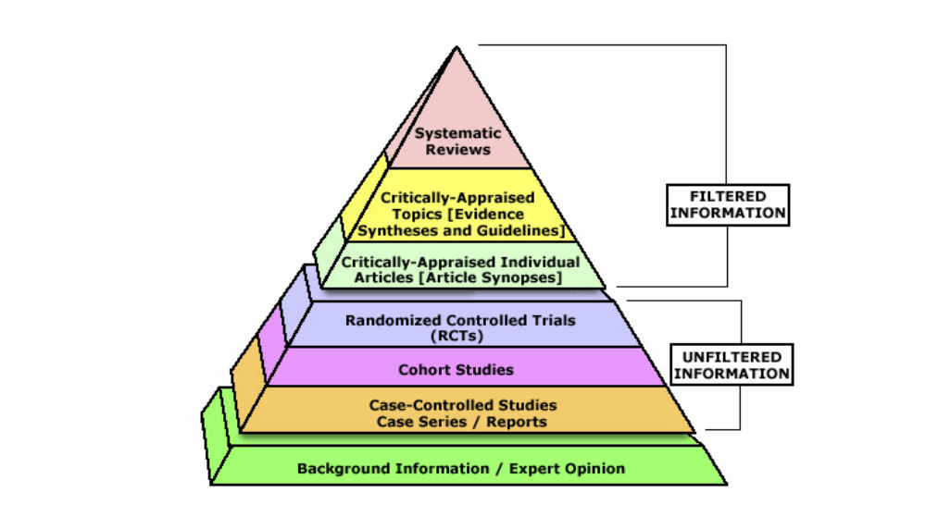
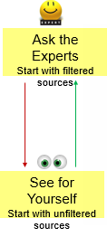
Hierarchy of Evidence & Search Approaches
Cochrane Database of Systematic Reviews
EBM Guidelines Essential Evidence Plus
PubMed CINAHL
CENTRAL PubMed CINAHL
PubMed CINAHL
Textbooks

Slide 16
The 5 steps of EBP process
1. ASK: Formulate an answerable clinical question.
2. ACCESS: Track down the
best evidence.
3. APPRAISE: Appraise the evidence for its validity and usefulness
4. APPLY: Integrate the results with your clinical expertise and your patient values/local conditions.
5. ASSESS: Evaluate the effectiveness of the process.
Ask
Assess
Access
Apply
Appraise

Slide 17
Evidence-based practice Step 1: Ask
Answer Background Questions First- What/How Questions; helps user learn more about the scope of the topic and the possible alternatives in order to address the real problem. For example, What is hypertension? How does treatment A work?
Formulate focused clinical questions using PICO* - Address the real problem. *You may not always have all 4 elements in one question.
Ask

Slide 18
Next – Classify the Type of Question
What is the treatment/preventive treatment? Question of INTERVENTION/PREVENTION
What causes the problem? Question of ETIOLOGY, RISK, HARM
Does this person have the problem? Question of DIAGNOSIS
Who (and how likely) will get the problem? Question of PROGNOSIS

Slide 19
Templates of EBP Questions
For a therapy: In adult patients w/total hip replacements (P), what is the effect of PCA pain Medication (I) on postoperative pain(O) compared with prn IM pain Medication(C)?
Prevention: For women under the age of 60 (P) does the use of low-dose aspirin (I) reduce the future risk of stroke (O) compared with none (C)?
For etiology/harm: Are adult males (P) who have a vasectomy (I) at an increased (Increased/decreased) risk for/of testicular cancer (O) compared with adult males (P) with/without no vasectomy (C)?
Diagnosis or diagnostic test: Are (is) mammogram(I) more accurate in diagnosing breast cancer (P) compared with clinical breast exam (C) for earlier diagnosis of breast cancer (O)?
Prognosis: Does smoking education (I) influence young people not to smoke (O) in patients who have high risk of smoking (P)?
Melnyk B. & Fineout-Overholt E. (2005). Evidence-based practice in nursing & healthcare. New York: Lippincott Williams & Wilkins.

Slide 20
Formulate Intervention Questions
For a 54-year-old male patient with intermediate grade prostate cancer, is radical prostatectomy more effective compared to radiation treatment in reducing the risk of mortality, impotence, and incontinence?
P - 54 years old male with intermediate grade prostate cancer
I - radical prostatectomy
C - radiation treatment
O - reduce risk of mortality, impotence, and incontinence

Slide 21
Formulate Etiology or Risk Question What causes a disease or health condition
This is the reverse of intervention questions- it deals with harmful outcomes of an activity or exposure (public health issues).
S. is a smoker and just found out that she is 3 months pregnant. She quit smoking immediately. But she is worried if her developing baby was harmed and if the baby is at risk for having developmental problems. She is asking you if smoking during the first trimester can harm her baby?
P - babies of mothers who smoke
I - smoking in first trimester
C - nothing
O - increase risk of developmental problems

Slide 22
EBP Step 2: Access the evidence
Access
Track down the best available evidence – filtered vs. nonfiltered
Start from the best resource for your question
Develop effective EBP search strategies

Slide 23
EBP Step 3: Appraise (validity, impact)
Appraise
Does PICO of the study match my PICO question?
internal validity – methods; how well was the study done? Is it biased?
external validity - generalizability
impact - does it matter to your patient?
See: Evaluating the Evidence section in the EBM tutorial
http://www.hsl.unc.edu/Services/Tutorials/ebm/welcome.htm Accessed: 24 January 2022)

Slide 24
EBP Step 4: Apply (patient, setting)
Apply
Integrate the results with your clinical expertise and
your patient values
Patient
Is my patient similar enough that the results of the study apply?
Will the potential benefits outweigh the potential harms of treatment ?
What does my patient think? What are his cultural beliefs?
Setting
Is the intervention feasible in my settings?
What alternatives are available?

Slide 25
EBP Step 5: Access (patient, yourself)
Assess
Evaluate the effectiveness of the process:
Am I asking questions?
Am I writing down my information needs?
How is my searching going? Am I becoming more efficient?
What is my success rate in the EBP steps?
Am I periodically syncing (checking) my skills and knowledge with new developments?
Teach others EBP skills
Keep a record of your questions

Slide 26
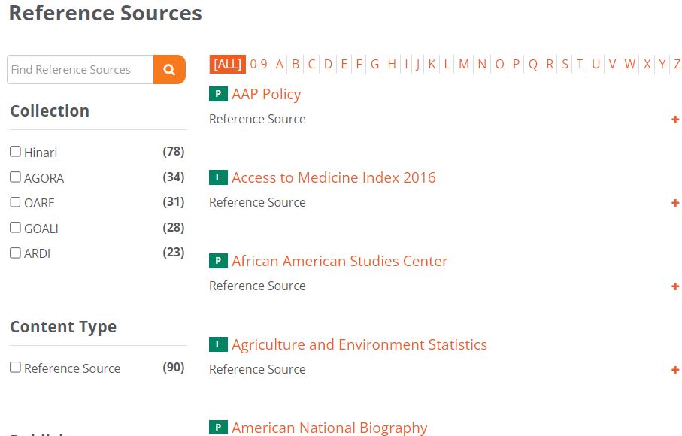
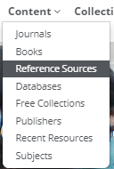
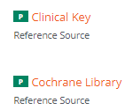
Content Portal Access – Reference Sources
Cochrane Library is accessed from the R4L Content Portal Reference Sources list. Once displayed, click on the C in the A-Z list or scroll down the list to the specific resource. Click to open. Ditto for Clinical Key and Essential Evidence Plus.

Slide 27
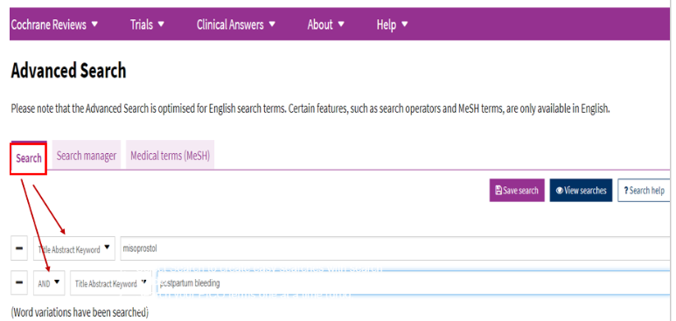
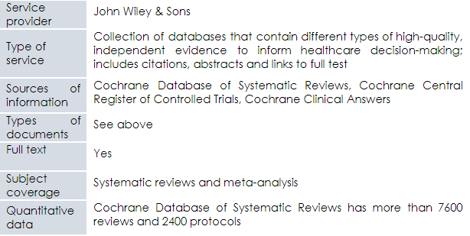
R4L resources: Cochrane Library (EBP resources available via Hinari)
See Research4Life Portal Reference Sources list/Cochrane Library
Note: Cochrane Library is available to all the R4L registered institutions; for the other resources, the publishers choose to grant access on a country-by-country basis.

Slide 28
Content: Cochrane Library
Independent non-for-profit international collaboration (36,000 contributors from 107 countries, 40 regional centers, 52 review groups)
Produces Systematic Reviews - internationally recognized as the highest standard in evidence-based health care because they contain the highest scientific evidence
Minimum Bias: Evidence is included/excluded on the basis of explicit quality criteria; A panel of experts reviews the evidence, peer-reviewed, dynamic (updated regularly)
Reviews involve exhaustive searches for all RCT, both published and unpublished, on a particular topic; focus on intervention, rehabilitation, prevention, or diagnoses
Content includes Cochrane Database of Systematic Reviews (7600 reviews & 2400 protocols), Central Registry of Controlled Trials (1.1 million articles) Cochrane Clinical Answers (1600) and Systematic Reviews from Epistemonikos (200,000)

Slide 29
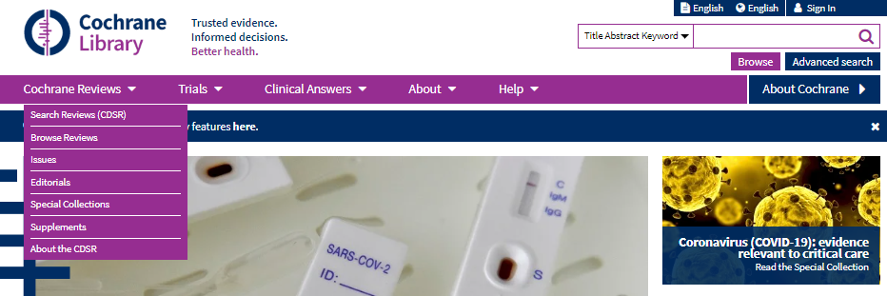
Cochrane Library options
This is the Initial page of Cochrane Library website.
Besides the search box, note the other tools for opening Cochrane Reviews.
Also note the Title Abstract Keyword search box.

Slide 30
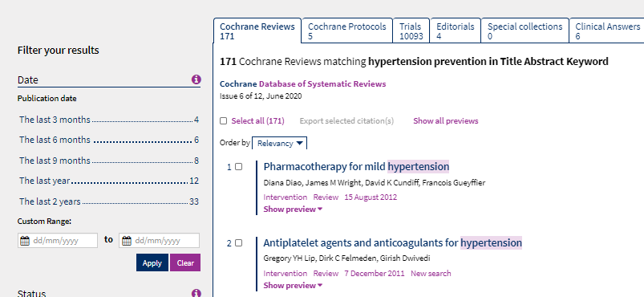
“hypertension prevention” search results/ Cochrane Database for Systematic Reviews
These are the search results for “hypertension prevention”; note how the results are divided into Cochrane Reviews, Cochrane Protocols and Trials, Editorials and Clinical Answers.

Slide 31
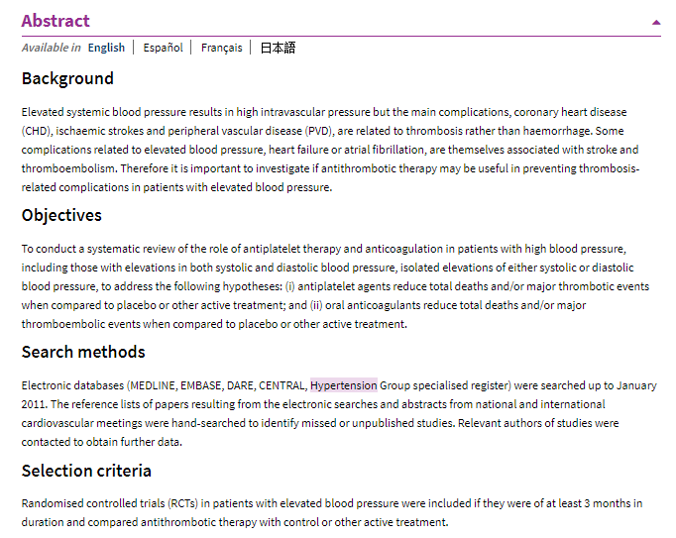
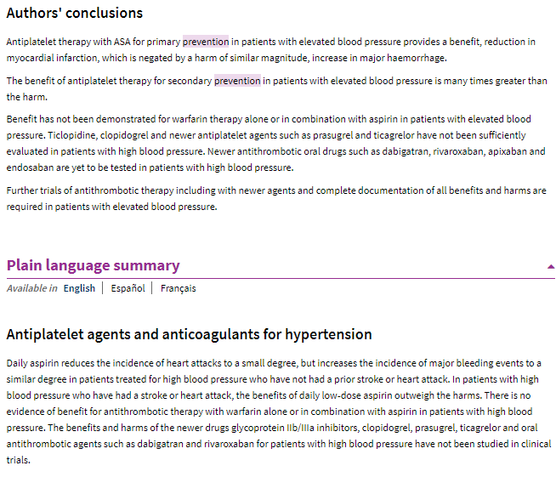
Sample of Cochrane systematic review abstract including Plain Language Summary

Slide 32
Cochrane Interactive Learning: Conducting an Intervention Review
To learn how to conduct an “Intervention Review”, go to the Cochrane website. Registration is required but is free. The course provides 10 hours of self-directed learning on conducting a complete systematic review process for new and experienced review authors.

Slide 33
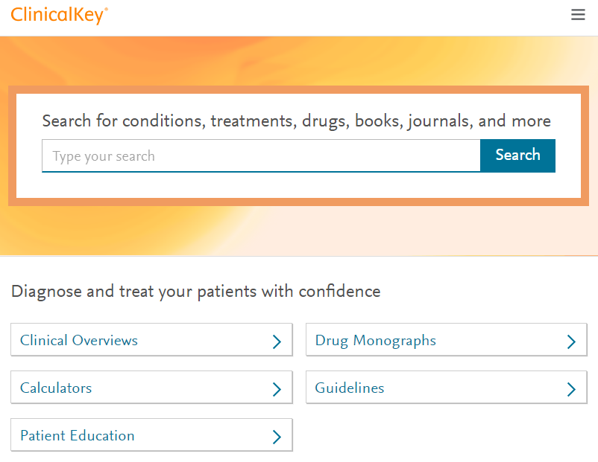
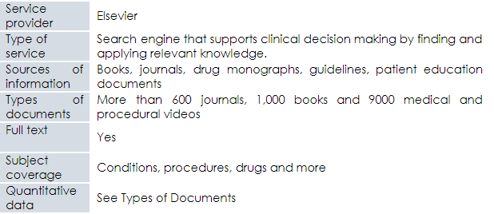
Clinical Key
See Research4Life Content Portal Reference Sources list/Clinical Key

Slide 34
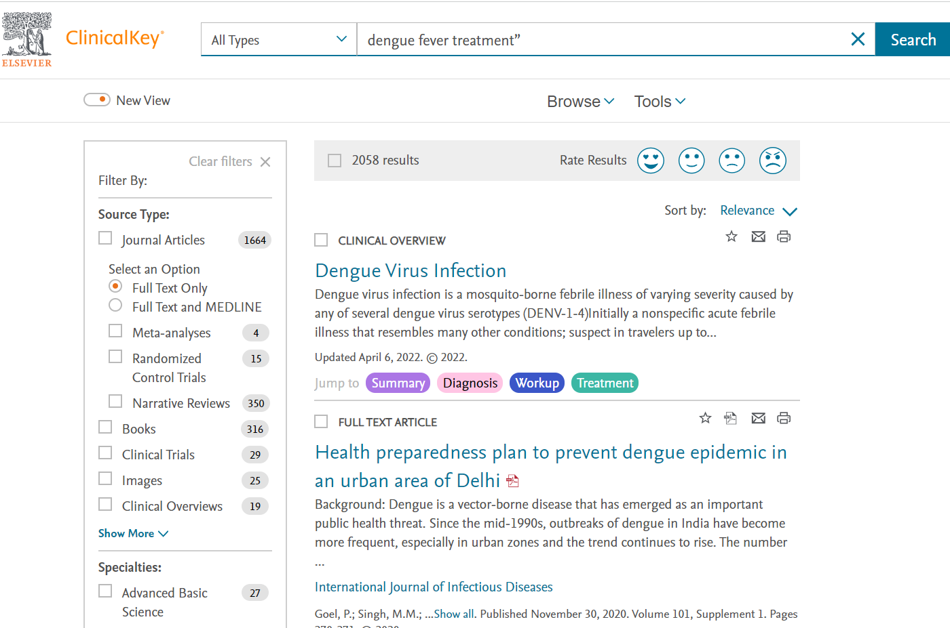
Clinical key search
In Clinical Key, complete a search for “dengue fever treatment”.
Note the options for limiting the search results.

Slide 35
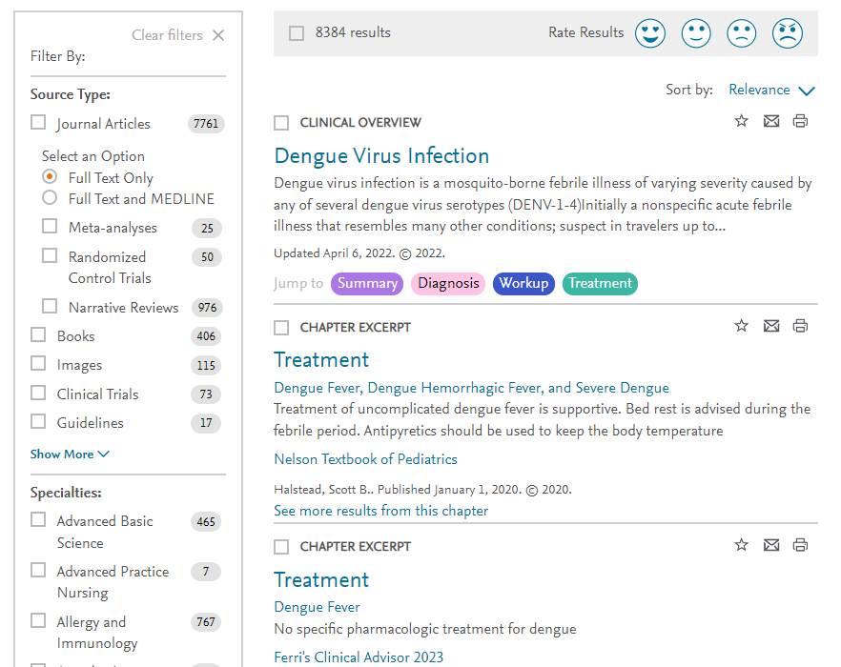
Clinical key search results
The “dengue fever treatment” search results in 8384 citations with many being evidence-based practice resources (systematic reviews, meta-analysis, randomized control trials).
Note Filter By option.

Slide 36
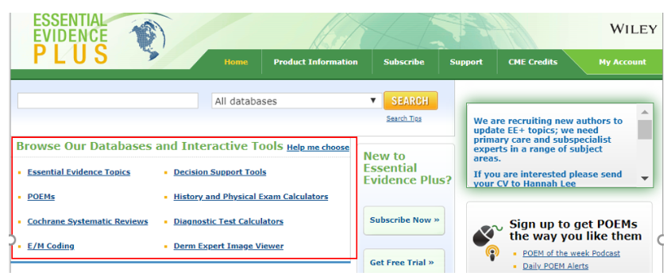
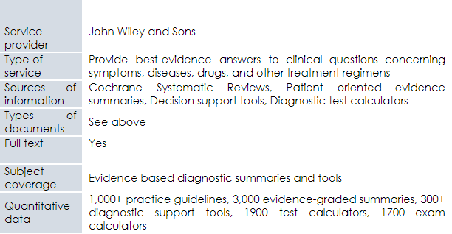
Essential Evidence Plus
See Research4Life Content Portal Reference Sources list/Essential Evidence Plus

Slide 37
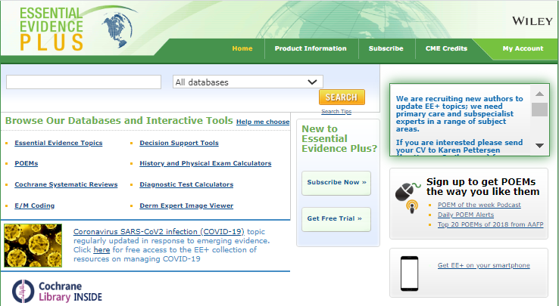
Essential Evidence Plus options
In Essential Evidence Plus, note the keyword search box and also the option to Browse Our Databases and Interactive Tools including Cochrane Systematic Reviews.
Similar to Clinical Key, the search results will use evidence-based practice studies.

Slide 38
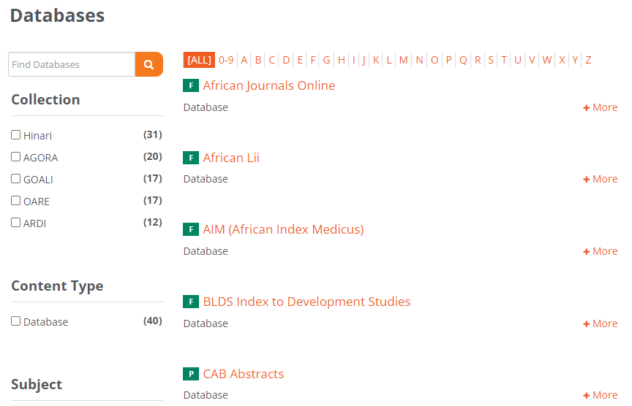
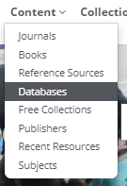
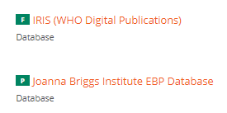
Content Portal Access - Databases
Joanna Briggs Institute EBP Database is accessed from the Research4Life Content Portal Databases list. Click on the J in the A-Z list or scroll down the list to the specific resource. Click to open.

Slide 39
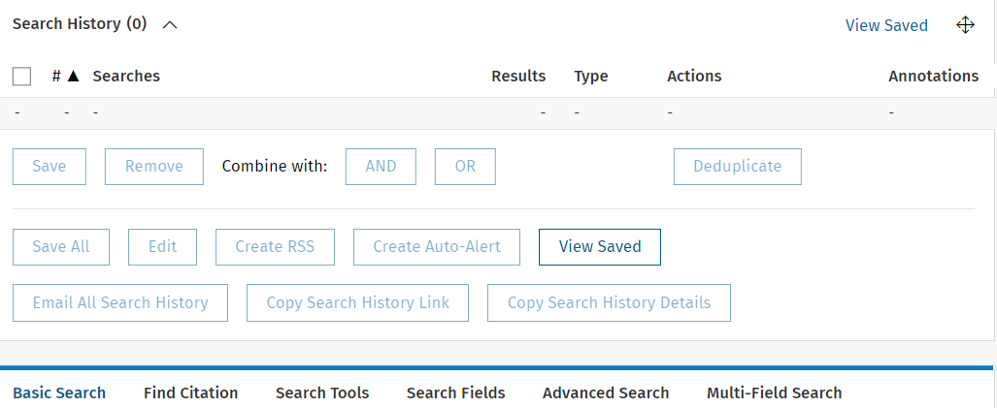
Joanna Briggs Institute EBP Database
See Research4Life Content Portal Databases list/ Joanna Briggs Institute EBP Database
Displayed is the basic search page and a summary of the database.

Slide 40
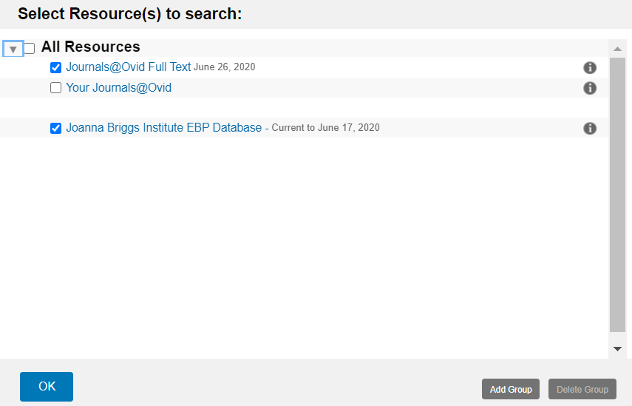
Joanna Briggs Institute EBP Database
Once the link to Joanna Briggs… is clicked on, the OVID resources page opens.
Check the boxes for Journals@OVID Full Text and Joanna Briggs Institute EBP Database and OK.
The user will have access to the database and full text resources linked to the search results.

Slide 41
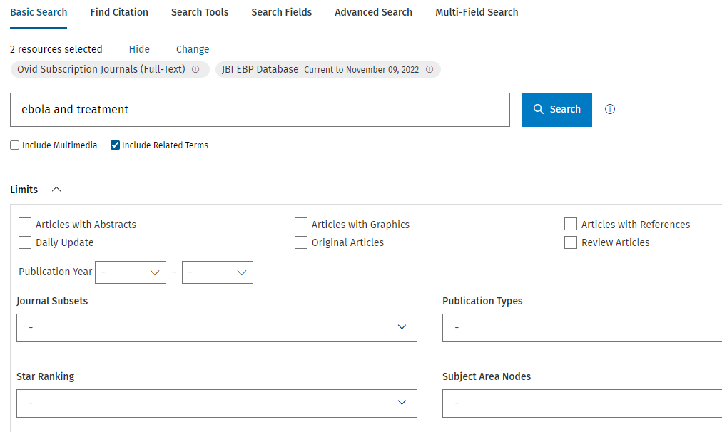
Joanna Briggs database search
Search for ebola and treatment Note the various limits (below) that can be added to a search.

Slide 42
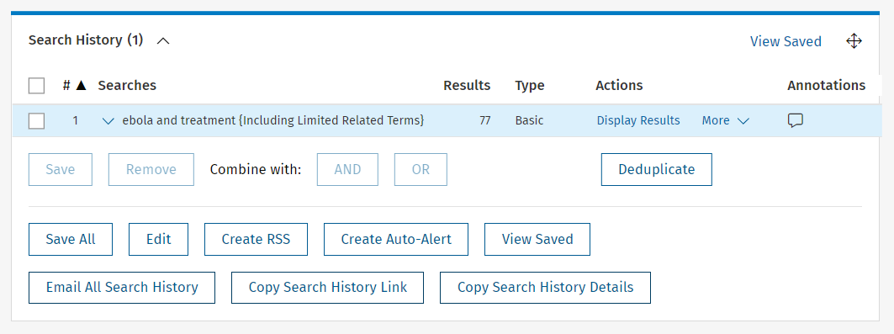
Search results display
The next slide will display the Search History. To view the 77 search results, click on Display Results or scroll down the page.

Slide 43
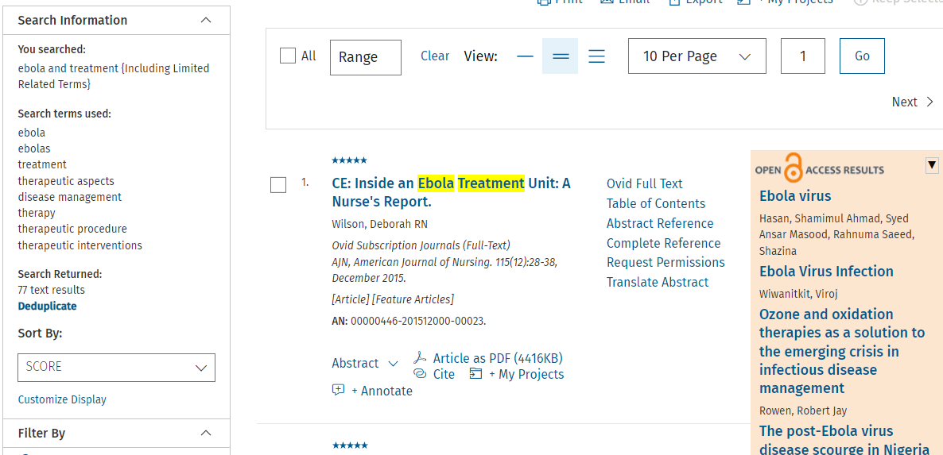
Search results continued
The results for the ebola and treatment search from the two OVID sources are displayed. Note the Search Information and Filter by options.

Slide 44
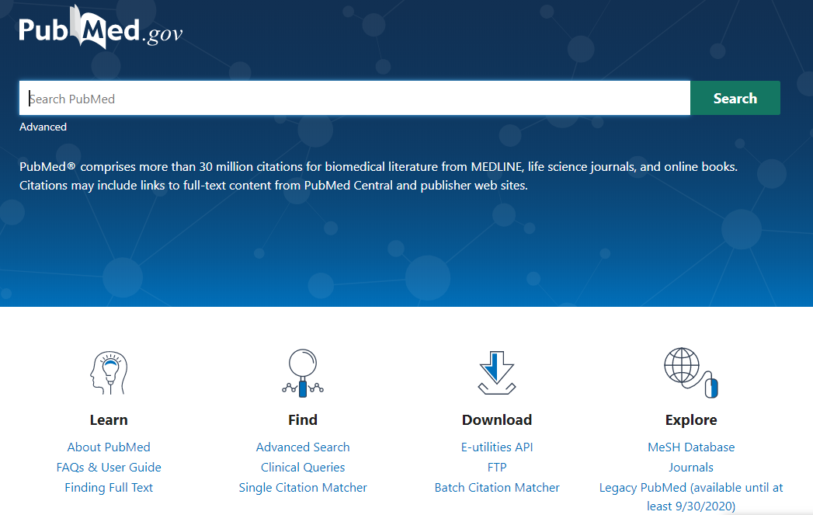
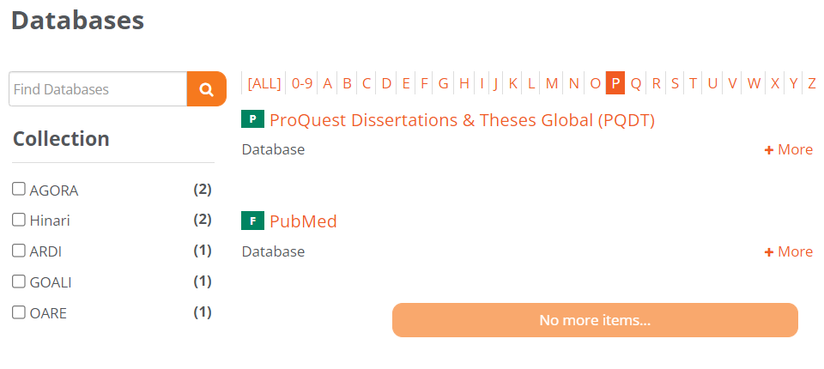
Clinical Queries (PubMed) – access to filtered and non-filtered research literature
See the Research4Life Content Portal Databases list/ PubMed/Clinical Queries

Slide 45
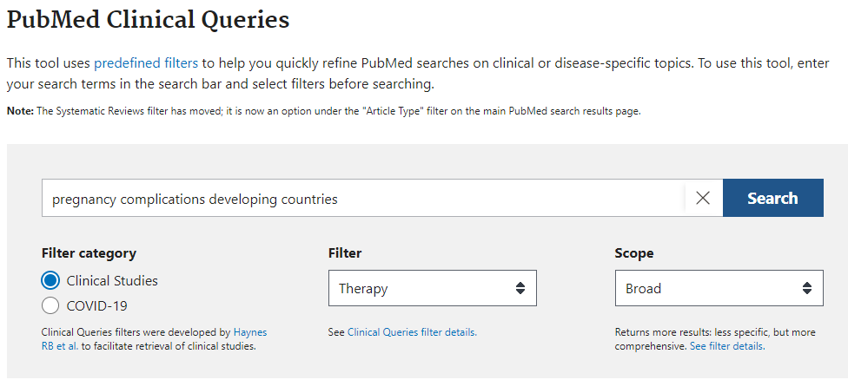
Clinical Queries search
In the PubMed Clinical Queries search box, enter pregnancy complications developing countries; click on Search. Note the Clinical Study Categories - Categories and Scope search options.

Slide 46
Clinical Queries search continued
In the Clinical Study Categories, choose the Diagnosis Category and Broad Scope.
Note the Category options: Therapy, Clinical Prediction Guides, Diagnosis, Etiology and Prognosis. The Scope options are Broad and Narrow.

Slide 47
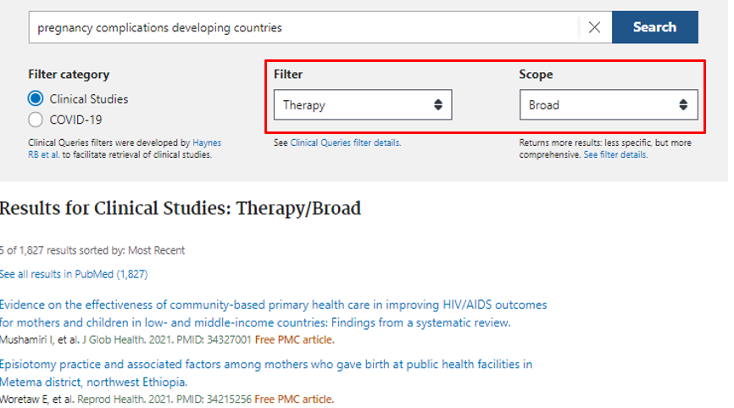
Queries search results
Now displayed are the Clinical Queries (1827) results for this search.
Note: if this search used the Narrow Scope, the number of citations would be 231.
At the bottom of this Results page, click on See all results in PubMed.

Slide 48
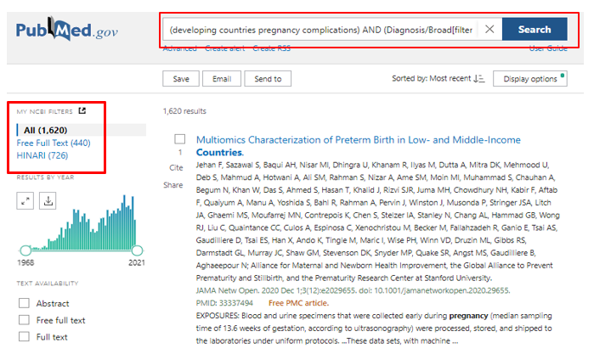
PubMed search results display
Displayed is the traditional PubMed search results page.
In the left column, note the links to the Free Full Text (440) and Hinari (728) citations.
Go to the Abstract version of the search results page for the links to full-text articles available from the Research4Life portal.
See lesson 4.1.1 for more details on using PubMed.

Slide 49
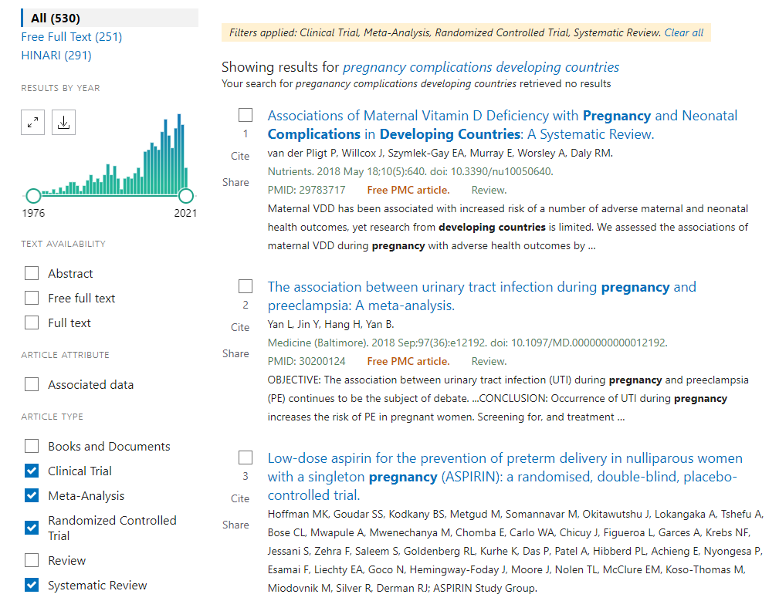
PubMed filters search results
Using the pregnancy complications developing countries search, add the filters for:
ARTICLE TYPE/Clinical Trial, Meta-Analysis, Randomized Controlled Trial and Systematic Review. The search results total 530.
Limited to ARTICLE/TYPE Systematic Review, the total is 224 citations.

Slide 50
Additional evidence-based practice resources
EBM Librarian: the purpose of this site is to develop a community of librarians who are involved in teaching and supporting the practice of Evidence-Based Medicine (EBM) also called Evidence-Based Practice (EBP). This site offers a place to share teaching materials and class handouts, discuss issues and ask advice from colleagues, share useful information about teaching EBM https://sites.google.com/site/ebmlibrarian/
EvidenceAlerts: an Internet service that notifies physicians and researchers about newly-published clinical studies. Researchers at the McMaster Health Information Unit find the highest quality studies, reviews, and evidence-based clinical practice guidelines from 121 premier clinical journals and these articles are rated by practicing physicians for clinical relevance and interest. Alerts are curated to your own clinical interests. https://www.evidencealerts.com/
Notes:
Several of the Free Collections listed on the Hinari Content page will be noted in the subsequent section.

Slide 51
Additional resources continued
McMaster PLUS (Premium Literature Service): Critical Appraisal Process (CAP) that identifies studies and systematic reviews that are scientifically strong; articles that meet our scientific criteria are then rated by frontline clinicians for relevance and newsworthiness through the McMaster Online Rating of Evidence (MORE) system. hiru.mcmaster.ca/hiru/HIRU_McMaster_PLUS_projects.aspx
Trip Database: “a smart, fast tool for you to find high-quality clinical research evidence”; contains access to research evidence and other content types including images, videos, patient information leaflets, educational courses and news. www.tripdatabase.com/

Slide 52
Summary
This lesson focuses on the concepts of evidence-based medicine/practice and key EBP resources that are available.
The first part of the lesson is an overview of components of EBP (systematic reviews, meta-analysis, other study types, hierarchy of resources – filtered/pre-appraised literature vs. nonfiltered/appraised literature) and the 5-step EBP process (ask, assess, appraise, apply, assess).
The second part of the lesson focuses on the key information resources that are available from Research4Life (Cochrane Library, Joanna Briggs Institute EBP Database, Clinical Key, Essential Evidence Plus), PubMed (Clinical Queries and Article Types filters) and the Internet.

Slide 53
You are invited to;
Visit us at www.research4life.org
Contact us at r4l@research4life.org
Find out about other training materials [www.research4life.org/training]
Subscribe to Research4Life newsletter [www.research4life.org/newsletter]
Check out Research4Life videos [https://bit.ly/2w3CU5C]
Follow us on Twitter @r4lpartnership and Facebook @R4Lpartnership

Slide 54
Research4Life is committed to the UN's Sustainable Development Goals.
Research4Life contributes to the United Nations Decade of Action by increasing research participation from the Global South.
The recent Strategic Plan to 2030 focuses on inclusion and equity in the global research community, supporting the creation of an even richer body of research which will help to advance the Sustainable Development Goals.
Research4Life offers our partners, users and supporters the opportunity to contribute to the creation of a diverse. inclusive and equitable research ecosystem for all.

Slide 55
Our unique public-private structure allows us to work effectively in alignment with SDG17: Partnership for the Goals for sustainable development and to support our community of users as both consumers and producers of critical research and advance SDG10: Reduced Inequalities within and among countries.
While R4L activities directly and indirectly support all the SDGs such as Good health and Wellbeing, Zero Hunger, Clean Water and Sanitation, Industry, innovation and infrastructure, and Peace and Justice, the Research4Life Program is closely aligned to SDG4: Quality Education that is fundamental to creating a peaceful and prosperous world and SDG5: Gender Equity to achieve the empowerment of all women and children.

Slide 56
For more information on Research4Life
www.research4life.org
r4l@research4life.org
Research4Life is a public-private partnership of five collections:

