Slide 1
Additional discipline-specific resources
Health sciences
Research4Life is a public-private partnership of five collections:

Slide 2
Outline
Introduction
PubMed
Basic Search, Export, Save, Email citations, Advanced search
WHO Electronic Information Resources
Five WHO regional office databases, Global Index Medicus, and the Institutional Repository for Information Sharing (IRIS)
Other Research4Life resources
Databases, Reference Sources, Free Resources
Internet Resources
Search engines, Highwire Journals - Free access, Grey literature guides
Summary
This work is licensed under Creative Commons Attribution-ShareAlike 4.0 International (CC BY-SA 4.0)

Slide 3
Learning objectives
Become aware of existing additional resources related to health.
Understand the additional collections and how to use them.

Slide 4
Introduction
This lesson will focus on key collection-specific resources in health accessible from Research4Life and also via the Internet.
The first part of the lesson reviews various tools available via the Unified Content Portal - Databases, Reference sources (i.e., PubMed), Free Resources and Recent Resources.
The second part of the lesson is a sampling of useful health-related internet tools for accessing free resources including grey literature. As of July 2022, an additional section on WHO databases has been added.

Slide 5
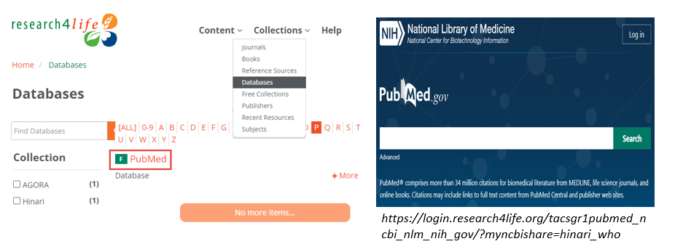
Research4Life/PubMed
The PubMed database comprises more than 34 million citations from MEDLINE, life science journals and online books. It uses the Medical Subject Headings (MeSH), a controlled and hierarchically organized vocabulary.
After logged into Research4Life content portal, open the Content drop down menu from the top, and select Databases. Click on P from the alphabetical result list, then PubMed. Accessing PubMed this way will activate for links to R4L full-text articles in PubMed result.

Slide 6
Best Practices in searching PubMed
PubMed is a smart search engine with lots of computing algorithms built in to help users search. Where possible, let PubMed do the work for you. NLM recommends the following best practices for search PubMed:
- be specific in search terms
- no punctuation or capitalization
- no need to enter Boolean operators especially “AND”
- no need to enter search tags like [tiab]
- avoid quotation remarks
- avoid truncation (*)
- when looking for a specific article, just type in the basic elements - like journal
name, author and year. The citation sensor in PubMed will find the article for you.
Notes:
Launched in October 2019, the new and streamlined design of PubMed the default is version as of 19 May 2020 - see new interface at PubMed site. This is the version available from the Unified Content Portal/Databases list and includes the links to the available Research4Life publishers’ articles and Free Full Text articles.

Slide 7
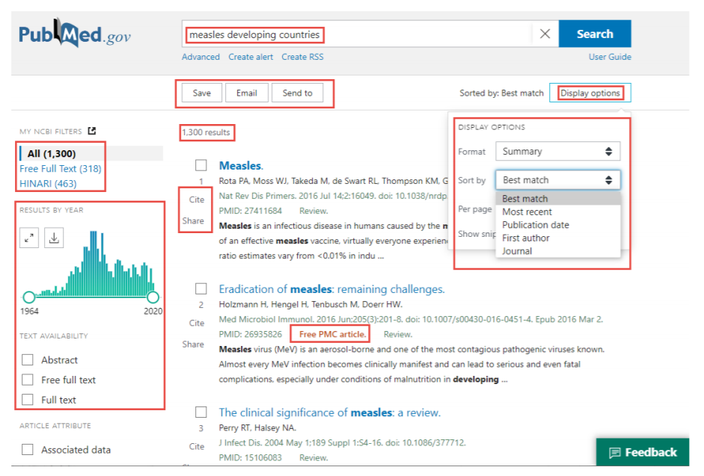
PubMed basic search
Displayed are the search results for measles developing countries - 1300 results.
The links to Free Full Text and HINARI full text are in the left column. To
get to the full text of an individual
article, click on the title.
The initial search results are displayed in the Summary format, with Best Match (the default) vs. Most recent, Publication Date, First author or Journal sort options.
The Summary format has the basic citation information (title, author, journal, pmid #) & some of the abstract.
Notes:
The Best Match algorithm is based on several “relevance-ranking signals” (factors), the most important being the past usage of an article, publication date, relevance score, and type of article.
The left-hand column contains the Results by Year graph and the filter list, including TEXT AVAILABILITY and ARTICLE TYPE. Next to the sort option, click the gear box () to open the DISPLAY OPTIONS. The search terms are highlighted in the abstract.

Slide 8
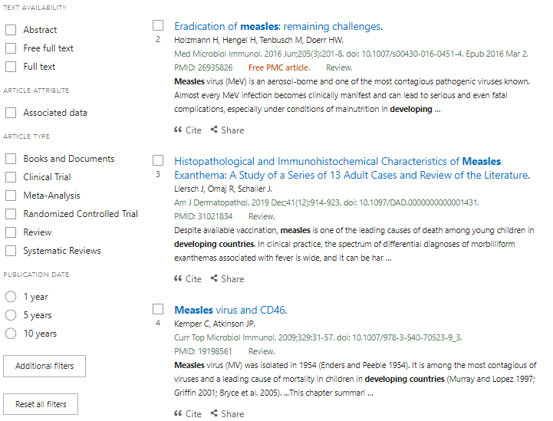
Initial (Summary) Search Results -
other options
Scroll down the left column of the Summary search results page to view the following filters:
Text availability: Abstract, Free full text and Full text.
Article Attribute: Associated data
Article Type: Books and Documents, Clinical Trial, Meta-Analysis, Randomized Controlled Trials, Review and Systematic Reviews.
Publication Date with 1, 5 and, 10 years options.
Additional filters - see next slide

Slide 9
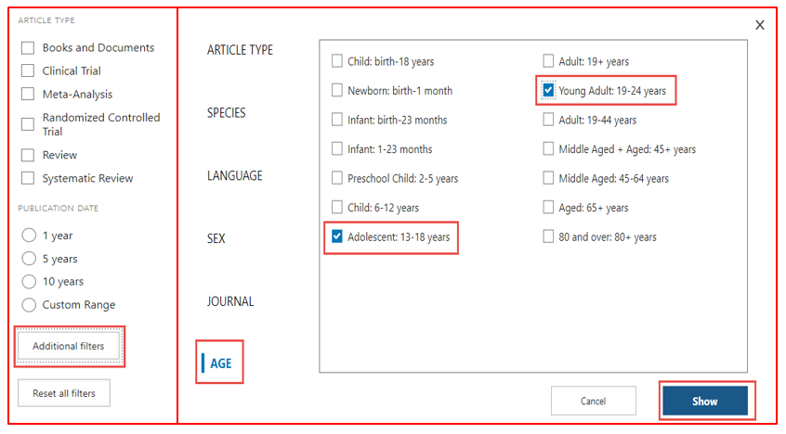
Default filters & Additional filters options
Now displayed is Additional filters that, besides ARTICLE TYPE, includes SPECIES, LANGUAGE, SEX, JOURNAL and AGE options.
Open the AGE option and click on the Adolescent 13–18 years and Young Adults 19–24 years filters.
Add these filters to the Search results by clicking on Show.
Also note the Reset all filters option that removes any that were selected.

Slide 10
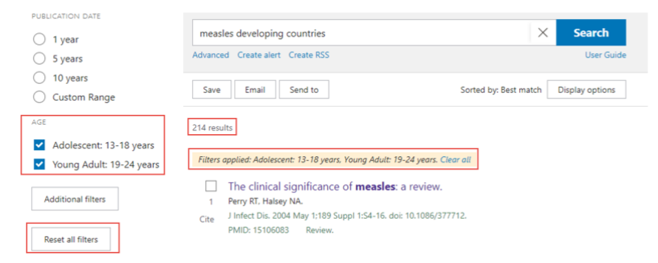
Additional Ages filters & revised search results
The two AGE filters have been added to the filters list in the left column.
Click on the boxes to activate them. The new search has 214 results not 1300.
Note the Reset all filters option - to delete all the filters.
Notes:
Remember to delete the filters either by clicking on the highlighted filters or opening Reset all filters or clicking on the Clear all in the Filters applied… box below the search results. Otherwise, these filters will continue to be used in new searches. All the filter options are valuable tools to limit a specific search.

Slide 11
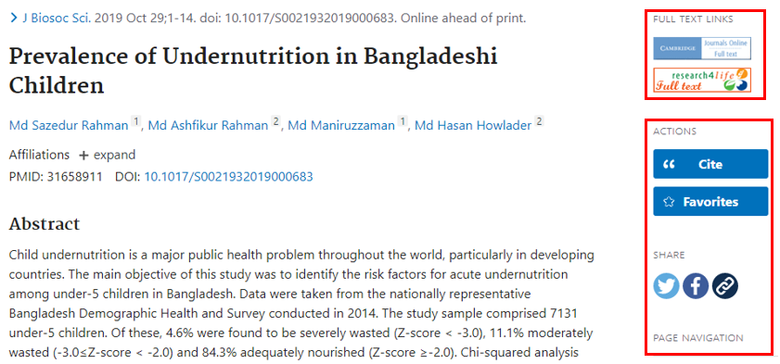
PuPuvbb
Abstract display & Full text access
In the Summary display, click on the title of any article to display the Abstract version.
The Abstract version has additional features including, in the right column, Cite, Favorites, Share and Page Navigation plus, below the abstract, links to Similar Articles, Cited by and Mesh Terms.
The Full Text Links in the right column has the Research4Life icon for material accessible to Hinari users. In addition, other full text options for the article are available.
Select the Research4Life full text icon under the Full Text Links section. The Research4Life 360 Link page will appear.

Slide 12
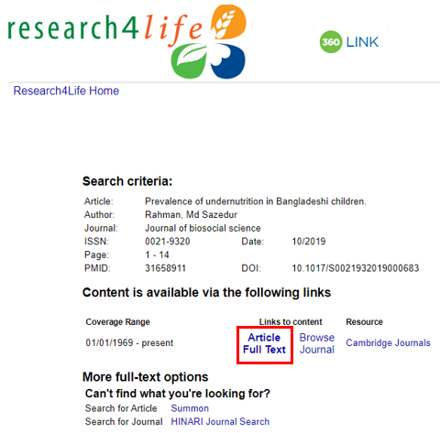
Research4Life 360 Link
Now displayed is the Research4Life 360 Link page.
Click on the link to the Article Full Text
Note that the Research4Life full text icon will display in all citations of search results.
Occasionally, Research4Life will not have the full text of a citation and the message no holdings were found for this journal will be displayed on the 360 Link page.

Slide 13
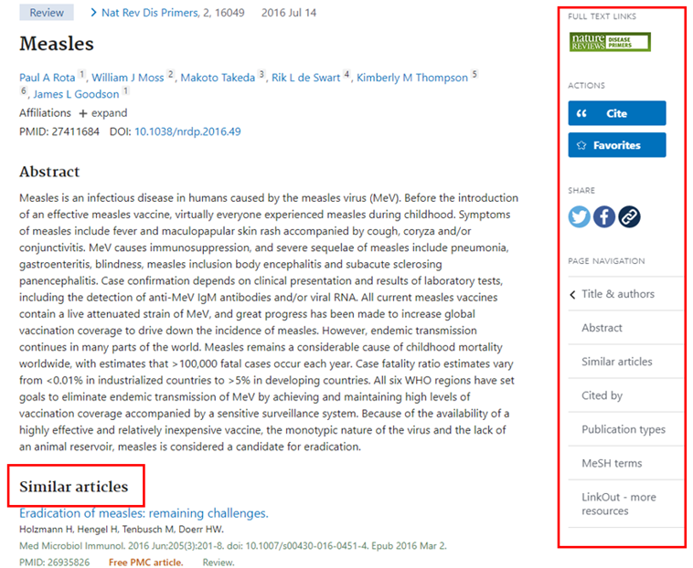
Additional options
In the Abstract format, other features are displayed in the right column and a Similar articles option also has been added below the Abstract.
Scroll down the Abstract to locate additional tools - Cited by and Mesh Terms.
See next slide for Cite and Share options (right column).
Note that these options also are available in the Summary display - in a horizontal box below the search box.

Slide 14
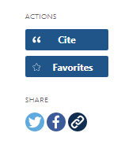
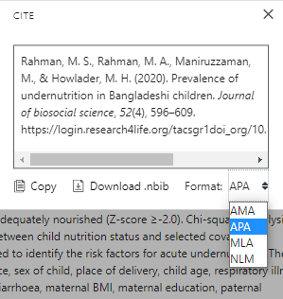
Cite and Share (right column)
Available in four citation formats - AMA, MLA, APA and NLM, the Cite format creates .txt files to Copy or .nbib files to Download.
This file format can be used by many citation management software programmes.
The Share option, allows users to share citations on Twitter, Facebook or via a PERMALINK.

Slide 15
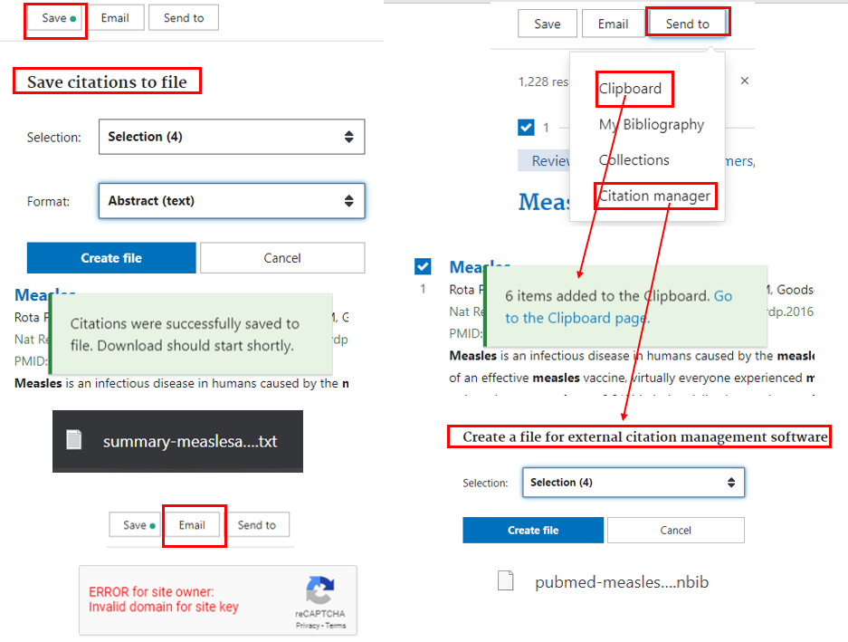
Save, Email, Send to options
(below Search box)
The Save option saves checked citations into a .txt file.
The Send to Clipboard option saves the citation(s) in a PubMed feature. The Clipboard link is below the PubMed search box.
The Send to Citation manager option creates .nbib file for various software options.
The Email function does not work via Hinari/PubMed.
Notes:
Other useful tools from the results page display are the Save, SEND TO Clipboard, My Bibliography, Collections or Citation manager options. To use these options, first check the boxes of several citations on the search results page. After opening the Save feature, users can choose Selection, All Results on page or All Results from the SELECTION option. In FORMAT, the choices are Summary (text), PubMed, PMID, CSV or Abstract(text). For this example, Selection (4) and Abstract have been selected. Click on Create File for the .txt file.

Slide 16
Advanced search options
Click on Advanced search.

Slide 17
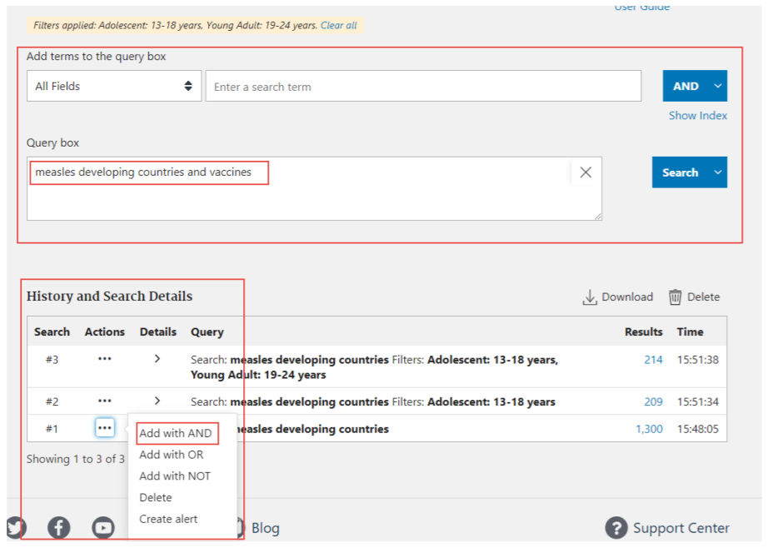
Advanced search options
History and Search Details list (below) shows all searches that have been completed.
Actions/Add query allows users to identify and add previous searches to the Query box (above) and create a new search.
Example - History #1 measles developing countries and vaccines are combined into a new Search.

Slide 18
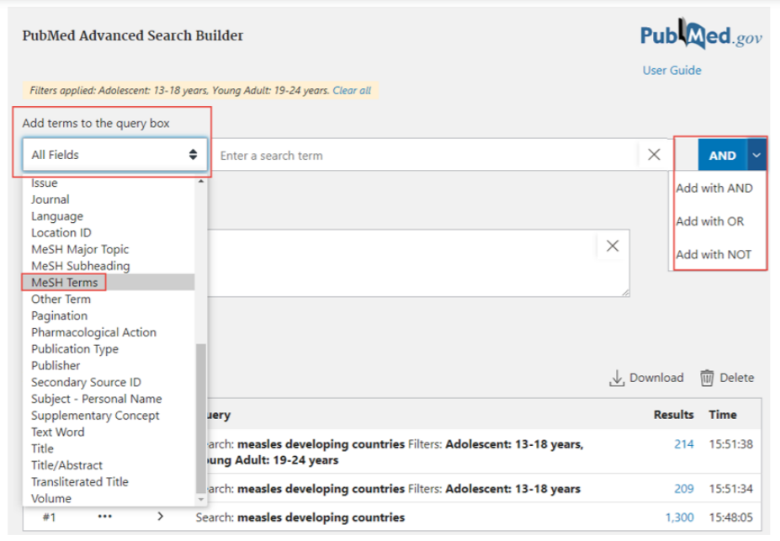
Advanced search options
Other features:
All Fields drop down menu allows searching in a specific field such as MeSH.
Boolean logic can be applied in the Add terms to the query box.
Click on Results # to open any of the previous PubMed searches.

Slide 19
Advanced search options
Complete search for vaccines measles and developing countries
Note 866 results.
Open Advanced and History/Search Details.

Slide 20
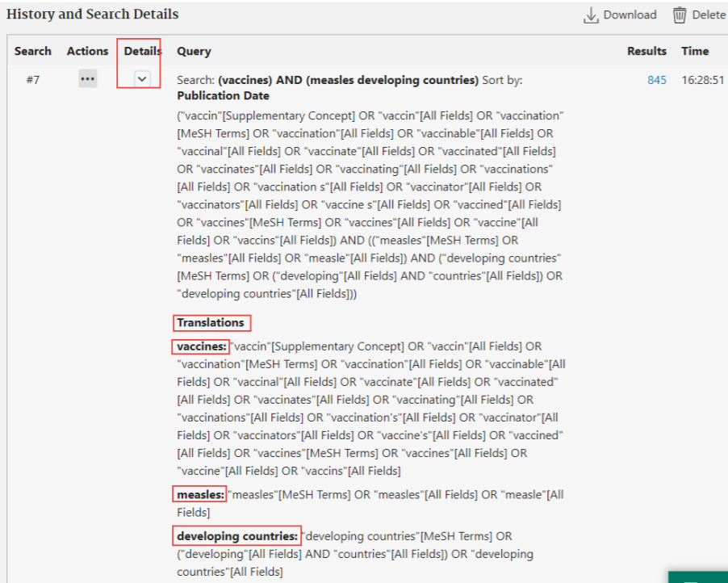
Advanced search options
In the History and Search Details section, click on Details
Note the Query and Translations that demonstrates how the PubMed Smart Search Options functions

Slide 21
Training Resources -
National Library of Medicine
“PubMed® Online Training.” Accessed 19 October 2022. https://learn.nlm.nih.gov/documentation/training-packets/T0042010P/
Includes Quick Tours, Tutorials, Webcasts & Videos, Classes, Handouts
“The PubMed Trainer’s Toolkit.” Accessed 19 October 2022. https://learn.nlm.nih.gov/documentation/training-packets/T0022014P/
Includes Slide Decks, Handouts, Quick Tours, Training for Trainers

Slide 22
World Health Organization (WHO) Electronic Information Resources (Expanded November 2022)
The following slides are an overview of the WHO Electronic Information Resources (EIR). In most cases, these resources are not indexed in PubMed or other major databases.
The WHO has developed the regional EIRs for many years to reduce the knowledge gap between high and low-income countries. The five regional EIRs provide users with free online access to peer-reviewed health and biomedical sciences publications from their country members. EMRO EIR is discussed in more detail – to demonstrate the tools for accessing these resources.
Global Index Medical (GIM) is the WHO database that has compiled biomedical and public health literature from the five regional indices including those produced by low-middle income countries.
Also discussed are the WHO COVID-19 Database and the Institutional Repository for Information Sharing (IRIS). This is the digital resource for articles, reports, statistics, books, and other publications from the WHO Headquarters, regional and country offices.

Slide 23
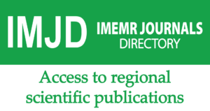
WHO-EMRO
Virtual Health Sciences Library (VHSL)
https://vlibrary.emro.who.int

Slide 24
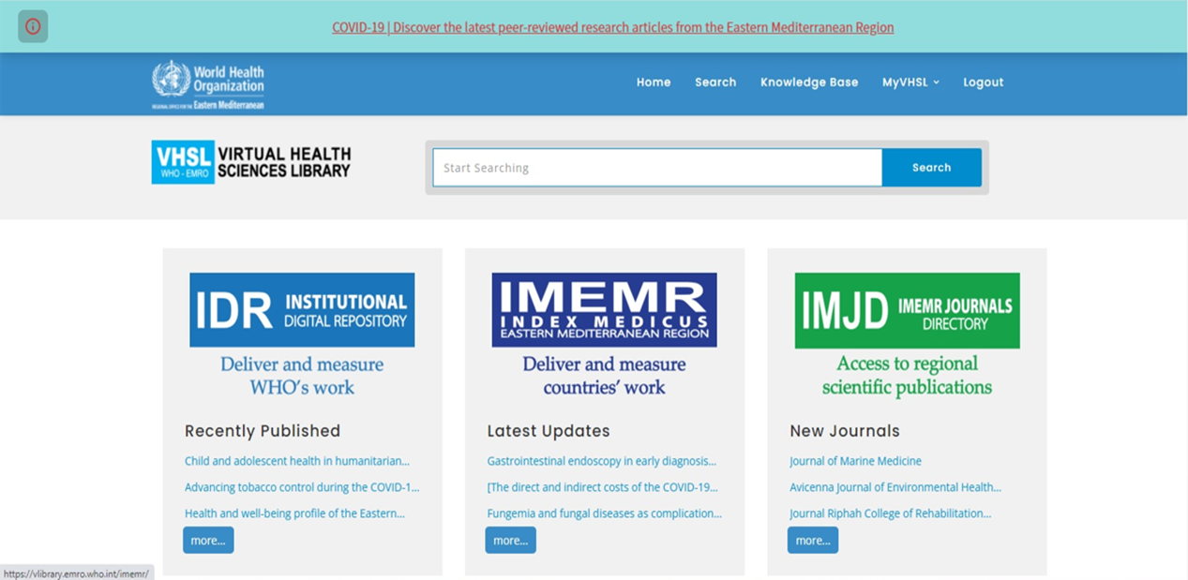
WHO-EMRO
Virtual Health Sciences Library (VHSL)
More than 306,199 records from three major library databases “Institutional Digital Repository” (IDR) 29,185
Index Medicus for the Eastern Mediterranean Region has (IMEMR) 276,082 records
EMR Journals Directory (IMJD) 932 have been uploaded merged and updated on the new VHSL portal successfully.
Updated 1 December 2022

Slide 25
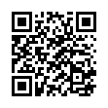
WHO-EMRO Index Medicus for the Eastern Mediterranean Region (IMEMR)
See Research4Life Portal Databases list/Index Medicus for the Eastern Mediterranean Region (IMEMR)
can also be accessed directly https://vlibrary.emro.who.int/imemr/
Service Provider | World Health Organization – Regional Office for the Eastern Mediterranean Region (EMRO)
Type of Service | EMRO virtual database that provides indexing and abstracting services for archiving, recording, and sharing national and regional health and biomedical sciences literature.
Source of information | Health and biomedical sciences literature published in 814 peer-reviewed journals from 20 countries in the EMR region.
Type of documents | Health and biomedical sciences literature citations with Abstracts
Full text | Yes; For any articles found in IMEMR without full text, you may request the full-text by clicking on the Request Full-Text Tab
Subject coverage | National and regional scholarly health and biomedical sciences literature published in EMR countries.
Qualitative data | More than 269,946 citations.
SCAN ME

Slide 26
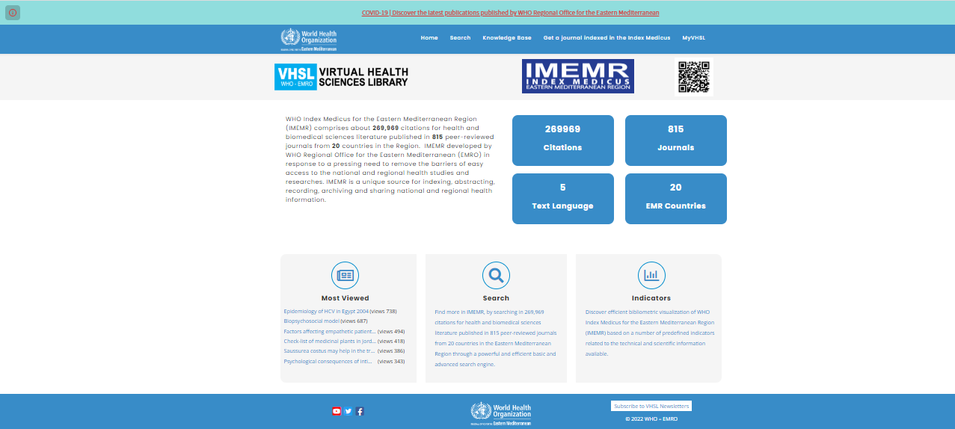
WHO Index Medicus for the Eastern Mediterranean Region (IMEMR)

Slide 27
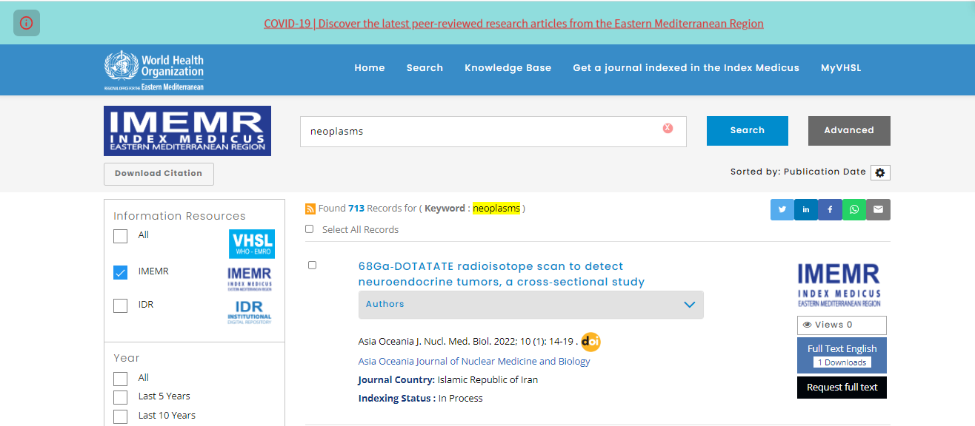
WHO Index Medicus for the Eastern Mediterranean Region (IMEMR)
Simple Search
A simple search with “Neoplasms”
Results 713 citations

Slide 28
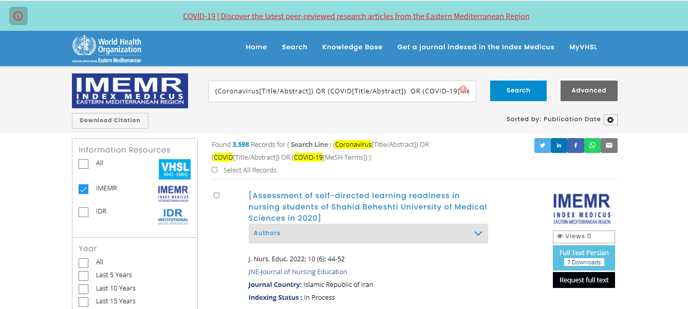
WHO Index Medicus for the Eastern Mediterranean Region (IMEMR)
COVID-19 peer-reviewed research article
A search with “COVID-19”
Results 3,598 citations

Slide 29
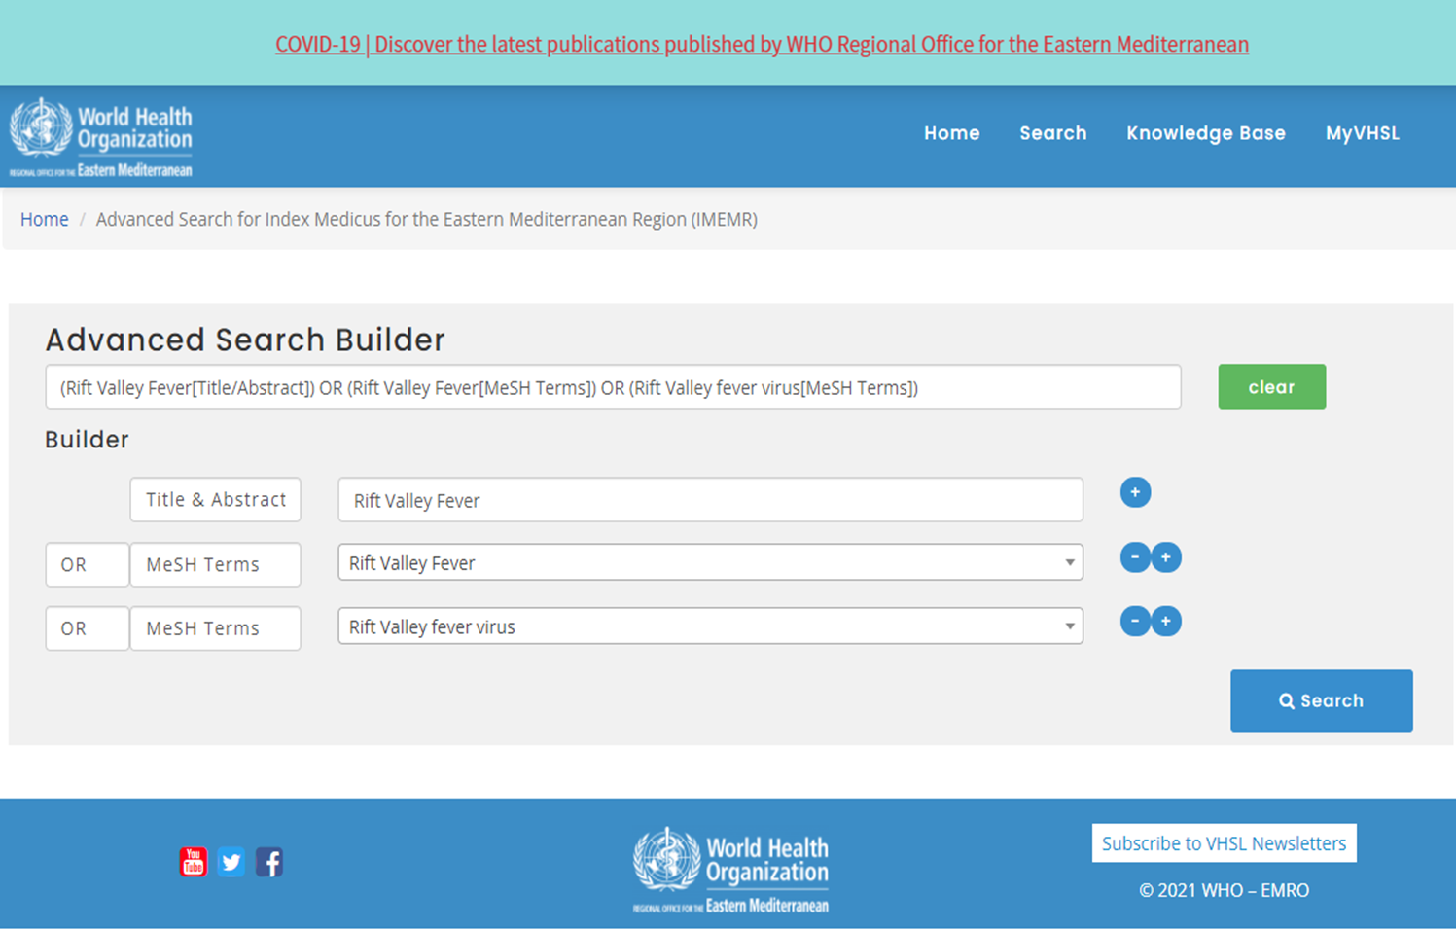
WHO Index Medicus for the Eastern Mediterranean Region (IMEMR)
Advanced Search

Slide 30
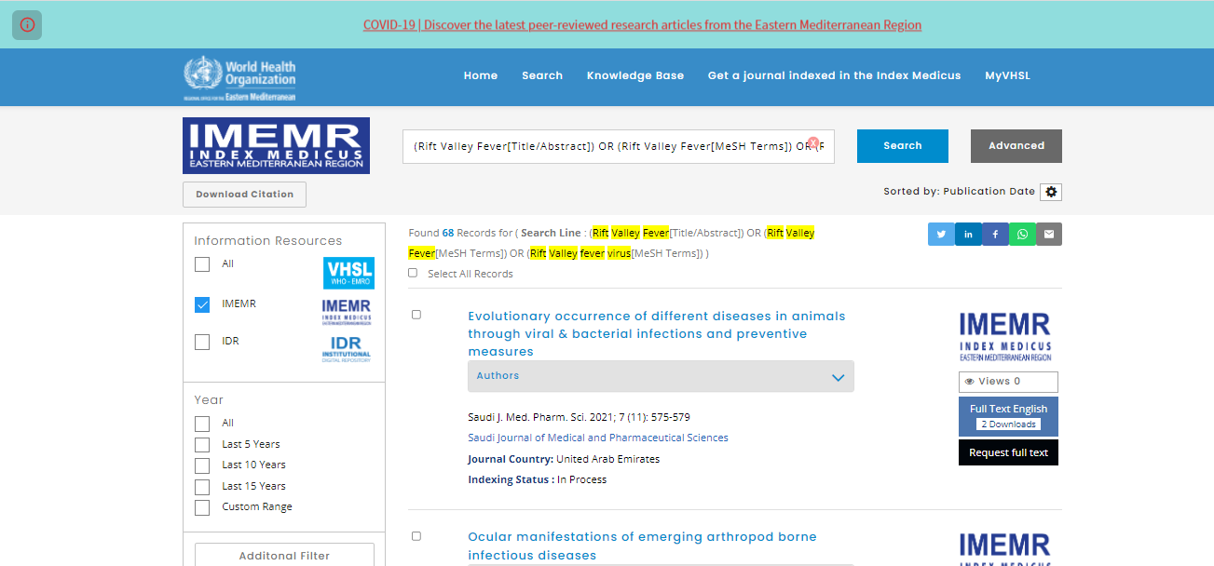
WHO Index Medicus for the Eastern Mediterranean Region (IMEMR)
Advanced Search
An Advanced Search with Rift Valley Fever (Title & Abstract, MeSH)
and Rift Valley Fever Virus (MeSH)
Results 68 citations

Slide 31
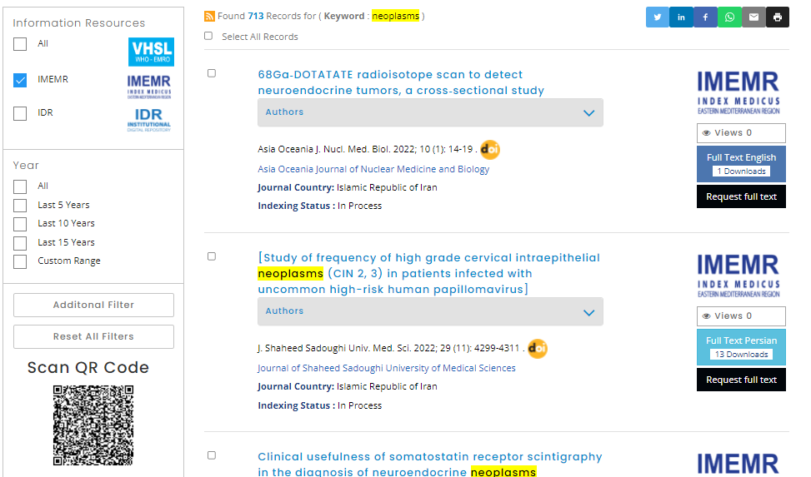
WHO Index Medicus for the Eastern Mediterranean Region (IMEMR)
IMEMR Bibliographic Record

Slide 32
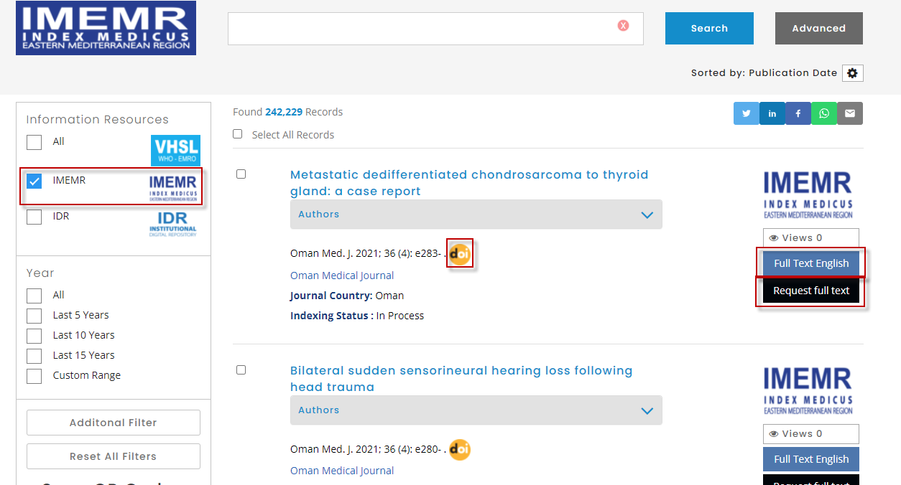

Slide 33
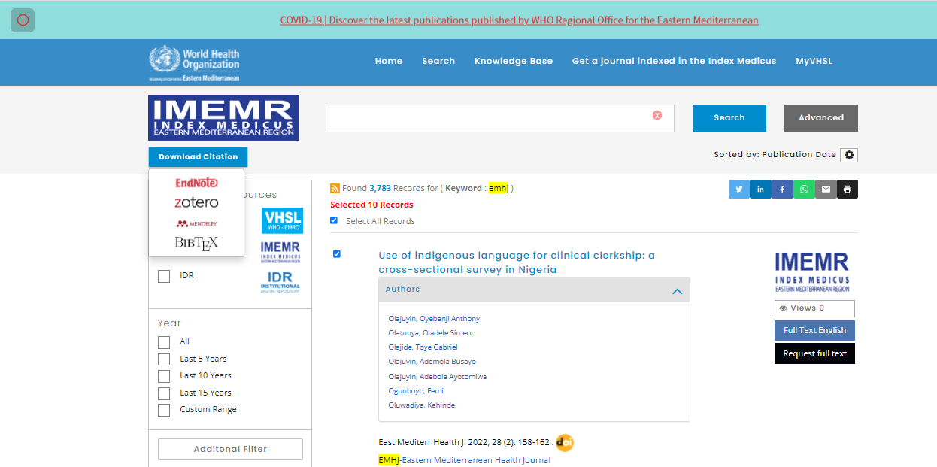
WHO Index Medicus for the Eastern Mediterranean Region (IMEMR)
Print, Send, Share, and Citation Export

Slide 34
WHO Index Medicus for the Eastern Mediterranean Region (IMEMR)
Filters
Country of Research
Country of Publication
Categories
Publication Type
Full-Text Language
Year

Slide 35
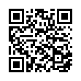
Institutional Digital Repository (IDR)
See Research4Life Portal Databases list
can also be accessed directly https://vlibrary.emro.who.int/idr/
Service Provider | World Health Organization – Regional Office for the Eastern Mediterranean Region (EMRO)
Type of Service | The IDR provides free of charge online full-text access to all WHO/EMRO publications. WHO staff only can access classified materials.
Source of information | WHO governing bodies documentation, annual reports of the Regional Director, messages and speeches, technical and intercountry meeting reports, videos and WHO campaign materials, since 1948 till present.
Type of documents | WHO-EMRO information products
Full text | Yes
Subject coverage | IDR provides online open access to the full text of WHO-EMRO official documents in 3 languages, Arabic, English and French, including more than 200 COVID-19 publications.
Qualitative data | More than 28,789 EMRO official documents.
SCAN ME

Slide 36
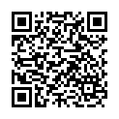
IMEMR Journals Director (IMJD)
See Research4Life Portal Databases list
can also be accessed directly https://vlibrary.emro.who.int/imemr-journals-directory-imjd//
Service Provider | World Health Organization – Regional Office for the Eastern Mediterranean Region (EMRO)
Type of Service | Complete bibliographic information of peer-reviewed health and biomedical sciences journals published from 20 countries in the Eastern Mediterranean Region.
Source of information | Peer-reviewed health and biomedical sciences journals published in the Eastern Mediterranean Region.
Type of documents | Peer-reviewed health and biomedical sciences Journals.
Full text | Yes;
Subject coverage | Health and biomedical sciences.
Qualitative data | More than 814 EMRO peer-reviewed health and biomedical sciences Journals.
SCAN ME

Slide 37
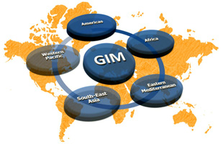
Global Index Medicus (GIM)
See Research4Life Portal Databases list/Global Index Medicus (GIM)
can also be accessed directly https://www.globalindexmedicus.net/
Service Provider | World Health Organization
Type of Service | Provide users worldwide with online access to health and biomedical science publications, as a compendium of the six regional indices, AIM (AFRO), LILACS (AMRO/PAHO), IMEMR (EMRO), IMSEAR (SEARO), WPRIM (WPRO), via a unique platform
Source of information | Peer-reviewed scientific journals from low- and middle-income countries
Type of documents | GIM is providing access to content that feeds into systematic reviews and the creation of evidence-based guidance for Member States
Full text | Yes;
Subject coverage | Health and biomedical sciences.
Qualitative data | More than 1.7 million bibliographic and full-text records from low- and middle-income countries

Slide 38
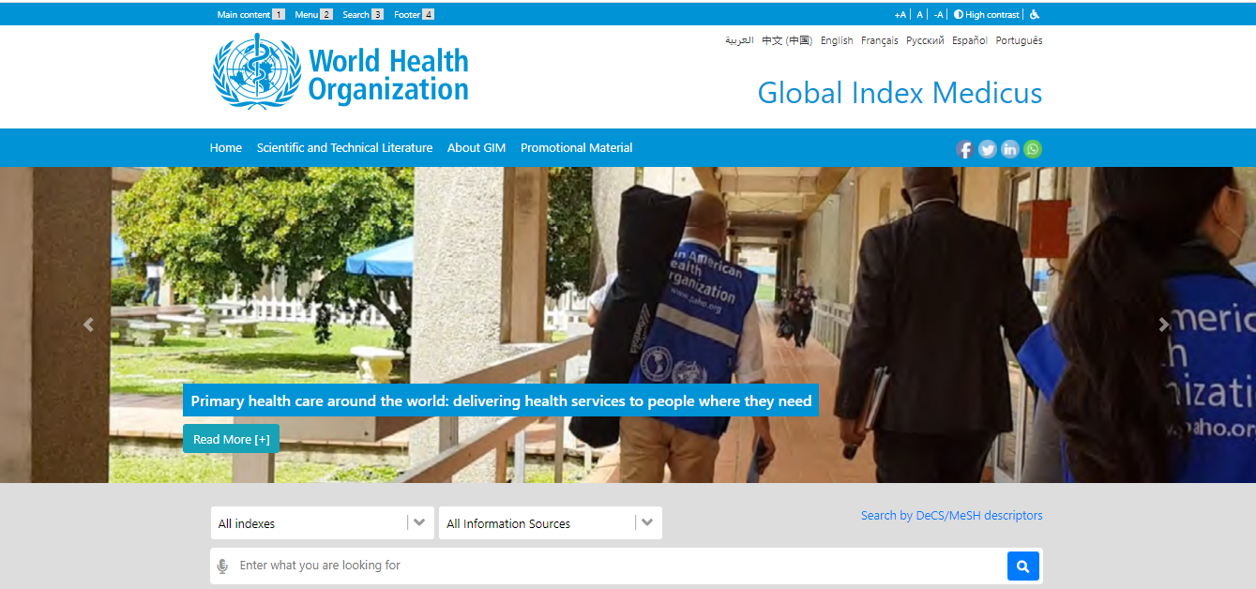
Global Index Medicus (GIM)
Simple Search

Slide 39
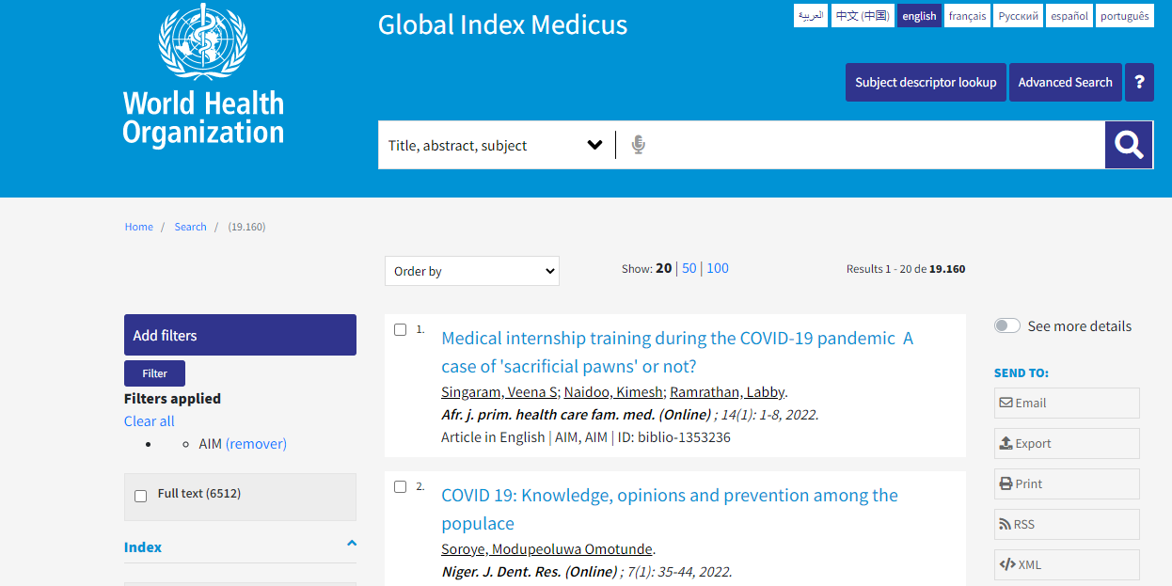

Slide 40
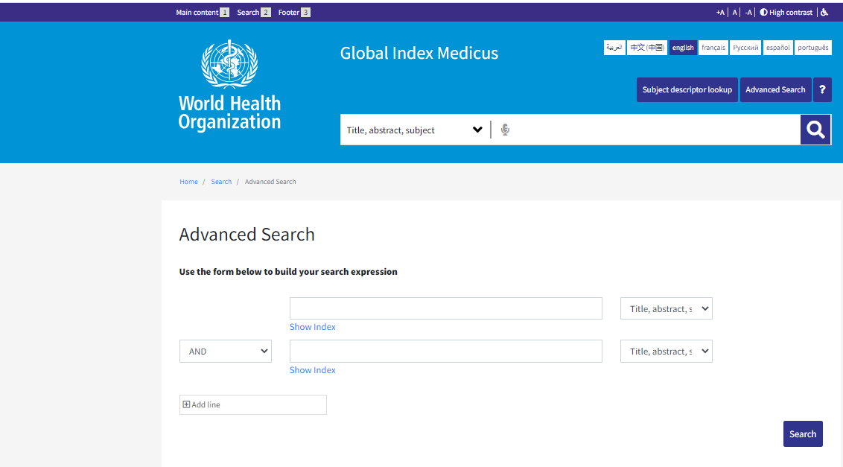
Global Index Medicus (GIM)
Advanced Search

Slide 41
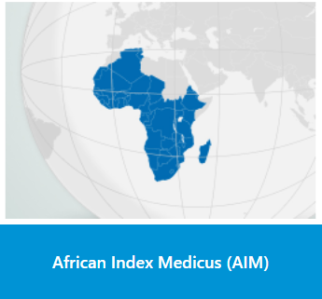
African Index Medicus (AIM)
See Research4Life Portal Databases list/Global Index Medicus (GIM)
can also be accessed directly https://www.globalindexmedicus.net/biblioteca/aim/
Service Provider | World Health Organization, in collaboration with the Association for Health Information and Libraries in Africa
Type of Service | Provide users worldwide with online access to African health and biomedical science publications.
Source of information | African health and biomedical information sources
Type of documents | Bibliographic references and scientific journals.
Full text | Yes;
Subject coverage | Health and biomedical sciences.
Qualitative data | More than 18.000 bibliographic reference from 258 Scientific Journals

Slide 42
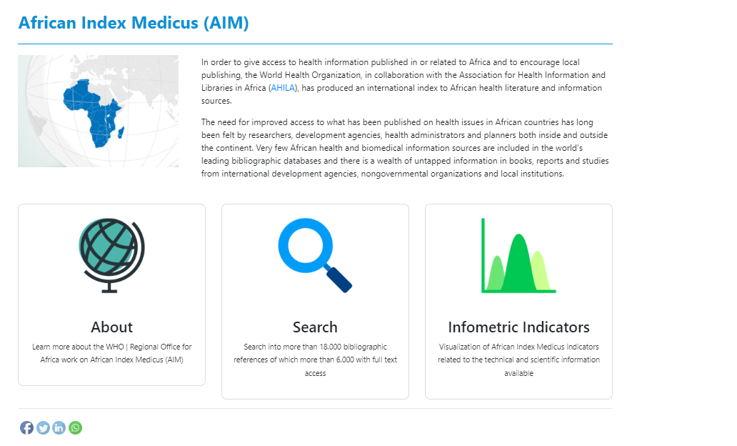

Slide 43
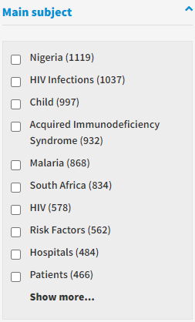
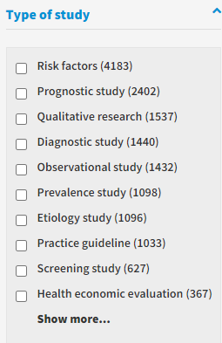
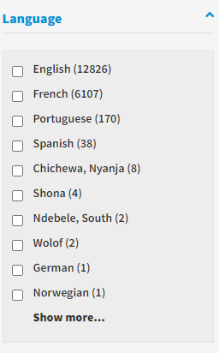
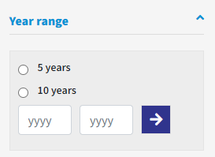
African Index Medicus (AIM)
Filters

Slide 44
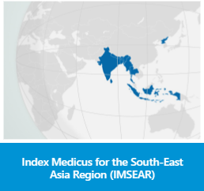
Index Medicus for the South-East Asia Region (IMSEAR)
See Research4Life Portal Databases list/Global Index Medicus (GIM)
can also be accessed directly https://www.globalindexmedicus.net/biblioteca/imsear/
Service Provider | IMSEAR is an archive of selected publications in health sciences in the WHO South-East Asia Region
Type of Service | Provide users worldwide with online access to health and biomedical science publications.
Source of information | Materials include formally published health science journals, health reports and documents.
Type of documents | Metadata of each item, original full text documents or links to original documents are provided whenever available, under Open Archives Initiative (OAI) framework.
Full text | Yes;
Subject coverage | Health science journals, health reports and documents.
Qualitative data | More than 208.000 bibliographic reference from more than 49 Scientific Journals

Slide 45
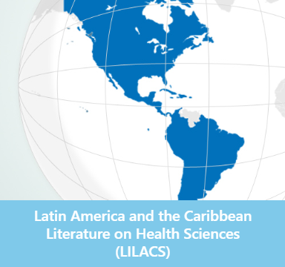
Latin America and the Caribbean Literature on Health Sciences (LILACS)
See Research4Life Portal Databases list/Global Index Medicus (GIM)
can also be accessed https://www.globalindexmedicus.net/biblioteca/lilacs/
Service Provider | LILACS is coordinated by the Pan-American Health Organization through BIREME.
Type of Service | Scientific and technical literature of Latin America and the Caribbean, contributing to increase visibility, access and quality of health information in the Region.
Source of information | Materials include formally published health science journals, health reports and documents.
Type of documents | Scientific and technical literature of Latin America and the Caribbean.
Full text | More than 50% have access to the full text.
Subject coverage | Health Sciences Information.
Qualitative data | More than 998.000 bibliographic reference from more than 800 Scientific Journals

Slide 46
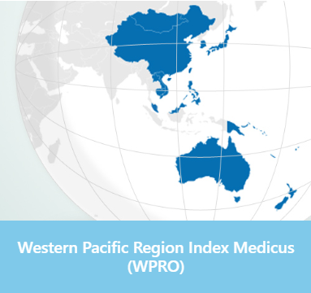
Western Pacific Region Index Medicus (WPRO)
See Research4Life Portal Databases list/Global Index Medicus (GIM)
can also be accessed https://www.globalindexmedicus.net/biblioteca/wprim/
Service Provider | (WPRIM) is the regional bibliographic index of medical and health journals published by the Member States of the Western Pacific Region.
Type of Service | Scientific and technical literature of Latin America and the Caribbean, contributing to increase visibility, access and quality of health information in the Region.
Source of information
Type of documents | Research, publications and medical and health journals
Full text | More than 60% have access to the full text.
Subject coverage | Health Sciences Information.
Qualitative data | More than 874.000 bibliographic reference.

Slide 47
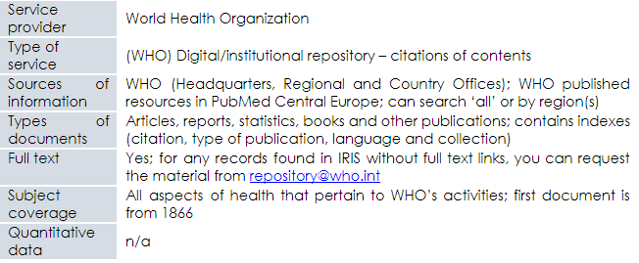
Institutional Digital Repository for Information Sharing (IRIS)
See Research4Life Portal Databases list/IRIS (WHO Digital Publications); can also be accessed directly https://apps.who.int/iris/

Slide 48
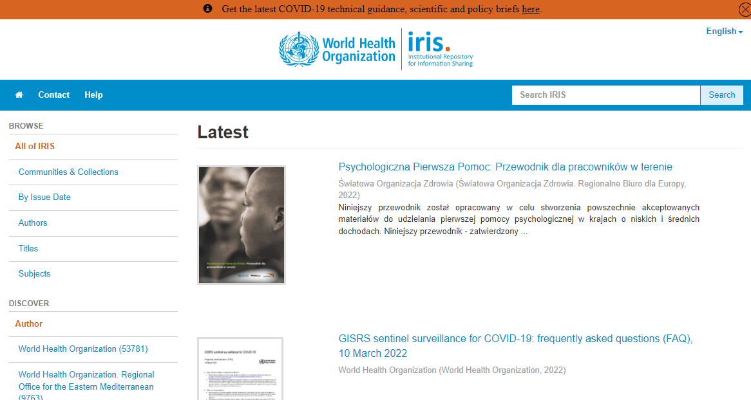
Institutional Digital Repository for Information Sharing continued
Simple Search

Slide 49
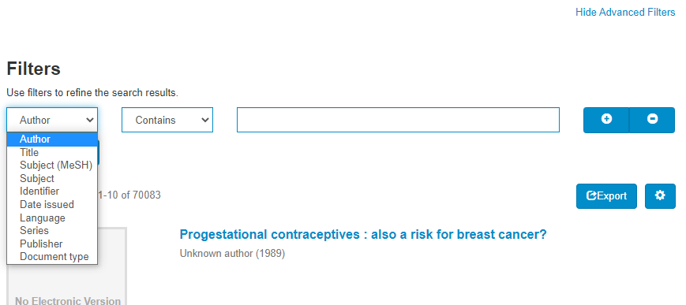
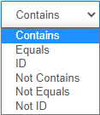
Institutional Digital Repository for Information Sharing (IRIS)
Advanced Search

Slide 50
WHO COVID-19 Research Database
accessed directly https://search.bvsalud.org/global-literature-on-novel-coronavirus-2019-ncov/

Slide 51
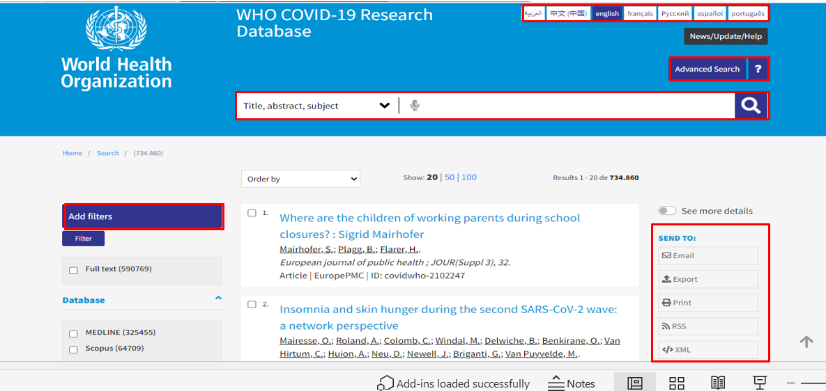
WHO COVID-19 Research Database
Cont.

Slide 52
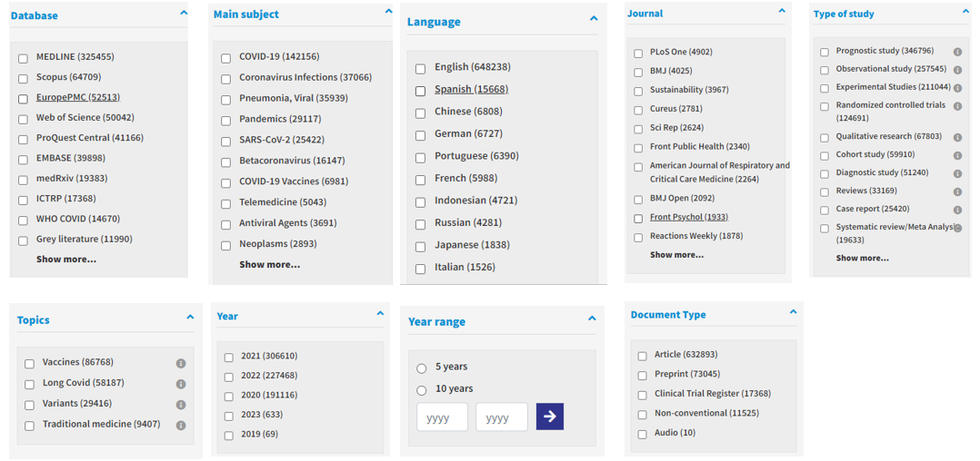
WHO COVID-19 Research Database
Refine Your Search

Slide 53
Other Research4Life resources
These include key Databases, Reference Source resources, Free collections and Recent Resources. Note also the list of Recent Resources added to the portal.
Each list contains several useful tools.
All four lists can be accessed from the Unified Content Portal page.
Note: some of these resources may not be available as the publishers may not grant access in a specific country.

Slide 54
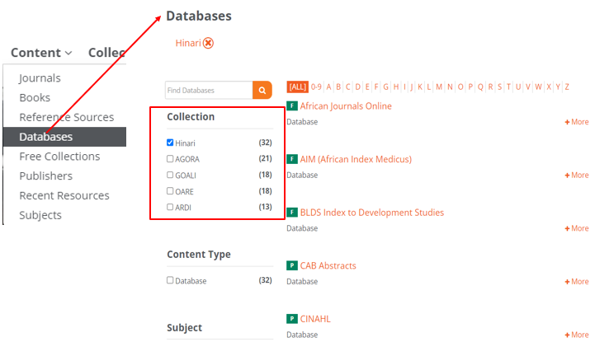
Databases
The Databases list is available from the Unified Content Portal/ Content list
Scroll down till the title of the database appears or click on a letter from A – Z list
A search can be limited to 85 Hinari resources
Several useful databases are summarized in the subsequent slides

Slide 55
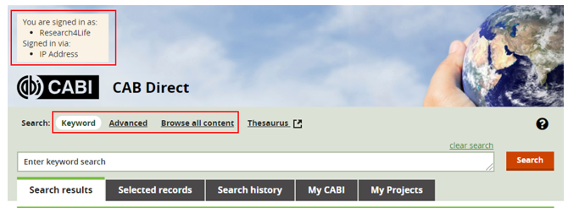
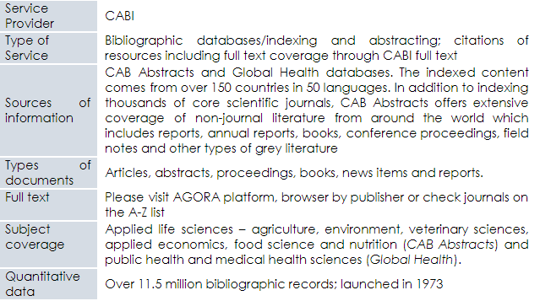
CABI
See Research4Life Portal Databases list/CABI/CAB DIRECT

Slide 56
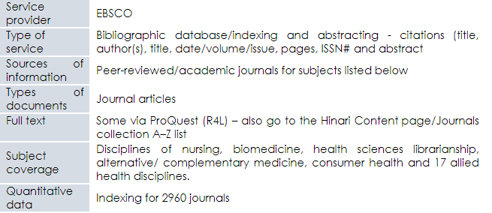
Cumulative Index for Nursing and Allied Health - CINAHL
See Research4Life Portal Databases list/CINAHL (Cumulative Index for Nursing and Allied Health)

Slide 57
Joanna Briggs Institute EBP Database
See Research4Life Portal Databases list/ Joanna Briggs Institute EBP Database

Slide 58
Reference Sources
Reference sources list is available from the Unified Content Portal/Content list
Scroll down till the title of the database appears or click on a letter from A – Z list
A search can be limited to 85 Hinari resources
See the subsequent slides for useful Reference Sources

Slide 59
Clinical key
See Research4Life Portal Reference Sources list /Clinical Key

Slide 60
Cochrane Library
See the Research4Life Portal Reference Sources list/Cochrane Library

Slide 61
Cochrane Interactive Learning: Conducting an Intervention Review
Visit the Cochrane website to learn how to conduct an “Intervention Review”,
Registration is required but is free.
The course provides 10 hours of self-directed learning on conducting a complete systematic review process for new and experienced review authors.

Slide 62
Essential Evidence Plus
See the Research4Life Portal Reference Sources list/Essential Evidence Plus

Slide 63
Oxford Medicine Online
See the Research4Life Portal Reference Sources list/Oxford Medicine Online

Slide 64
Free Collections
Free Collections list is available from the Unified Content Portal/Content list
Scroll down to find titles of interest.
A search can be limited to 17 Hinari resources.

Slide 65
Recent Resources
Reference sources list is available from the Unified Content Portal
Scroll down till the title of the database appears
A search can be limited to the Collection and Content Type.

Slide 66
Internet Resources
This section highlights the best examples of internet resources such as;
Search engines
Highwire Journals - Free access
Grey literature guides
See Lesson 4.6 for Interdisciplinary Internet Resources including thesis and dissertation databases
Notes:
Several of the Free Collections listed on the Hinari Content page will be noted in the subsequent section.

Slide 67
Open Access Biomedical Image Search Engine
Available at https://openi.nlm.nih.gov/

Slide 68
Open-i background/reuse options
What is Open-i ?
Open-i service of the National Library of Medicine enables search and retrieval of abstracts and images (including charts, graphs, clinical images, etc.) from the open-source literature, and biomedical image collections. Searching may be done using text queries as well as query images. Open-i provides access to over 3.7 million images from about 1.2 million PubMed Central® articles; 7,470 chest x-rays with 3,955 radiology reports; 67,517 images from NLM History of Medicine collection; and 2,064 orthopedic illustrations. May I reuse an image I found through Open-i?
We cannot grant permissions to use images. Copyright remains with the authors or the journal. A link to the copyright license type may be found below the individual Open-i image on the detailed view page. If copyright restrictions for an image are not specified or are unclear, please contact the journal that published the image.
https://openi.nlm.nih.gov/faq

Slide 69
Open-i: malaria search (total 9665 images)
Open-i: malaria search (total 9665 images)
Click on the detailed view link to find out the copyright license type

Slide 70
PLOS ONE license agreement
The image is from PLOS ONE, an open-access journal publisher. PLOS applies the Creative Commons Attribution (CC BY) license to articles. This allows reusers to distribute, remix, adapt, and build upon the material in any medium or format, so long as attribution is given to the creator.

Slide 71
MedlinePlus
Available at https://medlineplus.gov/

Slide 72
IGO Search Engine and NGO Search Engine – provided by Google
In Google, search Intergovernmental Organization Search Engine – Google or Non-governmental Organization Search Engine - Google

Slide 73
IGO Search Engine and NGO Search Engine cont.

Slide 74
Highwire Journals - Free access
Available at http://highwire.stanford.edu/lists/devecon.dtl

Slide 75
Ghana – UM Collaboration Research Guides: Information resources
Available at https://guides.lib.umich.edu/ghana-health

Slide 76
USC Libraries Research Guides
Available at https://libguides.usc.edu/healthsciences/grey_literature

Slide 77
Mary Couts Bernett Library – Library Guides
Available at https://libguides.tcu.edu/GreyLiterature

Slide 78
Summary
This lesson focused on health-related Internet resources that range from search tools/databases to open access journals, reports, policies and images.
Many of the resources are available from the Research4Life Unified Content Portal page indexes – Databases, Reference sources, Free collections and Recent Resources. The (U.S.) National Library of Medicine’s PubMed database is featured.
Others are accessible directly on the Internet.

Slide 79
Additional Resources
Research4Life. ‘Librarians hub/Training Presentations/Topic 4/Interdisciplinary Resources’ Accessed 20 September 2021
https://www.research4life.org/training/librarians-hub/

Slide 80
You are invited to;
Visit us at www.research4life.org
Contact us at r4l@research4life.org
Find out about other training materials [www.research4life.org/training]
Subscribe to Research4Life newsletter [www.research4life.org/newsletter]
Check out Research4Life videos [https://bit.ly/2w3CU5C]
Follow us on Twitter @r4lpartnership and Facebook @R4Lpartnership

Slide 81
Research4Life is committed to the UN's Sustainable Development Goals.
Research4Life contributes to the United Nations Decade of Action by increasing research participation from the Global South.
The recent Strategic Plan to 2030 focuses on inclusion and equity in the global research community, supporting the creation of an even richer body of research which will help to advance the Sustainable Development Goals.
Research4Life offers our partners, users and supporters the opportunity to contribute to the creation of a diverse. inclusive and equitable research ecosystem for all.

Slide 82
Our unique public-private structure allows us to work effectively in alignment with SDG17: Partnership for the Goals for sustainable development and to support our community of users as both consumers and producers of critical research and advance SDG10: Reduced Inequalities within and among countries.
While R4L activities directly and indirectly support all the SDGs such as Good health and Wellbeing, Zero Hunger, Clean Water and Sanitation, Industry, innovation and infrastructure, and Peace and Justice, the Research4Life Program is closely aligned to SDG4: Quality Education that is fundamental to creating a peaceful and prosperous world and SDG5: Gender Equity to achieve the empowerment of all women and children.

Slide 83
For more information on Research4Life
www.research4life.org
r4l@research4life.org
Research4Life is a public-private partnership of five collections:

