Slide 1
Collection specific browsing and searching
Search across Research4Life collections
Research4Life is a public-private partnership of five collections:

Slide 2
Outline
Introduction and Access from Content Portals
Summon search
Basic search
Preview, Altmetric Badge, Save/print/email citations
Export citations
Advanced search
Google Scholar (for Research4Life) Introduction
Google Scholar search
Using “My Library” and creating alerts
Export citations
Advanced search
Troubleshooting and support
Summary
This work is licensed under Creative Commons Attribution-ShareAlike 4.0 International (CC BY-SA 4.0)

Slide 3
Learning objectives
Use Summon to search across all available resources in Research4Life.
Use Google Scholar to search for resources available in Research4Life.
Refine and filter their search results.
Limit their search by available resources in the country.

Slide 4
Introduction
There are two main tools for searching across Research4life collections;
Summon
Google Scholar
These options are used to complete keyword searches and link to full-text documents available from the Research4Life participating publishers.
They also have different sets of resources and will be discussed separately.

Slide 5
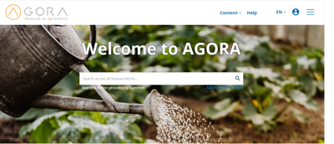
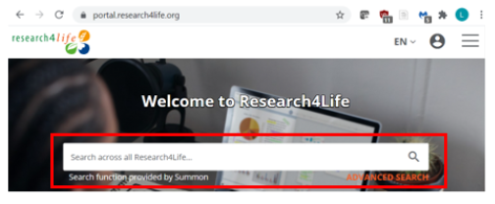
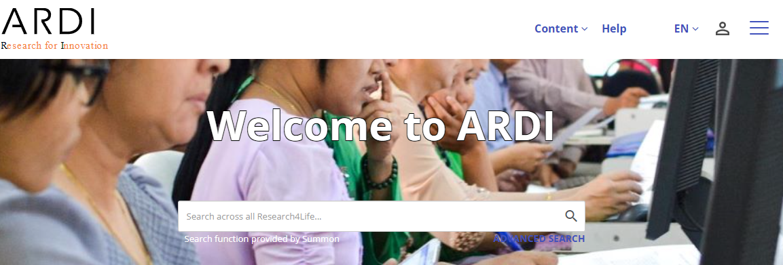
Content Portal Access
Summon is displayed on the initial page of all three Content Portals
Summon can be opened by clicking on the magnifying glass available in the search box

Slide 6
What is Summon?
Summon is like Google-like search engine that provides fast, relevancy-ranked results.
Users enter the search terms into a single search box or via the advanced search option.
The results of the search are displayed with links directly to full-text online and/or preview (abstract).
Searches can be refined (limited) by content type, discipline, publication date and other options.
Citations from searches can be saved with options to email, print or export to bibliographic management software

Slide 7
What is Summon continued
When using the search box on any Research4Life content page, Summon automatically performs the search in the appropriate country-specific Summon environment.
Summon makes use of the country offers defined by the publishers where they identify which countries they will grant access to their resources.
Search results are linked to the Summon Knowledge Base instance reflecting all the publishers’ offers in that country.

Slide 8
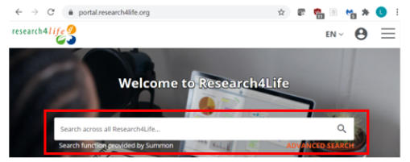
Summon search box
Users can begin Summon searches in the box below the name of any of the three initial Content Portal displays. After opening an option in one of the portals, click on the magnifying glass.
The Search across all Research4Life… note explains that any search will have the same results including full-text links from all Research4Life material regardless of Collection or Portal - that the publishers have granted access to in a specific country/institution.
For this lesson, the Unified Content Portal was used to complete the searches.

Slide 9
Search across Research4Life collections
If a solar panels and developing countries search is completed in any of the five Collections or three Content Portals, the results will be the same.
This search produced 823 citations that publishers have granted access to in the specific country/institution.
In this case, the Unified Content Portal and the ARDI Collection have the same -1,433 - results.

Slide 10
Basic search using the Unified Content Portal
Displayed below is the Summon search box. Note the ADVANCED SEARCH option.
Enter “hospital infections” and “developing countries” in the search box. Click on the icon.
By using the quotation marks (“...”), the results will be limited to citations where the two sets of words are linked together.

Slide 11
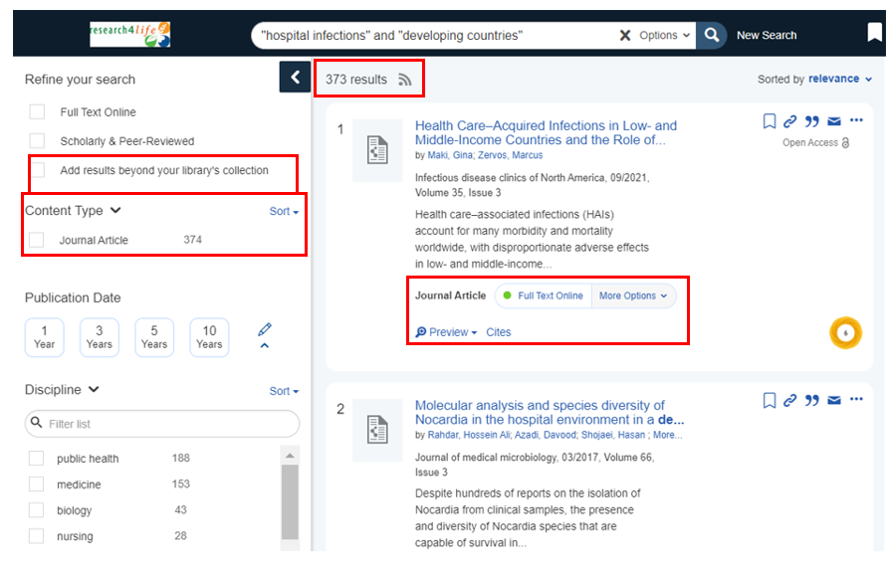
Basic search continued
This search produces 373 results by relevance – vs. date (newest) or date (oldest).
For the first citation, click on Journal Article: Full Text Online to open the document.
Note also the Preview option.

Slide 12
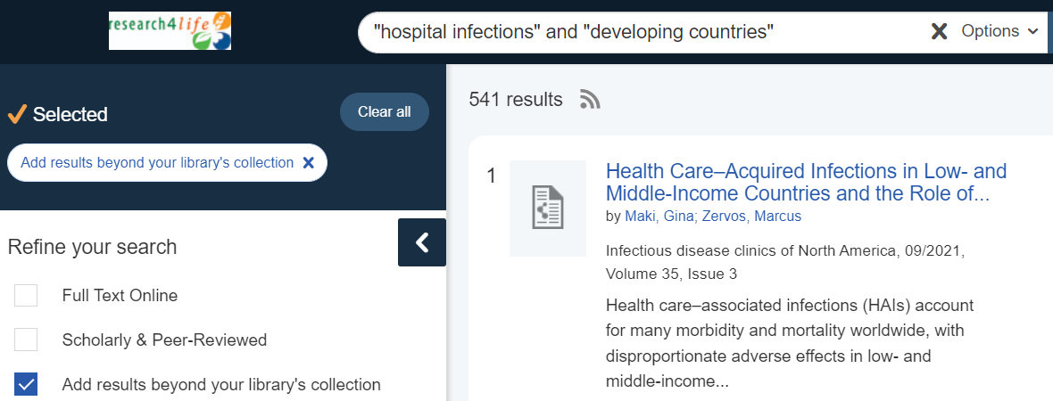
Publishers grant access
Publishers have the option to grant access or not in a specific country. The “hospital infections” and “developing countries” search has been completed using logins for Bhutan (Teaching hospital) and Nigeria (Teaching hospital).
The Bhutan results (373) are 37% higher than the Nigeria results in (234).
If Add results beyond your library’s collection is activated, the number of citations increases to 541 although access to the full-text may not be available.

Slide 13
Basic search continued
Please note that using quotation marks and “AND” boolean operators narrows the search and offers more relevant results.
The results may also differ from one country to another depending on the publishers’ offers in that country. In some cases, publishers grant access to their resources to only one category of institution within a country (E.g. Healthcare services might have access to a publisher’s content when no other category in the country does). For the institutions in the category with these bonus materials, the Summon search results do not include these resources.
Notes:
Note: Without the “...” quotation marks, the completed search will give 351,704 results. For hospital infections and “developing countries” there are 106,855 results, and for “hospital infections” and developing countries, there are 5801 results.
The “...” and “...” search results for Nepal are 1825 (almost identical to the original search results) and, for Nigeria (a country where fewer publishers grant access), the total is 1166.
Please note that Summon recognises the country that the search is being conducted apart from Colombia, Cuba, Ecuador, Peru. Those countries are advised to look up at Summon Per Country access links. http://www.research4life.org/summon-sites/

Slide 14
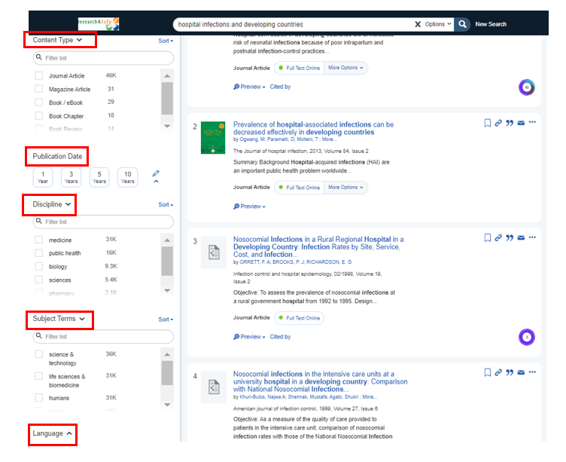
Refining your search
In the left-hand column, Summon has several options to REFINE YOUR SEARCH.
The options include;
CONTENT TYPE (which includes journal articles, book chapters, e-books and more),
PUBLICATION DATE
DISCIPLINE
SUBJECT TERMS
LANGUAGE
When appropriate, use these options

Slide 15
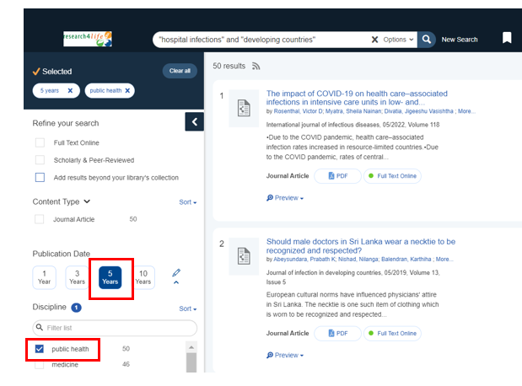
Summon DISCIPLINE and PUBLICATION DATE search features
In the following example, the search has been refined to contain Public Health material (DISCIPLINE) for the Last 5 years (Publication Date) – a total of 50 citations.
REMEMBER that the options must be cleared – either by clicking on the highlighted check for Public Health and the PUBLICATION DATE or using the Clear All option at the top of the column.

Slide 16
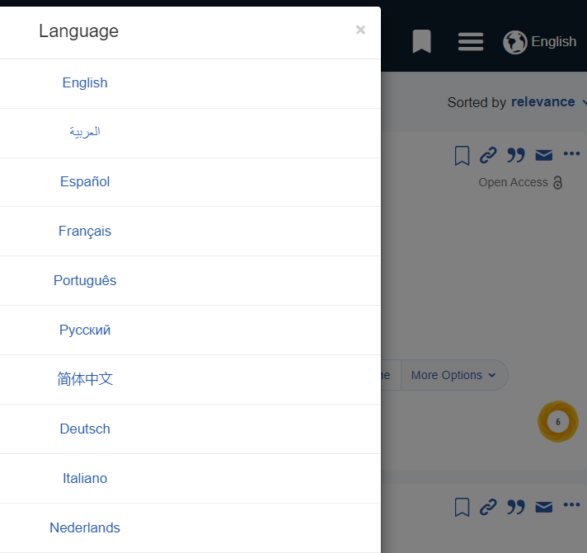
Summon Language interface options
By clicking on the default English interface, alternate language options are displayed. The French interface will be display in the next slide. In a different language interface, using English search terms will result in a larger number of citations. For example, “hospital infections” and “developing countries” has 374 results.
Searching in French will result in less results but will display material (articles, books) in that language. For example, "infections hospitalières" results in 72 citations.

Slide 17
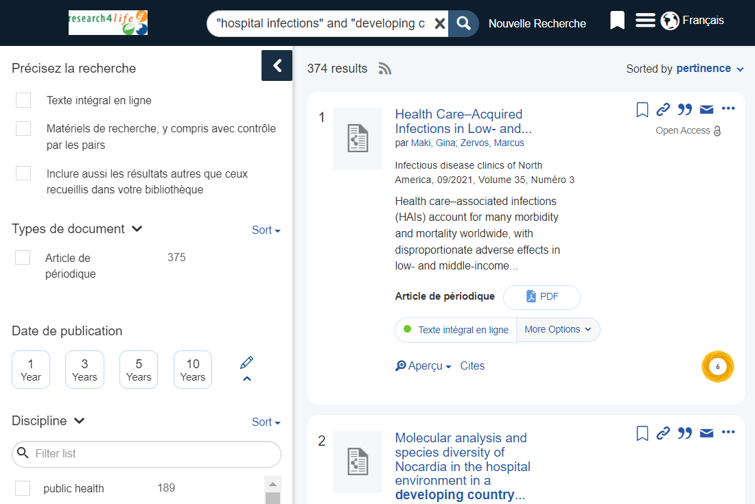
French interface
Now displayed is the French interface. Click on the language displayed for more language options.
Many but not all of the features are displayed in French especially in the Refine your search column.
This option would be useful in countries where English is not the primary language.
If you use French terms ("pays en développement" et infections hospitalières,) in the Search box, the results will be different (24).

Slide 18
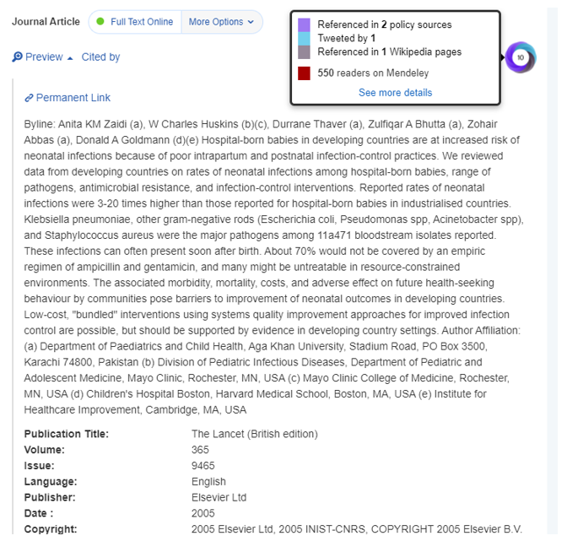
Preview feature
Almost all citations contain a Preview that includes an abstract of the article and detailed bibliographic information from the MEDLINE record – Publication, Volume, Issue, Pages, Genre and Subjects.
The Preview feature can be used to evaluate the content of the article or book & then to decide to download it or not.
Note the Altmetric Badge – to be discussed in the next slide

Slide 19
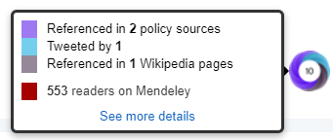
Altmetric Badge
Provided by altmetric.com, the Altmetric Badge contains metrics and qualitative data that are complementary to traditional, citation-based metrics. It provides an at-a-glance summary of the volume and type of attention a research item has received.
Placing the curser over the Badge, the summary data from altimetric.com is highlighted. For the example below, the categories of information are Referenced in policy sources (2), Tweeted by (1), Referenced in Wikipedia pages and Readers on Mendeley (560).

Slide 20
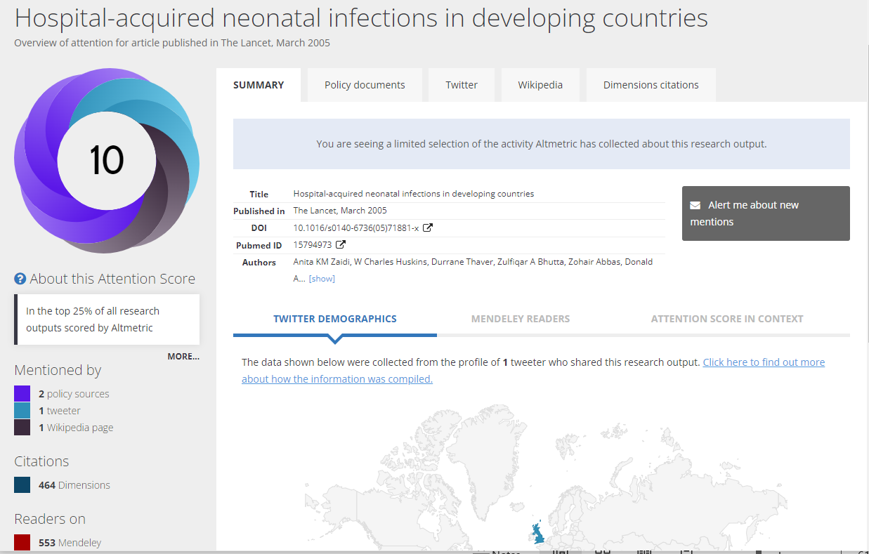
Altmetric Details Page
Each Altmetric Badge links to the associated Altmetric Details Page.
This includes a summary plus Twitter Demographics, Mendeley Readers and Attention Score in Context listings and an overview of the Altmetric Attention Score.

Slide 21
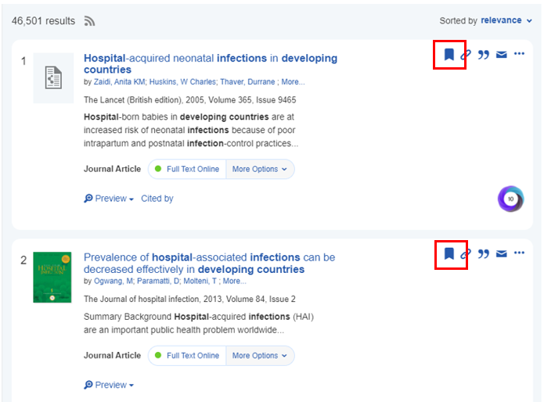
Saving items to cart
Other features include the option to Save Items to the Cart and then send Print, Email or Export to bibliographic software. Click on the Save items icon to move citations to the Cart.
Users are able to keep a record of search results.

Slide 22
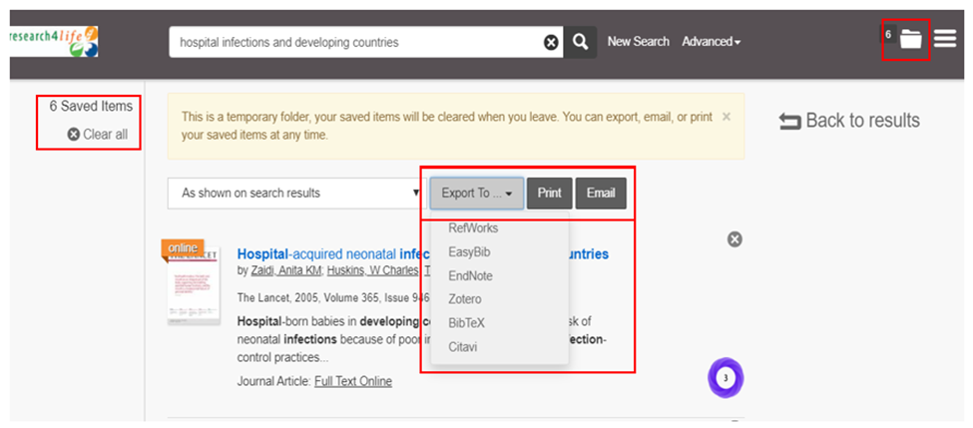
Options for Cart Saved Items
Below is the Cart with the 6 Saved Items with the Export To, Print and Email choices.
To clear all, click on the box in the left column. The Export To options are highlighted.

Slide 23
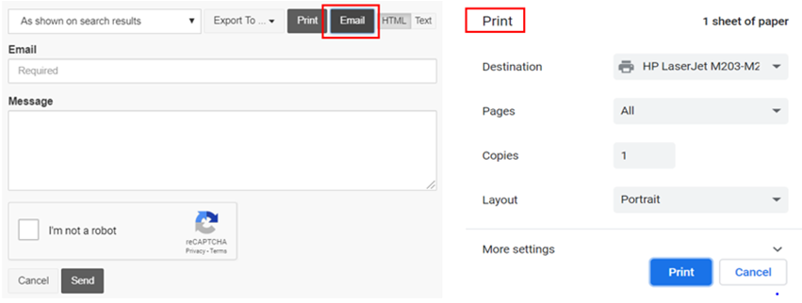
Email and Print options
The Print and Email options are displayed below.
These features are useful to save search results by printing the Saved Items or sending them to an email address.

Slide 24
Export citations
Reference Management Software is an excellent tool for recording and using bibliographic citations (reference) from multiple searches.
This information can be integrated with word processing software to generate in-text citations (footnotes) and bibliographies. The software saves bibliographic data from online sources including Summon and Google Scholar.
Summon has the option to export citations to RefWorks, EasyBib, EndNote, Zotero, BiblioTex, Citavi.

Slide 25
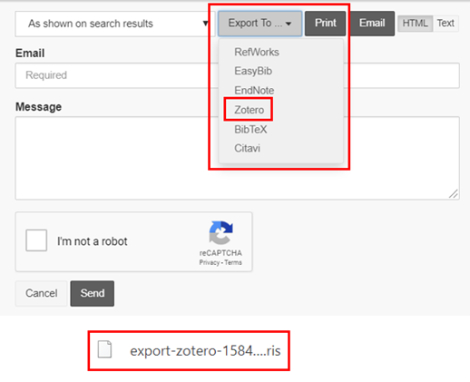
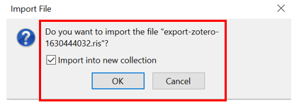
Export of citations from Summon
The examples will use the Zotero open-source software.
Displayed is the Summon search Cart with six citations and the Export to options.
After clicking on Zotero, Google Chrome creates a file that can be sent to (exported) and added to (imported) the Zotero Collection list. Click on the file to open the import into new collection option. Then click on OK.

Slide 26
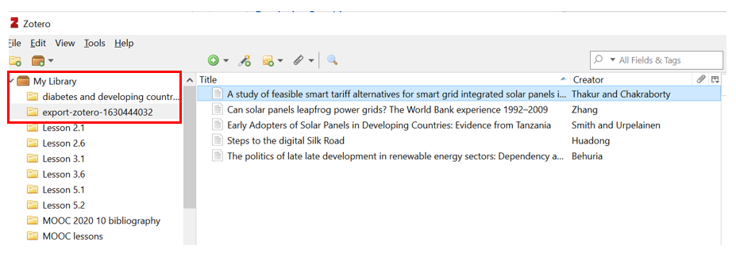
Import to Zotero file
In Zotero, My Library is displayed with the Collection options listed.
Note the export-zotero… file that has been imported from Summon.

Slide 27
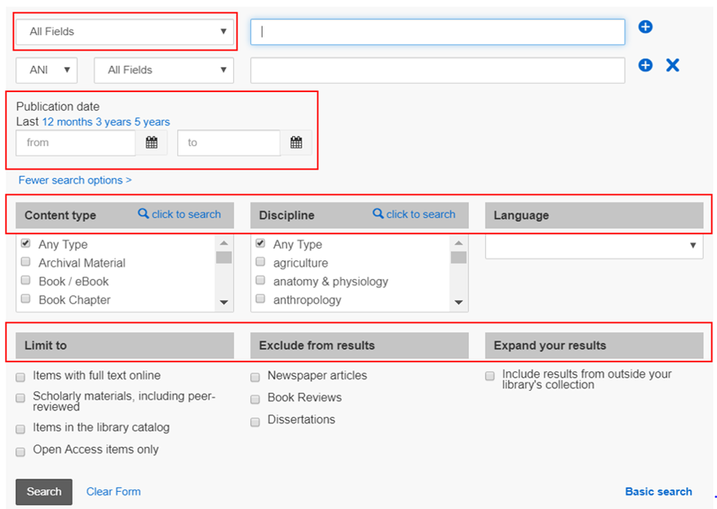
Advanced search
This is a very useful tool because multiple search options are listed on one page.
Users can enter Keywords in the initial boxes & limit the search by using the All Fields drop-down menu.
The previously discussed filters also are available – Publication date, Content type, Discipline, Language, Limit to, Exclude from results and Expand your results.
Notes:
Use the Expand your results option to include results from outside your library.

Slide 28
Introduction to Google Scholar (for Research4Life)
Google Scholar is a tool to perform broad searches for scholarly literature.
Users can search across disciplines and sources, and results include articles, theses, books, abstracts, etc. from academic publishers, professional societies, online repositories, universities and other web sites.
Search results are displayed by relevancy ranking, with year and date options. Results contain brief abstracts with links to full-text documents.
Notes:
For journals, the citations will contain links to full text from Research4Life-participating publishers’ portals plus titles that commercial publishers grant access to, open access articles and pre-publication documents. Citations can be saved to a Library or exported to bibliographic management software.
Google Scholar makes use of the country IP lists that are seen by the publishers when the user is logged in. As noted in the Summon introduction, the Scholar search results are linked to the Summon Knowledge Base instance reflecting all the publishers’ offers in that country.

Slide 29
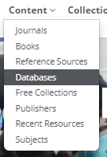
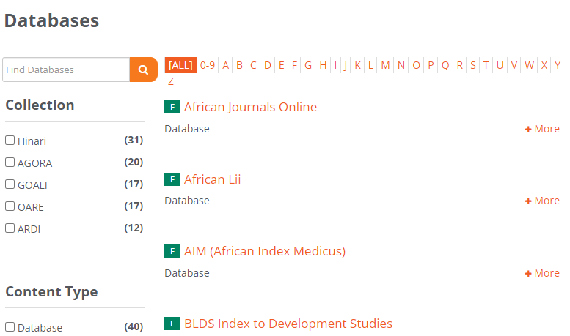
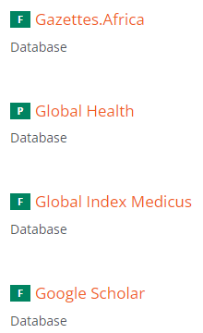
Content Portal Access
Research4Life/Google Scholar is accessed from the Content Portal’s Databases list. Once displayed, scroll down the list to Google Scholar. Click to open or click on G in the A-Z list.

Slide 30
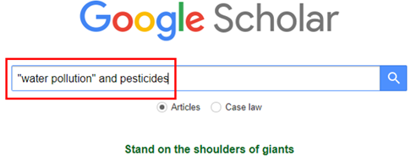
Google Scholar search box
For this example, the terms “water pollution” and pesticides have been entered in the Search box with Articles being the default for the results.
*This search is relevant for the health, agriculture and environment disciplines.

Slide 31
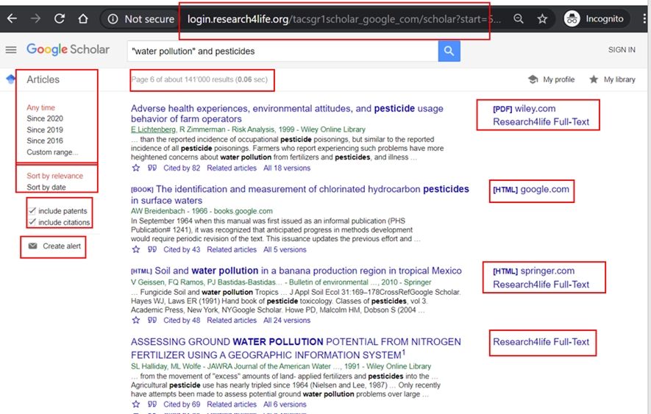
Scholar search results
Listed in relevancy order, the search displays 141,000 results (citations).
At the bottom of each citation, note the Save, Cite, Cited by, Related articles, All versions and other full-text options are listed.
In the right-hand column, the links to Research4Life Full-Text and other full-text options are listed.
In the left-hand column, note the options to limit the search dates including a custom range, Sort by relevance (default) or Sort by Date plus the options to delete or include patents and citations.
One can also create Alerts.
Notes:
Note: the large number of search results (141,000) would have significantly been larger (182 Million) without the quote marks “water pollution”.
By logging into Google Scholar from a Research4Life programme, the url links to a login.research4life.org/… address.

Slide 32
Links to full text access
Readers can click on the links on the right-hand column [PDF] wiley.com, [HTML] springer.com and Research4life Full-Text to access the full text.
Three of these citations are from Research4Life participating publishers who have granted access to the country - in this case Belize.
The [HTML] springer.com link is highlighted on the next slide.
Notes:
For Research4Life links that do not work properly, see the Troubleshooting and support section at the end of this lesson.

Slide 33
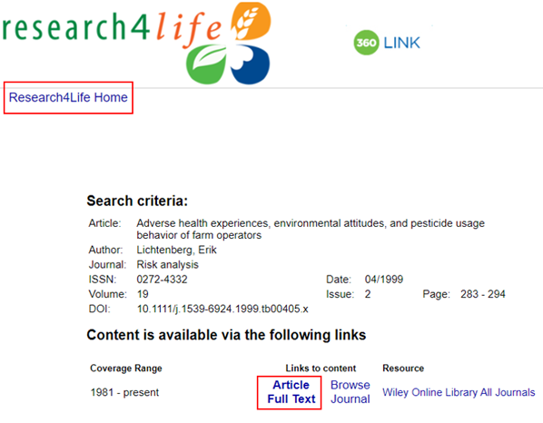
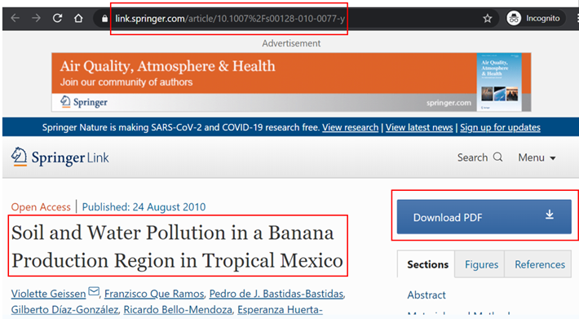
Research4Life full text links
Research4life 360 link
Springer Link to full text

Slide 34
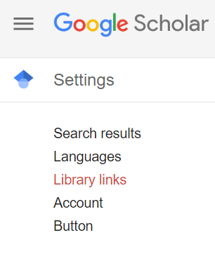
Links to full text access in (regular) Google Scholar
In regular Google Scholar (scholar.google.com), you can link your Scholar account with your Research4Life Country by following these steps:
Click Hamburger Menu, then go to Settings
In Settings, select Library Links
This will add full-text links to the search results and is independent of R4L/Google Scholar.

Slide 35
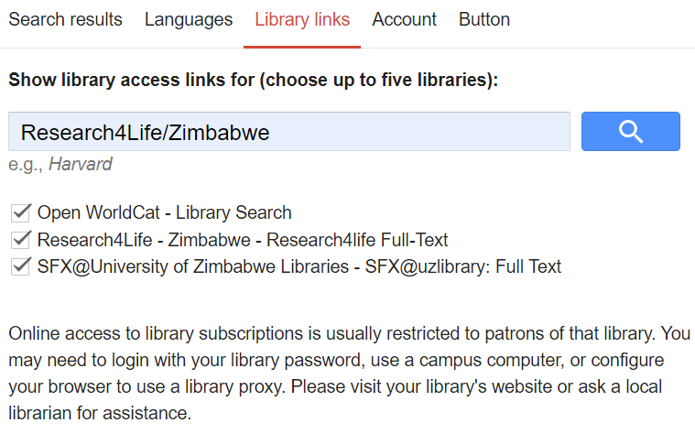
In the search box, type Research4Life and scroll down the list till the name of your Country is displayed. Click on your Country and check the box
The search will be updated to show the full text articles that can be accessed through R4L in your country
Note that your specific Library’s electronic holding also can be added to the search results. This is independent from searches completed using Research4Life Google Scholar
Links to full text continued

Slide 36
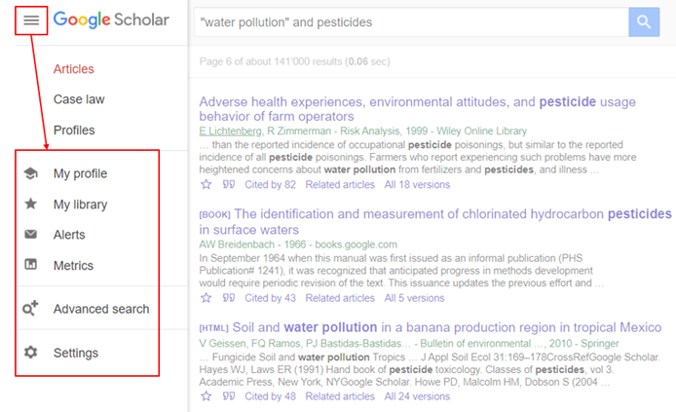
Google Scholar’s Other Features
To open Google Scholar’s Other Features, click on the three horizontal bars found at the top left of the search results.
Key features are My Library, Alerts and Advanced Search. Note the bottom Settings option where users can customize the access to these features.
In order to use these tools, users must have a Google account. To set up an account, complete a Google search for Create Google Account or copy the following url: https://accounts.google.com/signup
Notes:
In order to use these tools, users must have a Google account. To set up an account, complete a Google search for Create Google Account or copy the following url: https://accounts.google.com/signup

Slide 37
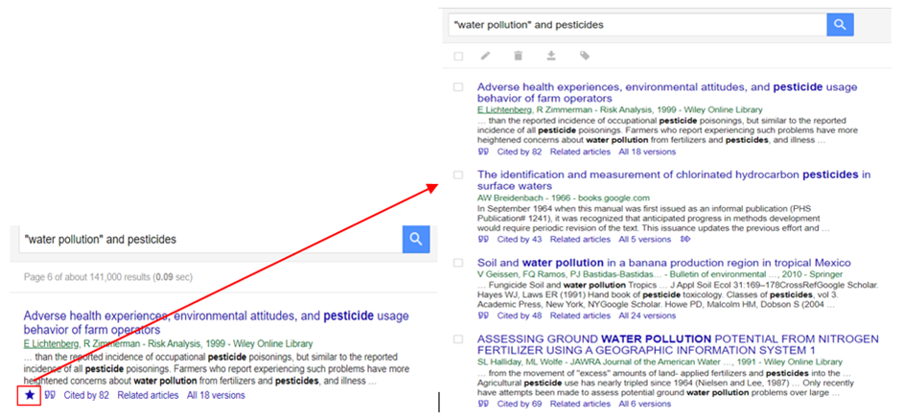
My library
The first feature opened is My Library.
By clicking on the star (*) below a search result abstract, the bibliographic information is moved to My Library. Also shown are the four citations that have been transferred to My Library. Note that the search title – “water pollution” and pesticides – is listed.

Slide 38
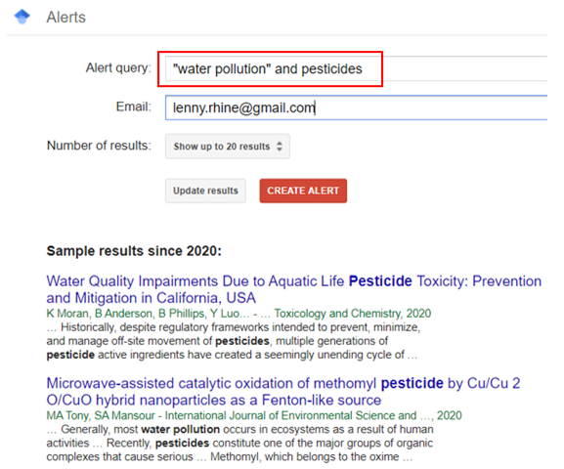
Create Alerts
A second useful feature is the Alerts.
From the left-hand column of the Search results page, click on
The graphic on the right shows the steps necessary to create alerts.

Slide 39
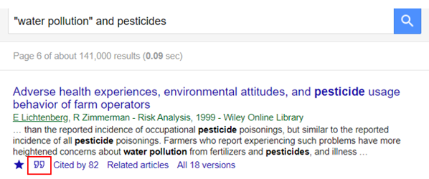
Export citations
From Scholar, users can Export Citations to BibTeX, EndNote, RefMan and RefWorks, but not Zotero or Mendeley. From the search results page, click on the cite symbol.

Slide 40
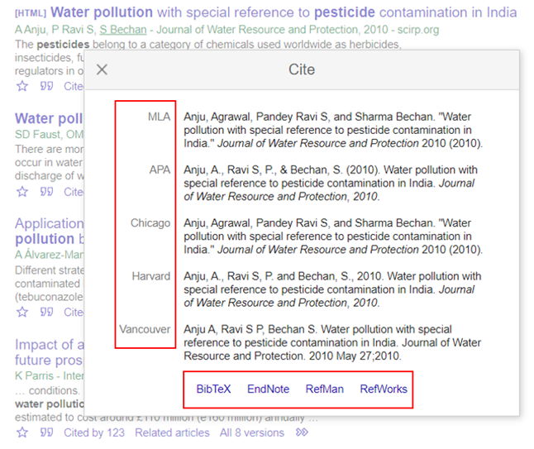
Cite and export options
A second screen will display five key citation styles for the article and the option to export the citations to multiple reference management softwares - BibTeX, EndNote, RefMan or RefWorks
By activating the proper setting in Mendeley and Zotero, a .ris file can be created/downloaded.
By clicking on one of these options, an exportable file is created.

Slide 41
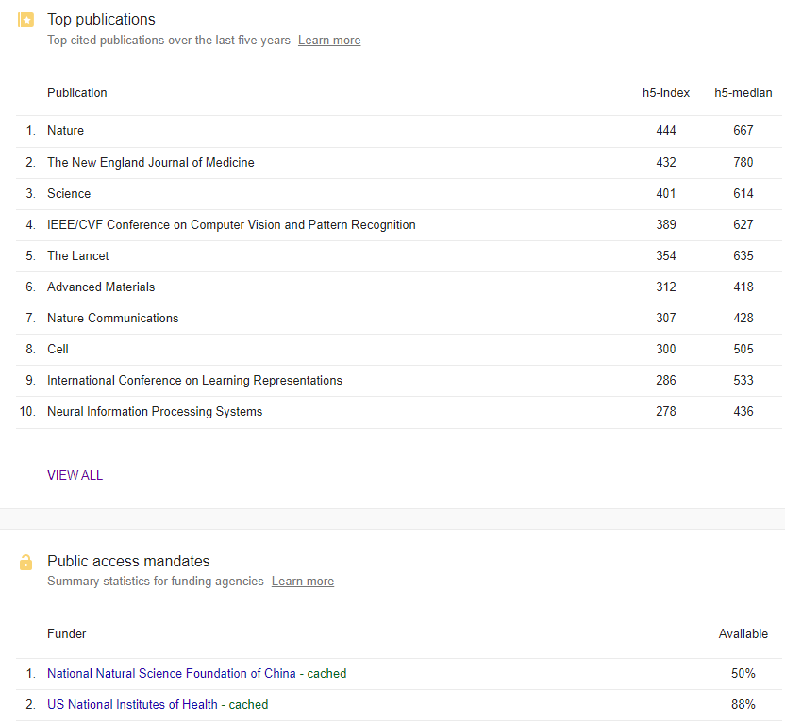
Metrics
From the Scholar options, click on Metrics. The search is sorted by Publications with the h5-index and h5- median rankings. Displayed is the initial list of the top 10 journals.
Click on VIEWALL. The following screen will have broad CATEGORIES and publication LANGUAGE options.
Note also the Public Access Mandates at the bottom of the page.

Slide 42
h5-Index and h5-median rankings definitions
h5-index is the largest number h such that h articles published in [the past 5 years] have at least h citations each. Thus, an h5-index of 60 means that that journal has published 60 articles in the previous 5 years that have 60 or more citations each.
h5-median is based on h5-index, but instead measures the median (or middle) value of citations for the h number of citations. A journal with an h5-index of 60 and h5-median of 75 means that, of the 60 articles with 60 or more citations, the median of those citation values is 75.
Rachel Borchardt. “Subject Guides: Scholarly Research Impact Metrics: Journal-level impact - impact factor and more”. Accessed June 2021 https://subjectguides.library.american.edu/c.php?g=175335&p=1154177
See lesson 1.2 for more information on bibliographic metrics.

Slide 43
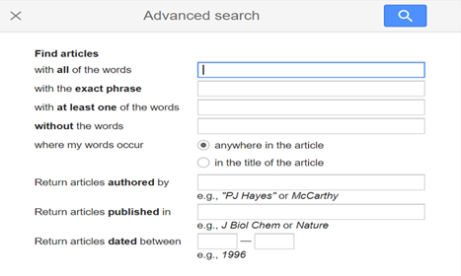
Advanced search
A final highlighted feature is Advanced search. This option is displayed below.

Slide 44
Troubleshooting and support
Common issues;
access to the journal has a blocked popup message
failure to properly login with the institution's Username/Password
journal or book titles not included in publisher’s offer
technical problems at the publisher's website.
What to do:
If the user is logged in and the institution has access to the specific title, this confirms that there is a technical problem at the publisher’s website. Report this problem to the Research4Life HelpDesk at r4l@research4life.org
Notes:
If access is not granted to a journal, first check if there is a blocked pop-up message that needs to be resolved. If the publisher requests an individual login or for the user to pay for access, check that the login has been completed properly. Then check whether the publisher does or does not grant access to this title/specific issue that is being requested.

Slide 45
Contact the HelpDesk
When contacting the HelpDesk, please use the following checklist:
What is your institution name and country?
What is the username and password you are using? (if applicable).
Does your institution use IP-based access to Hinari and Research4Life? (if applicable).
Are you able to login or do you get a ‘Failure to authenticate’ message?
Are you having problems accessing all content or a specific journal or book?
If you have a problem to access a specific title, please write down the name of the journal or book.
Please include a screenshot (including URL) of the error you experienced.

Slide 46
Summary
This lesson focused on two search tools that are available for all five collections. Both contain links to full-text material from the Research4Life participating publishers.
Search across all Research4Life… is searched from any of the Content Portals’ initial page or the Content page of any Research4Life Collections. Google Scholar (Research4Life) is available from the Databases list of any Collection.
In both tools, the search results are linked to the Summon Knowledge Base instance reflecting all the publishers’ offers in that country. The Summon search link resolver maps the results to include the available Research4Life resources.

Slide 47
Additional Resources
‘Google Scholar Search Tips’. Accessed 6 November 2020. https://scholar.google.com/intl/en/scholar/help.html
How Library Stuff Works: Searching in Google Scholar, 2013. Accessed 6 November 2020. https://www.youtube.com/watch?v=WsTPZItV3No
Schuetze, Scott. ‘LibGuides: Summon: A Great Place to Start Your Research: About’. Accessed 6 November 2020. https://proquest.libguides.com/summon/about

Slide 48
You are invited to;
Visit us at www.research4life.org
Contact us at r4l@research4life.org
Find out about other training materials [www.research4life.org/training]
Subscribe to Research4Life newsletter [www.research4life.org/newsletter]
Check out Research4Life videos [https://bit.ly/2w3CU5C]
Follow us on Twitter @r4lpartnership and Facebook @R4Lpartnership

Slide 49
Research4Life is committed to the UN's Sustainable Development Goals.
Research4Life contributes to the United Nations Decade of Action by increasing research participation from the Global South.
The recent Strategic Plan to 2030 focuses on inclusion and equity in the global research community, supporting the creation of an even richer body of research which will help to advance the Sustainable Development Goals.
Research4Life offers our partners, users and supporters the opportunity to contribute to the creation of a diverse. inclusive and equitable research ecosystem for all.

Slide 50
Our unique public-private structure allows us to work effectively in alignment with SDG17: Partnership for the Goals for sustainable development and to support our community of users as both consumers and producers of critical research and advance SDG10: Reduced Inequalities within and among countries.
While R4L activities directly and indirectly support all the SDGs such as Good health and Wellbeing, Zero Hunger, Clean Water and Sanitation, Industry, innovation and infrastructure, and Peace and Justice, the Research4Life Program is closely aligned to SDG4: Quality Education that is fundamental to creating a peaceful and prosperous world and SDG5: Gender Equity to achieve the empowerment of all women and children.

Slide 51
For more information on Research4Life
www.research4life.org
r4l@research4life.org
Research4Life is a public-private partnership of five collections:

