Slide 1
Scholarly communication and Research4Life
Scientific landscape
Research4Life is a public-private partnership of five collections:

Slide 2
Outline
Scholarly communication and scientific publishing.
Life-cycle of scholarly research.
Open access movement.
Predatory publishers.
Literature repositories for research dissemination.
Open science and research data.
This work is licensed under Creative Commons Attribution-ShareAlike 4.0 International (CC BY-SA 4.0)

Slide 3
Learning objectives
Have an overview of scholarly communication and scientific publishing.
Understand publishing economy and open access business models.
Perceive channels to disseminate scholarly work.
Identify trustworthy environments to publish in.
Become familiar with open data and open science movements.
Notes:
This lesson sets out the fundamentals of the scholarly communication system, the history of publishing and the current state of publishing business models, evolving research dissemination channels and academic evaluation. It will act as the basis for our introduction to the benefits of the Research4Life Initiative in terms of its contribution to enhancing scholarly communication in low-income countries

Slide 4
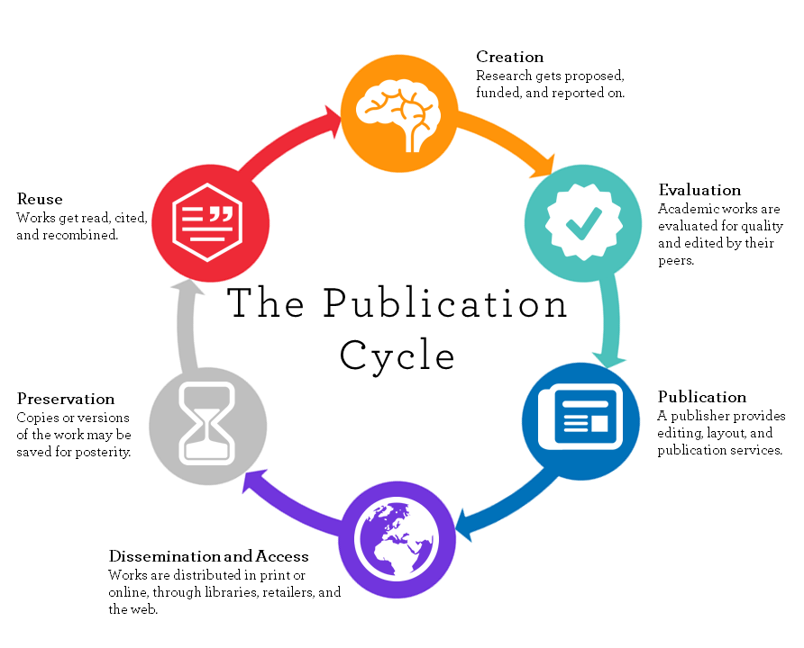
What is scholarly communication?
Scholarly communication is the process of sharing, disseminating and publishing the research findings of academics and researchers.
Generated academic results are made widely available and communicated to the global academic communities.
It forms a life-cycle of steps involved in the creation, evaluation, publication, dissemination, discovery, preservation and reuse.
Source: ‘Scholarly Publishing & Open Access| University of Washington Libraries’. Accessed 21 July 2023. https://www.lib.berkeley.edu/scholarly-communication/about/what-is-scholarly-communication
Notes:
Scholarly communication is the process of sharing, disseminating and publishing the research findings of academics and researchers so that the generated academic results are made widely available and communicated to the global academic communities.
As shown in the diagram on the left, it forms a life-cycle of steps involved in the creation, publication, dissemination and discovery of scholarly research and involves a number of actors including researchers, peer reviewers, librarians, publishers, funders, technologists, and many more in between data collection and knowledge discovery.

Slide 5
Brief history on publishing
Science publishing enables research outcomes to be disseminated to the academic community and the public through journal articles, monographs, conference proceedings, working papers, datasets etc.
The current system of “traditional”, commercial science publishing, where publishers manage the peer review and publishing process of scholarly publications, rose to dominance in the 1970s. The peer review process didn’t become standard until mid-20th century.
The quality of publishing and science has improved as salaried professionals were responsible for managing the various aspects of the publication process, such as review and marketing of the published work.
Notes:
It is known that the first published scientific journal, the Philosophical Transactions of the Royal Society adopted editorial peer-review, whereas Nature didn’t introduce a formal peer-review system until 1967.

Slide 6
Scientific publishing today
Scientific peers from common research fields assess the articles that are submitted for publication, and advise on acceptance or rejection, and suggest improvements to the concepts presented. This is called peer review process.
It is known that the acceptance or rejection rate for authors’ submitted papers may be a key indicator of the quality of a journal.
Authors usually aim to publish in high “impact factor” journals, the so-called “top-tier” journals.
Today, the market share of the commercial publishers continues to grow, and the largest publishers represent the highest number of publications in this landscape.
Scholarly communication environment experiences some challenges.

Slide 7
Challenges in scholarly communication in a nutshell
Ever-increasing subscription prices brings affordability problem even in the developed countries.
Paywalled access to publicly funded research is a form of double payment for research by taxpayers.
Delays in the publishing cycles due to secret peer review process and high rejection rates block timely dissemination of research.
Dependence on journal impact factor in research assessment as a surrogate measure of the quality of individual research articles, to assess an individual scientist’s contributions.
Sharing only the end product of research cycle, not the research data itself creates a reproducibility issue of research and emphasis the importance of open science.
Notes:
The high cost of subscriptions for scientific journals has long been prohibitive for universities and research institutes in low-income countries. In the 1990s and 2000s cost cutting also became an issue in developed countries.
The Periodicals Price Survey 2019 reports that the average price for food science journals is $3,219, for chemistry $5,950, and for health sciences $2,156 annually.

Slide 8
Responses from the scholarly communication world
Big deals (journal packages)
Open access
Pre-print open archives
Funder requirements
Transformative deals
Open science
Data sharing
Notes:
Pre-print open archives came into the seen as a response to delays in publishing
Funders started asking for certain set of criteria to fund a research inc. OA
Big deals started turned into a open access deals callled transformative deals
Open science didn’t came into seen over night but economic data of data and research is so high for governments, that’s also become an
Data sharing is the key element of open science. we see how crucial it is in the days of pandemic.

Slide 9
Peer review in scientific publications
Scientific peers from common research fields assess the articles that are submitted for publication.
They advise on acceptance or rejection and suggest improvements to the concepts presented.
The acceptance or rejection rate for authors’ submitted papers is a key indicator of the quality of a journal.
For tenure and promotion in academic institutions, publishing in peer review journals is critical.
Authors usually aim to publish in high “impact factor” journals, the so-called “top-tier” journals.
Notes:
*The American Psychological Association’s report of journal operations in 2017 shows that their journals’ overall rejection rate is 70%
*Another example is Elsevier’s Biomaterials: its acceptance rate in 2018 is 15.4%
*There are other examples where rejection rates are even higher than that. Many articles are eventually published somewhere, but in a journal of a lesser standing than the one that authors targeted initially

Slide 10
Affordability and accessibility
Publishers have been making so-called “Big Deals” with consortiums of libraries where they offer bundles of journals at a discount.
However, appetites for this model are declining as it doesn’t allow for libraries to build the most appropriate collections for their audience and is thus not cost effective.
An increasing number of libraries have cancelled their Big Deal subscriptions.
Open access movement and responses encouraged an alternative business model called , ‘Gold Open Access’.
Notes:
*Nevertheless, the Big Deal’s benefits continue to appear sufficient for the model to retain its importance for some time, though perhaps evolving in scope (e.g. the bundling or offsetting of open access charges) and in new pricing models

Slide 11
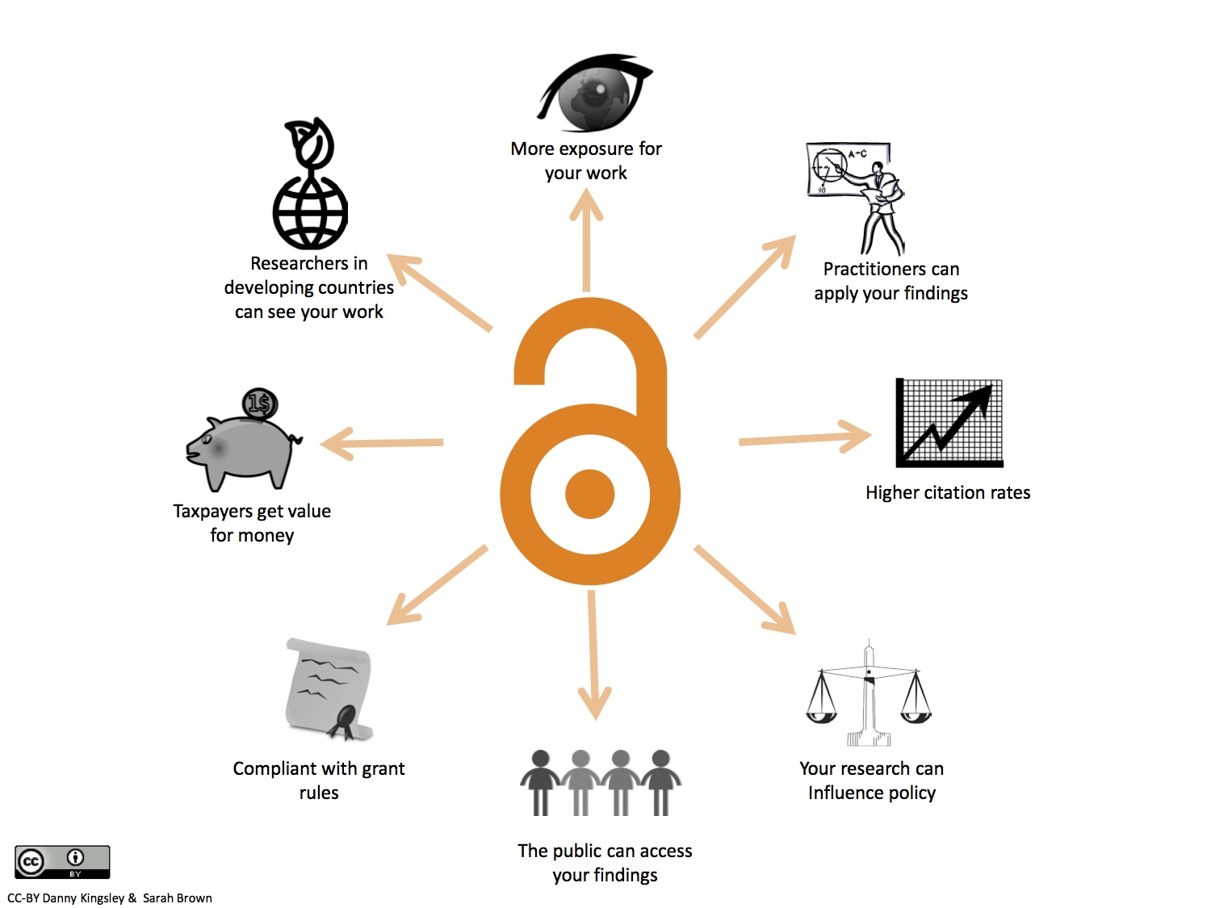
Open access movement
The movement started by scientists in 1991 with the preprint open archive for physics, arXiv.
Open access gained momentum around the millennium through calls that scientific output – particularly public-funded research – should be freely available.
Open access makes original research freely accessible on the web, free of most copyright and licensing restrictions on reuse.
Scientific output should not be ‘locked’ in behind paywalls that require payment to access a research output.
Source: https://osc.cam.ac.uk/open-access Accessed: 24 January 2022
Notes:
With a subscription cost for a single journal title at several thousands of dollars, access to a wide range of scientific journals is out of reach for low-income countries and put pressure on even the most well-funded university libraries
The Periodicals Price Survey 2019 reports the average price for food science journals is $3,219, for chemistry $5,950, and for health sciences $2,156 annually.
Average prices for science, technology, and medical (STM) serials remain the highest, compared with prices for serials in other subject areas

Slide 12
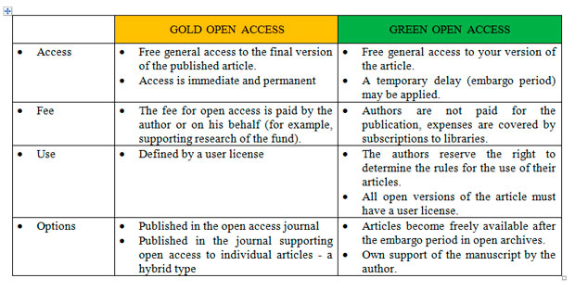
Open access models
Source: https://l-e-journal.com/en/authors/open-access/ Accessed:21 July 2023
Notes:
Sustainability issues in subscription prices and right to access the information brought preprint archives and green route open access into the academic world, and urged publishers to initiate different business models.

Slide 13
Gold open access
Unlike traditional publishing model, it allows everyone to read scientific publications free of charge.
Open access articles can be published either in “hybrid journals” OR in fully open access journals.
Readers are not charged to read and there is no journal subscription fee, instead the funding institution pay Article Processing Charge (APC) for the publication of an article.
There are also journals with non-APC or waiving policies.
List of open access journals are indexed by Directory of Open Access Journals (DOAJ) at https://doaj.org
Notes:
*Hybrid journals : a variant of traditional subscription-based journals in which authors can choose to pay an APC and make their individual article open access.
*Fully open access journals : all the articles in the journals are open access to the readers.
*The Open APC Initiative is an up-to-date comprehensive source releasing data sets on fees paid for open access journal articles by universities and research institutions

Slide 14
Green open access: self archiving
A repository is an open, online archive to collect, preserve, and disseminate digital copies of the intellectual output of an institution or in a specific discipline, compliant with OAI (Open Archive Initiative) protocol.
Repositories are forms of Green Open Access in which authors self-archive their publications in institutional or subject/domain repositories such as arXiv or PubMed Central.
Authors can deposit articles which have been published by a traditional publisher but not in an open access journal. This is only allowed if authors have the right to distribute their work electronically.
List of open access repositories;
for literature repositories- Directory of Open Access Repositories
for data repositories - Registry of Research Data Repositories
Notes:
*Explain Green open access, Gold open access explained earlier
*The authors should hold on their rights while they submit their work to a publisher
*Today 81% of the publishers worldwide allow authors to deposit some version of their work in a repository

Slide 15
Publisher policies on self archiving
The SHERPA/ROMEO Publisher copyright policies & self-archiving website provides a searchable list of publisher and journal policies which defines self archiving conditions.
It is important to know which version is allowed to be deposited
Pre-prints is the version of the paper before peer review.
Post-print is the version of the paper after peer-review, with revisions having been made.
Author’s copy is their typescript of the peer-reviewed final version of the paper.
Publisher’s version is the publisher-generated PDF file.
Source http://sherpa.ac.uk/romeo Accessed: 21 July 2023
Notes:
*Repositories ensure that research output is available to readers immediately, with free access and the least restriction of copyright.
*The first open, preprint archive, arXiv was established in 1991 for physics, mathematics and computer science papers.
*In recent years, there has been a growth in preprint services hosted by the Center for Open Science (COS) such as AgriXiv, AfricArxiv, EarthArxiv
*Institutional repositories gained momentum as well as subject/domain repositories in the late 1900s and early 2000s.
*The global Directory of Open Access Repositories (OpenDOAR) shows that there are currently over 4350 repositories worldwide
*

Slide 16
Predatory publishers:
Identify trustworthy publishing environments
Open access journals should follow best practices for scientific peer review of all articles submitted.
There is a misconception that because open access journals charge APCs therefore, they are necessarily poor quality, “predatory” and not peer reviewed.
Authors need to carefully check for quality of both traditional subscription journals and open access journals and publishers.
Guides and checklists are available to help authors select the right journal and publisher to publish their research findings. See an example: Himmefalb Health Library
Notes:
*It is true that there can be rogue or predatory publishers that are only motivated by the fee. However, this is not limited to open access publishing, it happens in toll publishing too.

Slide 17
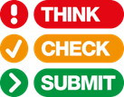
Think. Check. Submit. helps researchers identify trusted journals for their research.
This international initiative by a coalition of scholarly publishers and associations aims to educate researchers, promote integrity, and build trust in credible research and publications.
Notes:
*Go to https://beallslist.net/

Slide 18
Do you or your colleagues know the journal?
Can you easily identify and contact the publisher?
Is the journal clear about the type of peer review it uses?
Are articles indexed in services that you use?
Is it clear what fees will be charged?
Do you recognize the editorial board?
Is the publisher a member of a recognized industry initiative?
Notes:
*Go to https://beallslist.net/

Slide 19
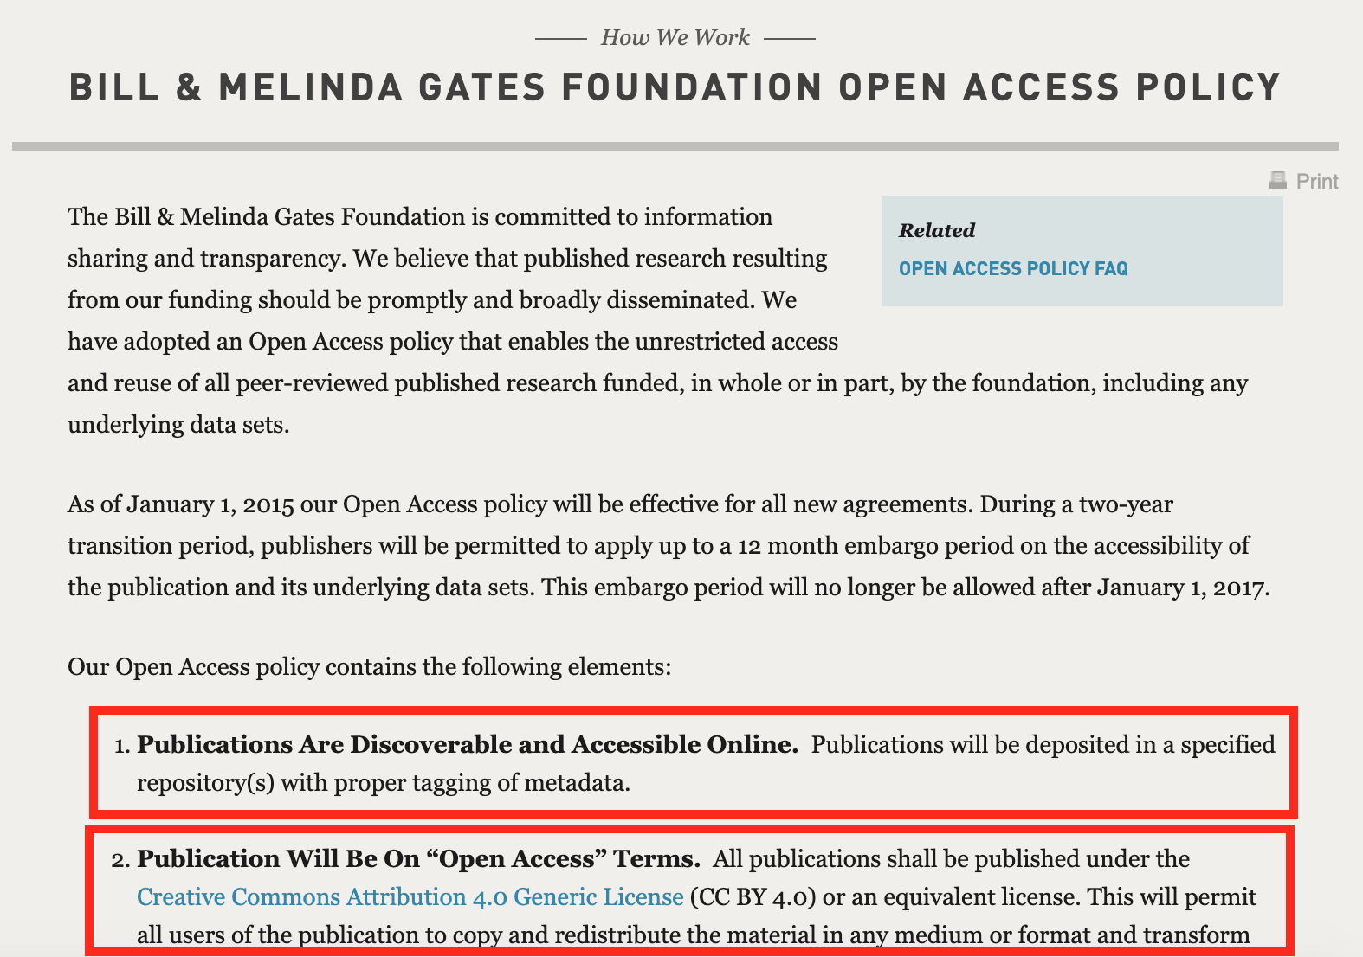
Open access and Open science policies
Funders require open access for publications resulting from the research they fund both for literature and data.
Literature and data repositories for research dissemination.
See example on the right.
Notes:
These policies ties publishers too. If your funded research is published by a publisher, author needs to meet the requirements both from publisher and the publisher but obviously funder’s policy is indicative for such a case.
Taylor & Francis deposit agreements with major research funders https://authorservices.taylorandfrancis.com/publishing-open-access/funder-open-access-policies/#
List of funder requirements from UCL https://www.ucl.ac.uk/library/open-access/research-funders-open-access-policies
OECD https://www.oecd-ilibrary.org/docserver/5jrs2f963zs1-en.pdf?expires=1587828712&id=id&accname=guest&checksum=E484910D9EA5CAB5846A535E31D9046B

Slide 20
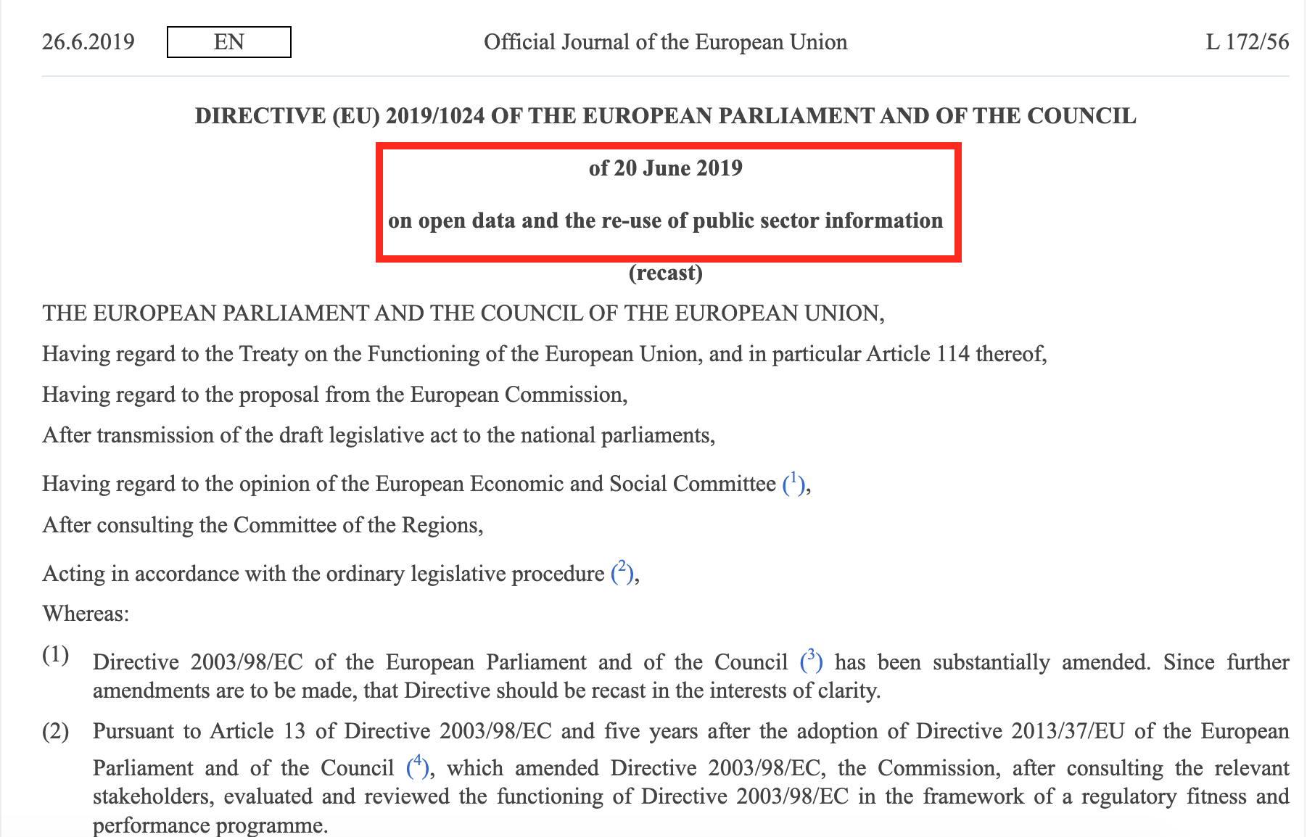
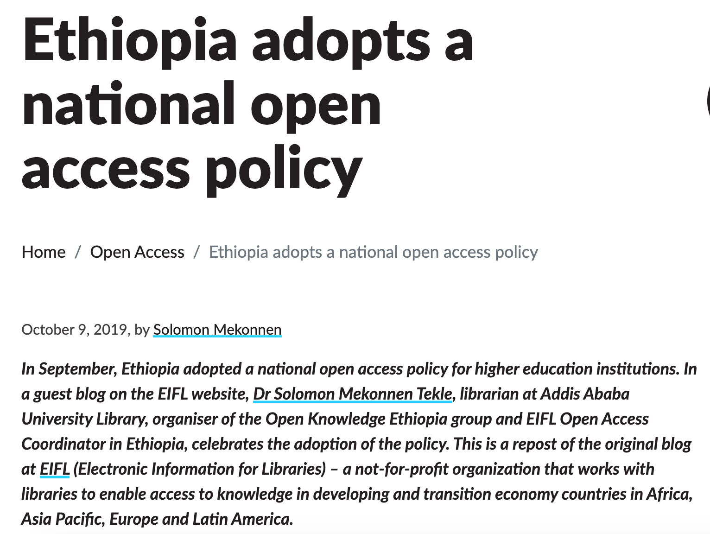
Open access and Open science policy examples

Slide 21
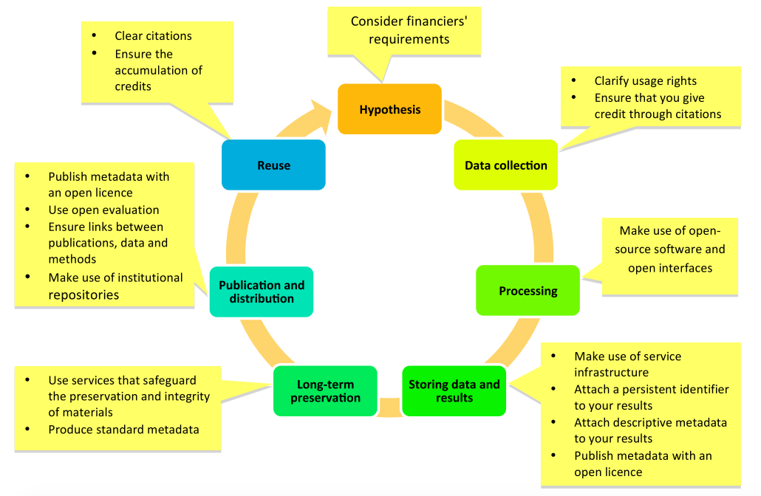
Promoting openness
“Open Science is about extending the principles of openness to the whole research cycle”
Source: https://like-itn-digitalization.readthedocs.io/en/latest/1_research_lifecycle/ Accessed 24 January 2022.
Notes:
Open Science allows for primary outputs of publicly funded research results – publications and the research data – publicly accessible in digital format with no or minimal restriction.
Open Science is about extending the principles of openness to the whole research cycle fostering sharing and collaboration as early as possible thus entailing a systemic change to the way science and research is done.

Slide 22
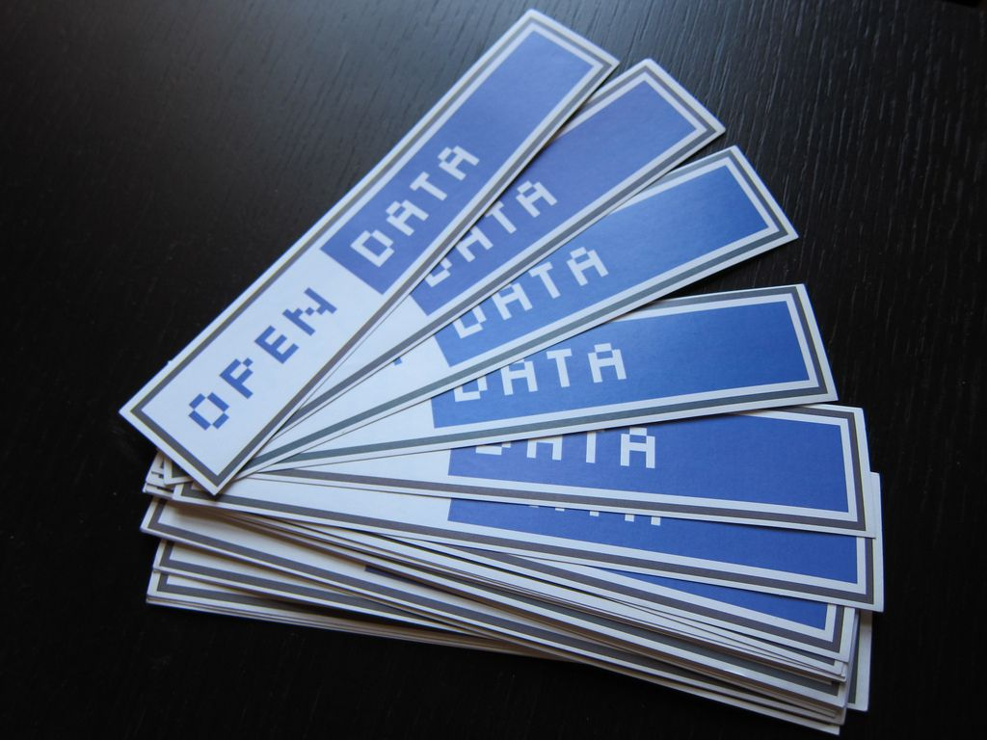
Open science and Research data
The concept of open science has also been introduced to the academic environment in policies since 2015.
Open science “is extending the principles of openness to the whole research cycle” going beyond the publication of findings.
Reusability of research data and outputs involves open licensing which allows others to share, re-use and create new work from data and publications.
Many funders these days require research data to be made available to the public.
Notes:
Reusability of research data and outputs involves open licensing (e.g. Creative Commons licences) which allows others to share, re-use and create new work from data and publications

Slide 23
Why manage research data?
Research data management is important:
To increase research efficiency;
To make research accessible;
To make research reusable by other researchers.
Registry of Research Data Repositories www.re3data.org
“The EU open data market is a key building block of the overall EU data economy. According to the study supporting the impact assessment carried out to provide input to the review of the PSI Directive, the total direct economic value of PSI is expected to increase from a baseline of EUR 52 billion in 2018 for the EU28, to EUR 194 billion in 2030.”
European Commission - Open Data - https://ec.europa.eu/digital-single-market/en/open-data
Notes:
*Data repositories all over the world across all disciplines can be found here: https://www.re3data.org/

Slide 24
Summary
Scholarly communication is the process of sharing, disseminating and publishing the research findings of academics and researchers so that the generated academic results are made widely available and communicated to the global academic communities and open access seeks to make research findings freely available accessible by the public.
Authors need to carefully check for quality of journals before publishing and should make use of literature repositories which are available for research dissemination.
Research data management is important to increase research efficiency and make research accessible and reusable by other researchers.

Slide 25
References and useful resources
Das, Anup-Kumar. ‘Introduction to Scholarly Communication’. In UNESCO Curriculum for Researchers, Module 1: Scholarly Communications, edited by M. P. Satija and Sanjaya Mishra, 5–16. UNESCO, Paris, 2015. http://eprints.rclis.org/24814/
Frank Norman Information Services Manager at Crick Institute, ‘The History of Peer Review, and Looking Forward to Preprints in Biomedicine’, Research in progress blog, 5 May 2017, https://blogs.biomedcentral.com/bmcblog/2017/05/05/the-history-of-peer-review-and-looking-forward-to-preprints-in-biomedicine/
‘History of Publishing - Scholarly Journals’, Encyclopedia Britannica, accessed 6 October 2019, https://www.britannica.com/topic/publishing

Slide 26
You are invited to;
Visit us at www.research4life.org
Contact us at r4l@research4life.org
Find out about other training materials [www.research4life.org/training]
Subscribe to Research4Life newsletter [www.research4life.org/newsletter]
Check out Research4Life videos [https://bit.ly/2w3CU5C]
Follow us on Twitter @r4lpartnership and Facebook @R4Lpartnership

Slide 27
Research4Life is committed to the UN's Sustainable Development Goals.
Research4Life contributes to the United Nations Decade of Action by increasing research participation from the Global South.
The recent Strategic Plan to 2030 focuses on inclusion and equity in the global research community, supporting the creation of an even richer body of research which will help to advance the Sustainable Development Goals.
Research4Life offers our partners, users and supporters the opportunity to contribute to the creation of a diverse. inclusive and equitable research ecosystem for all.

Slide 28
Our unique public-private structure allows us to work effectively in alignment with SDG17: Partnership for the Goals for sustainable development and to support our community of users as both consumers and producers of critical research and advance SDG10: Reduced Inequalities within and among countries.
While R4L activities directly and indirectly support all the SDGs such as Good health and Wellbeing, Zero Hunger, Clean Water and Sanitation, Industry, innovation and infrastructure, and Peace and Justice, the Research4Life Program is closely aligned to SDG4: Quality Education that is fundamental to creating a peaceful and prosperous world and SDG5: Gender Equity to achieve the empowerment of all women and children.

Slide 29
For more information on Research4Life
www.research4life.org
r4l@research4life.org
Research4Life is a public-private partnership of five collections:

