Slide 1
Advocate for Research4life and facilitate capacity development
Research4Life advocacy toolkit
Research4Life is a public-private partnership of five collections:

Slide 2
Outline
Introduction
Definition of advocacy
Steps for a successful advocacy strategy
Step 1: Identify the challenge you face
Step 2: Setting up specific goals and objectives
Step 3: Identifying and analysing your target audience
Step 4: Mapping out resources and capabilities
Step 5: Developing a strategic plan and activities
Step 6: Monitor and evaluate the results
Other activities
Summary
This work is licensed under Creative Commons Attribution-ShareAlike 4.0 International (CC BY-SA 4.0)

Slide 3
Learning objectives
Make a case for their upper management to obtain institutional. Research4Life membership.
Present benefits of the Research4Life programmes to various key. constituencies, including library management.

Slide 4
Introduction
Research4Life Advocacy
The materials in the Research4Life Advocacy Toolkit uses the Creative Commons Attribution-ShareAlike 4.0 International (CC BY SA 4.0) license.
Users can share (copy and redistribute the material in any medium or format) and adapt this material (remix, transform and build upon the material for any purpose, even commercially).
Users are required to give attribution (give appropriate credit, provide a link to the license and indicate if changes have been made) and use the same license in any revised document.

Slide 5
Advocacy defined
According to UNICEF:
“Advocacy is the deliberate process, based on demonstrated evidence, to directly and indirectly influence decision-makers, stakeholders and relevant audiences to support and implement actions that contribute to enhanced access to scientific knowledge.”

Slide 6
Advocacy in the context of a library
“Advocacy is the ongoing process of building partnerships so that others will act for and with you, turning passive support into educated action for the library media program.
Advocacy is a planned, deliberate, sustained effort to raise awareness of an issue. It's an ongoing process in which support and understanding are built incrementally over an extended period of time”
Source: http://www.ala.org/aasl/advocacy/definitions , accessed 24 January 2022

Slide 7
Librarians as advocates
Librarians are increasingly acting as advocates for their resources and services.
Advocacy can improve the visibility of libraries and get the message out to larger communities about what the modern library is and does.
Advocacy can also help librarians become part of larger local, regional, or national conversations.
Advocacy requires the staff to move out of the library and into the community to promote services and resources and connect with partners, stakeholders and supporters.

Slide 8
Research4Life Advocacy Toolkit
Research4Life has developed an Advocacy Toolkit to support librarians’ advocacy activities.
The Research4Life Advocacy Toolkit, a practical instrument that provides a range of resources to get support from decision-makers, administration or management to promote the academic library and the Research4Life programmes.
The full toolkit has practical exercises that help individuals create advocacy strategies for specific libraries.
Note: The Advocacy Toolkit is different than the development of a marketing plan that is aimed at users and reviewed in Lesson 6.2.

Slide 9
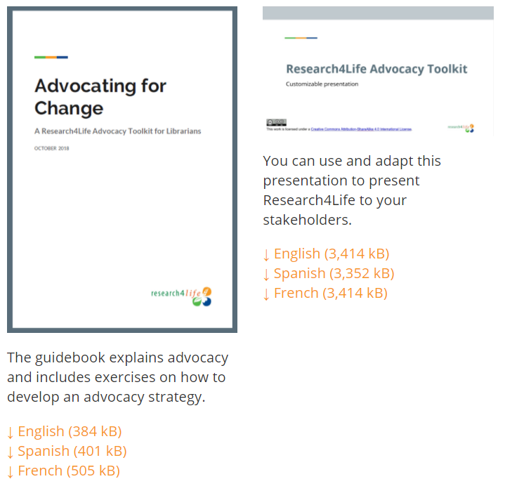
Research4Life Advocacy Toolkit
This resource can be downloaded from:
Get Support for your library with the Advocacy Toolkit

Slide 10
Some examples from the field
Mary Acanit (Uganda) advocated for Kyambogo University to link to the Research and Education Network for Uganda (RENU), which aims to connect all Ugandan universities, colleges, and research institutions via an affordable country-wide high-speed network backbone for cheaper and faster access to global research resources.
Alice Matimba’s (Zimbabwe) team successfully advocated for a health policy that has transformed the care and treatment for patients with diabetic retinopathy and other eye complications.
Lui Philip Kame (Papua New Guinea), a Technical Services Librarian at the PNG University of Natural Resource and Environment in Port Moresby, Papua New Guinea, developed a solution himself: a mini-ICT networking system that provides online services for the library to complement its traditional over-the-counter services

Slide 11
Steps for a successful advocacy strategy
The steps are:
Identify the challenge
Note types of advocacy efforts
Understand Research4Life and identify Research4Life resources
Set up specific objectives
Analyze the audience
Map out resources and capabilities
Develop a strategic plan and activities
Monitor and evaluate results
Notes:
The Research4Life Advocacy Toolkit presents several steps to develop a successful and structured advocacy strategy focusing specifically on librarians in developing countries.
The hands-on material will facilitate the implementation of activities that can help obtain support to foster the usage of the Research4Life programmes: Hinari, AGORA, OARE, ARDI and GOALI

Slide 12
Advocacy efforts
The toolkit reviews some examples of advocacy efforts such as;
Collecting evidence: gathering data or conducting surveys about your library
Attending professional development: following a course or training
Being a member of association or task force
Communicating with decision-makers
Attending faculty or staff meetings
Attending conferences and giving presentations
Collaborating and networking with other librarians
Notes:
Question to the audience: How many of these activities have you completed? Are some of these ideas new to you?

Slide 13
Activity 1
Can you identify and list other types of advocacy efforts ?

Slide 14
Activity 2
What can your library offer? Make a list of the available
e-resources and describe the benefits of each.

Slide 15
Examples of possible situations in a library
An institutional library would like to access the resources in the five Research4Life programmes, but it is situated in a Group B country. The library has to secure funding for the annual fee of 1500 USD.
An institution has provided its members with free access to scientific knowledge through Research4Life for years, but now the country has been reclassified to group B. The institutional members have to convince their management to pay the 1,500 USD annual fee.
The librarians of an institution that is subscribed to Research4Life notice that their institutional members are not aware of the resources that Research4Life provides.
The staff needs to raise awareness about the resources. To organize training, they need funding and support from their management.
A library would like to make more use of Research4Life but is lacking technical equipment to provide access to the resources. They need to convince their institutional management to invest in infrastructure or look for other ways of funding.

Slide 16
Step 1: Identify the challenge you face
Before starting to plan the advocacy strategy, it is important that the planners ask several questions that will help them to shape the efforts in the best way.
It is also important to identify problems and opportunities.
What is the problem you are trying to solve?

Slide 17
Activity 3
Is one of the above examples your case? If not, can you describe the problem you are trying to solve in a clear statement?

Slide 18
Step 2: Setting up specific goals and objectives
Now that the problem has been identified, the staff needs to develop the main/broader goal(s) and a series of (specific, measurable, attainable and realistic) objectives.
What is the main goal you aim to achieve? What are the long and short-term objectives that build towards your goal?
Notes:
Remember that goals can be defined as headers for the objectives. In other words, a goal is more general, while objectives can be more specific and relate to one goal.
Some examples are listed below:
obtain funds to pay the Research4Life Group B annual fee
raise awareness about the resources that the library offers
convince institutional management to invest in library infrastructure.

Slide 19
Activity 4
List the Advocacy and goal(s) and specific objective(s).
Notes:
List the main goal(s) and objectives

Slide 20
Step 3: Identifying and analysing your target audience
Once the staff has identified the problem and outlined goals and objectives, they need to identify the advocacy target audiences.
Make a list of the target audiences so the staff can work out how to influence them.
Who is your target audience?
Notes:
Possible user groups include:
student communities of the institution – undergraduate or postgraduate or discipline(s)
management of institution
local policymakers
funding organizations
Research4Life team

Slide 21
Activity 5
Who is your target audience? List the different types of audiences you are trying to reach and provide a brief description of them.

Slide 22
Step 4: Mapping out resources and capabilities
Numerous resources are available from the Research4Life website or specific programme training pages.
Research4Life resources include a PowerPoint presentation for advocacy, factsheets and infographics, posters, case studies, interviews, and videos.
Also remember that the institution’s communications department can help.

Slide 23
Activity 6
List the resources that your library has and the ones that you can develop yourself to help your advocacy strategy.
Notes:
List your library’s resources that would help you develop your strategy

Slide 24
Step 5: Developing a strategic plan and activities
This is the step where planning is converted into effective activities.
Different communication and marketing tools can be combined or just use one that meets your needs.
A number of potential activities are listed below:
Organize open library events and invite administrators to attend.
Using the Research4Life Advocacy PowerPoint presentation, make presentations to a faculty, student, research or management groups conduct interviews to gather testimonials on the use and impact of Research4Life resources.
Please Note: the complete Advocacy Toolkit has more details about these possible activities.

Slide 25
Activity 7
List the activities for the Strategic Plan.

Slide 26
Step 6: Monitor and evaluate the results
To monitor the project’s progress, the planners should evaluate each objective at regular intervals.
If they find that one objective progresses more slowly than the others, the activities for that objective may be ineffective and may need to be changed.
Below are several examples of evaluation tools for certain objectives:
Open events: How many people attended? Were they satisfied with the event? You can conduct a small satisfaction survey to hand out at your library event.
Interviews: Did you gather the intended data you wished to obtain? If not, why not?
Social media: What were your specific objectives for this activity? Likes? Engagement? Or simply setting up social media accounts?

Slide 27
Activity 8
List the activities and the describe the evaluation methods for each.

Slide 28
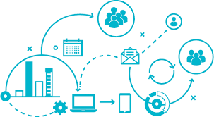
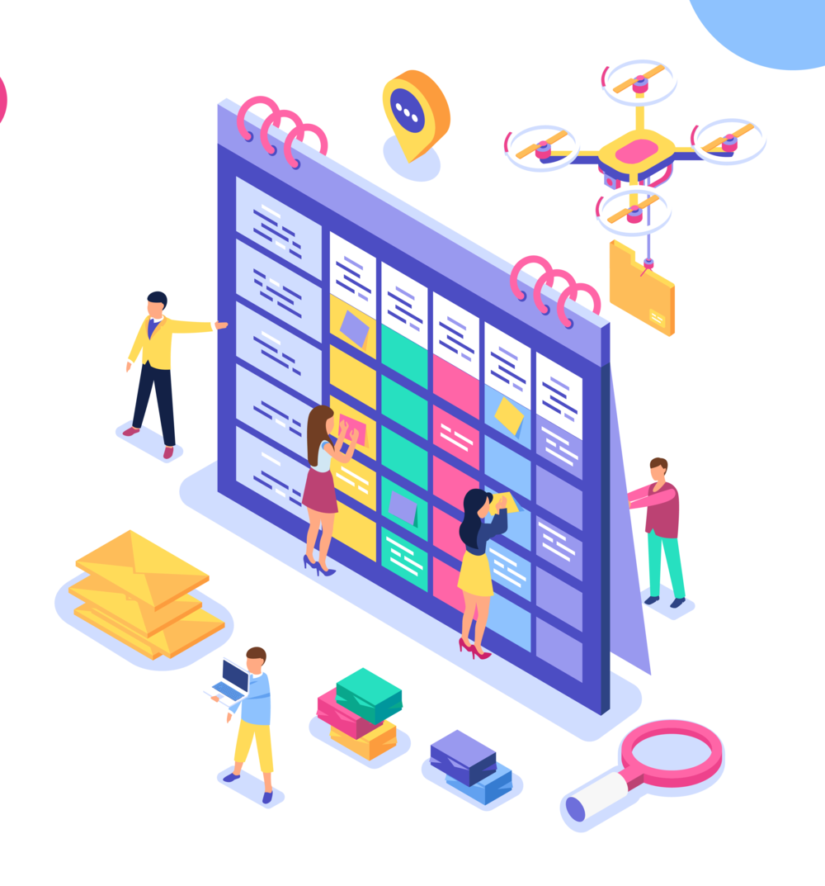
Other activities
For the final exercise, the objective is to develop a year-long plan: a calendar of 52 weeks of tools and activities for advocacy in the library
Activity: Write down a mix of tools and activities you wish to implement for your communication strategy and organize them in a calendar.

Slide 29
Summary
This lesson focused on using the Research4Life Advocacy Toolkit to develop an advocacy strategy for a library.
Initially focused on Group B institutions and the need to obtain funds for the annual fee, the plan is useful for all institutions that use or plan to use Research4Life.
Advocacy can improve the visibility of the library and raise awareness about the resources.
The exercises in the Toolkit will help with the development of a plan for an institution – based on the goals and objectives for a specific situation.

Slide 30
Additional Resources
AASL. 2007. What Is Advocacy? In: American Association of School Librarians (AASL) [online]. [Cited 8 April 2020]. http://www.ala.org/aasl/advocacy/definitions
ALA. 2018. Frontline Advocacy Toolkit. In: ALA (American Library Association) [online]. [Cited 8 April 2020]. http://www.ala.org/advocacy/frontline-advocacy-toolkit
Canadian Association of Public Libraries (CAPL). 2011. Library Advocacy Now! A Training Program For Public Library Staff and Trustees. [Cited 8 April 2020]. http://cla.ca/wp-content/uploads/LibraryAdvocacyNow.pdf
J CARMICHAEL. ‘Frontline Advocacy Toolkit’. Text. ALA (American Library Association), 22 August 2018. Accessed June 23, 2021 http://www.ala.org/advocacy/frontline-advocacy-toolkit
Research4Life. ‘Library Advocacy Toolkit’ Presentation. Accessed June 23, 2021. https://www.research4life.org/wp-content/uploads/2019/02/Research4Life-Advocacy-Toolkit-presentation.pptx

Slide 31
You are invited to;
Visit us at www.research4life.org
Contact us at r4l@research4life.org
Find out about other training materials [www.research4life.org/training]
Subscribe to Research4Life newsletter [www.research4life.org/newsletter]
Check out Research4Life videos [https://bit.ly/2w3CU5C]
Follow us on Twitter @r4lpartnership and Facebook @R4Lpartnership

Slide 32
For more information on Research4Life
www.research4life.org
r4l@research4life.org
Research4Life is a public-private partnership of five collections:

