Slide 1
Collection-specific browsing and searching
Research4Life Unified Content Portal
Research4Life is a public-private partnership of five collections:

Slide 2
Outline
Introduction
Access to The Unified Content Portal
Browse Unified Portal
Browse by Collections
Database Search
Journals Search
Browse Databases, Reference Sources and Free Collections
Search across Research4Life using Summon
Country Offer
Find/download an article and export a journal citation
Troubleshooting and support
This work is licensed under Creative Commons Attribution-ShareAlike 4.0 International (CC BY-SA 4.0)

Slide 3
Learning objectives
Understand how to access resources from the Uniform Content Portal and AGORA and ARDI portals.
Understand the coverage of the five programme collections.
Browse Research4Life content efficiently.
Search Research4Life content effectively.
Use the Hamburger menu’s additional tools.
Understand content country collections.
Troubleshoot known issues and ask for assistance from the R4L help desk.

Slide 4
Research4Life (R4L) Collections (www.research4life.org)
Since 2002, Research4Life has provided researchers at more than 10,000 institutions in over 125 lower- and middle-income countries with free or low-cost online access to up 151,000 leading journals, e- books and other information resources in the fields of health, agriculture, environment, applied sciences, social sciences and legal information.
Research4Life does this in partnership with organizations in the fields of scholarly communications, technology and international development: WHO, FAO, UNEP, WIPO, ILO; Cornell and Yale Universities; the International Association of Scientific, Technical & Medical Publishers and more than 200 international publisher partners.

Slide 5
Research4Life (R4L) Collections (www.research4life.org) cont.
Via the Unified Content Portal, there are five collections through which users can access content: Research for Health (Hinari), Research in Agriculture (AGORA), Research in the Environment (OARE), Research for Development and Innovation (ARDI) and Research for Global Justice (GOALI). AGORA and ARDA also have separate Content Portals.
R4L offers access up to 30,000 journals, 131,000 books and 155 other information sources (January 2022).
The goal of Research4life collections is to “reduce the knowledge gap between high-income and low- and middle-income countries by providing affordable access to scholarly, professional and research information”.

Slide 6
Access to the Unified Content Portal
The Unified Content Portal and other portals are accessible through direct links:
Unified Portal - https://portal.research4life.org/
AGORA - https://agora.research4life.org/
ARDI - https://ardi.research4life.org/
LOGIN tab from the Research4Life initial page https://www.research4life.org/
Any member of a registered institution can login to the portal using a Username and Password. Login details are usually available through the institution’s library.
Access is available from desktop/laptop computers and mobile phones.

Slide 7
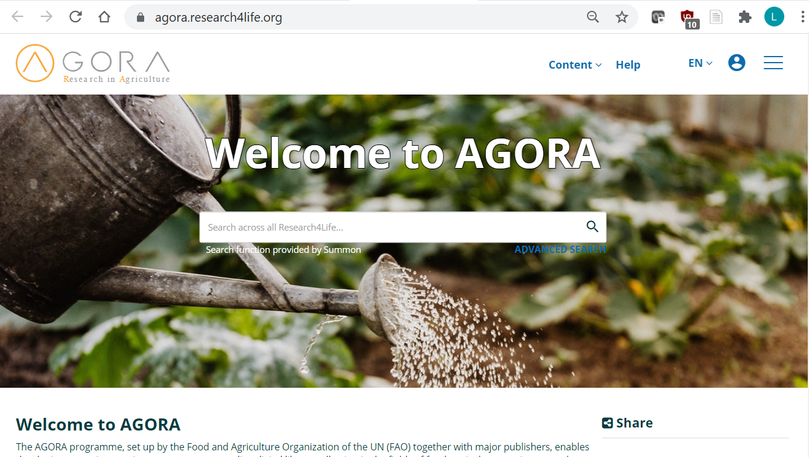
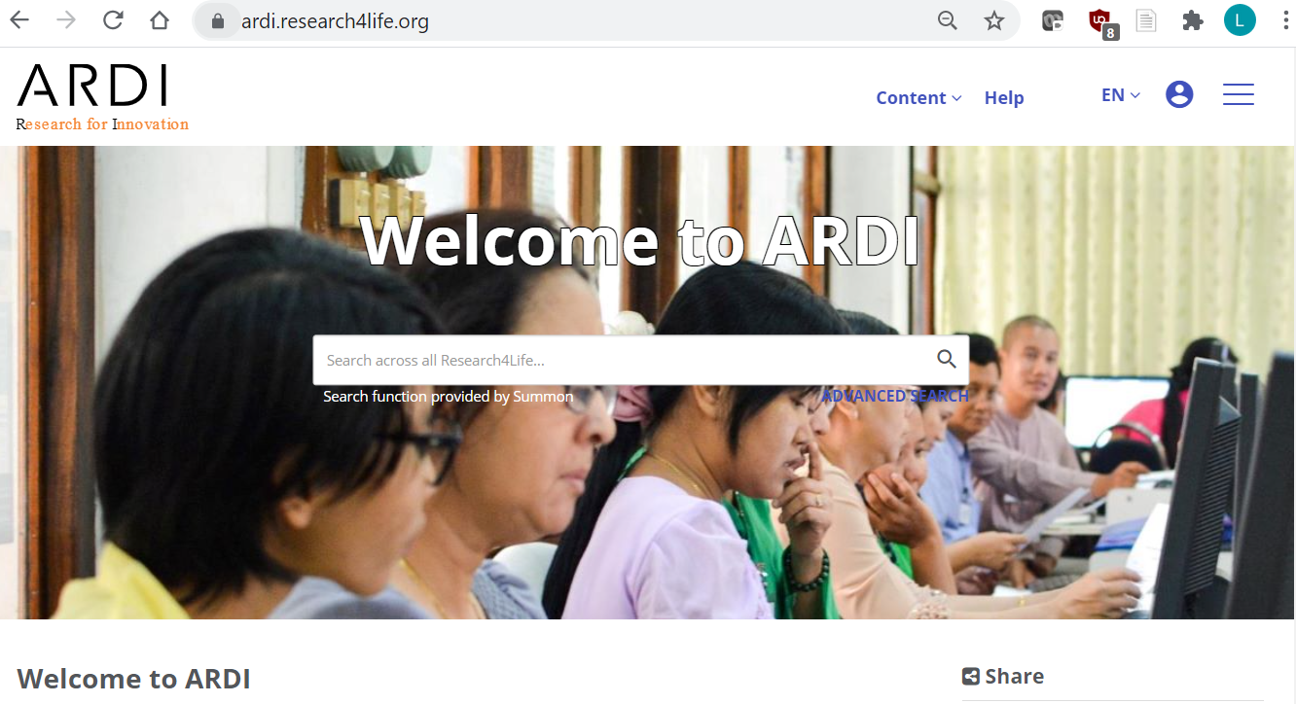
I]
Initial Content Portal Pages (Note the symbol for login).
This presentation focuses on the Unified Content Portal but can also be used for AGORA or ARDI content portal training. All the content portals are displayed.

Slide 8
Login to the Unified Content Portal
You can login to the portal through the Research4life website: https://www.research4life.org/
Access to the login page is also located on the initial web pages of the five collections.
In both cases, users will be prompted to enter login credentials.

Slide 9
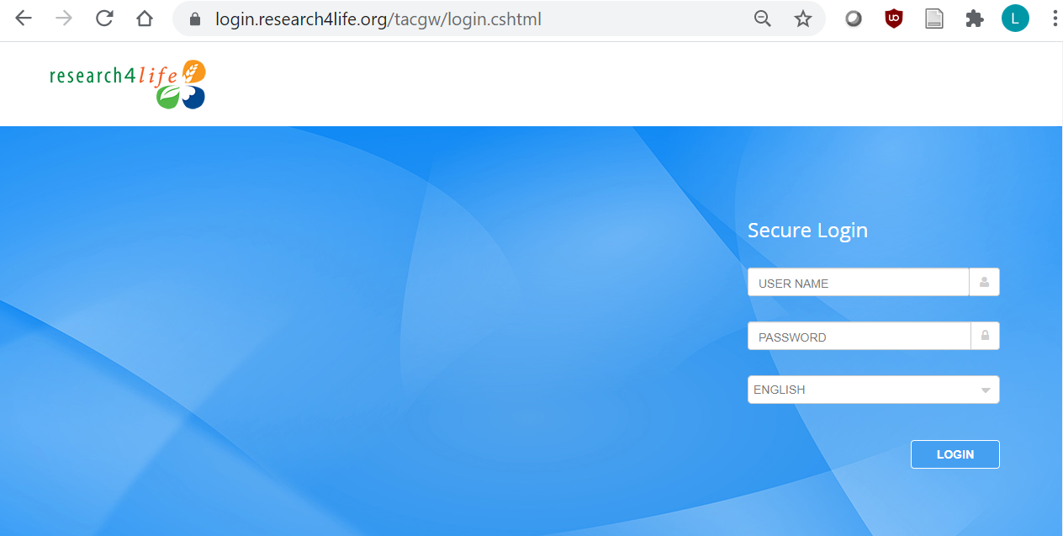
Login instructions
Users must use the login credentials of their institution – both the username and password are case-sensitive & no spaces are allowed.
Users from institutions that have IP-based access to R4L, will not be asked for credentials within the institution’s premises & will be automatically logged in.
Contact the institution’s librarian for login info. If not available, contact the help desk - r4l@research4life.org.
Notes:
Please consult the librarian at the institution for questions and further information about this. If you are unable to get the information you need, contact the help desk at r4l@research4life.org if needed

Slide 10
Persistent Login
Persistent Login provides 3 months of recognition for a device that is used to connect to Research4Life from an approved IP address of one of the Research4life institutions.
Once a user has successfully logged in from an approved IP address, the user can reconnect for three months from the same device and browser without the need to retype the username and password and without the need to be on the campus or the institution’s VPN or proxy.
If the user clears cookies on that device/browser, the persistent login is lost.

Slide 11
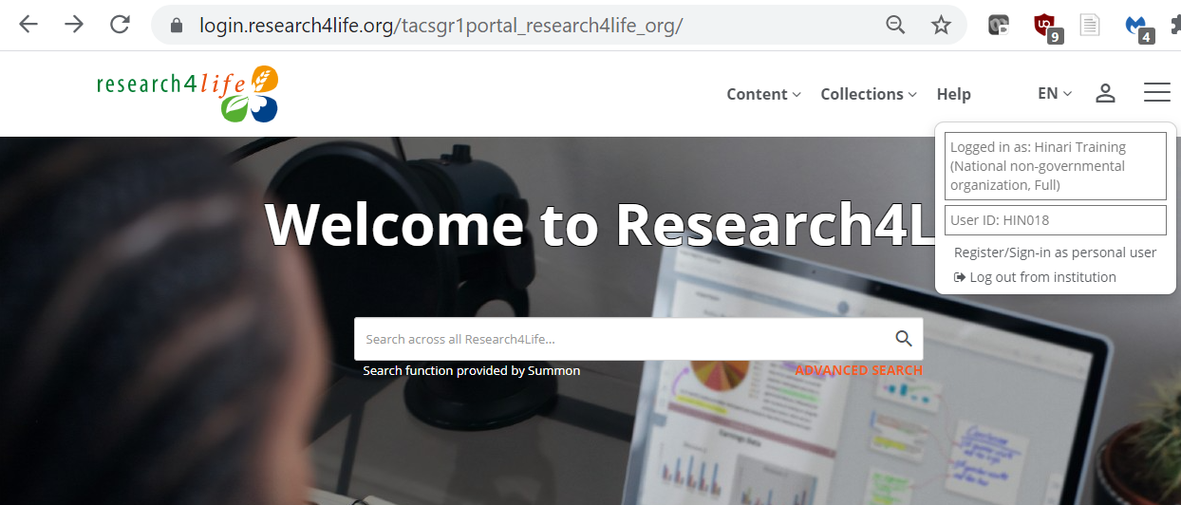
Initial display of the Unified Content Portal
The initial page displays a link to the Summon search box that links to citations and full-text available at your institution.
Click on the person symbol located at the top right corner of the login page to open the login information –in this case, for a Hinari Training: National Non-governmental login; the symbol has changed.
Note that, after logging into the portal, you can ‘sign-in as a personal user’; see slides 29 & 30.

Slide 12
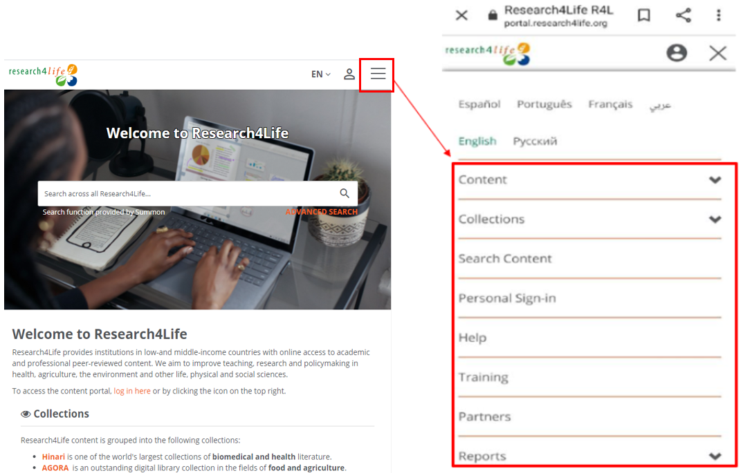
Hamburger Menu: Mobile phone access
Displayed is the mobile phone version of the Unified Content Portal:
Initial page; click on the Hamburger Menu symbol.
The various browse and search and other content portal options are listed and will be discussed in subsequent slides.

Slide 13
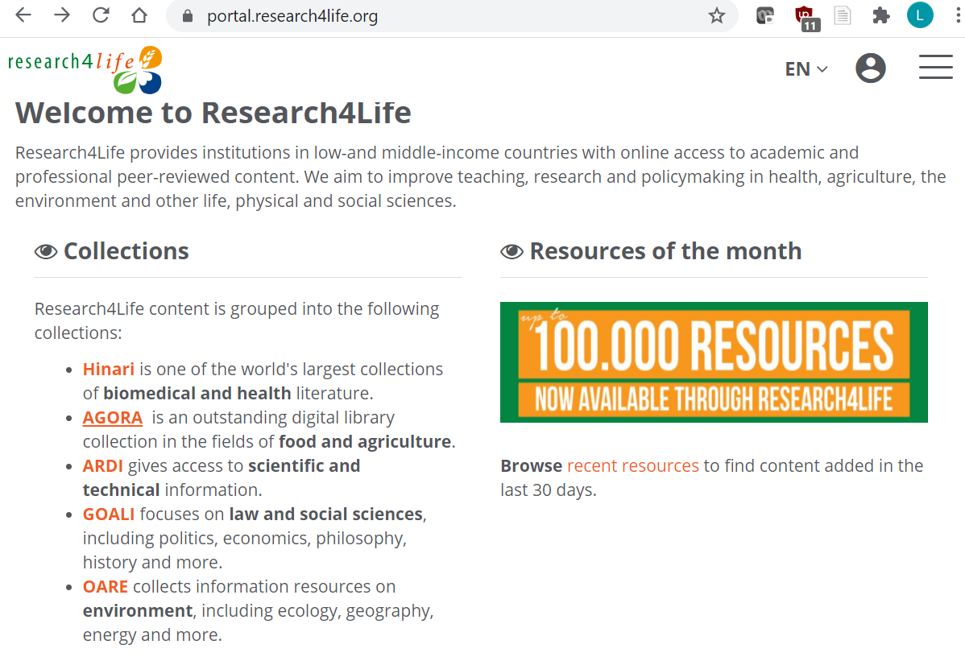
Access to specific Collections from initial portal page
Once logged in, scroll down the initial page till the Collections listing is displayed
Note the links to the five collections.
For Hinari, GOALI and OARE, the specific programmes and resources will be displayed from the Unified Content Portal.
For AGORA and ARDI, the stand-alone content portals will be displayed. Click on ARDI.

Slide 14
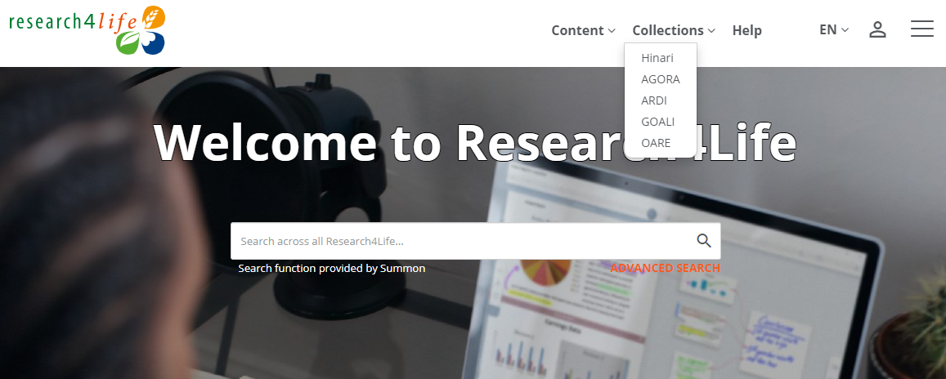
Browsing by Collections
In the Unified Content Portal, the initial page displays the Collections option.
Users can access the resources for a specific collection by clicking on the title of the program.
The next slide displays the AGORA Collection within the Unified Content Portal.

Slide 15
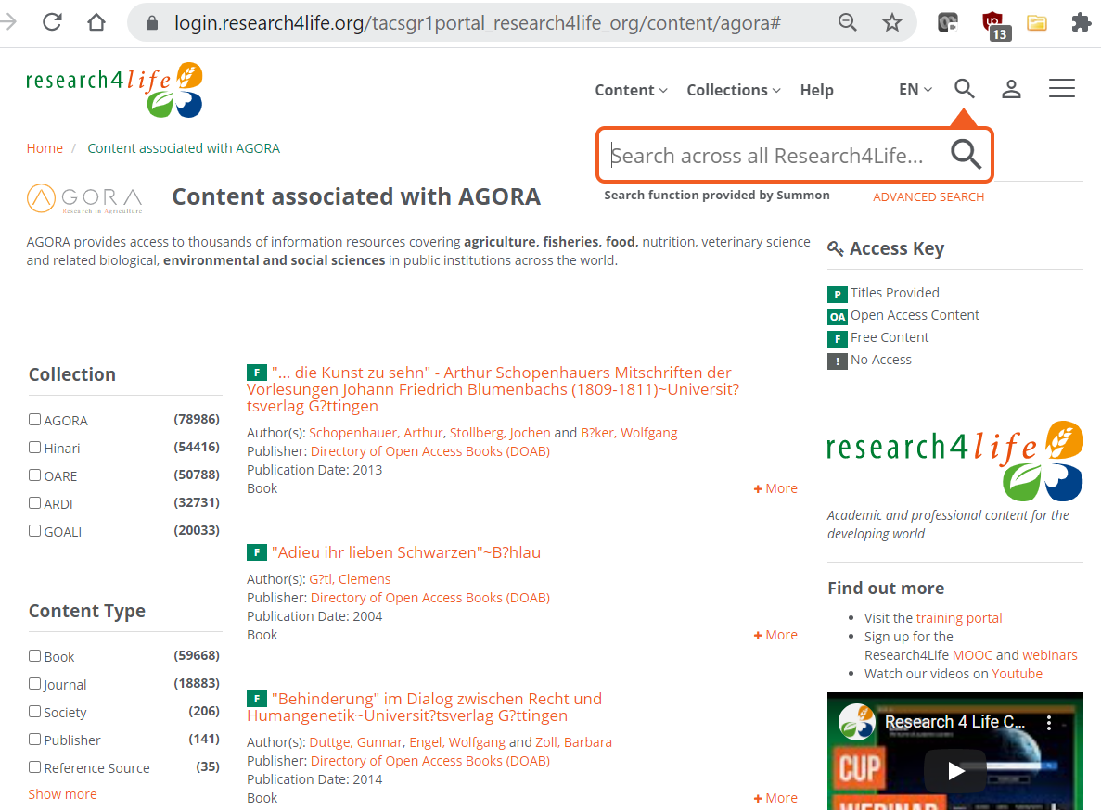
Collections: AGORA
For the AGORA programme, the initial page displays the Collections Content, Type and other options for searching.
The symbol at the top right corner displays the Summon search tool.
The Access Key notes if the specific item is available or not for the user.
Click on Home to clear.
*Note that AGORA and ARDI have separate Content Portals

Slide 16
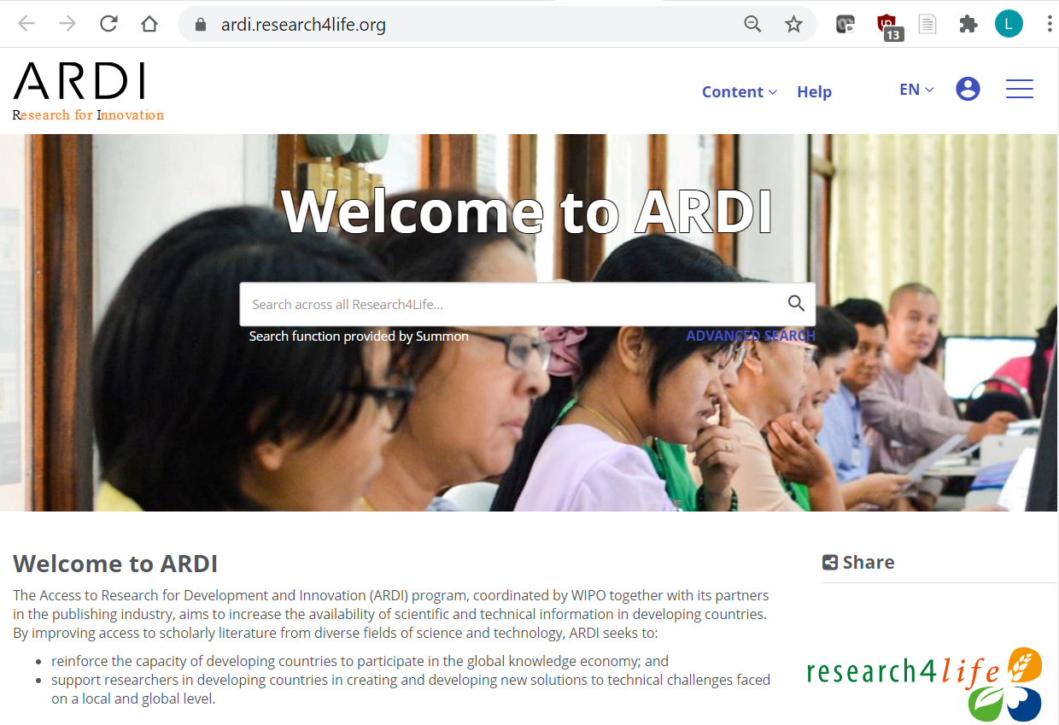
ARDI Content Portal
Displayed is the ARDI Content Portal.
The features and browse/ search options are similar to those in the Unified Content Portal
To return to the Unified Content Portal, click on the Research4Life logo

Slide 17
Databases Search: Identical for Journals, Books, Reference Sources and Free Resources
Returning to the Unified Content Portal, click on Content menu.
Note the options for Journals, Books, Reference Sources, Databases, Free Collections, Publishers, Recent Resources and Subject.
Click on Databases - to access all the R4L resources in this category.

Slide 18
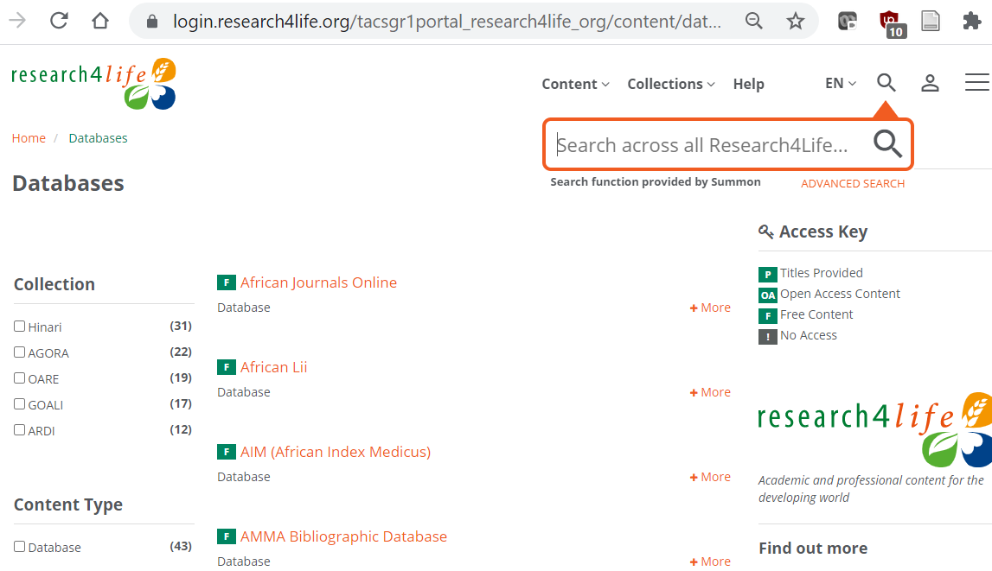
Databases Search continued
All the R4L databases are listed in alphabetical order – a total of 43.
Note that you can apply the Collection, Publishers, Language and Subject filters to the Databases listing.
See the Access Key – in this case, all resources have the Green ‘P’ Title Provided symbol.
The Summon search tool can be activated - by clicking on

Slide 19
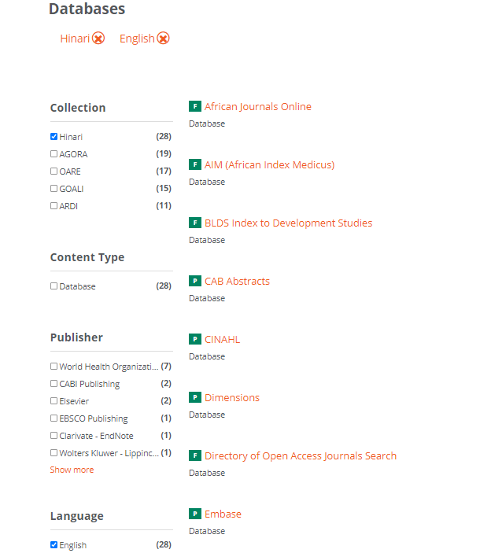
Databases Search continued
The Hinari and English filters have been applied to the Databases page. The search results are 28 resources.
Scroll down the list to the PubMed (premier biomedical database) link.
At the top of the page, the Hinari and English filters are noted in red. To remove the filters, click on the X; otherwise, they remain activated.

Slide 20
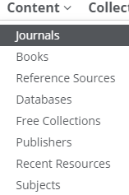
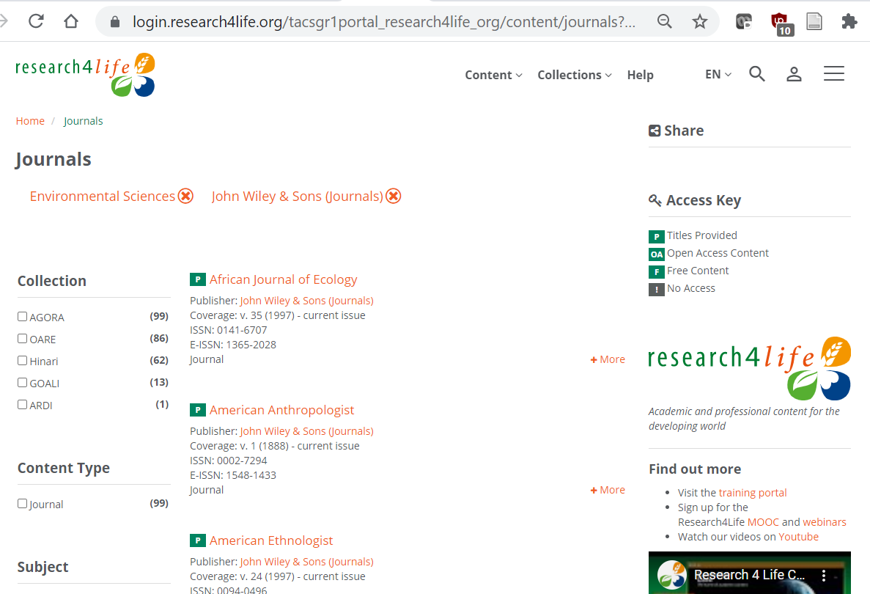
Journals Search
From the Content menu, the Journals collection has been opened. Using the filters, Environmental Sciences (subject) and John Wiley & Sons (publisher) have been activated – a total of 99 titles.
Note the various options in the left column. Remember to de-active the filters by clicking on the X.
Click on title African Journal of Ecology to link to the Wiley Online Library.

Slide 21
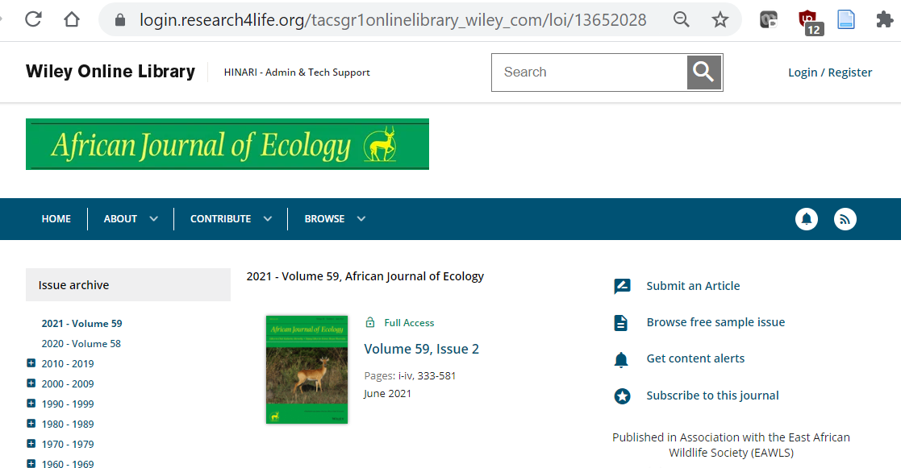
Journals Search continued
The volumes and issues of the African Journal of Ecology in the Wiley Online Library are been displayed.
For the current Volume 50, Issue 2, click the link.
The specific volume/issue now is displayed.
Please note the process for opening Books is identical.

Slide 22
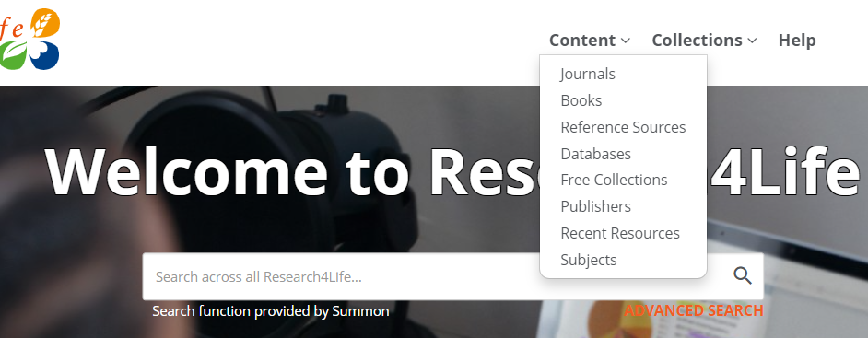
Databases, Reference Sources and Free Collections
In the Content drop down menu, note the Reference Sources, Databases and Free Collections listings.
Included are discipline specific resources (i.e., Environmental Index, Agriculture and Environmental Statistics for the environment; PubMed for health).
Also available are Interdisciplinary resources such as Research4Life/ Google Scholar, Dimensions and The Lens.

Slide 23
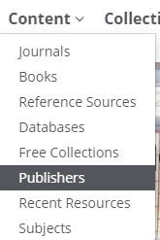
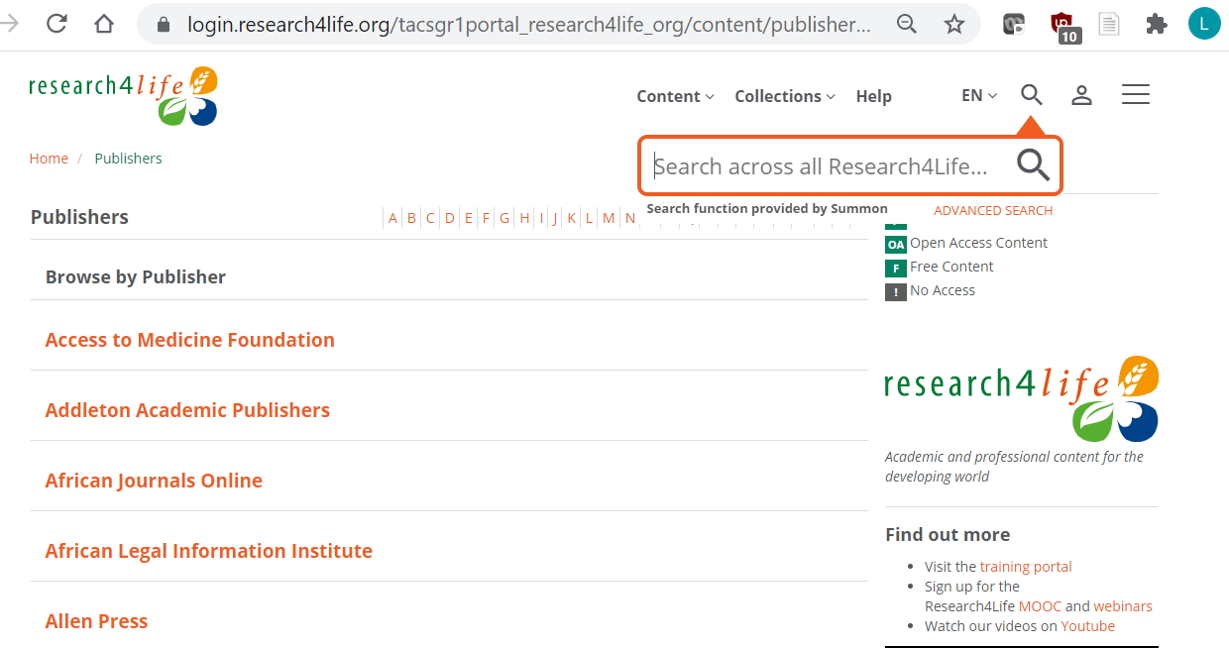
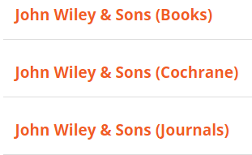
Publishers Search
From the Content menu, click on Publishers.
The Publishers information is organized differently – with an A-Z title listing.
Click on John Wiley and Sons
Some publishers with multiple formats cluster all the titles together while other prefer separate lists:

Slide 24
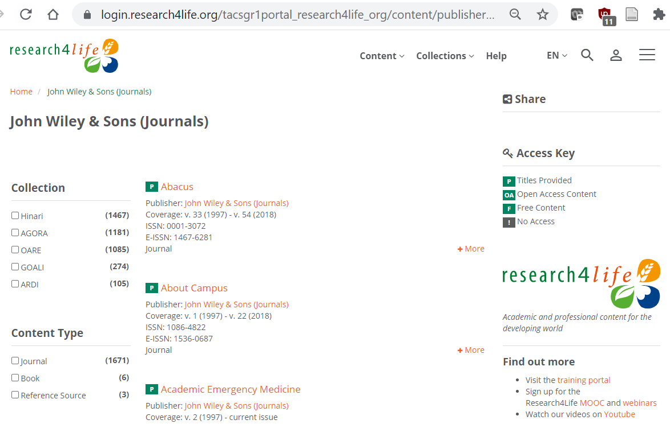
Publisher Search continued
From the Publishers list, displayed are the initial titles for John Wiley & Sons (Journals).
By clicking on the title, users can access the journal’s contents.
The Content Type notes the number of journals, books, reference sources, etc. – from the publisher.

Slide 25
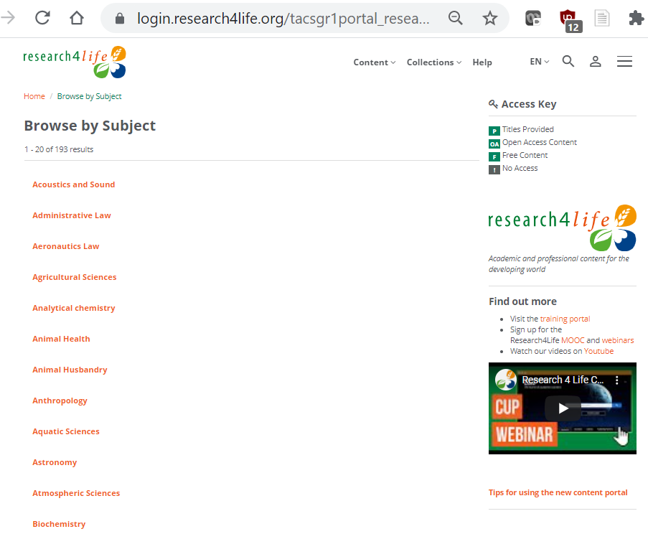
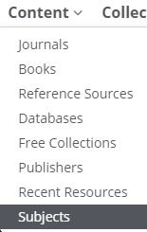
Browse by Subject
From the Content menu, click on Subjects.
Displayed is the first of 20 of 193 subjects.
Listed are Subject topics for all the programmes’ disciplines.
Each subject contains a list of Research4Life books and journals that fall under the topic.

Slide 26
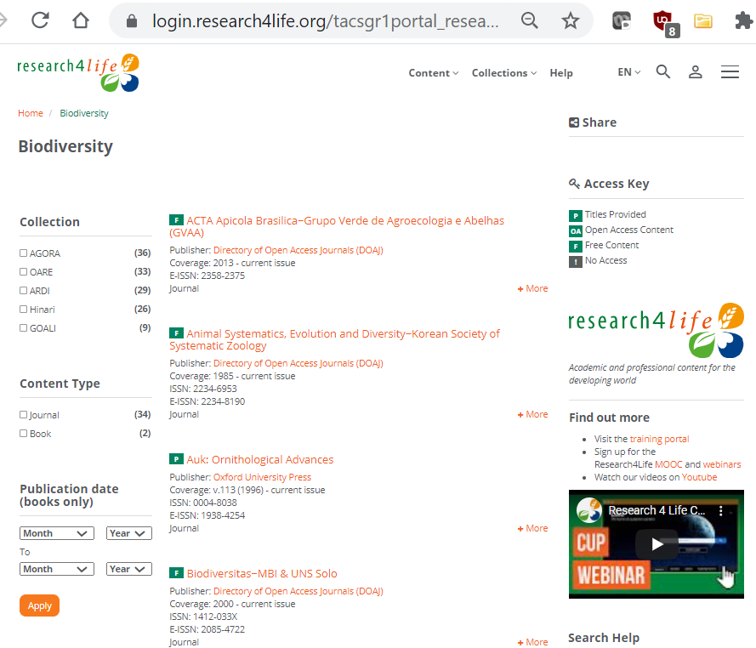
Browse by Subject continued
Opened is the Biodiversity subject listing.
Note that the filters (Collection, Content Type, etc.,) can be applied.
The Access Key will note if the material is available at your institution.

Slide 27
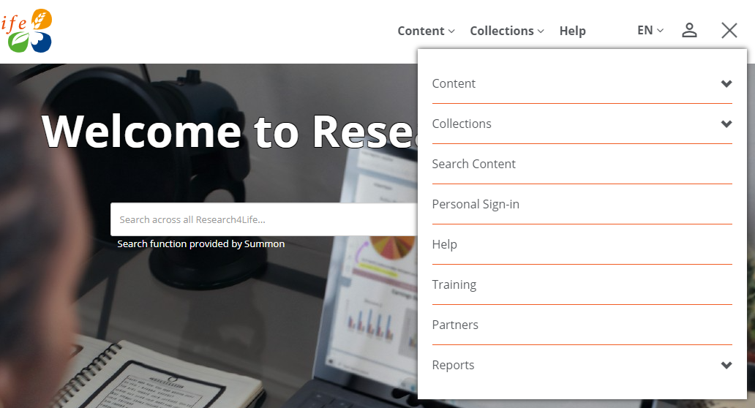
Hamburger Menu – additional tools
Displayed is the Hamburger Menu – accessed from the initial Unified Content Portal page.
Key additional tools are:
Search Content
Personal Sign-in
The subsequent slides are an overview of these two features.
The Search Content tool searches the R4L journal and book titles plus authors but not the text; go to Summon for keyword searching.

Slide 28
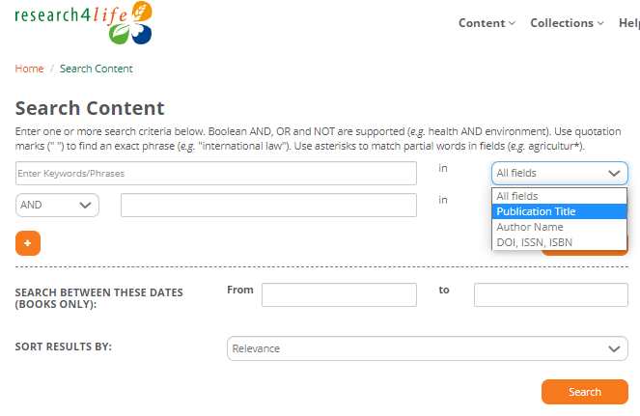
Search Content – initial page features
From the Hamburger menu, the Search Content page is displayed
Boolean logic, fields and Sort by options are available.
Note the limited # fields – Publication Type, Author Name and DOI, ISSN or ISBM # plus All Fields.
The Search Content tool searches the journal or book titles available in Research4Life.

Slide 29
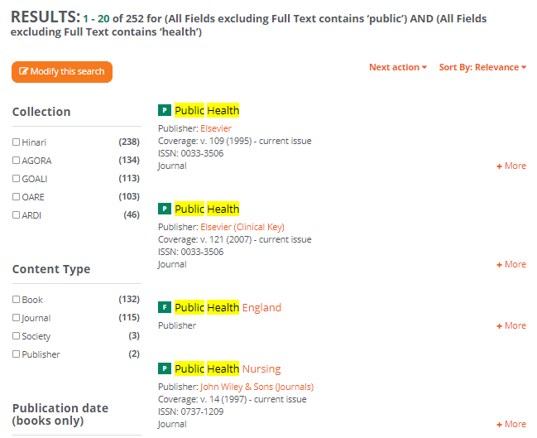
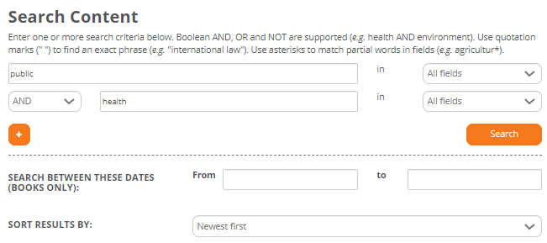
Topic search & results (e.g., public and health)
Type public and health with All Fields and sort results by Newest First
Figure in the right shows the Search results and they are bolded in yellow.
This search produced 252 results – 1st four listed are 3 Journals and 1 publisher; books included.
Notes:
‘Search content’ side doesn’t display

Slide 30
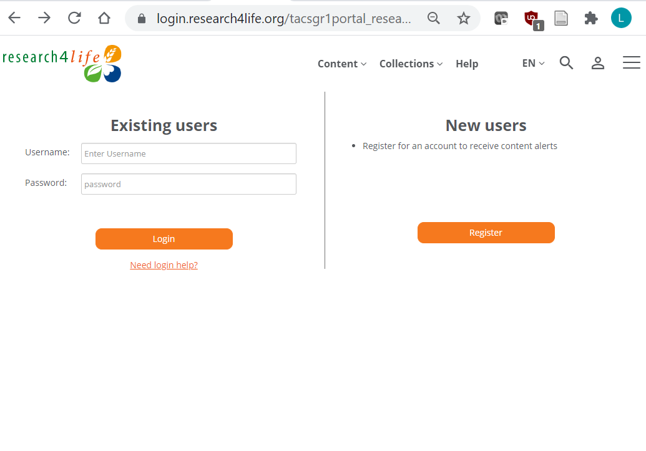
Personal Sign-in
After completing the institutional login, open the hamburger menu and click on Personal Sign-in.
The Existing users and New users options will display.
Once registered and logged in, the personal sign-in will be displayed by clicking on the person symbol.
Need login help? Use this link for forgotten username or password. The link is available below the login field.

Slide 31
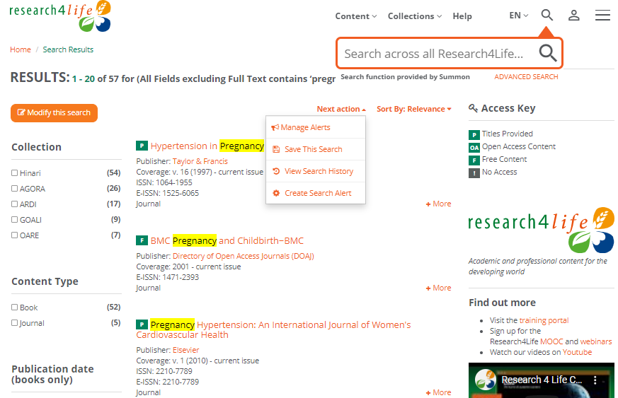
Personal Sign-In Options – Search Content (initial page features)
Use the Search Content tool from the Hamburger menu.
Displayed is a pregnancy title search
From a Search Results page, click on the drop-down menu Next Action
to Save a Search, View Search History
or Create Search Alert.
Saved searches etc. can be viewed under My profile by clicking on
Remember to use Summon for keyword searches for articles, book chapters, etc. available at a specific institutions.

Slide 32
Searching across Research4Life using Summon
Summon is known as a ‘Google-like’ search engine.
It allows users to refine keyword searches by content type, publication date, discipline, subject terms & language.
Summon search results are mapped to the material that the publishers grant access to in a specific country & are linked to the full text.
See detailed information in training lesson 3 ‘Searching Across Research4Life Using Summon’
https://www.research4life.org/training/resources-for-information-specialists/presentations/
Notes:
Detailed information about Summon and its various features is available on Lesson 3.6.

Slide 33
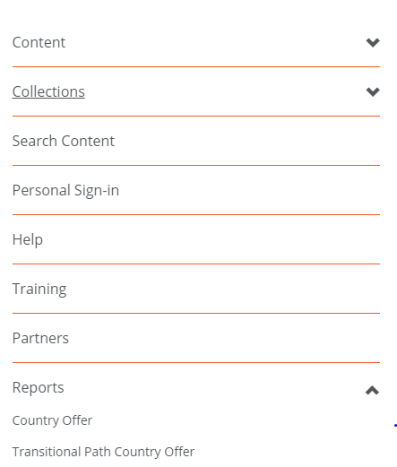
Country Offer
To check the content that publishers have granted access to in a specific country and institution type,
Open the Hamburger Menu.
Click on Reports.
Then click on Country Offer.
Notes:
http://extranet.who.int/hinari/en/country_offer.php
If a publisher is listed, the institution’s users should have access to the material. If a specific journal title or book is not available, report this to r4l@research4life.org.

Slide 34
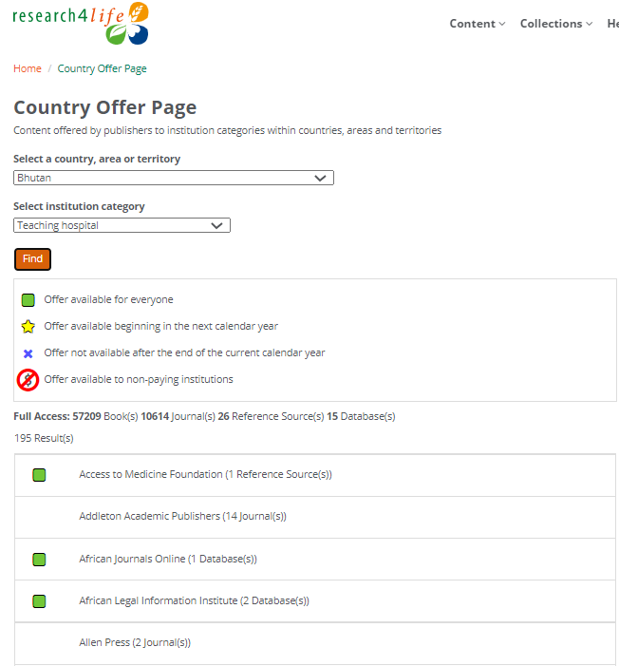
Country Offer continued
Displayed is the Country Offer Page. From the drop-down menu;
Select a country e.g., Bhutan
Select an institutional category e.g., Teaching hospital
Click on Find
Note the code used for the subsequent alphabetical list of Research4Life publishers that are granting access.
For Bhutan, the total access #s are 57209 books, 10614 journals, 26 reference sources and 15 databases

Slide 35
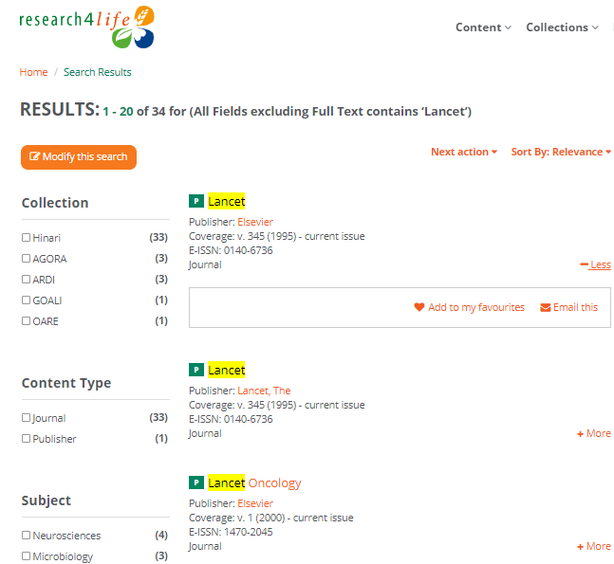
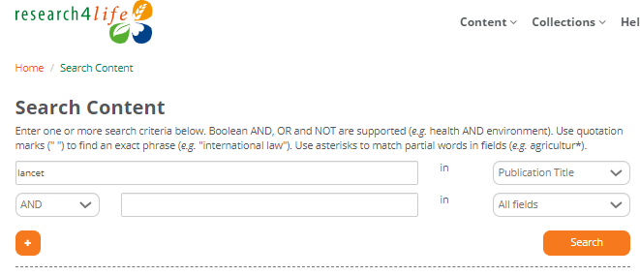
Open, download a pdf and export a citation - access to The Lancet (via Hamburger Menu/Search Content)
The Lancet with Publication Type search results
Search results - bolded in yellow
12 results – click on the 1st listing
Notes:
This one is OK!

Slide 36
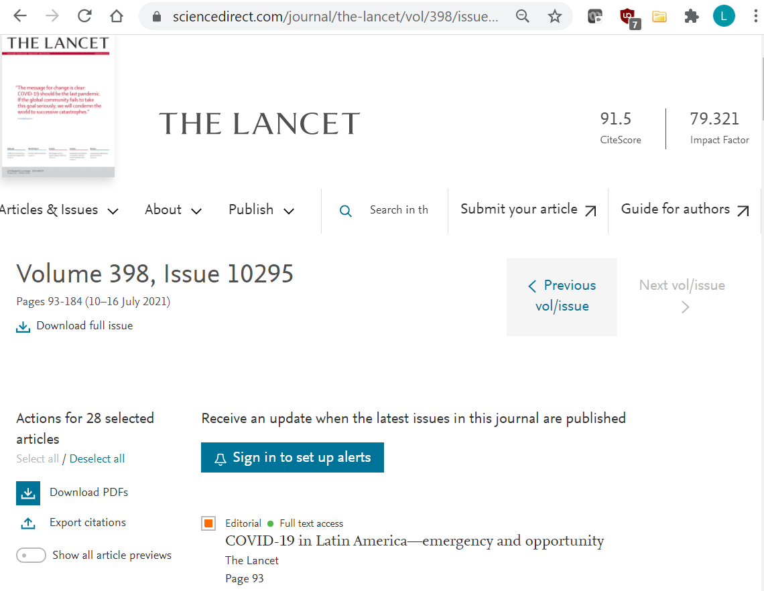
Open, download continued
Via Elsevier’s Science Direct, the current volume of The Lancet has been opened.
Follow the instructions in the subsequent slides.

Slide 37
Downloading a journal article from The Lancet
There are options to download a PDF and Save the article
Click on PDF to save the article to your device
Click on the Export Citations option – see next slide

Slide 38
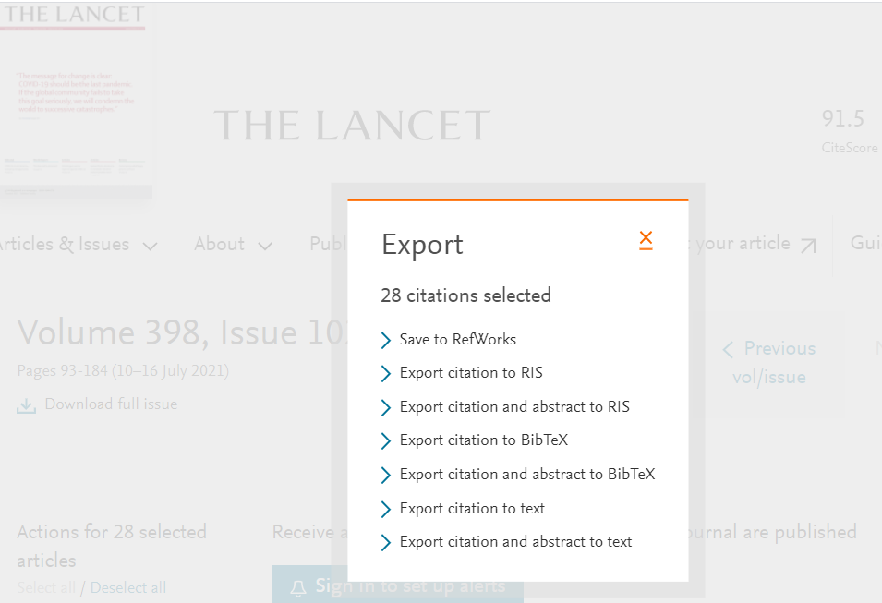
Exporting a journal citation from The Lancet
Now displayed are the Export options
Note the options to:
Save to RefWorks
Export to RIS
Export to BibTeX
Export to Text
Check your bibliographic software to identify the required format

Slide 39
Troubleshooting and support
Common issues;
access to the journal has a blocked popup message.
failure to properly login with the institution's Username/Password.
journal or book titles not included in publisher’s offer.
technical problems at the publisher's website.
What to do.
If the user is logged in and the institution has access to the specific title, this confirms that there is a technical problem at the publisher’s website. Report this problem to the Research4Life HelpDesk at r4l@research4life.org
Notes:
If access is not granted to a journal, first check if there is a blocked pop-up message that needs to be resolved. If the publisher requests an individual login or for the user to pay for access, check that the login has been completed properly. Then check whether the publisher does or does not grant access to this title/specific issue that is being requested.

Slide 40
Contact the HelpDesk
When contacting the HelpDesk, please use the following checklist:
What is your institution name and country?
What is the username and password you are using? (if applicable)
Does your institution use IP-based access to Hinari and Research4Life? (if applicable).
Are you able to login or do you get a ‘Failure to authenticate’ message?
Are you having problems accessing all content or a specific journal or book?
If you have a problem to access a specific title, please write down the name of the journal or book.
Please include a screenshot (including URL) of the error you experienced.

Slide 41
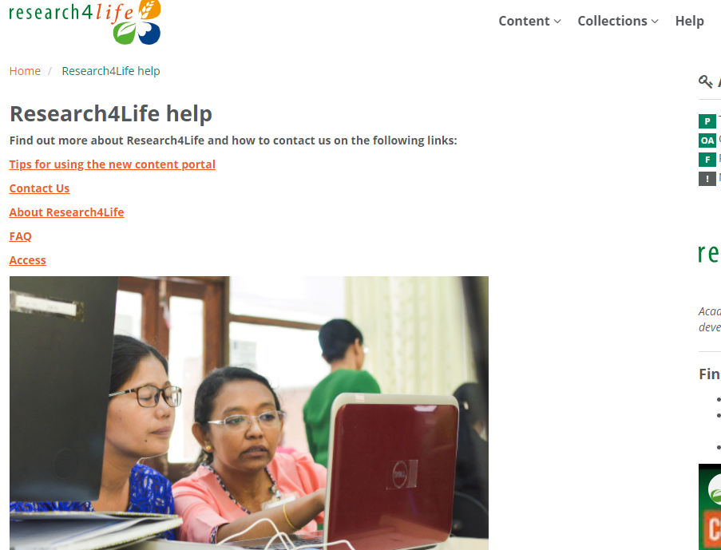
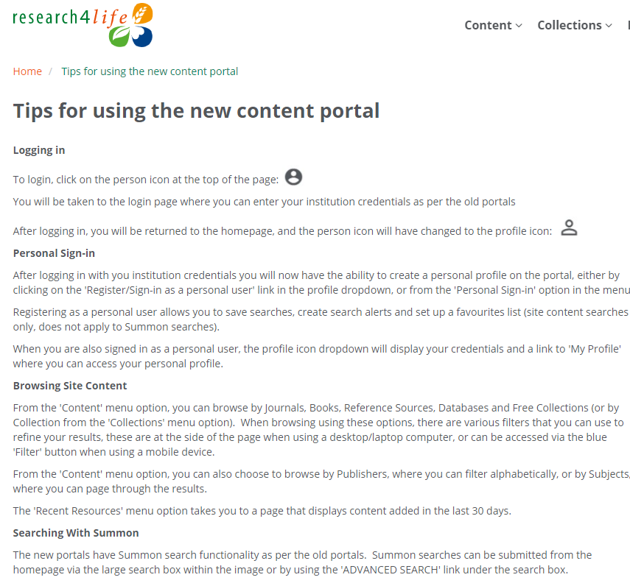
Additional Resources – Portal Help page

Slide 42
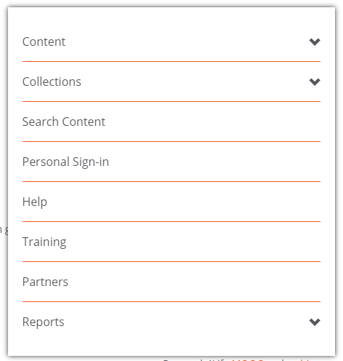
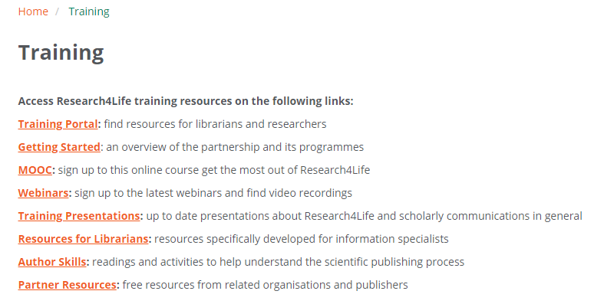
Additional Resources – Research4Life Training Portal
From the Hamburger Menu, users can access the Research4Life Training Portal numerous topical pages including Training Presentations

Slide 43
Summary
This lesson focused on access to Research4Life collections ’ resources by the Unified or AGORA or ARDI Content Portals.
It explored how to browse/search by Content, Collections, Databases and Journals or search for the content across all collections.
The lesson also covered additional resources that are available via the Databases, Reference sources and Free collections listings.
Also reviewed is how to identify what the publishers have granted access to in a specific country/type of institution via the Content offered by publishers to institutions within countries, areas and territories page.
Several additional resources from the Content Portal’s help page and R4L training portal are summarized.

Slide 44
You are invited to;
Visit us at www.research4life.org
Contact us at r4l@research4life.org
Find out about other training materials [www.research4life.org/training]
Subscribe to Research4Life newsletter [www.research4life.org/newsletter]
Check out Research4Life videos [https://bit.ly/2w3CU5C]
Follow us on Twitter @r4lpartnership and Facebook @R4Lpartnership

Slide 45
For more information on Research4Life
www.research4life.org
r4l@research4life.org
Research4Life is a public-private partnership of five collections:

