Slide 1
Scholarly communication and Research4Life
Research4Life
Research4Life is a public-private partnership of five collections:

Slide 2
Lesson outline
Introduction
Research4Life Partnership
Research4Life collections
Research4Life collections eligibility criteria
Group A and Group B country categories
Research4Life user agreement and terms of use
Registration for Research4Life collections
Access to Research4Life collections
Research4Life helpdesk
Summary
v1.3 January 2022
This work is licensed under Creative Commons Attribution-ShareAlike 4.0 International (CC BY-SA 4.0)

Slide 3
Learning objectives
The Research4Life partnership.
The collections of Research4Life and their subject coverage.
The factors for the eligibility to access collections.
User agreements and the terms to use the collections.
Type access and authentication system.

Slide 4
Introduction
Access to a wide range of scientific literature is out of reach for universities and research institutes in low-income countries.
Typical subscription cost for a single journal title is at several thousand dollars.
Research4Life initiative was created to reduce the knowledge gap between high-income countries and low and middle-income countries.
Research4Life provides affordable access to important scientific research.
Further information is available from the Research4Life website at https://www.research4life.org/
Notes:
The high cost of subscriptions for scientific literature has long been prohibitive for universities and research institutes in low-income countries. Starting from the early 2000s, cost cutting became an issue even in wealthy countries. With the typical subscription cost for a single journal title at several thousand dollars, access to a wide range of scientific journals is out of reach for most communities in the world and this increased the knowledge gap among them. The Research4Life initiative was created to reduce the knowledge gap between high-income countries and low and middle-income countries by providing affordable access to important scientific research. This lesson will introduce the Research4Life partnership, its programmes, the way it works in terms of eligibility criteria, terms of use and provided services. This will prepare learners to explore individual collection in detail later in the course.

Slide 5
What is Research4Life ?
Research4Life is a public–private partnership of the FAO, WHO, UNEP, WIPO, ILO, Cornell University, Yale University, the International Association of Scientific, Technical & Medical (STM) Publishers and up to 155 international scientific publishers.
Main goal for Research4Life to reduce the knowledge gap between high-income countries and low and middle-income countries by providing affordable access to high-quality scientific research.
Since 2002, Research4Life provided researchers from more than 10,000 institutions in more than 125 low- and middle-income countries with free or low-cost online access to up to 151,000 leading journals. Books and other resources in the fields of health, agriculture, environment, applied sciences and global justice.

Slide 6
Research4Life collections
Via the Unified Content Portal, users can access the following collections:
Research in Health (Hinari),
Research in Agriculture (AGORA),
Research in the Environment (OARE),
Research for Development and Innovation (ARDI),
Research for Global Justice (GOALI).
To access the Unified or AGORA or ARDI Content Portal, go to https://portal/research4life/org/

Slide 7
Hinari - Research in Health
Launched in 2002. Managed by the World Health Organization partnership with Yale University and 160 scholarly publishers.
Provides access to up to 21,000 journals, 68,000 e-books and 120 other resources.
The journals can be searched through a special version of PubMed (Medline) and other article indexes.
Notes:
•The journals available through Hinari can be searched through a special version of PubMed (Medline), and other article indexes. Access and further information is available at www.research4life.org/ and the contact address for the programme is hinari@who.int.

Slide 8
AGORA - Access to Global Online Research in Agriculture
Launched in 2003; managed by the Food and Agriculture Organization.
For students, faculty and researchers in agriculture, fisheries, food, veterinary science, nutrition and related biological and life sciences in the developing world.
Provides free or low-cost access to a collection of up to 18,500 key journals, 70,000 books and 70 other information resources
Notes:
AGORA is designed to enhance the scholarship of the many thousands of students, faculty and researchers in agriculture and life sciences in the developing world. The programme covers the full spectrum of biological, environmental and related social sciences, cutting through diverse subjects including soil science, nutrition, economics, chemistry and others. Access and further information is available at http://www.fao.org/agora and the contact address for the programme is agora@fao.org.

Slide 9
OARE - Research in the Environment
Launched in 2006.
OARE (Online Access to Research in the Environment) is managed by the United Nations Environment Programme (UNEP) partnership with Yale University and up to 65 in publishers.
Covers disciplines such as; natural environment, environmental toxicology and pollution, zoology, botany, ecology and many others.
Provides access to up to 14,500 journals, 38,000 e-books and 60 other resources.
Notes:
•OARE (Online Access to Research in the Environment) is managed by the United Nations Environment Programme (UNEP) in partnership with Yale University and up to 65 publishers.
•OARE provides access to up to 11,500 journals, 27,000 e-books and 40 other information resources in a wide range of disciplines including the natural environment, environmental toxicology and pollution, zoology, botany, ecology, environmental chemistry, geology, hydrology, oceanography, meteorology, climatology, geography, environmental economics, environmental law and policy, conservation policy and planning, environmental biotechnology, environmental engineering, energy, and many others.
Access and further information is available at http://www.unenvironment.org/oare and the contact address for the collection is oare@research4life.org.

Slide 10
ARDI - Research for Development and Innovation
Launched in 2009.
ARDI (Access to Research for Development and Innovation) is managed by the World Intellectual Property Organization in partnership with its publishing partners.
Aims to improve to scholarly literature from diverse fields of science and technology.
ARDI provides access to up to 9,000 journals, 52,000 e-books and 35 other resources.
Notes:
ARDI aims to promote the integration of developing and least developed countries into the global knowledge economy, allowing them to fully realize their creative and innovative potential.
By improving access to scholarly literature from diverse fields of science and technology, the ARDI programme is designed to reinforce the knowledge infrastructure in developing and least developed countries and to support researchers in these countries in creating and developing new solutions to technical challenges faced on a local and global level.
ARDI provides access to up to 30,000 journal, e-books and reference work in 120 countries. Access and further information is available at www.wipo.int/ardi and the contact address for the collection is ardi@wipo.int.

Slide 11
GOALI - Research for Global Justice
Launched in 2018.
GOALI (Global Online Access to Legal Information) is coordinated by the International Labour Organization (ILO), the International Training Centre of the ILO, Lillian Goldman Law Library at Yale Law School and the Cornell Law School Library.
Provides access to up to 3,000 journals, 18,000 books and 45 other information resources. Focuses on legal research and training.
Notes:
GOALI - Global Online Access to Legal Information is a new programme to provide free or low-cost online access and training to law and law-related content to eligible institutions in developing countries.
The aim of GOALI is to improve the quality of legal research, education and training in low- and middle-income countries, and in turn strengthen legal frameworks and institutions and further the rule of law.
Access and further information is available at www.ilo.org/goali and the contact address for the collection is goali@ilo.org.

Slide 12
Access to Content Portals
As of 01 July 2021, Research4Life launched a new content portal that reorganizes and enhances access to numerous journals, books and other resources.
Unified Content Portal – access to the five discipline Collections https://portal.research4life.org/
AGORA Content Portal https://agora.research4life.org/
ARDI Content Portal https://ardi.research4life.org/
Also available from the R4L website https://login.research4life.org

Slide 13
Eligibility
Access to Research4Life is restricted to eligible institutions in eligible countries. These include:
National universities
Professional schools
Research institutes
Teaching hospitals and healthcare centres
Government offices
National libraries
Agricultural extension centres
Local non-governmental organizations

Slide 14
Factors that define if a country is eligible.
Total GNI by World Bank
GNI per capita by World Bank
United Nations Least Developed Country (LDCs)
Human Development Index (HDI) by UNDP
Healthy Life Expectancy (HALE) by WHO
Countries, areas or territories with a total GNI above US$1 trillion are not eligible for Research4Life programmes, regardless of other factors.
Notes:
The eligibility of countries is assessed once a year. It depends on different factors that define if a country is eligible and whether eligible countries will form part of the categories “Group A” or “Group B”

Slide 15
Group A and Group B country categories
Group A countries have free access to Research4Life. Group B countries must pay US$1,500 per year to obtain access to the Research4Life.
Core Offer Group A – Free Access
Core Offer Group B – Fee-based access
United Nations Least Developed Country List and/or
Total Gross National Income (GNI) is at or less than US$ 15 billion where Gross National Income per capita (GNIpc) at or less than US$ 3000
Total GNI is at or less than US$ 2 billion where GNIpc at or less than US$ 5000
Total GNI is at or less than US$ 200 billion where: Human Development Indicator (HDI) is at or less than 0.60 and/or (GNIpc) is at or less than US$ 1500
Total GNI is at or less than US$ 1.5 billion and/or
Total GNI is at or less than US$ 25 billion where GNIpc is at or less than US$10,000 and/or
GNIpc is at or less than US$ 6000 where Healthy Life Expectancy (HALE) is at or less than 55
Total GNI is at or less than US$ 300 billion where: HDI is at or less than 0.67 and/or GNIpc is at or less than US$ 6000
Notes:
The eligibility of countries is assessed once a year. It depends on different factors that define if a country is eligible and whether eligible countries will form part of the categories “Group A” or “Group B”
Group A interpretation: – A country, area, or territory must fulfill at least one of the four factors designated by solid bullet points. – The last factor is a complex one. In order to fulfill it, the country, area, or territory must meet the main criterion of the solid bullet point and at least one of the sub-factors designated by the open bullet points under it.
Group B interpretation:
– A country, area, or territory must fulfill at least one of the four factors designated by solid bullet points.
– The second and third factors are complex ones. In order to fulfil them the country, area, or territory must meet both criteria listed in the solid bullet.
– The last factor is a complex one. In order to fulfil it, the country, area, or territory must meet the main criterion of the solid bullet point and at least one of the sub-factors designated by the open bullet points under it.

Slide 16
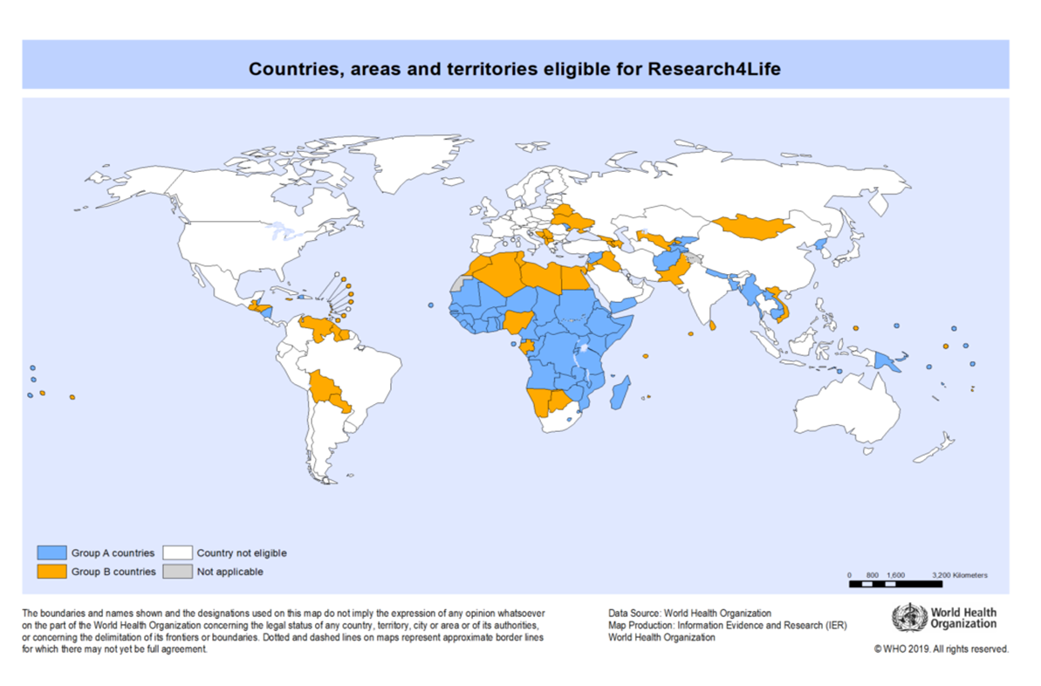
Group A and Group B country categories cont.
Countries that are assigned to Group A or Group B are eligible for all Research4Life collections.
Group A
Group B
Not eligible
Not applicable
Notes:
https://www.research4life.org/access/criteria/

Slide 17
Research4Life user agreement and terms of use
Research4Life collections require a signed user agreement that activates the account.
The user agreement is between the registered institution and the publisher partners of Research4Life.
It allows the licensee to use the publishers’ offer and defines the rules of use for all Research4Life collections.
It covers key information on the use of credentials, copyright and fair usage.
Notes:
The institution appoints a contact person (usually a librarian) who is responsible for sharing the passwords with institutional members and for making sure that users understand the proper use of Research4Life resources. The contact person helps to prevent any accidental violations or withdrawal of the institution’s access privileges and will notify Research4Life of any difficulties in operating the license.
Important contractual items:
Access to the online version of the publishers’ material will be given to employees, faculty members and students of the institution and to persons permitted by the institution to access its services.
The range of back issues available online may vary from publisher to publisher. The publisher may add or remove from the range at any time. This may result in some exclusions from the offer of certain publishers

Slide 18
Research4Life ALLOWS registered institutions and their authorized users to:
Share the password with colleagues, students or faculty members in the same institution,
Download or print up to 15% of a journal issue or book,
Use material for educational purposes (course packs or reserves) or make copies for institutional members,
Use Research4Life collections on personal computers owned personally by the employees, faculty or students of the institution.

Slide 19
Research4Life does NOT allow registered institutions and their authorized users to:
Share the Research4Life username and password outside the registered institution,
Post content on websites or publish credentials online,
Access Research4Life programmes remotely from other installations than institutional devices or devices owned by employees, faculty members or students of the institution,
Access Research4Life programmes whilst travelling outside their own countries,
Download or print complete journal issues or books,
Supply documents available through any Research4Life programmes for a fee,
Modify, adapt, transform or create any derivative work from the publishers’ material,
And they must recognize that:
Owners, employees or affiliates of for-profit corporations are not considered authorized users.

Slide 20
Registration for Research4Life collections
A step-by-step guide on how to register online is available at the Research4Life web site - https://www.research4life.org/access/how-to-register/
Individuals are not eligible to register, only institutions are.
An online registration form is available at the Research4Life web site
Before proceeding, please check the list of registered institutions to see if the institution is already registered.
Once the submitted registration form has been reviewed by Research4Life, the applicant will receive an email with further instructions.

Slide 21
Access to Research4Life
Research4Life grants access in two ways:
Through institutional IP address.
Through institutional login credentials.
Registered institutions are recommended to upgrade access by registering their institutional IP as this provide seamless access for its users.
Please make sure that the IP address of the institution is registered in the IP Registry, this is a necessary validation step before Research4Life can register the institutional IP in its system.
Once registered in the IPRegistry, send your request for IP registration to r4l@research4life.org
Notes:
To do so, first, please make sure that the IP address of the institution is registered in the IPRegistry (theipregistry.org). Please consult with an IT focal point at your institution to check what your institutional IP is. Alternatively, external websites such as whatismyip.com can be used to check this information. Registering in the IPRegistry is a necessary validation step before Research4Life can register the institutional IP in its system. Once registered in the IPRegistry, send your request for IP registration to r4l@research4life.org. You will be informed when the process is completed.

Slide 22
Research4Life helpdesk
If you need any help with using Research4Life collections, please contact: r4l@research4life.org
Checklist for access issues:
What is your institution name and country?
What is the username and password you are using? (if applicable)
Does your institution use IP-based access to the Research4Life Programme? (if applicable)
Are you able to login or do you get a ‘Failure to authenticate’ message?
Are you having problems accessing all content or just a specific journal or book?
If you have a problem in accessing a specific title, please write down the name of that journal or book.
Please include a screenshot (including URL) of the error you experience.

Slide 23
Summary
This lesson introduced to basic information about the Research4Life partnership as a whole and its collections including registration, access, terms of use and support services.
For more detailed information, go to https://www.research4life.org/

Slide 24
Bibliography
Research4Life. 2020a. Eligibility for access to Research4Life. In: Research4Life [online]. [Cited 1 October 2020]. https://www.research4life.org/access/eligibility/
Research4Life. 2020b. Eligibility criteria. In: Research4Life [online]. [Cited 1 October 2020]. https://www.research4life.org/access/criteria/
Research4Life. 2020. How to register. In: Research4Life [online]. [Cited 1 October 2020]. https://www.research4life.org/access/how-to-register/
Research4Life. 2020d. Research4Life Registration Form [online]. [Cited 1 October 2020]. https://registration.research4life.org/register/default.aspx
Research4Life. 2020e. Research4Life Academic Institutions. [Cited 1 October 2020]. https://www.research4life.org/wp-content/uploads/2019/06/Research4Life-Academic-Institutions.pdf

Slide 25
For more information on Research4Life
www.research4life.org
r4l@research4life.org
Research4Life is a public-private partnership of five collections:

