Slide 1
Publishing and Research Communications (PRC) Webinar Series
Webinar Five
Getting Published: how to increase your chances of success
6 July 2022

Slide 2
What is in PubMed?
Topics for today
Outline
Introduction to the webinar series and the webinar
Presentation
Open Q&A
Wrap up

Slide 3
Structured along a simple research life cycle model
What is PubMed?
Vaughan KT, Hayes BE, Lerner RC, McElfresh KR, Pavlech L, Romito D, Reeves LH, Morris EN. Development of the research lifecycle model for library services. J Med Libr Assoc. 2013 Oct;101(4):310-4. Available from: https://www.ncbi.nlm.nih.gov/pmc/articles/PMC3794687/figure/mlab-101-04-13-f01/

Slide 4
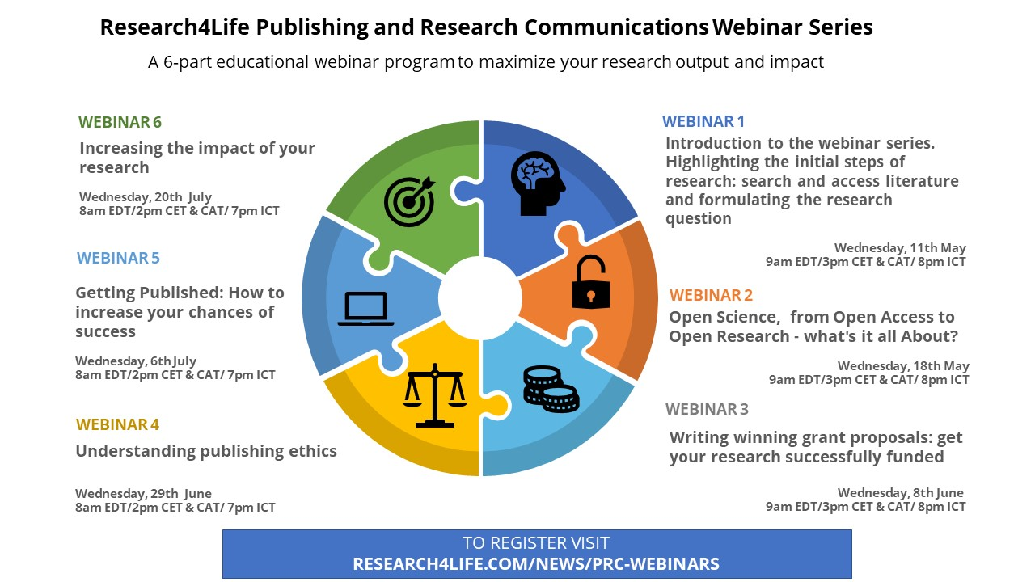
What is in PubMed?
6 educational webinars, aligned with the research life cycle
Disseminating:
research impact
Idea Development
Disseminating:
writing and publishing research output
Research Landscape
Conducting: publishing ethics
Funding + Proposals

Slide 5
Highlights
Collaboration among multiple Research4Life partners
Target audience
webinar attendance: Research4Life eligible countries
recordings and materials will be freely available on the Research4Life website: https://www.research4life.org/training/webinars/#prc
Challenges facing LMIC/R4L users will be discussed

Slide 6
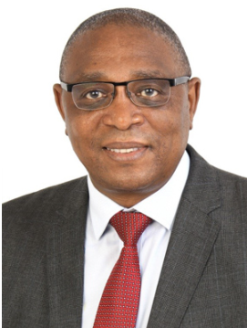
Today’s presenters
Victoria Babbit
Director of Researcher Development & Outreach
Taylor & Francis
Gracian Chimwaza
Executive Director
ITOCA
Mercy Moyo
Senior Program Officer (Research & Training)
ITOCA
Notes:
Victoria Babbit is the Director of Researcher Development and Outreach. Victoria joined Taylor & Francis in 2008 and throughout the past decade has supported societies, editors and authors as they navigate the rapidly changing publishing landscape. Her work involves engaging with global researcher communities to build knowledge and capacity related to publishing and editorial activities. Prior to joining Taylor & Francis, Victoria was a post-graduate researcher within the field of Geography, focusing on migration, at the University of Washington in Seattle.
Gracian Chimwaza is the Executive Director of ITOCA and the current Chair of the Research4life Executive Council. Gracian has more than 20 years experience of developing and deploying online and face to face training courses on information discovery and management, including but not limited to Research4life courses. Gracian holds a PhD in Information Science from University of Pretoria in South Africa and an MBA from Thames Valley University in the UK.
Mercy Moyo is a Senior Programme officer for Research and Training at ITOCA. Mercy has over 10 years experience in capacity building, information, knowledge and project management. Mercy holds a Masters in Information Science from University of South Africa and is a third year PhD student at the same institution.

Slide 7
Outline
Choosing a journal
Preparing a manuscript
Submission
Peer Review

Slide 8
www.menti.com
code: 9020 2713

Slide 9
Choosing a publishing venue

Slide 10
Questions to ask yourself about your article
Who is the audience for my article?
Does my article arouse interest globally, regionally, or locally?
What is the subject matter of my article?

Slide 11
Issues to consider about Journals
Take into consideration the type of article you would like to publish: a full length article, a letter or a review;
Check the references in your article, to give an indication of possible journals of interest;
Read the journal’s aims and scope on the journal homepage: check if my article fits the aims and scope of the journal.
Some journals specify the type of research they do not publish.

Slide 12
Issues to consider about journals
Issues to consider about Journals continued
Check if the journal has published work similar to yours in quality and scope, in the past 5 years;
Read or download the journal’s Guide for Authors. It is important to note word count restrictions;
Check if the journal is invitation-only: some journals only accept articles after inviting the author to submit;
Check the journal’s performance review and publication timelines;
Submit your paper to only one journal at a time.

Slide 13
Issues to consider about Journals continued consider about journals cont..
If you choose to publish open access, remember that most journals explain their open access options on the journal homepage (Consider the metric for journals known as the Impact Factor (IF) which is usually found on the Journal’s homepage: see the example on next slide.

Slide 14
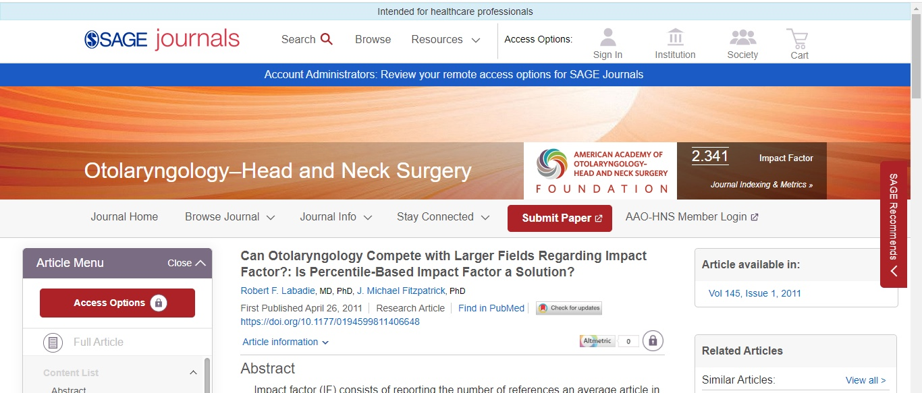

Slide 15
How to target a journal that is right for your research
The slides that follow, show resources that researchers/students/Scientists can make use of when selecting journals in which to publish their research.

Slide 16
(SciDev.Net)
This resource includes information on:
Pointers for avoiding predatory journals;
An explanation of the open access model;
Cautions regarding impact factor;
Questions to consider regarding a journal’s audience;
Advice for developing a communication strategy.
Available at: www.scidev.net/global/publishing/practical-guide/target-journal-right-research-communicate-publish.html

Slide 17
Jane (Journal/Author Name Estimator)
A tool for assisting in the selection of the journal to submit to, or to locate similar research articles, or for an editor to find reviewers.
In a box, users enter title and or abstract of his or her paper.
Click on either find journals, find authors or find articles.
Search terms are matched against articles in the Medline database.
Also available is a keyword search tool.
Available at: https://jane.biosemantics.org/

Slide 18
Journal Selector English editing for scientists)
This resource uses semantic technology to help identify the proper journal(s) for the publication of specific research.
In the Journal Selector box, enter an abstract or sample text;
Results are a list of journals that publish in related areas;
Search results are based on such factors as publication frequency, Impact Factor or publishing model: including open access.
Available at: www.edanzediting.com/journal_selector

Slide 19
Open Access
Making content freely available online to read. Meaning your manuscript can be read by anyone, anywhere.
Making content reusable by third parties with little or no restrictions.

Slide 20
OA Publishing Models
Gold Open Access
Full OA
Hybrid OA
Journals that publish all content Open Access.
Funded by:
APC (article publishing charge)
Sponsorship
Institutional agreement
Subscription-funded journals that offer the option of Open Access.
Open Access cost is funded by:
APC
Under an agreement with a institution

Slide 21
Waivers & discountsrs & discounts
Discounted rates for select hybrid journals
R4L has a page with Best practices for APC waivers - https://www.research4life.org/partner-resources/apc-waivers/
They also have a page with links to publisher APC waiver policies so that its users can quickly find this information. The page will be updated once a year along with other information that is requested of participating publishers.
Waivers for fully Open Access journals https://authorservices.taylorandfrancis.com/publishing-open-access/requesting-an-apc-waiver/

Slide 22
How to Read a Licence
CC Creative Commons licence
BY Others must acknowledge you when they re-use your work
NC Others can only re-use your work non-commercially
ND Others cannot amend your work
SA The work must be shared under the same licence as the original
22

Slide 23
Predatory Journals
There are questionable, scholarly open-access publishers. Some issues:
Accepting articles quickly with little or no peer-review.
Notifying scholars of article fees only after papers are accepted.
Aggressively campaigning for scholars to submit articles and serve on editorial boards
Listing scholars as members of editorial boards without their permission or appointing fake scholars to editorial boards
Mimicking the name or web site style of a more established journal.
Misleading claims about the publishing operations, such as a false location.

Slide 24
Identify trustworthy publishing environments
Open access journals should follow best practices for scientific peer review of all articles submitted.
There is a misconception that because open access journals charge APCs therefore, they are necessarily poor quality, “predatory” and not peer reviewed.
Authors need to carefully check for quality of both traditional subscription journals and open access journals and publishers.
Guides and checklists are available to help authors select the right journal and publisher to publish their research findings. See an example: Himmefalb Health Library
Notes:
*It is true that there can be rogue or predatory publishers that are only motivated by the fee. However, this is not limited to open access publishing, it happens in toll publishing too.

Slide 25
Predatory Publishers
A detailed webpage on this unfortunate byproduct of Open Access publishing
Contains information on criteria for determining predatory OA publishers, list of hijacked journals, list of misleading metrics, list of predatory journals and ways to identify if predatory OA journal publishers plus related articles on this topic
Part of an extensive Open Access/Scholarly Communication website hosted by the University of Witwatersrand, South Africa
libguides.wits.ac.za/openaccess_a2k_scholarly_communication/Predatory_Publishers

Slide 26
Think. Check. Submit checklist
Also use the Think.Check.Submit checklist.
Think. Check. Submit. helps researchers identify trusted journals for their research. This international initiative by a coalition of scholarly publishers and associations aims to educate researchers, promote integrity, and build trust in credible research and publications.
Notes:
*Go to https://beallslist.net/

Slide 27
Do you or your colleagues know the journal?
Can you easily identify and contact the publisher?
Is the journal clear about the type of peer review it uses?
Are articles indexed in services that you use?
Is it clear what fees will be charged?
Do you recognize the editorial board?
Is the publisher a member of a recognized industry initiative?

Slide 28
Preparing a manuscript

Slide 29
Common problems identified in manuscripts
Poor regard of the journal’s conventions/academic writing.
Poor style, grammar, punctuation or English.
No contribution to the subject.
Not properly contextualised.
Poor theoretical framework.
Messy presentation and sloppy proofreading.
Notes:
.

Slide 30
Preparing your manuscript: some basic tips
Write first, edit later
Keep it simple, express complicated ideas plainly
The paper structure (IMRaD)
You are telling a story-make sure it is consistant and easy to follow
Notes:
.

Slide 31
Style and Language
Refer to the journal’s author guide for notes on style (usually available on the journal’s homepage).
Consider that:
Some authors write their paper with a specific journal in mind.
Others write the paper and then adapt it to fit the style of a journal they subsequently choose.
The objective is to report your findings and conclusions as clearly and as concisely as possible.

Slide 32
Style and Language cont.
Complex language is not needed, bear in mind that poorly written manuscripts get rejected
If English is not your first language, find a native English speaker such as a colleague/editor (if possible) to review the content and language of the paper before submitting it.
See example: Uniform Requirements for Manuscripts Submitted to Biomedical Journals: Writing and Editing for Biomedical Publication http://www.icmje.org/

Slide 33
Ethical Issues
Researchers are encouraged to follow the prescribed guidelines for scientific writing to avoid scientific misconduct
Scientific conduct involves the following :
Plagiarism
Confidentiality
Inaccuracies and biasness
Failure to disclosure conflicts of Interest
Failure to acknowledge funding sources
Data manipulation (Falsification and Fabrication)
For more information on Ethics in Scientific writing: https://www.researchgate.net/publication/320557873_ETHICS_IN_SCIENTIFIC_WRITING

Slide 34
Main components of a Scientific Paper
Title
Authors
Abstract
Introduction
Materials and Methods
Results
Discussion
Conclusion

Slide 35
Title, Authors & Abstract
Title: It should accurately describe the contents of your paper. Try to include as much information in the fewest words possible. Do not include unnecessary words.
Authors: List the most important authors first; others are listed in a descending order of contribution.
Abstract: This is found at the beginning of the paper, after the title and authors. It provides the content of the article in a short form. A well-prepared abstract helps the reader to decide whether the paper is relevant to their interests or not.

Slide 36
Writing an abstract
Write the paper first-it is a map of the entire paper.
Check the IFAs for the journal.
Think about your intended audience.
Focus on the essential information.
Revise everytime you revise the paper.
Language-difficult to read?

Slide 38
Introduction
An introduction serves to:
Provide context and background of the research, and why the research is important.
Clearly state the purpose and /or hypothesis that you investigated.
Briefly explain your rationale and approach and, whenever possible, the possible outcomes your study can reveal.
A good introduction should address the following questions:
What led to the study?
What does literature say?
What are the gaps?
Why was the study important?
What were the outcomes of the research?

Slide 39
Materials and Methods
This section answers the following questions:
What was used? What was done? How was it done?
Describe each procedure in a chronological manner and provide enough details for other researchers to repeat your study and reproduce the results
This means that another scientist should be able to repeat your experiment after reading the description
Other names that can be used for this sections include; Methods, Experimental details, Methodology, Simulations, or Computational setup.

Slide 40
Materials and Methods cont.
What to include:
Study design: procedures should be listed and described, or the reader should be referred to papers that have already described the used procedure.
Techniques used and why, if relevant.
Modifications of any techniques; be sure to describe the modification.
Specialized equipment, including brand-names.
Temporal, spatial, and historical description of study area and studied population.
Assumptions underlying the study.
Statistical methods, including software programs.

Slide 41
Results
In this section, you present your findings: display items (figures and tables) are central in this section.
This section presents the facts--what was found during this investigation. Detailed data such as measurements, counts, percentages, patterns--usually appear in tables, figures, and graphs, and the text of the section draws attention to the key data and relationships among data.
The 3 rules below will help you with this section:
present results clearly and logically
avoid excess verbiage
consider providing a one-sentence summary at the beginning of each paragraph if you think it will help your reader understand your data

Slide 42
Discussion
This is where you discuss your results.
You can start with analyzing the results of the study and end with suggestions for future research or practice.
This section is usually organized in a logical manner so that readers can see the connection between your study question and your results.
Be sure to address the objectives of the study in the discussion and to discuss the significance of the results.
Don’t leave the reader thinking “So what?”

Slide 43
Conclusion
In this section, you can provide a clear scientific justification for your work, indicate uses and extensions if appropriate.
Moreover, you can suggest future experiments and point out those that are underway.
This section should reflect the flow and outcomes of the entire paper. Its not just a restatement of your results

Slide 44
Acknowledgements
At the end of your paper, remember to acknowledge those who helped or made contributions. This can include people who provided technical assistance, people who assisted with experiments, and the funding agency (if any).
In some journals, sources of grant support are noted in the Acknowledgements; in others, they are noted elsewhere (for example, in a footnote). Some journals also include a section on ‘Facilities used’.
Please note that this section is optional.

Slide 45
References
This section includes all the sources of information referred to in the paper.
Makes sure references are listed properly in an alphabetical order and follow the journal guidelines.
Reference should be provided in accordance with the same referencing style used for the in-text citations.
The 10 rules for responsible refencing can be found here
Always remember to CITE WHILE YOU WRITE to avoid plagiarism!

Slide 46
The crucial role of feedback
Share your work throughout the writing process
Colleagues
Conferences
Preprint servers
Writing groups
The paper you submit should be in the best possible shape

Slide 47
Submitting your paper to a journal

Slide 48
Instructions for authors

Slide 49
Preparing visuals for submission
Visuals include data presentation such as charts, tables, and figures.
Check resolution and formatting guidelines for images an artwork.
Visuals should be submitted separately to the article.
Visuals should be clearly labelled, and in-text references should match the files.
You should obtain permission and consent to use visuals where necessary (e.g. if copyrighted, subject identifiable).
Always check the journal guidelines!

Slide 50
Preparing data for submission
Data can include (but is not limited to): notes, lab notebooks, interviews and transcripts.
Data can be shared in your article, but this depends on the journal’s data sharing rules and ethical implications.
The best option for data sharing is typically to deposit the data in an online repository and then reference it in your article.
Sharing data is the first step of the ‘FAIR’ process, which means data is ‘Findable, Accessible, Interoperable, and Reusable’.
‘As open as possible, as closed as necessary.’

Slide 51
Required documentation
Ethics approval
Consent
Permission
Ethical approval should be submitted with the article. If not required, you may include a short explanation stating why.
Where human participation was needed for research, a statement confirming consent was obtained is necessary.
Where images and data produced by others are used, the permissions should be included in the submission.
Conflict of interest
Publishing consent
There should be a statement covering competing interests, including if this was not the case.
In some cases, authors may have to get consent for publication as well as participation from those involved in the research.

Slide 52
How to write a cover letter
Address
Title
Disclaimers
Address the editor by their name if you know it.
Include the manuscript title and name of journal.
State that your article has not been published by/submitted to another journal.
Research
Declarations
Contact
Briefly describe your research and why it is important. Why will readers find it interesting?
Declare conflicts of interest, or confirm that there are no conflicts of interest.
Include your contact information as well as the contact information of any co-authors.

Slide 53
Submitting a manuscript to a journal: what you need
Understanding of the submission process and platform
All the necessary manuscript files, figures, tables and any other data files
Permission to use images and data
Email addresses for all your co-authors and the correct spelling of their names
Agreement with co-authors on publishing choices and responsibilities
The correct, anonymized version of your paper

Slide 54
The peer review process
Notes:
Goto mentimeter

Slide 55
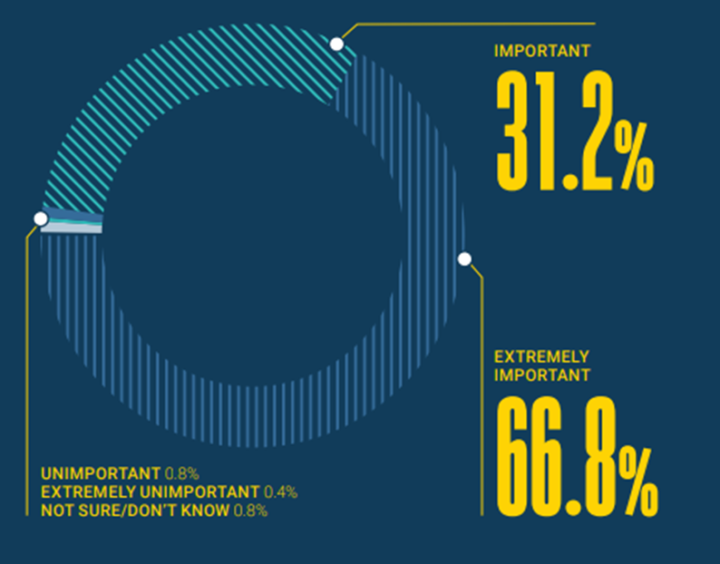
Quality control: peer review
Peer review is at the heart of research. It is the gold standard for ensuring the trust and integrity of scholarly communication. More still, it is a form of collaboration between experts, with critical feedback often improving research and helping propel research forward.
Andrew Preston, Publons

Slide 56
Types of peer review
Reviewers know the identity of the authors
Authors do not know the identity of the reviewers
Most common model of peer review in STM
Single-anonymous
Double-anonymous
Reviewers do not know the identity of the authors
Authors do not know the identity of the reviewers
Most common in HSS
Reviewers know the identity of the authors
Authors know the identity of the reviewers
Reviewer reports may be published with reviewer names if article accepted
Open peer review

Slide 57
The peer review process
Admin Checks & EIC Assignment
EIC/AE invites reviewers
Reviewers Score & suggest Decision
EIC Review and Decision feedback to Author
Revision and amendments
Revise & resubmit: major
Revise & resubmit: minor
Desk Reject
Accept*
Reject

Slide 58
The peer review report
Note
Core examination
Major comments
Minor comments
There will be a note from the Editor with decisions, next steps for the article and relevant deadlines.
The reviewers will assess the following:
Article topic
Key findings and conclusions
Scholarly contribution
Strengths and weakness
This will include essential points the authors must address for the work to be considered further for publication.
Minor comments are important but will not affect the overall conclusion. Minor comments may not be essential changes but would improve the work.

Slide 59
Types of decisions
Accept – the article can be published as is.
Reject – the article cannot be published, not even with revisions.
Desk reject: article is rejected before being sent out for peer review.
Revise and resubmit with major revisions – the article can be published after major revisions. The Editor and reviewers will need to be satisfied that appropriate changes have been made.
Revise and resubmit with minor revisions – the article can be published after minor revisions. The Editor and reviewers will need to be satisfied that appropriate changes have been made.

Slide 60
Responding to reviewers comments
Carefully read the decision letter.
Don’t become disheartened.
Consult your co-authors.
Break down the comments by category-create a list.
Make all the suggested amendments if appropriate.
If the peer reviewer has misunderstood something, review your explaination.

Slide 61
Make it easy for the editor
Address every comment:
Where you amended (page number, new material)
Why you didn’t amend (be specific and again, respectful)
Review the response twice to make sure it is clear and deviod of any frustration.
Be professional and respectful of the reviewers and editor.
Remember: the reviewers are trying to help you publish your best work.

Slide 62
Frequently asked questions
What do reviewers really look for?
Clear communication, contribution, originality, study design, language and grammar.
How do I appeal in case of rejection?
Provide evidence and clear explanations. Successful appeals tend to be rare.
What is the average response time in peer review?
It depends…
How can one become a reviewer?
Publish, show interest, take part in a training session.

Slide 63
What is in PubMed?
Next webinar on Wednesday, 20 July
Notes:
Need to replace this image

Slide 64
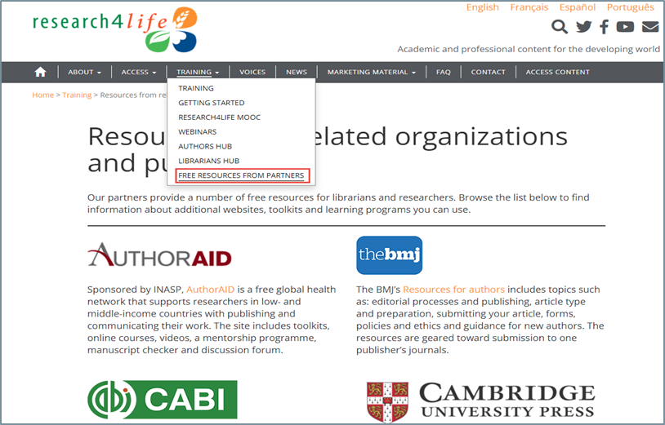
Wrap up -
More resources from Research4Life partners
Research4Life, 2021. Resources from related organizations and publishers. In Research4Life Training portal [Online] [Cited 17 September 2021] https://www.research4life.org/training/resources-related-organizations/

Slide 65
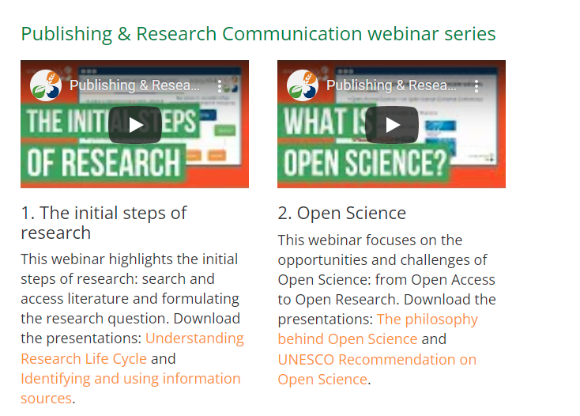
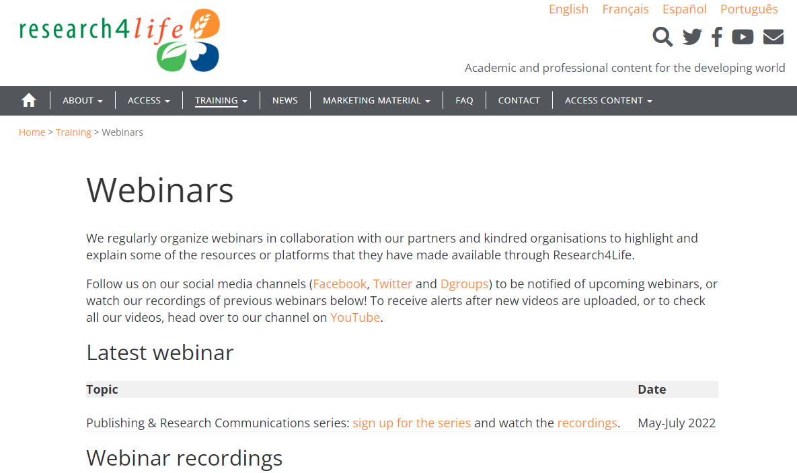
Wrap up -
Let us know what you think
Post webinar survey
Recordings and presentations will be available at:
https://www.research4life.org/training/webinars/#prc

Slide 66
What is in PubMed?
Next webinar on Wednesday, 20 July
Notes:
Need to replace this image

Slide 67
Wrap up -
More resources from Research4Life partners
Research4Life, 2021. Resources from related organizations and publishers. In Research4Life Training portal [Online] [Cited 17 September 2021] https://www.research4life.org/training/resources-related-organizations/

Slide 68
Wrap up -
Let us know what you think
Post webinar survey
Recordings and presentations will be available at:
https://www.research4life.org/training/webinars/#prc

