Slide 1
Additional collection-specific resources
Environment
Research4Life is a public-private partnership of five collections:

Slide 2
Outline
Introduction
Environment Index
Accessing Environmental Index
Searching Environmental Index
Environmental Science Collection
Accessing Environmental Science collection
Searching Environmental Science Collection
Command Line Search
Meteorological Monographs
Accessing Meteorological Monographs
Searching Meteorological Monographs
Advanced Search
Internet Resources (Databases and Gateways)
Summary
This work is licensed under Creative Commons Attribution-ShareAlike 4.0 International (CC BY-SA 4.0)

Slide 3
Learning objectives
Become aware of existing additional resources related to environment.
Understand the additional collections and how to use them.

Slide 4
Introduction
This lesson focuses on key discipline-specific (environment) resources from OARE; it reviews three databases available via the OARE portal plus eight Internet resources for the environment.
Environmental Index,
Environmental Science Collection and
Meteorological Monographs.

Slide 5
Environmental Index
This is a bibliographic database from EBSCO Information Services.
Formerly known as Environmental Knowledgebase Online
Coverage includes areas of agriculture such as; ecosystem ecology, energy, renewable energy sources, natural resources and many more.
Coverage backing date to 1888
It contains more than 4.7 million records from more than 2,200 domestic and international journals also features an in-depth thesaurus & author profiles for about 6,500 authors in the discipline.
Environmental Index provides metadata and only links to some full-text articles.
Notes:
Environment Index offers deep coverage in applicable areas of agriculture; ecosystem ecology; energy; renewable energy resources; natural resources; marine and freshwater science; geography; pollution and waste management; environmental technology; environmental law; public policy; social impacts; urban planning; and more.
Environment Index contains more than 4.7 million records from more than 2,200 domestic and international journals going back to 1888 (including more than 1,350 active core titles) as well as more than 200 monographs.
Environment Index also features an in-depth thesaurus, and author profiles will be provided for 6,500 authors in the discipline.
Some of these journal titles and full-text articles are available from Research4life. Environmental Index is a bibliographic database that has some metadata and only links to some full-text articles.

Slide 6
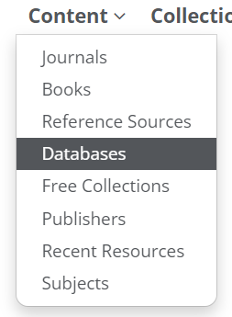
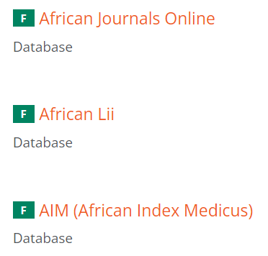
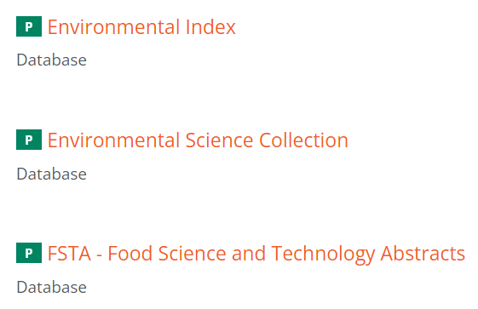
Accessing Environmental Index from the R4L Unified Content Portal
To access the database, click on Content/Databases on the Research4life Unified Portal homepage and select Environmental Index as shown above.

Slide 7
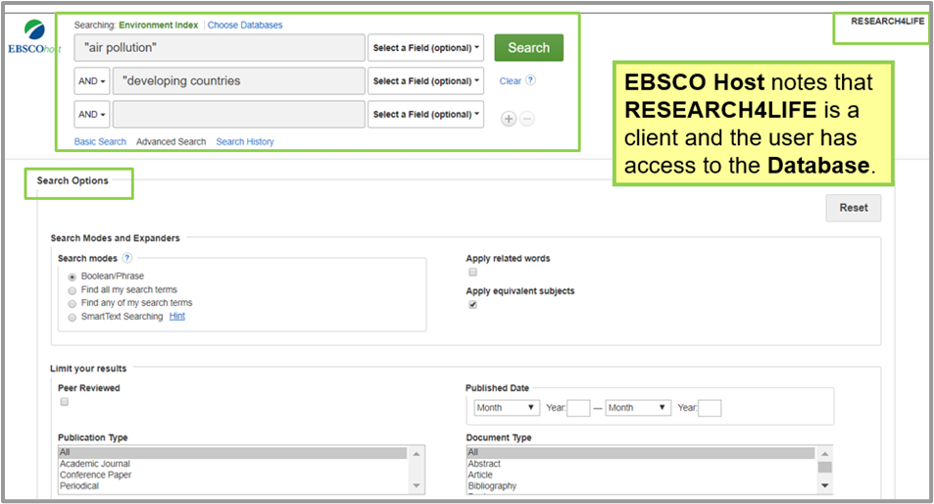
Searching Environmental Index
The default page for Environmental Index shows Advanced Search where the user can enter keywords & apply different search options.
*Note that users must be logged in to gain access to the database.
Enter the search keywords terms “air pollution” AND “developing countries” and click Search.
Notes:
(Please note the AND Boolean operator is used to limit the search results; see Lesson 1.4 Refine Search, for more information about using Boolean operators).

Slide 8
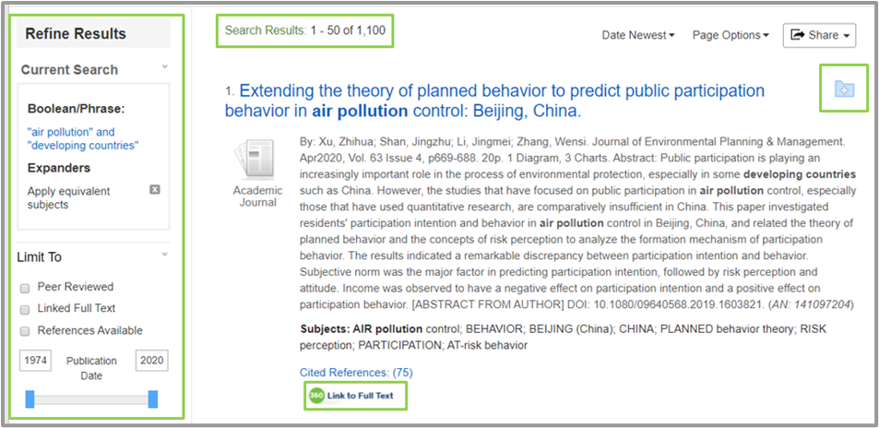
Environmental Index Search results page
After clicking the Search button, the results will be displayed.
From the keywords “air pollution” AND “developing countries”, the search results retrieved 1100 citations.
Refine Results allows the user to limit the search results using several features.
Note the Link to full text at the bottom of the figure.

Slide 9
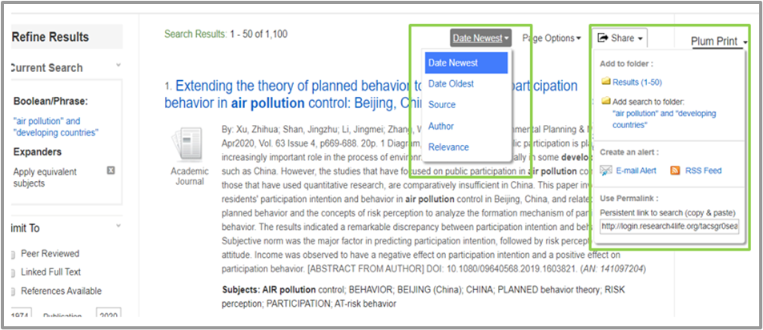
Result page showing the results display, page and sharing options
Search results can be displayed by Date Newest, Date Oldest, Source, Author and Relevancy.
This can be done by clicking the dropdown menu on Date Newest, Brief.
The Page Options button allows the user to select options for their preferred page view.
Share button gives the user the option to save the search results into a folder, create alerts and use Permalink.
Another way to add citations to the folder is to click on the Add to Folder (+) icon.

Slide 10
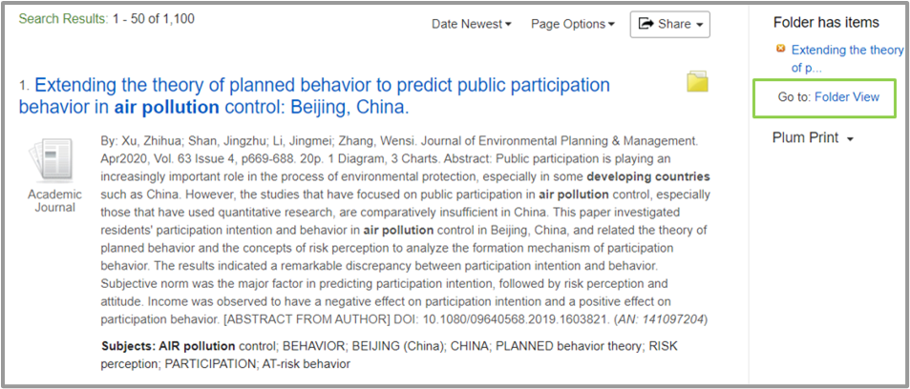
Folder view on Environmental Index
The icon next to the title of each search result also enables the user to save, email and print the citation of an article
Note that, once a file has been added to a folder, it changes its color to yellow as shown below.

Slide 11
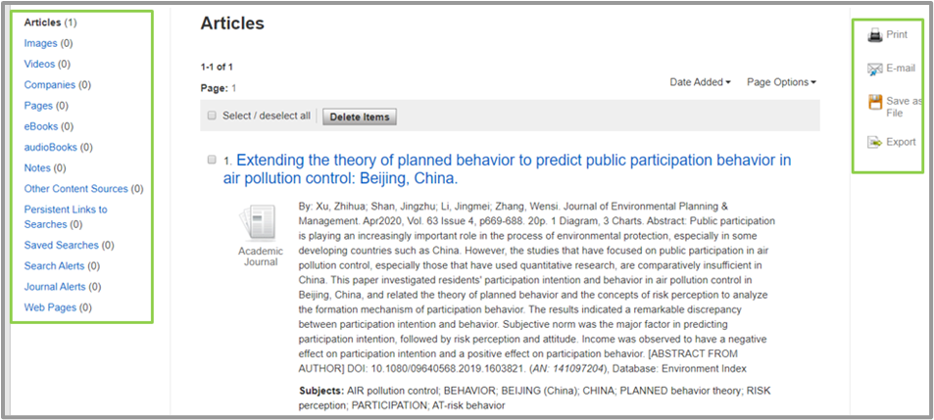
Folder contents view
To view the contents of a saved folder, click on Folder View.
Folder view also shows a breakdown of content type available in the folder.
The user can also print, email, save and export the folder contents.
Notes:
Important: Please note that the result folder is a temporary folder and will disappear the moment the user logs out of Research4Life. If the user wants to retrieve the results for future use, she or he needs to create an EBSCO host account

Slide 12
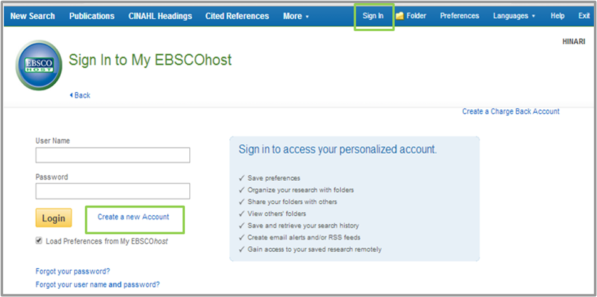
Creating an account on EBSCOhost
Click the Sign in button at the top bar of the Environmental Index search page and choose Create a new account.
Note that this is the user’s personal account on EBSCO host and is separate for the OARE username and password.
*Once a user has logged into OARE and opened Environment Index, they must use their own username and password - to open the EBSCOhost account

Slide 13
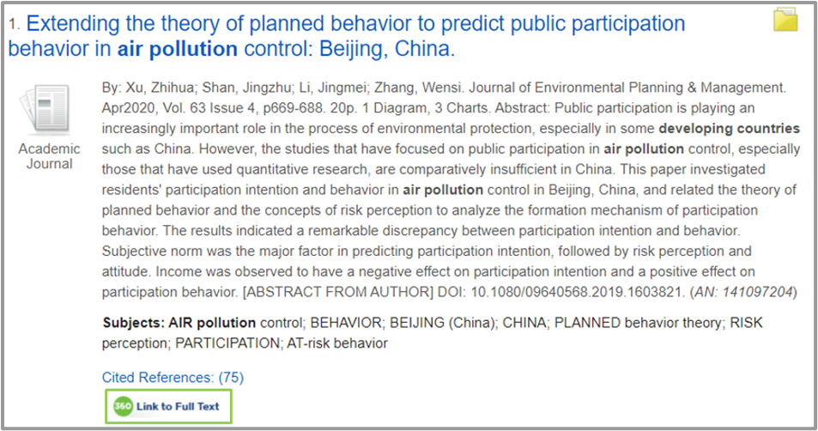
Accessing full-text articles
To view the full text of a title, click Link to Full text.
This action will take the user to a Research4Life page displaying links to the content; select the publisher by clicking any of the Article Full Text links.

Slide 14
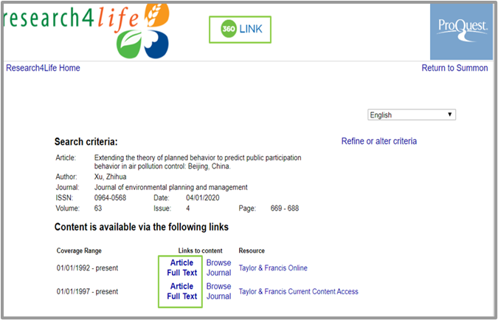
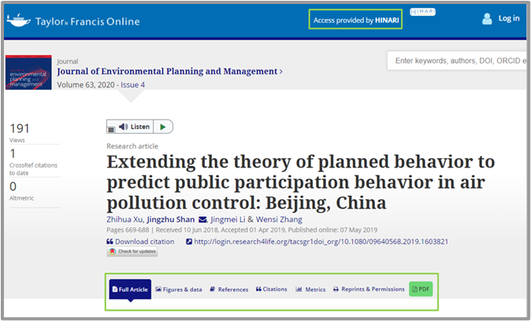
Research4Life page showing links to the full-text content
Once the publisher’s website is opened, there are options to download, save and export the citation
Notes:
Please note: publishers’ website features differ, hence the features might be different on another publisher’s website;
Also note that some full-text content may not be available in Research4Life and the user should consider other access options in their library

Slide 15
Search history on Environment Index
To view recent searches the user can click the Search History tab below the search box.
This will take the user to the Search History/Alerts page.
Note that any initial and refined searches are listed.
For each search, there are View Results, View Details or Edit options.
Other options are to complete a Search with AND or Search with OR or Delete Searches.

Slide 16
Environmental Science Collection
The Environmental Science Collection is a product of ProQuest Publishers and is a combination of two databases, namely Environmental Science Database and Environmental Science Index
Environmental Science Database
This is cross-disciplinary resource of full-text content from the global literature across this field and related disciplines.
It provides the most complete collection of resources available to support research and learning in environmental science and related fields.
It covers disciplines such as such as engineering, biotechnology, bacteriology, atmospheric science, ecology, and biology.
Contains full text sources from include scientific journals, trade journals, new sources, conference proceedings, reports, monographs, books and government publications.
Environmental Science Index
It provides in-depth abstracting and indexing coverage from the environmental science literature and related disciplines.
Abstracts and citations are drawn from thousands of peer-reviewed journals, trade titles, conference proceedings and other content types.
Content coverage available in the databases starts from 1960 and runs through to current material.

Slide 17
Accessing Environmental Science Collection from the R4L Unified Portal
To access the database, click Content/Databases on the Research4life Unified Portal homepage, and select Environmental Science Collection as shown above.

Slide 18
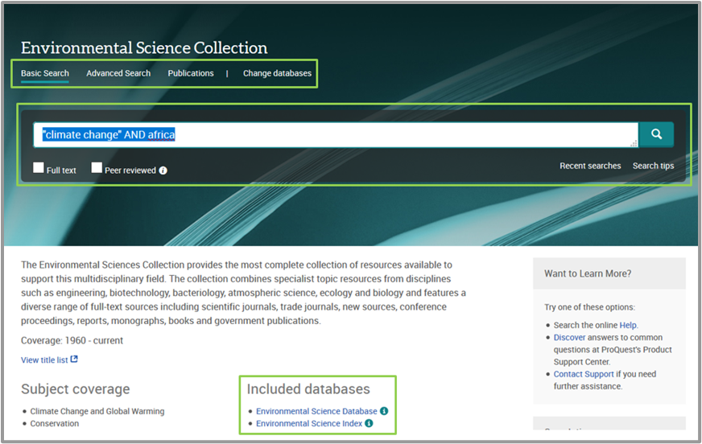
Environmental Science Collection homepage
The user will be taken to the publisher’s website where they can choose to search both databases at the same time or search each database separately.

Slide 19
Searching Environmental Science Collection
The user can search either using the Basic Search, Advanced Search, Publication search or Change the database.
The Search tips link below the search box window gives instructions on the most effective ways of searching ProQuest databases.
These include Search Syntax and Field codes, Basic and Advanced search, Search results display options, Document view and My research.
Notes:
In this lesson, both databases are searched at the same time.
*The same search functions can be used to search each of the two databases separately as the interfaces are similar.

Slide 20
Searching Environmental Science Collection cont.
The My research functionality allows the user to save, manage, and organize content and supporting materials found in ProQuest through creation of a ProQuest Account.
The Basic search box allows the user to limit their searches either by full-text content, peer-reviewed content or both.
The next slide will show a basic search for “Climate change in Africa”
Keywords “climate change” and "Africa“ will be used.
Quotation marks searches “climate change” as a phrase and the Boolean operator "AND" is used to join the two keywords “climate change” and "Africa“.
Please note the "AND" Boolean operator is used to limit your search results, and the quotation marks are used for phrase searching.
Notes:
Refine Search, or click the search tips tab at the bottom of the Environmental Science Collection database Basic search box for more information about searching databases effectively.

Slide 21
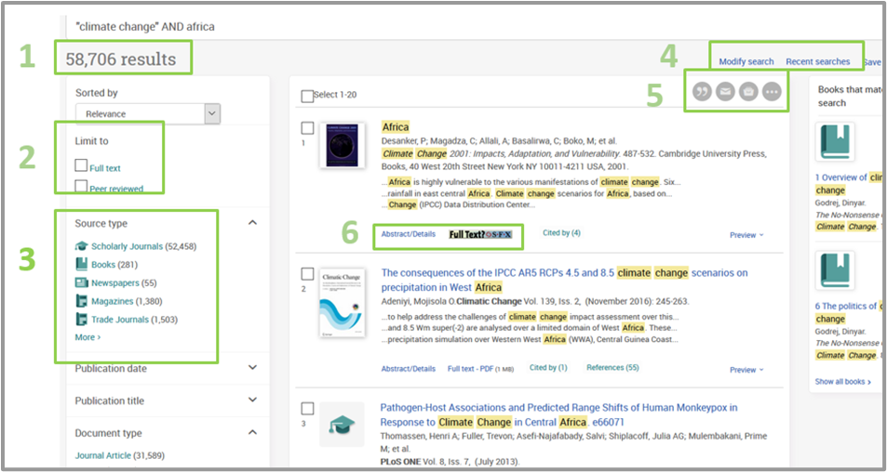
Search results
The search for “climate change” AND Africa retrieved 58,706 results.
The results page displays various options for refining search results.
Notes:
The search for “climate change” AND Africa retrieved 58,706 results. The keywords used in the search are highlighted in yellow on each result. The results can be sorted by Relevance, Oldest first and Most recent first.
The Limit to functionality gives the user options to limit search results to only Full text content , Peer reviewed content or both
The Source Type tab allows the user to include or exclude content types on the search results. Search results can also be refined by Publication Date, Publication Title, Document Type, Subject, Company/Organization, Location, Language and Database.
Other options include Modify the search, View recent searches, Save search and Create alerts.
Please note that the Save and Create Alerts functions can only work for users with ProQuest Accounts.
5. The user also has the option to cite, email, print and save each citation
6. To open the Abstract, click Abstract–Details at the bottom of each search result. To access the full text (PDF), click either the Title of the article or the Full text – PDF link at the bottom of each result, and the article will be displayed in PDF format.

Slide 22
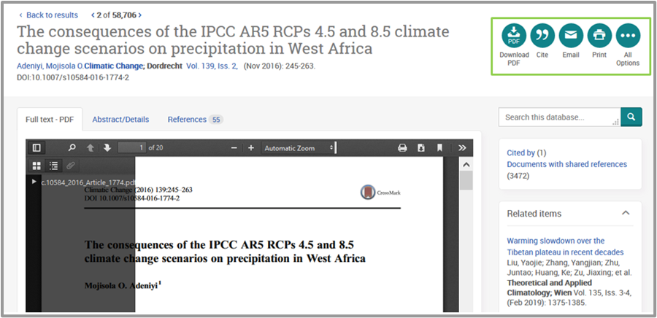
Downloading full text articles in Environmental Science Collection
To access the full text (PDF), click either the Title of the article or the Full text – PDF link at the bottom of each result, and the article will be displayed in PDF format.
Please note that full text PDF can only be downloaded by users with Adobe Acrobat software installed on their computer.

Slide 23
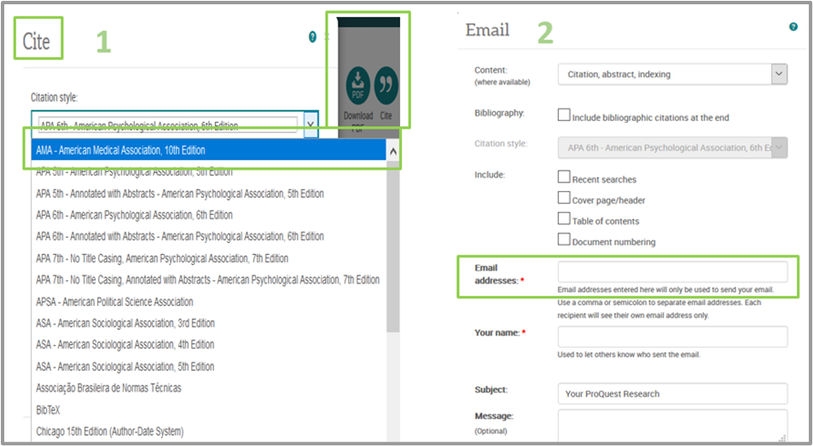
Cite and email functions
Clicking on Cite allows the user to select their desired citation style, then copy and paste the citation into their document.
Clicking on Email option allows the user to enter his or her name, email addresses and choose the email format - the original file format or the citation, abstract and indexing.

Slide 24
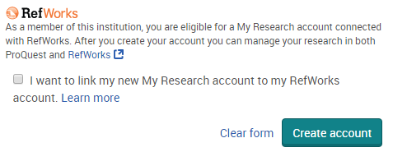
Creating a ProQuest account
Click on the ProQuest Profile tool at the top right of the screen in the Environmental Science Collection database.
Select Create My ProQuest Account.
Complete the profile information.
To link your RefWorks account to your ProQuest accounts, tick on “I want to link my new My Research account to my RefWorks account”.
Notes:
To save an article for future use one should click the Save button. Please note that the save option only works if a user has a ProQuest Account.
RefWorks -provided by ProQuest- is a web-based bibliography and database manager that allows users to create their own personal database by importing references from text files or online databases and other various sources.
Linking Refworks to ProQuest helps to manage research in both ProQuest and RefWorks.

Slide 25
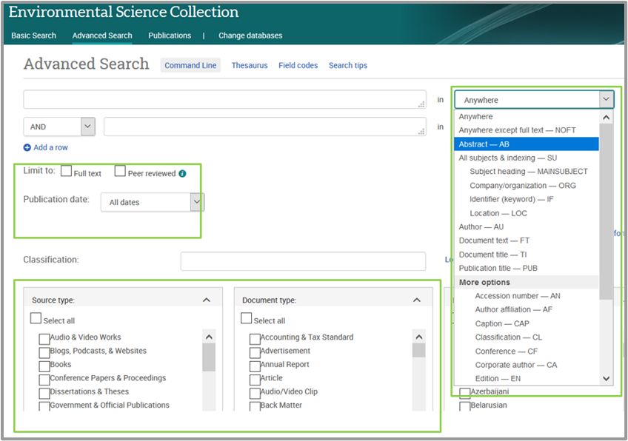
Using Advanced search
Click on the Advanced Search tab on the Environmental Science Collection database.
This search feature allows a user to specify additional requirements for a search.
The user enters keywords and selects additional filters that they want to apply to the search.
A search can be limited to either full text or peer reviewed, source type, document type and language.
A user also can specify the location of the keywords in a search.

Slide 26
What is a Command Line Search ?
Allows precise searching by using operators to combine different fields that target the search terms. ProQuest will only search for the specified fields.
This feature is useful if a user wants to;
combine fields within a search without filling in each of the fields individually, or
when the user needs to find information in one field, but not in another
To perform a command line search, a user can prefix term(s) with field name abbreviations & enter them directly into the search box.
For example: AU (Johns) and PUB (Journal of Animal Science)
This command is instructing the Environmental Science Collection database to look for the author named Johns in the publication named Journal of Animal Science.
AU is the field name abbreviation for Author and PUB is the field name abbreviation for Publication Name

Slide 27
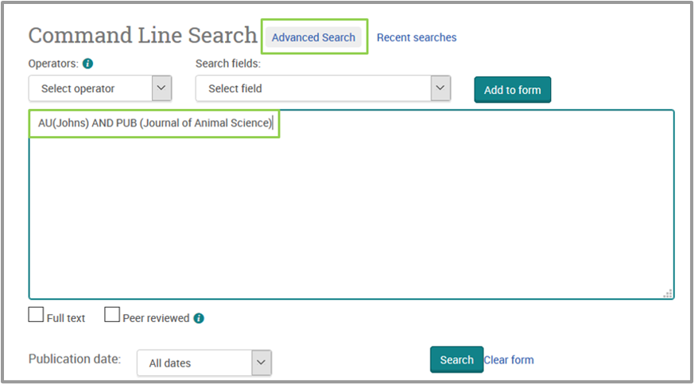
Command Line Searching
Click Advanced Search. Then click Command Line, select the first field which is Author (AU) & click Add to Form.
Enter Author name to search in brackets such that it appears as AU(Johns).
If a user wants to combine fields with Boolean operators, click the arrow next to the Operators list and choose the required operator.
Select the second field which is Publication Name (PUB) and click Add to Form.
Enter Publication Name to be searched in brackets such that it appears as PUB (Journal of Animal Science).
A search can be limited to Full text or Peer review by clicking each respective box
A search also can be limited by publication date by clicking the arrow next to All dates.

Slide 28
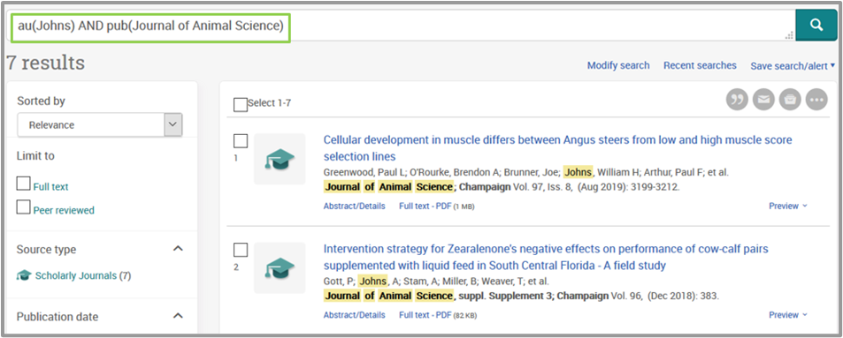
Command line search results
This example has retrieved 7 results and search words are highlighted in the results.
Results can be sorted by Relevance, Oldest first and Most recent first, and also apply the search filters needed as with a simple search.
Users can also cite, email, print and save each citation - these options only work when a user has selected an article from the retrieved results

Slide 29
Meteorological Monographs
American Meteorological Society (AMS) Meteorological Monographs are thematic collections of peer-reviewed, original papers, survey articles, tribute volumes, and other materials in meteorology and closely related fields.
These publications are unique textbooks and literature for the weather, water, and climate community.

Slide 30
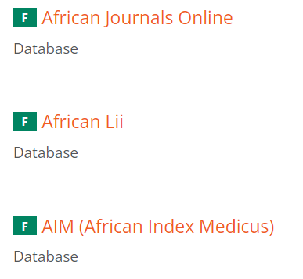
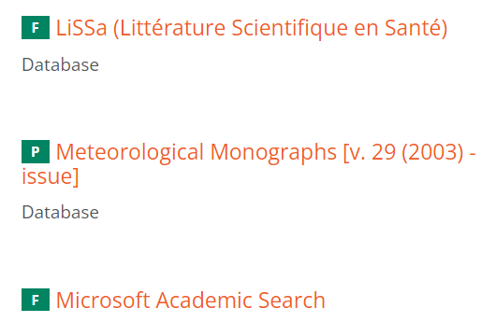
Accessing Meteorological Monographs from the R4L Unified Portal
To access the database, click on Content/Databases on the Research4life Unified Portal homepage and select Meteorlogical Databases as shown above.

Slide 31
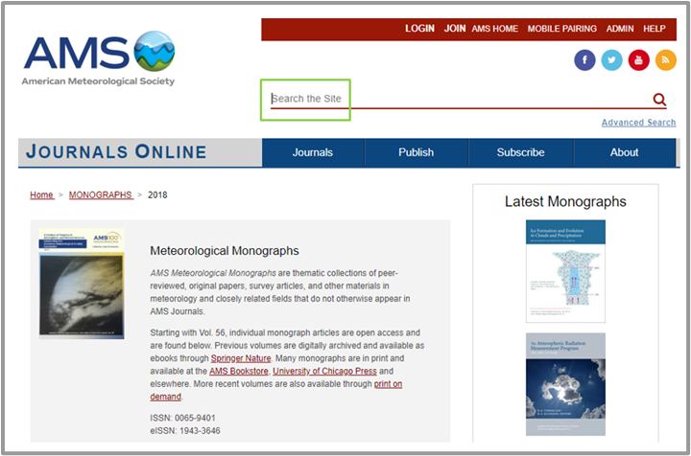
Meteorological Monographs homepage
Publisher’s Website allows the users to search for content through the Simple Search and Advanced Search boxes or use the browse by issue option (Journal, Decade, Volume, Issue).
AMS has twelve publications including Meteorological Monographs on the same portal.
A simple or advanced search will retrieve results from all twelve publications.
Users can apply the publication filter to restrict the search to Meteorological Monographs or they click on available volumes to find a specific title.

Slide 32
Meteorological Monographs
Starting with Volume 56, individual monograph articles are open access at AMS Journals Online.
Previous volumes are digitally archived and available through Springer Nature.
Many monographs are in print and available at the AMS Bookstore, University of Chicago Press, Amazon etc.

Slide 33
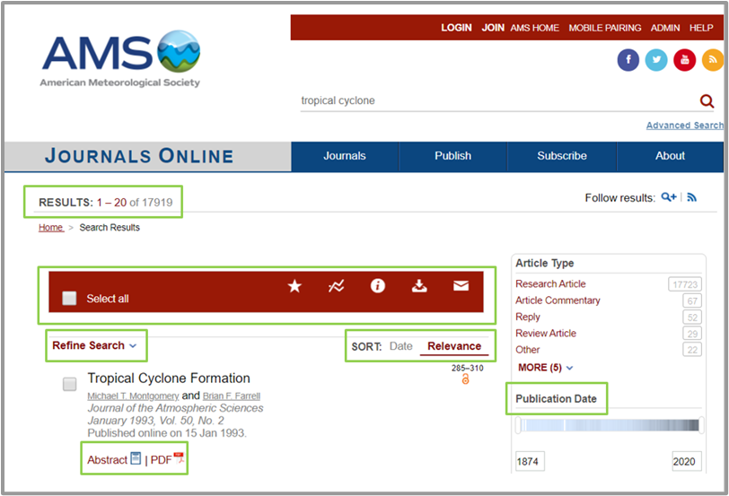
Searching Meteorological Monographs
The AMS portal supports both Simple and Advanced search.
Type “Tropical Cyclone” in the simple search box and click search.
The phrase should be enclosed in quotation marks so the database can search it as a phrase and not as separate words.
The search retrieved 17919 results, which is the total number of results from the publications in the portal.
Note the SORT by Date or Relevance and Abstract and PDF options for each search result.

Slide 34
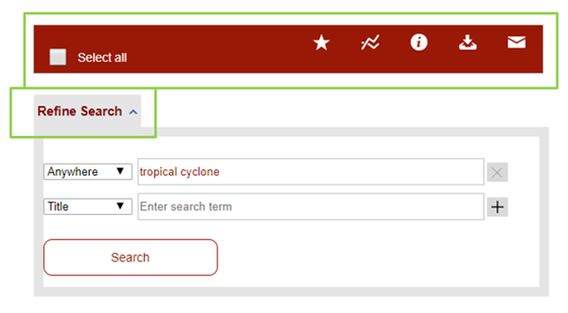
Favorites, Track Citations, View Abstracts, Download Citations and Email options
The (red) Select all bar has the options to (from left to right) Add to Favorites, Track Citations, View Abstracts, Download Citations and Email.
The Refine Search option is also available.

Slide 35
Browse journals by Issue
To view specific journals, click on Journals from the horizontal bar – the Browse by Issue will box display as shown below.
Then click on the Browse by Issue drop down menu to select a journal by title or Monographs.

Slide 36
American Meteorological Society account
Registering for an account on the American Meteorological Society site is free and registered users can:
manage account settings;
request email content alerts and article tracking alerts;
save searches to be re-run later;
save favourite articles and journals;
purchase individual articles;
directly access freely available AMS monographs online; and
link their mobile device to access their institution’s content.
Notes:
Note: The Add to favourites and Track citations features only work for Registered American Meteorological Society users

Slide 37
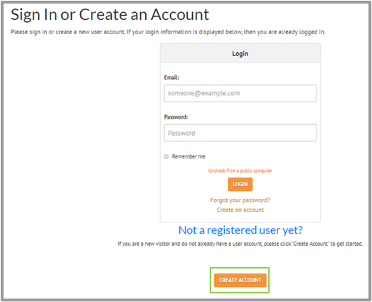
Creating an American Meteorological Society account
Click the Join button at the top of the AMS portal, and, on the next window, click Join AMS.
In the following window, click Create Account.
Enter a user’s email address - to check if that email exists in the system- and click search
If no matching result is found, click create account.
Enter details, click continue, enter and confirm password.
The user’s profile will be loaded and the account is activated.

Slide 38
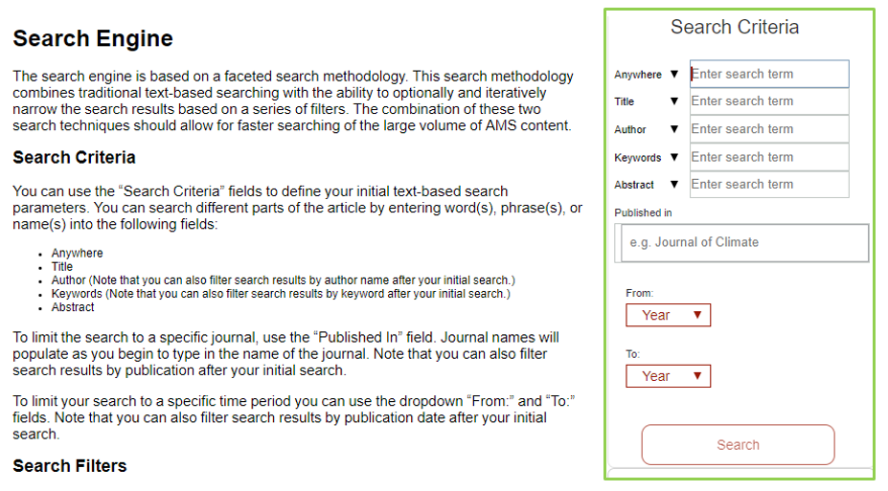
Advanced Search on AMS homepage
The Advanced search option is accessible from the AMS homepage.
The Advanced search window gives the user instructions on how to search the portal.
The Search Criteria helps limit the results by Title, Author, Keywords, Abstract, Publication and Year.

Slide 39
Internet Resources (Databases and Gateways) for Environment
This section will introduce some of resources that are useful in the field of environment. These include;
Centre for International Earth Science Information Network.
ECOLEX
Environmental Data Explorer database
United Nations Environment Programme document repository
United Nations Environment Programme: World Environment Situation Room
World Environmental Organization (World Org)
Yale University Library Research guides

Slide 40
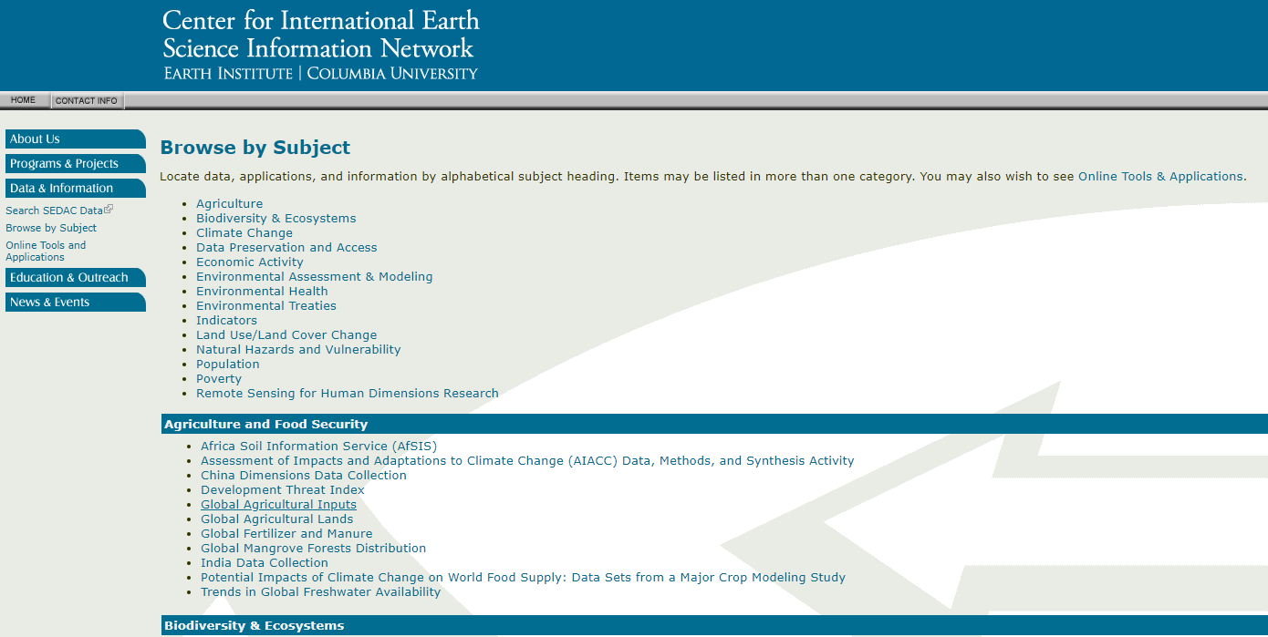
Centre for International Earth Science Information Network
Available at http://www.ciesin.org/sub_guide.html
Search page for
Centre for International Earth Science Information Network

Slide 41
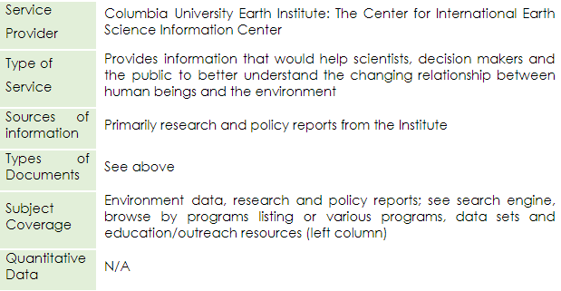
Centre for International Earth Science Information Network cont.

Slide 42
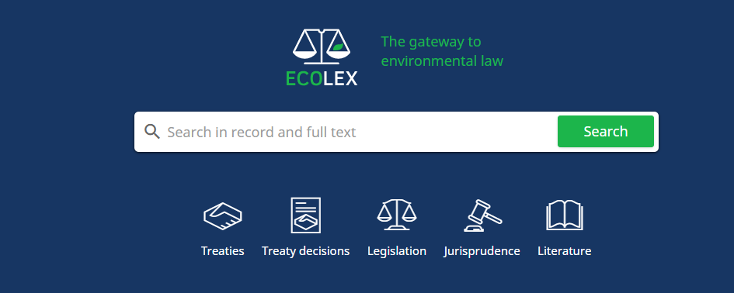
ECOLEX
Available at https://www.ecolex.org/
Search page for ECOLEX

Slide 43
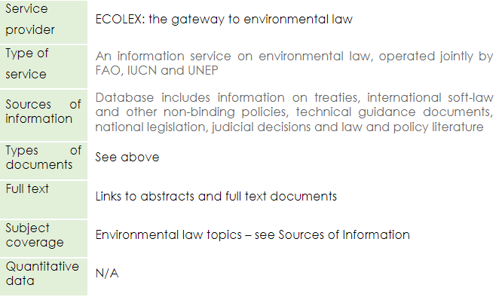
ECOLEX cont.

Slide 44
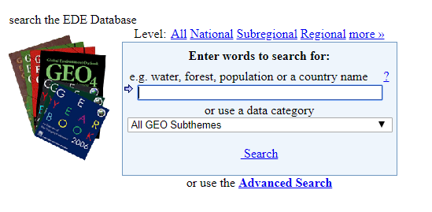
Environmental Data Explorer database
Available at https://geodata.grid.unep.ch/
Search page for Environmental Data Explorer

Slide 45
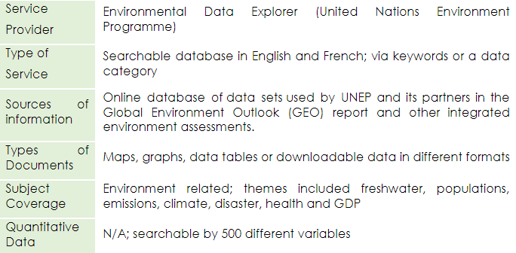
Environmental Data Explorer database cont.

Slide 46
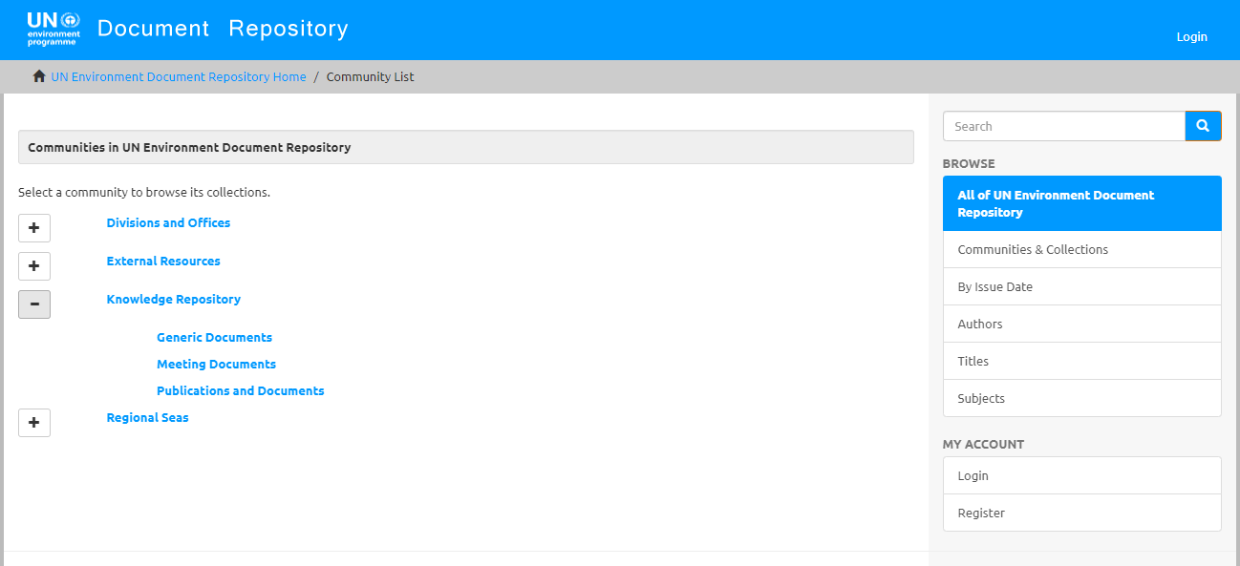
United Nations Environment Programme document repository
Available at http://wedocs.unep.org/handle/20.500.11822/1
Search page for United Nations Environment Programme document repository

Slide 47
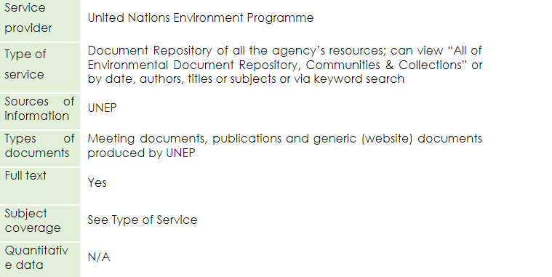
United Nations Environment Programme document repository cont.

Slide 48
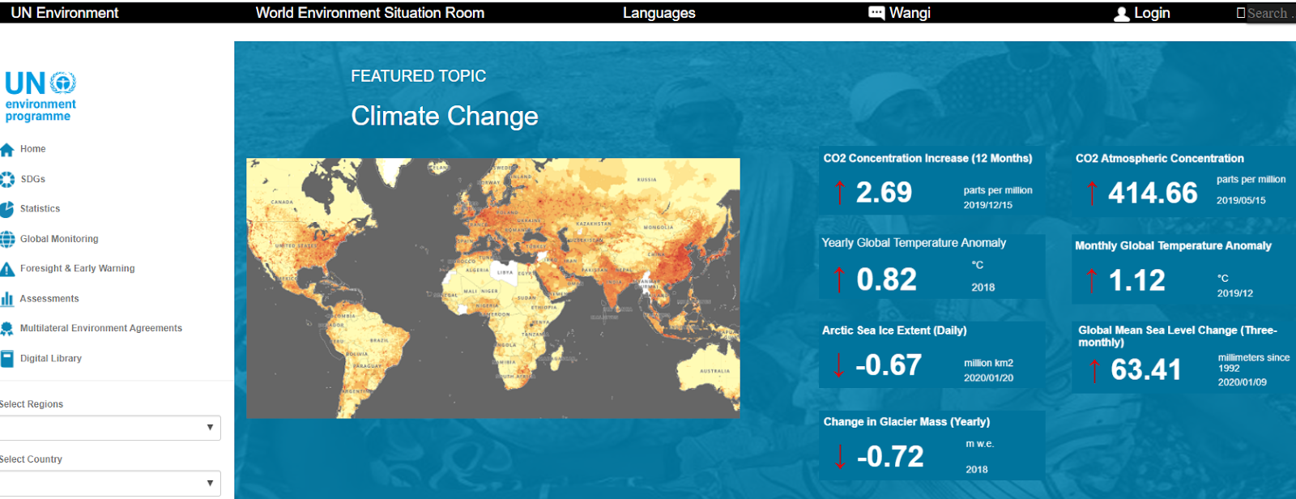
United Nations Environment Programme: World Environment Situation Room
Available at https://environmentlive.unep.org/
Search page for United Nations Environment Programme: World Environment Situation Room

Slide 49
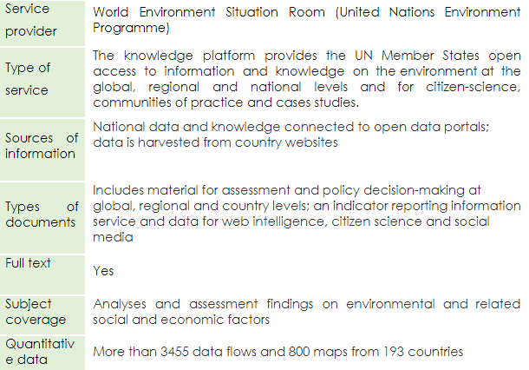
United Nations Environment Programme: World Environment Situation Room cont.

Slide 50
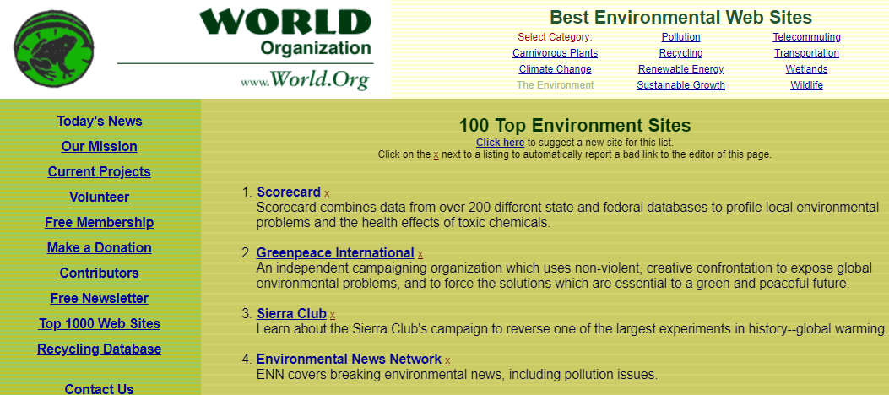
World Environmental Organization (World Org)
Available at http://www.world.org/weo/environment
Search page for World Environmental Organization (World Org)

Slide 51
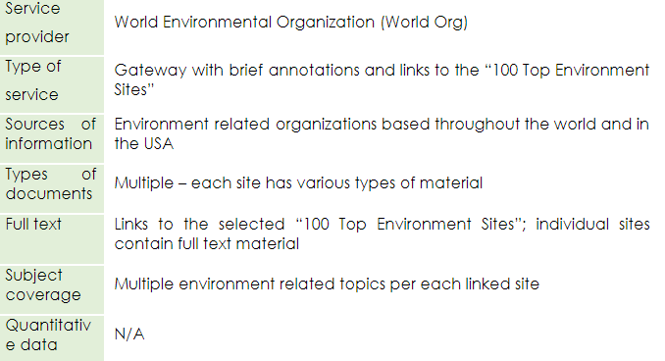
World Environmental (World Org) cont.

Slide 52
Yale University Library Research guides
Available at https://guides.library.yale.edu/FESalumni
Search page for Yale University Library Research guides

Slide 53
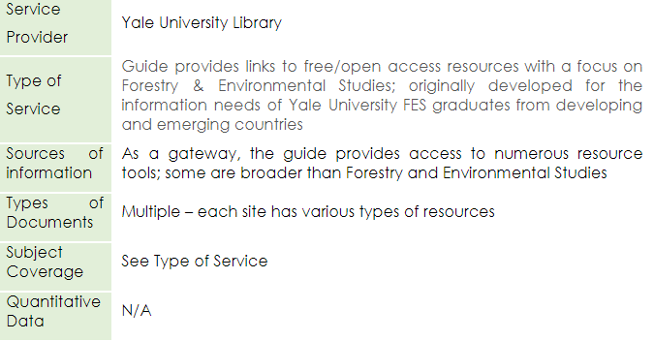
Yale University Library Research guides cont.

Slide 54
Summary
This lesson has focused on three environment-related databases namely Environment Index, Environmental Science Collection and Meteorological Monographs accessible through the Databases for discovery link on the OARE content page.
This lesson has explored the ways of accessing and searching these databases efficiently and effectively, and how to create user accounts so a user can get full functionalities of the databases.
The lesson also contains annotated links to Internet repositories and gateways that expand the access to relevant environment information beyond the Research4Life resources with special focus on United Nations Environment Programme access tools.

Slide 55
You are invited to;
Visit us at www.research4life.org
Contact us at r4l@research4life.org
Find out about other training materials [www.research4life.org/training]
Subscribe to Research4Life newsletter [www.research4life.org/newsletter]
Check out Research4Life videos [https://bit.ly/2w3CU5C]
Follow us on Twitter @r4lpartnership and Facebook @R4Lpartnership

Slide 56
For more information on Research4Life
www.research4life.org
r4l@research4life.org
Research4Life is a public-private partnership of five collections:

