Slide 1
Research4Life
Academic and professional content for the developing world
www.research4life.org
R4L_partnership
R4Lpartnership
Research4Life

Slide 2
What is Research4Life?
Research4Life provides institutions in low-and middle-income countries with online access to academic and professional peer-reviewed content. It aims to improve teaching, research and policymaking in health, agriculture, the environment and other life, physical and social sciences.

Slide 3
Who can access Research4Life? (1)
Over 10,000 institutions are currently registered.
Institutions in 69 low-income countries receive free access (Group A)
Institutions in a further 57 countries pay US $1,500 per year for a subscription to the Research4Life content – an effective discount of over 99.9% (Group B)

Slide 4
Who can access Research4Life? (2)
Eligible institution types are:
Universities
Professional schools
Research institutes
Teaching hospitals and healthcare centers
Government offices
National libraries
Agricultural extension centers
Local and international NGOs
Publishers may exclude countries or types of institutions based on their commercial activities in those territories

Slide 5
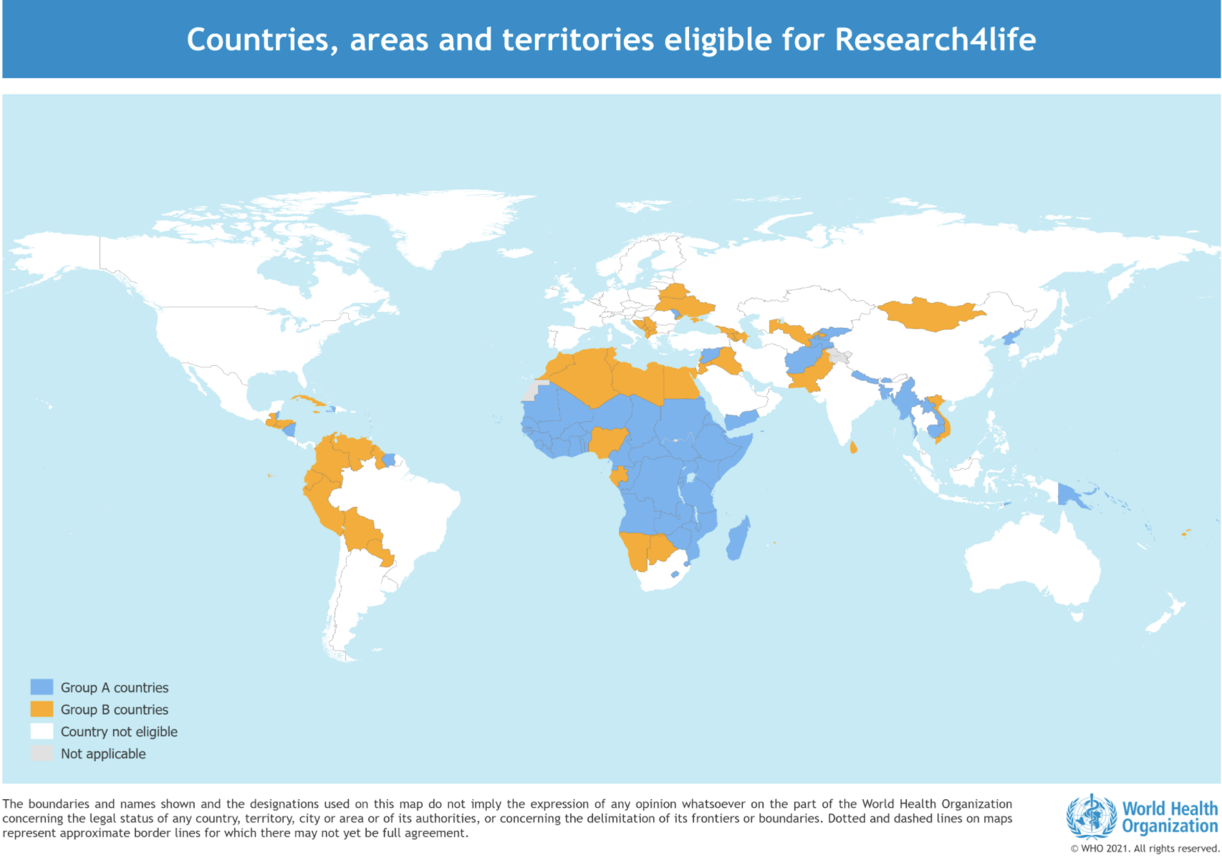
Who can access Research4Life? (3)

Slide 6
Registered institutions

Slide 7
Who uses Research4Life?
Policymakers
Librarians
Students and researchers
Health professionals

Slide 8
Five programs
Health WHO WHO
Agriculture FAO
Environment UNEP
Innovation and technology WIPO
Law and social sciences ILO

Slide 9
Core partners
UN Agencies
WHO
FAO
ILO
UNEP
WIPO
US University Libraries
Yale
Cornell
Technical Partners
PortSys (authentication system)
Proquest (Summon search tool)
STM Association (Publisher coordination)
Contributing publishers (c. 180). New publishers are joining all the time, covering all disciplines

Slide 10
In practice
Registrations are validated by a UN office (WHO or FAO)
Participating publishers treat Research4Life as a huge library consortium
The UN agencies manage the programs on a day-to-day basis
The universities assist with metadata allocation and ensuring content discoverability
STM appoints an Outreach Director to represent the interests of the content providers
In addition to access, Research4Life offers training and webinars on its resources

Slide 11
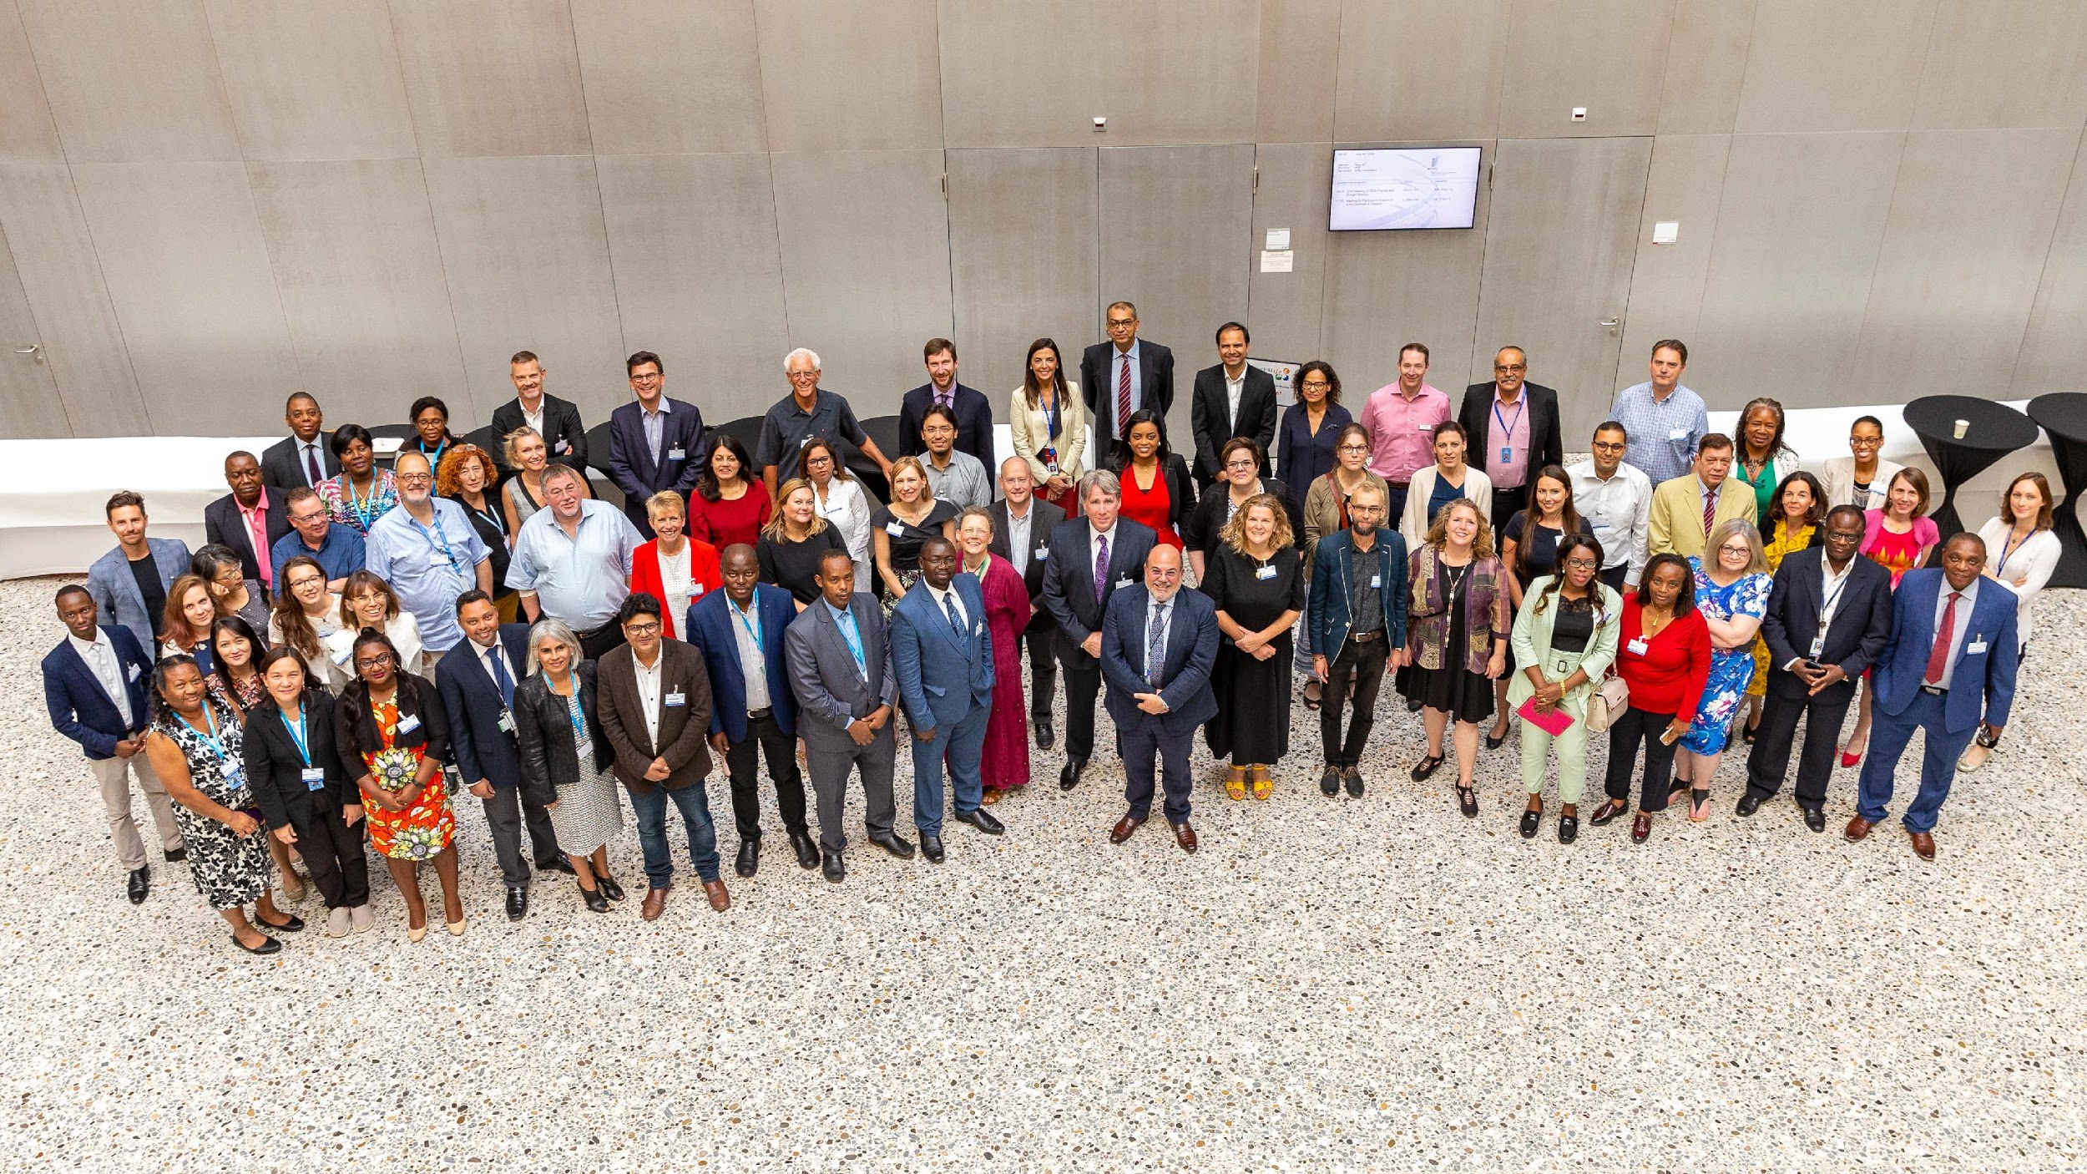
Governance
The Executive Council represents the major contributing partners and takes ongoing operational decisions. Teams report back to it: Capacity Development, Comms & Marketing, Eligibility, Finance, Fundraising and Technology.

Slide 12
What are the benefits for publishers?
Support the ambitions of the Sustainable Development Goals by removing barriers to access for researchers in emerging economies
Support your mission or CSR strategy
Improve the diversity and inclusivity of your business
Increase your brand awareness in growing markets, while protecting your existing business in excluded countries
Attract new authors, reviewers and editors to your publications
Promote good practice in information retrieval
Leverage the collective effort made by all participating partners
Give you access to a new network of partners
Give you an equal say in the running of Research4Life

Slide 13
What’s expected of publishers?
Provide access to your content, and set any exclusions
Add our IP address ranges to your access control system (or set up for Shibboleth), so that users can be authenticated for access to your content
Provide marketing and comms channels and support, e.g. by featuring Research4Life on your social media or website
Help to oversee Research4Life through representation on the Executive Committee and by participating in other committees
Agree that any fees raised from Group B countries should be used by Research4Life for operational activities, including outreach, training & evaluation
Consider offering occasional grants and donations
Confirm your details with us on an annual basis

Slide 14
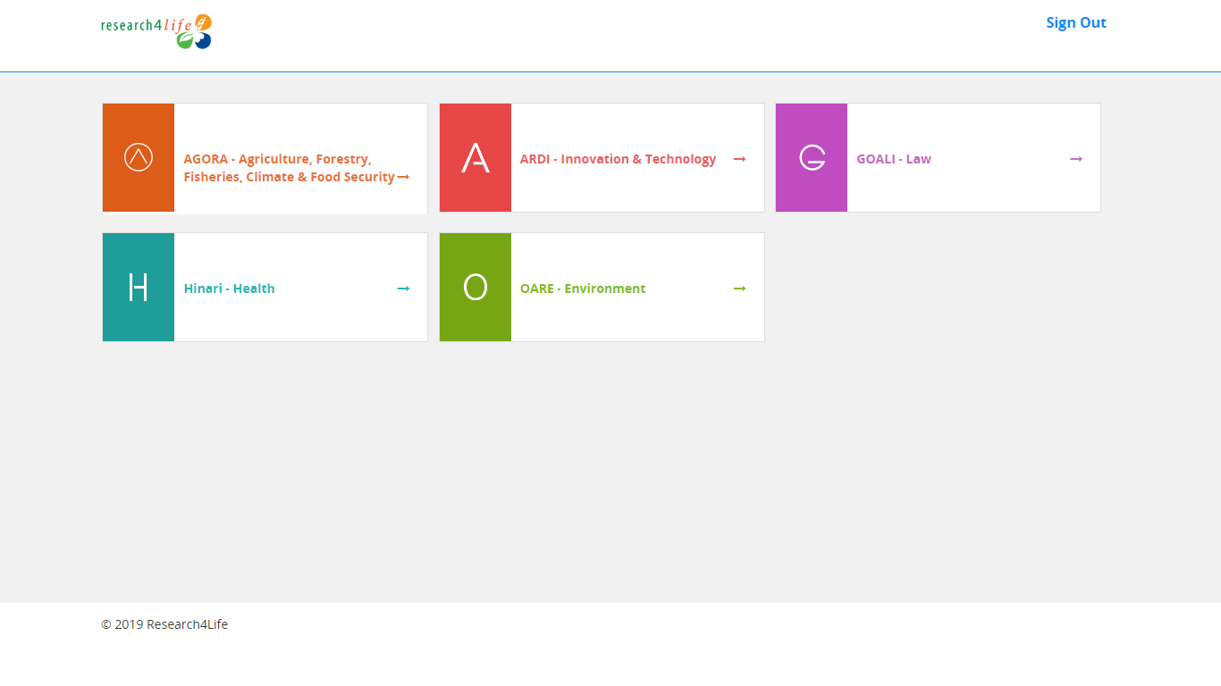
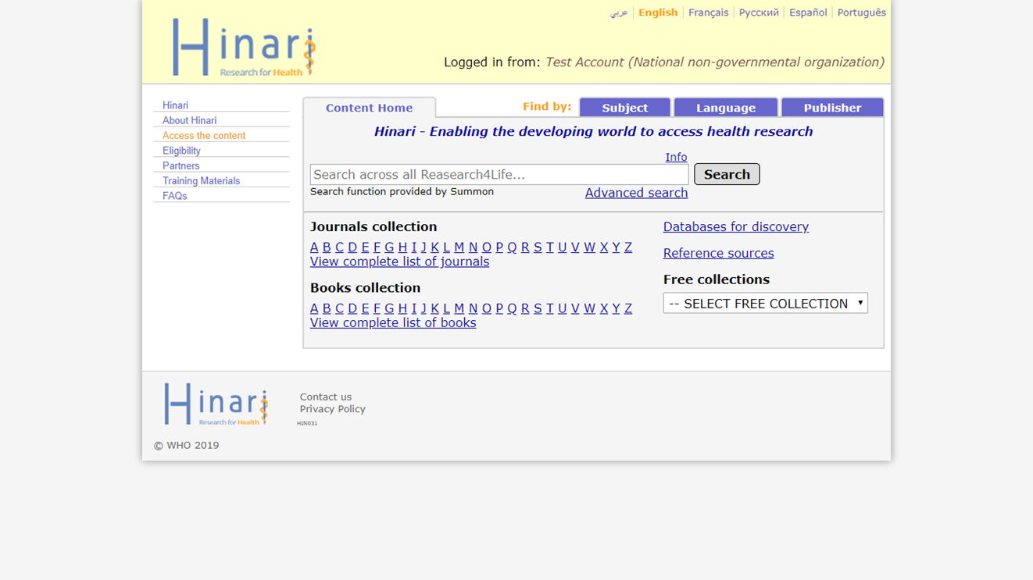
What is the user experience like?

Slide 15
Technology upgrades underway
Direct feed of IP addresses from the IPRegistry to enable more seamless authentication
Complete redevelopment of the content portal (front-end) to provide a modern and user-friendly experience
Mobile optimisation
Commitment to give Research4Life users the same quality of experience as any other customer

Slide 16
How is Research4Life promoted?
Marketing & Comms team has an annual budget of c. $30K to cover channels and promotional activities
A wide range of brochures, videos and testimonials can be viewed or downloaded from the Research4Life website
Most materials are available in English, French, Spanish & Portuguese, including the website
Research4Life User Advisory Group also provides key outreach and feedback

Slide 17
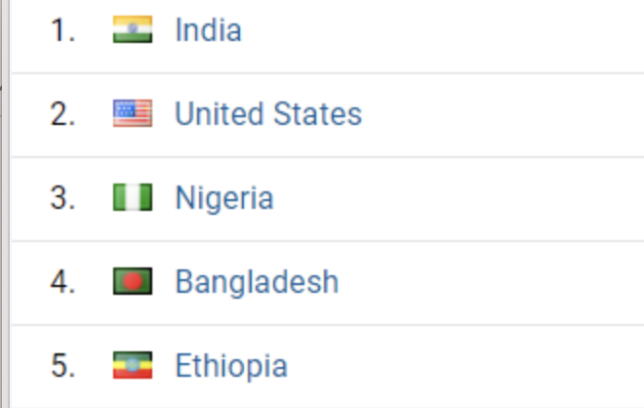
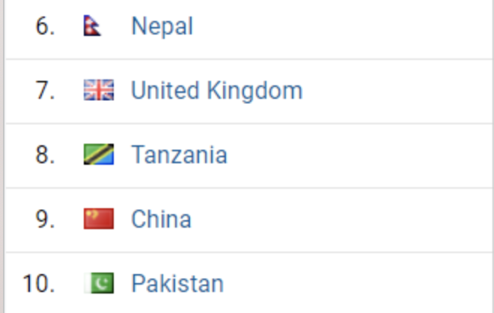
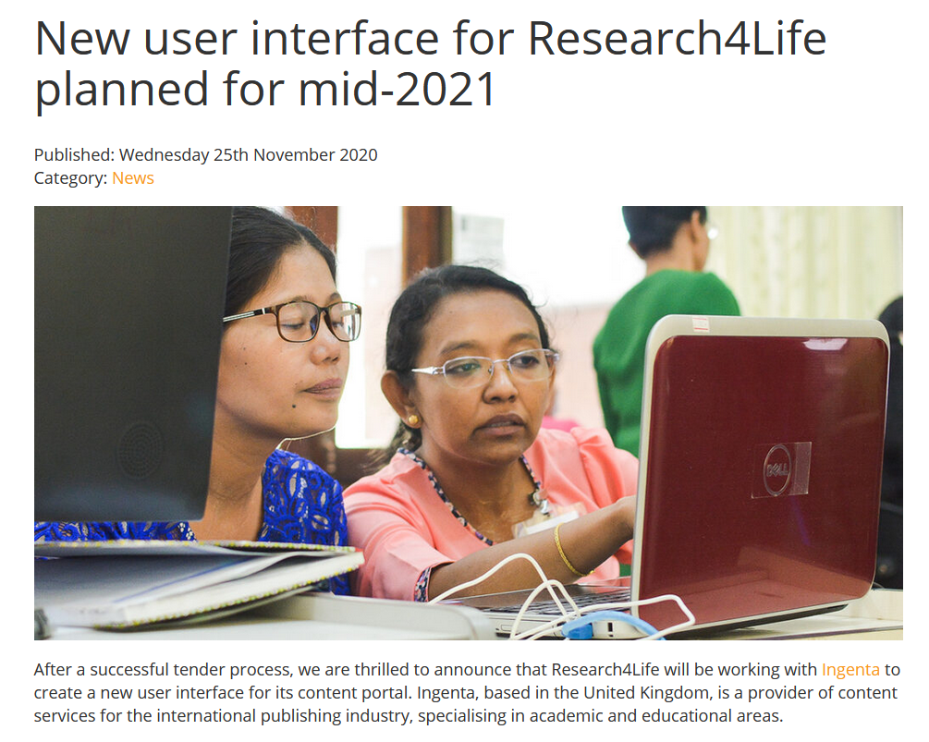
Channels
Twitter: 3,600 followers
Facebook: 12,000 followers
Dgroups: 16,000 members
Monthly newsletter: 4150 subscribers
Website: 600 unique visitors/day
Paid Facebook campaigns for MOOCs and webinars: average 366,000 people reached/$60 spent per campaign.

Slide 18
Training
c. $70k per annum spent on training around the world, with increasing focus on online courses
Webinars on selected resources and search tools are now a regular feature
Research4Life MOOC has now run 4 times, with over 7000 participants; better reach than face-to-face training
Training covers not just how to use the Research4Life platform but also how to make effective use of the content, as a librarian, researcher or practitioner (e.g. Advocacy Toolkit)

Slide 19
User feedback
“The timing was perfect, given that the coronavirus pandemic has reduced mobility and most of the activities around the world and therefore we were able to utilize this time for the MOOC.”
Saint Vincent and the Grenadines
““I found this course very well designed which covers all information required for a librarian. In addition, anyone who wants to be a trainer in any area of Research4Life programme must take this course.”
Nepal

Slide 20
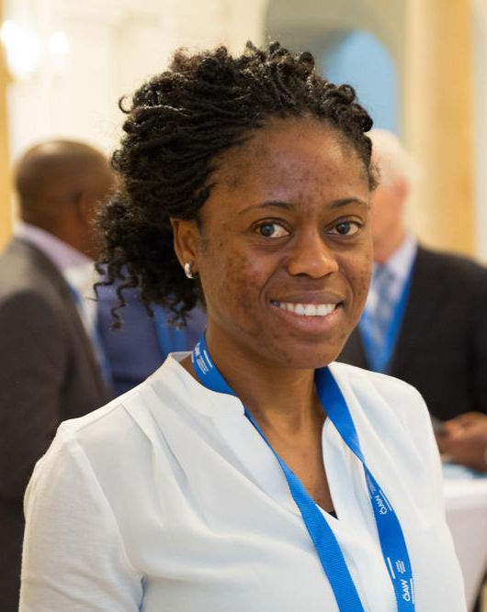
How we make a difference
“Thanks to Research4Life for providing access to evidence-based scientific information, we were finally capable of doing a literature review, which confirmed our hypothesis.”
Alice Matimba, senior lecturer at College of Health Sciences, University of Zimbabwe

Slide 21
For more information
Andrea Powell
Publisher Coordinator, Research4Life Programmes
Powell@stm-assoc.org
Or contact Research4Life:
communications@research4life.org
www.research4life.org

