Slide 1
Research4Life
Free or low-cost access to academic and professional content online

Slide 2
What is Research4Life?
Research4Life provides institutions in lower income countries with online access to academic and professional peer-reviewed content.
Our goal is to close the knowledge gap between the Global North and South, by making it easier for researchers in the Global South to access research and to publish, and as such contribute to a more equitable world of research.
Numbers from September 2021

Slide 3
Five collections
Health WHO
Agriculture FAO
Environment UNEP
Innovation and technology WIPO
Law and social sciences ILO

Slide 4
Access by country
Free access
Low-cost access

Slide 5
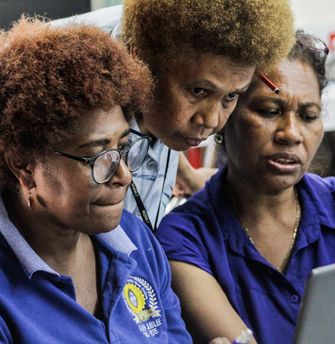
Who can use Research4Life?
Universities
Research Institutes
Teaching hospitals, Healthcare Services
National NGOs
National Libraries
Government Offices
Vocational Training Centres

Slide 6
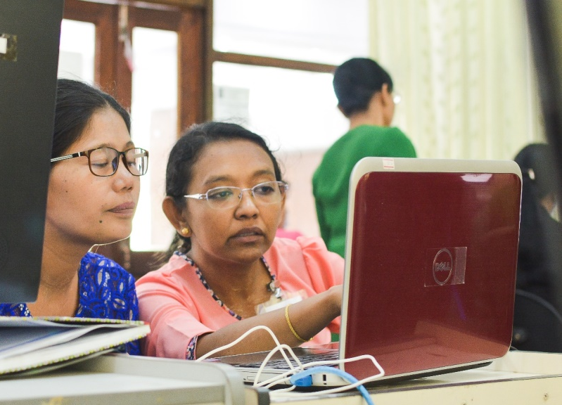
How to access Research4Life?
With UserID
Each institution has one UserId/password
Via your campus network
IP based login inside your institution’s network grants convenient access – if your institution has established
Contact your library or director’s office for access

Slide 7
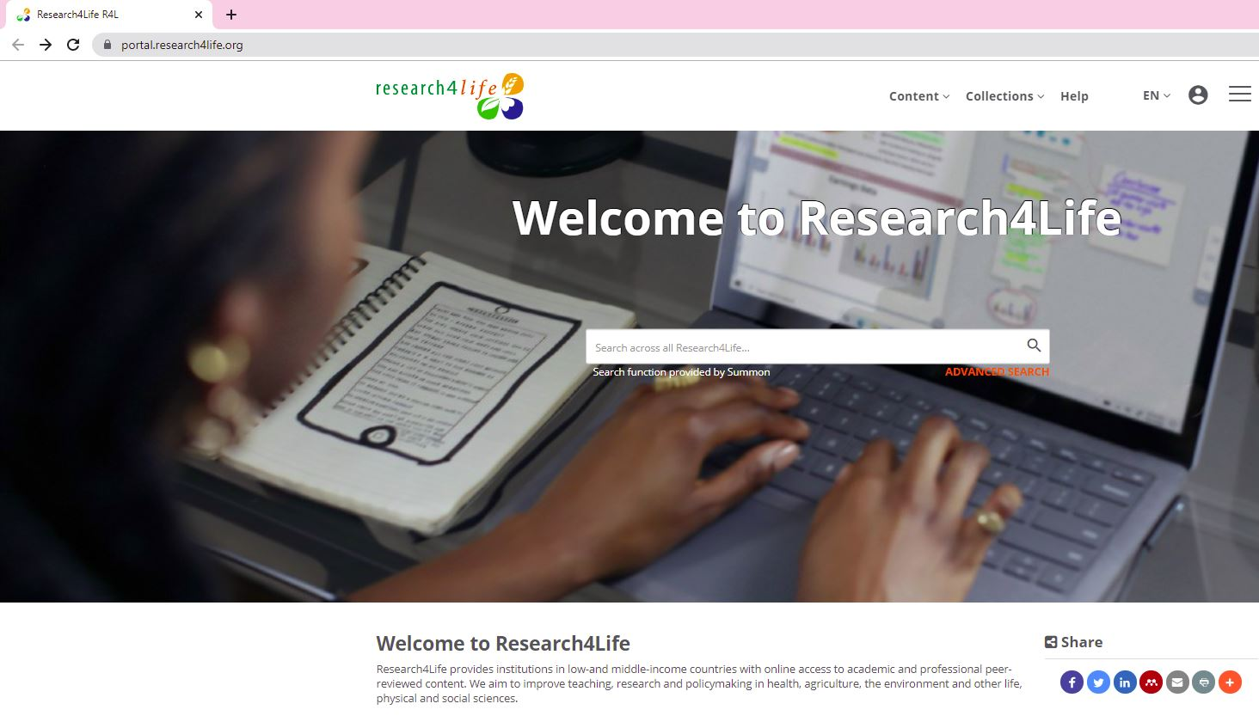
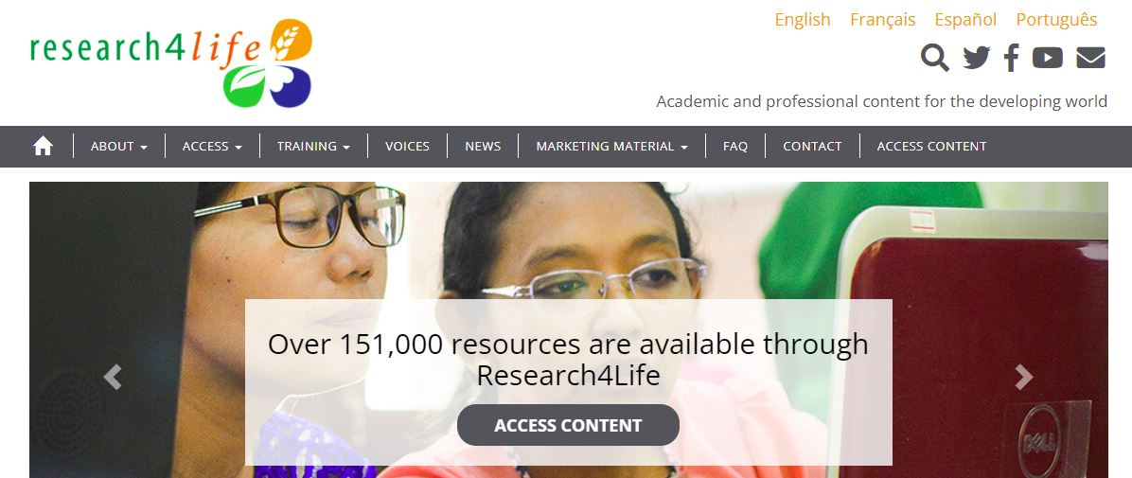
Log in from our homepage
https://www.research4life.org/

Slide 8
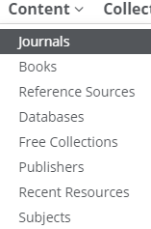
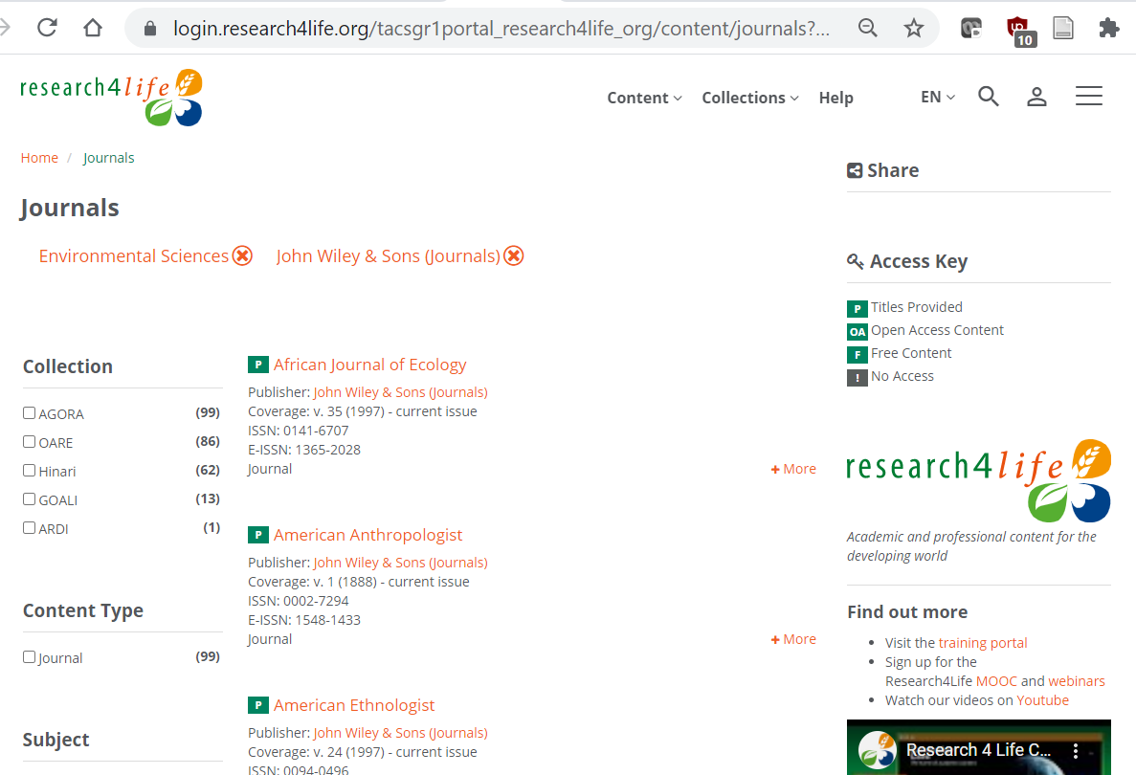
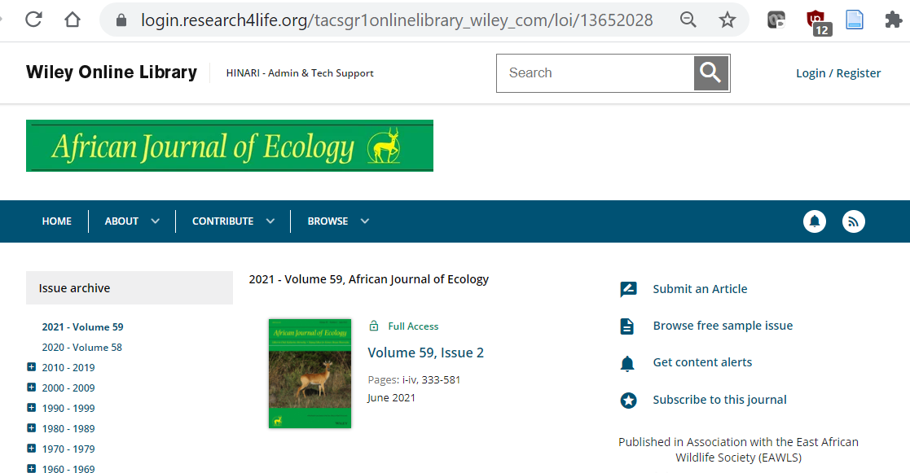
Browse thousands of journals and books

Slide 9
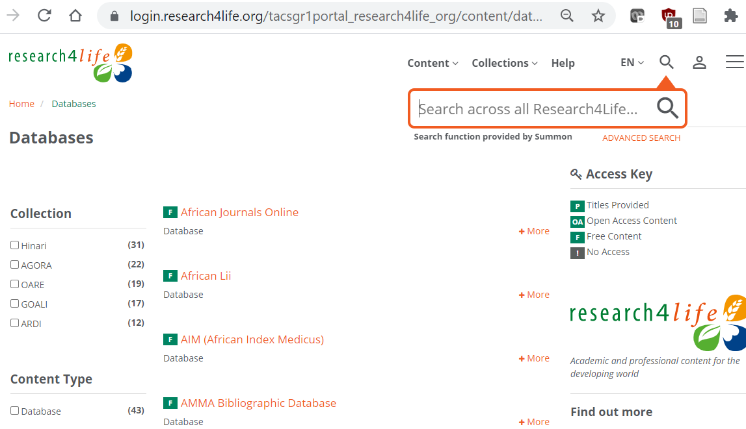
Access databases

Slide 10
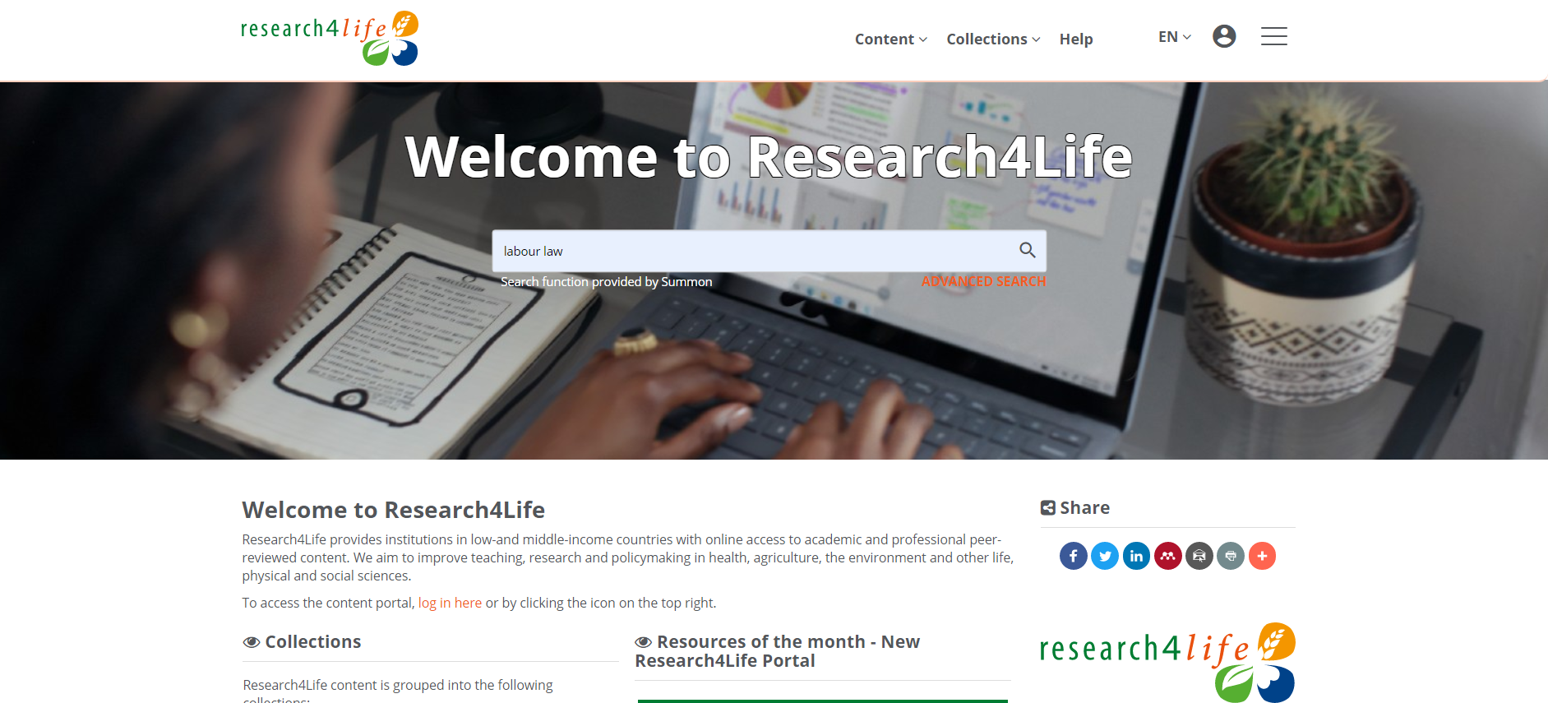
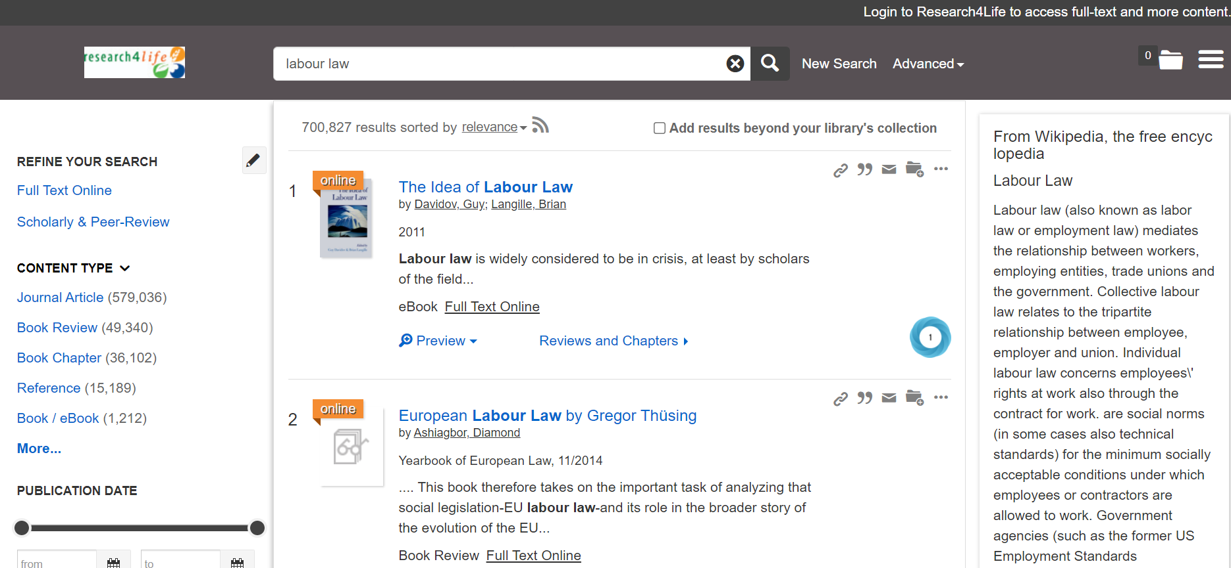
Search on all content by keywords

Slide 11
How we make a difference
“We can’t always buy the latest books and journals, so Research4Life is really our only source of current information. It allows me to read what I need to read to be able to stay up to date.”
Neurosurgeon Dr. Pratyush Shrestha from Nepal

Slide 12
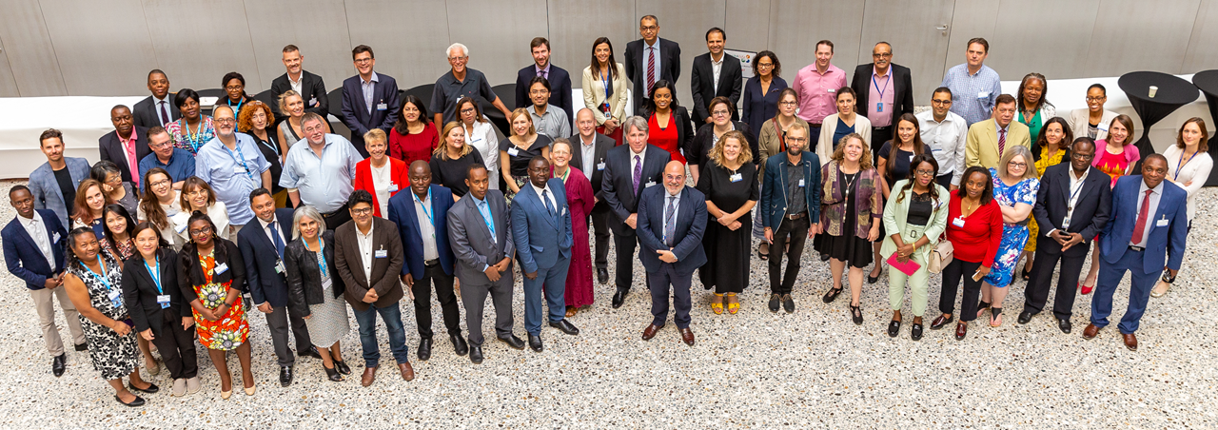
More information?
Visit www.research4life.org or write to r4l@research4life.org.

