Slide 1
Research4Life Advocacy Toolkit & Marketing Plan
Research4Life -2021

Slide 2
Overall goal
Improve the visibility of libraries and get your message to larger communities
Help librarians become part of larger local, regional, or national conversations
research4life.org/resources

Slide 3
Steps towards effective advocacy

Slide 4
Step 1: Identify your challenge
From previous MOOCs:
Getting support from leadership to raise the profile of my library and get more funding
Raising awareness of Research4Life within your institution
Securing the annual Research4Life fee (group B countries)
Remember: make the distinction between end goals and short-term objectives → specific, measurable and realistic.

Slide 5
Step 2: Set up your goals
Inform: highlight events or actions your audience can take
Educate: provide deeper understanding of your library’s resources
Connect: inspire your audience to join you, make them want to get involved, to know more, to participate

Slide 6
Step 2: Set up your goals
Each channel can fulfill different purposes:
Inform: share news on digital media (institutional site or newsletter, LinkedIn, etc.)
Educate: use specific sections of your website, or posters in the library, etc.
Connect: Facebook, Instagram, Twitter or other social media, depending on your country

Slide 7
Step 3: Audience
Who is your audience?
Student communities
Management of institution
Local policymakers
Funding organizations
How can you reach them?
At the library: posters, flyers...
During meetings or events
Online: social media, newsletters, website…
Remember: different strategies can be used for different audiences.

Slide 8
Step 3: Audience and channels
Educate
Institutional website
(or sections of it)
Researchers, communities, general public
Newsletter or blog
Colleagues, other institutions, decision-makers, potential partners
Students, young public
Inform
Connect
Researchers, communities, other partners

Slide 9
Step 4: Resources
Marketing material
PowerPoint presentation, factsheet, poster, brochure, case study booklets: research4life.org/marketing-material
Videos and case studies of users’ stories: research4life.org/voices
Remember to ask for help: is there communications staff at your institution?

Slide 10
Step 4: Resources
Training
Research4Life introduction video: research4life.org/training/getting-started
Webinars: research4life.org/training/webinars
Author skills: research4life.org/training/author-skills
Training presentations: research4life.org/training/resources-for-information-specialists/presentations
Additional resources: research4life.org/training/resources-related-organizations

Slide 11
Step 5: Advocacy activities
From previous MOOCs:
I have talked about Research4Life during faculty meetings
I have conducted Research4Life training for researchers/faculty at my institution
I have distributed infographics, factsheets or flyers/posters about Research4Life
Group discussion

Slide 12
Step 6: Evaluation
What was successful?
What wasn’t successful and why?
Remember to be specific: it will help you monitor your progress. Example metrics: How many people attended my event? Were they satisfied? Did they ask you for specific resources? What’s the reach and engagement on social media? How about your website traffic?
Group discussion

Slide 13
Get in touch
We always have news about training opportunities, webinars and stories!
www.research4life.org
R4L_partnership
R4Lpartnership
Research4Life
We are also open for feedback or story ideas! Reach out at communications@research4life.org.
For technical support, contact our helpdesk: r4l@research4life.org.

Slide 14
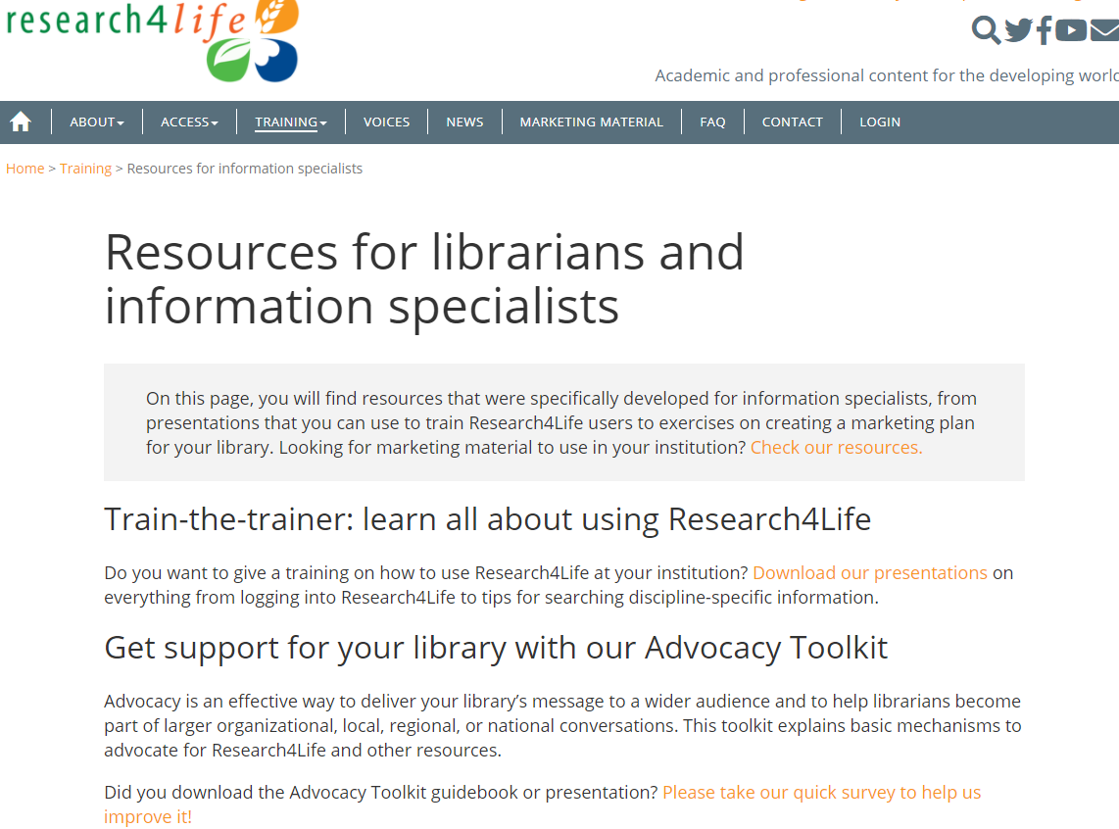
https://www.research4life.org/training/resources-for-information-specialists/

Slide 15
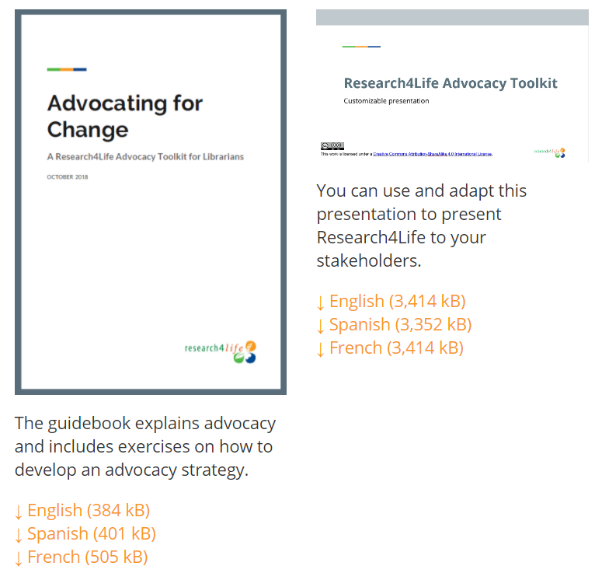
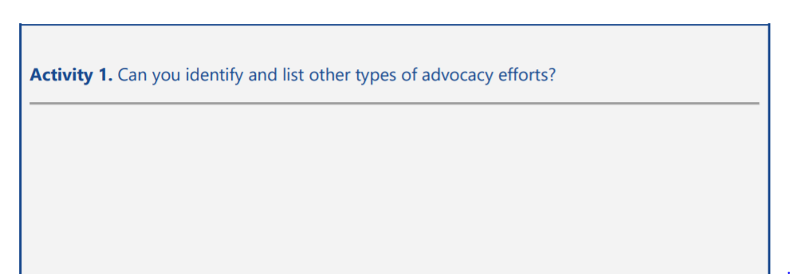
https://www.research4life.org/training/resources-for-information-specialists/

Slide 16
https://www.research4life.org/training/resources-for-information-specialists/presentations/

Slide 17
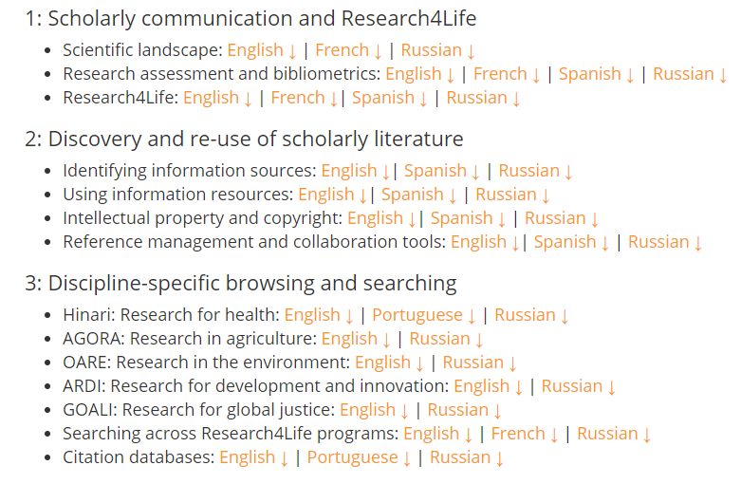
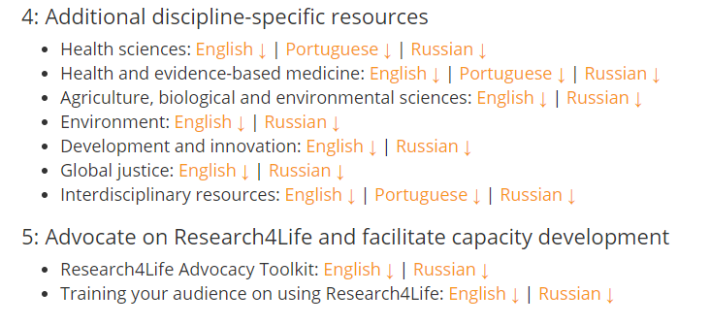
This material is licensed under a Creative Commons Attribution-ShareAlike 4.0 International License (CC BY-SA 4.0). The logos used in the course are exempt. This CC BY-SA 4.0 license allows trainers to modify and adapt the material for specific training purposes at the host institution to meet the group’s specific needs. By using the training material, individuals do not represent or are employed by Research4Life.

Slide 18
https://www.research4life.org/training/resources-for-information-specialists/

