Slide 1
Research4Life user review 2020:
Summary of findings
Siân Harris
sharris@inasp.info
www.inasp.info
@INASPinfo

Slide 2
Objectives
1.
Patterns and trends in usage
Relevance
Perceived value of training and outreach, platform and contents
2.
Effectiveness
3.
Impact of the programmes on scientific and workplace productivity of users
Impact
4.
Constraints affecting wider use
Key learnings

Slide 3
Our approach
Interviews in 11 countries
Algeria, Bangladesh, El Salvador, Ghana, Mozambique, Myanmar, Nicaragua, Papua New Guinea, Rwanda, Ukraine, Viet Nam
Conducted in 8 languages
Bangla, English, French, Portuguese, Russian, Spanish, Ukrainian, Vietnamese
Survey of 1886 people in 85 countries
In English, French and Spanish
2 country case studies
Kenya and Honduras

Slide 4
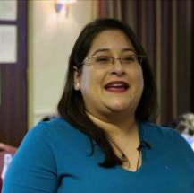
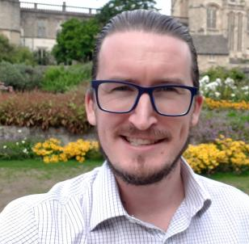
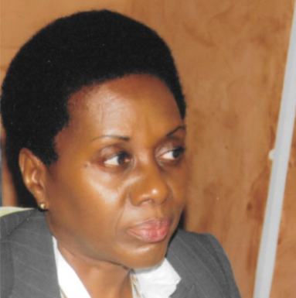
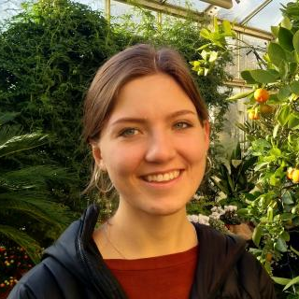
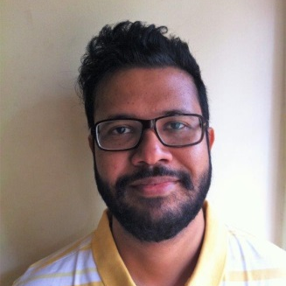
User Review researchers
Alejandra, Alex, Anne, Davi, Diem-Phuc, Femi, Gary, Haseeb, Josie, Lamiaa, Lê Ha, Leandro, Oksana, Ravi, Rebecca, Siân

Slide 5
Relevance
To what extent does Research4Life respond to the needs of its users?

Slide 6
Research4Life…
Remains relevant for users who are aware of it, have had appropriate training for it and have infrastructure to support it
Content is seen as high quality and trustworthy
Users report a good experience around access and use

Slide 7
But…
Awareness is low
&
Usage has dropped

Slide 8
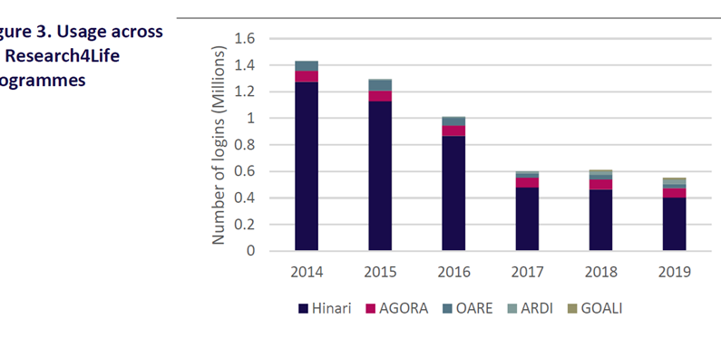
Source: 2020 Landscape review, Research Consulting
Notes:
This graph, from the Landscape review conducted by Research Consulting last year, showed that usage of Research4Life continued to drop from 2014 to 2017 levelling off more recently

Slide 9
Factors influencing usage:
• Awareness
Demand
Statistics

Slide 10
“No one told me about it, so the first step would be start promoting it by e-mail, handouts and lectures/seminars (even online).”
- Female lecturer, Sri Lanka
Notes:
Source: interviews

Slide 11
“When you're processing the registrations of new institutions for joining R4L you find some institutions that are already registered. It means whoever is registering is not aware that his institution is already registered.”
Notes:
Source: case study, Kenya

Slide 12
“As a librarian, how do I defend to my authorities that this access is necessary? It can be through usage statistics. But we don’t have access to these statistics.”
Notes:
Source: case study, Honduras

Slide 13
Effectiveness
Is Research4Life achieving its goals for the user?

Slide 14
97% of users rate Research4Life valuable to their career
68% of users found searching content easy
68% of users found it very or quite easy to log onto the platform
53% of respondents were satisfied with training

Slide 15
Factors that influence effectiveness
• Local support available to the user
• Support from Research4Life
• Language
• Scope of content and publisher exclusions
• Authentication
• Underlying infrastructure challenges
• Confidence

Slide 16
“In addition to the trainings that we organise as the library, we have been privileged in the sense that information literacy has been integrated in the curriculum … whenever we add training, Hinari is always a database that we will cover.”
Notes:
Source: case study, Kenya

Slide 17
“The language is also a challenge, most of the articles are in English. We offer English classes to push this forward.”
Notes:
Source: case study, Honduras

Slide 18
“The presentation slides were in English and they were delivered in French. In this way, both Anglophones and Francophones could follow the training.”
- Laboratory Manager, Rwanda
Notes:
Source: interviews

Slide 19
“… It is easy to access, but one needs to be patient to ask the right questions to find what one needs. Navigating is easy, but getting the information takes time.”
- Academic, Nicaragua
Notes:
Source: interviews

Slide 20
Impact
What do users feel is the “difference made” by Research4Life

Slide 21
87% reported Research4Life has improved the quality of their output
78% reported Research4Life has improved the quantity of their output
87% reported Research4Life has improved their
research skills
75% rated Research4Life as having a large positive impact

Slide 22
“We can’t try to strengthen research for health if there is no access to information.”
- User, Honduras
Notes:
Source: case study, Honduras

Slide 23
“To make a scientific paper was a headache, but now we can easily do it with no problem.”
- Researcher, Mozambique
Notes:
Source: interviews

Slide 24
“In my role as an Editorial Assistant, [R4L] helps me to double check submitted manuscripts, to ensure that we are not duplicating already published works.”
- Researcher, Kenya
Notes:
Source: case study, Kenya

Slide 25
Factors that influence impact
• Content is trusted and seen as quality material
• Content is free
• Opportunity for capacity development

Slide 26
“Although 1500 dollars is not a lot, in a country like Honduras it is a figure that carries weight.” – - Librarian, Honduras
Notes:
Source: case study, Honduras

Slide 27
“More members would be able to publish in these journals if they had accessed some of the content in them in the review, but now that has actually reduced because the access is limited.”
- Librarian, Kenya
Notes:
Source: case study, Kenya (regarding publisher exclusions)

Slide 28
3 key learnings

Slide 29
Adaptation
How well has Research4Life been able to learn and adapt its approaches in light of changes in the broad operating context?
Many of the issues raised in previous reviews surfaced once again
While technological improvements have improved ease of access for many users, the issue of usage is yet to be fully engaged with

Slide 30
Open Access
The future of any access initiative cannot be considered without also considering the role of Open Access in the overall research communication system

Slide 31
Local agency
Investment is needed in local capacities and structures to enable a greater uptake of Research4Life
Research4Life is effectively placed to support the process, but bespoke training, engagement, interaction and support must be developed locally

Slide 32
Recommendations

Slide 33
Recommendation 1
Define how and why Research4Life’s goal will be achieved; develop a Theory of Change

Slide 34
Recommendation 2
Build awareness, communication and community

Slide 35
Recommendation 3
Expand and reconceptualise training

Slide 36
Recommendation 4
Improve support networks

Slide 37
Recommendation 5
Ensure platform and technology supports effective usage

Slide 38
Recommendation 6
Address gaps and sudden changes in content

Slide 39
Recommendation 7
Explore potential new avenues for work

Slide 40
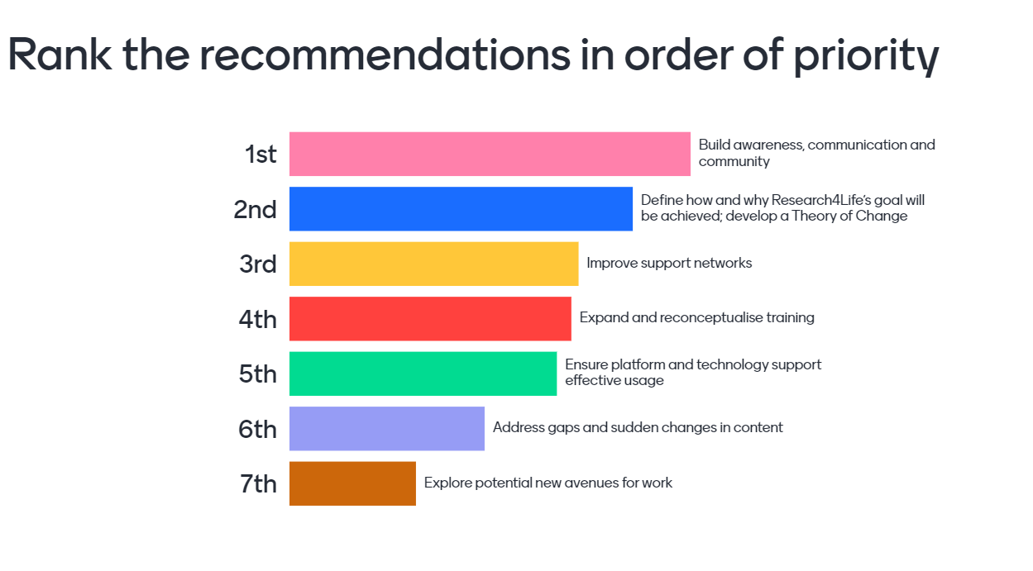
Workshop feedback

Slide 41
Thank you for listening!
Siân Harris
sharris@inasp.info
www.inasp.info
@INASPinfo

