Slide 1
ADDITIONAL COLLECTION-SPECIFIC RESOURCES
Databases in Agriculture
Research4Life is a public-private partnership of five collections:

Slide 2
Outline
Introduction
AGRIS - International Information System of Agricultural Science and Technology
Content coverage
How to search AGRIS database?
How to become a data provider?
Databases in Agriculture
CAB Abstract
USDA National Agricultural Library - PubAg
This work is licensed under Creative Commons Attribution-ShareAlike 4.0 International (CC BY-SA 4.0)

Slide 3
Learning objectives
Become familiar with discovery resources related to agriculture.
Understand how to use and contribute to AGRIS.
Notes:
In this lesson, learners will be introduced to the AGRIS database and additional discipline-specific external resources in the fields of agricultural sciences.

Slide 4
What is AGRIS ?
AGRIS stands for International Information System of Agricultural Science and Technology.
AGRIS has been maintained by the Food and Agriculture Organization of the United Nations (FAO) since 1975.
Its main objective is to improve the access to & exchange of information on agricultural research to developed and developing countries.
447 data providers from 148 countries provide free access to more than 13 million bibliographic records and more than 4,251 datasets through AGRIS.
Notes:
AGRIS is a network of more than 447 data providers (research centres, academic institutions, publishers, governmental bodies, development programmes, international and national organizations) from up to 148 countries.

Slide 5
Content coverage
AGRIS has a data set of multilingual bibliographic resources on agricultural research and other related subjects.
AGRIS Data Providers submit bibliographic metadata of data sets, journal articles, book chapters, monographs, grey literature and other content types related to agriculture.
AGRIS records are fully indexed by Google Scholar; 85% of AGRIS records are indexed by the AGROVOC multilingual thesaurus;
covers all areas of interest of FAO including food, nutrition, agriculture, fisheries, forestry, the environment and more.
AGRIS is accessed by up to 400,000 users each month from more than 200 countries and territories.
Audience includes researchers, graduate students, librarians and many others.
Notes:
AGROVOC is a controlled vocabulary covering all areas of interest of the Food and Agriculture Organization (FAO) of the United Nations, including food, nutrition, agriculture, fisheries, forestry, environment etc. It is published by FAO and edited by a community of experts. It is widely used in specialized libraries as well as digital libraries and repositories to index content and for the purpose of text mining. It is also used as a specialized tagging resource for content organization by FAO and third-party stakeholders.
AGROVOC consists of +37,000 concepts and +750,000 terms in up to 37 languages.
AGRIS is an international brand with an international audience for the data providers increasing visibility of resources, creating the opportunity to contribute to agriculture and related sciences globally.
AGRIS Data providers can submit including unpublished science, technical reports, theses, dissertations, conference papers).
AGRIS supports both developed and developing countries.
The audience is researchers, professors, and graduate students looking for bibliographies; plus librarians, cataloguers; journal publishers, conference organizers, and decision makers in the agricultural domain.

Slide 6
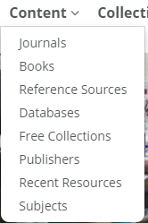
AGRIS
The AGRIS database contains 13,417,430 records - including 4,251 datasets - from 447 data providers.
After logging into the AGORA Portal, open the Content list, scroll down the titles, click on Free Collections then click on AGRIS

Slide 7
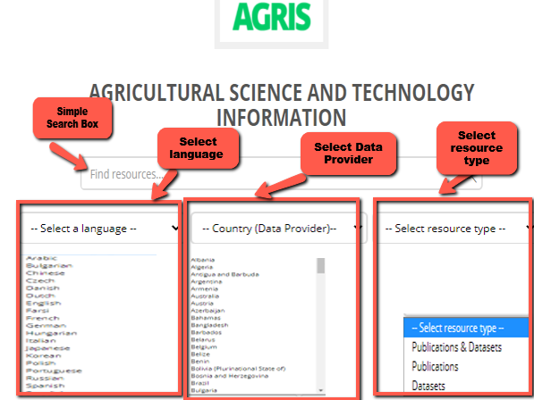
How to search the AGRIS database?
The interface allows users to perform basic searches.
User can perform a simple (basic) search with any keywords through the search box.
Users are also filter their search by type of resources: publications or datasets or both
Language filters can also be used to retrieve the results in a particular language.
Data Provider filters can be used to retrieve results from Data providers from each of the listed countries
*Note that AGRIS indexes datasets as well as publications such as articles, proceedings, reports with and without full text.

Slide 8
Basic search using resource type filter
Step 1 shows an example of a basic search with the keywords of “Antimicrobial Resistance”
Initial search was done by selecting both publications & datasets.
Step 2 show that the search provided 5,177 records on the topic.
Step 2 also shows that once the search is completed, results can still be filtered by content type.
Step 3 shows that datasets were selected, and the total number of results changed from 5,177 to 6 in total.
Icon next to the title represents a dataset.
1
2
3

Slide 9
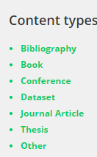
Filter results by content type
Once the search has been completed, the AGRIS results can be filtered by content type, such as;
bibliography,
book,
conference proceeding,
dataset
journal article,
thesis
other

Slide 10
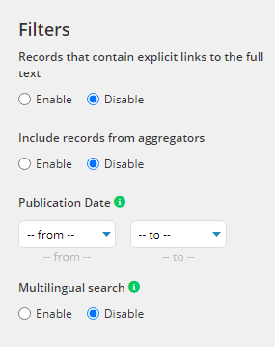
Filters on AGRIS search result page
AGRIS filters allows users to;
Limit search results to records with/without links to full text.
Enable or disable results from aggregators.
Refine by publication date.
Retrieve results in different languages.
Notes:
The “Advanced Search” option is also available and will be explained later in this section.
The search results retrieved for “Antimicrobial Resistance” can be refined by “Filters”
AGRIS Filters explained;
“full text links” which leads to the full text of the record;
“publication date” where timeline of the research is important;
“data provider” when user needs resources from a specific organisation;
“type of results” where distinction of resource type is important;
“including records from aggregators” to extend the search beyond AGRIS content; and
“multilingual search” to search keywords in other languages.

Slide 11
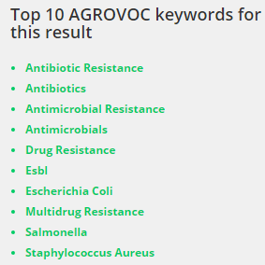
AGROVOC Keywords
Most of the AGRIS records are indexed by AGROVOC.
The “Top 10 AGROVOC keywords for this result” is a very useful tool to help find the precise and most relevant records to your search terms.
Notes:
FAO’s multilingual Thesaurus and the contributors, data providers are advised to describe their collections by using AGROVOC thesaurus.

Slide 12
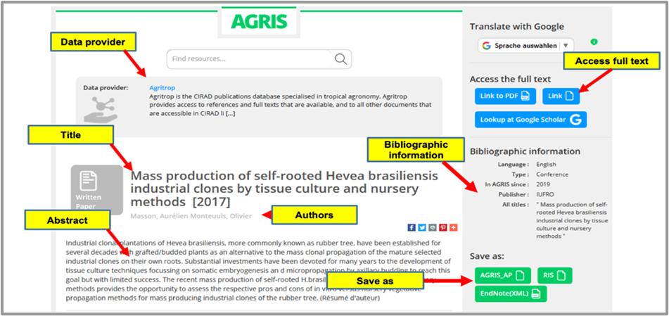
Bibliographic details on a record in AGRIS
An example of a bibliographic record in AGRIS.
Notes:
When you click on a title in AGRIS, first the “data provider” is displayed in the centre area to indicate where this record is indexed from.
Then “title” with ‘author” information is displayed followed by an “abstract” in this sample record.
Checking the abstract is a key step to see if a title is relevant to the research topic.
On the right side of the page, users are provided with links to the full text of the publication if it is available.
Full-text links are followed by the details of the bibliographic record including the publisher, language and the year it started being indexed in AGRIS.

Slide 13
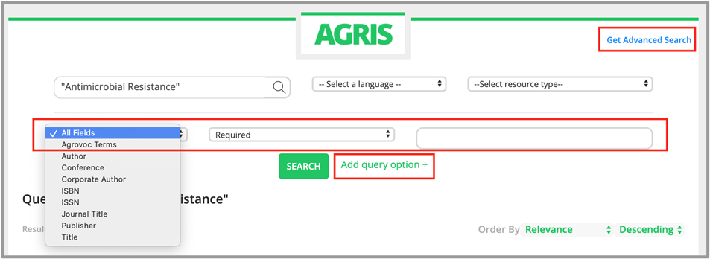
Refining options in AGRIS
Users can revise their searches using the Add query option. Clicking on this prompts a new set of refine options.
Users can select any field from the dropdown menu to refine their results e.g. a term from AGROVOC or by searching for a specific author.
The Get Advanced Search option takes users to the advanced search page with filters and refine search options.

Slide 14
Advanced search in AGRIS
A refine search box is available to revise your existing search terms.
Users can revise their search by adding another term or phrase or make a new search by using this search box.
This feature allows users to refine their search with only “full text” title, choice of datasets or publication, date, language, content type, country as well as the choice of content provider.
*As an example, in the next slide, search results for "Antimicrobial Resistance" was narrowed by adding a keyword of “Farm”

Slide 15
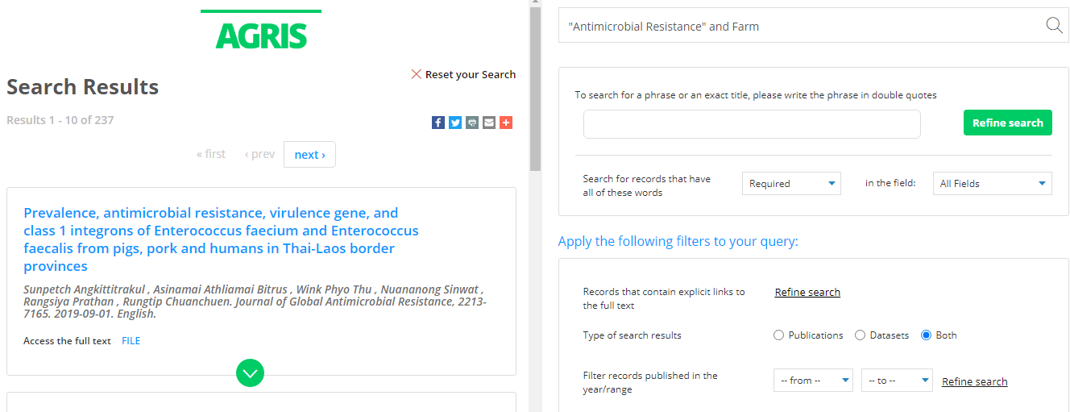
Advanced search in AGRIS
Search results are on the left.
Refine search box is available on the top right to revise your existing search terms.
Notes:
Being multilingual is one of the many great features of AGRIS and language filtering may be particularly useful for non-English speaking countries which are commonly underrepresented in the scholarly communication landscape

Slide 16
How to become a data provider?
Organizations which are eligible to become data providers in AGRIS are institutional repositories, journal publishers and aggregators.
Individual author contributors are not accepted as data providers.
Resources should be in the area of food, nutrition, agriculture, forestry, fishery, environmental or other related sciences which are included in the AGROVOC thesaurus.
If you are interested to register as a data provider, please contact agris@fao.org.
Recommendations of a set of metadata properties and encoding vocabularies are provided on FAO’s AIMS website.
More information about providing data to AGRIS can be found at http://agris.fao.org/agris-search/info.action. AGRIS also has a dedicated mailing list at https://dgroups.org/fao/agris where anyone interested in it can join the list to stay up-to-date with the database and relevant activities.
Notes:
AGRIS receives metadata in various formats, like the AGRIS Application Profile (AP) XML format as a minimum standard or better.
Recommendations of a set of metadata properties and encoding vocabularies are provided on FAO’s AIMS website. Meaningful Bibliographic Metadata is intended to assist content providers in selecting appropriate metadata properties for the creation, management and exchange of meaningful bibliographic information in open repositories.
The most common metadata standard formats are: Crossref, DOAJ, Endnote, MARC21, MODS, Simple DC, and PubMed. When there is a need to create metadata from scratch, it is recommended to use a reference management software to export the data in XML format. There are also reference management software applications that can be downloaded for free, for example Mendeley or Zotero.

Slide 17
Databases in Agriculture
This section will introduce two of the databases that are available through the AGORA Portal or the R4L United Content Portal, from the list of Databases or externally at the given URLs.
CAB Abstract
USDA National Agricultural Library - PubAg

Slide 18
CAB Abstracts
CAB Abstracts is a comprehensive database for applied life sciences.
It is published by CABI (formerly the Centre for Agriculture and Biosciences International).
CAB Abstracts provides users access to more than 13 million records from 1973 onwards.
Subject coverage includes agriculture, environment, veterinary sciences, applied economics, food science and nutrition.
CAB Abstracts is indexed with the CAB Thesaurus which makes searching easier and provides a more precise access to all relevant research.
CAB Abstracts has an international focus with strong representation in developing countries.

Slide 19
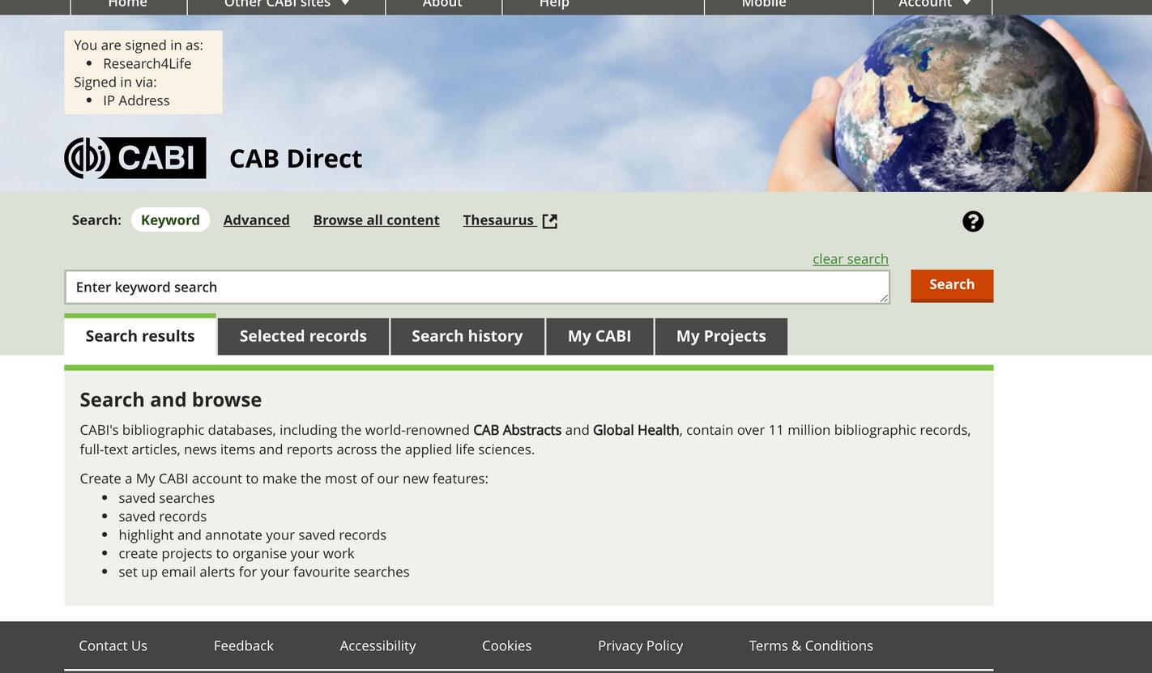
CAB Abstracts
After logging into the AGORA Portal, open the Content list, scroll down the titles and click on Databases.

Slide 20
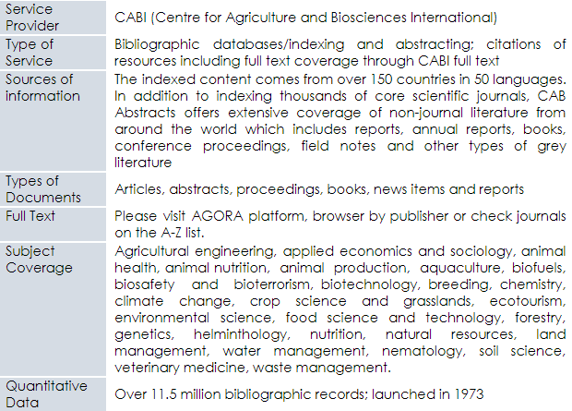
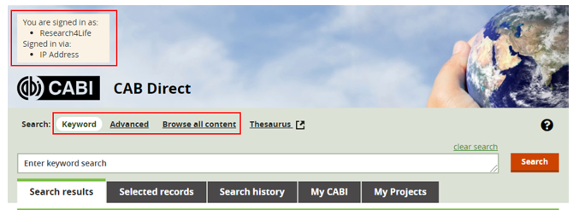
CAB Abstracts cont.
Available at :
Login into AGORA Portal, open Content and click on Databases to access CAB Abstract.
Direct URL is www.cabdirect.org
CAB Abstracts search page

Slide 21
USDA National Agricultural Library - PubAg
PubAg is a search engine that gives the public enhanced access to research published by scientists from US Department of Agriculture (USDA) scientists.
It is provided by the US Department of Agriculture (USDA) National Agricultural Library.
PubAg is a portal to USDA-authored and other highly relevant agricultural research.
PubAg is easy to use an and it serves diverse users, including the public, farmers, scientists, academicians and students.
There is no requirement for a username, password or any other form of registration to use PubAg.

Slide 22
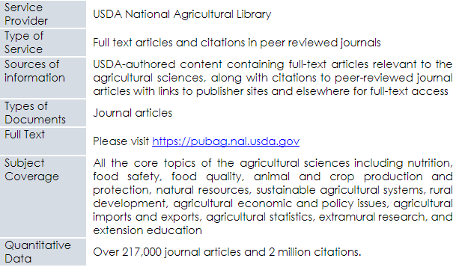
USDA National Agricultural Library – PubAg cont.
Available at https://pubag.nal.usda.gov
PubAg search page

Slide 23
Summary
This lesson focused on databases for discovery in agriculture.
The lesson introduced learners to AGRIS and it provided training on how to use and contribute to AGRIS.
Learners were also introduced to CAB Abstracts and USDA National Agricultural Library – PubAg, these resources can be used to search for agriculture related content.

Slide 24
References and useful resources
CABi. 2020. CABI Direct. In: CABI Direct [online]. [Cited 29 September 2020]. https://www.cabdirect.org/cabdirect/about
FAO. 2019. How to submit data to AGRIS. Instructions to data providers. In: Agricultural Information Management Standards (AIMS) [online]. [Cited 29 September 2020]. http://aims.fao.org/how-submit-data-agris-instructions-data-providers
FAO. 2020c. AGROVOC. In: Agricultural Information Management Standards (AIMS) [online]. [Cited 25 September 2020]. http://aims.fao.org/vest-registry/vocabularies/agrovoc
FAO. 2020a. AGRIS: Agricultural Science and Technology Information. In: AGRIS [online]. [Cited 25 September 2020]. http://agris.fao.org/agris-search/index.do
Research4Life. 2020. Materials for trainers. In: Research4Life [online]. [Cited 29 September 2020]. https://www.research4life.org/training/resources-for-information-specialists/materials-for-trainers/
Subirats, I. & Zeng, M.L. 2012. Meaningful Bibliographic Metadata (M2B). In: Agricultural Information Management Standards (AIMS) [online]. [Cited 29 September 2020]. http://aims.fao.org/metadata/m2b
USDA National Agricultural Library. 2020. PubAg. In: USDA National Agricultural Library [online]. [Cited 29 September 2020]. https://pubag.nal.usda.gov/faq
FAO. 2020b. What is AGRIS? In: AGRIS [online]. [Cited 29 September 2020]. https://agris.fao.org/agris-search/info.action

Slide 25
You are invited to;
Visit us at www.research4life.org
Contact us at r4l@research4life.org
Find out about other training materials [www.research4life.org/training]
Subscribe to Research4Life newsletter [www.research4life.org/newsletter]
Check out Research4Life videos [https://bit.ly/2w3CU5C]
Follow us on Twitter @r4lpartnership and Facebook @R4Lpartnership

Slide 26
For more information on Research4Life
www.research4life.org
r4l@research4life.org
Research4Life is a public-private partnership of five collections:

