Slide 1
ADVOCATE FOR RESEARCH4LIFE AND FACILITATE CAPACITY DEVELOPMENT
Training your audience on how to use Research4Life
Research4Life is a public-private partnership of five programmes:

Slide 2
Outline
Marketing Plan Tool
Training and promotional material
Social Media
User training and workshops
Summary
This work is licensed under Creative Commons Attribution-ShareAlike 4.0 International (CC BY-SA 4.0)

Slide 3
Learning objectives
Define their institution’s users’ needs by developing a marketing plan.
Find available training materials and other resources on the Research4Life website.
Create user training outlines and workshop programmes based on user needs.
Combine different research4life training materials for locals.
Note: To complete the Marketing Plan Tool, print a copy of the spreadsheet and enter the information manually or download a copy and use your computer to enter the data. The workbook is downloadable from:
Resources for librarians and information specialists/Promote your library... marketing plan/download Workbook

Slide 4
Marketing Plan Tool
There are some similarities between developing a marketing strategy and an advocacy strategy.
Marketing is more customer-oriented and aims to “sell” a product or service.
Marketing can increase the library’s visibility therefore it should be part of a library’s overall strategic plan.
A marketing plan provides libraries with a framework for the effective, logical and comprehensive development of marketing activities.
A marketing plan that is tailored to an institution can help the library use its resources more efficiently and benefit advocacy work.

Slide 5
Marketing for Research4Life
A marketing plan will educate the institution’s customers or client groups about the full potential of the resources available through the Research4Life platform.
This will benefit research, education, policy-making, and other outcomes.
An effective marketing strategy will increase the use of the Research4Life and justify the continued support by the participating publishers.

Slide 6
Marketing for Research4Life
A marketing plan will educate the institution’s customers or client groups about the full potential of the resources available through the Research4Life platform.
This will benefit research, education, policy-making, and other outcomes.
An effective marketing strategy will increase the use of the Research4Life and justify the continued support by the participating publishers.

Slide 7
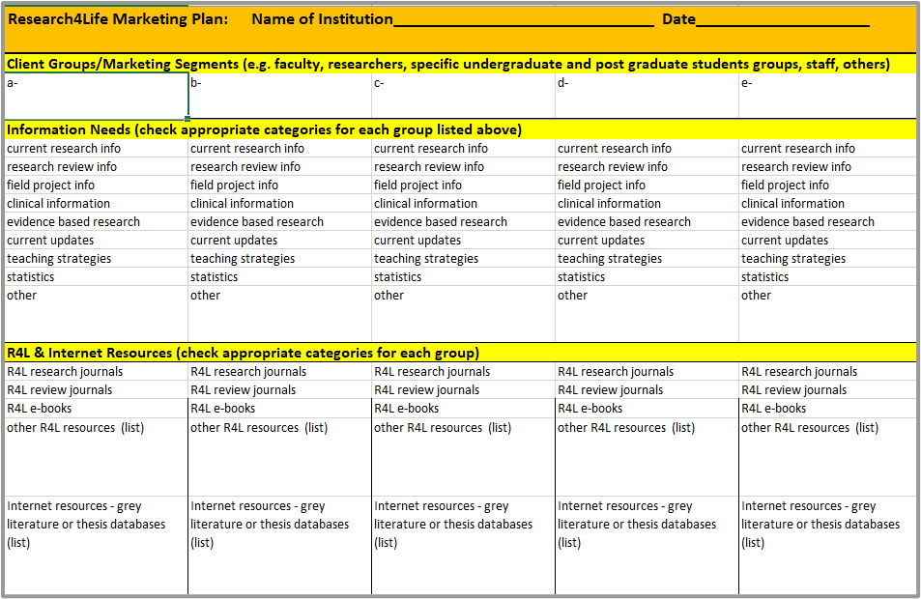
First page of the Research4Life Marketing Plan Tool
The first page of the Research4Life marketing plan tool allows a user to enter
the institution’s Client Groups (listed horizontally for up-to-five)
each group’s Information Needs (list vertically with an X)
the R4L & Internet Resources options (list vertically with an X or type in term)
Notes:
Enter the institution’s client groups horizontally in the five boxes.
Once these groups have been added, work vertically down the column. For example, if the first group is lecturers, put checks next to the appropriate categories for the group’s Information Needs – listed below in the same column.
Continue down the column and check the Research4Life and Internet Resources for lecturers. For the second client group (for example researchers), again go down that specific column vertically and check the boxes for this group.

Slide 8
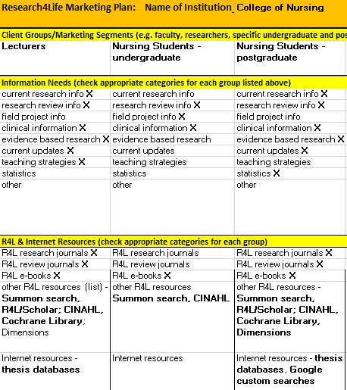
Sample of completed first page of the Marketing Plan for a College of Nursing
Sample for a College of Nursing
add the institution’s Client Groups (listed horizontally)
note each group’s Information Needs (listed vertically with an X)
note the Research4Life & Internet Resources options (list vertically with an X or type in term)

Slide 9
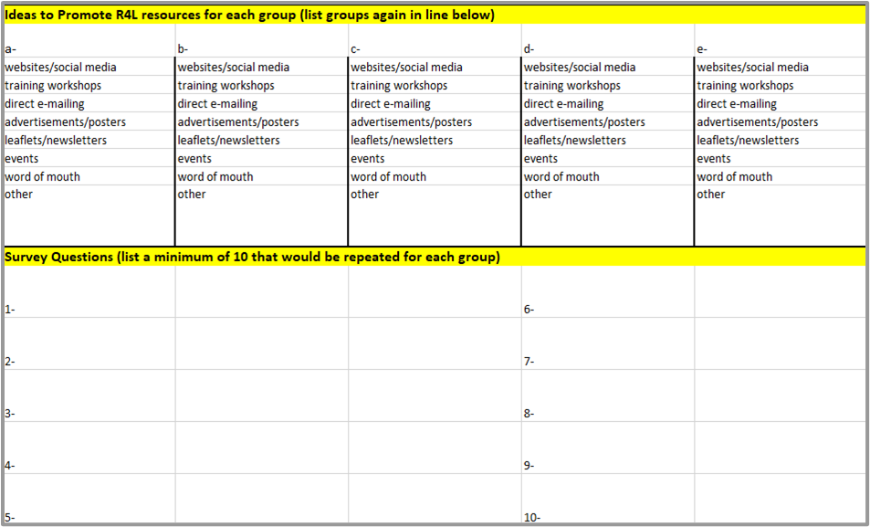
Second page of the Research4Life Marketing Plan Tool
The second page Marketing Plan tool allows a user to enter
the Client Groups that were listed horizontally on the previous pages.
the Ideas to Promote Research4Life resources for each group (listed vertically with an X)
ten Survey Questions for all the client groups in boxes.

Slide 10
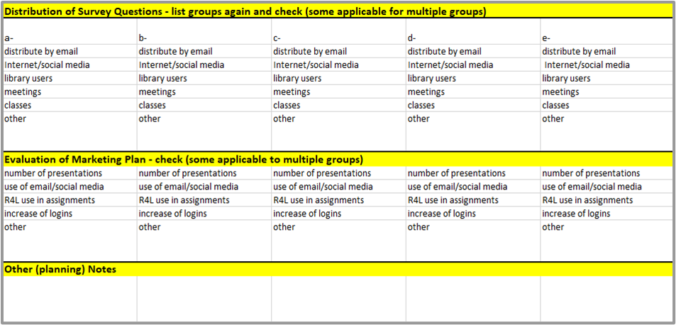
Third page of the Research4Life Marketing Plan Tool
The third page of the Marketing Plan Tool allows a user to enter
the Client Groups in the appropriate boxes (horizontally)
the methods for Distribution of Survey Questions for each group (listed vertically with an X)
the options for Evaluation of Marketing Plan for each group (listed vertically with an X)

Slide 11
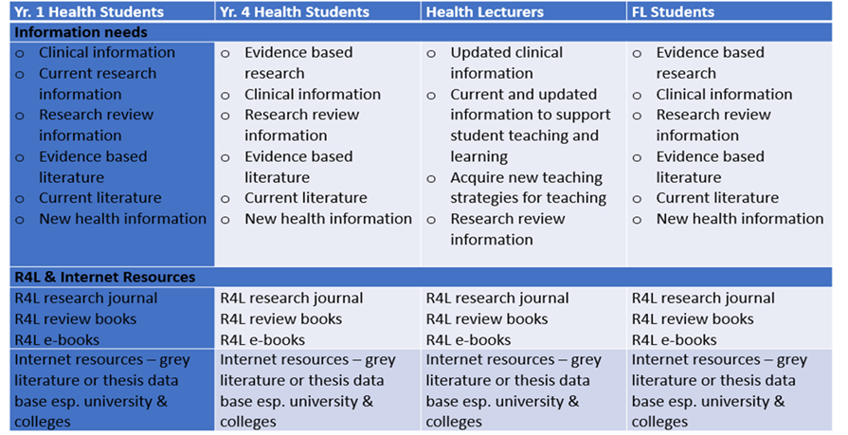
An example of a marketing plan from Divine Word University, Papua New Guinea
Research4Life Marketing Plan, Divine Word University (DWU), Madang, Papua New Guinea; 25 May 2017
Notes:
Client Groups (horizontal), Information needs and available Research4Life and Internet resources (vertical in each column)

Slide 12
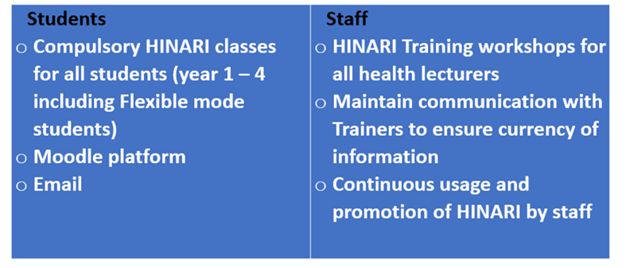
DWU ideas to promote Research4Life resources

Slide 13
Survey questions developed by DWU workshop participants
Can you access Hinari on campus (Madang)?
Are you familiar with the features of Hinari?
Is Hinari useful for updating the information you need?
Is Hinari useful for current research information?
Is Hinari useful for research review information?
What features in Hinari are useful for you?
What features in Hinari are not useful for you?
How much time during a week do you spend on Hinari?
If you have problems with accessing Hinari, who do you contact?
Would you recommend Hinari to other people?

Slide 14
Distribution of survey questionnaires
Email all staff and students
Upload questionnaire on Moodle so students can answer it
Give questionnaire to students and staff

Slide 15
Proposed evaluation of DWU marketing campaign
Number of students trained
Number of staff trained
Number of Hinari workshops conducted
Increase of logins among staff and students
Better teaching strategies
Follow-up survey (post-training)

Slide 16
Training and promotional materials
Capacity development is a central part of the Research4Life partnership.
The subsequent slides will discuss various training and promotional material that are available from the Research4Life website.
Besides the training material focused on Research4Life programmes, the training portal contains information on the MOOCs, sponsored webinars, publishing and author skills including reference management software tools plus resources from publishers and related organizations.
Notes:
This section focuses on where to find training and promotional materials. As previously noted, this material is necessary to successfully implement the numerous Advocacy Toolkit and Marketing Plan Tool tasks. These resources are located on the Research4Life website and the training pages of the five programmes

Slide 17
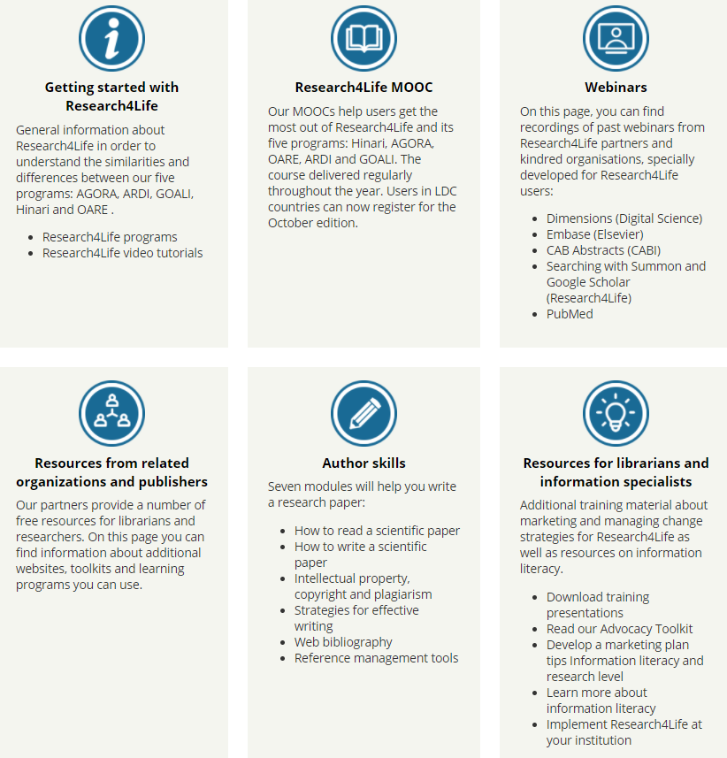
Research4Life Training Portal
The training portal is available through this link:
Research4Life training portal
Notes:
For trainers preparing a workshop or speech, these resource pages have numerous presentations and exercises that can be adapted for a specific activity.

Slide 18
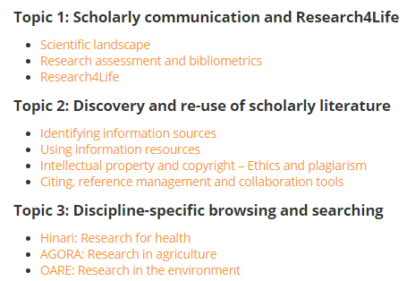
Materials for trainers
As of July 2020, a new version of the training material for all five programmes was launched at Materials for trainers
Similarly to the MOOC material, the PowerPoint presentations contain either inter-programme and individual programme information

Slide 19
Promote your library/
“Advocating for Change”
This page includes the Advocacy Toolkit, the Advocacy Toolkit PowerPoint presentation and factsheet.
Please note that the Toolkit and presentation are available in English, Spanish and French.
This material will be invaluable for advocacy-related presentations. See:
Advocacy Toolkit

Slide 20
Marketing materials
Users can download and print a Research4Life poster and six-page Access to Research in the Developing World brochure, available in English, Spanish and French.
Also available to download is a one-page brochure insert with information about Research4Life eligibility that is accessible in the three languages plus Arabic.
All these items can be useful to distribute at presentations and workshops. Scroll down the following page:
Marketing material

Slide 21
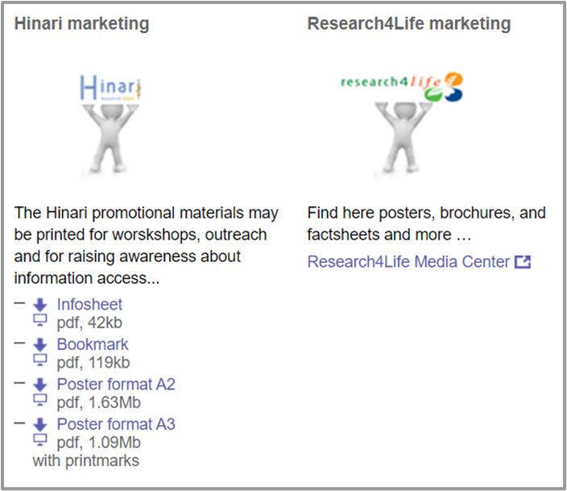
Hinari marketing materials
Hinari offers a branded bookmark, info sheet and several posters plus links to videos
See: Hinari Marketing materials

Slide 22
GOALI promotional materials
GOALI also has developed a selection of materials including a brochure, poster, postcards, and infographic.
See:
GOALI Promotional materials

Slide 23
Research4Life Voices
The Voices section has links to:
Stories of Change: a series of videos and photo stories showcasing the impact of access to information in the developing world
Case study booklets: insights into how access to peer-reviewed research from Research4Life is benefiting the health, well-being, and economic and social development of communities in the developing world
Testimonials from Research4Life users
Videos that have been posted on the Research4Life YouTube channel
See: Research4Life Voices

Slide 24
AGORA User Guide
This url links to a lengthy pdf that covers all aspects of using AGORA:
AGORA Users Guide
On page 31, see the links to AGORA publications, training materials, videos and other useful recordings.
See also: AGORA Training

Slide 25
Social Media
The Research4Life Communications team is responsible for communicating about Research4Life through its official channels on Twitter and Facebook:
Twitter: Users can tag @R4Lpartnership in their tweets about Research4Life. Also consider the following hashtags: #accesstoinformation #equityinresearch #africanresearch or anything else that is appropriate.
Facebook: The Research4Life address at www.facebook.com/r4lpartnership; join the community of over 11.000 followers.
Notes:
Social media channels can be a powerful tool to promote events that are related to Research4Life and highlight success stories from users around the world.

Slide 26
For trainers
Trainers who are organizing a workshop and would like to promote it online or want to share a story or a case study should contact the Communications team via the comms@research4life.org email address and the staff will help spread the word.

Slide 27
For individuals
Individuals are encouraged to share information about Research4Life through their own channel, or that of their institution – and don’t forget to add visual content to the article or social media post!
Visual content such as photos gets viewed up to 90% more often than purely textual content online.

Slide 28
User training and workshops
This section will focus on how to develop a workshop.
For context, the programmes of two workshops will be summarised.
Also included will be four scenarios for workshops.
These examples will highlight the range of programmes for Research4Life training.
Depending on the institution’s client groups and their specific information needs plus the time available, each training will be unique.
Notes:
When developing a workshop programme, useful tools are the training material of the five programmes and the Research4Life training portal. For links to these, see the Training pages

Slide 29
Example 1: Hinari National “Train the Trainers” Workshop
Hinari National “Train the Trainers” Workshop Zambia Library Consortium/University of Zambia Lusaka, Zambia, 22–25 July 2019 Day 1 Registration and opening ceremony; Research4Life overview and Internet searching; Hinari portal; Summon search tool for Research4Life programmes; Google Scholar; Practical Hinari considerations Day 2 Hinari/PubMed interface; PubMed filters; PubMed advanced search/history Day 3 Evidence-based practice for Hinari users; Additional Internet Resources and Research4Life training and promotion material Day 4 Marketing Hinari; Reference management software - Zotero; How to read and write a scientific paper; Intellectual property - copyright and plagiarism; Web-bibliography

Slide 30
Example 2: Workshop on Access to Global Research in Agriculture, Fisheries and Forestry
Workshop on Access to Global Online Research in Agriculture, Fisheries and Forestry Yangon University; Yangon, Myanmar 25–26 April 2016 Day 1 Registration and opening ceremony; New trends on open science, open access and open data in agriculture; Brief overview of intellectual property and copyright; Access to information in agricultural research - what are some tools I can use? Day 2 Panel session on “Access to scientific information in Myanmar”; Research4Life (R4L) programmes; AGORA, Access to Global Online Research in Agriculture; How to find books and journals in AGORA using the AGORA portal, Summon, Scopus

Slide 31
Examples of how different workshops need to be developed for unique groups with specific requirements
Example 1
Two four-hour session workshops:
Participants are medical residents and physicians from a teaching hospital. There has been a recent outbreak of respiratory tract infections and the participants are interested in prevention/control and treatment.
What resources should be included in the eight-hour course?
Example 2
Two two-hour sessions:
Participants are agriculture extension agents attending a week-long meeting. One of the most discussed topics in the field is “high protein forage and dairy production”. Where can the participants find current research and useful grey literature?
What search tools should be taught during the four hours of instruction?

Slide 32
Examples of how different workshops need to be developed for unique groups with specific requirements
Example 3
One-day workshop:
Participants are postgraduate students in environmental sciences. They are beginning their literature search for their research projects and are interested in finding a computer program to organize all the article and book results.
What resources would be covered in this seven-hour workshop?
Example 4
Three two-hour sessions:
Participants are fourth-year nursing students about to begin their literature searches for their graduation thesis. Besides learning how to identify and read current research information, students need a tool to keep track of the articles they find and create citations and bibliographies.
What material should be included in this six-hour training?

Slide 33
Summary
Compared to an advocacy strategy, marketing is more customer-oriented and aims to “sell” a product or service.
A marketing plan will educate the institution's members or client groups about the full potential of the resources available through the Research4Life platform and increase the use of the material.
Using the Marketing strategies for Research4Life resources workbook, the library staff can identify the institution’s client groups, their information needs and what resources are available, plus develop a survey and the strategy for distributing the questionnaire.
This lesson also discussed the Research4Life promotional and marketing material plus the social media channels. These resources are useful for all advocacy and marketing activities.
The lesson concludes with examples of two workshop programmes and scenarios for four workshops. These examples show how training is tailored to the unique information needs of various client groups.

Slide 34
Additional Resources
Association of College & Research Libraries (ACRL). ‘Marketing The Academic Library’. Text, 11 September 2011. Accessed 3 November 2020 http://www.ala.org/acrl/issues/marketing
Hardenbrook, Joe. ‘Marketing and Advocating for the Academic Library’. Mr. Library Dude (blog), 5 March 2019. Accessed 3 November 2020 https://mrlibrarydude.wordpress.com/2019/03/04/marketing-and-advocating-for-the-academic-library/
StatPac. ‘How to Design a Survey’. Accessed 3 November 2020. https://www.statpac.com/surveys/

Slide 35
You are invited to;
Visit us at www.research4life.org
Contact us at r4l@research4life.org
Find out about other training materials [www.research4life.org/training]
Subscribe to Research4Life newsletter [www.research4life.org/newsletter]
Check out Research4Life videos [https://bit.ly/2w3CU5C]
Follow us on Twitter @r4lpartnership and Facebook @R4Lpartnership

Slide 36
For more information on Research4Life
www.research4life.org
r4l@research4life.org
Research4Life is a public-private partnership of five programmes:

