Slide 1
ADDITIONAL DISCIPLINE-SPECIFIC RESOURCES
Interdisciplinary Resources
Research4Life is a public-private partnership of five programmes:

Slide 2
Outline
Introduction
Aggregator Search Tools and Repositories
Free E-journal resources/databases and publishers
Thesis/Dissertation Portals and Gateways
Miscellaneous tools
E-book resources
Summary
This work is licensed under Creative Commons Attribution-ShareAlike 4.0 International (CC BY-SA 4.0)

Slide 3
Learning objectives
Become aware of existing additional resources which are interdisciplinary and beneficial for at least two or more of Research4Life thematic topic
Understand the additional collections and how to use them

Slide 4
Introduction
This lesson focuses on multi-disciplinary internet resources and tools that should be of use for all specialties.
These tools range from the following categories: Aggregator Search Tools and Repositories; Free E-journal Resources, Databases and Publishers; Thesis/Dissertations Portals and Gateways, Miscellaneous Tools; and E-books.
Besides peer-reviewed articles, many of these resources provide links to grey literature (technical or research reports, thesis and dissertations, preprint material and many more).
The use/value of each tool will be summarized in sections that follow.
Notes:
Depending on specific information needs (i.e. peer review articles vs. policy issues or teaching material), some of these tools will be more useful than others.
Note that this lesson is a sampling and that there are other useful resources that have not been discussed.
see Modules 4.1 - 4.5 Lessons for more information on internet resources that are geared toward Research4Life discipline specific programmes can be found in.

Slide 5
Categories for multi-disciplinary internet resources and tools

Slide 6
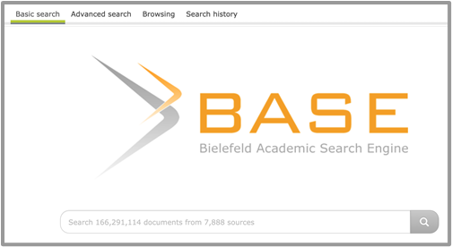
AGGREGATOR SEARCH TOOLS AND REPOSITORIES - BASE
Available at https://base-search.net
Search page for BASE

Slide 7
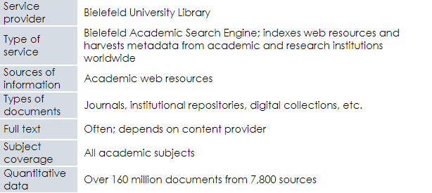
BASE cont.

Slide 8
CORE
Available at https://core.ac.uk
Search page for CORE

Slide 9
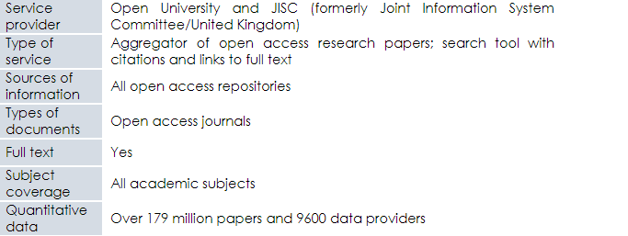
CORE cont.

Slide 10
Europe PMC
Available at https://europepmc.org
Search page for Europe PMC

Slide 11
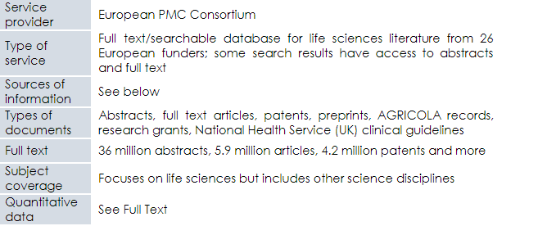
Europe PMC cont.

Slide 12
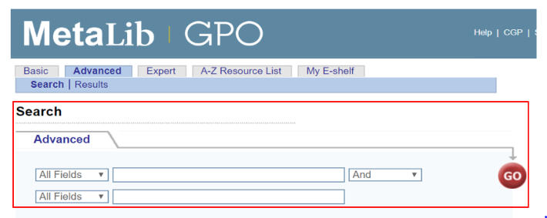
MetaLib
Available at https://metalib.gpo.gov/
Search page for MetaLib

Slide 13
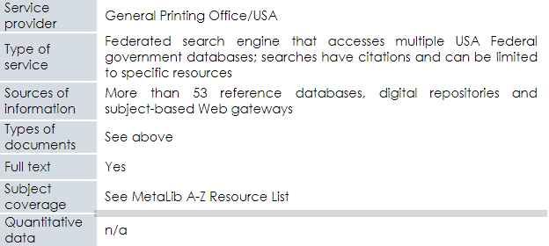
MetaLib cont.

Slide 14
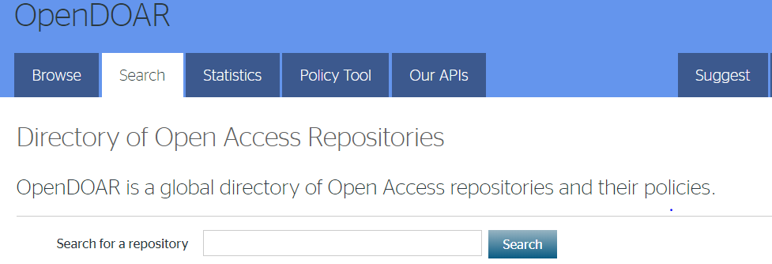
OpenDOAR
Available at https://v2.sherpa.ac.uk/opendoar/
Search page for OpenDOAR

Slide 15
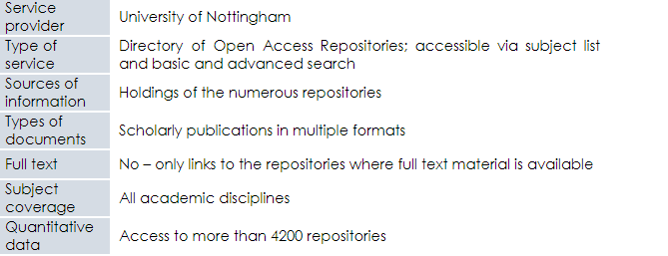
OpenDOAR cont.

Slide 16
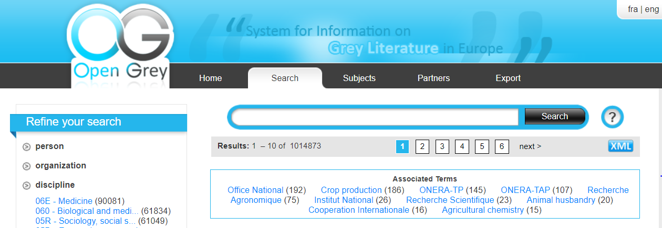
Open Grey
Available at http://www.opengrey.eu/search/
Search page for Open Grey

Slide 17
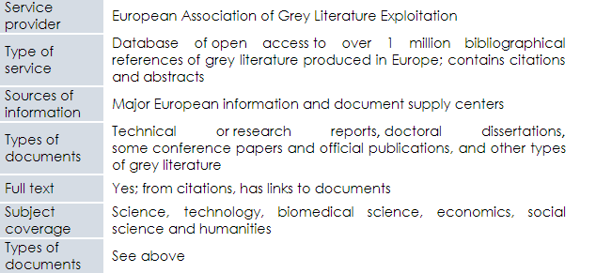
Open Grey cont.

Slide 18
PubMed Central
Available at https://www.ncbi.nlm.nih.gov/pmc
Search page for PubMed Central

Slide 19
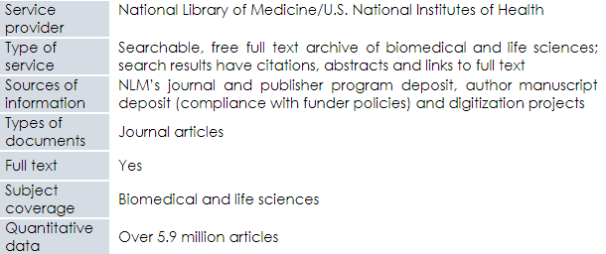
PubMed Central cont.

Slide 20
WorldWideScience.org
Available at https://worldwidescience.org/
Search page for WorldWideScience.org

Slide 21
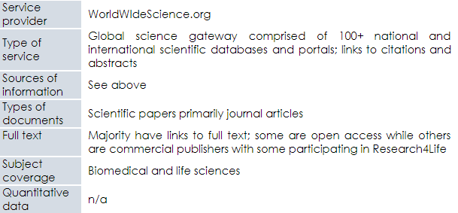
WorldWideScience.org cont.

Slide 22
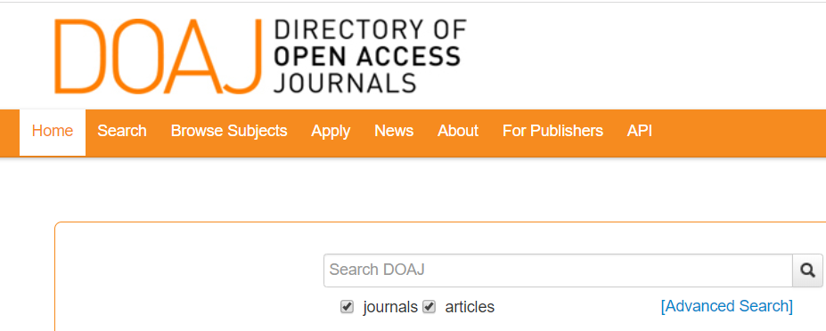
FREE E-JOURNAL RESOURCES - DOAJ: Directory of Open Access Journals
Available at https://doaj.org/search/
Search page for DOAJ

Slide 23
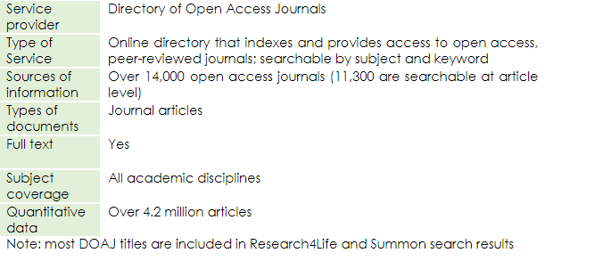
DOAJ: Directory of Open Access Journals cont.
Notes:
For additional access to discipline specific free e-journal resources, go to Lessons 4.1–4.5. Also Google Scholar (Research4Life) is another useful tool for accessing free articles (see Lesson 3.6).

Slide 24
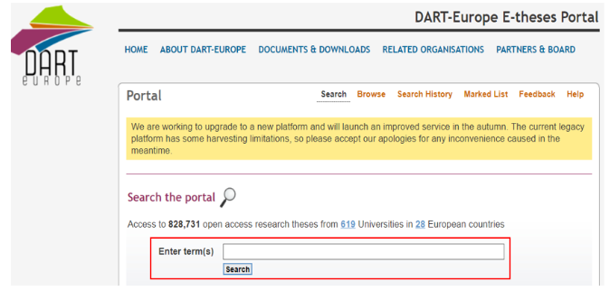
THESIS/DISSERTATION PORTALS AND GATEWAYS - DART-Europe
Available at http://www.dart-europe.eu/basic-search.php
Search page for DART- Europe

Slide 25
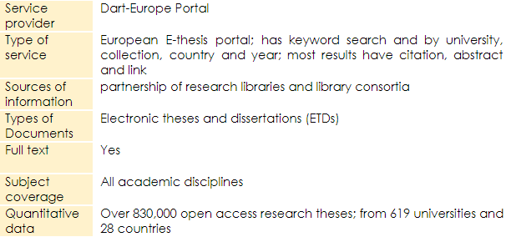
DART-Europe cont.

Slide 26
DATAD-R
Available at http://datad.aau.org/
Search page for DATAD-R

Slide 27
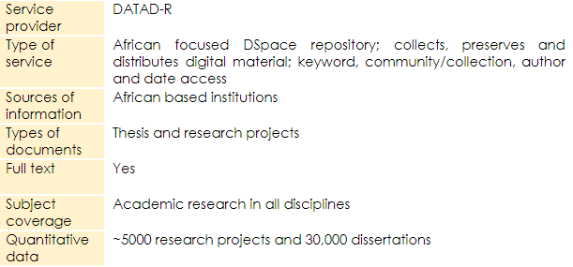
DATAD-R cont.

Slide 28
Global ETD
Available at http://search.ndltd.org/
Search page for Global ETD

Slide 29
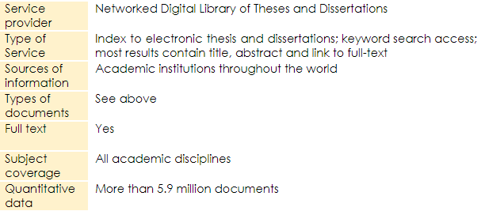
Global ETD cont.

Slide 30
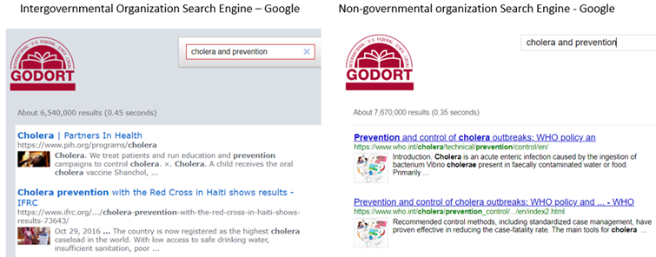
MISCELLANEOUS TOOLS - Google Custom Search
Available at https://www.google.com
(complete keyword search of title)
Search page for Google Custom Search

Slide 31
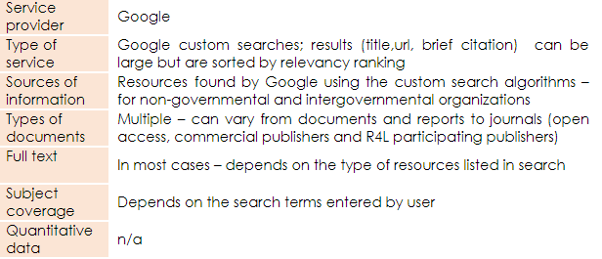
Google Custom Search cont.

Slide 32
E-BOOK RESOURCES:
Directory of Open Access Books
Available at https://www.doabooks.org/
Search page for DOAB

Slide 33
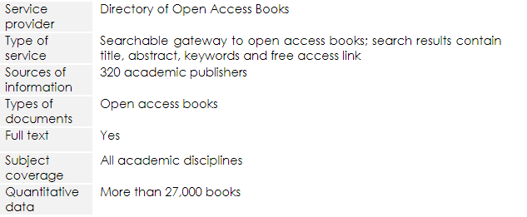
Google Custom Search cont.

Slide 34
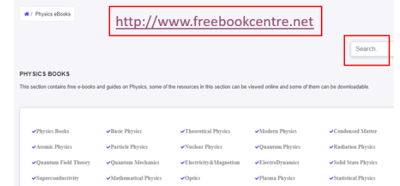
Free Book Centre
Available at http://freebookcentre.net/
Search page for Free Book Centre

Slide 35
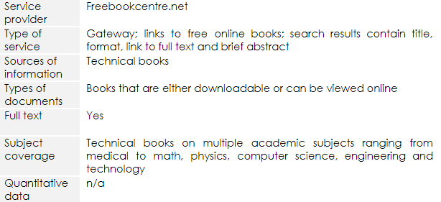
Free Book Centre cont.

Slide 36
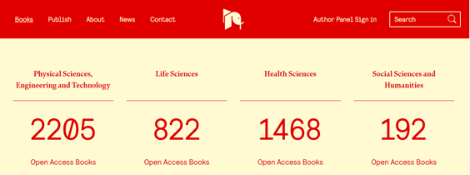
IntechOpen Access Book
Available at https://www.intechopen.com/books
Search page for IntechOpen Access Book

Slide 37
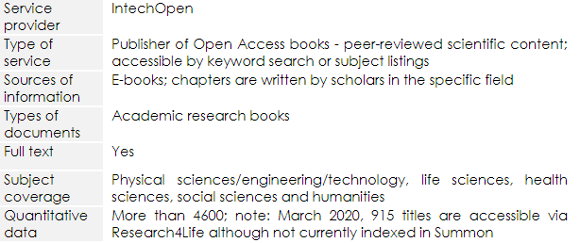
IntechOpen Access Book cont.

Slide 38
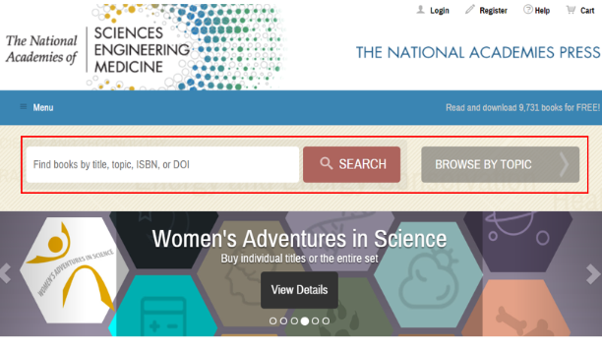
National Academies Press
Available at https://www.nap.edu/
Search page for National Academies Press

Slide 39
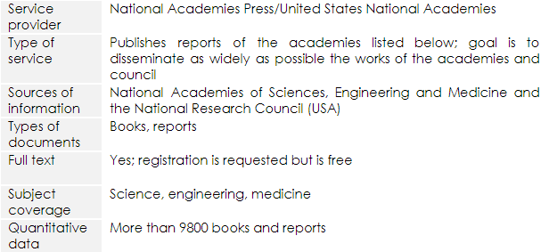
National Academies Press cont.

Slide 40
Open Textbook Library
Available at https://open.umn.edu/opentextbooks/
Search page for Open Textbook Library

Slide 41
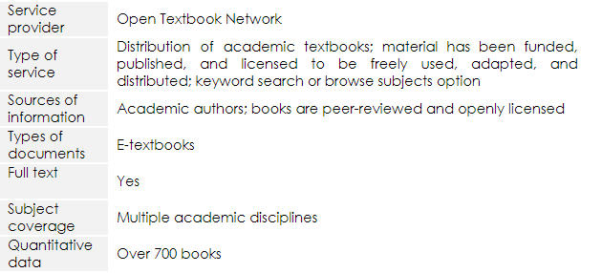
Open Textbook Library cont.

Slide 42
Summary
This lesson has focused on Internet resources that would be of use by users from all the Research4Life programmes.
It expands on the discipline specific resources discussed in Lessons 4.1–4.5. The tools were divided into the following categories: Aggregator Search Tools and Repositories; Free E-journal Resources, Databases and Publishers; Thesis/Dissertations Portals and Gateways, Miscellaneous Tools; and E-books.
These category lists highlight key Internet resources and are not comprehensive.
Remember that search results from several of these tools will link to grey literature plus open access and fee-based journals and books.

Slide 43
Additional Resources
‘Indispensable Resources for Online Academic Research: OnlinePhDprogram.Org’. Accessed 5 November 2020. https://onlinephdprogram.org/academic-research/
Rebar, Lauri. ‘LibGuides: Free Resources: Welcome’. Accessed 5 November 2020. https://libguides.fau.edu/freeresources/Welcome
‘Wikipedia: List of Free Online Resources’. Accessed 5 November 2020. https://en.wikipedia.org/w/index.php?title=Wikipedia:List_of_free_online_resources&oldid=902337967

Slide 44
You are invited to;
Visit us at www.research4life.org
Contact us at r4l@research4life.org
Find out about other training materials [www.research4life.org/training]
Subscribe to Research4Life newsletter [www.research4life.org/newsletter]
Check out Research4Life videos [https://bit.ly/2w3CU5C]
Follow us on Twitter @r4lpartnership and Facebook @R4Lpartnership

Slide 45
For more information on Research4Life
www.research4life.org
r4l@research4life.org
Research4Life is a public-private partnership of five programmes:

