Slide 1
DISCOVERY AND RE-USE OF SCHOLARLY LITERATURE
USING INFORMATION RESOURCES
Research4Life is a public-private partnership of five programmes:

Slide 2
Outline
Literature search
Search strategies
Refining a search
Search filters
Boolean operators
Parentheses and wildcards
Search limits
Summary
This work is licensed under Creative Commons Attribution-ShareAlike 4.0 International (CC BY-SA 4.0)

Slide 3
Learning objectives
Build a search strategy.
Use the advanced search techniques for the most relevant search results.
Locate the best information resources for an effective literature search.
Notes:
In this lesson, learners will learn how to identify relevant information sources, identify types of information sources and evaluate information sources
This will help to ensure that they identify their information needs, locate them efficiently, evaluate the information resources and use them to the fullest in order to enhance their research both as a user and researcher

Slide 4
What is a literature search?
A literature search involves finding out what other work has already been done in the field in which you focus.
It involves survey of publications and information on a specific topic.
There are various search strategies for carrying out a literature search, mainly depends on the stage of your research
Notes:
The reasons for conducting literature search are numerous e.g.
drawing information for making evidence-based guidelines,
Step in the research method
as part of academic assessment.
However, the main purpose of a thorough literature search is to formulate a research question by evaluating the available literature with an eye on gaps still amenable to further research.
People usually starts with a basic search, followed by a more advanced or systematic search. Once highly relevant articles are found, those can be used to find other related articles by following a thread, or as a way of improving your systematic search.

Slide 5
1. Simple search - basic search
This is a quick and first step search for online resources.
Usually done through Google Scholar, university library’s catalogue or Wikipedia .
One can search by typing in a single search term or phrase
One can also search by typing part of bibliographic record e.g. title or journal name into the search engines to get the full bibliographic information.
Notes:
If a reference or part of a bibliographic record is available such as title or journal name, you can simply type this information into one of the search engines to get the full bibliographic information. This may also be the case when you know what to search for. In this case, simply type the reference on Google, Google Scholar or university library’s catalog to get the full-text of the publication.

Slide 6
2. Systematic search - building a query
Requires a more comprehensive search strategy.
Usually done for a complex piece of research which aims to identify, select and synthesize all research published on a particular question or topic.
A systematic research consists of identifying search items, using boolean operators, advanced search techniques and building a query.
Notes:
You will need to have a complete overview of all the information resources available on the subject.
Key concepts to search for should be the general idea or a main theme and the search terms are the words to describe these concepts, topics.

Slide 7
3. Following a thread - snowballing
Snowballing involves using a key publications on your subject as a starting point.
The references listed in your relevant publications lead you to other relevant publications.
The snowball method helps to find a lot of literature about a subject quickly and easily.
related publication
related publication
related publication
Key publication
related publication
related publication
related publication

Slide 8
What you should do!
Collect background information in order to get an overview on the topic.
An encyclopedia provides a good start.
Newspapers & professional journals are useful for familiarizing yourself with current developments and opinions.
Books & review articles provide an introduction and overview of various aspects of the topic.
Narrow your focus.
Turn your research focus into a question
The 4W+H questions are a great way to start: What ? Where? Who? Why? How?
Notes:
Collecting background information helps to get an overview on the topic, to direct yourself to the most important issues and controversies, to gain an understanding of how the topic area relates to other topics and to introduce yourself to the vocabulary or jargon relating to the topic.

Slide 9
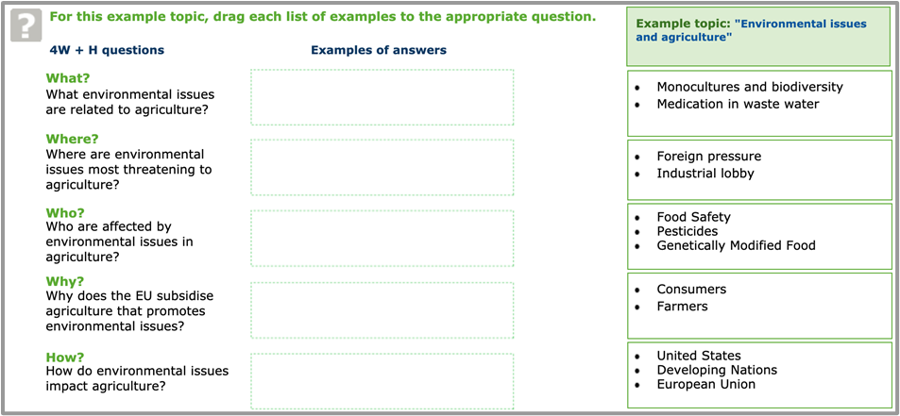
The 4W+H questions
The given example topic is “environmental issues and agriculture”
Source: https://library.wur.nl/infoboard/module_2/page14872.html

Slide 10
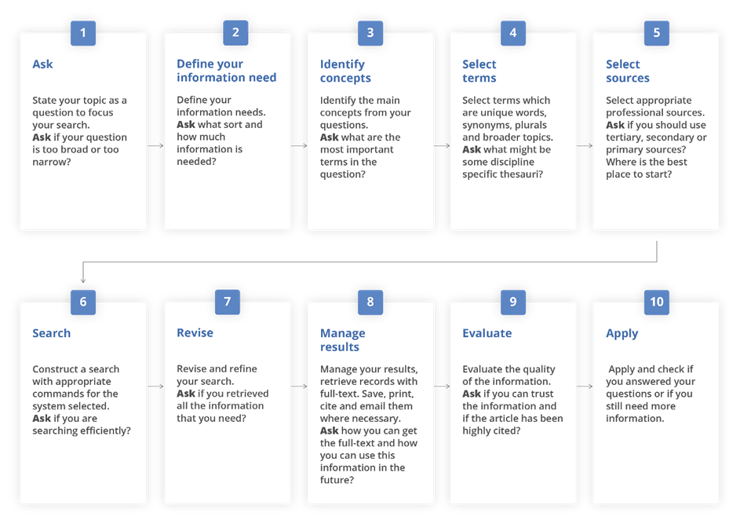
Developing a search strategy: Process overview
Source: https://www.who.int/hinari/training/Basic_Course/en/ Accessed April 6th, 2020
Notes:
Good search practice could involve keeping a search diary or document detailing your search activities, so that you can keep track of effective search terms, or someone else can reproduce your steps and get the same results.

Slide 11
Refining a search
Think critically and judge what information is relevant and appropriate for your purpose.
A filter enables you to refine your search criteria further, by adding some additional search criteria.
A filter can be applied before running a search or it can be used to refine search results after the initial search has been executed.
“There is no such thing as the perfect search…”
Notes:
Sometimes you will find that there is just too much information. This might be because lots have been written on your main topic or your topic has links with many other subject areas.
Returning to your research question and re-focusing can solve this problem by giving you a clearer idea of what you really want to find out.
OR
Sometimes you will struggle to find much relevant material. Sometimes your topic is quite new and not much literature has been published so far. You will need to think of ways of broadening the scope of your project. In particular you can think about:
making the project (or just your keywords) more general or
searching for comparative or related information.

Slide 12
Search filters
Search filters are used to evaluate & improve search queries appropriate information is retrieved.
A simple search retrieves thousands of records, try different search strategies to get pertinent results.
E.g. A search on a broad topic such as “globalization” or “organisational behaviour”, will receive too many results. Use a connected string words to retrieve a more manageable list.
Repeat the process to find the best match.
Remember that all search strategies do not function the same way in all databases
Notes:
The number of records found appropriate in the search leads to precise results.
Recall refers to the percentage of relevant records retrieved through your search query as compared to all existing relevant records.
The obvious reason for thousands of records to appear in the results is that somewhere in the results this word is used. A short string of connected words would help to reduce the number of hits and retrieve a more manageable and pertinent list.

Slide 13
Boolean operators
Boolean search operators (AND, OR, NOT) connect terms and locate records containing matching terms.
They strengthen the relevancy ranking in your search results.
Booleans Operators can allow you to either narrow, broaden or exclude search results.
AND operator is used to combine two or more concepts and narrows a search.
OR operator is used to contain one or other terms and broadens a search.
NOT operator is used to exclude one or other terms and narrows a search.
Notes:
Relevancy Ranking is the sorting of search results so that the most pertinent documents are listed first. This is a grading that gives extra importance to a document when the search terms appear in the headline or are capitalized.
AND
Link different concepts with AND
Linking with AND narrows a search (reduces the number of results) by retrieving only those records that include all of your specified keywords
Example: hearing impaired AND communication
OR
Link keywords related to a single concept with OR
Linking with OR broadens a search (increases the number of results) by searching for any of the alternative keywords
Example: hearing impaired OR deaf
NOT
using NOT narrows a search by excluding certain search terms
Most searches do not require the use of the NOT operator
Example: hearing impaired NOT deaf will retrieve all results that include the words hearing impaired but don’t contain the word deaf.

Slide 14
Parentheses and wildcards
These help to narrow your results and make your search more specific.
Phrase or proximity searching | “…” or (…) allows you to search for an exact phrase “crop plantation” and (soil condition)
Truncation/wildcards | * or $ allow you to search for alternative spellings child* for child OR childs OR children parasite* for parasite OR parasites
Alternate spellings | ? can be used to substitute for characters anywhere in a word wom?n would search for “woman” and “women”
Notes:
“……” or (…….) It narrows your search down by searching for an exact phrase or sentence. It is particularly useful when searching for a title or quotation. It allows the use of brackets (…) or quotation marks “…” to connect the words together.
* or $ allows you to search variations on spellings with the symbol representing one or more characters within a word.

Slide 15
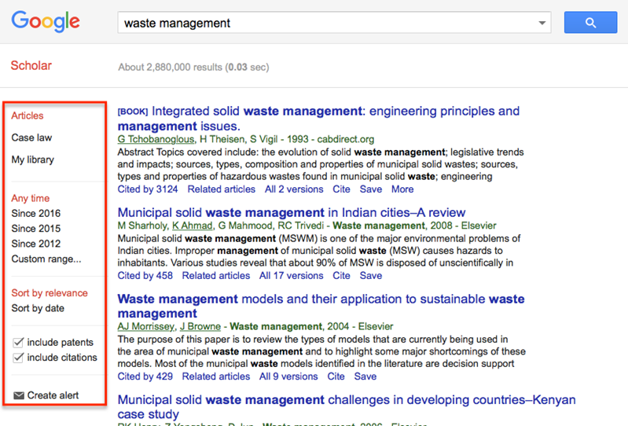
Search limits
Most databases & search platforms allow you to limit a search by author, title, journal, date, and language etc
You can use an advance search and refine your options on a search platform.
Drop down menus are available.
Notes:
Search limiting allows you to narrow the focus of your search so that the information retrieved from the databases you search is limited according to the fields you selected.
Basic Search offers less possibilities for limiting your search; Advanced Search offers some more. In databases, you can limit your search according to many specific features.

Slide 16
Summary
This lesson focused on building search queries and the use of advanced search techniques to conduct an effective literature search.

Slide 17
References and useful resources
Cooper, C., Booth, A., Varley-Campbell, J., Britten, N. & Garside, R. 2018. Defining the process to literature searching in systematic reviews: a literature review of guidance and supporting studies. BMC Medical Research Methodology, 18(1): 85. https://doi.org/10.1186/s12874-018-0545-3
ISU. 2019. Refine your search. In: International Space University Library [online]. [Cited 2 October 2020]. https://isulibrary.isunet.edu/index.php?lvl=cmspage&pageid=4&id_article=955
Smith, C. 2020. Oxford LibGuides: Systematic Reviews and Evidence Syntheses: Home [online]. [Cited 2 October 2020]. https://ox.libguides.com/systematic-reviews/home
University of Leeds Library. 2020. Literature searching explained. In: University of Leeds [online]. [Cited 2 October 2020]. https://library.leeds.ac.uk/info/1404/literature_searching/14/literature_searching_explained/5
WUR. 2016. Searching for literature. In: Wageningen University & Research Library [online]. [Cited 2 October 2020]. https://www.wur.nl/en/Library/Students/Searching-for-literature.htm
WUR. 2019. E-learning modules. In: Wageningen University & Research Library [online]. [Cited 2 October 2020]. https://www.wur.nl/en/Library/Students/e-learning-modules.htm
WUR. 2020. The 4 W’s. In: Wageningen University & Research Library [online]. [Cited 4 October 2020]. https://library.wur.nl/infoboard/module_2/page14872.html
WHO. 2019. Hinari Basic Course. In: WHO [online]. [Cited 2 October 2020]. http://www.who.int/hinari/training/Basic_Course/en/

Slide 18
You are invited to;
Visit us at www.research4life.org
Contact us at r4l@research4life.org
Find out about other training materials [www.research4life.org/training]
Subscribe to Research4Life newsletter [www.research4life.org/newsletter]
Check out Research4Life videos [https://bit.ly/2w3CU5C]
Follow us on Twitter @r4lpartnership and Facebook @R4Lpartnership

Slide 19
For more information on Research4Life
www.research4life.org
r4l@research4life.org
Research4Life is a public-private partnership of five programmes:

