Slide 1
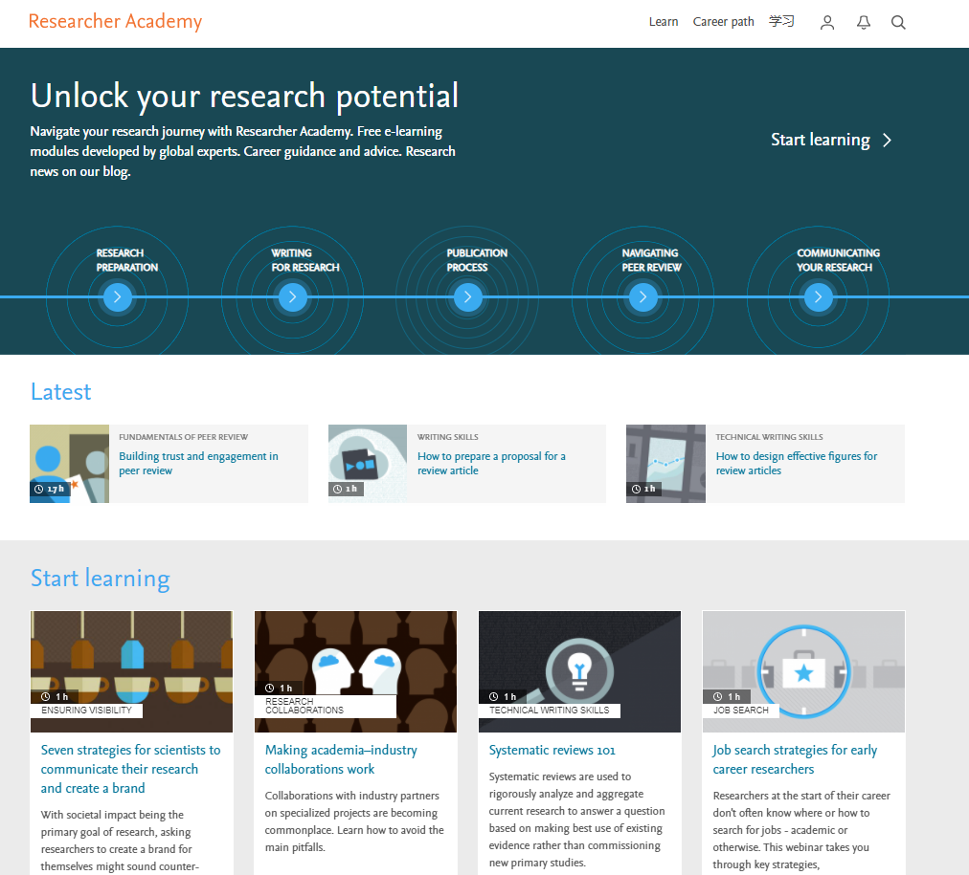
Priyanka Kalra
2021

Slide 2
Coming up
What is Researcher Academy?
How does it help researchers?
Topics and modules
Career path
Recognition and reward
Your profile/account

Slide 3
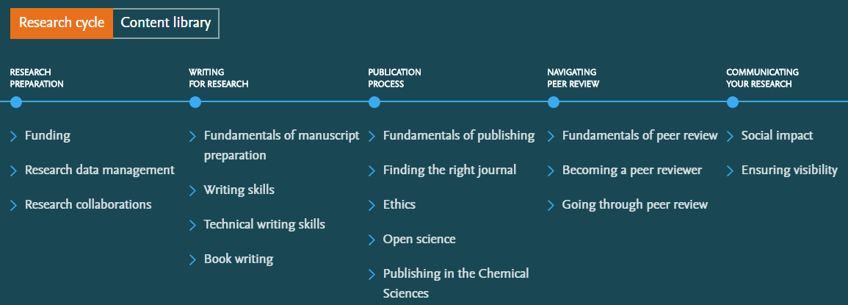
What is Researcher Academy?
A free e-learning platform designed to guide and support Early and Mid-Career Researchers throughout their research journey. In doing so we hope to unlock their potential.
45% PhD/Postdoc
30% Masters
25% Other

Slide 4
Topics

Slide 5
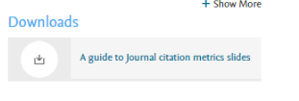
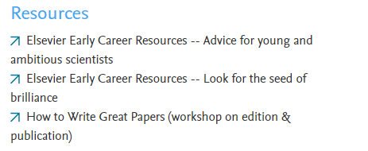
Modules

Slide 6
Become a peer review expert

Slide 7
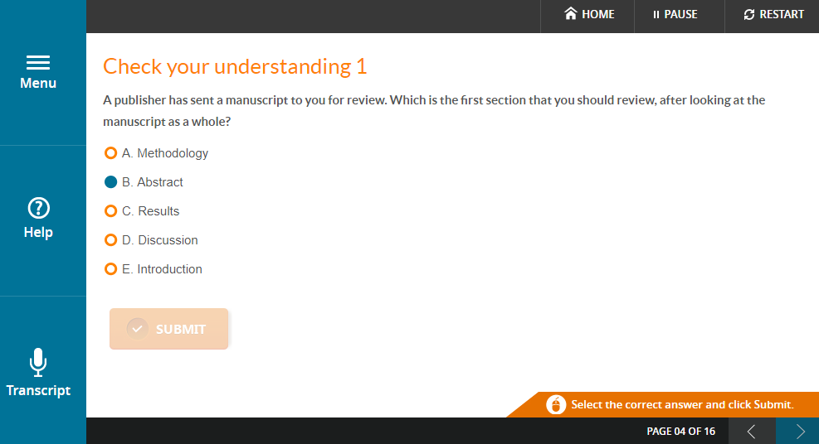
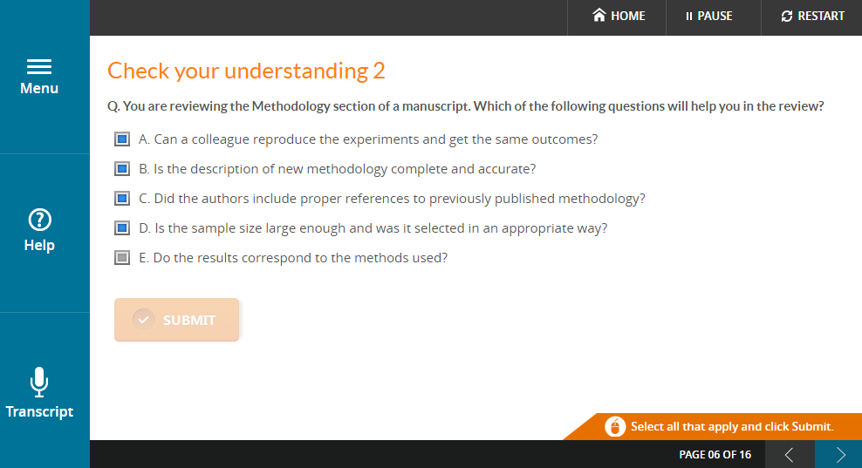
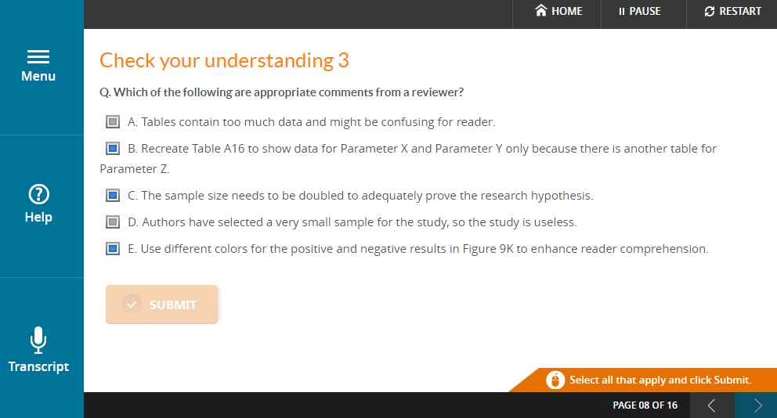
Question and answer module

Slide 8
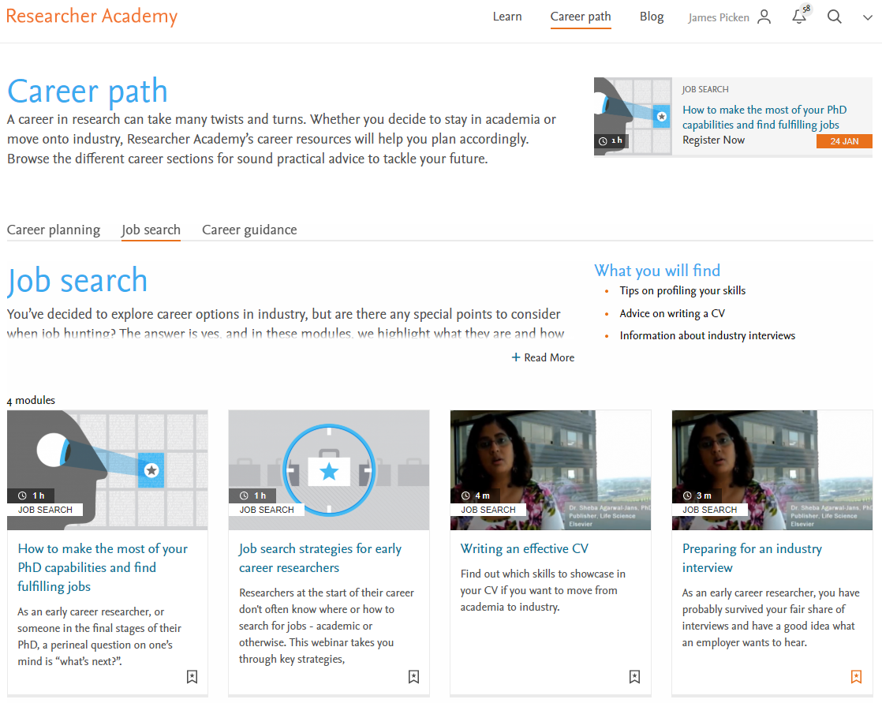
Career path

Slide 9
Notifications to keep you up-to-date

Slide 10
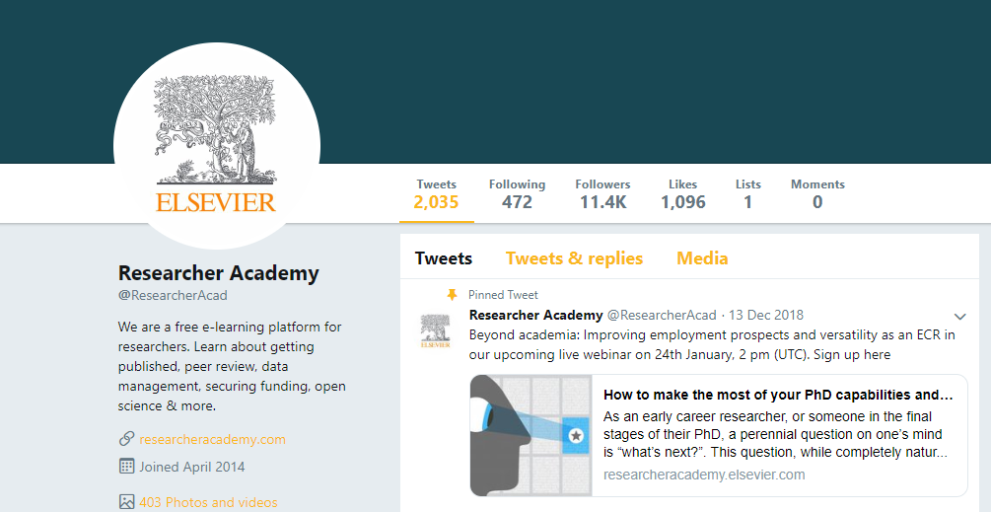
Researcher community

Slide 11
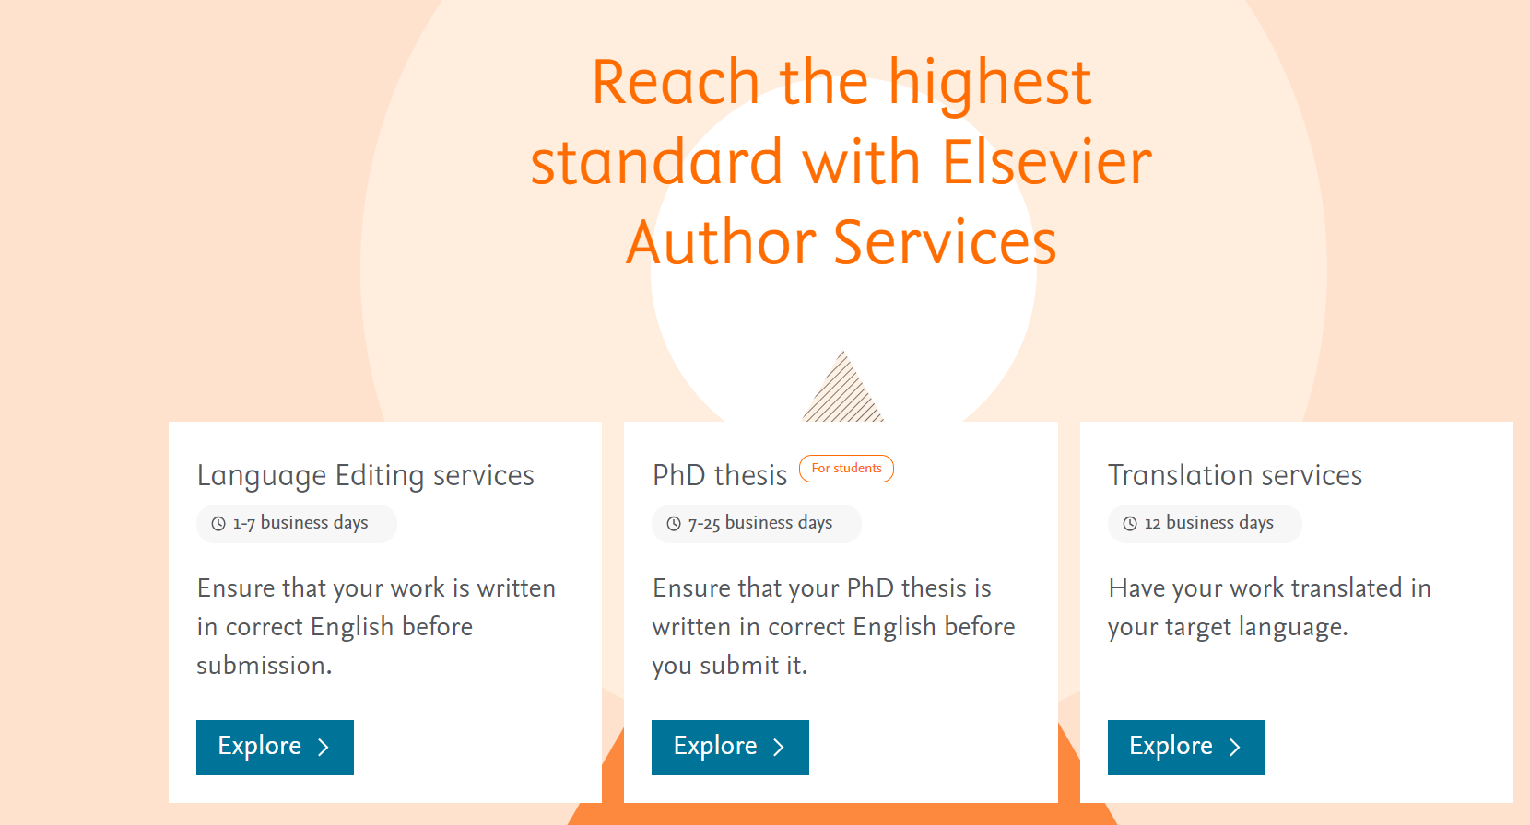
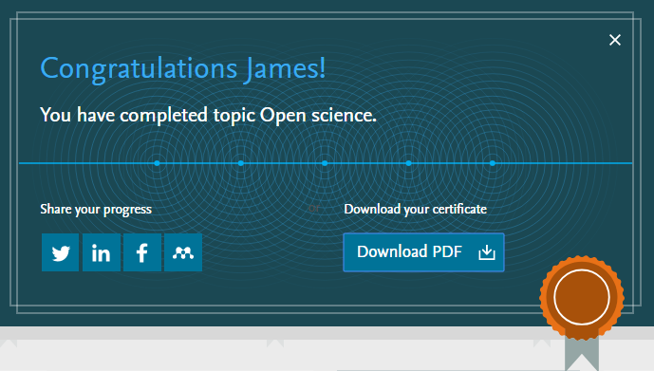
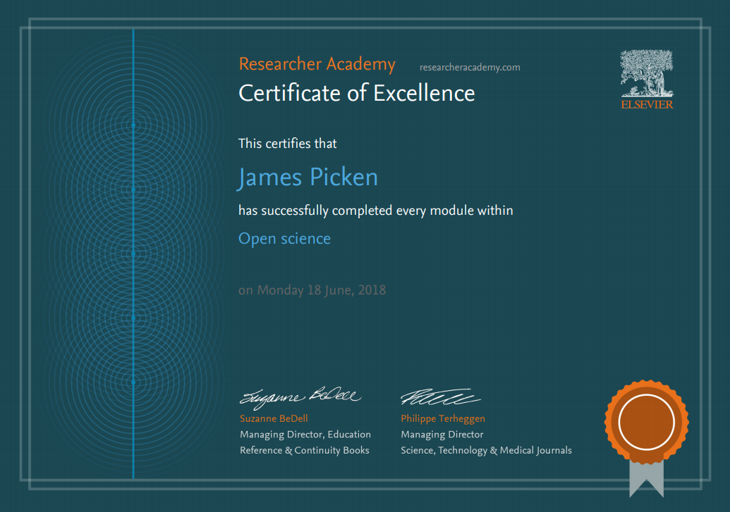
Recognition and reward

Slide 12
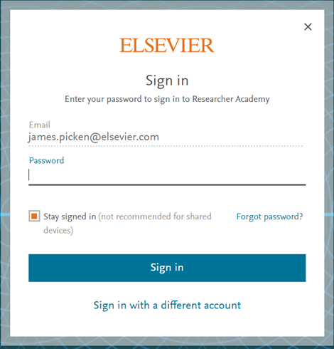
Your profile

Slide 13
Thank you.
Questions? Get in touch.
p.kalra@elsevier.com

