Slide 1
ADDITIONAL DISCIPLINE-SPECIFIC RESOURCES
Health Sciences
Research4Life is a public-private partnership of five programmes:

Slide 2
Outline
Introduction
PubMed
Basic Search
Export, save, email citations
Advanced search
Other Research4Life resources
Databases for discovery
Reference Sources
Internet Resources
Search engines
Highwire Journals - Free access
Grey literature guides
Summary
This work is licensed under Creative Commons Attribution-ShareAlike 4.0 International (CC BY-SA 4.0)

Slide 3
Learning objectives
Become aware of existing additional resources related to Health.
Understand the additional collections and how to use them.

Slide 4
Introduction
This lesson will focus on key discipline-specific resources in health accessible from the Hinari and also via the Internet.
The first part of the lesson reviews various tools available via the Hinari portal in the Databases for discovery and Reference sources sections such as PubMed.
The second part of the lesson is a sampling of useful health-related internet tools for accessing free resources listed in the Hinari Free collections drop-down menu.

Slide 5
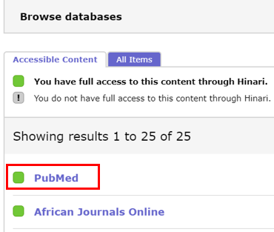
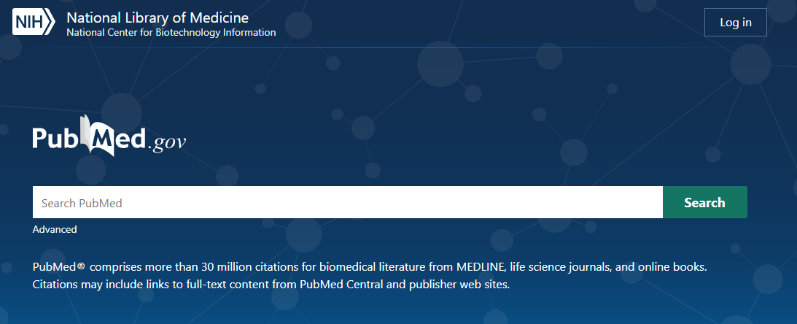
PubMed
The PubMed database comprises more than 30 million citations from MEDLINE, life science journals and online books.
After logging into Hinari, go to the Databases for discovery list and, in Browse databases, click on PubMed
For indexing, PubMed database uses the Medical Subject Headings (MeSH), a controlled and hierarchically organized vocabulary.
Notes:
Launched in October 2019, the new and streamlined design of PubMed the default is version as of 19 May 2020 - see new interface at PubMed site. This is the version available from the Hinari/Databases for discovery list and includes the links to the available HINARI and Free Full Text articles.

Slide 6
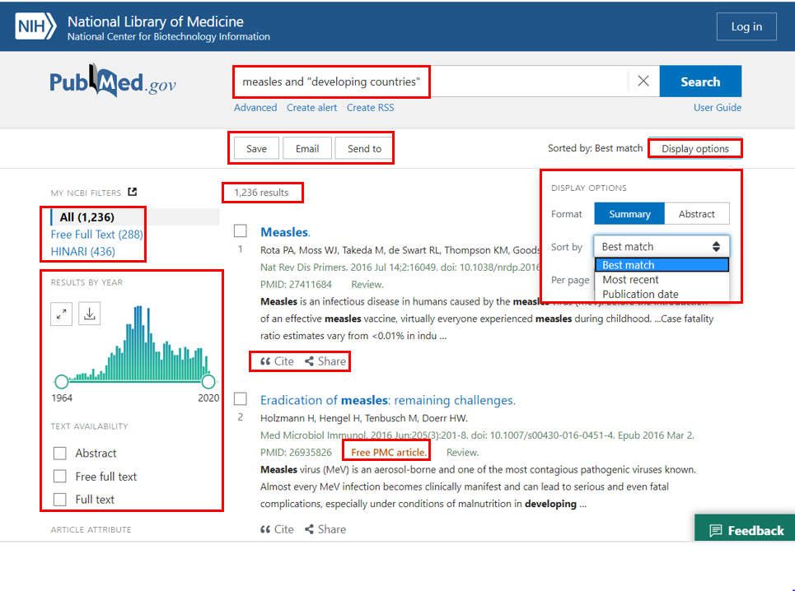
PubMed basic search
Displayed are the search results for measles and “developing countries” - 1236 results.
The links to Free Full Text and HINARI full text are in the left column. To
get to the full text of an individual
article, click on the title.
The initial search results are displayed in the Summary format, with Best Match (the default) vs. Most recent or Publication Date sort option.
The Summary format has the basic citation information (title, author, journal, pmid #) & some of the abstract.
Notes:
The Best Match algorithm is based on several “relevance-ranking signals” (factors), the most important being the past usage of an article, publication date, relevance score, and type of article.
The left-hand column contains the Results by Year graph and the filter list, including TEXT AVAILABILITY and ARTICLE TYPE. Next to the sort option, click the gear box () to open the DISPLAY OPTIONS. The search terms are highlighted in the abstract.
Please note that the Hinari Team is working with the National Library of Medicine on linking to the Hinari collection full-text in this version of PubMed.

Slide 7
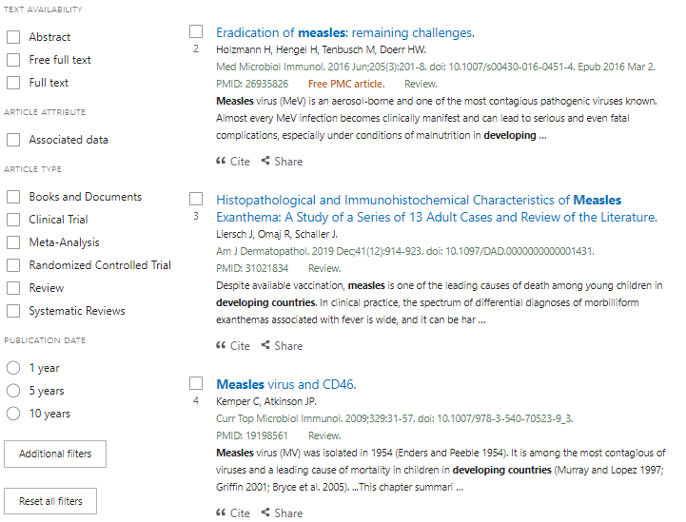
Initial (Summary) Search Results -
other options
Scroll down the left column of the Summary search results page to view the following filters:
Text availability: Abstract, Free full text and Full text
Article Attribute: Associated data
Article Type: Books and Documents, Clinical Trial, Meta-Analysis, Randomized Controlled Trials, Review and Systematic Reviews
Publication Date with 1, 5 and 10 years options
Additional filters - see next slide

Slide 8
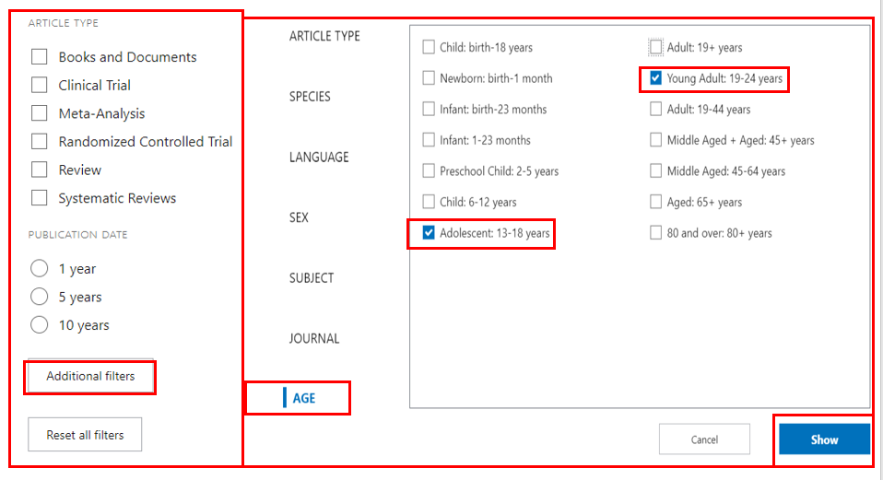
Default filters & Additional filters options
Now displayed is Additional filters that, besides ARTICLE TYPE, includes LANGUAGE, SEX, SUBJECT, JOURNAL and AGE options.
Open the AGE option and click on the Adolescent 13–18 years and Young Adults 19–24 years filters.
Add these filters to the Search results by clicking on Show.
Also note the Reset all filters option that removes any that were selected.

Slide 9
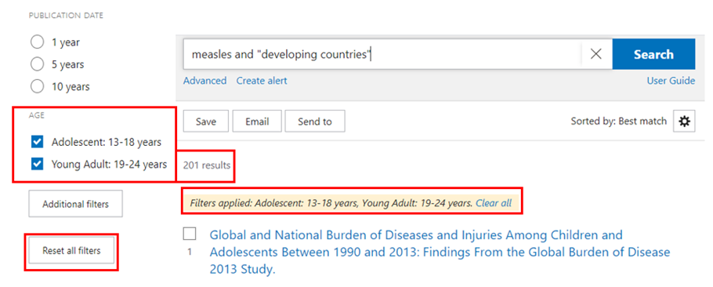
Additional Ages filters & revised search results
The two AGE filters have been added to the filters list in the left column.
Click on the boxes to activate them. The new search has 201 results not 1236.
Note the Reset all filters option - to delete all the filters.
Notes:
Remember to delete the filters either by clicking on the highlighted filters or opening Reset all filters or clicking on the Clear all in the Filters applied… box below the search results. Otherwise, these filters will continue to be used in new searches. All the filter options are valuable tools to limit a specific search.

Slide 10
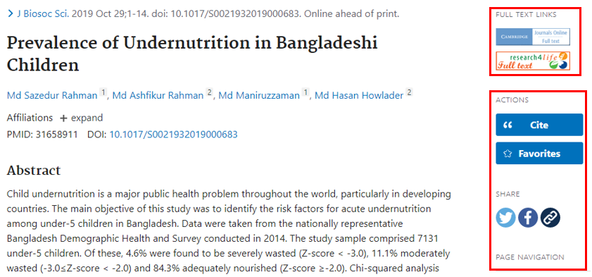
PuPuvbb
Abstract display & Full text access
In the Summary display, click on the title of any article to display the Abstract version.
The Abstract version has additional features including, in the right column, Cite, Favorites, Share and Page Navigation plus, below the abstract, links to Similar Articles, Cited by and Mesh Terms.
The Full Text Links in the right column has the Research4Life icon for material accessible to Hinari users. In addition, other full text options for the article are available.
Select the Research4Life full text icon under the Full Text Links section. The Research4Life 360 Link page will appear.

Slide 11
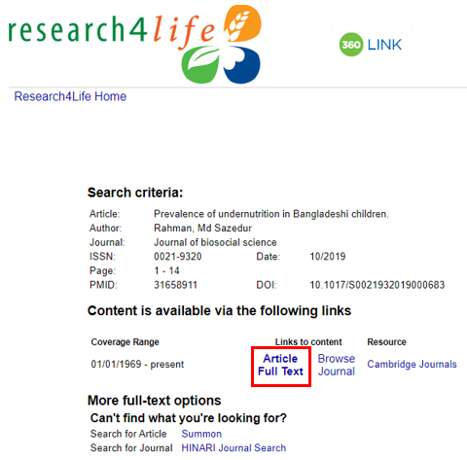
Research4Life 360 Link
Now displayed is the Research4Life 360 Link page.
Click on the link to the Article Full Text
Note that the Research4Life full text icon will display in all citations of search results.
Occasionally, Research4Life will not have the full text of a citation and the message no holdings were found for this journal will be displayed on the 360 Link page.

Slide 12
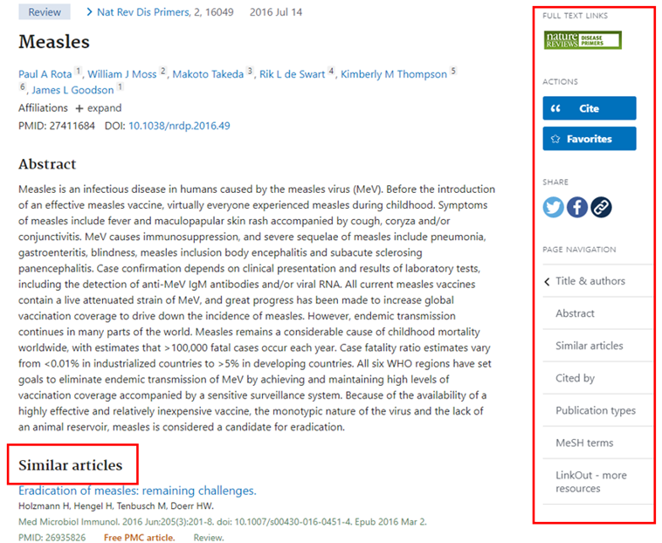
Additional options
In the Abstract format, other features are displayed in the right column and a Similar articles option also has been added below the Abstract.
Scroll down the Abstract to locate additional tools - Cited by and Mesh Terms.
See next slide for Cite and Share options (right column).
Note that these options also are available in the Summary display - in a horizontal box below the search box.

Slide 13
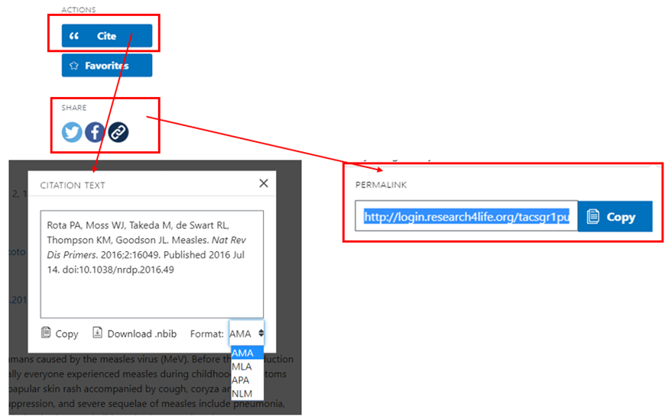
Cite and Share (right column)
In four citation formats - AMA, MLA, APA and NLM, the Cite format creates .txt files to Copy or .nbib files to Download.
This file format can be used by many citation management software programmes.
The Share option, users can share citations in Twitter, Facebook or via a PERMALINK.

Slide 14
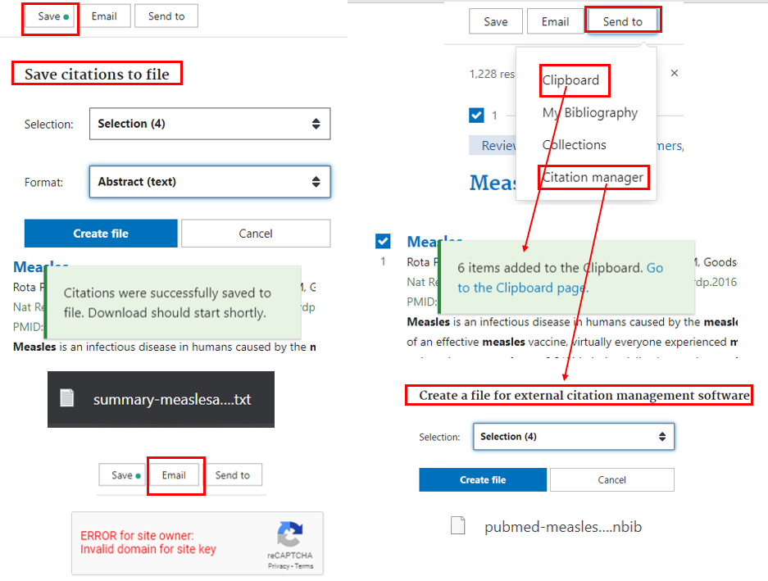
Save, Email, Send to options
(below Search box)
The Save option saves checked citations into a .txt file.
The Send to Clipboard option saves the citation(s) in a PubMed feature. The Clipboard link is below the PubMed search box.
The Send to Citation manager option creates .nbib file for various software options.
The Email function does not work via Hinari/PubMed.
Notes:
Other useful tools from the results page display are the Save, SEND TO Clipboard, My Bibliography, Collections or Citation manager options. To use these options, first check the boxes of several citations on the search results page. After opening the Save feature, users can choose Selection, All Results on page or All Results from the SELECTION option. In FORMAT, the choices are Summary (text), PubMed, PMID, CSV or Abstract(text). For this example, Selection (4) and Abstract have been selected. Click on Create File for the .txt file.

Slide 15
Advanced search options
Click on Advanced search. Also note previously discussed Clipboard option.

Slide 16
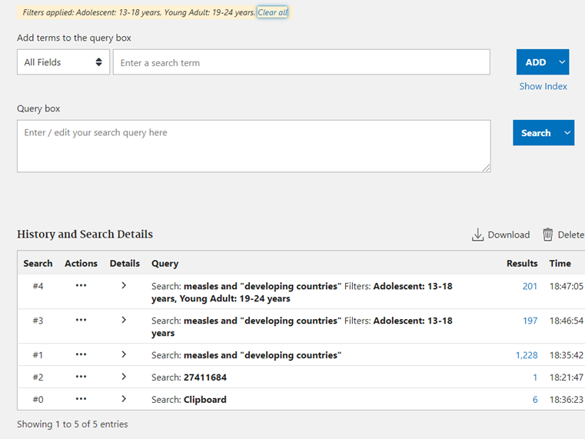
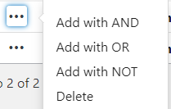
Advanced search optionsA
History and Search Details list (below) shows all searches that have been completed.
Actions/Add query allows users to identify and add previous searches to the Query box (above) and create a new search.
Example - History #1 (measles and “developing countries”) and vaccines are combined into a new Search.

Slide 17
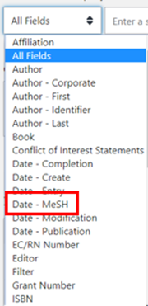
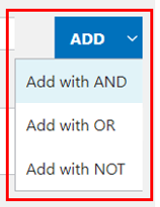
Advanced search options
Other features:
All Fields drop down menu allows searching in a specific field such as MeSH.
Boolean logic can be applied in the Add terms to the query box.
Click on Results # to open any of the previous PubMed searches.

Slide 18
Advanced search example
Example:
From the History list, type vaccines into the Query Box and, for search #2 (measles and “developing countries”), click on Actions/Add with AND
Then click on Search. This will be displayed as #6 in a new listing in the History list.
See results in the next slide

Slide 19
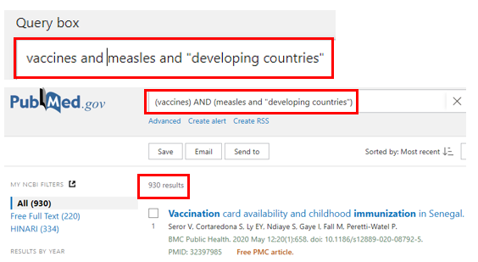
Advanced search example
Displayed first is the Query Box vaccines and measles and “developing countries” search terms.
The PubMed search page with 930 results is displayed below the Query box.

Slide 20
Training Resources -
National Library of Medicine
“PubMed® Online Training.” Accessed May 19, 2020. https://learn.nlm.nih.gov/documentation/training-packets/T0042010P/
Includes Quick Tours, Tutorials, Webcasts & Videos, Classes, Handouts
“The New PubMed: Trainer’s Toolkit.” Accessed May 19, 2020. https://learn.nlm.nih.gov/documentation/training-packets/T0022014P/
Includes Slide Decks, Handouts, Quick Tours, Training for Trainers

Slide 21
Other Research4Life resources
These include key Databases for discovery, Reference Source resources and Free collections.
Each list contains several useful tools.
All three lists can be accessed from the Hinari Content page.
Note: some of these resources may not be available as the publishers may not grant access in a specific country.

Slide 22
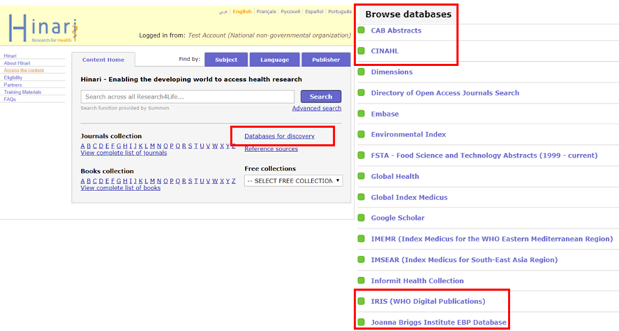
Databases for discovery
The Databases for discovery list is available from the Hinari content page.
Figure on the right illustrates where to find the links to these databases on the Hinari content page.
Notes:
Note : Google Scholar and Summon are already covered in the Lesson 3.6, PubMed is covered in this lesson and, Scopus and Dimensions are explored in the Lesson 3.7.

Slide 23
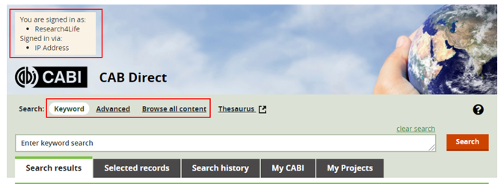
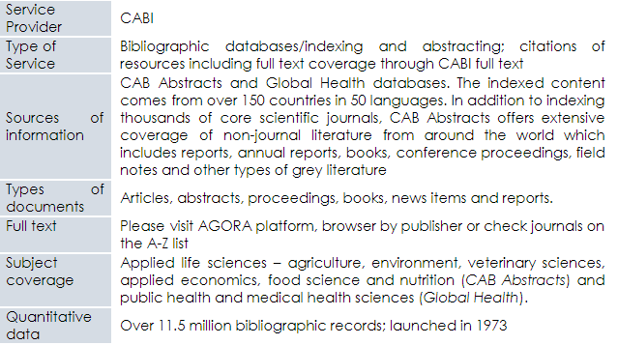
CABI
See Hinari Databases for discovery list/CABI/CAB DIRECT

Slide 24
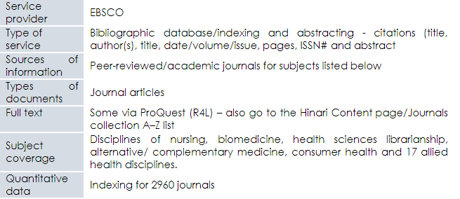
Cumulative Index for Nursing and Allied Health - CINAHL
See Hinari Databases for discovery list/CINAHL (Cumulative Index for Nursing and Allied Health)

Slide 25
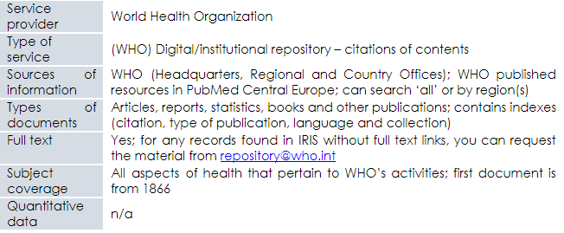
IRIS (WHO Digital Publications)
See Hinari Databases for discovery list/IRIS (WHO Digital Publications); can also be accessed directly https://apps.who.int/iris/

Slide 26
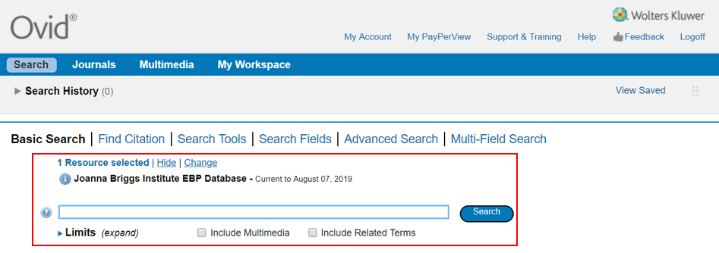
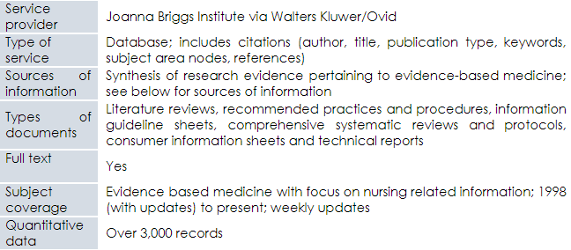
Joanna Briggs Institute EBP Database
See Hinari Databases for discovery list/Joanna Briggs Institute EBP Database

Slide 27
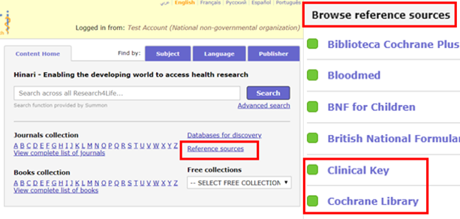
Reference Sources
Reference sources are accessible through the Hinari content page.
Figure on the right shows where to find the links to these resources on the Hinari content page
Notes:
Note: The Databases for discovery, Reference sources and Free collections lists contain resources that have not been discussed in this lesson. Investigate the other resources that meet specific information needs.

Slide 28
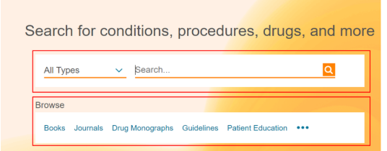
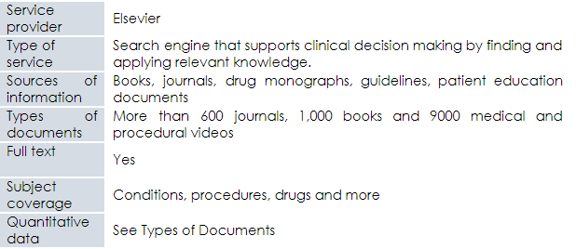
Clinical key
See Hinari References sources list/Clinical Key

Slide 29
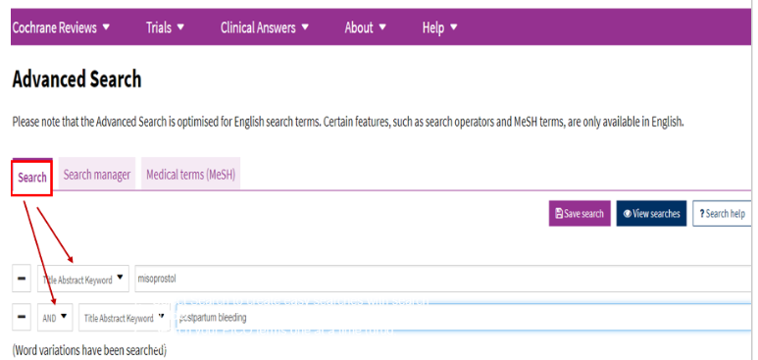
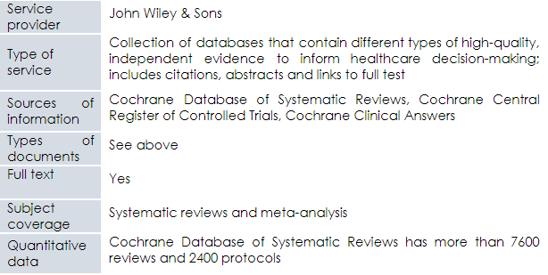
Cochrane Library
See Hinari References sources list/Cochrane Library

Slide 30
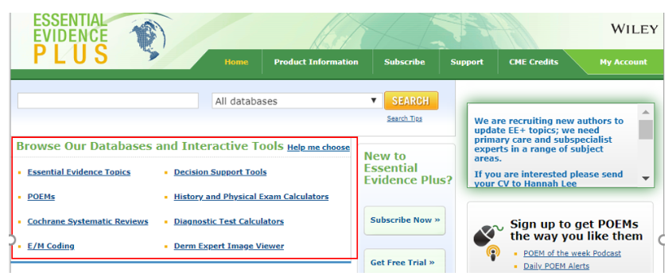
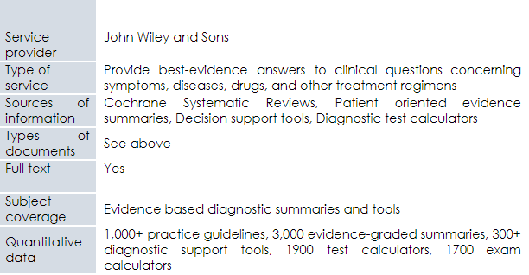
Essential Evidence Plus
See Hinari References sources list/Essential Evidence Plus

Slide 31
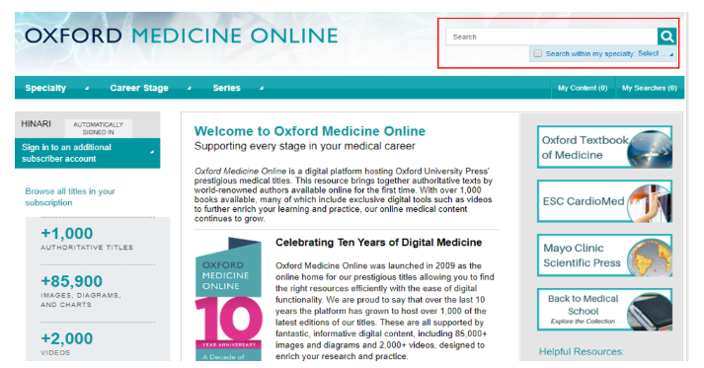
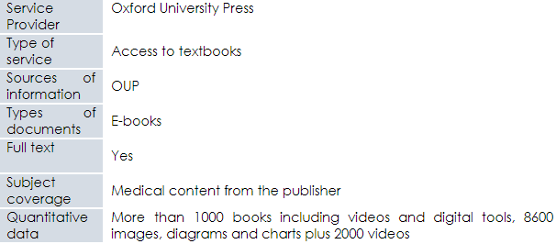
Oxford Medicine Online
See Hinari References sources list/Oxford Medicine Online

Slide 32
Internet Resources
This section highlights the best examples of internet resources such as;
Search engines.
Highwire Journals - Free access.
Grey literature guides.
Notes:
Several of the Free Collections listed on the Hinari Content page will be noted in the subsequent section.

Slide 33
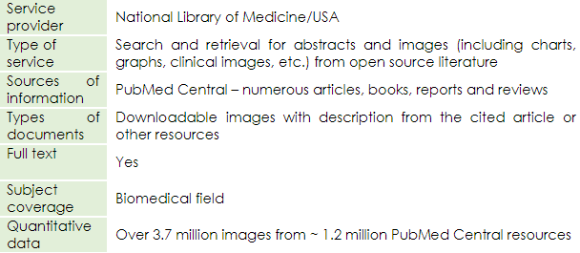
Open Access Biomedical Image Search Engine
Available at https://openi.nlm.nih.gov/

Slide 34
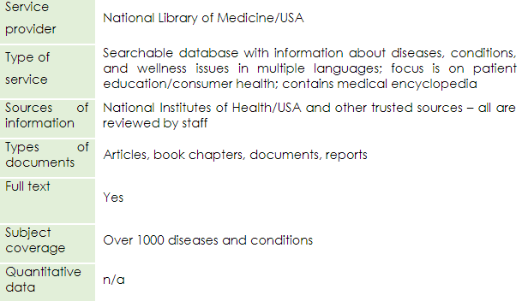
MedlinePlus
Available at https://medlineplus.gov/

Slide 35
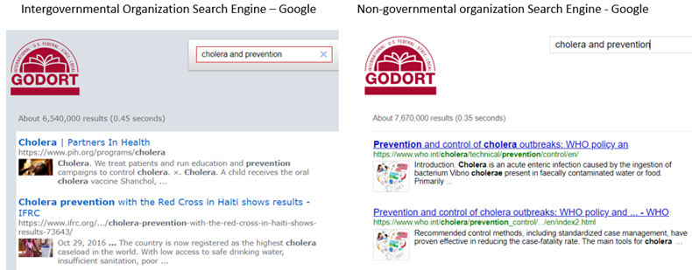
IGO Search Engine and NGO Search Engine
Provided by Google; for access, complete a search by title in Google

Slide 36
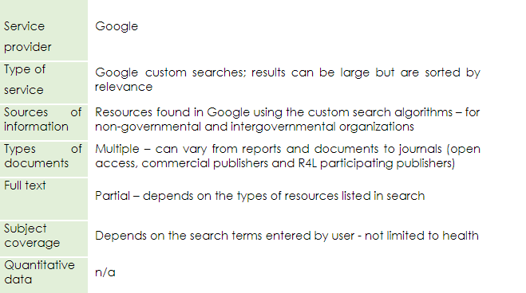
IGO Search Engine and NGO Search Engine cont.

Slide 37
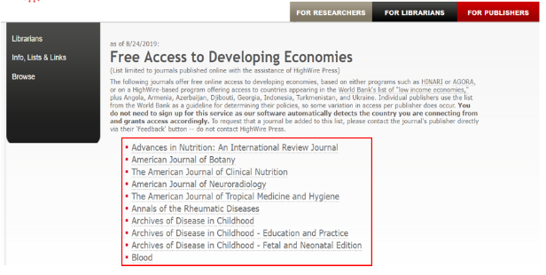
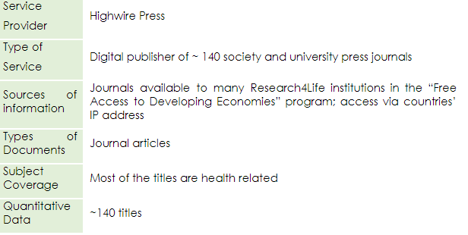
Highwire Journals - Free access
Available at http://highwire.stanford.edu/lists/devecon.dtl

Slide 38
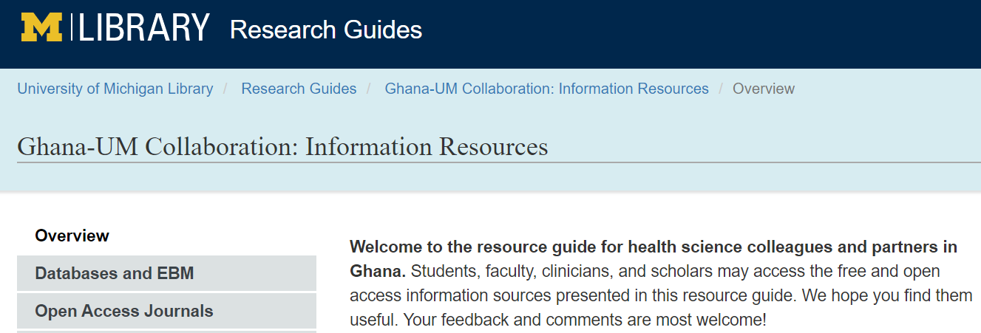
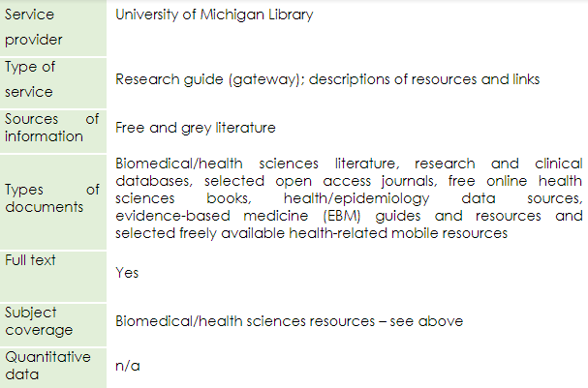
Ghana – UM Collaboration Research Guides: Information resources
Available at https://guides.lib.umich.edu/ghana-health

Slide 39
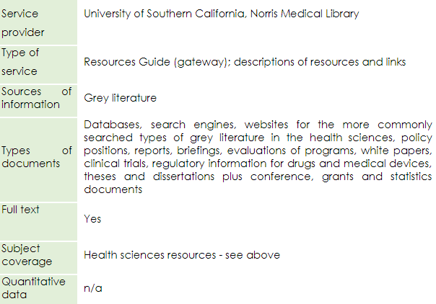
USC Libraries Research Guides
Available at https://libguides.usc.edu/healthsciences/grey_literature

Slide 40
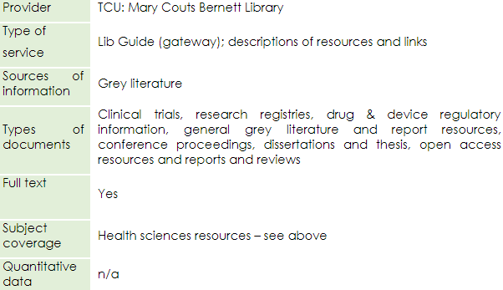
Mary Couts Bernett Library – Library Guides
Available at https://libguides.tcu.edu/GreyLiterature

Slide 41
Summary
This lesson focused on health-related Internet resources that range from search tools/databases to open access journals, reports, policies and images.
Many of the resources are available from the Hinari Content page indexes – Databases for discovery, Reference sources and Free collections.
Others are accessible directly on the Internet.

Slide 42
You are invited to;
Visit us at www.research4life.org
Contact us at r4l@research4life.org
Find out about other training materials [www.research4life.org/training]
Subscribe to Research4Life newsletter [www.research4life.org/newsletter]
Check out Research4Life videos [https://bit.ly/2w3CU5C]
Follow us on Twitter @r4lpartnership and Facebook @R4Lpartnership

Slide 43
For more information on Research4Life
www.research4life.org
r4l@research4life.org
Research4Life is a public-private partnership of five programmes:

