Slide 1
Research4Life
Free or low-cost access to academic and professional content online

Slide 2
What is Research4Life?
Research4Life aims to reduce the knowledge gap between industrialized countries and developing countries by providing affordable access to academic and professional resources.
28,450
journals
98,200
books
135
other resources
numbers from 30 June 2020

Slide 3
Subjects
Health
Agriculture
Environment
Law and Social sciences
Scientific, technical information

Slide 4
Who can use Research4Life?
Free access
Low-cost access

Slide 5
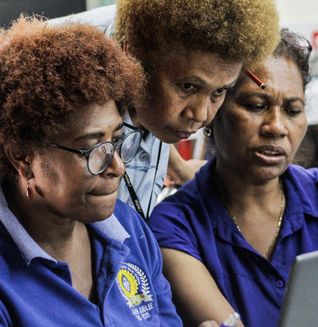
Who can use Research4Life?
Universities
Research Institutes
Teaching hospitals, Healthcare Services
National NGOs
National Libraries
Government Offices
Vocational Training Centres

Slide 6
Five programs
Health WHO
Agriculture FAO
Environment UNEP
Innovation and technology WIPO
Law and social sciences ILO

Slide 7
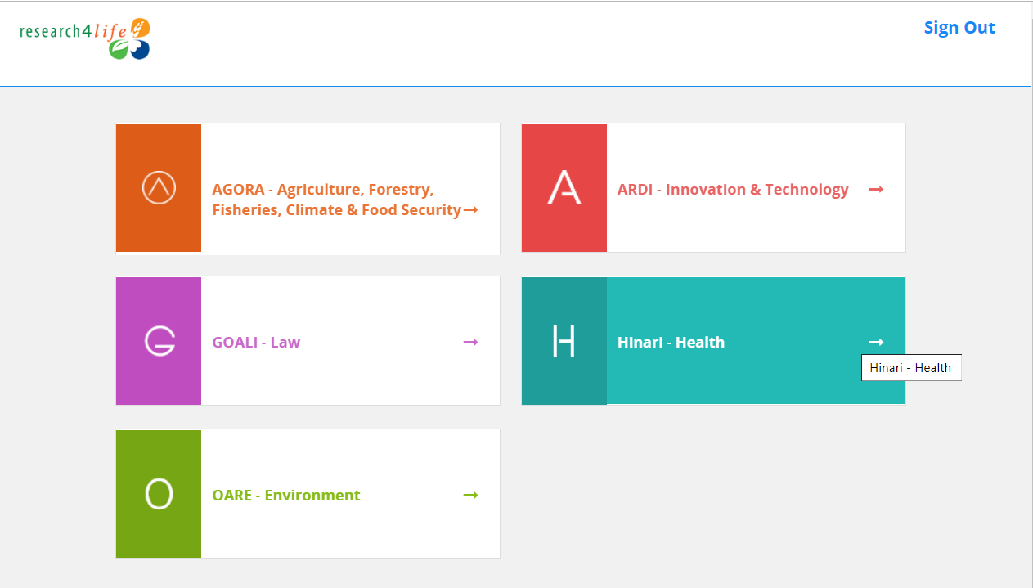
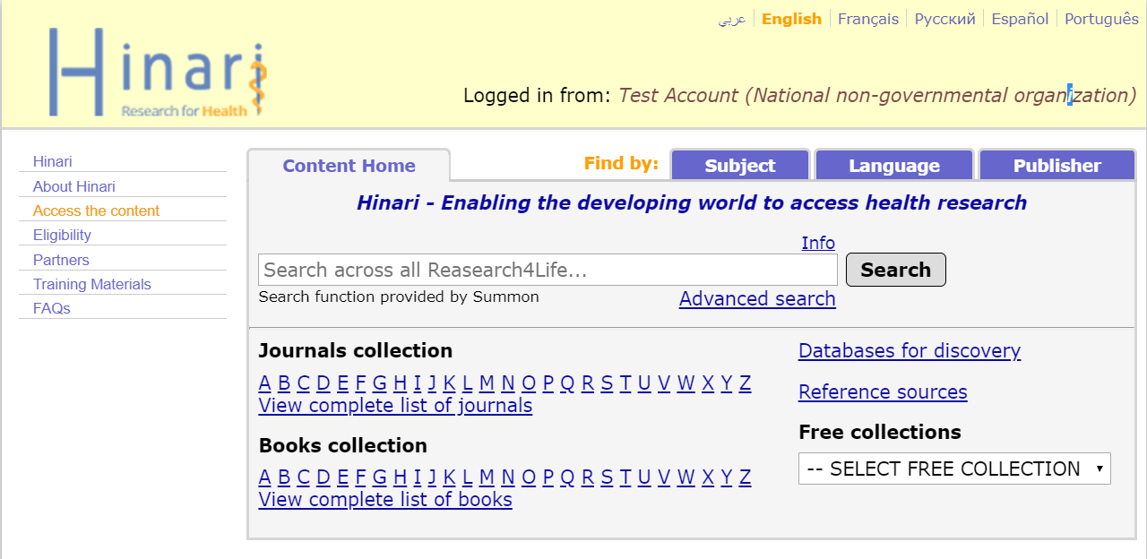
Log in from our homepage

Slide 8
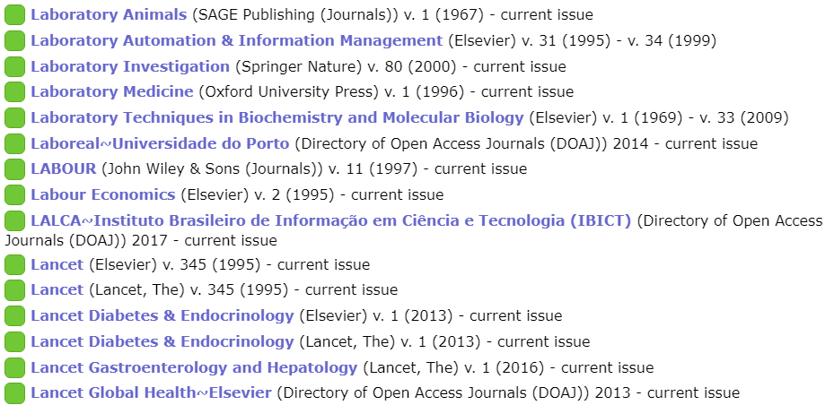
Browse thousands of journals
Screenshot from the Hinari journal collection

Slide 9
Search on keywords
Example: “novel coronavirus” search

Slide 10
Access databases
Screenshot from Hinari

Slide 11
How we make a difference
“Thanks to Research4Life for providing access to evidence-based scientific information, we were finally capable of doing a literature review, which confirmed our hypothesis.”
Alice Matimba, senior lecturer at the College of Health Sciences, University of Zimbabwe

Slide 12
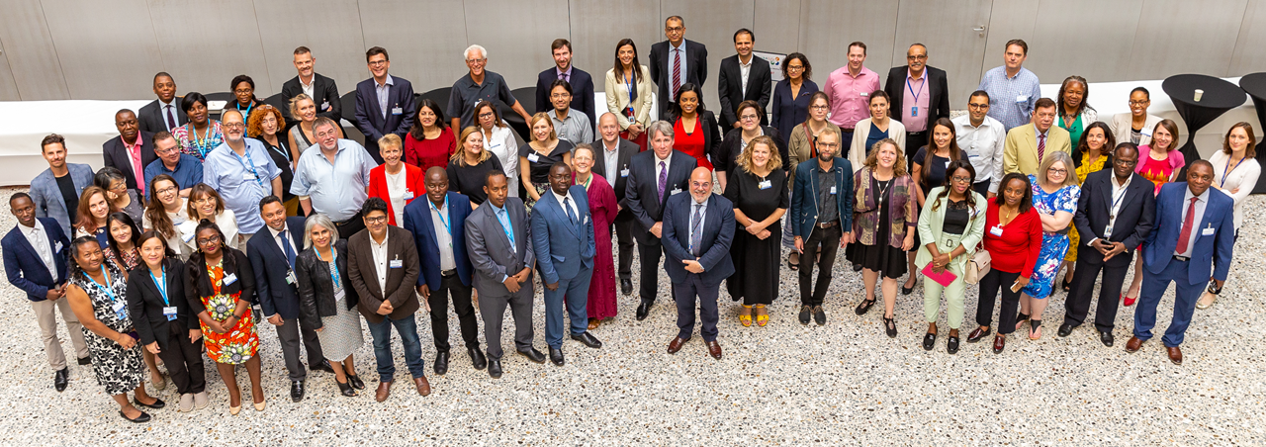
More information?
Visit www.research4life.org or write to r4l@research4life.org.

