Slide 1
EVIDENCE-BASED PRACTICE: OVERVIEW & RESOURCES
Research4Life is a public-private partnership of five programmes:

Slide 2
Outline
Evidence and Evidence-based Practice background
Definitions
5 step EBP process
Export, save, email citations
Advanced search
Hinari Resources
Cochrane Library
Johanna Briggs Institute…… Database
Essential Evidence Plus
PubMed
Clinical Queries
Filters
Internet Resources
Summary
This work is licensed under Creative Commons Attribution-ShareAlike 4.0 International (CC BY-SA 4.0)

Slide 3
Learning objectives
Become aware of key concepts of evidence-based medicine (EBM) and strategies for evidence-based practice (EBP).
Understand the Research4Life EBP tools and how to use them.
Understand the PubMed EBP tools and how to use them.
Become knowledgeable of Internet-based EBP resources

Slide 4
Introduction
This lesson will focus on the concepts of evidence-based medicine/practice and key EBP resources that are available.
The first part of the lesson is an overview of components of EBP (systematic reviews, study-types, hierarchy of resources) and the 5-step EBP process.
The second part of the lesson focuses on the key information resources that are available from Research4Life, PubMed and the Internet.

Slide 5
What is Evidence?
What is Evidence?
Evidence concerns facts intended for use to support a conclusion:
A fact is something known by experience or observation
Evidence is used to support a conclusion; it is not the conclusion itself
Lomas J et al. Conceptualizing and combining evidence for health system guidance. Canadian Health Services Research Foundation, 2005
Context-free scientific evidence (medical effectiveness or biomedical research)
Tacit evidence (views and realities of doctors and patients)
Context sensitive scientific evidence (putting evidence into a particular operational setting)

Slide 6
What are EBM and EBP
Evidence-based Medicine is “the integration of best evidence from current research, patient preferences and values, and clinical expertise to clinical questions in a timely fashion”. Sackett D et al. Evidence-based medicine: How to practice and teach EBM. London: Churchill Livingstone, 2000.
Evidence-based Practice “requires that decisions about health care are based on the best available, current, valid and relevant evidence. These decisions should be made by those receiving care, informed by the tacit and explicit knowledge of those providing care, within the context of available resources”.
Sicily statement on evidence-based practice. BMC Medical Education, 2005 Jan 5;5(1):1
Best Evidence
Patient Values/Local Conditions
Clinical Expertise

Slide 7
Why use EBP? What are some of the barriers?
Why use EBP
Improve care & prevent death
To bridge the gap between research & practice
New treatments, fewer side effects, cheaper or less invasive options, resistance to existing therapies,
Keep knowledge and skills current (continuing education)
To save time to find the best information
Barriers
Time, effort & skills needed
Lack of access to evidence
Overuse, underuse, misuse of evidence
Poor decision making
Environment not supportive of EBP
Intimidation by senior clinicians

Slide 8
PuPuvbb
How does EBP help?
A patient comes to a clinic with a fresh dog bite. It looks clean and the nurse and patient wonder if prophylactic antibiotics are necessary. The nurse searches PubMed and found a meta-analysis study indicating that the average infection rate for dog bites was 14% and that antibiotics halved this risk to 7%.
For every 100 people with dog bites, treatment with antibiotics will save 7 from infection.
Treating 14 (NNT) people with dog bites will prevent 1 infection.
You explain these numbers to the patient along with possible consequences and patient decides not to take antibiotics.
On a follow up visit you find out that he did not get infected.
Glasziou P, Del Mar C, Salisbury J. EBP Workbook, 2nd. ed. BMJ Books, 2007.

Slide 9
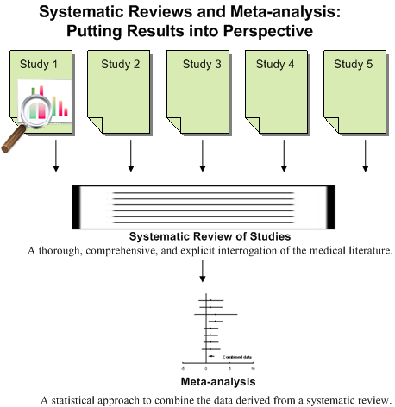
Systematic Review and Meta-analysis definitions
Systematic Review:
A review in which specified and appropriate methods have been used to identify, appraise, and summarize studies addressing a defined question. (It can, but need not, involve meta-analysis). Aims to decrease bias and increase reproducibility and transparency. They provide guidance for practice and policy-making, identify gaps in knowledge and need for further research.
Meta-analysis:
A statistical technique that summarizes the results of several studies in a single weighted estimate in which more weight is given to results of studies with events and sometimes to studies of higher quality. “Guides: Evidence-Based Medicine Resource Guide: Defining EBM.” Accessed June 25, 2020. https://guides.dml.georgetown.edu/ebm/definingebm

Slide 10
Traditional (narrative) literature review vs. systematic review
Review stage | Narrative review | Systematic review
Review question | Question is broad and terms are not well-defined | Question is specific; terms and protocol are defined in advance
Study selection | Convenience sampling and biased selection | Exhaustive searches with pre-defined criteria applied for selection by more than one reviewer
Quality assessment | None | Selected studies assessed for risk of bias and study quality
Synthesis | Qualitative and narrative; vote-counting may be used | Sometimes quantitative, including meta-analysis with risk of bias considered

Slide 11
Definitions of other study types
Randomized Controlled Trial: a trial in which participants are randomly assigned to two or more groups: at least one (the experimental group) receiving an intervention that is being tested and another (the comparison or control group) receiving an alternative treatment or placebo. This design allows assessment of the relative effects of interventions.
Controlled Clinical Trial: a trial in which participants are assigned to two or more different treatment groups. In Clinical Evidence, we use the term to refer to controlled trials in which treatment is assigned by a method other than random allocation. When the method of allocation is by random selection, the study is referred to as a randomized controlled trial (RCT). Non-randomized controlled trials are more likely to suffer from bias than RCTs.
Cohort Study: a non-experimental study design that follows a group of people (a cohort), and then looks at how events differ among people within the group. A study that examines a cohort, which differs in respect to exposure to some suspected risk factor (e.g. smoking), is useful for trying to ascertain whether exposure is likely to cause specified events (e.g. lung cancer). Prospective cohort studies (which track participants forward in time) are more reliable than retrospective cohort studies.

Slide 12
Definitions continued
Case control study: a study design that examines a group of people who have experienced an event (usually an adverse event) and a group of people who have not experienced the same event, and looks at how exposure to suspect (usually noxious) agents differed between the two groups. This type of study design is most useful for trying to ascertain the cause of rare events, such as rare cancers.
Case Series: analysis of series of people with the disease (there is no comparison group in case series).
BMJ Glossary of EBM Terms: Accessed June 10, 2020 https://bestpractice.bmj.com/info/us/toolkit/ebm-tools/a-glossary-of-ebm-terms/

Slide 13
Types of EBP resources
Pre-appraised literature uses an explicit review process – by experts - to find and appraise evidence; to provide clinicians with the best evidence, often at the point of care (evidence summaries, journals that summarize research, clinical practice guidelines).
Accessed September 23, 2016 https://learn.maricopa.edu/courses/804760/pages/understanding-pre-appraised-sources?module_item_id=5387411; 23 September 2016
Non-appraised or primary sources (individual research articles) answer very specific questions and provide the most recent data. User must be able to search efficiently and critically appraise the information.
Regardless of category, sources must be appraised by the user
Accessed September 23, 2016 www.pdqa.gov.hk/english/ebeplatform/ebm/ebm_bestevid.php

Slide 14
Sources to find primary studies
Priority 1: Filtered (pre-appraised literature): Cochrane Library, Joanna Briggs Institute EBP Database…
Priority 2: Non-filtered (non-appraised literature) primary sources: Medline (PubMed), Scopus, Google/Scholar...
Save Time
Ask the experts
Use quality research only
Use at the point of care
Not all clinicians will need or want to do literature searches and clinical appraisal
Create comprehensive searches
Conduct systematic reviews
Conduct synonym searching using thesauri
Set up and distribute alerts
Limit to populations & publication types

Slide 15
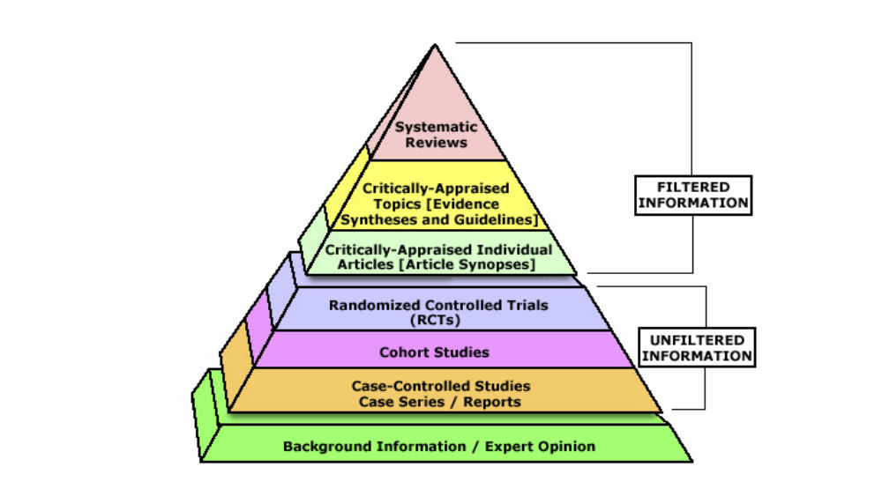
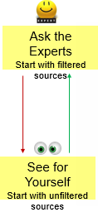
Hierarchy of Evidence & Search Approaches
Cochrane Database of Systematic Reviews
EBM Guidelines Essential Evidence Plus
PubMed CINAHL
CENTRAL PubMed CINAHL
PubMed CINAHL
Textbooks

Slide 16
The 5 steps of EBP process
1. ASK: Formulate an answerable clinical question
2. ACCESS: Track down the
best evidence
3. APPRAISE: Appraise the evidence for its validity and usefulness
4. APPLY: Integrate the results with your clinical expertise and your patient values/local conditions
5. ASSESS: Evaluate the effectiveness of the process
Ask
Assess
Access
Apply
Appraise

Slide 17
Evidence-based practice Step 1: Ask
Answer Background Questions First- What/How Questions; helps user learn more about the scope of the topic and the possible alternatives in order to address the real problem. For example, What is hypertension? How does treatment A work?
Formulate focused clinical questions using PICO* - Address the real problem. *You may not always have all 4 elements in one question.
Ask

Slide 18
Next – Classify the Type of Question
What is the treatment/preventive treatment? Question of INTERVENTION/PREVENTION
What causes the problem? Question of ETIOLOGY, RISK, HARM
Does this person have the problem? Question of DIAGNOSIS
Who (and how likely) will get the problem? Question of PROGNOSIS

Slide 19
Templates of EBP Questions
For a therapy: In adult patients w/total hip replacements (P), what is the effect of PCA pain Medication (I) on postoperative pain(O) compared with prn IM pain Medication(C)?
Prevention: For women under the age of 60 (P) does the use of low-dose aspirin (I) reduce the future risk of stroke (O) compared with none (C)?
For etiology/harm: Are adult males (P) who have a vasectomy (I) at an increased (Increased/decreased) risk for/of testicular cancer (O) compared with adult males (P) with/without no vasectomy (C)?
Diagnosis or diagnostic test: Are (is) mammogram(I) more accurate in diagnosing breast cancer (P) compared with clinical breast exam (C) for earlier diagnosis of breast cancer (O)?
Prognosis: Does smoking education (I) influence young people not to smoke (O) in patients who have high risk of smoking (P)?
Melnyk B. & Fineout-Overholt E. (2005). Evidence-based practice in nursing & healthcare. New York: Lippincott Williams & Wilkins.

Slide 20
Formulate Intervention Questions
For a 54 year old male patient with intermediate grade prostate cancer, is radical prostatectomy more effective compared to radiation treatment in reducing the risk of mortality, impotence, and incontinence?
P - 54 years old male with intermediate grade prostate cancer
I - radical prostatectomy
C - radiation treatment
O - reduce risk of mortality, impotence, and incontinence

Slide 21
Formulate Etiology or Risk Question What causes a disease or health condition
This is the reverse of intervention questions- it deals with harmful outcomes of an activity or exposure (public health issues).
S. is a smoker and just found out that she is 3 months pregnant. She quit smoking immediately. But she is worried if her developing baby was harmed and if the baby is at risk for having developmental problems. She is asking you if smoking during the first trimester can harm her baby?
P - babies of mothers who smoke
I - smoking in first trimester
C - nothing
O - increase risk of developmental problems

Slide 22
EBP Step 2: Access the evidence
Access
Track down the best available evidence – filtered vs. nonfiltered
Start from the best resource for your question
Develop effective EBP search strategies

Slide 23
EBP Step 3: Appraise (validity, impact)
Appraise
Does PICO of the study match my PICO question?
internal validity – methods; how well was the study done? Is it biased?
external validity - generalizability
impact - does it matter to your patient?
See: Evaluating the Evidence section in the EBM tutorial
http://www.hsl.unc.edu/Services/Tutorials/ebm/welcome.htm

Slide 24
EBP Step 4: Apply (patient, setting)
Apply
Integrate the results with your clinical expertise and
your patient values
Patient
Is my patient similar enough that the results of the study apply?
Will the potential benefits outweigh the potential harms of treatment ?
What does my patient think? What are his cultural beliefs?
Setting
Is the intervention feasible in my settings?
What alternatives are available?

Slide 25
EBP Step 5: Access (patient, yourself)
Assess
Evaluate the effectiveness of the process:
Am I asking questions?
Am I writing down my information needs?
How is my searching going? Am I becoming more efficient?
What is my success rate in the EBP steps?
Am I periodically syncing (checking) my skills and knowledge with new developments?
Teach others EBP skills
Keep a record of your questions

Slide 26
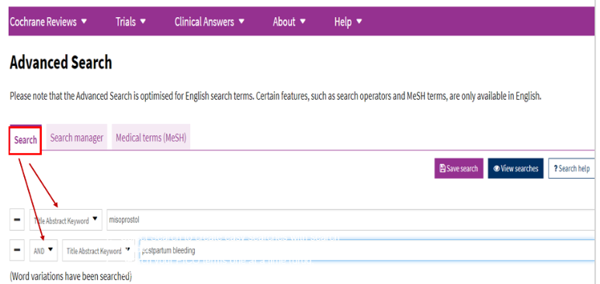
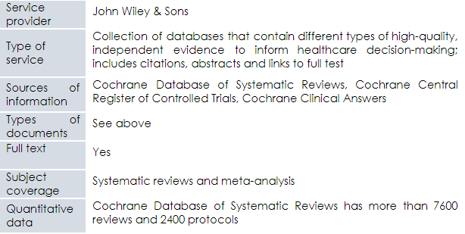
R4L resources: Cochrane Library (EBP resources available via Hinari)
See Hinari References sources list/Cochrane Library
Note: Cochrane Library is available to all the R4L registered institutions; for the other resources, the publishers choose to grant access on a country by country basis

Slide 27
Content: Cochrane Library
Independent non-for-profit international collaboration (36,000 contributors from 107 countries, 40 regional centers, 52 review groups)
Produces Systematic Reviews - internationally recognized as the highest standard in evidence-based health care because they contain the highest scientific evidence
Minimum Bias: Evidence is included/excluded on the basis of explicit quality criteria; A panel of experts reviews the evidence, peer-reviewed, dynamic (updated regularly)
Reviews involve exhaustive searches for all RCT, both published and unpublished, on a particular topic; focus on intervention, rehabilitation, prevention, or diagnoses
Content includes Cochrane Database of Systematic Reviews (7600 reviews & 2400 protocols), Central Registry of Controlled Trials (1.1 million articles) Cochrane Clinical Answers (1600) and Systematic Reviews from Epistemonikos (200,000)

Slide 28
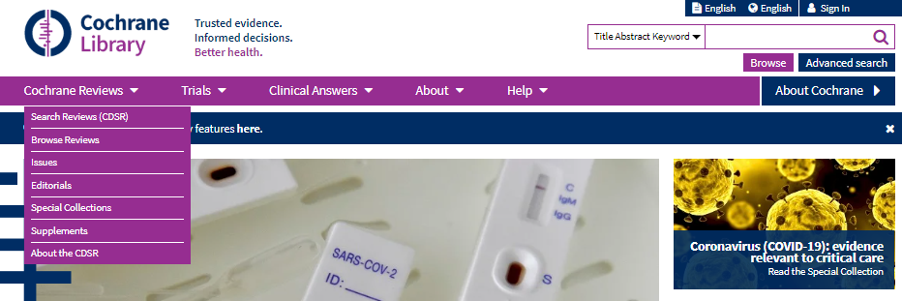
Cochrane Library options
From Hinari Databases for discovery list, open Cochrane Library.
Initial page of Cochrane Library website.
Besides the search box, note the other tools for opening Cochrane Reviews.

Slide 29
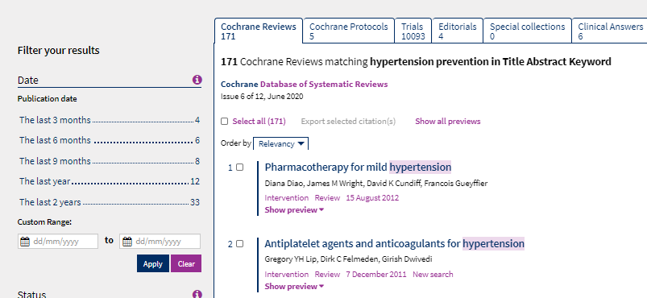
“hypertension prevention” search results/ Cochrane Database for Systematic Reviews
These are the search results for “hypertension prevention”; note how the results are divided into Cochrane Reviews, Cochrane Protocols and Trials, Editorials and Clinical Answers.

Slide 30
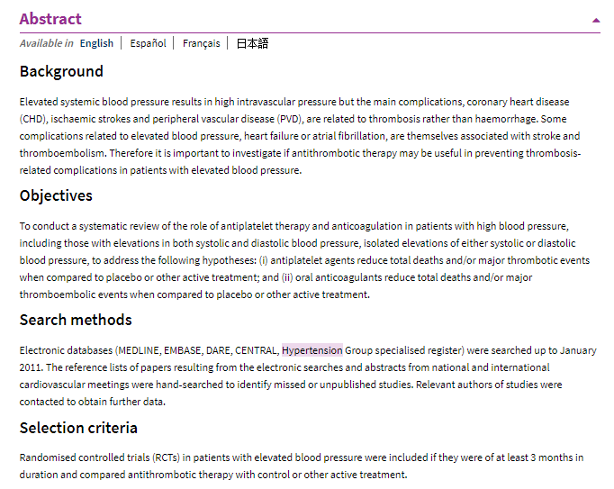
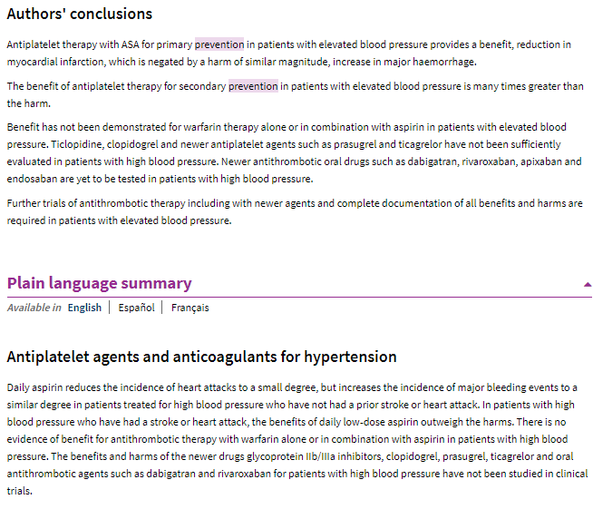
Sample of Cochrane systematic review abstract including Plain Language Summary

Slide 31
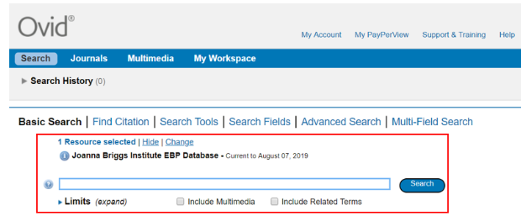
Joanna Briggs Institute EBP Database
See Hinari Databases for discovery list/Joanna Briggs Institute EDP Database

Slide 32
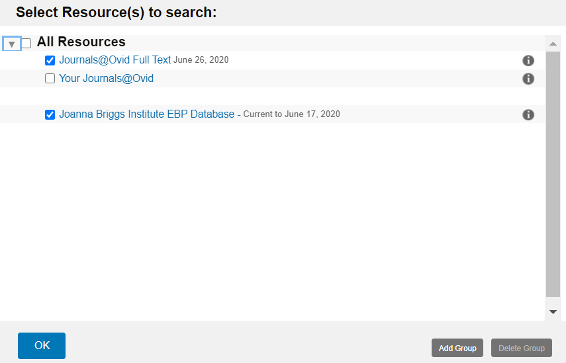
Joanna Briggs Institute EBP Database
From the Hinari Reference sources list, open the Joanna Briggs Institute EDP Database. On the OVID resources page, click on Journals@OVID Full Text and Joanna Briggs Institute EBP Database and OK.

Slide 33
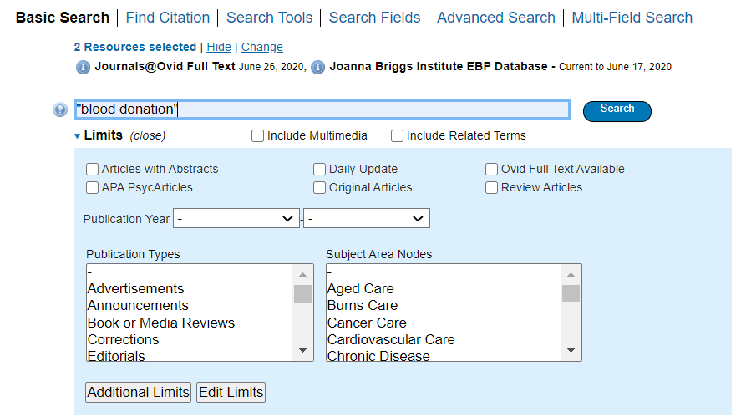
Joanna Briggs database search
Search for “blood donation”. Note the various limits that can be added to a search,

Slide 34
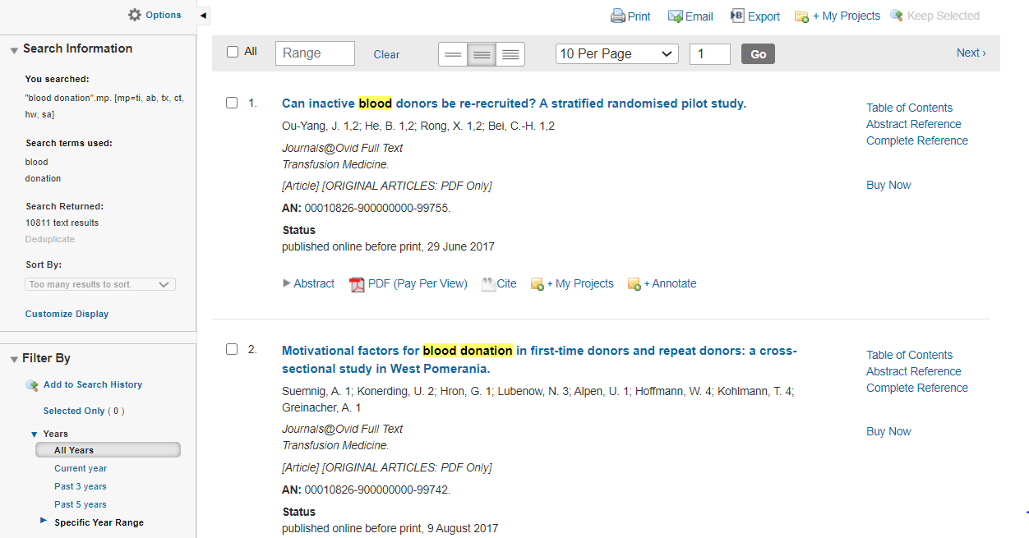
Joanna Briggs database search results
The results for the “blood donation” from the two OVID sources are displayed.
Note the Search Information and Filter by options.

Slide 35
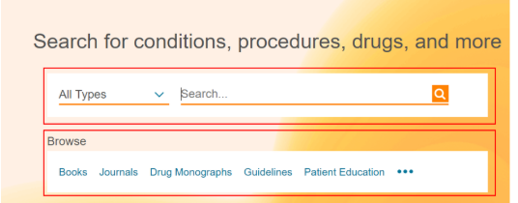
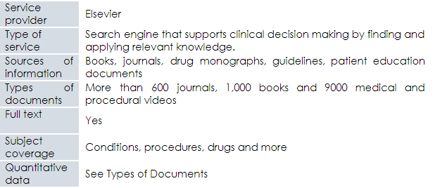
Clinical Key
See Hinari References sources list/Clinical Key
Note: the final two resources are not evidence-based practice databases but, for clinical practice outcomes, often use the results from the EBP resources previously noted.

Slide 36
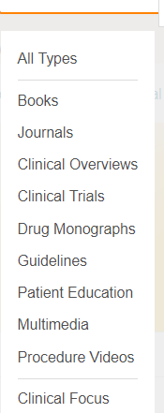
Clinical key search
From the Hinari References sources list, Click on Clinical Key
Complete a search for “dengue fever treatment”.
Note the types of resources available.

Slide 37
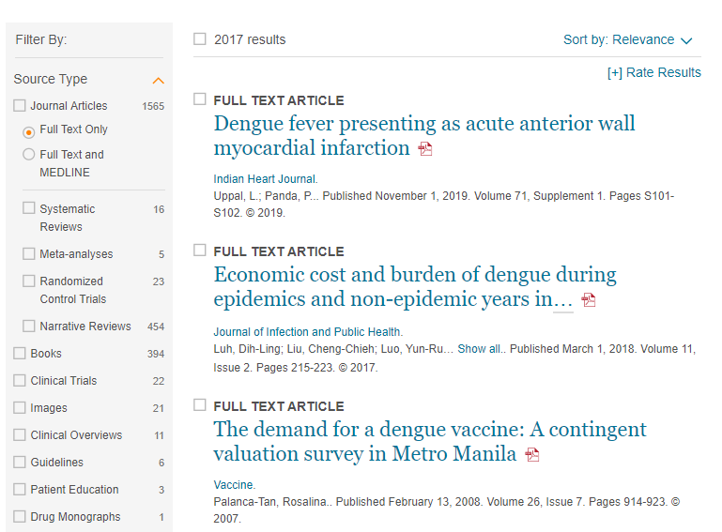
Clinical key search results
The “dengue fever treatment” search results in 2017 citations with many being evidence-based practice resources (systematic reviews, meta-analysis, randomized control trials).
Note Filter By: Source Type option.

Slide 38
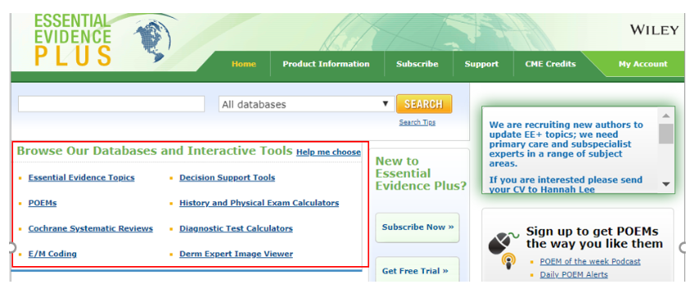
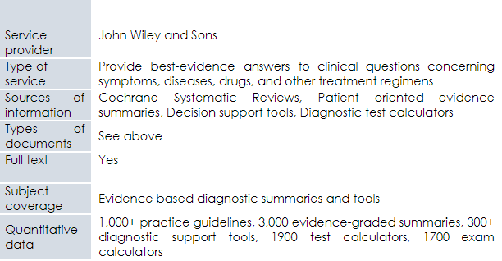
Essential Evidence Plus
See Hinari References sources list/Essential Evidence Plus

Slide 39
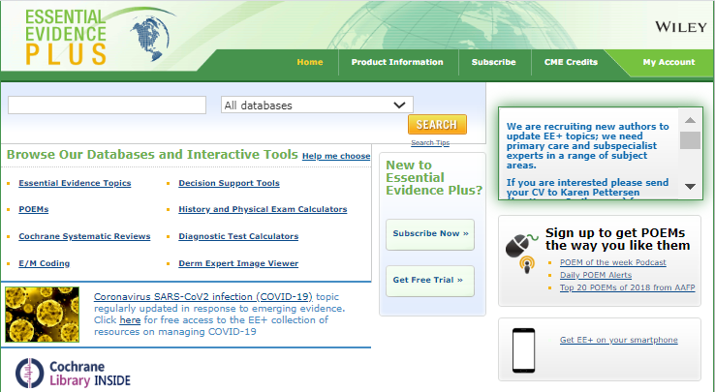
Essential Evidence Plus options
From the Hinari References sources list, Click on Essential Evidence Plus. Note the keyword search box and also the option to Browse Our Databases and Interactive Tools including Cochrane Systematic Reviews.
Similar to Clinical Key, the search results will use evidence-based practice studies.

Slide 40
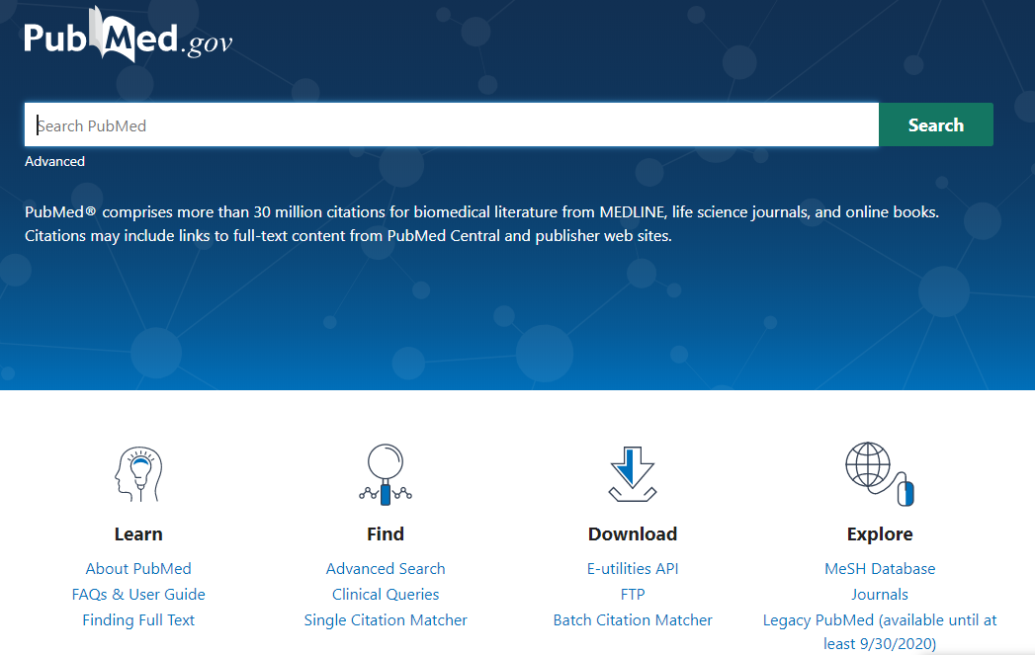
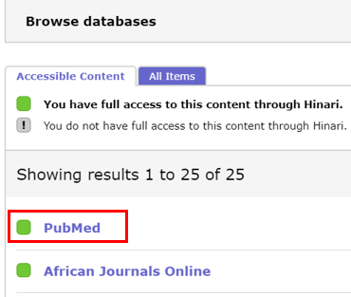
Clinical Queries (PubMed) – access to filtered and non-filtered research literature
From the Hinari content page, open Databases for discovery and click on PubMed.
In Hinari/PubMed, click on Clinical Queries.

Slide 41
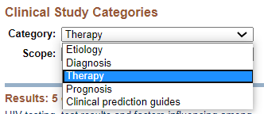
Clinical Queries search
In the PubMed Clinical Queries search box, enter “pregnancy complications” and “developing countries” ; click on Search.
Note the Clinical Study Categories and Scope search options.

Slide 42
Queries search results
Results for Clinical Study Categories (non-filtered) and Systematic Reviews (filtered) citations. For Clinical Study Categories, click on See all(808) and for Systematic Reviews, click on See all (79)

Slide 43
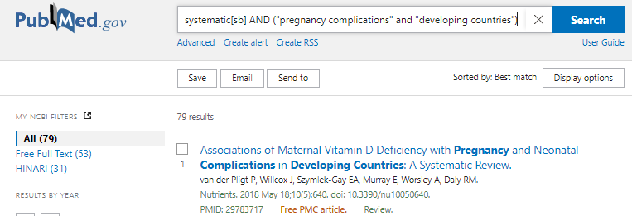
PubMed search results
Displayed are the results for the systematic[sb] AND (“pregnancy complications” and “developing countries”) search with 79 citations. Note the links to Hinari full-text (31) and Free Full Text (53).

Slide 44
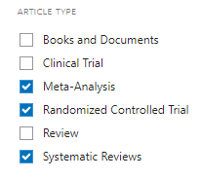
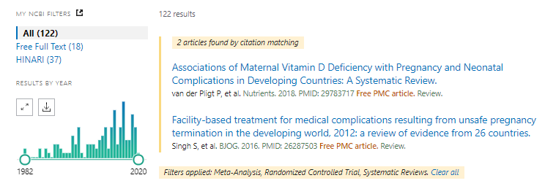
PubMed filters search
Using the “pregnancy complications” and “developing countries” search, add the filters for ARTICLE TYPE/Meta-Analysis, Randomized Controlled Trial and Systematic Reviews. The search results total 122.

Slide 45
Additional evidence-based practice resources
EBM Librarian: the purpose of this site is to develop a community of librarians who are involved in teaching and supporting the practice of Evidence-Based Medicine (EBM) also called Evidence-Based Practice (EBP). This site offers a place to share teaching materials and class handouts, discuss issues and ask advice from colleagues, share useful information about teaching EBM https://sites.google.com/site/ebmlibrarian/
EvidenceAlerts: an Internet service that notifies physicians and researchers about newly-published clinical studies. Researchers at the McMaster Health Information Unit find the highest quality studies, reviews, and evidence-based clinical practice guidelines from 121 premier clinical journals and these articles are rated by practicing physicians for clinical relevance and interest. Alerts are curated to your own clinical interests. https://www.evidencealerts.com/
Notes:
Several of the Free Collections listed on the Hinari Content page will be noted in the subsequent section.

Slide 46
Additional resources continued
McMaster PLUS (Premium Literature Service): Critical Appraisal Process (CAP) that identifies studies and systematic reviews that are scientifically strong; articles that meet our scientific criteria are then rated by frontline clinicians for relevance and newsworthiness through the McMaster Online Rating of Evidence (MORE) system. hiru.mcmaster.ca/hiru/HIRU_McMaster_PLUS_projects.aspx
Open Clinical: Clinical Practice Guidelines – a "one-stop shop" tracking developments on advanced knowledge management technologies for healthcare such as point-of-care decision support systems, "intelligent" guidelines and clinical workflow www.openclinical.org/guidelines.html
Trip Database: “a smart, fast tool for you to find high-quality clinical research evidence”; contains access to research evidence and other content types including images, videos, patient information leaflets, educational courses and news. www.tripdatabase.com/

Slide 47
Summary
This lesson focuses on the concepts of evidence-based medicine/practice and key EBP resources that are available.
The first part of the lesson is an overview of components of EBP (systematic reviews, meta-analysis, other study types, hierarchy of resources – filtered/pre-appraised literature vs. nonfiltered/appraised literature) and the 5-step EBP process (ask, assess, appraise, apply, assess).
The second part of the lesson focuses on the key information resources that are available from Research4Life (Cochrane Library, Joanna Briggs Institute EBP Database, Clinical Key, Essential Evidence Plus), PubMed (Clinical Queries and Article Types filters) and the Internet.

Slide 48
You are invited to;
Visit us at www.research4life.org
Contact us at r4l@research4life.org
Find out about other training materials [www.research4life.org/training]
Subscribe to Research4Life newsletter [www.research4life.org/newsletter]
Check out Research4Life videos [https://bit.ly/2w3CU5C]
Follow us on Twitter @r4lpartnership and Facebook @R4Lpartnership

Slide 49
For more information on Research4Life
www.research4life.org
r4l@research4life.org
Research4Life is a public-private partnership of five programmes:

