Slide 1
SCHOLARLY COMMUNICATION AND RESEARCH4LIFE
RESEARCH ASSESSMENT AND BIBLIOMETRICS
Research4Life is a public-private partnership of five programmes:

Slide 2
Lesson outline
Research assessment and academic evaluation.
Bibliometrics and indicators for research impact.
Citation analysis and research performance
Summary.
This work is licensed under Creative Commons Attribution-ShareAlike 4.0 International (CC BY-SA 4.0)

Slide 3
Learning objectives
Become familiar with research impact and how it is evaluated
Understand commonly used indicators and methodologies
Understand alternative merits to journal-based metrics
Recognize existing tools such as Google scholar, altmetrics, Scopus, Web of science, dimension, scival, incites
Notes:
This lesson introduces the concept of and recent developments in research assessment in academia. Commonly used methodologies in research impact analysis, including bibliometric indicators, are introduced. An overview of prominent tools and services for research assessment are also included. Please note that some examples of bibliometric analysis are covered in Lesson 3.7 on Citation databases.

Slide 4
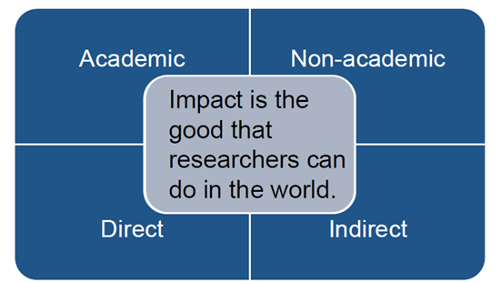
Research Impact
Research impact can simply be defined as the good that researchers can do in the world,
Academic impact, the focus of this lesson, is the intellectual contribution that a researcher has made in his/her field of study within academia
Forms of research impact include:
1
2
3
4
Notes:
Research impact is further described as “…when the knowledge generated by our research contributes to, benefits and influences society, culture, our environment and the economy.
Even though research is linked to the research done researchers, it goes beyond academia.
Impact is assessed alongside research outputs and environment to provide an evaluation of research taking place within an institution.
Some of the key areas of research impact include; Cultural impact, Economic impact, Environmental impact, Social impact, Impact on health and wellbeing, Policy influence and change

Slide 5
Key factors for evaluating research impact in research orgs.
Accountability – to demonstrate to funders the value of their research investment and enhance the chances for further funding.
Understanding – to understand how research leads to impact, and thus ways in which it can be developed to maximize the impact of research findings.
Performance evaluation – research impact assessment is being used widely in guidelines for employment, performance evaluation and promotion of researchers.
Notes:
For a research organization, such as a university, impact evaluation of all its research output enables the organization to gain an overall understanding of its performance. This helps to monitor and disseminate its contributions to society.
For research funders, impact evaluation of the research they supported enables them to understand the return on their investment, helping them to allocate funding to what is most impactful and identify the trend of research for future investment.

Slide 6
Methodologies used to evaluate research impact.
There are two main approaches:
Qualitative approach
Quantitative approach
Qualitative approach uses narratives such as peer review. Scholarly manuscripts are scrutinized by those in the same field, feedback and judgements are then used to improve the research.
Quantitative approach is based on measurable indicators or metrics. Quantitative metrics are convenient, easy to understand and less time-consuming to produce.
Notes:
Once scholarly manuscripts have passed peer review, research publications are then often the primary measure of a researcher's work (hence the phrase "publish or perish").
However, assessing the quality of publications is difficult and subjective. Although some general assessment exercises use peer review, general assessment is often based on metrics such as the number of citations publications (H-index)or even the perceived level of prestige of the journal it was published in (Journal Impact Factor).

Slide 7
Research impact assessment
Overemphasis on metrics in academic research impact assessment brought adverse effects to both researchers and research organizations.
Researchers and practitioners in scholarly communication have long called for better assessment schemes.
The Declaration on Research Assessment (DORA) is one of those calls. It was developed in 2012.
The main goal of DORA is to promote better research assessment by encouraging the development of and showcasing robust, efficient ways to evaluate research and researchers.

Slide 8
The Declaration on Research Assessment (DORA)
“Do not use journal-based metrics, such as Journal Impact Factors, as a surrogate measure of the quality of individual research articles, to assess an individual scientist’s contributions, or in hiring, promotion, or funding decisions.”
Notes:
The Declaration on Research Assessment (DORA) general statement.

Slide 9
The Declaration on Research Assessment (DORA) cont.
In response to the DORA general recommendation, the Leiden Manifesto for research metrics set out ten principles for a balanced and effective research evaluation scheme.
In general, the golden rule for research impact assessment is to adopt both qualitative and quantitative approaches.
Always use more than one metric/indicator when evaluating research.
Notes:
The 10 Principles are available in the next slide

Slide 10
The 10 principles for a balanced and effective research evaluation scheme.
1. Quantitative evaluation should support qualitative, expert assessment
2. Measure performance against the research missions of the institution, group or researcher.
3. Protect excellence in locally relevant research.
4. Keep data collection and analytical processes open, transparent and simple.
5. Allow those evaluated to verify data and analysis
6. Account for variation by field in publication and citation practices.
7. Base assessment of individual researchers on a qualitative judgement of their portfolio.
8. Avoid misplaced concreteness and false precision.
9. Recognize the systemic effects of assessment and indicators.
10. Scrutinize indicators regularly and update them
Notes:
Visit: https://www.nature.com/news/bibliometrics-the-leiden-manifesto-for-research-metrics-1.17351

Slide 11
Bibliometrics and indicators for research impact.
Bibliometrics are quantitative methods of analyzing research using publications as a proxy for research.
Other metrics used in research assessments are:
Scientometrics - covers output of science in general, not limited to publications
Webmetrics (cybermetrics) – covers indicators appearing on the WWW and other electronic resources
Infometrics – covers all information objects
Alternative metrics (a.k.a. Altmetrics) – covers page views/downloads, tweets, discussion, saves, recommends, and reports
Notes:
Bibliometrics have been widely used in the quantitative approach for research assessment. They are also used in the study of history and sociology of science, information organization and management, and science policy.

Slide 12
Bibliometrics
Aspects of the publication/bibliographic data that bibliometrics examine are:
Characteristics of publication, i.e. the year, journal and document type, etc
Authorship, including collaboration among authors, organizations, countries, and funders)
Research topics and subject categories
Citation impact (cited references and citing articles)

Slide 13
Bibliometrics cont.
Questions that bibliometrics can help to answer include:
What is the productivity? (Using the number of articles by year/type/subject category/journal as the measurement)
Who works together?
Which organizations work together in certain research?
Which countries work on certain research?
Which organizations funded research/researchers together?
What are the major research topics/areas and their trend?
What is the citation impact? (Percent of articles in the top 10% of citations)
Which guidelines and patents supported by certain research?

Slide 14
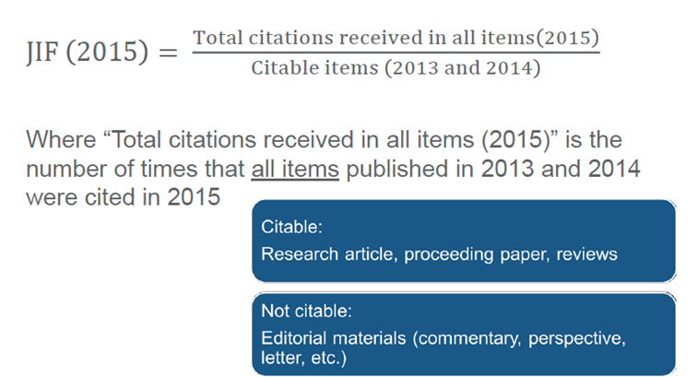
Bibliometric indicators
Two bibliometric indicators are frequently used in research assessment tools:
The Journal Impact Factor (JIF) – a journal-level bibliometric indicator. It is commonly used as a proxy for the relative importance of a journal.
Example of JIF calculation
Notes:
However, many evaluation bodies use it to evaluate the performance of a researcher, making the assumption that articles published in journal with a high JIF would have more impact.
DORA and the Leiden Manifesto both pointed out the faults of this approach
Example shows the calculation for a JIF in 2015

Slide 15
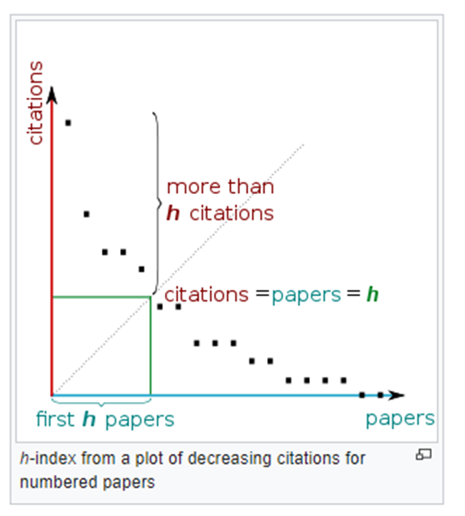
Bibliometric indicators cont.
2. The h-index - an individual-level bibliometric indicator used in evaluating research impact of a researcher by measuring both the productivity and citation impact of an author and of a journal.
Example of H- index
Notes:
The h-index is defined as the maximum value of h such that the given author/journal has published h papers that have each been cited at least h times.”
However, h-index is arbitrary and not normalized to research field. It also favors senior researchers and older publications.
Example shows a graphical presentation of h-index.

Slide 16
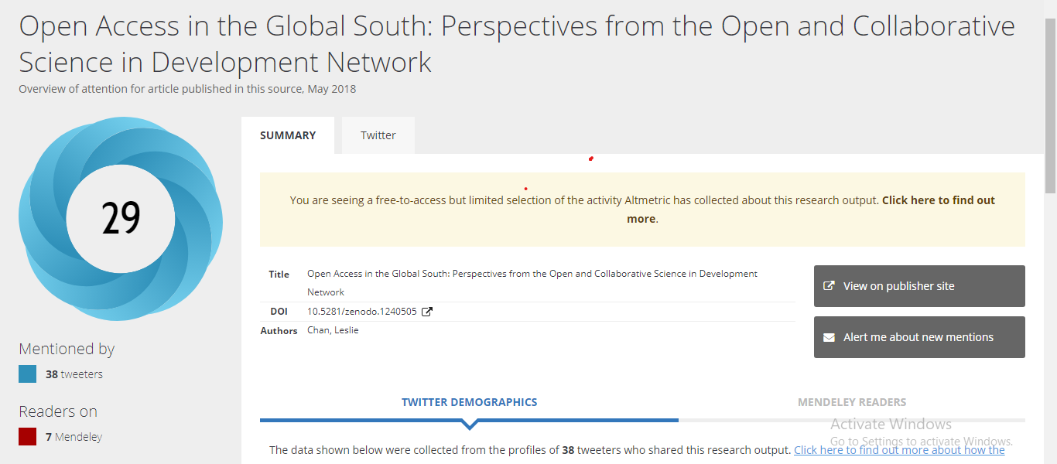
Bibliometric indicators cont.
3. Altmetrics (alternative metrics) -attempts to indicate research impact based on the popularity of research output on the web including social media.
*An example of activity collected by Altimetric
Notes:
Altmetrics are considered to be complementary to the citation-based metrics. These indicators track immediate attention ,i.e., viewed, tweeted, discussed, saved, recommended, reported.
Altmetrics are not yet widely incorporated into research assessment. However, there have many proponents. A few organizations have incorporated Altmetrics into review for promotion, the Mayo Clinic in the United States being an example.

Slide 17
Prominent tools and services for research performance.
Many data sources and tools are available to help conducting research impact analysis.
They differ in terms of coverage, functionalities and analytical methods utilized.
Users should choose the ones that best meet their needs.

Slide 18
Web of Science and Scopus
These are online subscription-based scientific citation indexing services.
Web of Science is maintained by Clarivate Analytics. Its 73 million records cover publications and citations back to 1900 from over 20,000 journals. Web of Science does not participate in Research4Life.
Scopus, produced by Elsevier, contains 70 million records, with publication data from 1996 and citations back to 1970 from over 22,000 journals. Scopus is available to some Research4Life members
Notes:
Web of Science - A platform providing access to multidisciplinary and regional citation indexes; specialist subject indexes; a patent family index; and an index to scientific data sets. The Web of Science provides a common search language, navigation environment, and data structure allowing researchers to search broadly across disparate resources and use the citation connections inherent to the index to navigate to relevant research results and measure impact
Scopus - With over 1.4 billion cited references now on Scopus, each paper indexed has, on average, 10-15% more citations than our nearest competitor. More cited references mean: more extensive bibliometric and historic trend analysis, more complete author profiles, improved h-index measures for authors who began publishing prior to 1996

Slide 19
InCites and SciVal
InCites by Clarivate and SciVal by Elsevier offer advanced levels of metrics and analytical reports
Useful for portfolio analysis and benchmarking of organizations and research programs
InCites is built on Web of Sciences collections.
SciVal is built on data from Scopus.
Both tools are fee-based and do not participate in Research4Life

Slide 20
Dimensions
Dimensions is a dynamic linked-research data platform.
It allows users to explore the connections between publications, grants, clinical trials, patents and policy documents.
The basic level of Dimensions is available to everyone, it offers full-text searching of publications data and some metrics.
Dimensions Plus, an advanced level of access, is a fee-based product which covers additional content and offers additional analytical tools.
Dimensions Plus is available to all Research4Life member organizations.

Slide 21
Google Scholar Citations
It is a free tool available for everyone, it allows authors to keep track of citations to their articles.
Authors can find out who is citing their publications, graph citations over time, and compute several citation metrics.
Bibliometrics indicators, such as number of articles and h-index will be presented and updated automatically as new citations are added to Google Scholar
To see your own Google Scholar citations, visit https://scholar.google.com, sign in and click on “My Citations”.
Notes:
Authors can find out who is citing their publications, graph citations over time, and compute several citation metrics.
Anyone can create a Google profile to search for all citations in Google Scholar published by a researcher or a research organization.
Go live; https://scholar.google.com

Slide 22
Summary
This lesson introduced the concept of research assessment, particularly in academia.
Commonly used methodologies in research impact analysis, including bibliometric indicators were introduced.
An overview of prominent existing tools and services for research assessment were shown towards the end of the lesson.

Slide 23
For more information on Research4Life
www.research4life.org
r4l@research4life.org
Research4Life is a public-private partnership of five programmes:

