Slide 1
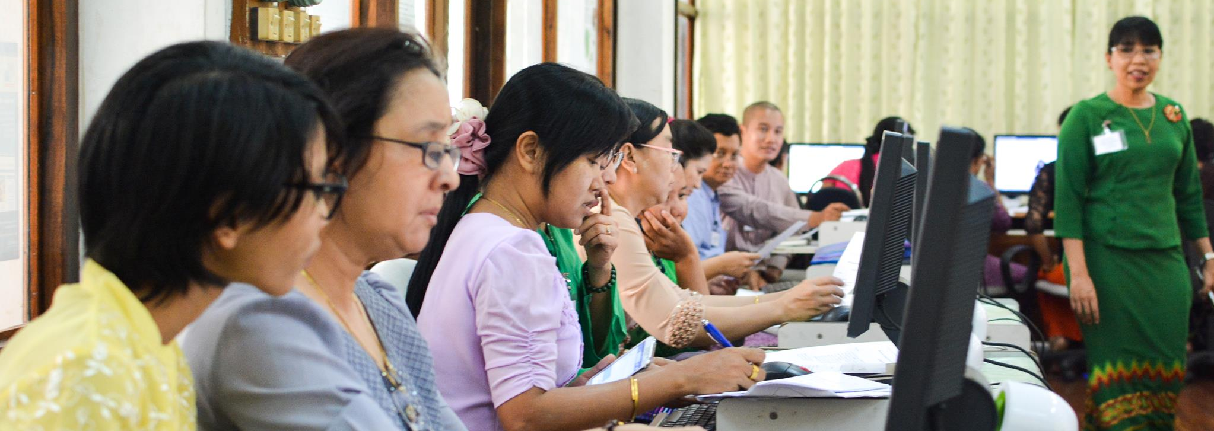
Research4Life
Free or low-cost access to academic and professional content
www.research4life.org
R4L_partnership
R4Lpartnership
Research4Life

Slide 2
What is Research4Life?
Research4Life aims to reduce the knowledge gap between industrialized countries and developing countries by providing affordable access to academic and professional resources.
23,500
journals
86,000
books
120
other resources

Slide 3
Subjects
Health
Agriculture
Environment
Law and Social sciences
Scientific, technical information

Slide 4
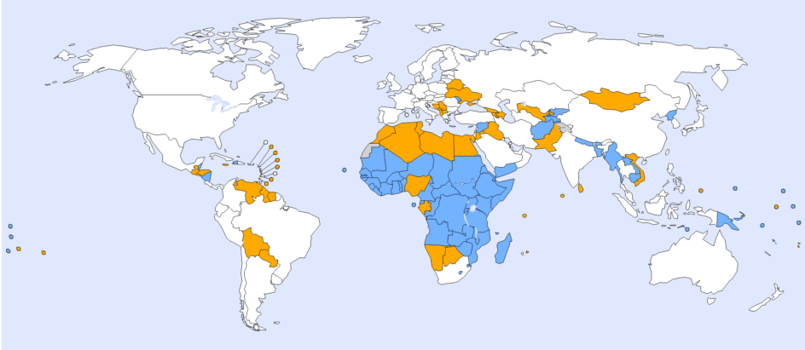
Who can use Research4Life?
Free access
Low-cost access

Slide 5
Who can use Research4Life?
Universities
Research Institutes
Teaching hospitals, Healthcare Services
National NGOs
National Libraries
Government Offices
Vocational Training Centres

Slide 6
Five programs
Health WHO
Agriculture FAO
Environment UNEP
Innovation and technology WIPO
Law and social sciences ILO

Slide 7
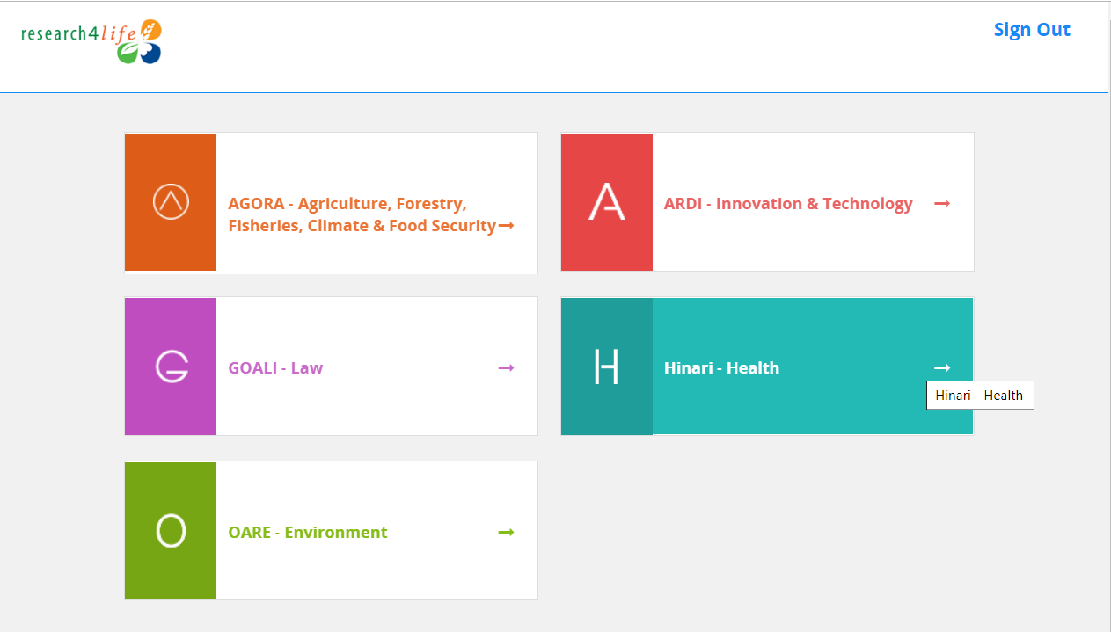
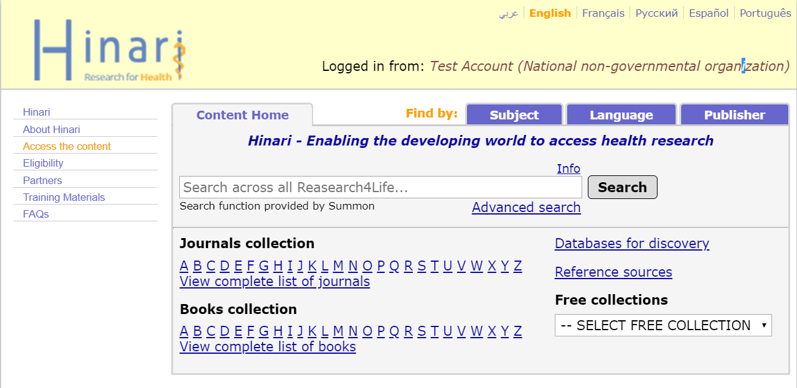
Log in from our homepage

Slide 8
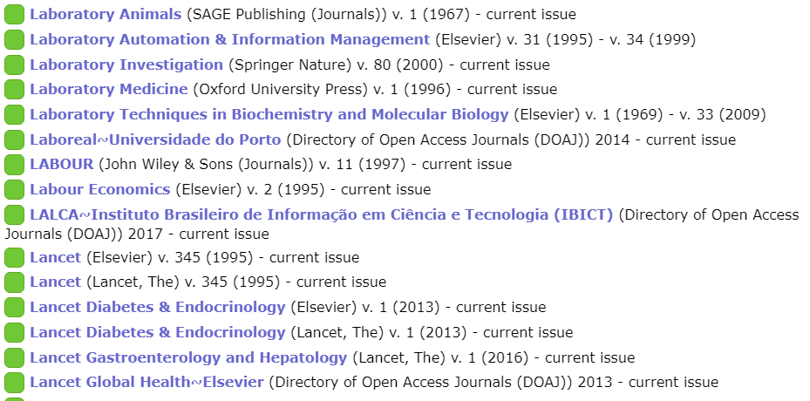
Browse thousands of journals
Screenshot from the Hinari journal collection

Slide 9
Search for keywords
Example: “novel coronavirus” search

Slide 10
Access databases
Screenshot from the Hinari portal

Slide 11
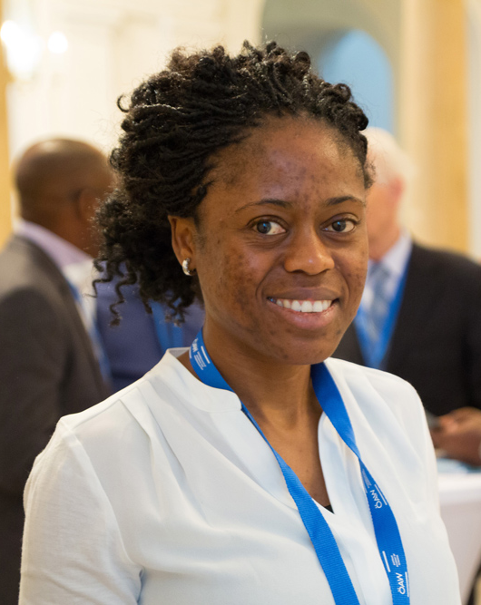
How we make a difference
“Thanks to Research4Life for providing access to evidence-based scientific information, we were finally capable of doing a literature review, which confirmed our hypothesis.”
Alice Matimba, senior lecturer at College of Health Sciences, University of Zimbabwe
Notes:
Alice Matimba, PhD is a senior lecturer at the Department of Clinical Pharmacology, College of Health Sciences, University of Zimbabwe.
In Zimbabwe, diabetic patients don’t usually have their eyes checked for retinopathy, the most common cause of vision loss among people with diabetes. “It was not hard to sense the distress of an ophthalmologist who took care of people with diabetic eye disease who present when it is too late to save their eyesight,” Alice Matimba explained. She shared her story of how her team started to take action and address the many alarming knock on health effects of diabetes—in particular blindness which can be prevented if diagnosed and treated in time.
Dr. Alice Matimba and her team found up-to-date and reliable information in Research4Life to advocate for a policy of investment in the advanced technology and services needed to tackle the burden of diabetes in Zimbabwe.
The team established telemedicine as a cheaper and faster way to develop solutions for diabetes eye care. With this in mind, her team took a further step to pilot a tele-ophthalmology clinic for diabetes patients at the major hospitals in Harare, the capital city of Zimbabwe.

Slide 12
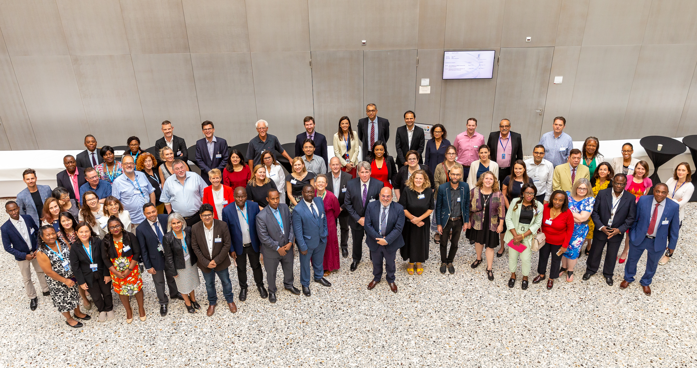
More information?
www.research4life.org or r4l@research4life.org

