Slide 1

Mendeley Software Features

Slide 2
Prior to completing this module, you must install and register all the necessary components of Mendeley
For instructions, see the Mendeley Download Instructions Presentation
This presentation will focus on the features of the software
Each screen has notes that further explain the features (useful for instruction)

Slide 3
Table of Contents
Mendeley platforms
Desktop
  Reference management features
  Cite while you write feature (MS Word)
Additional reference management options
  Web version
  Note: Exercises noted in this presentation are in the Mendeley Exercises (Word) document
Notes:
You should have completed the pre-lab exercise to register and installed all of the necessary components to set up Mendeley.
Today we are going to teach you how to use this tool to help organize your research and improve your writing process.
We’ll briefly go over the various platforms that Mendeley runs on, and discuss what you can do.
After that we will go over the features in the Desktop version.
Then we’ll make sure you know how to use the cite while you write feature.
Finally we will go over the Web version.

Slide 4
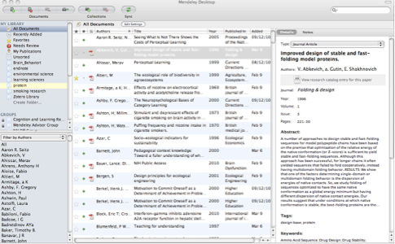
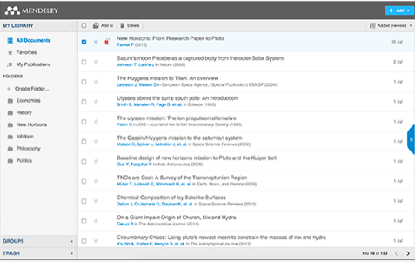
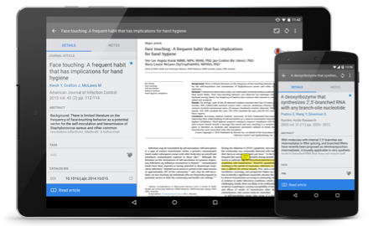
Free Software
What is Mendeley?
cite while you write
  insert citations
  generate bibliographies
  easily change citation style
quickly save and organize citations
download PDFs
  read offline
  mark-up
  share with a group
Desktop
Web
Mobile
Notes:
What is Mendeley? Mendeley is free software which is available across a number of different platforms.
Mendeley’s Desktop application offers the most complete experience. It allows you to download and organize citations, mark up pdfs and share them with a group. And then when you write papers you can quickly insert citations, generate bibliographies, and a highly valuable feature - change citation styles.
The other versions - Web and Mobile - offer you the ability to access and annotate your references on the go.
Mendeley is not a perfect tool – you will run into glitches - as with any reference management software that you use. But using this tool will provide you with a powerful way to organize your information and most of all, it is FREE.

Slide 5
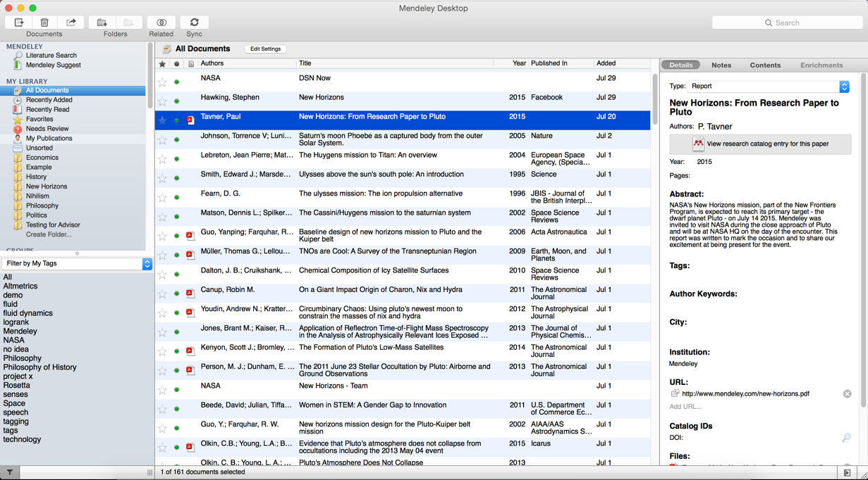
Mendeley Desktop
Left panel
filter options
Center panel
references
Right panel
modify citation info
Notes:
Open up Mendeley Desktop on your laptop now.
We’ll start off by taking a closer look at Mendeley Desktop. This is what it looks like on a Mac. The Windows version may have a few cosmetic differences, but the functionality is exactly the same.
Mendeley Desktop has three columns. The left-hand panel allows you to navigate through different filtering options for your library. In this screenshot we have ‘All Documents’ selected, which means the center panel is listing all of our references.
The center panel allows you to select individual references, and you can also select multiple papers if you want to perform bulk actions, such as mass deletions or additions to folders.
Clicking on a reference will display this document’s details in the right-hand panel. Here is where you can modify the details by clicking into the individual fields. Ensuring accuracy here will ensure that your citations are totally correct.

Slide 6
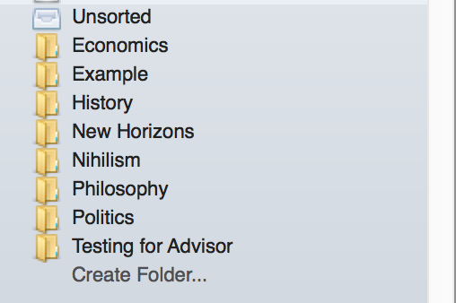
Create and Use Folders
References not added to a folder
will appear in ‘unsorted’, or “All Documents”
Drag and drop to re-order folders, or to create a folder within a folder.
Click ‘Create Folder’. Enter a
new folder name.
Notes:
One of the main reasons to use Mendeley is to organize your citations. Creating Folders will allow you to quickly file your references under different topic headings. To Create a Folder you will just click on the Create Folder link.
References not added to a folder will be located either in “ Unsorted” or “All Documents”. You can drag and drop references onto the folder name in the left panel to add that reference to a folder.
You can also drag and drop a folder into another one, to create sub-folders.

Slide 7

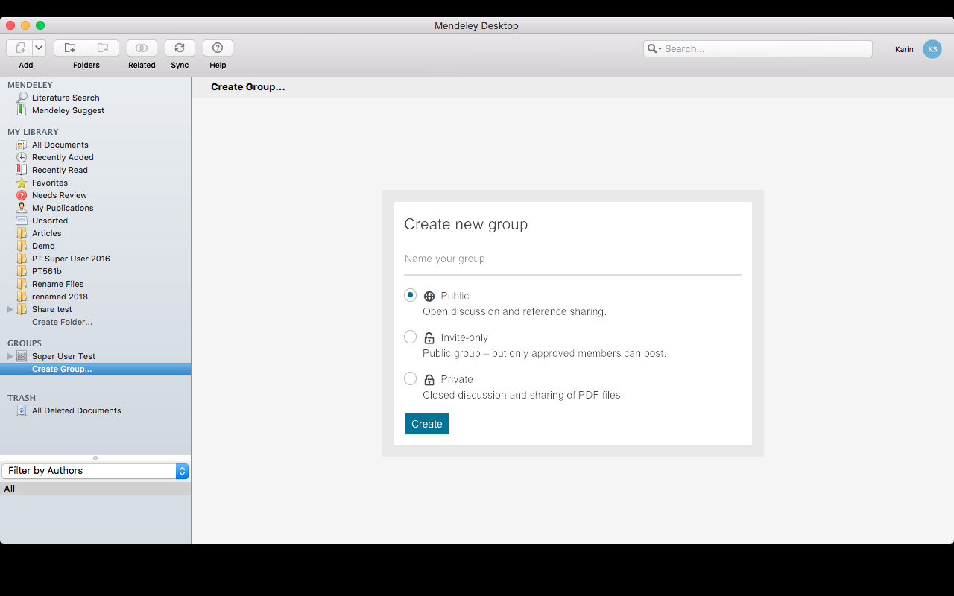
Create Groups
Private groups – free version:
create 1
max 3 members
join unlimited
read about storage limits here: limitations
Add documents to a group by dragging and dropping.
Notes:
-You can also create a group folder which allows you to collaboratively share citations and pdfs.
-Mendeley offers three different types of groups: Public and Invite-only are publicly visible, Private groups are not. Members need to be invited and then you can share full-text papers with each other, and collaboratively highlight & annotate these materials.
-With the free version of Mendeley you can create a maximum of 5 private groups with up to 25 collaborators for sharing common documents.
With 100MB shared web storage across all groups.
To create a new group click on the Create a Group link/Private radio dial. Then follow the prompts.
https://service.elsevier.com/app/answers/detail/a_id/18206/c/10542/supporthub/mendeley/

Slide 8
Complete Exercise 1
See Mendeley Exercises (Word) document
Notes:
Please complete Exercise 1 now.

Slide 9
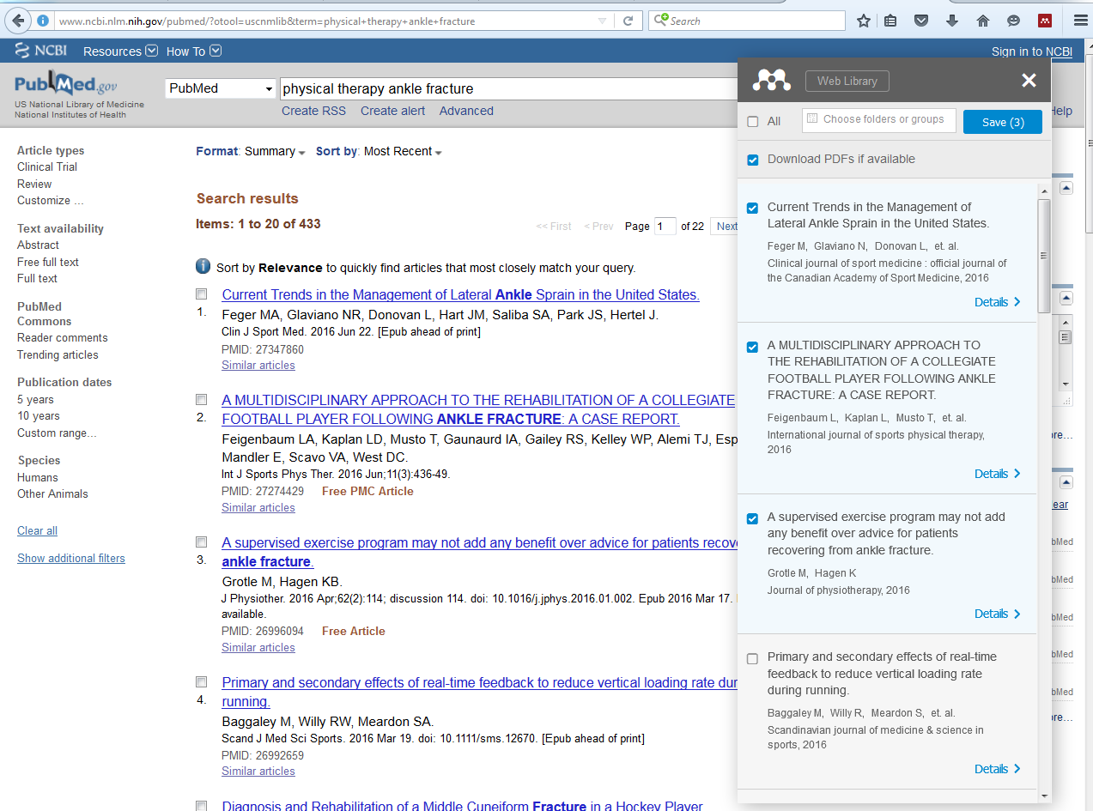
Add References & PDFs - Web
Check the boxes to add citations.
Select a folder or group to add citations.
Notes:
Now that we have a folder, the next thing we will do is to add some references to them. With the free version of Mendeley, you have 2GB of space for personal document storage. There are several ways to add references. First we will look at how to add citations directly from a database, or online resource.
Run a search in PubMed@USC for: physical therapy ankle fracture
Click on the check box next to the first 5 articles.
Click on the Send to dropdown, add to Clipboard.
Click on the link next to Clipboard.
Click on the Mendeley Web Importer – the red, square icon at the top of your browser tool bar.
You may be asked to sign in to your Mendeley account.
Select the folder to add the citations to.
Click on Save.
If a PDF is available it will automatically be attached to the citation.
Go back to Mendeley Desktop.

Slide 10
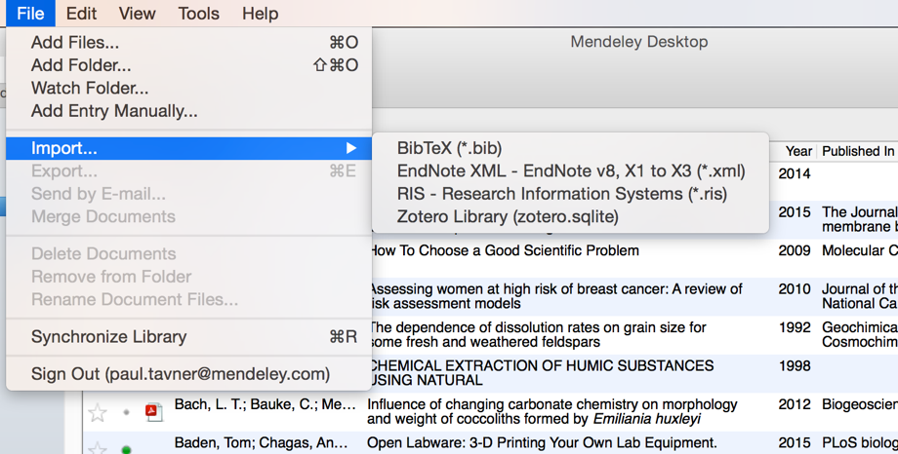
Adding Documents – from Computer
Easiest way - drag & drop pdf.
Use the File Menu to select a file or folder to
add from your computer.
Import from another reference
manager, drag and drop .xml file
Watch: Adds reference when you add pdf to a folder.
Add reference by
manually entering details.
Notes:
If you already have files on your computer that you would like to add to Mendeley, the easiest way is going to be to drag and drop the pdf or the folder into the Mendeley folder of your choice.
Mendeley also offers a number of other options for adding material to your library. You can find these by opening the File menu. Point out Files/Folders.
Another nice feature, is that you can set up Mendeley to “watch” a particular folder on your computer and automatically add references to your library when you add a pdf to that folder. This might be a useful feature to share articles for group projects. For example if you create a shared folder on Dropbox and have Mendeley “watch” this folder it will automatically add the citations to Mendeley, and then you can move them to your group folder.
Under the File menu option is also where you will find the option to add a manual entry, which will be useful for adding book or website citations.
Finally, you can easily import a library from other reference managers; i.e. EndNote, Refworks. XML file
-----------------------------------
Tutorial videos: https://community.mendeley.com/teaching#lightbox/4/

Slide 11
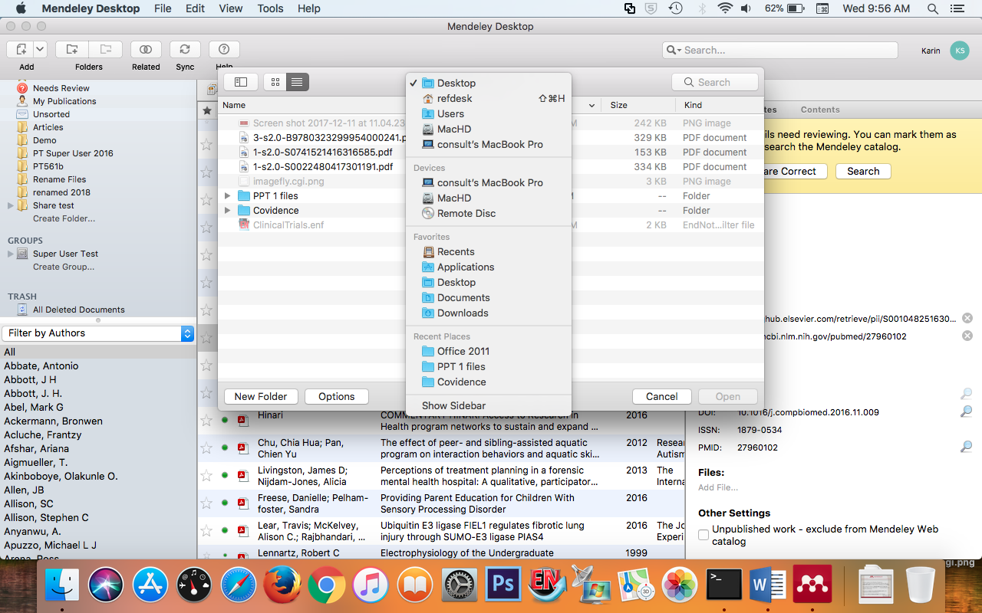
Adding Documents - to a Saved Citation
Notes:
If you want to add a file to a citation that you have already saved:
1) Clicking on a reference will display this document’s details in the right-hand panel. Scroll to Files and click on the “Add file” box. Select a file to add from your computer.

Slide 12
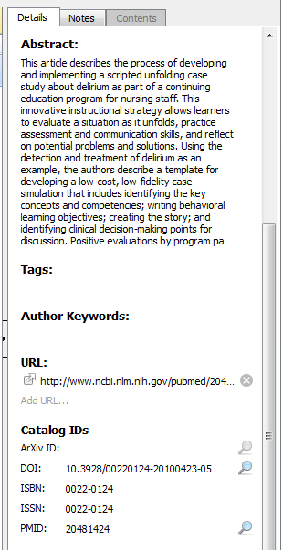
Change citation details
2 options
1) Manually enter corrections to the citation (right panel)
2) Or you can import the correct information from PubMed:
  click on article title to open the sidebar
  scroll down and type in the PMID
  click on the magnifying glass to pull the citation information from PubMed. See image →
Notes:
Sometimes you will have a PDF that is missing citation information or you need to correct some of the details. You can click on the reference in the center panel, and then manually enter in the correct information in the right panel, but a quick and easy way is to download the information from PubMed.
To Import the correct information from PubMed click on the article title to open the right panel.
Scroll down and type in the PMID into the box.
Click on the magnifying glass to pull the citation information from PubMed.
If you do not have the PMID, you can look up the article in PubMed - it will be listed in the citation information.

Slide 13
Complete Exercises 2, 3, 4, and 5
Notes:
Please complete exercises 2, 3, and 4.

Slide 14
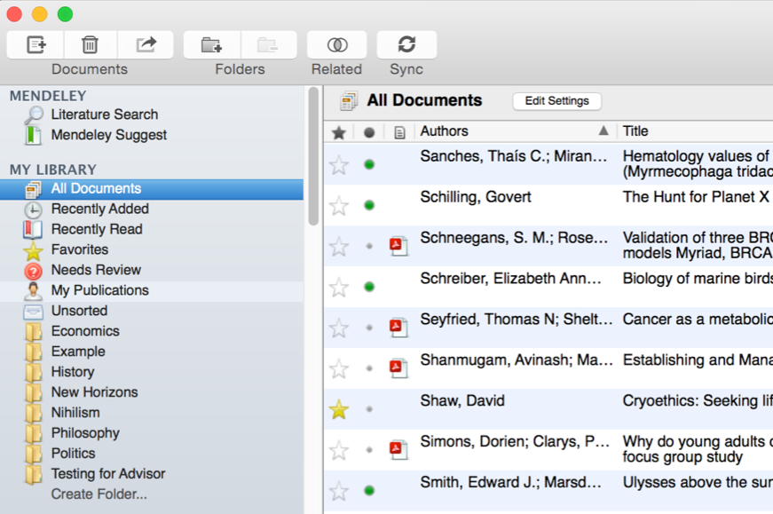





Manage Your Library
Use column
headings
to order your
references
All items in
your personal
library
Items added
in the last two
weeks
Mark entries
read or unread
Access your
recently read
items
Entries with
attached PDFs
can be opened
with the PDF
Reader
All items you’ve
starred in your
library
Items in need
of review
Star items to
mark them as
favorites
Notes:
Now that we have some references, let’s take a look at a few more of the features in the Mendeley Desktop interface.
It pretty much functions like iTunes. The left-hand panel offers a number of different options to help filter your document list to find exactly what you need.
The default position when opening Mendeley Desktop is ‘All Documents,’ which will list all items in your library. You can use the column headings in the center panel, i.e. Author Names, Year, etc., to order your documents by that value.
When you add materials to your library, they will initially be marked as unread - indicated by a large green dot in the center panel. You can toggle this off and on by clicking it. Alternatively, a document will be marked as read once you’ve spent a certain amount of time reading it in the Mendeley PDF reader.
You can also ‘star’ documents in the center panel to mark them as favorites.
In the left-hand panel you can then access items you’ve recently added, read, or starred as favorites.
Have them star an article and then find it in Favorites in left side folder.

Slide 15
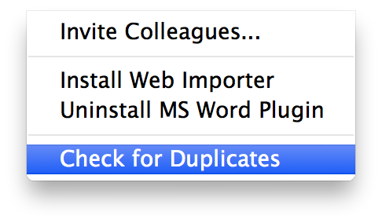
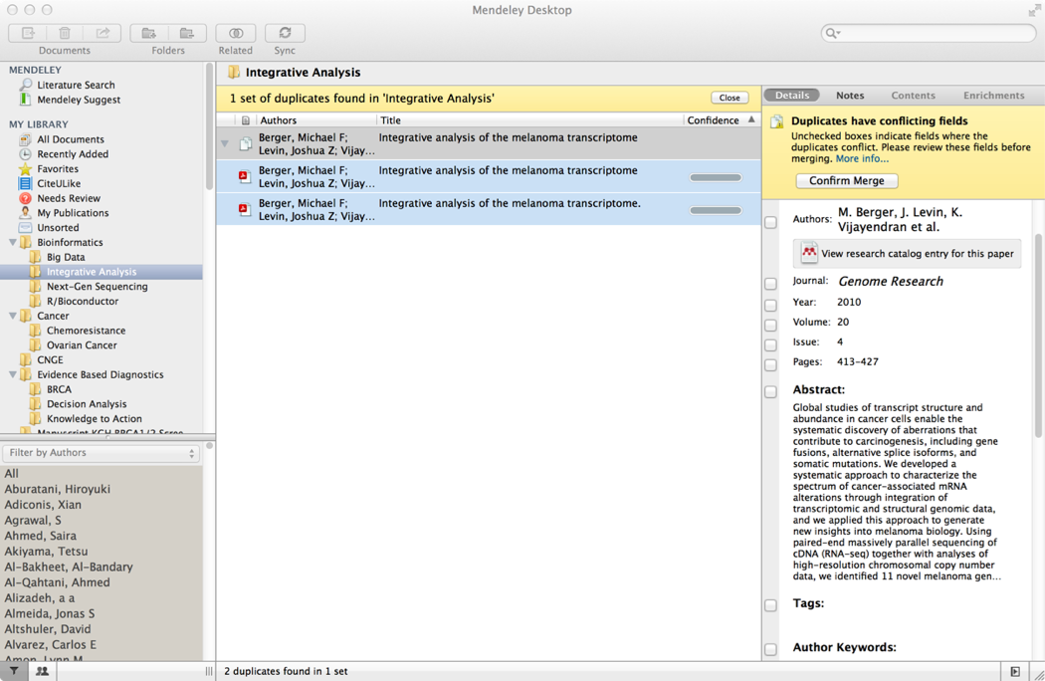
Checking for duplicates
Tools/Check for duplicates
Notes:
You may find that after collecting a library of references that you have accumulated some duplicate entries - where two copies of the same reference have been added to your library.
Luckily, Mendeley can clean these up for you. Click on the Tools menu at the top, and then ‘Check for Duplicates’. Mendeley will identify any duplicate entries and offer to merge these into a single, combined entry. You will be prompted to check over the details of the combined version before the merger is completed - allowing you to take details from each of the entries you’re merging.

Slide 16
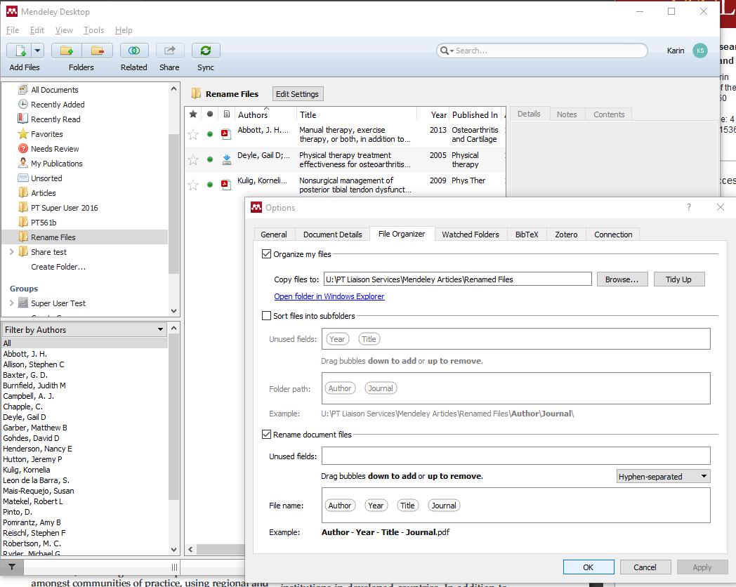
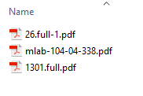
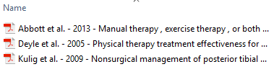
Rename PDF files
1) Drag pdfs into Mendeley folder. 2) Windows Tools/Options or in
Mac Mendeley Desktop/Preferences
Before
After
Click Browse to create new folder on your computer to save renamed files.
drag bubbles into this box
Notes:
As I’m sure you’ve noticed, pdfs tend to have unidentifiable file names when you download them to your computer. As most of us do not take the time to re-name and file each pdf, Mendeley offers the very useful feature of quickly re-naming pdf files that you have saved on your computer.
Point out before and after images on slide.
There is an optional exercise on the handout that walks you through this process.
In Mac click Mendeley Desktop/ Preferences in Windows click Tools/Options
Click File Organizer
Check the “organize my files box”
Click Browse to select the file on your computer to save renamed documents to
Check the Rename document files box
Drag bubbles for categories to include in name into File name: box
Click ok

Slide 17

PDF Viewer
Highlight and Annotate Documents
Notes:
Mendeley also has a pdf viewer that allows you to open any pdfs that you downloaded within Mendeley Desktop. This offers you a number of features….

Slide 18
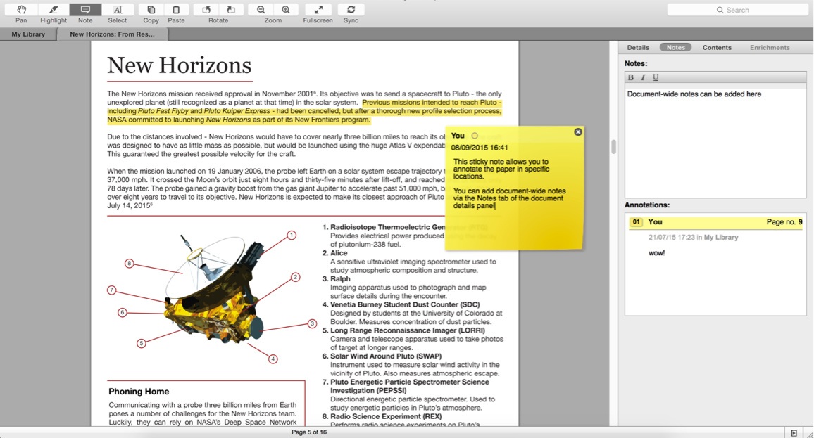
Highlighting and Annotating PDFs
Click to go back to library.
general notes
sticky notes
Click “Notes” tab to view w/out opening pdf.
Notes:
At the top of the screen you’ll see a number of tools, which are mostly self-explanatory.
You can highlight important passages using the Highlight tool - just as you would when reading a physical copy. If you are working in a group, each person is assigned a different color.
You can add ‘sticky notes’ to specific locations in the text. These allow you to make content-specific notes at a particular location. Sticky notes will appear in the list of annotations in the document details panel on the right side. You can use these entries to jump to the appropriate location within the paper - allowing you to retrieve your notes in context. Make sure you click on the Notes tab to view these.
You can also add general notes to the paper to help organize your thoughts in the Notes box which appears in the document detail panels as well. These notes are document-wide and can also be viewed from the main library view - without opening the paper for reading. Just click on the document and then on the Notes tab.
You’ll also notice that Mendeley operates with a tabbed format - allowing you to open multiple PDFs for reading at once, and to switch back and forth between them.
Click on MyLibrary tab to get back to the main page.
--------
Additional details:
Can copy text (double paper icon)
Sync – syncs with Mendeley web

Slide 19
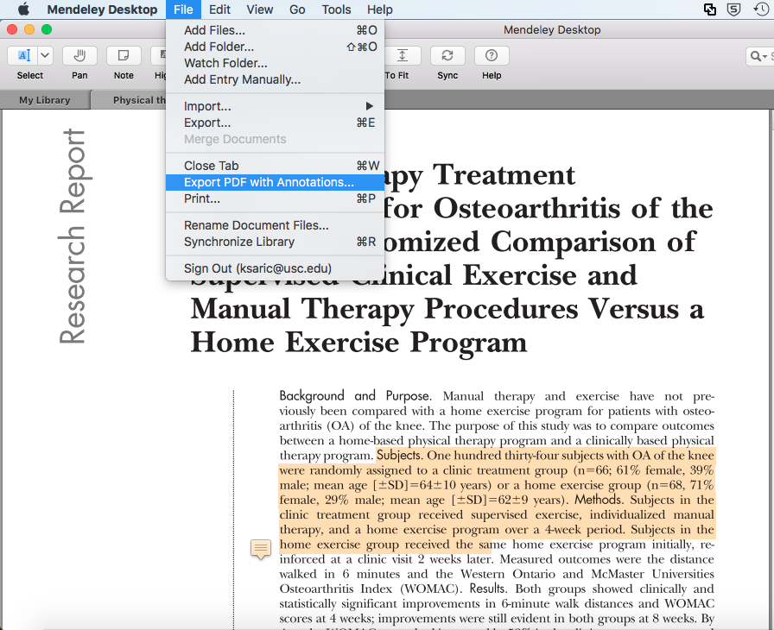
Export an Annotated PDF
In Mendeley Desktop, double-click on a reference to open the PDF in a new tab.
Go to File menu and then select Export PDF with Annotations
Next, select to export the contents with notes and highlights, or just the notes.
Click OK and select the location and name you’d like to save the file.
Notes:
You can export your marked up articles into a document that can be shared with others.

Slide 20
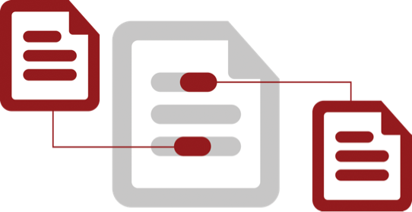
Cite
Using the Mendeley Citation Plug-In
Notes:
One of the most valuable features of Mendeley is its ability to improve the citing process, so let’s go over that now.

Slide 21
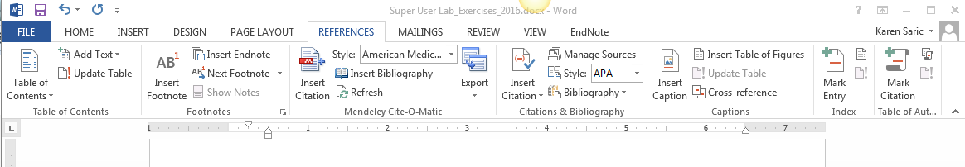
Mendeley Toolbar in Word
If you are using a Mac and do not see the Mendeley Toolbar,
click View→Toolbars→Mendeley Toolbar
Notes:
You need to be running Mendeley Desktop – it will be prompted to start it if it is not currently running.
Now we need to open the Mendeley Toolbar. Just a reminder, its appearance will vary slightly depending on your operating system, but you will see the same buttons and options in both.
Click on References to open up the Mendeley toolbar (will work in PC and some Macs).
If you are using a Mac and do not see the Mendeley Toolbar, click View→Toolbars→Mendeley Toolbar
MS Word downloaded from USC site – citation features may be in their own tab (it will not say Mendeley).

Slide 22
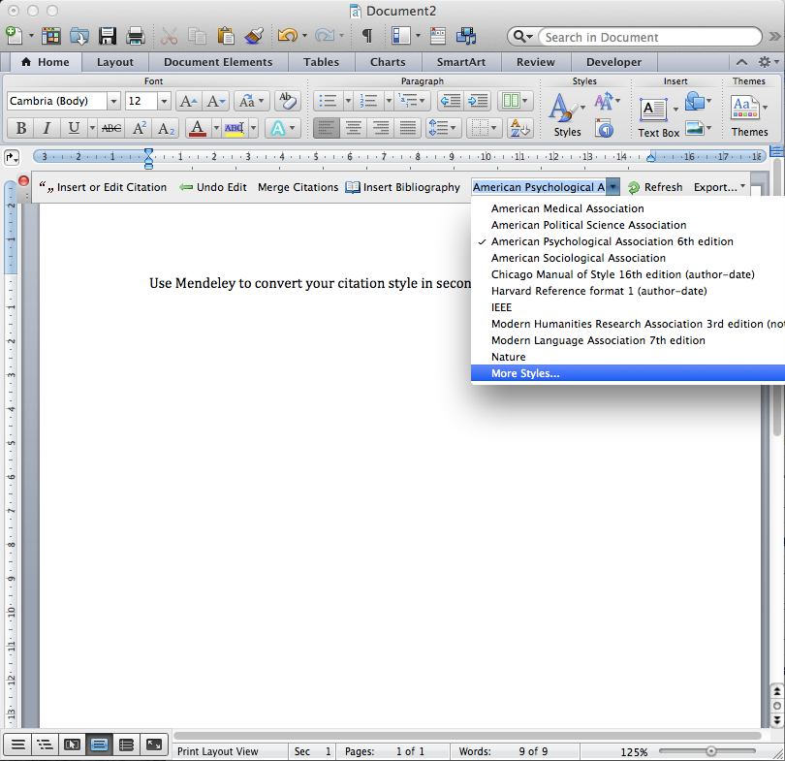
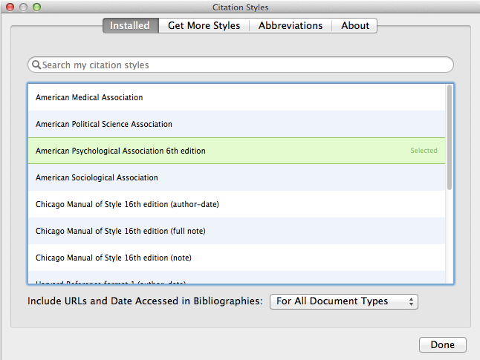
Finding a Citation Style
If you don’t see AMA, click “More Styles”
This will take you to Mendeley Desktop,
where you can install a new style:
Mendeley Desktop View→Citation Styles→More Styles
Notes:
Next we will select a citation style.
The exact ordering and appearance of your bibliography will depend on the citation style you select – your discipline uses AMA.
If for any reason you have to change the citation style, (i.e. for a journal), you can choose the appropriate style for your manuscript, and Mendeley will restyle all the citations in your manuscript automatically.
To select citation styles, open the styles dropdown menu which appears on the Mendeley toolbar in your Word doc.
If you don’t see the style you need, you can click ‘More Styles’ to be taken to the Styles tool within Mendeley Desktop so that you can install new styles.
In Mendeley Desktop View→Citation Styles→More Styles
Saved styles are then added to the Mendeley database, and will appear in your drop-down menu in Word.

Slide 23
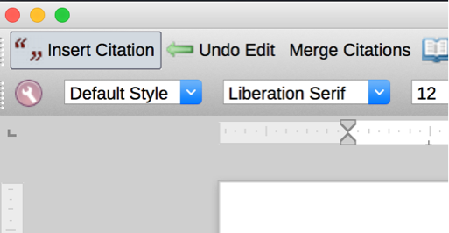
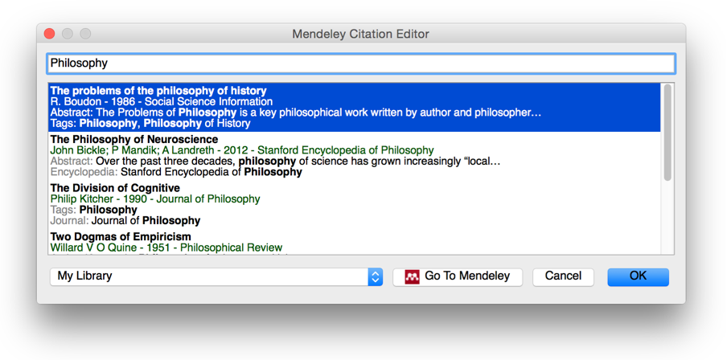

Generate In-Text Citations in Word
Notes:
Now we are ready to insert a citation.
Type a sentence, and position your cursor in the appropriate location and then click the ‘Insert Citation’ button on the Mendeley toolbar.
This will open the Mendeley search tool. Enter an author name or keyword into the search box.
This will return search results from your library.
Locate the reference you want to cite, click to select it and press the Ok button. You will see that the citation is added.

Slide 24
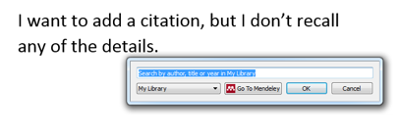
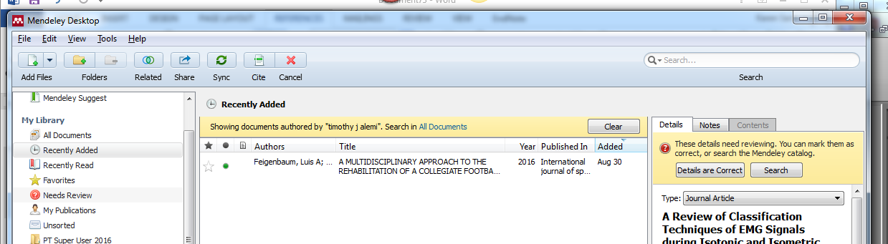
In-Text Citation (II)
Notes:
If you’re looking for a particular citation and can’t remember the details you can also opt to switch to Mendeley desktop to locate it. Just press the ‘Go to Mendeley’ button to switch over to Mendeley, and then use the search tool to find it.
Once you’ve located the appropriate reference, click to highlight it and press the ‘Cite’ button which temporarily appears on the Mendeley Desktop toolbar.
Note that your manuscript is considered locked while this process is active. You need to cancel the citation to return to the document, or insert a citation before you can switch back to your word processor.

Slide 25
Merging Citations
Notes:
Many publishers require adjacent citations to be combined into a single, properly-styled format.
Highlight the two citations that are next to each other, and then click ‘Merge Citations’ in the toolbar to combine them.

Slide 26
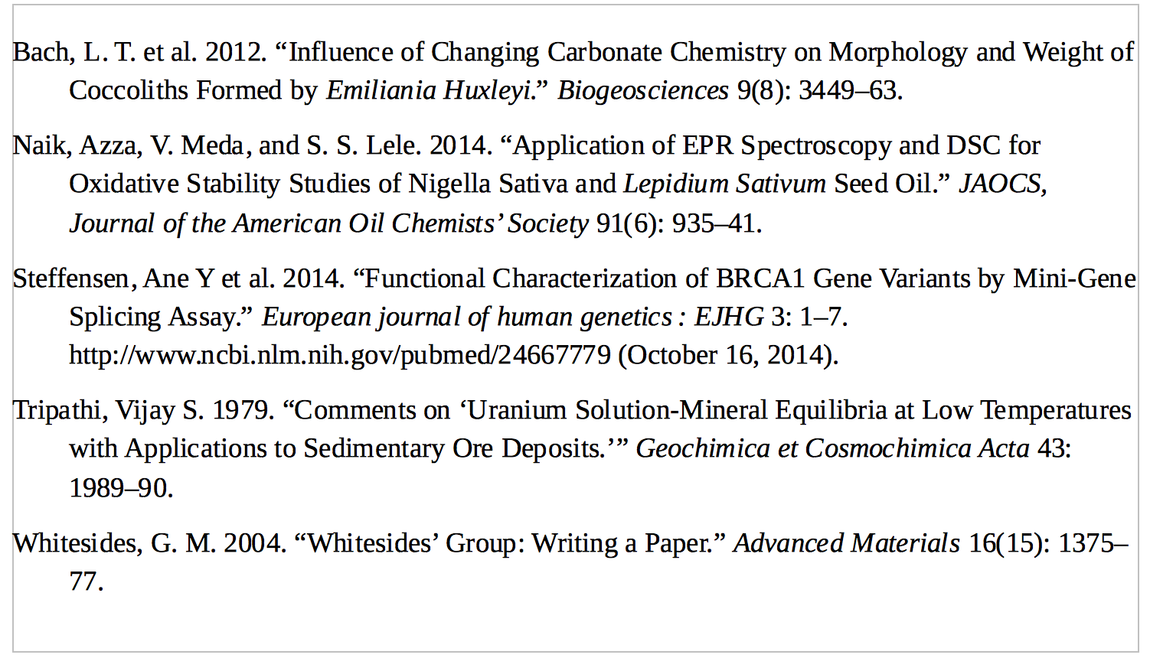
Inserting Your Bibliography
Notes:
Once you’re done adding citations you’ll need to generate a bibliography.
Make sure your cursor is positioned where you want your bibliography to appear ( at least a few rows below your last sentence) and press the ‘Insert Bibliography’ button - it just takes one click!

Slide 27
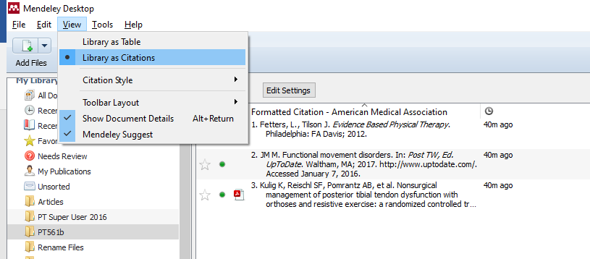
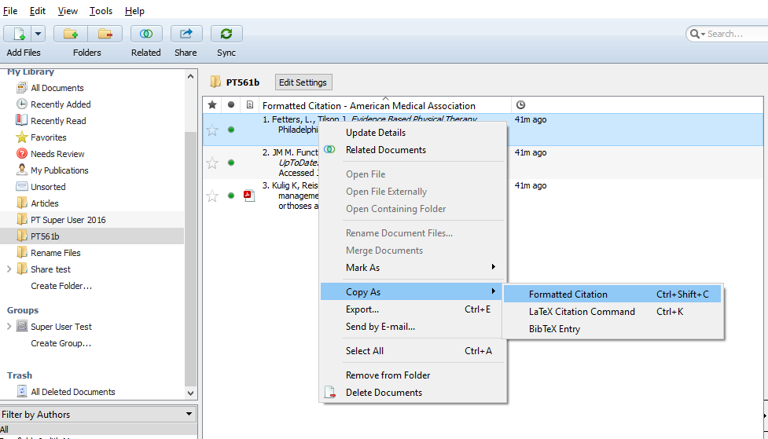
Copy just one citation
v
Click View/Library as Citations
Click on the title of the article
Right click/Copy as/Formatted citation
Paste in Word doc
1. Fetters, L., Tilson J. Evidence Based Physical Therapy. Philadelphia: FA Davis; 2012.
Notes:
If you just need to quickly copy one citation in proper format:
Go to Mendeley
Click on View/Library as Citations
Click on the title of the article
Right click/Copy as/Formatted citation
Paste in Word doc

Slide 28
Complete Exercise 6
Notes:
Please complete Exercise 6.

Slide 29
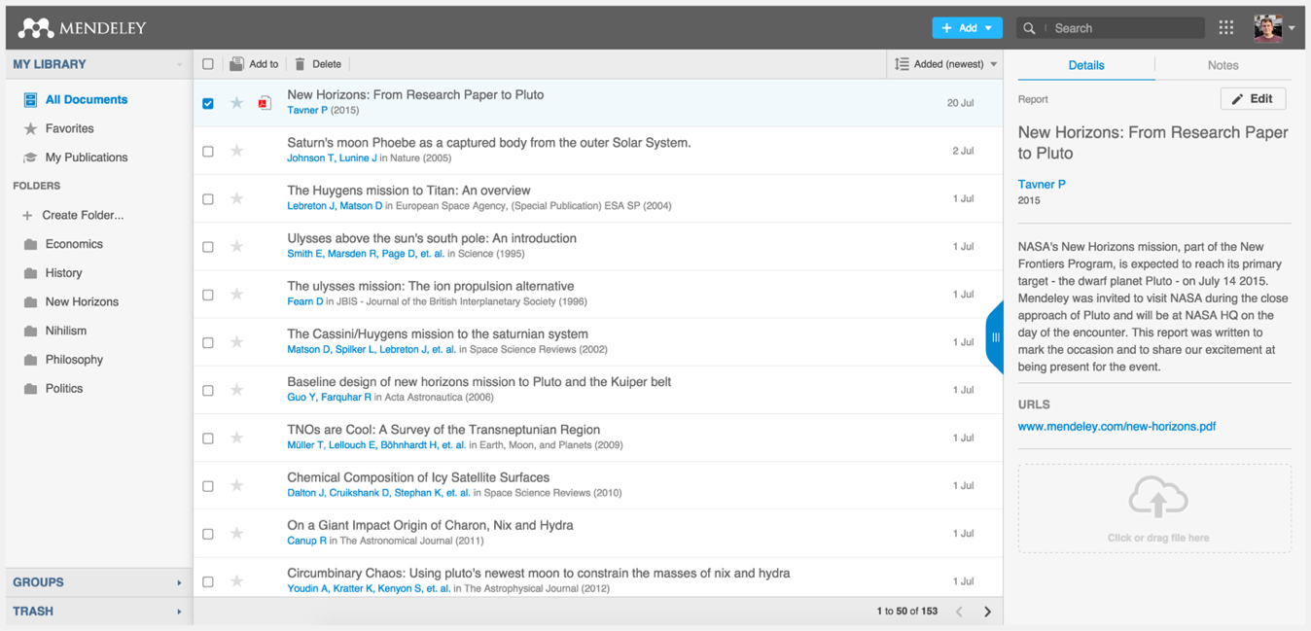

Mendeley Web
www.mendeley.com
Notes:
You will only be able to add citations to a paper you are writing from Mendeley Desktop, but Mendeley Web is a nice companion tool if you want to be able to access your library from the web. You can add references via Mendeley Web and then sync your Mendeley desktop and Mendeley Web libraries. WARNING: Make sure you establish a system when using multiple interfaces. I.e. if you delete a citation or article in one interface, make sure you delete it in all interfaces before you sync. otherwise it will be added back into your library.
Go to the Mendeley website (https://www.mendeley.com/) and sign in. Click on the “Library” tab to access your account.
The layout is similar to what we’ve just seen for Mendeley Desktop - although it has been optimized for use in a browser. The same three panel structure persists.
Left panel: Create folders / Create Groups
Center panel: Move citations to folders: Click on the boxes next to the citations / Click on Add to / Select Folder or Group
To Access the pdf: Click on the pdf icon
To access the record: Click on the title / Record will open in Right panel

Slide 30
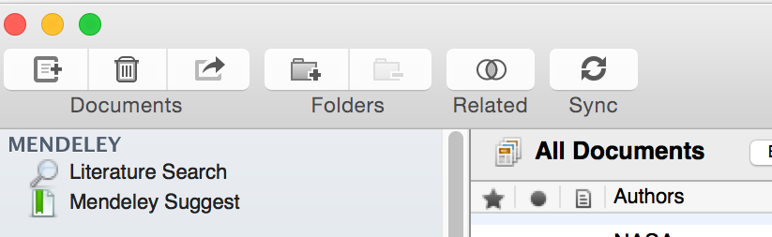




Sync: from web to desktop
Notes:
Whenever you add information in the web version, you will want to click on the Sync button in Mendeley desktop to import it there, if it didn’t do so automatically.

Slide 31

For trainers, it is useful to become a Mendeley Advisor – to receive updates about the tool.

Slide 32
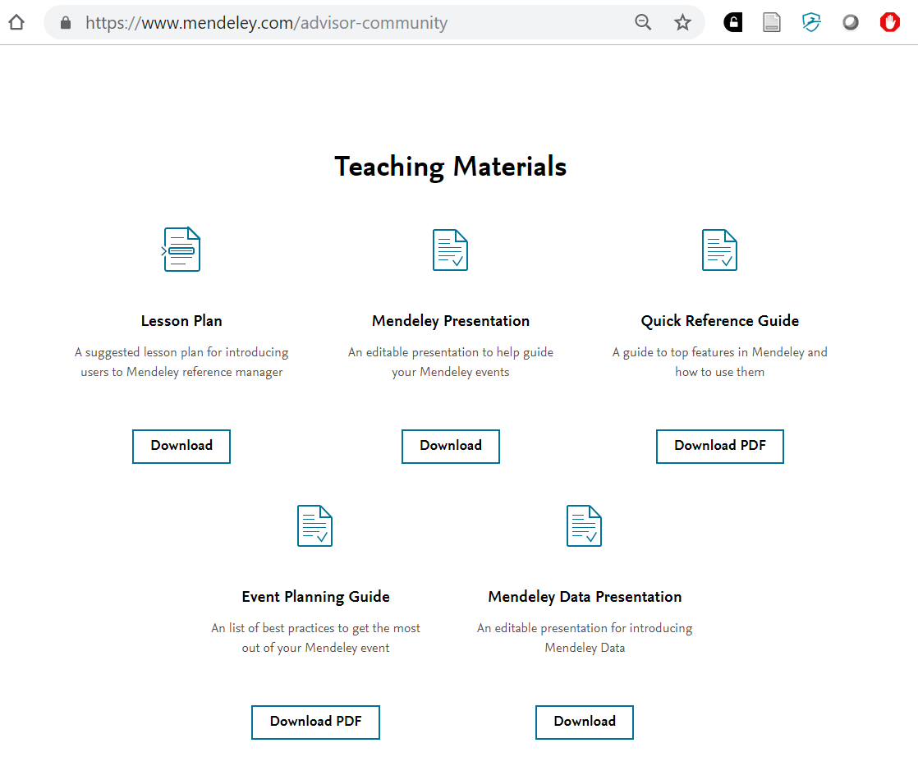
From the Advisor Community page, scroll down to the Teaching Materials section. Note the links to download useful PPTX files or PDFs – to help you train others.

Slide 33
Thank you!
This material was developed by Karin Saric, MLIS, Norris Medical Library, University of Southern California
Updated: 2019-05

