Slide 1
Research4Life: the Library that Opens Doors

Slide 2
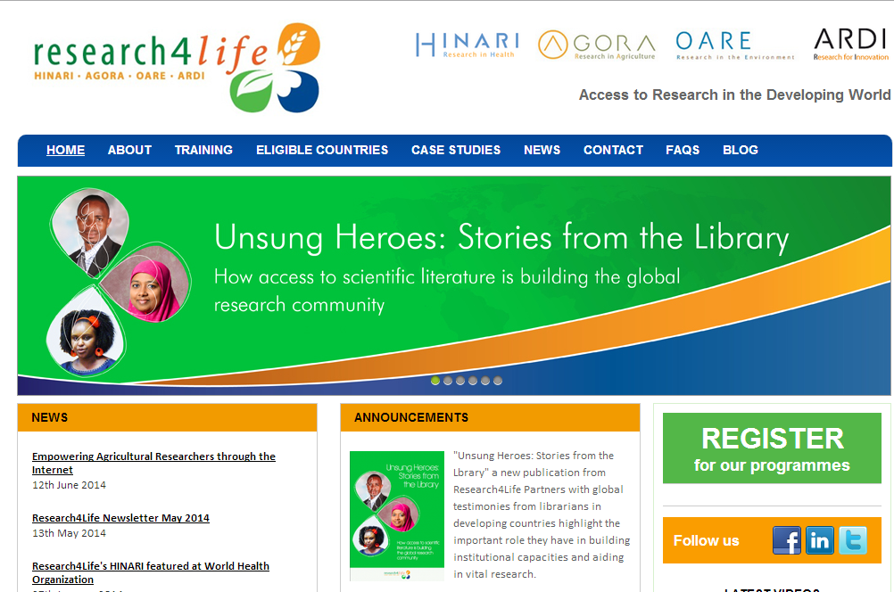
Research4Life
http://www.research4life.org
Notes:
Research4Life is the collective name for four programmes: Hinari, AGORA, OARE and ARDI that provides lower income countries with free or low cost access to academic and professional peer-reviewed content online.
Research4Life is a public-private partnership of the World Health Organization, Food and Agriculture Organization of the United Nations, United Nations Environment Programme, Cornell and Yale Universities and the International Association of Scientific, Technical and Medical Publishers. These work along with technology partners such as Serial Solutions and others.
Research4Life’s goal is to reduce the scientific knowledge gap between higher income and lower income countries.

Slide 3
Why is information important?
Imagine you didn't have access to consumer magazines or other reliable sources of information when you went to buy a car, washing machine, lawn mower.
Imagine you were an engineer trying to build a bridge and didn't have access to information about the breaking points for the materials you were using.
Imagine you were trying to grow vegetables to sell in your market without knowing anything about the plants most resistant to pests in your neighborhood.
Notes:
Information is important to researchers, academics, policy makers. But it is also important to ordinary people or ordinary workers trying do their jobs, or live a more comfortable life.

Slide 4
Research4Life pre-history
Now think about when:
medical students studied from teachers who taught from the lectures notes they took 30 years before
university libraries had few books and all old
government officials were setting policy without access to the latest public health or agricultural research
This scenario was common for every country at one point or another in their history. For the present-day lower income countries, they were facing this at the end of the 1990's.
Notes:
Lack of important information is frustrating for those who face it and saddening for those who are imagining or remembering a time when that barrier existed. Research4Life is the library that has opened doors to a wealth of information.

Slide 5
Notes:
21,000 journals would stack up to approximately the height of the Jet d'Eau in Geneva. And that doesn't even count the 49,000 books…
5

Slide 6
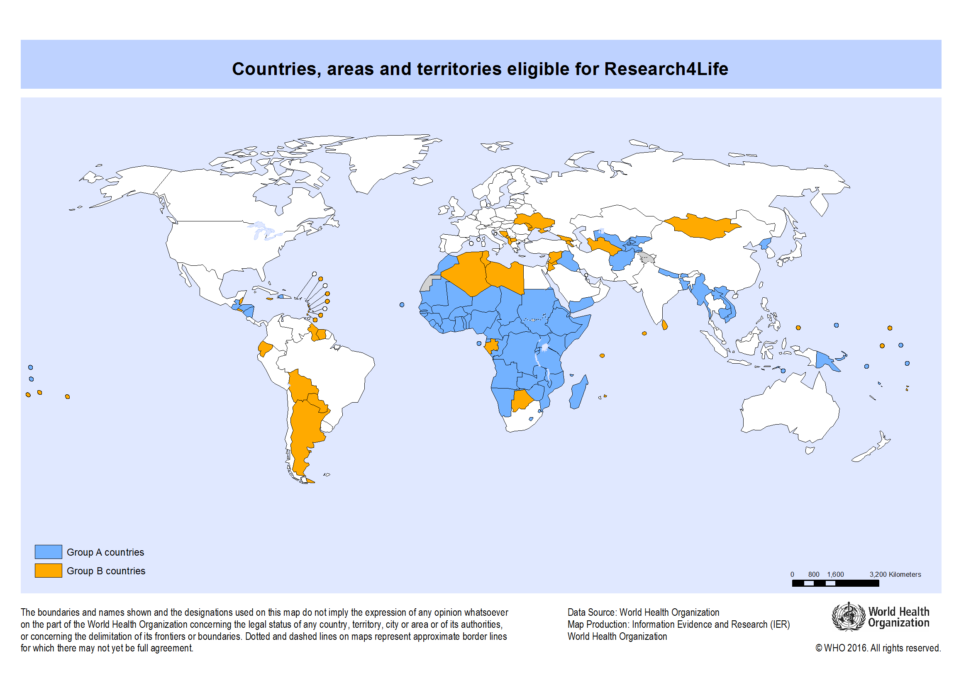
Who is Eligible?
Notes:
This slide notes the location of Group A countries (blue) and Group B countries (orange). In 2016 there are 117 eligible countries, areas and territories.
The same eligibility criteria is used for all Research4Life programmes: HINARI, AGORA, OARE and ARDI.
An institution must register separately for each programme.

Slide 7
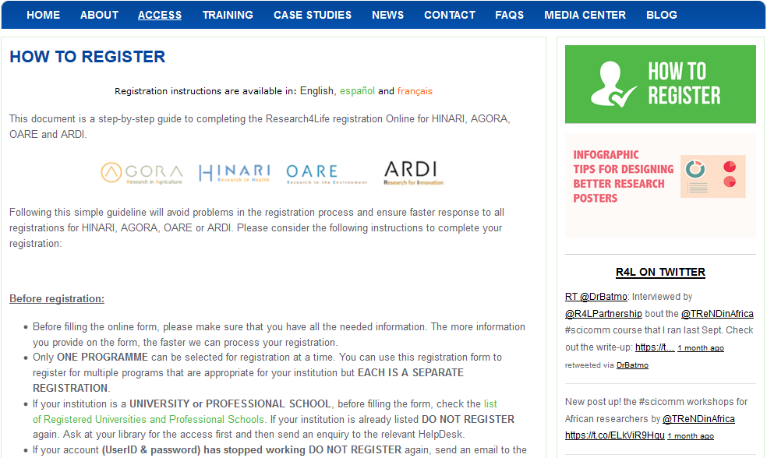
Registration Guide
http://www.research4life.org/howtoregister2/
Notes:
This document is a step-by-step guide to completing the Research4Life registration online for Hinari, AGORA, OARE or ARDI.
The registration instructions are also available in French and Spanish.
Following this guide will ensure faster response to all registrations for Hinari, AGORA, OARE or ARDI.
Only ONE PROGRAMME can be selected for registration at a time. You can use the registration form to register for multiple programs that are appropriate for your institution but EACH IS A SEPARATE REGISTRATION.

Slide 8
Partnership is a key ingredient
Research4Life partners include four United Nations entities, Yale and Cornell University Libraries, more than 200 publishers.
http://www.research4life.org/about/partners/
Notes:
Less then 1/3 of all our partners are listed in this image. It is a very large partnership.

Slide 9
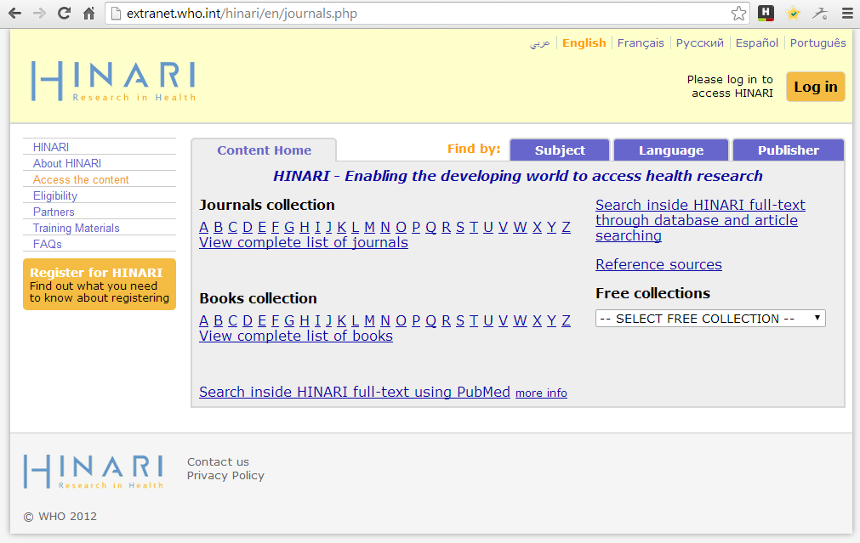
HINARI Portal
Notes:
This is the HINARI Portal. Through each one of the tabs, menus and links you can browse thousands of information resources.
A special version of PubMed is also included.
The same portal is also available in the following languages: Arabic, English, French, Russian, Portuguese and Spanish.

Slide 10
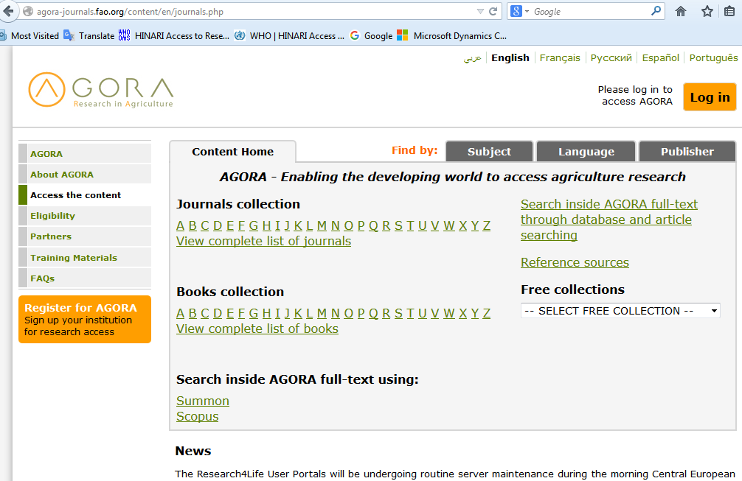
AGORA Portal
Notes:
The Portals of each programme are similar.
This also is true for the access to the journals once you have logged in with your institutional User Name and Password.
Each programme issues separate User Name and Passwords to access their contents.
These User Names and Passwords can be distributed to all staff and/or students at the institution.

Slide 11
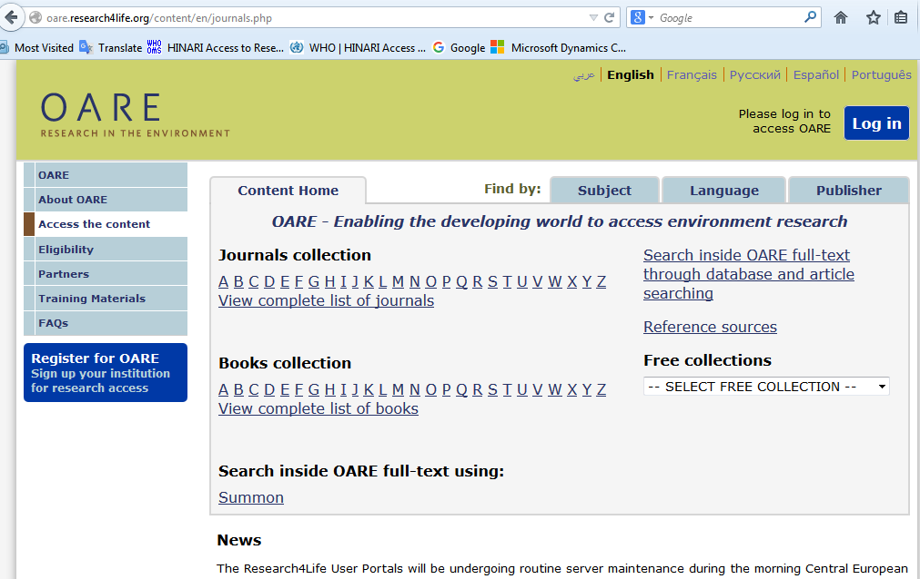
OARE Portal
Notes:
As you can see, the portals are very similar. Once you learn one, the others are familiar

Slide 12
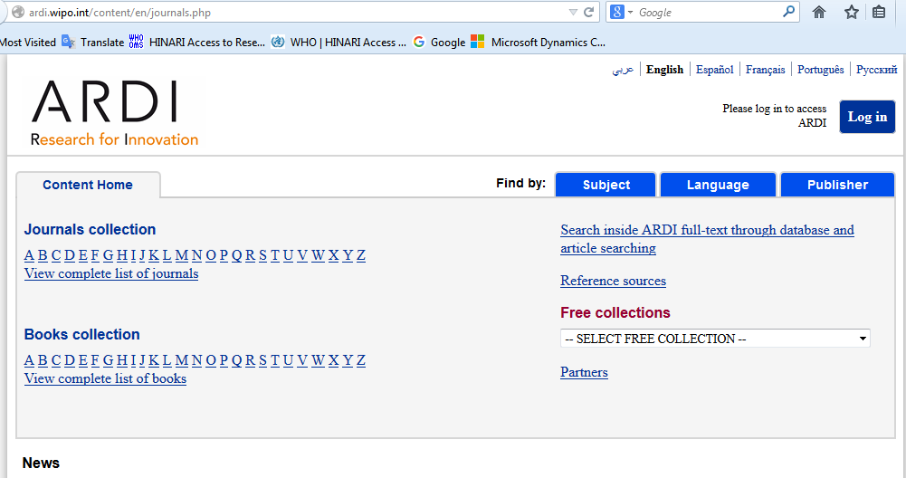
ARDI Portal
Notes:
ARDI is the newest of the programmes and is still growing rapidly.

Slide 13
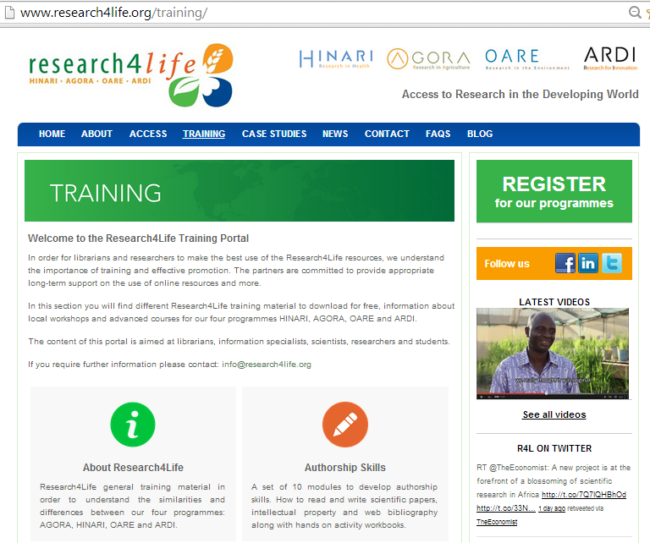
Displayed is the new Research4Life Training portal. All the inter-program training material plus information about courses and workshops information is located on this page – in six sections.
Notes:
Now it is important to consider how make use of all these many publications. For that, you may need training to be most efficient in your explorations.
Note the two sections on this page – About Research4Life and Authorship Skills.

Slide 14
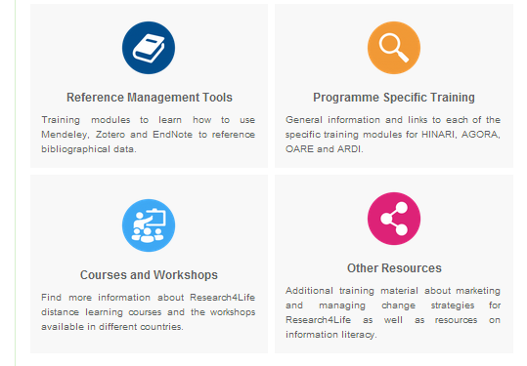
The other four sections of the Research4Life Training resources are displayed in this slide.
Notes:
The next group of slides display specific sections of this training site.

Slide 15
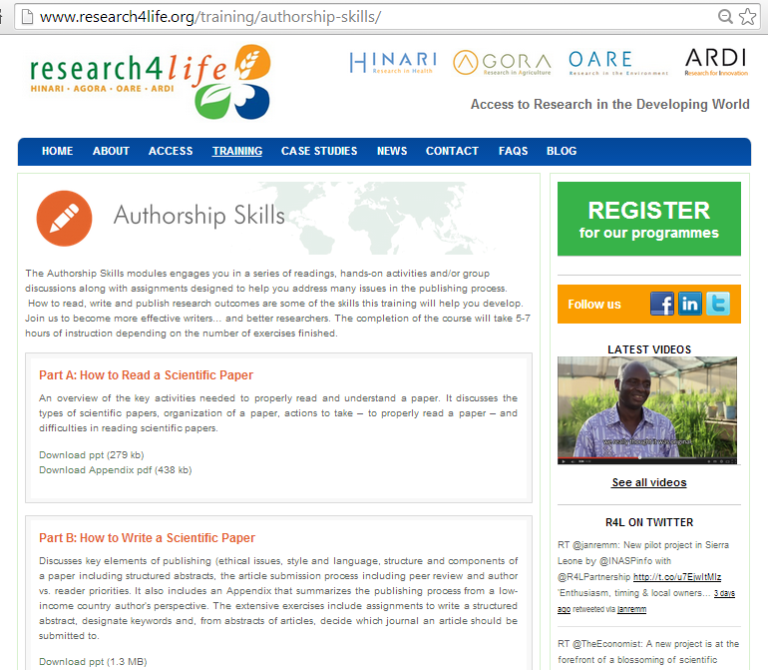
This page contains a series of Authorship Skills presentations and exercises:
How to Read a Scientific Paper, How to Write a Scientific Paper, Copyright & Plagiarism, Strategies for Effective Writing, Web-Bibliography and Frequently Asked Questions
Notes:
The Authorship Skills section contains a series of presentations and exercises:
How to Read a Scientific Paper, How to Write a Scientific Paper, Copyright & Plagiarism, Strategies for Effective Writing, Web-Bibliography and Frequently Asked Questions

Slide 16
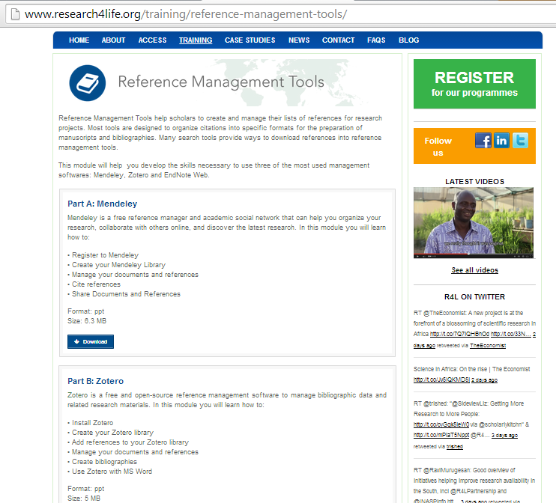
Highlighted in this section are three Reference Management Tools – Mendeley Basic (available to all users), Zotero (open source option) and EndNote Web – how to access, download and use these resources.
Notes:
On the Reference Management Tools section, you learn about Mendeley (the basic version) and Zotero (Open source) which are available even to individuals from non-Research4Life eligible countries. The presentations review how to download the software and use the numerous options – to create footnotes and develop bibliographies in the multiple formats required by publishers (e.g. APA, Harvard, Vancouver styles).

Slide 17
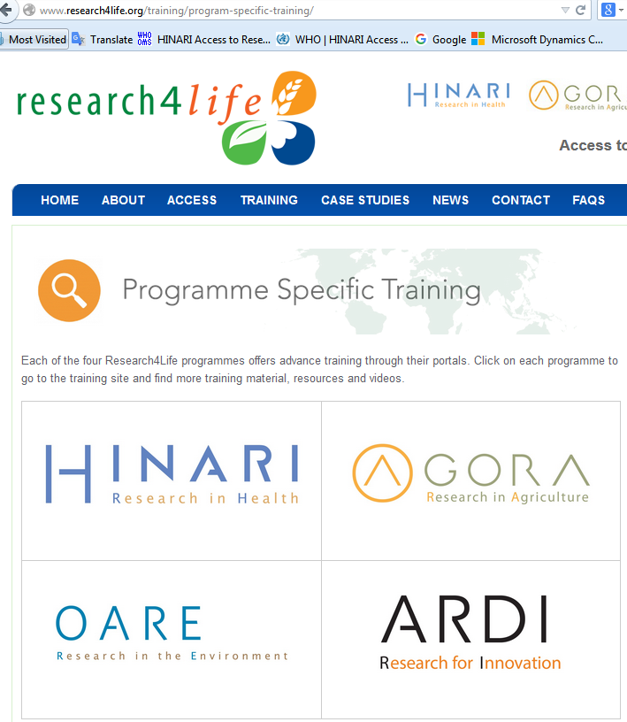
This section contains the links to the specific programmes’ training material for Hinari, AGORA, OARE and ARDI.
Notes:
This section contains the links to the specific programmes’ training material for Hinari, AGORA, OARE and ARDI, where you will find targeted training materials specific to Health, Agriculture, Environment, or Technology

Slide 18
Research4Life has made an impact
Researchers
and
Practitioners
Notes:
Research4Life makes a difference when it opens doors.

Slide 19
Dr Sami Kambire
Notes:
AGORA has opened Dr Kambire’s eyes to the importance of information management. AGORA helped him to develop better and more informed scientific writing skills, produce focused research that he can discuss with top researchers worldwide, compete more effectively for research funding, and deliver better teaching programmes.

Slide 20
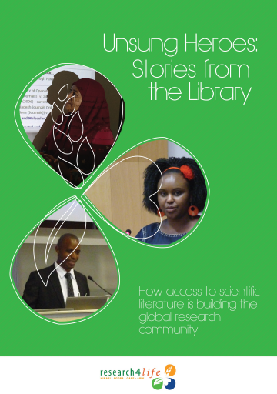
Research4Life has made an impact
Librarians
Notes:
Research4Life and Librarians are a powerful combination.

Slide 21
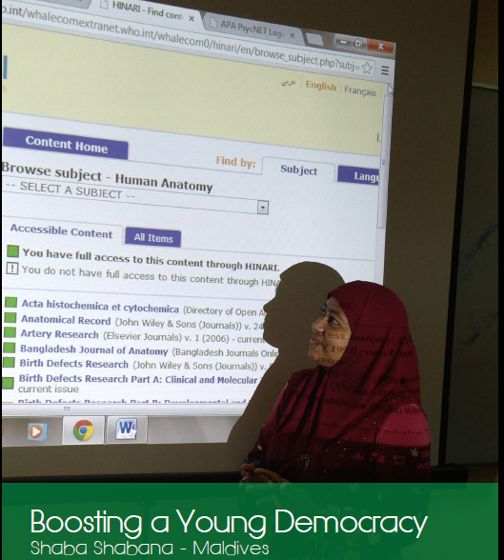
Shaba Shabana
Notes:
Shaba is a passionate Librarian. “If we can encourage people to use Research4Life in their research and to publish, we can build up this young country more,” she says, “It is my goal to be part of this change in the future.”
Shaba believes that high-quality, evidence-based, scientific literature is essential to enable researchers and students in the new Environmental Science programme to find ways to protect the island nation from threats posed by global climate change. “We are educating the students who will become future policy makers,” she announces, “Research4Life can help them make better, informed decisions.”

Slide 22
Thank You
Notes:
Thank you for taking the time to learn about Research4Life.

